Slide 1
Optical VBB

Slide 2
PIONEERS – WP2 goals
Design, built, integrate and test a very high performance optical vertical seismometer for the Moon.
Key driver
  Very High Performances : (self-noise below 10⁻¹¹ m.s⁻²/sqrt(Hz) over 1mHz to 1 Hz.
  Easy to implement
  Low complexity for operation
  Easy to qualify / low risk
  Light weight / light power consumption
Technological concept
  Move from electrostatic displacement sensors to interferometer to get rid of electrostatic force limitation
  Operate in open loop to simplify the instrument and remove FB contributions. Induced risk : non-linearity.

Slide 3
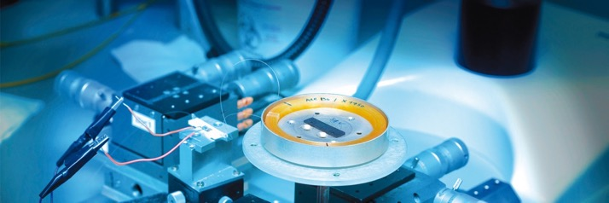
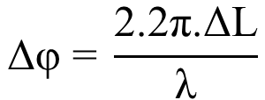
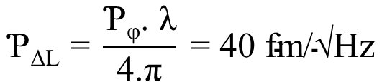
Design concept – Optical Readout
FOG expertise as a starting point
Typical PSD value of phase noise of iXblue FOG technology is:
Ƥ_{φ} = 3.10⁻⁷ rad/√Hz
In a Michelson interferometer, the difference in phase Δφ corresponding to the displacement of a mirror attached to the proof mass is given by equation:
So, FOG technology could theoretically reach a typical PSD value of displacement measurement:

Slide 4
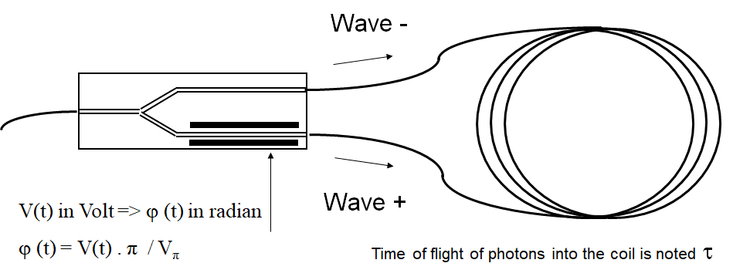
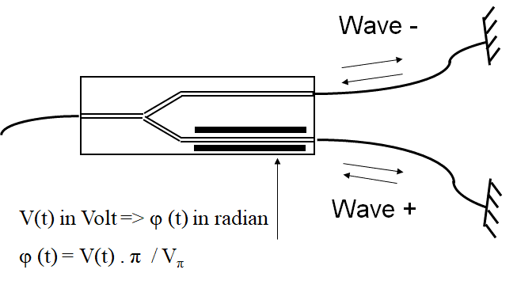
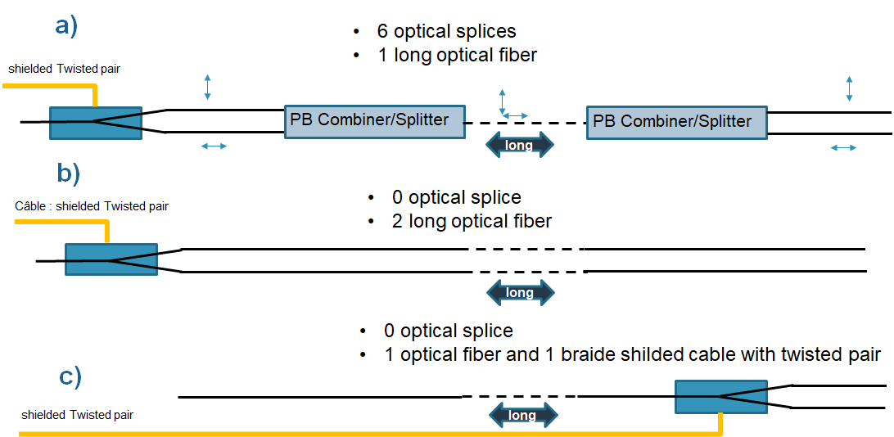
Design trades – Optical Readout
How to go from a »looped” interferometer (sagnac like) to the detection of a displacement of mass with a remote electronic ?

Slide 5
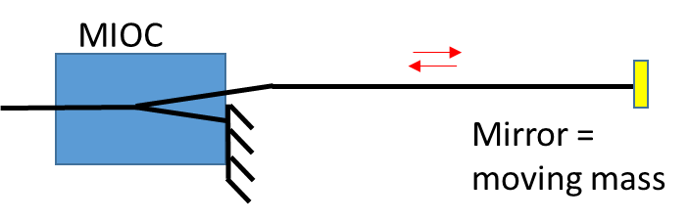
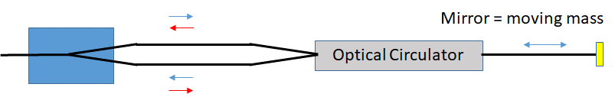
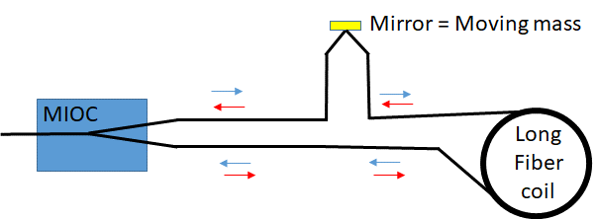
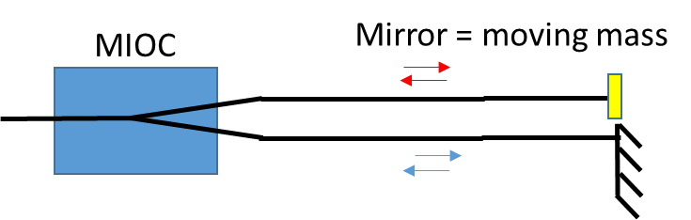
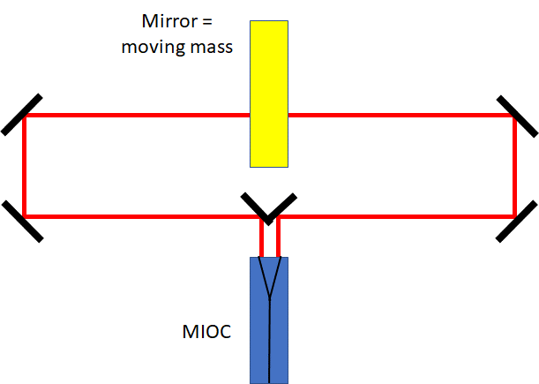
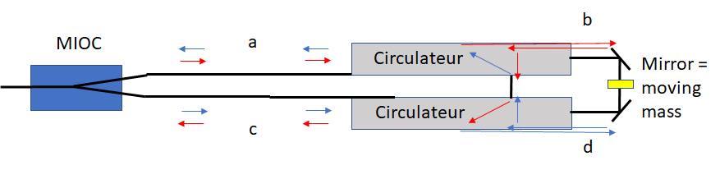
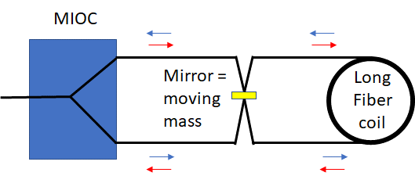
Design trades – Optical Readout
Unbalanced, balanced and balanced&differential optical readout:
(for different interferometer types)
Current
baseline
Simple
Semi-looped
Looped

Slide 6
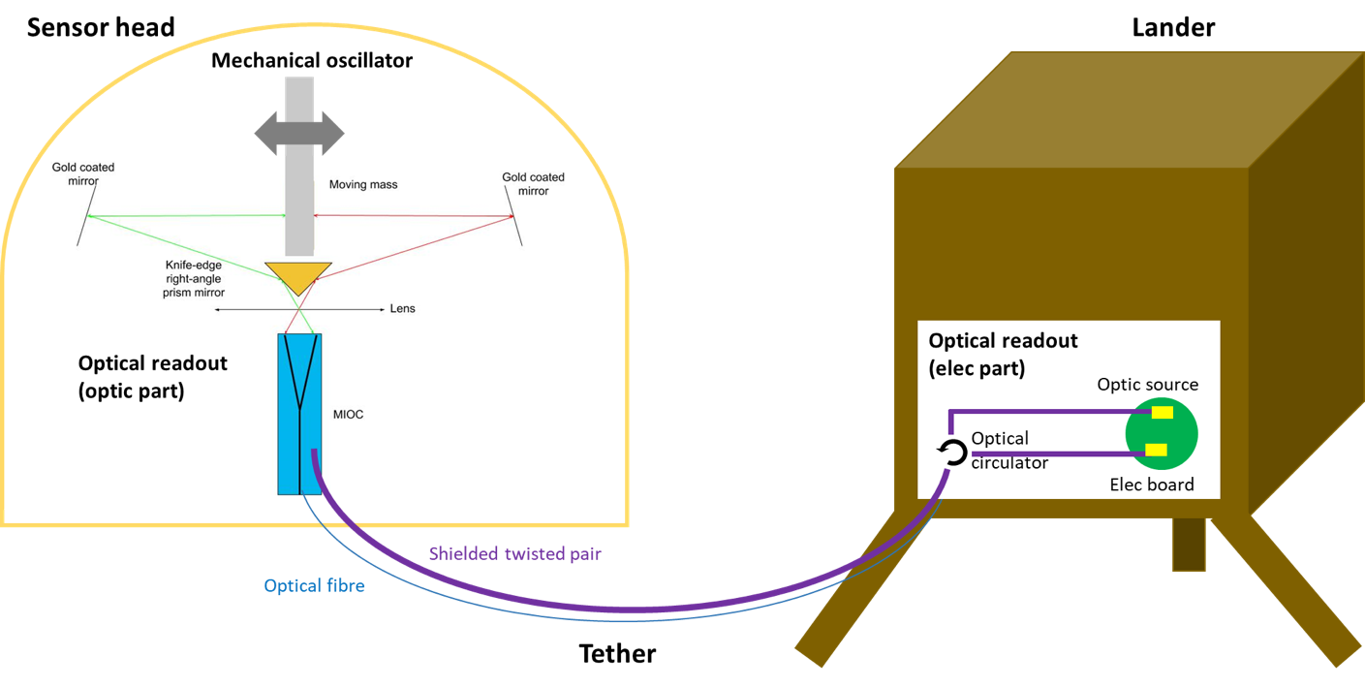
Design overview - schematic diagram

Slide 7


Design overview - heritage
New : free space michelson
New : Mechanical oscillator

Slide 8
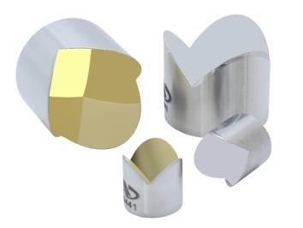
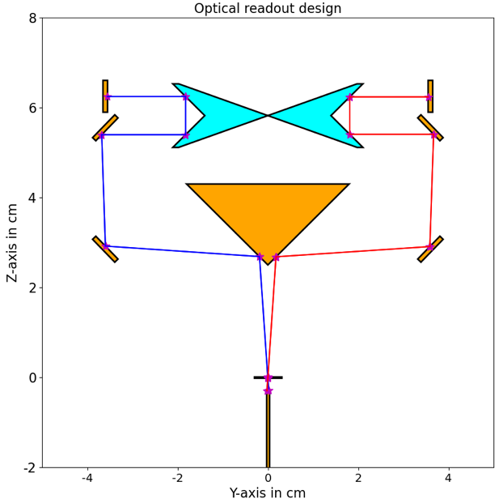
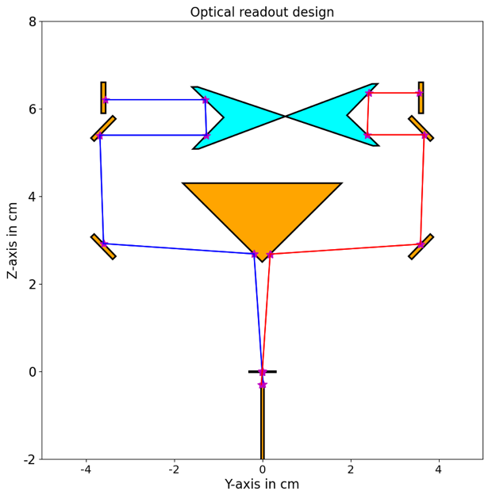


Optical configuration– Insertion losses: robust set-up
Robust configuration with corner cubes + mirrors:
$$κ=8$$
$$κ=8$$
Aligned measurement mirror
Displacement of 5 mm

Slide 9
Mechanical gain
Method
Mechanical gain / Normal frequency
Mobile mass to get Brownian noise @ 5.10⁻¹² m.s-2.Hz^{-1/2c}
Motion range & Optical self noise
Suspension : stiffness -> size
Levelling / recentering need
3 axes sensor head mass budget estimation

Slide 10
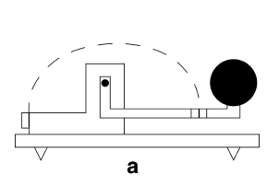
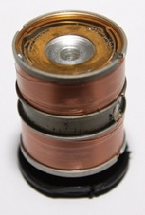
Mechanical gain
Same performances for all configuration
Better overall mass budget for the high gain configuration

Slide 11
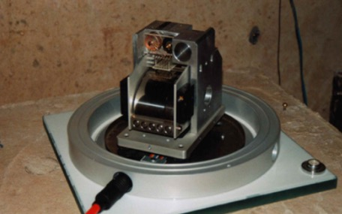
Mechanical Oscillator Design
Axis of sensitivity
Mechanical Oscilator Type: Pendulum
=> Pivot
=> Boom (CDG offset wrt pivot) + Mass
Sensitivity Axis : Vertical
=> Horizontal Pendulum
=> Need for a spring to counter balance the weight momentum
Pivot
Support
Spring
Dg
Mobile Mass
CDG
Moon Pendulum Target :
Mobile Mass : 1Kg
Dg (centre of mass to centre of rotation distance) : 10cm
Mechanical Gain: 0,3 m / m.s⁻²
F₀ : 0,35 Hz
Exemple of such configuration :
STS1 seismometer (vertical axis)

Slide 12
Earth / Moon gravity
Earth 2.
Same spring
Additional proof mass to be added for the Moon
Earth 3.
Same spring
Counterweight for Earth
Earth 1.
Same proof mass
Different spring
9,81 m.s⁻²
1,62 m.s⁻²

Slide 13
Accommodation - Horizontal

Slide 14
Accommodation - Vertical

Slide 15
Accommodation – integration

Slide 16
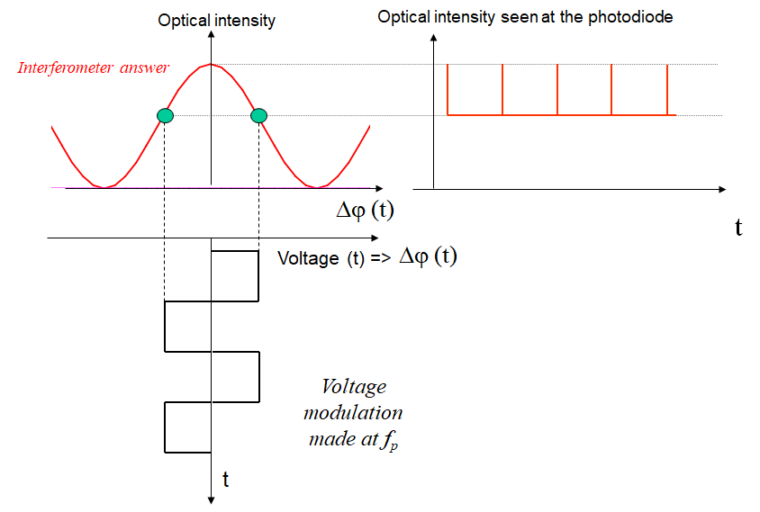
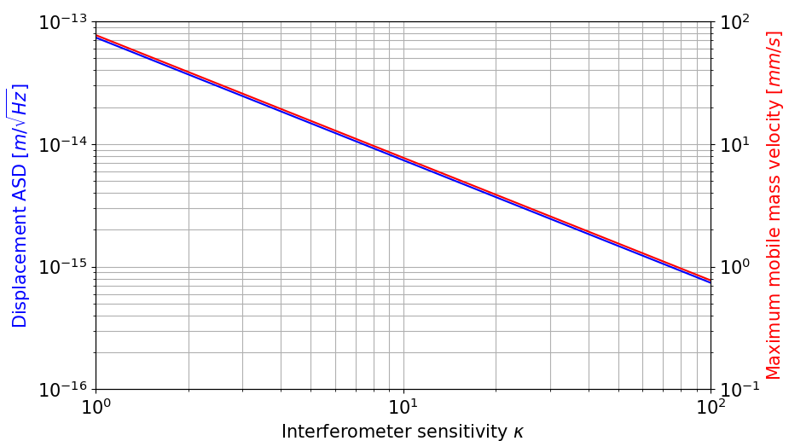

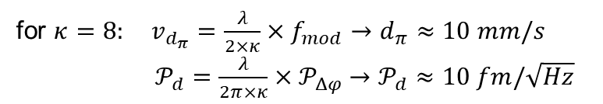

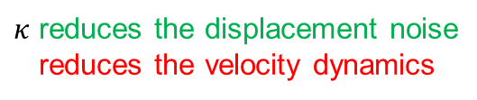
Optical configuration – General principle: interferometer sensitivity
Dynamic vs sensitivity
A mirror displacement $d$ leads to a phase shift
$$Δφ=\frac{2π×κ×d}{λ}$$
$κ$ reduces the displacement noise
reduces the velocity dynamics
for $κ=8: v_{d_{π}}=\frac{λ}{2×κ}×f_{mod}→d_{π}≈10 mm/s$
${\text{𝒫}}_{d}=\frac{λ}{2π×κ}{×\text{𝒫}}_{Δφ} →{\text{𝒫}}_{d}≈10 fm/\sqrt{Hz}$

Slide 17
Performances budget
On the vertical

Slide 18
Performances budget
On the horizontal

Slide 19
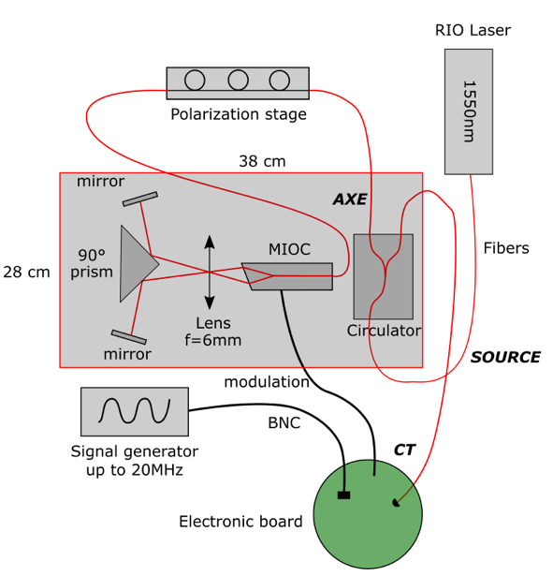
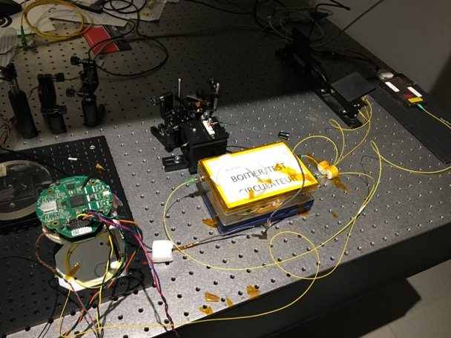
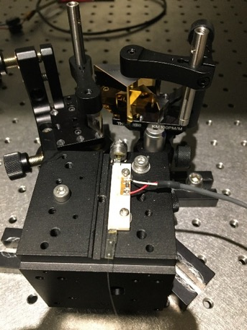
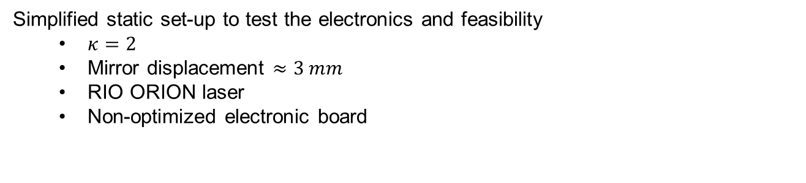
Optical readout experimental validation setup
Simplified static set-up to test the electronics and feasibility
  $κ=2$
  Mirror displacement $≈3 mm$
  RIO ORION laser
  Non-optimized electronic board

Slide 20
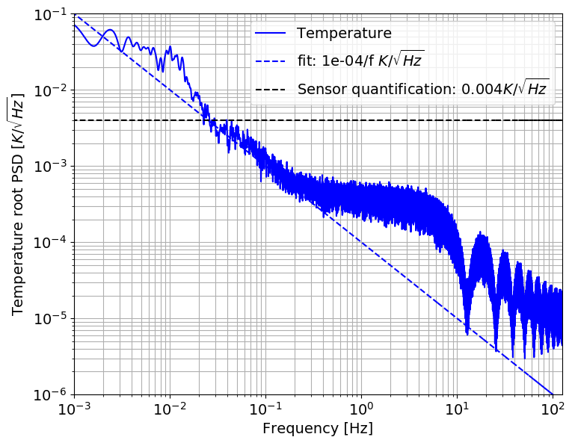
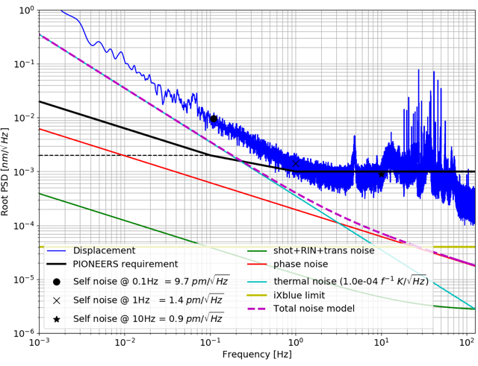
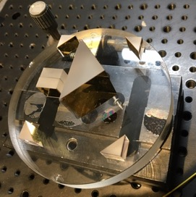
Optical readout experimental validation setup
Current limitations: Thermal fluctuations (long term)
Vibrations (short term)
Room temperature fluctuations
→ Place set-up under vacuum
Vibrations
→ Glue all optical components

Slide 21
Road Map –
2021
2022
2023
2024
2025
Sub system validation tests
Detailed design
Prototype built & tests
Funded
TRL 4/5
TRL 6 demonstrator

