Slide 1
3D Spatial Integration Plan for the Einstein Telescope
ET-0165A-26
Lucas Hermida Pena (ETO & Nikhef), IV Workshop on ET-LF TM Tower Integration, Pisa 18/03/2026

Slide 2
Outline
Introduction
ETO 3D Integration Plan
Definition of Interfaces & Clearances
Current Status
Pilot End Station Integration
Collaboration with stakeholders
Next Steps
Conclusions

Slide 3
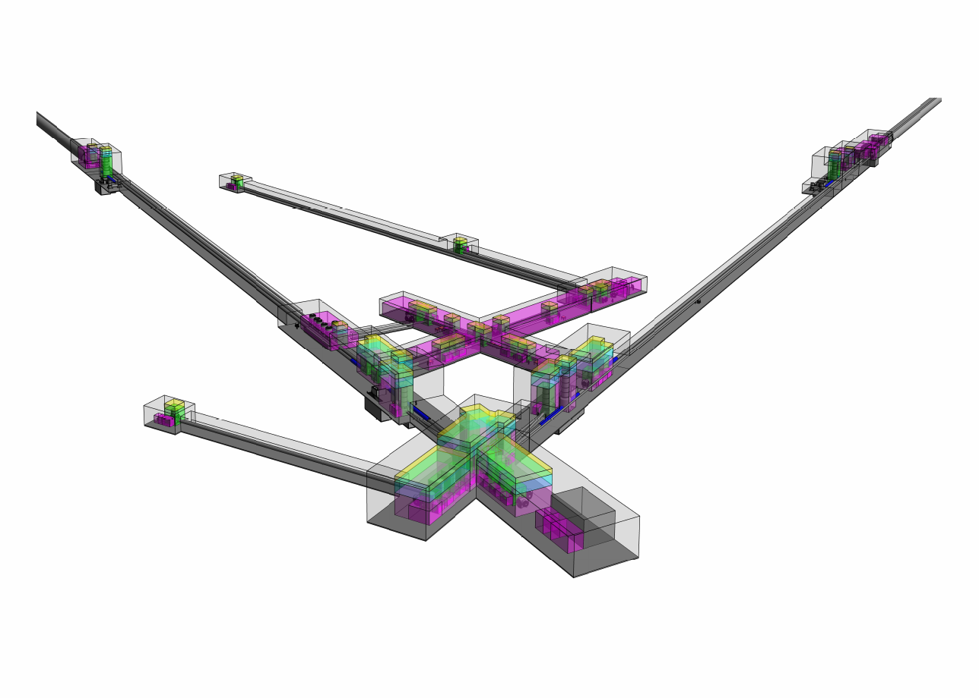
Introduction
The Einstein Telescope (ET) as the next generation of gravitational wave detectors, demands an unprecedented level of 3D spatial integration and coordination.
Active design activities within ETO consider:
Technical Infrastructure
As the technical infrastructure evolves, specially with the 2025 Design Task Force update, integration between the subsystems becomes more important.
Facility Infrastructure
The current collaboration with CERN is providing valuable expertise from the SPS & LHC.
Goal of the Presentation
Introduce the ETO 3D Spatial integration plan, the current challenges & the stakeholders of the process.

Slide 4




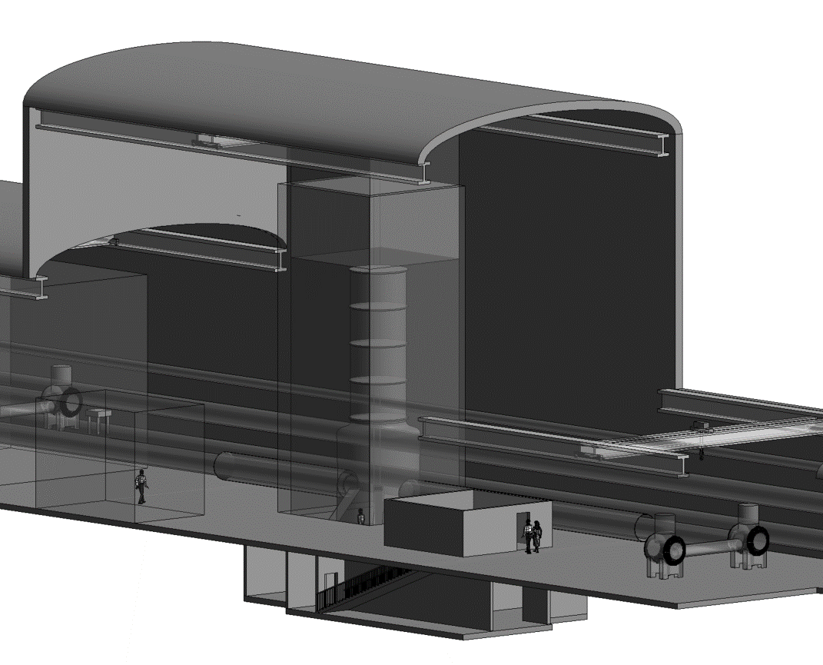


ETO 3D Integration Plan
System Identification
Identification of all the elements to be integrated (CM&SE)
Interfaces
Define the interfaces between different systems.
Skeleton Model & Volume Claims
Coordinates, positions & spaces required
Dedicated Models
Update the envelopes with the specific 3D Models.
Final Integrated Model
In Parallel
Review cycle & Release Procedure
Assure the quality of the integration process
(CM)
Change Management
In order to deal with clashes.

Slide 5

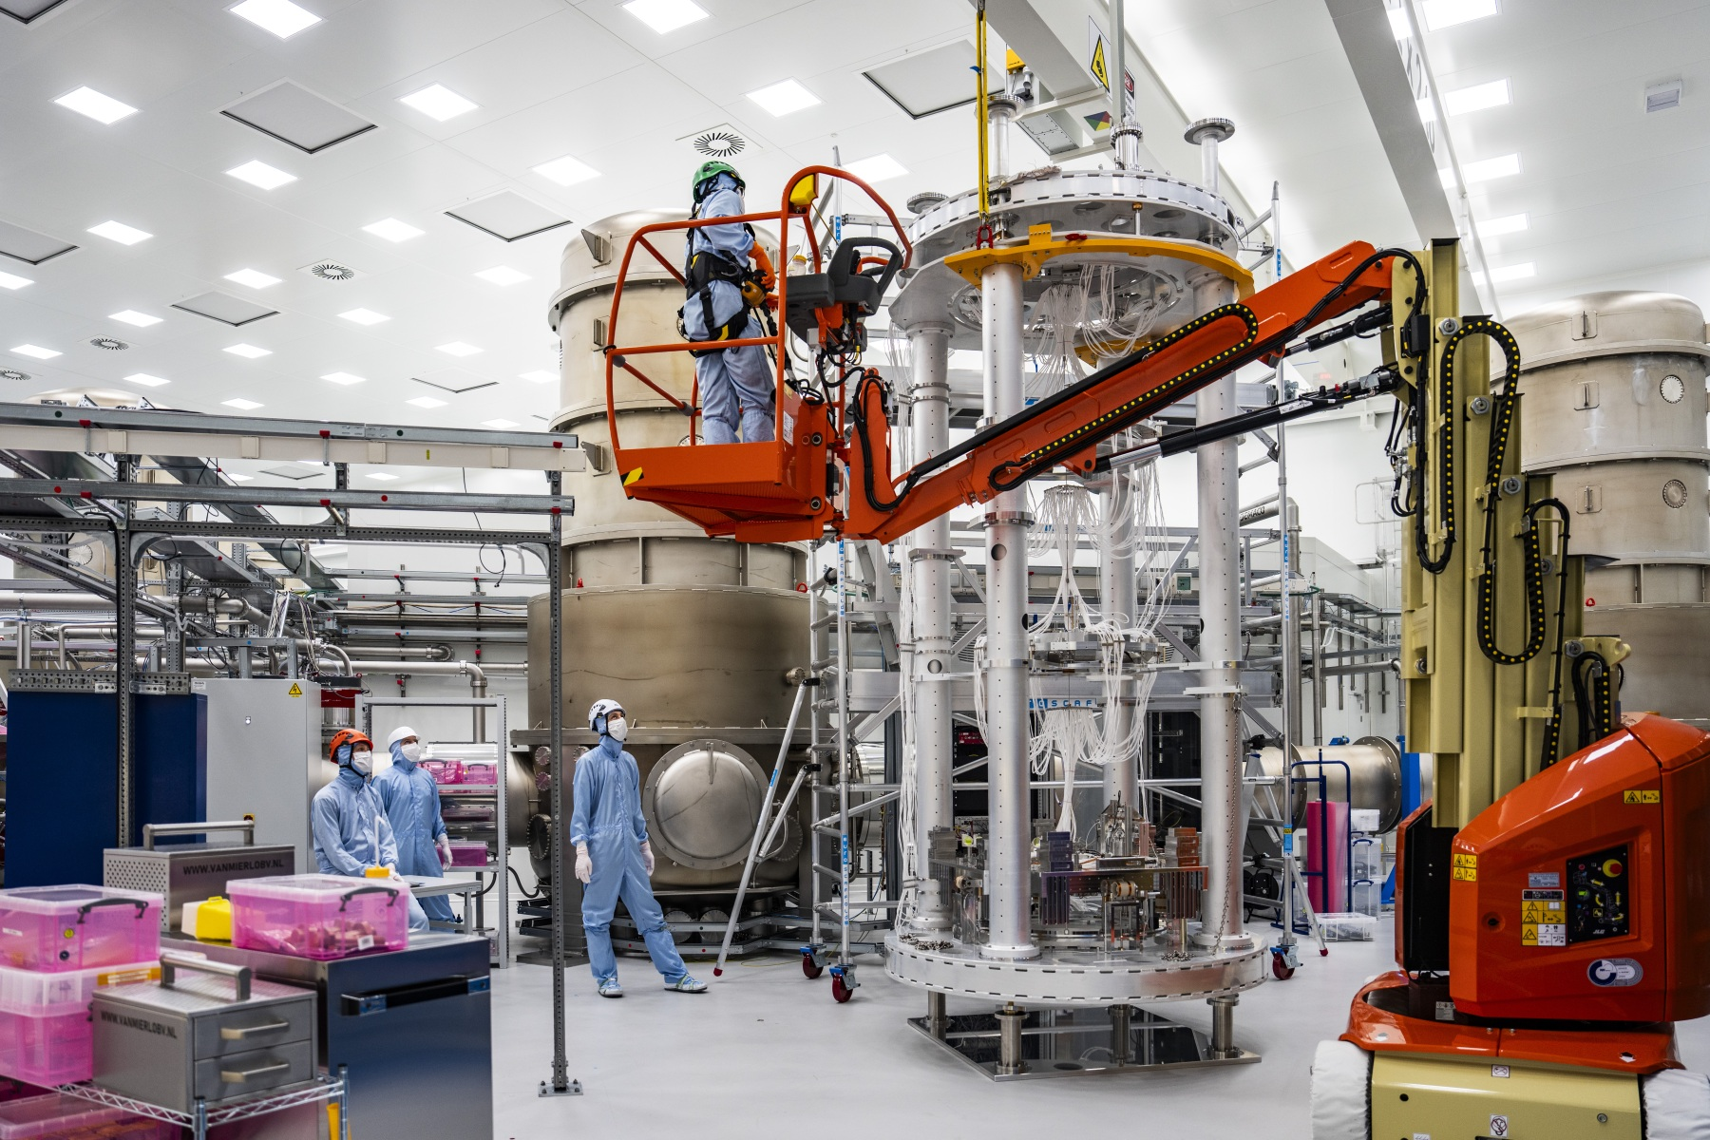
Interfaces & Clearances
Map of the Interfaces
Many of the interfaces have to be formalized & documented but they still need to be taken into account for 3D Integration. Responsibles also have to be allocated.
ET Pathfinder

Slide 6
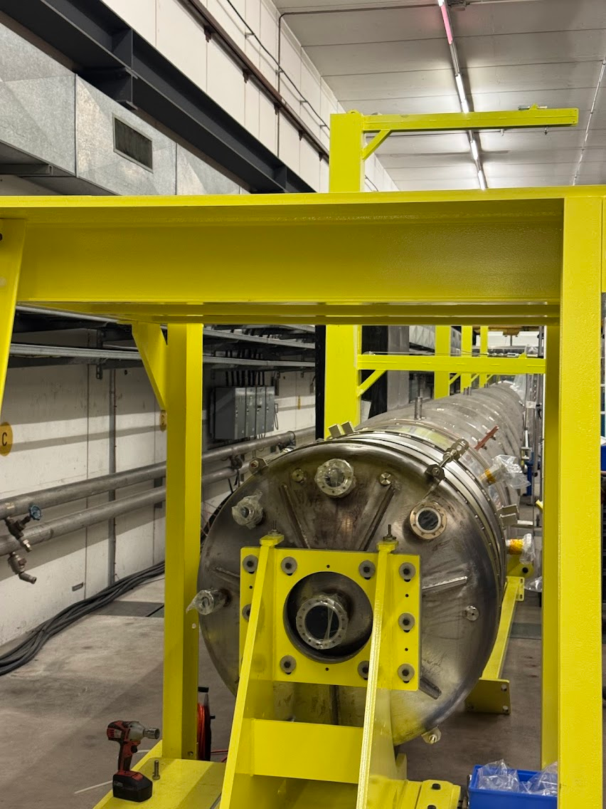

Interfaces & Clearances
Map of the Interfaces
Many of the interfaces have to be formalized & documented but they still need to be taken into account for 3D Integration. Responsibles also have to be allocated.
Hidden Space Consumers
Elements not present in the PBS (gate valves, bellows, supports) consume 3D volume.
Beampipe Prototype at CERN

Slide 7
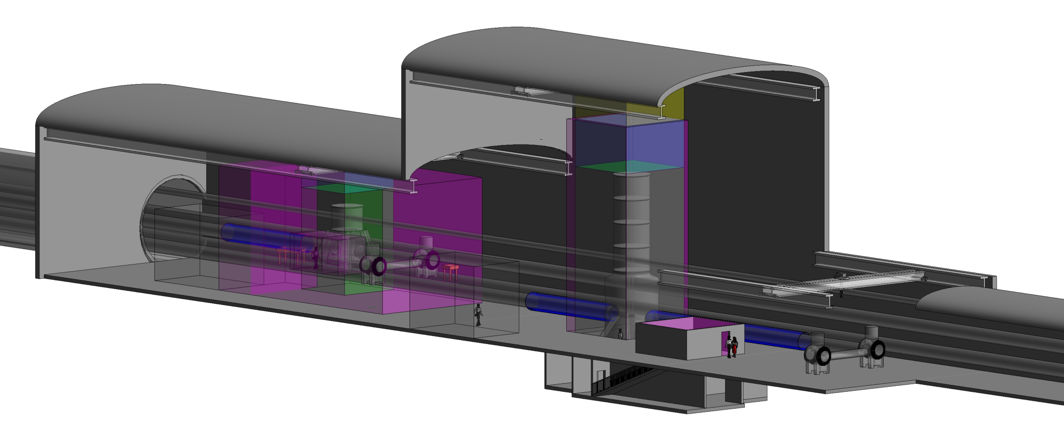

Interfaces & Clearances
Map of the Interfaces
Many of the interfaces have to be formalized & documented but they still need to be taken into account for 3D Integration. Responsibles also have to be allocated.
Hidden Space Consumers
Elements not present in the PBS (gate valves, bellows, supports) consume 3D volume.
Clearance Margins
Envelopes must include margins for installation, logistics & transportation paths, survey, safety, handling, and maintenance.
End Station with Clearances (J. Bratanata)

Slide 8
Review Cycle & Release Procedure
CERN-Aligned Integration Reviews
Following CERN model: Reviews at each milestone (concept → preliminary → detailed → pre-installation → as-built).
Check iteratively 3D model for envelope compliance and clearance margins.
Change Management Process
When subsystems exceed envelopes:
Trigger formal impact assessment on neighbours.
Renegotiate envelopes.
Update central 3D model (CATIA/PBS-structured).​
Prevents silent encroachments and late clashes
The development of this process will be carried together with CERN-ACE (Accelerator Configuration & Engineering) & ETO Project Office.

Slide 9
Outline
Introduction
ETO 3D Integration Plan
Definition of Interfaces & Clearances
Current Status & Ongoing work
Pilot End Station Integration
Collaboration with stakeholders
Next Steps
Conclusions

Slide 10
Current Status & Ongoing work
The starting point is the 2025 Design Taskforce. One of the most substantial achievements from this work is the 3D Revit model with the updated optical layout, including preliminary space claims.
Crane Space Claim
Tower Space Claim
Cleanroom Space Claim
End Station with Clearances (J. Bratanata, ETO)

Slide 11
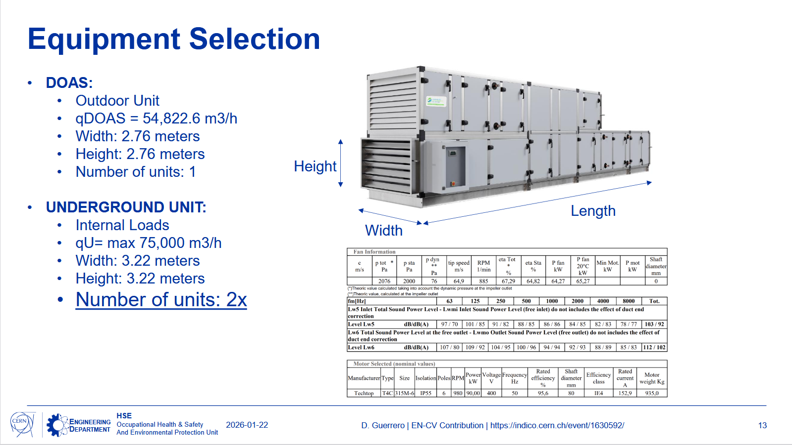
Current Status & Ongoing work
As the status of the project evolves, more systems are being further developed. ETO current collaboration with CERN is providing updated designs for:
HVAC Systems
Safety Systems
Electrical Systems
Access & Alarms Systems
To adequate this work, a new 3DX Catia pilot integrated model is being developed.
HVAC Design (D. Guerrero, CERN)

Slide 12
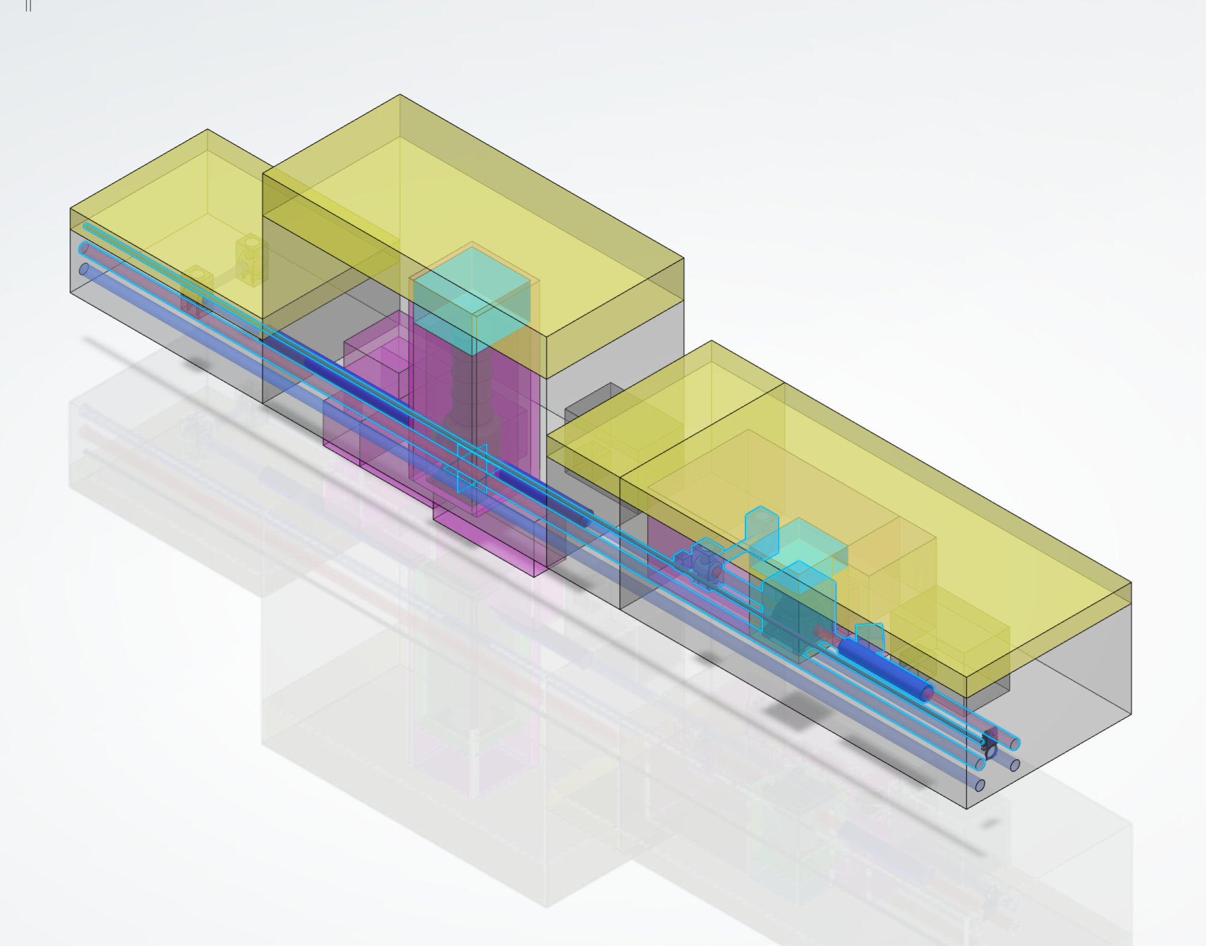
Integration Pilot: BA End Station
End Station with Clearances (J. Bratanata , ETO)
3DX CATIA End Station with Clearances (G. Cortis, INFN)

Slide 13
Integration Pilot: BA End Station
Transitioning to CATIA enhances precision modeling and collaboration across the Einstein Telescope project.
Superior clash detection and real-time interference checks during integration.
Hierarchical PBS breakdown enables system-specific development (e.g., HVAC, Safety, Access).
Improved data interoperability with PLM tools for lifecycle management from envelopes to as-built.
This Pilot serves as an exercise to learn how to properly integrate the rest of ET.
3DX CATIA End Station with Clearances (G. Cortis, INFN)

Slide 14
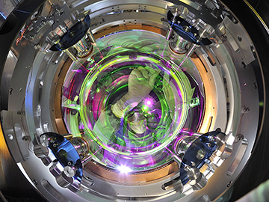
Collaboration with Stakeholders
To fully realize the required integration close collaboration with the different project stakeholders will be required namely:
Einstein Telescope Collaboration (ISB)
Capture subsystem requirements (optics, vacuum, cryogenics, suspensions) and translate them into spatial envelopes in the 3D model. (CM)
Joint definition of interfaces: which systems connect, what clearances are needed, who owns each boundary. (CM)
Incorporate evolving instrument designs into the integration model via structured review milestones.
Ensure the envelope strategy is compatible with the physics performance requirements.
EGO – Virgo Collaboration
Profit from their expertise in the integration of a GW detector for both Local systems (bellows, cryostats, supports) & distributed systems (HVAC, beampipes, electricity)
Virgo Test Mass [Image: EGO/Virgo Collaboration/Perciballi]

Slide 15
Next Steps
Strengthen the collaboration with the ETC ISB & EGO to improve the integration.
Establish responsibles for the different interfaces (Gate valves, bellows) & set up integration meetings.
Continue the collaboration with CERN to further develop the technical systems, safety & integration.
Continuous work in the end station pilot to introduce more required space claims.

Slide 16
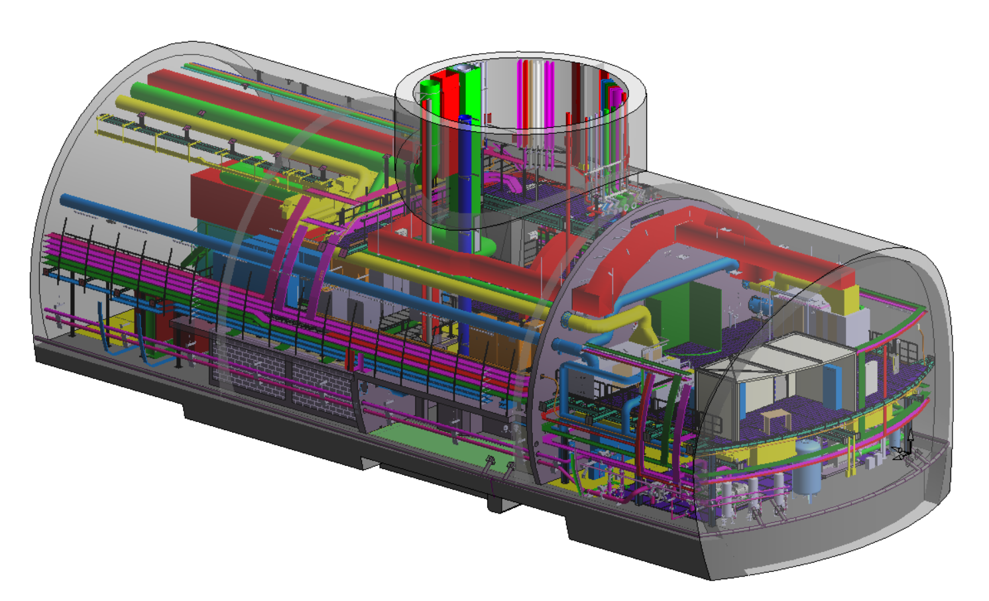


Next Steps
Strengthen the collaboration with the ETC ISB & EGO to improve the integration.
Establish responsibles for the different interfaces (Gate valves, bellows) & set up integration meetings.
Continue the collaboration with CERN to further develop the technical systems & safety.
Continuous work in the end station pilot to introduce more required space claims.
Native
Exported & Linked
HL-LHC Cavern: As-built CE Revit model
+ Catia integration linked as coordination model (Naviswork file)
3DX CATIA End Station with Clearances (G. Cortis, INFN)

Slide 17
Conclusions
A robust 3D integration plan is established: Revit → 3DX CATIA integrated pilot to develop the ET integration procedures.
CERN-inspired reviews and change management will improve interface management and prevent clashes across the different ET systems.
Stakeholder collaboration (ETC, EGO, CERN) key to envelope compliance and physics goals.

