Slide 1

ET Tower Design
Possible Investigation of the Warm Tower Concept
Workshop ET-LF TM in Pisa 18 – 20 March
A.Buggiani*, J.Gargiulo, A.Pasqualetti, T.Zelenova
Notes:
Good morning to everyone.

Slide 2
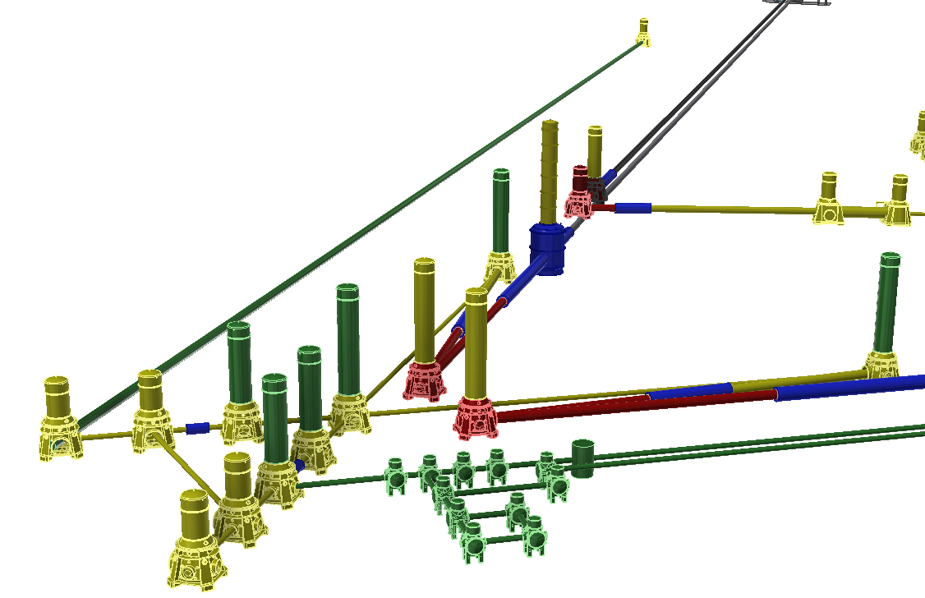
Warm Tower: Role and Design Drivers
Where it sits:
underground at ~300 m depth — hard constraints on transport, installation and maintenance
What it must do:
Maintain UHV (Ultra High Vacuum)
Provide clean environment for optics installation
Host the seismic isolation system
Interface with beampipes (links)
Allow periodic access for maintenance and commissioning
Main features for the tower design (from TDR):
Parameter | Value
Material | AISI 304L SS
Tower height | TBD (Open Point)
Access | Lateral or Bottom
Surface finish | Ra ≤ 0.8 μm
Outgassing H₂ | < 1×10⁻⁹ Pa·m/s
Outgassing H₂O | < 5×10⁻⁸ Pa·m/s (unbaked @100h)
1st mechanical mode | > 20 Hz
Rated environment | ISO Class 5
Notes:
Warm Tower: Role and Design Drivers
Let me start with a quick overview of what the warm tower is and what it has to do — just to make sure we all share the same starting point.
The warm tower sits underground at ~300 m depth — this sets hard constraints on installation, transport, and maintenance that a surface detector would never face.
(CLICK) Five requirements, one vessel: vacuum, cleanliness, seismic isolation, optical interfaces, and ease of maintenance. All of this in a compact underground space.
(CLICK) Here are the key numbers from the TDR baseline — material, surface-quality, outgassing, cleanliness class. One thing to highlight: tower height is still an open point.

Slide 3
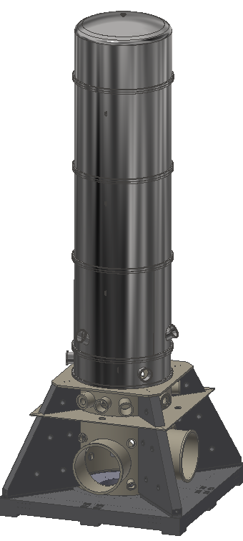
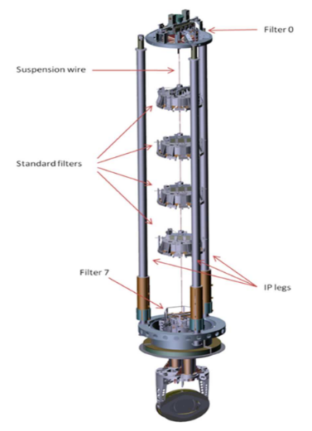
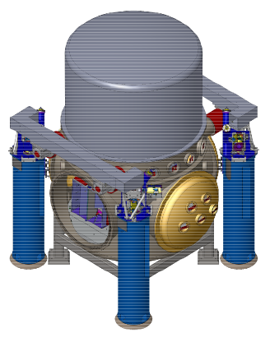
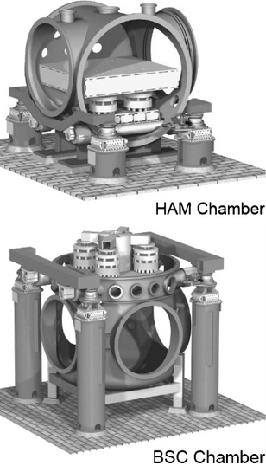
Lessons from Virgo and LIGO towers
Virgo — Tall cylindrical tower
LIGO — Compact base chamber
Two-compartment vessel, suspensions above / optics below
Bottom access via flange below floor level
Super Attenuator: inverted pendulum + multi-stage chain
Excellent seismic attenuation down to very low frequencies
Issue for ET: access requires dedicated excavation in rock — costly and complex underground
Wide and low base — more underground-friendly
Lateral access with large circular opening
HAM-ISI: active isolation platform internal to the chamber
⚠️ Wide base — reduced space for pumping, benches and access
Notes:
Lessons from Virgo and LIGO towers
Before presenting our proposal, let’s start from what we know— two different approaches, two different lessons.
(CLICK) Virgo gave us the Super Attenuator — one of the best seismic isolation systems ever built. But the tower is tall, needs a pit below the floor, and that means cutting into the rock underground. Not ideal for Einstein Telescope.
(CLICK) LIGO went the opposite direction — compact, wide base, lateral access. Much more underground-friendly.
The one thing to keep in mind is that the wide base takes up more floor space — which leaves less space around the tower for pumping systems, optical benches and maintenance access.
This could be an issue— it really depends on how much space is available around each tower.

Slide 4
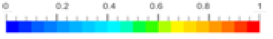
Access Configuration: Bottom vs Lateral
Bottom access
Lateral access
Velocity Magnitude m/s
Directed airflow top-down — favorable for cleanliness
⚠️ Requires dedicated pit excavation in rock
⚠️ Confined space — personnel safety constraints
No pit, no additional excavation
⚠️ More complex airflow management
⚠️ Large flange reduces available surface for connections
"Neither solution is perfect — bottom access wins on cleanliness, lateral access wins on underground compatibility. This drives the need for an alternative geometry."
Notes:
Access Configuration: Bottom vs Lateral
Let’s take a step back first, we need to understand why neither access option for the conical tower works perfectly underground.
(CLICK) Bottom access — the air flows from top to bottom, which is naturally good for cleanliness. But underground, this means cutting a pit into the rock. Expensive and complex.
(CLICK) Lateral access solves the excavation problem — but airflow management is more complex and the large flange on the side reduces the available surface for connections.
Neither option is perfect. So we started looking for a better approach.

Slide 5
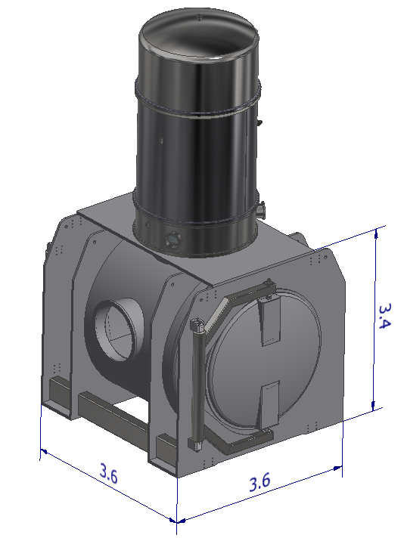
Alternative Geometry: Compact Base Tower
Motivation
Conical tower remains valid where no lateral space available
Where lateral space exists: compact base is preferred underground
Work in progress — concept under development, not a final design
Proposed geometry
Wide and low compact base — LIGO-inspired
Large circular lateral openings
Dimensions: 3.6 × 3.6 × 3.4 [m]
Weight around 16-18 t
Key advantages
No pit excavation
Removable corner casting frame for transport
Notes:
Alternative Geometry: Compact Base Tower
Just to be clear from the start— what you are going to see is a preliminary concept, work in progress, not a final design. We are here today to collect your inputs.
(CLICK) The starting point is simple: the conical tower stays where there is no space on the sides — we are not replacing it. But where there is lateral space, a compact base geometry is a better fit for underground.
(CLICK) The geometry is inspired by LIGO — wide and low base, large circular openings on the sides. Dimensions around 3.6 × 3.6 × 3.4 m, weight around 16-18 tonnes.
(CLICK) Two main advantages: no excavation in the rock, and transport was considered from the very start of the design.

Slide 6
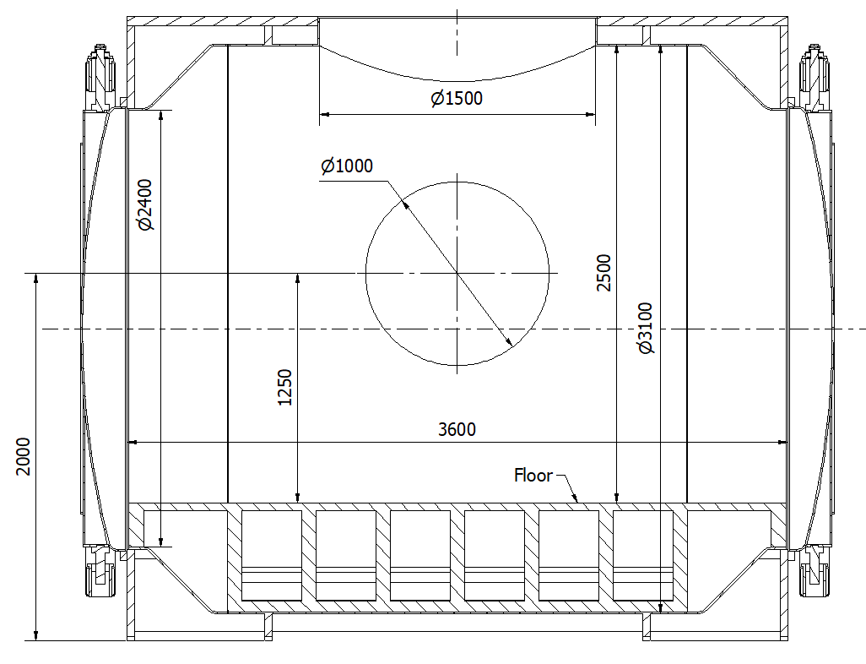
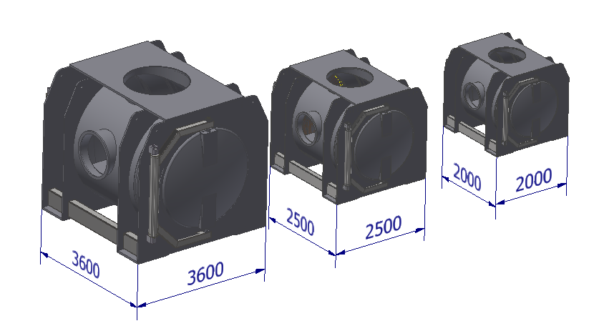
Inner Volume and Scalability
 | Small | Medium | Large
Inner diameter | ~1,8 m | ~2,2 m | ~3,1 m
Base footprint | 2 x 2 m | 2,5 x 2,5 m | 3,6 × 3,6 m
Typical use | Auxiliary optics | Central IFO | Test mass
Weight | TBD | TBD | ~26 t
"Same concept, scalable geometry — footprint and inner volume adapt to requirements."
Notes:
Inner Volume and Scalability
The compact base concept is not fixed — it can be scaled up or down.
(CLICK) For towers hosting smaller systems — auxiliary optics, benches — the base can be made smaller. Less volume needed, less stringent seismic requirements, smaller footprint.
In this way the project gets flexibility without having to design a completely different tower for each case.

Slide 7
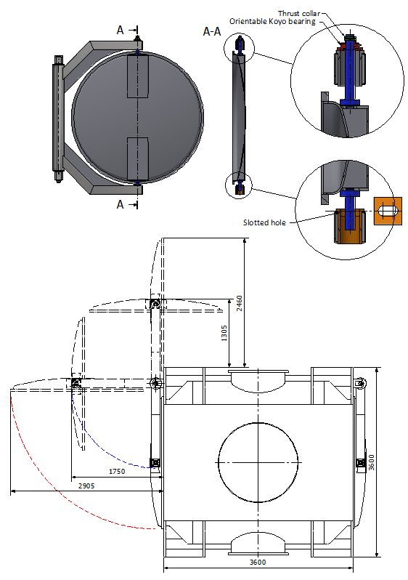
Access System: Double-Hinge Door
Design drivers
Limited lateral space — single door not feasible
Double hinge minimizes opening footprint
Isostatic constraint scheme
Top: orientable Koyo bearing + thrust collar carries vertical load
Bottom: slotted hole — radial constraint only
Centre of mass management
Mass redistribution on hinge side to minimise tilting moment
Small residual tilt acceptable — door repositions on closing
“Simple, robust — suitable for both major installation activities and short operations.”
Notes:
Access System: Double-Hinge Door
We also looked at the access system — and this is one of the mechanical details we have worked on.
(CLICK) Underground space is limited — a double hinge keeps the opening footprint smaller than a single hinge door.
(CLICK) The hinge system is fully isostatic: the bearing at the top takes all the vertical load, the slotted hole at the bottom only guides laterally. No precision alignment needed during assembly.
(CLICK) One open point: the door tilts slightly when opening, as the centre of mass is not on the hinge axis — we are working on it. In any case it finds its position back when you close it
Simple, robust — works for both installation and maintenance operations.

Slide 8
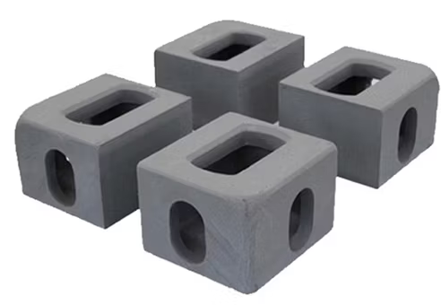
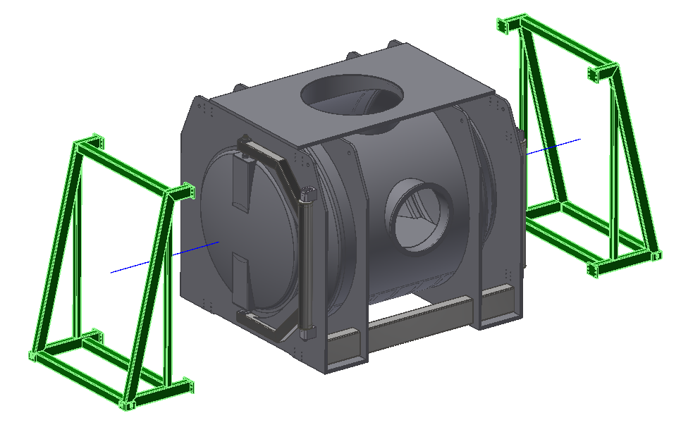
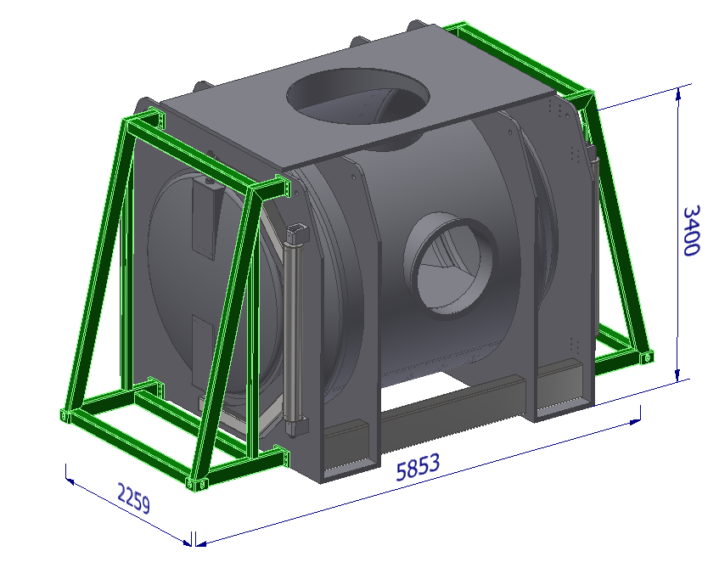
Transport Concept: ISO Corner Castings
Corner castings
Standard ISO 1161 — 178 × 162 × 118 mm
Breaking load: 50 t
Removable Transport Frame (🟩 Highlighted in Green)
Corner casting spacing: 2259 × 5853 mm — matches ISO 668 20' container footprint
Removable bolted frame — installed for transport, removed after
Compatible with twist-lock handling, ships, trucks
Dedicated lifting lugs for crane handling (🔴 Inside Red circles:)
Notes:
Transport Concept: ISO Corner Castings
From the very beginning we thought about transport. Before reaching the experimental hall, the tower has to travel — by road and maybe by sea.
(CLICK) First, the corner castings. They follow the ISO 1161 standard — breaking load 50 tonnes, well above the 18 tonnes of the tower.
(CLICK) These castings are mounted on a removable frame — bolted on for shipping, taken off after installation. It is not part of the tower itself. The spacing between the castings matches the ISO 668 standard for 20-foot containers — so the tower is handled exactly like a standard shipping box: twist-locks on trucks, flat rack slots on ships.
(CLICK) The tower also has dedicated lifting lugs for crane handling — separate from the transport frame.

Slide 9
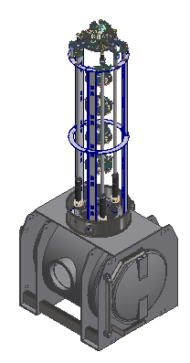
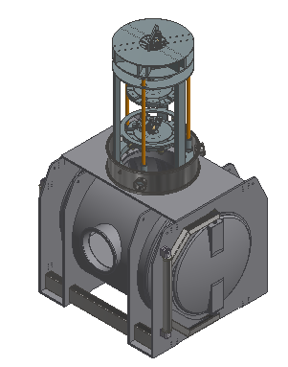
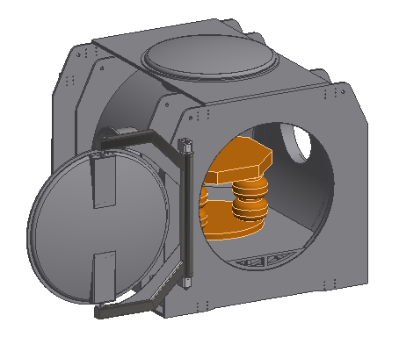
One Vessel, Multiple Suspension Schemes
Floor-supported Bench
No suspension chain
Optical bench from below
Adapted base required
Use: auxiliary optics
Soft Suspension Chain
Shorter chain
Active platform
Compact height
Use: central IFO optics
Super Attenuator
Multi-stage suspension chain
Inverted pendulum on top
Maximum seismic attenuation
Use: test mass towers
"Same vessel — suspension scheme adapts to each tower's seismic requirements."
Notes:
One Vessel, Multiple Suspension Schemes
From the start we wanted the tower to work with different suspension systems.
Where full seismic attenuation is needed, a Super Attenuator sits on top of the tower — as in Virgo.
(CLICK) Where requirements are less tight, a shorter chain may be enough.
(CLICK) And for auxiliary benches, the optical table can simply sit on a seismic isolation support from below — no suspension chain at all.
(CLICK) Same tower, three different solutions — but this needs to be confirmed with the suspension and Optic teams.

Slide 10
Open Points and Next Steps
Team | Input needed
Suspension & Seismic isolation | Chain length, flange position, platform dimensions→ drives the tower height
Optic & Payload | Max component dimensions → drives cleanroom sizing
"We are ready to collaborate — these conversations are the next step."
Notes:
Open Points and Next Steps
Most of these open points cannot be solved by the vacuum team alone.
From the suspension and seismic isolation team we need the chain length, the flange position and the platform dimensions — these directly drive the tower height.
From the optic and payload team we need the maximum component dimensions — this drives the cleanroom sizing.
We are ready to work together — let’s start these conversations.

Slide 11
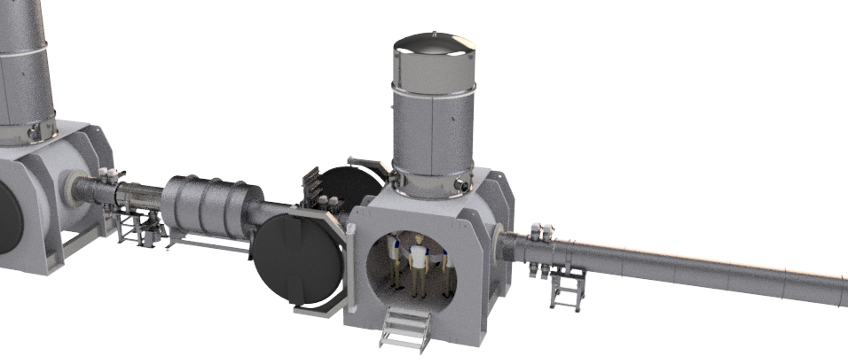
Thank you for your attention!
End of presentation
"Happy to discuss and open to contributions — this design evolves with your input."
Notes:
Thank you for your attention
Thank you. I am happy to take questions and discuss.
As you saw, there are several open points where we need your input — so think of this as the beginning of a conversation, not the end of a presentation.

Slide 12
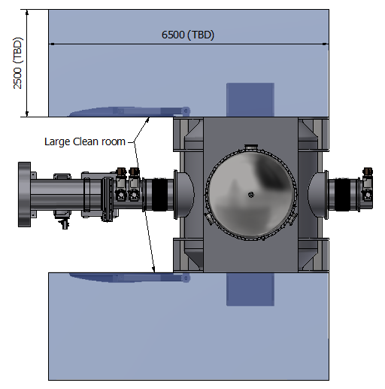
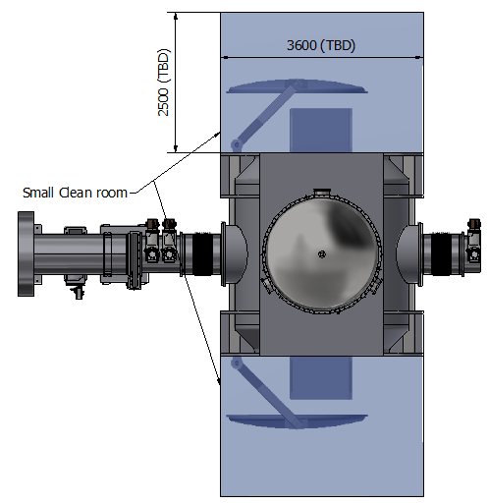
Integration and Cleanroom Strategy
Large cleanroom
Full Cleanroom enclosure on door opening
For payload installation and large components
ISO Class 5 — personnel access with full PPE
Positive pressure maintained during operations
Small cleanroom
Compact Cleanroom encosure on access port
For maintenance and commissioning operations
ISO Class 5 — limited personnel access
Faster to deploy than full enclosure
"Two cleanroom configurations for two operational modes — installation and maintenance."
Notes:
Integration and Cleanroom Strategy
We also thought about the cleanroom interface. The idea is simple: two configurations for two different needs.
(CLICK) A large enclosure covering the full door opening — for installing major components like optics and suspension elements.
(CLICK) A smaller enclosure on the access port — for routine maintenance and commissioning. Faster to set up and easier to manage underground.
Dimensions are indicative — the final sizing will be decided together with the integration team.

Slide 13
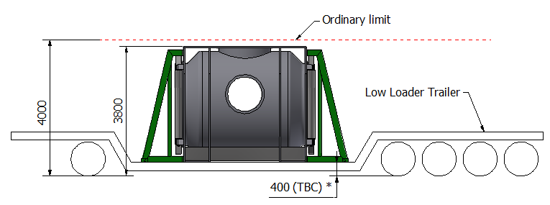
Road Transport: Feasibility Assessment
Parameter | Value | Italy | EMR (NL/BE/DE) | Status
Width | 3600 mm | 2550 mm | 2550 mm | ⚠️ Exceptional both
Height | ~3800 mm | 4000 mm | 4000 mm | ✅ OK both
Weight | ~18 t | — | — | ✅ OK both
Permit | Required | ANAS 15 days | TBD | ⚠️
Police escort | Not required | >4500 mm | >4000 mm | ✅
* Floor height depends on trailer type — low loader: ~400-500 mm, semi low loader: ~800 mm
Notes:
Road Transport: Feasibility Assessment
The critical dimension is the width — 3600 mm is above the 2550 mm standard limit, so an exceptional transport permit is needed in both candidate sites.
Height is fine: with a low loader at 400 mm (TBC) floor height, the total convoy height is around 3800 mm — under the 4000 mm limit.
No police escort needed.
EMR is the Euregio Meuse-Rhine region — at the borders of Netherlands, Belgium and Germany.

Slide 14
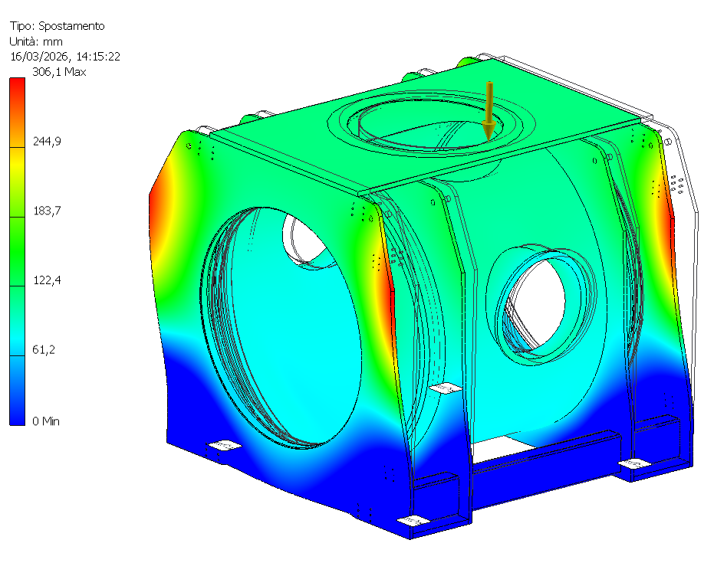
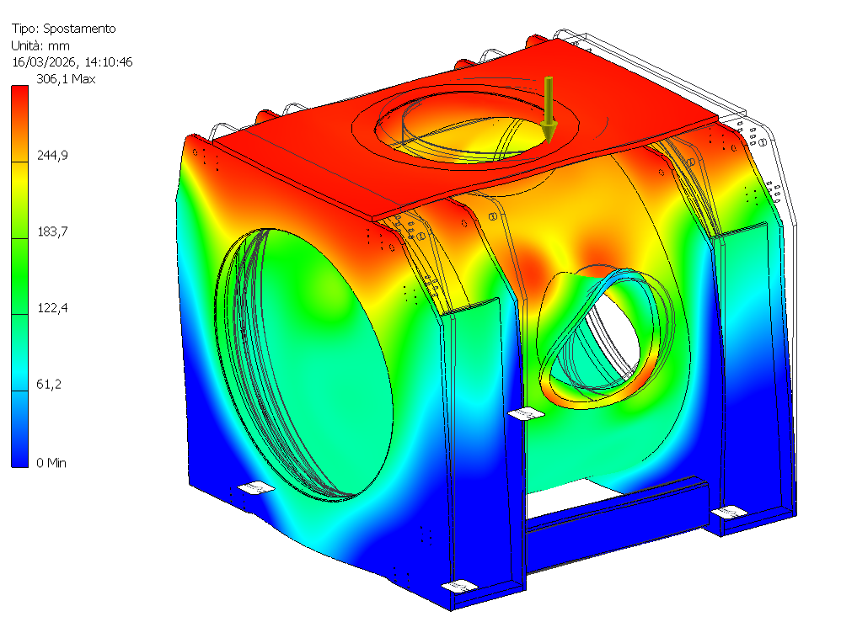
Tower Mechanical Response — Preliminary FEM
 | Initial Geometry | After first structural intervention
1st mode | 24.5 Hz | 47 Hz
Requirement | > 20 Hz (ET pTDR Table 3.61) | > 20 Hz
Status | ✅ | ✅
Note: Applied load includes suspension chain, optical bench and surrounding structural elements (~8 t). Full modal analysis with distributed mass planned.
"Requirement already met — geometry will be refined based on inputs from other teams."
Notes:
Tower Mechanical Response — Preliminary FEM
Here are two preliminary FEM results.
The initial geometry gives 24.5 Hz — already above the 20 Hz requirement from the pTDR.
After a first structural intervention we reach 47 Hz.
An equivalent static force of 8 tonnes was applied — this includes the suspension chain, the optical bench and the surrounding structural elements. A full modal analysis is planned.
One important point: the final geometry will change depending on inputs from other teams — where the flanges go, how many viewports, what additional connections are needed.
So there is space for improvement, but also for necessary compromises.

