Slide 1
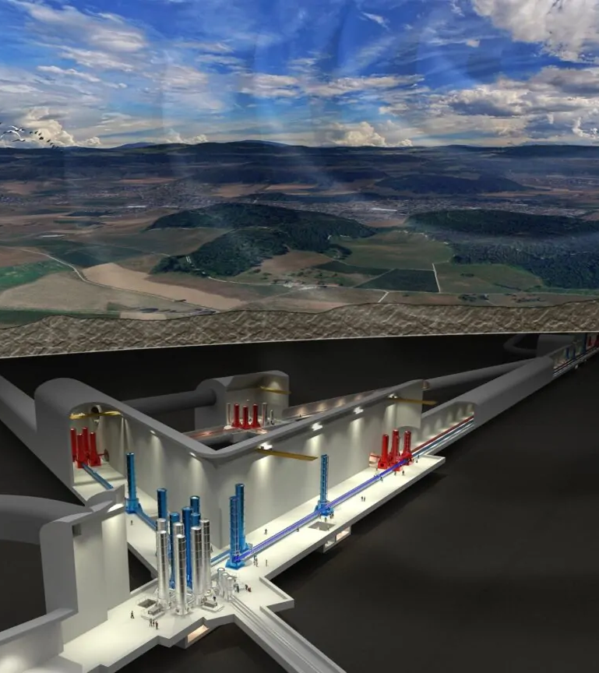






Mechanical tests on silicon fibers
14 th KAGRA International Workshop, 2026
Michele Arcangelo Dicorato, Flavio Travasso – University of Camerino, University of Perugia, INFN Perugia
Ardiana Nela, Andrew Spencer – IGR, University of Glasgow
Iryna Buchovska, Robert Menzel – Institut für Kristallzüchtung, Berlin
Alex Amato, Maike Kuhler – Maastricht University
Alessandro Bertolini - Nikhef

Slide 2















Outline
Why crystalline test-mass suspension
Fiber sizing
Fiber production
Fibers mechanical characterization
Q-factor measurement
Tensile strength measurement
Bending strength measurement
  Michele Arcangelo Dicorato, Mechanical tests on silicon fibers, KAGRA International Workshop 2026

Slide 3
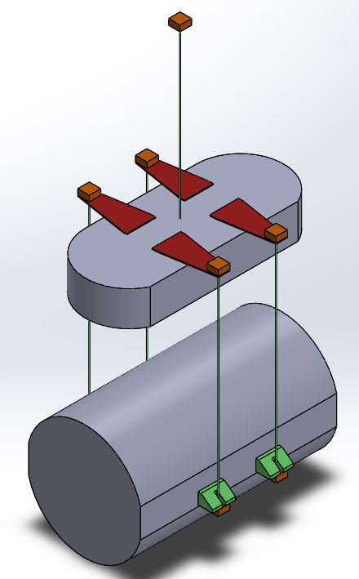
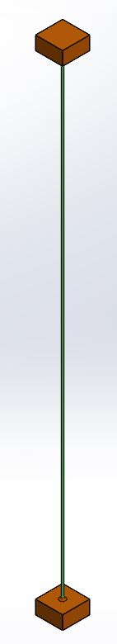

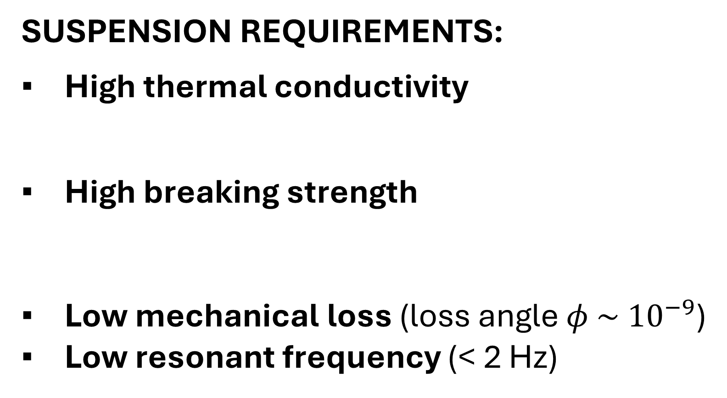
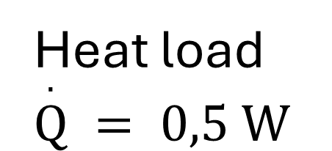
Towards the development of a silicon cryogenic suspension
Heat load $\overset{.}{Q} = 0,5 W$
SUSPENSION REQUIREMENTS:
High thermal conductivity
High breaking strength
Low mechanical loss (loss angle $φ \sim { 10}^{−9}$)
Low resonant frequency (< 2 Hz)
$$∅_{Si}=3 mm$$
Mirror mass 211 kg
Blade
Marionette
Excellent surface quality
Anchor
220 MPa with a safety factor of 3
Low thermal noise
Fiber
Cryogenic temperature (10 K -20 K )
Monocrystalline silicon is one of the most promising candidate materials.
This is due to its thermoelastic nulling regions (zero crossing of the thermal expansion coefficient at 18K and 123K) and low mechanical loss at cryogenic temperatures.
Ear
Substrate
  Michele Arcangelo Dicorato, Mechanical tests on silicon fibers, KAGRA International Workshop 2026

Slide 4
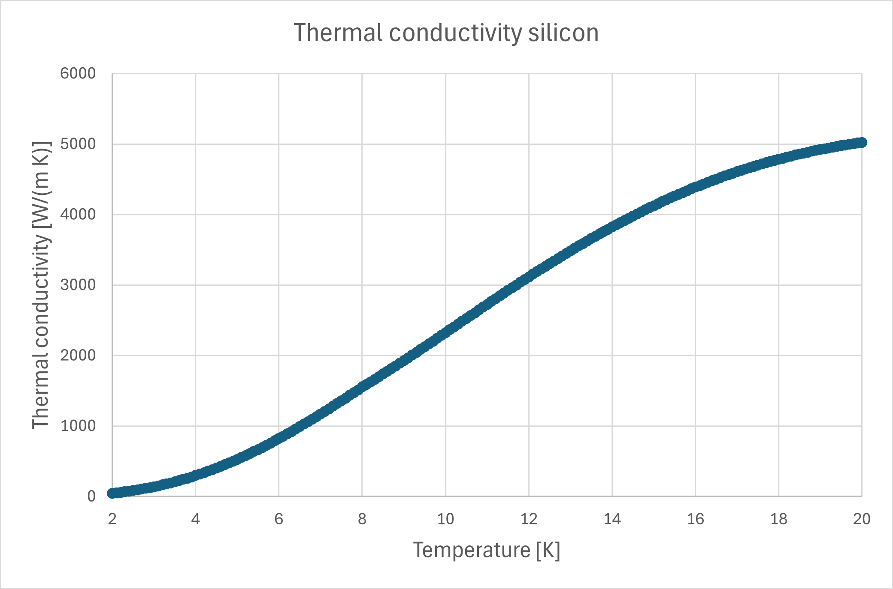
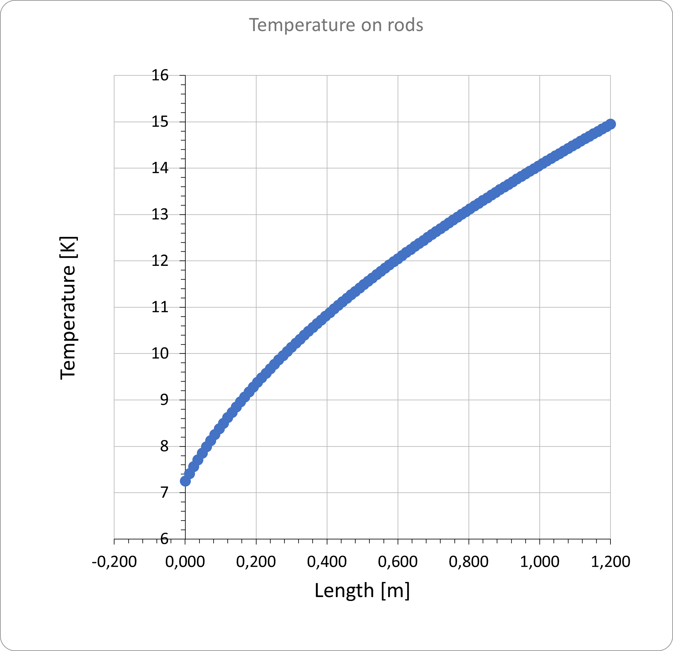
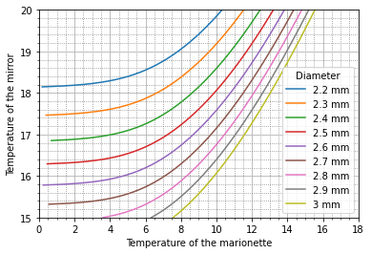
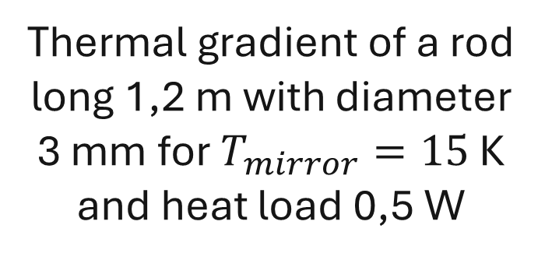
Fiber sizing
Thermal conductivity of silicon taken from Material Properties Database (MPDB) software
Thermal gradient of a rod long 1,2 m with diameter 3 mm for $T_{mirror}=15$ K and heat load 0,5 W
Mirror temperature as a function of marionette temperature for some rod diameters, considering 4 silicon rods of length 1,2 m and a heat load of 0,5 W
CURRENT DIAMETER BASELINE CHOICE: 3 mm
  Michele Arcangelo Dicorato, Mechanical tests on silicon fibers, KAGRA International Workshop 2026

Slide 5
Fiber sizing
BREAKING STRENGTH
4 wires of 3 mm diameter
211 kg mirror
Stress on each wire = 73 MPa
High variability in the breaking strength measurements
Safety factor of 3 or 6
220 MPa or 440 MPa tensile strength
Improvement of production process and breaking strength measurements to reduce the safety factor.
LENGTH
A decreasing length yields a reduction of temperature of the mirror, but also shift all the modes to higher frequencies.
Constraint imposed by the tower dimensions and cryostat dimensions
CURRENT REFERENCE LENGTH: 1,2 m
  Michele Arcangelo Dicorato, Mechanical tests on silicon fibers, KAGRA International Workshop 2026

Slide 6

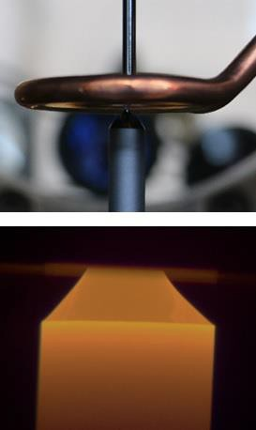
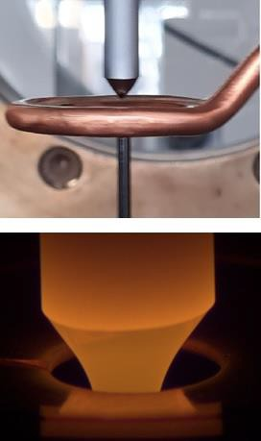
Fiber production
LEIBNIZ ⁻ INSTITUT FÜR KRISTALLZÜCHTUNG
Float-zone technique produces high purity, contaminant free, single crystal uniform silicon fibers with exceptionally good surface quality.
Pedestal growth
Float zone growth
Crystal
HF
Inductor
Feed
Melt
A silicon feed rod is melted at the bottom using an inductive coil
The molten zone contacts a monocrystalline seed
The seed is moved downwards, and crystallization begins
Molten silicon solidifies into a large single crystal silicon fiber without direct contact with seed rod, minimizing impurities
Pulling
Pulling
  Michele Arcangelo Dicorato, Mechanical tests on silicon fibers, KAGRA International Workshop 2026

Slide 7
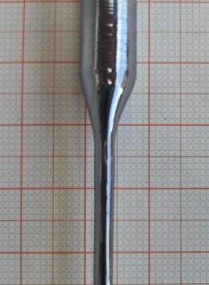

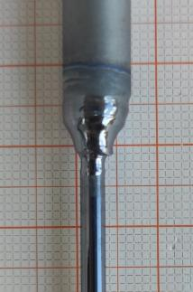

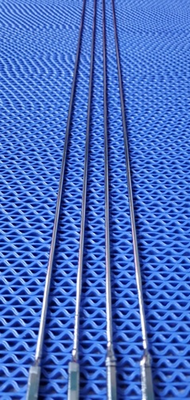
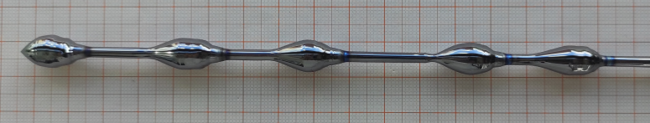
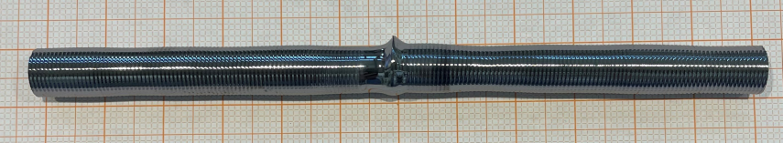
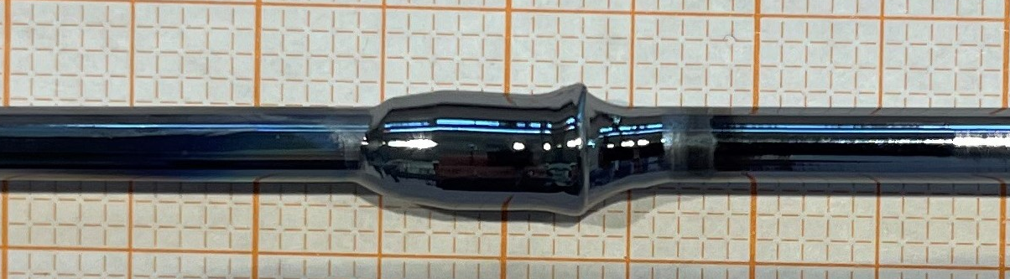
Fiber production
Welding of 8 mm rods
Welding of 3 mm rods
Long fibers with grown thicker ends
  Michele Arcangelo Dicorato, Mechanical tests on silicon fibers, KAGRA International Workshop 2026

Slide 8
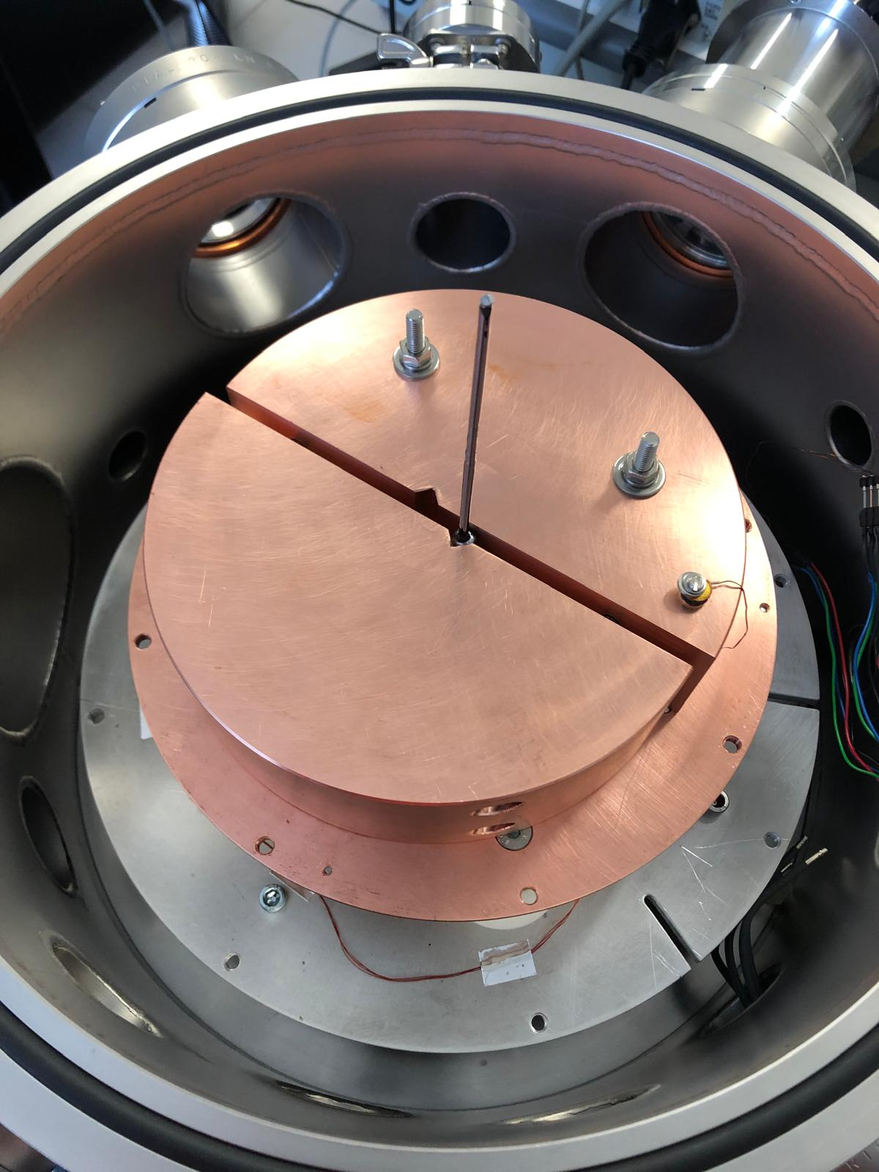
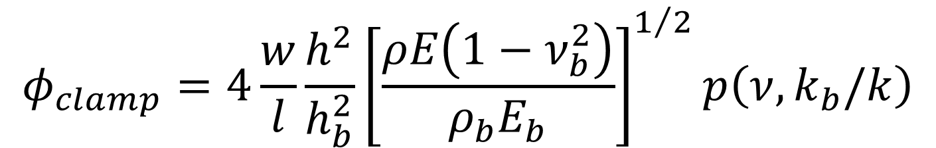

Fiber characterization
Mechanical loss measurements
Mechanical loss measurements at the University of Camerino to accurately measure the loss of fibers with the ring-down method
If the fiber has an excellent surface quality and a good crystallinity, the limiting factor for this measurement at cryogenic temperature is the clamp loss
$$h_{b}$$
Clamp material (rigidity, density)
Clamp dimensions
Fastening strength
$$φ\left(ω\right)=φ_{bulk}+φ_{surface}+φ_{thermoelastic}\left(ω\right)+φ_{clamp}\left(ω\right)+φ_{gas}\left(ω\right)+φ_{other}(ω)$$
$$φ_{clamp}=4\frac{w}{l}\frac{h^{2}}{h_{b}^{2}}{\left[\frac{ρE\left(1−ν_{b}^{2}\right)}{ρ_{b}E_{b}}\right]}^{1/2}p\left(ν,k_{b}/k\right)$$
[Douglas M. Photiadis and John A. Judge Attachment losses of high Q oscillators]
  Michele Arcangelo Dicorato, Mechanical tests on silicon fibers, KAGRA International Workshop 2026

Slide 9
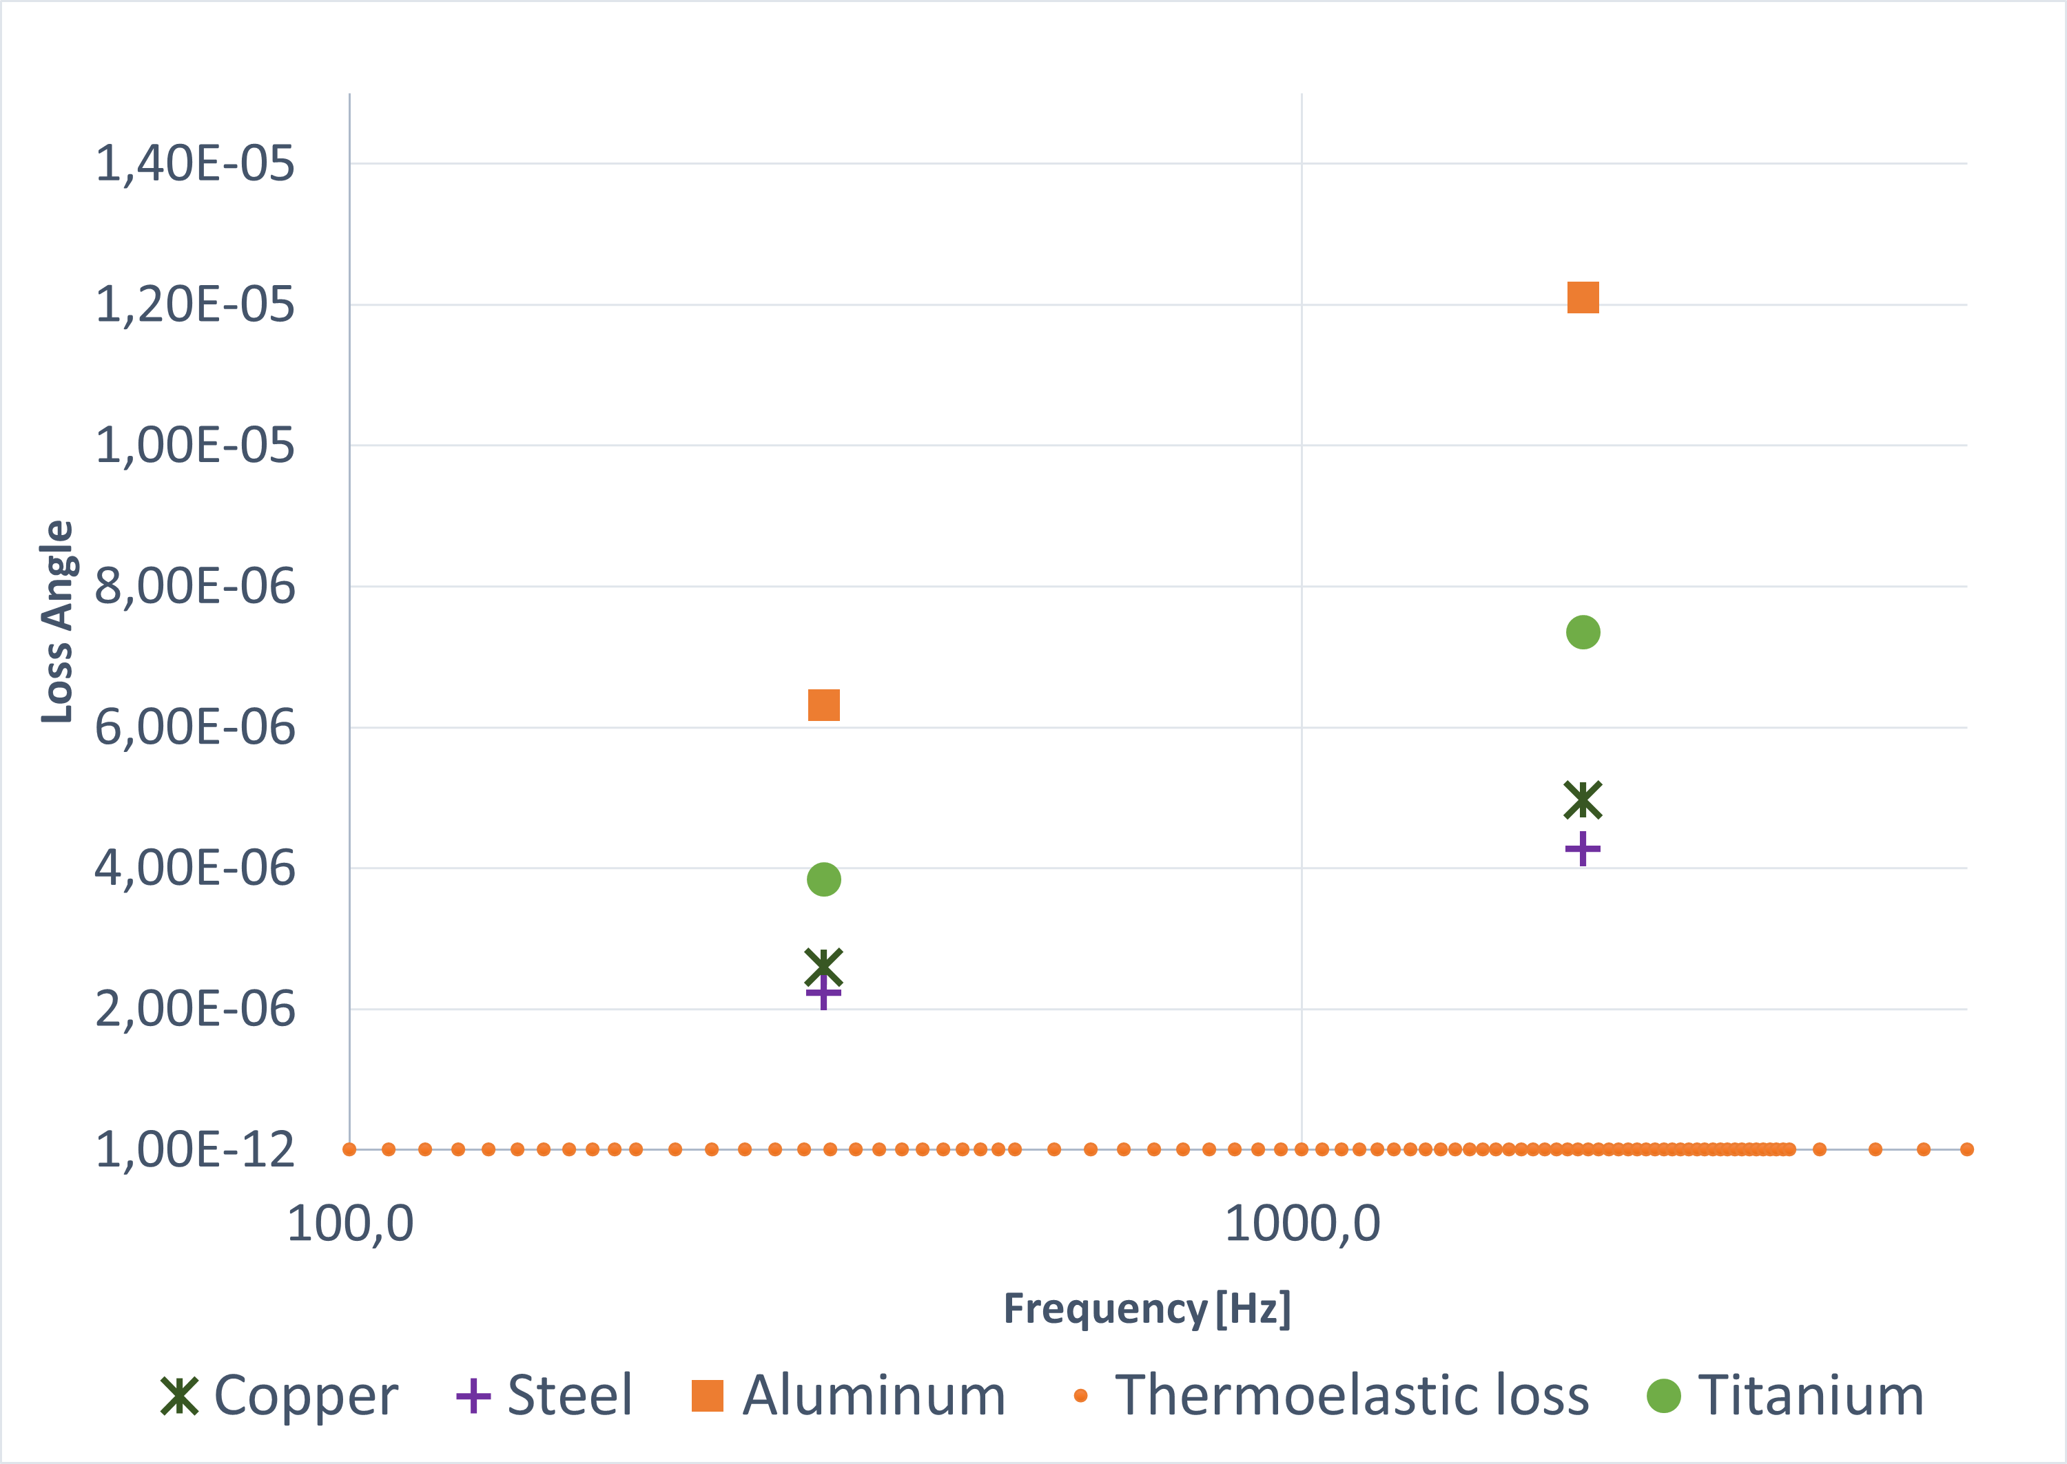
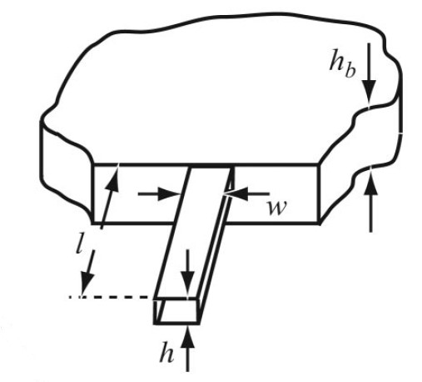
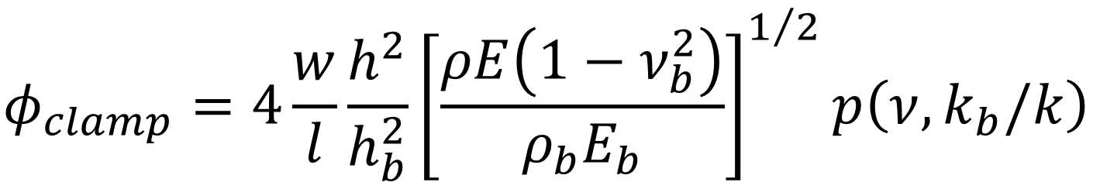
Fiber characterization
Attachment loss estimation – clamp sizing
Silicon fiber
Diameter 3 mm
Length 10 cm
Clamp
Thickness 18 cm
Temperature 15 K
$$φ_{clamp}=4\frac{w}{l}\frac{h^{2}}{h_{b}^{2}}{\left[\frac{ρE\left(1−ν_{b}^{2}\right)}{ρ_{b}E_{b}}\right]}^{1/2}p\left(ν,k_{b}/k\right)$$
$$p\left(ν,k_{b}/k\right)=α_{11}β_{n}^{2}−2α_{12}ν_{n}\left[k_{b}/k\right]+α_{22}{\left[k_{b}/k\right]}^{2}$$
[Douglas M. Photiadis and John A. Judge Attachment losses of high Q oscillators]
  Michele Arcangelo Dicorato, Mechanical tests on silicon fibers, KAGRA International Workshop 2026

Slide 10
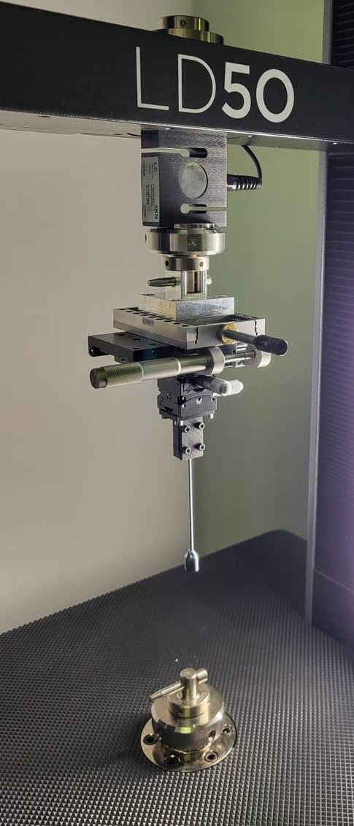
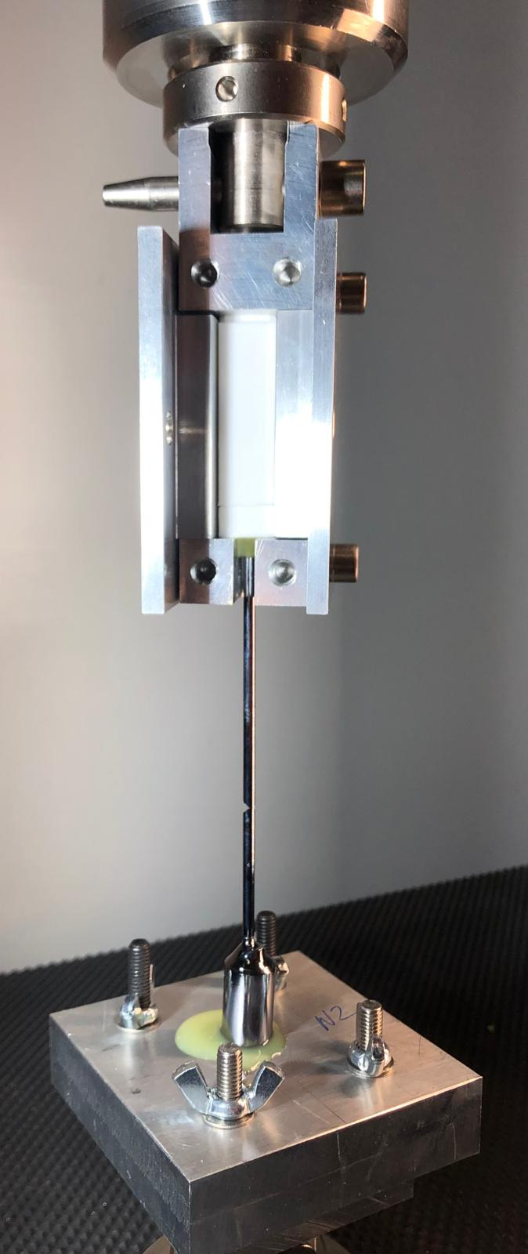
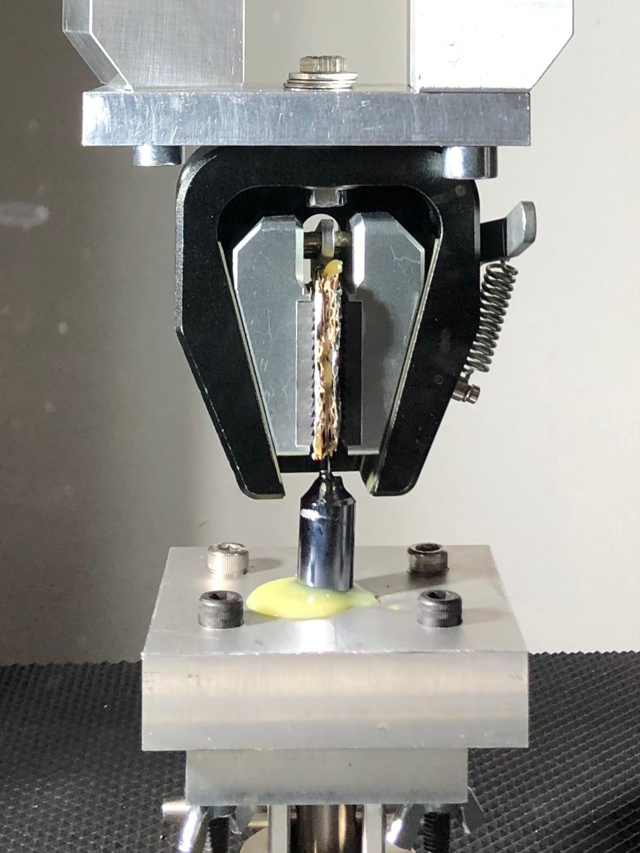
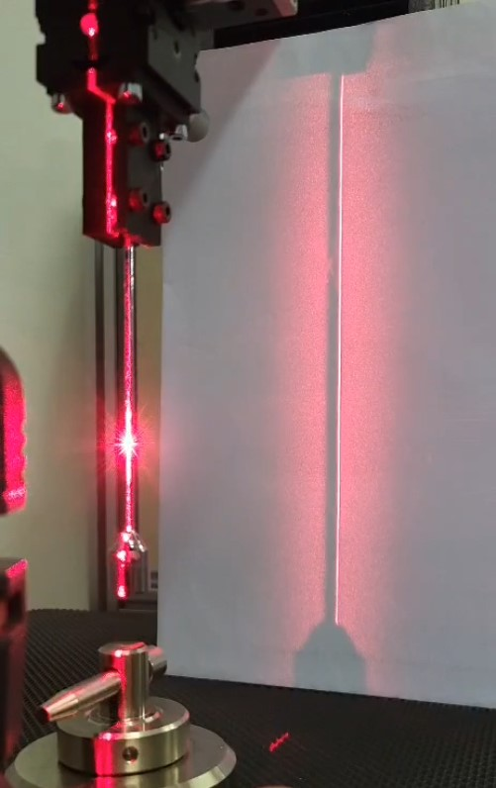
Fiber characterization
Tensile stress measurements
Vertical Alignment with micrometric controls and laser level
Fiber with seed
(Perugia method)
Fiber without seed
(Glasgow method)
Work done with Ardiana Nela and Dr Flavio Travasso at the University of Perugia
  Michele Arcangelo Dicorato, Mechanical tests on silicon fibers, KAGRA International Workshop 2026

Slide 11
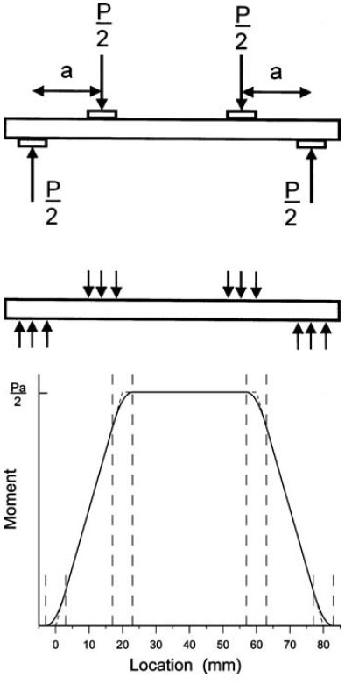
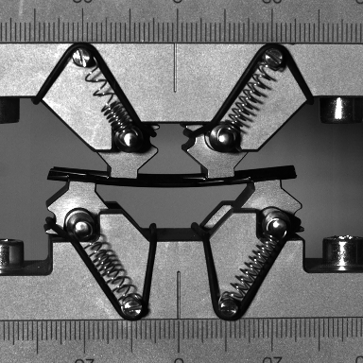
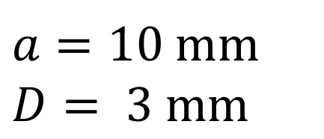
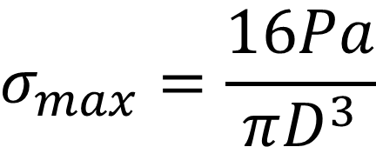
Fiber characterization
Bending stress measurements
2a
4-point bending method
Maximum tensile stress
$$σ_{max}=\frac{16Pa}{πD^{3}}$$
$$a=10 mm$$
$$D= 3 mm$$
Why bending test?
To determine the assembly precision (some misalignment in the assembly can cause the fiber to bend)
To determine the dynamic displacement range during the setup of the active controls
Bending system designed and optimized for cylindrical rods 3 mm thick and 5 cm long, according to the standard ASTM C1684-18 2023
Work done with Ardiana Nela and Dr Flavio Travasso at the University of Perugia
[Quinn et al., Journal of Testing and Evaluation, 2009]
  Michele Arcangelo Dicorato, Mechanical tests on silicon fibers, KAGRA International Workshop 2026

Slide 12
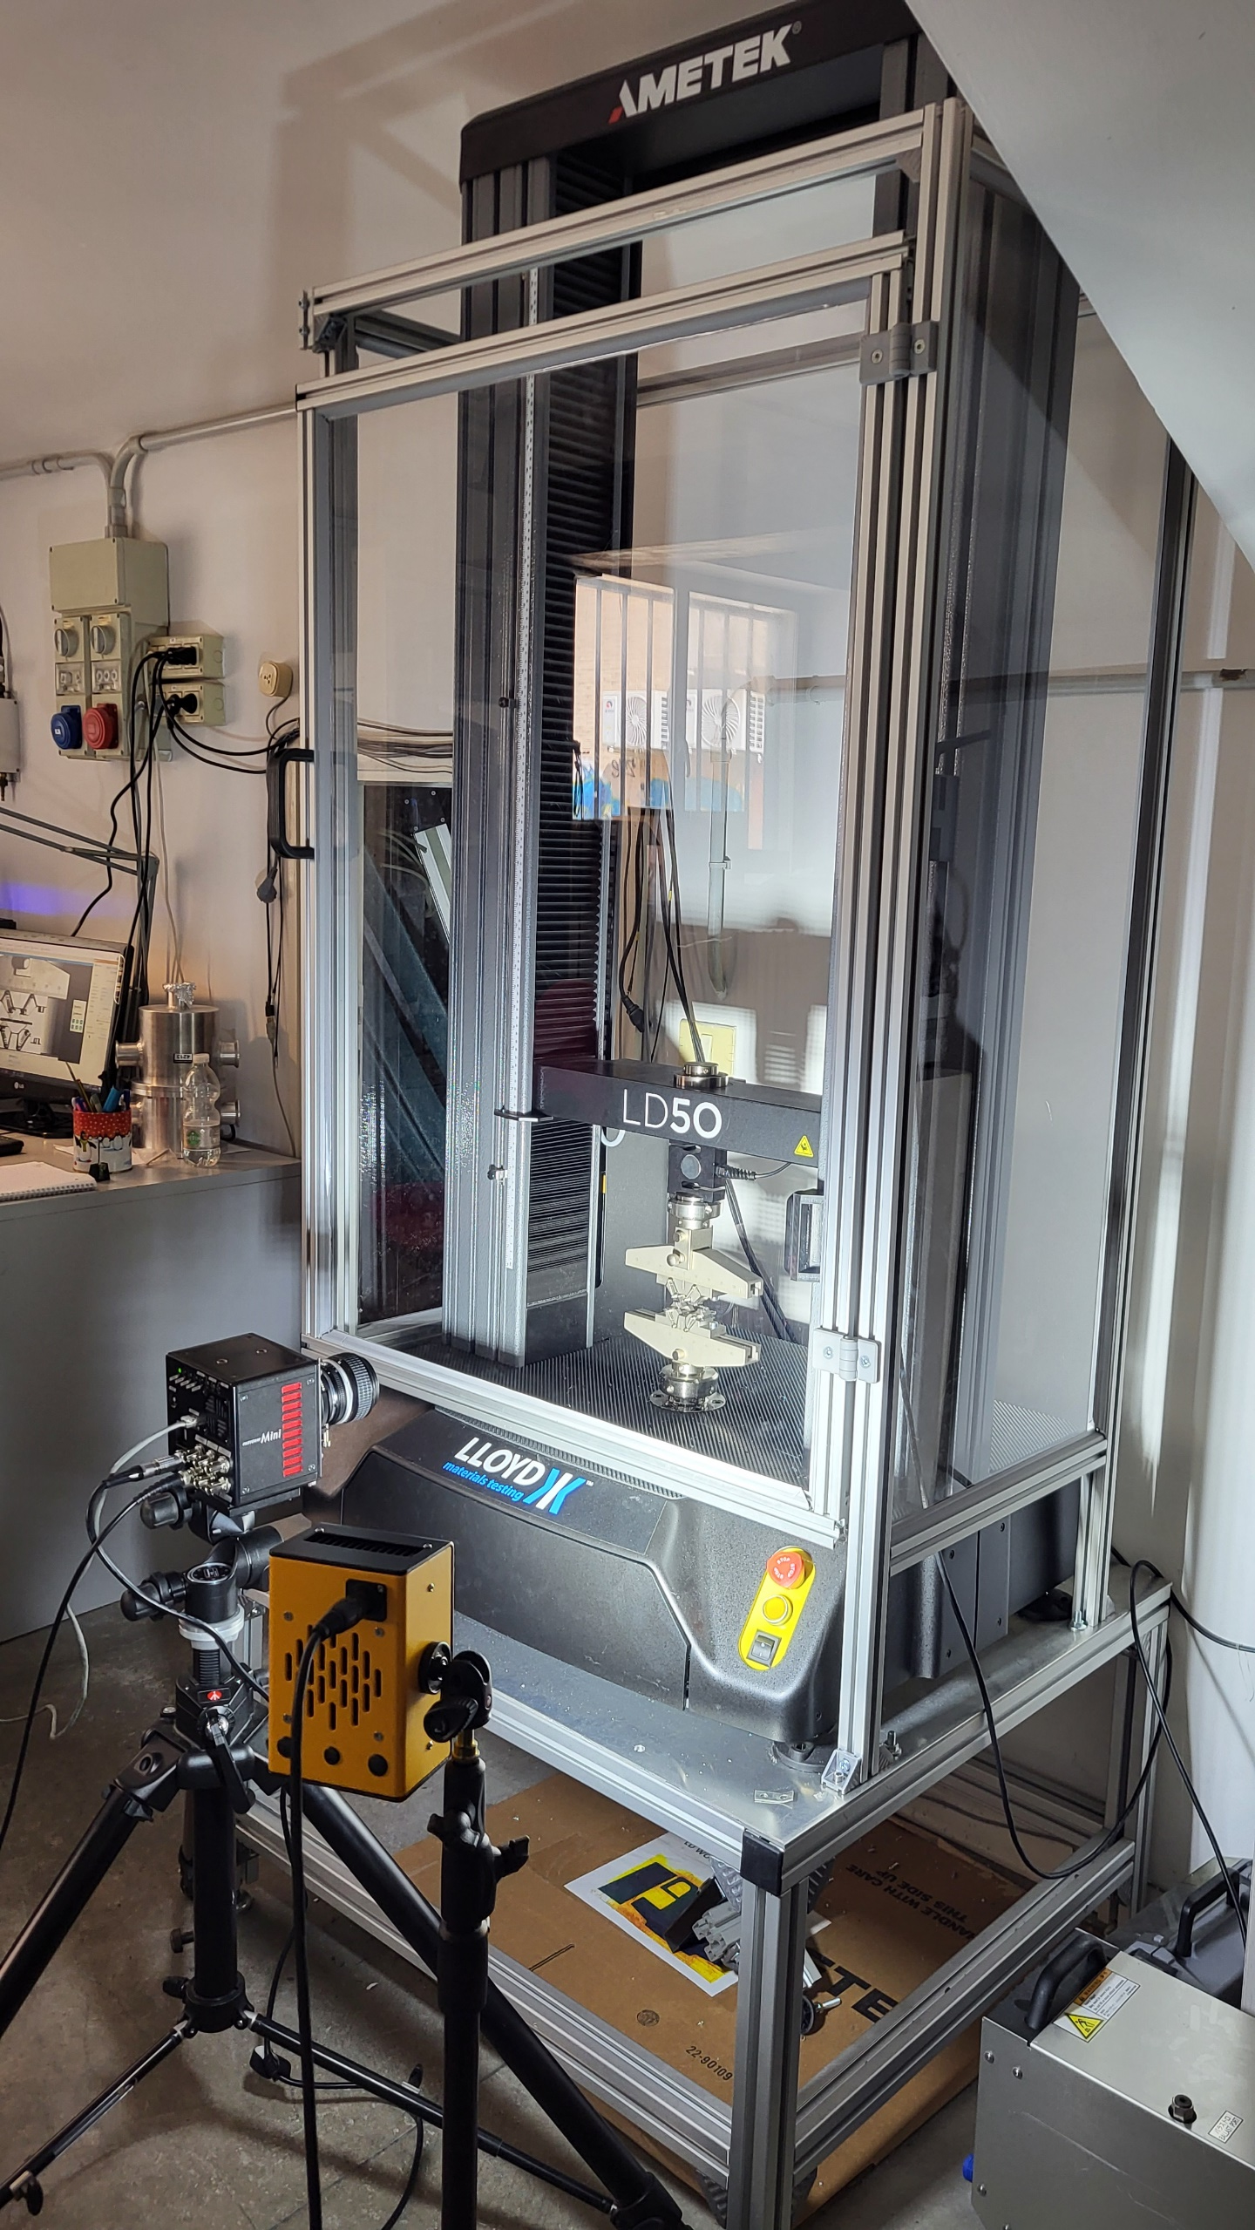
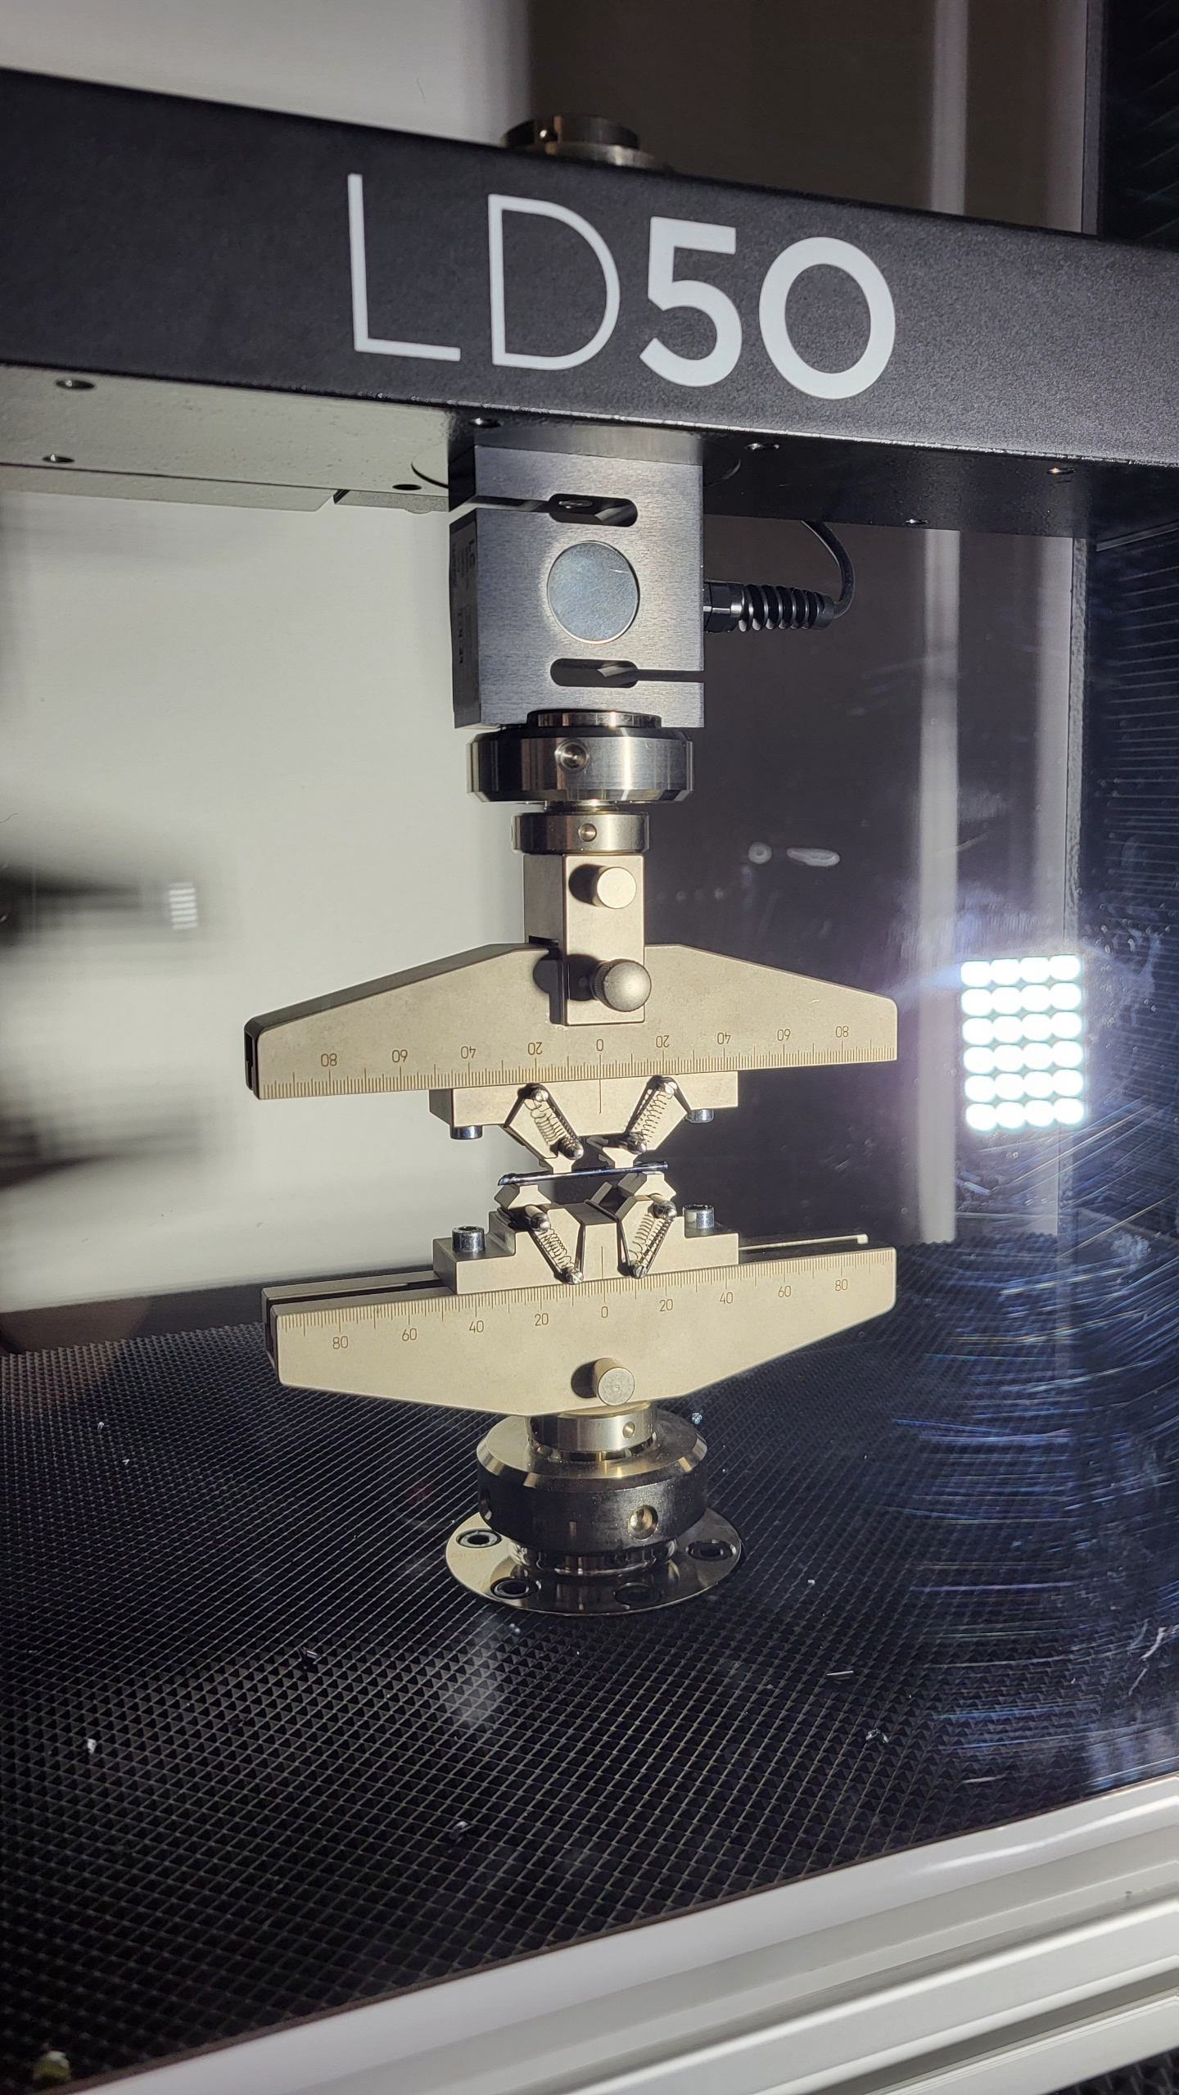
Fiber characterization
Bending stress measurements - setup
Lloyd LD50 testing machine with 5kN load cell (set to apply a uniform displacement of 5 mm/min)
Ultra high speed camera (set to 5000 fps)
  Michele Arcangelo Dicorato, Mechanical tests on silicon fibers, KAGRA International Workshop 2026

Slide 13
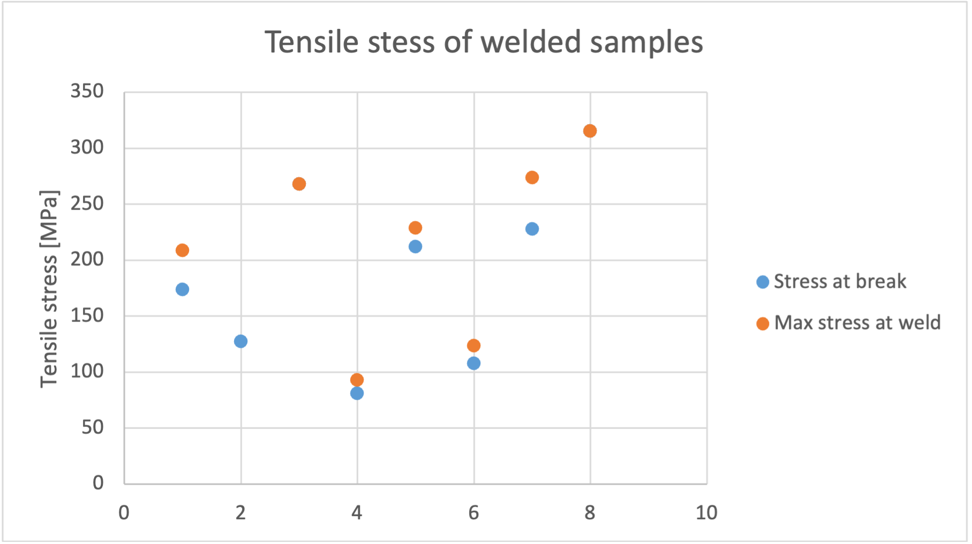
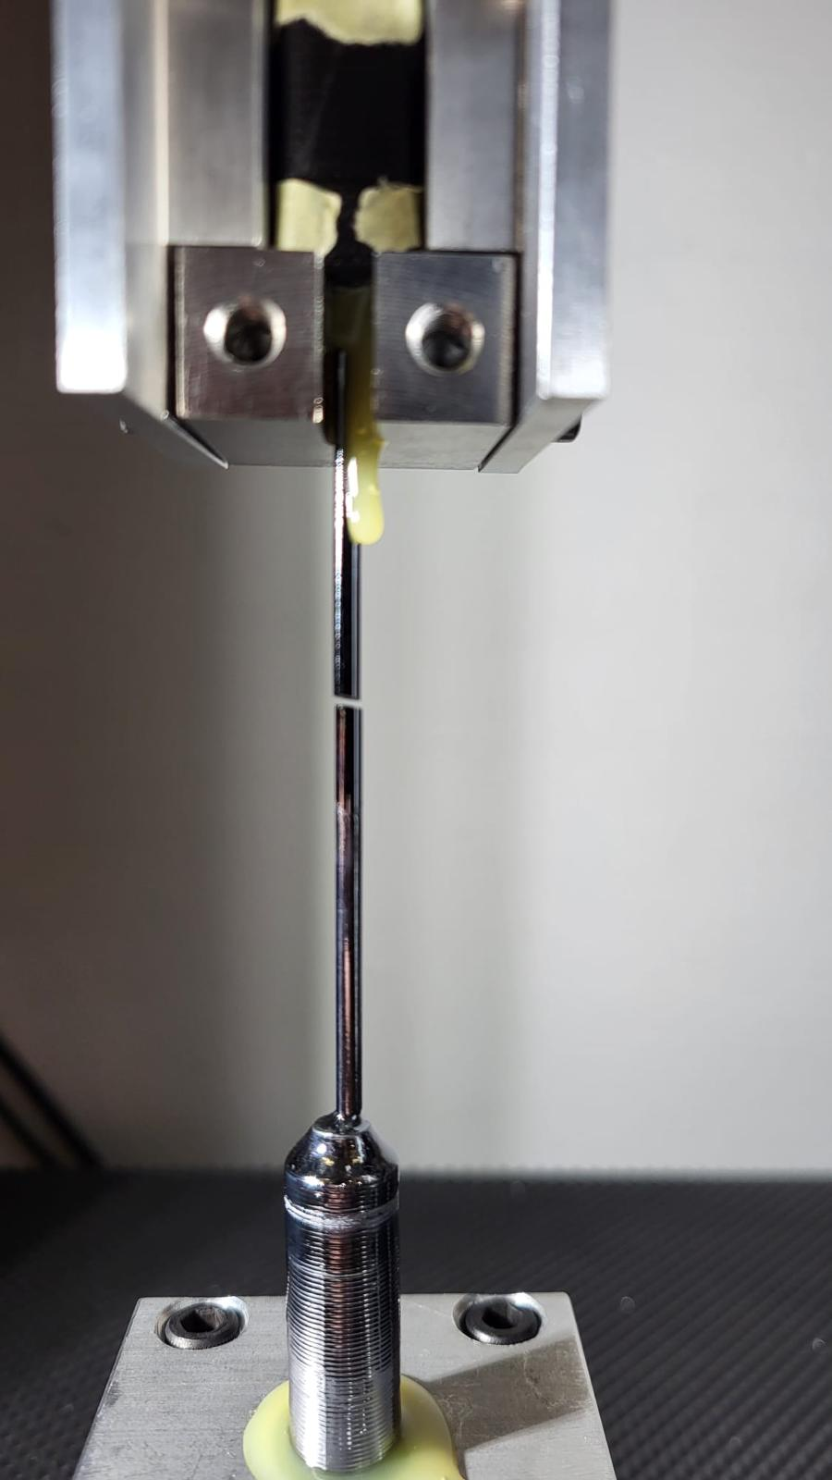
Tensile tests
The good news is that fibers don’t break at the welding point
Expected value
Data dispersion on tensile tests is most likely due to imperfection on the fibers (microcracks): maybe not optimal shipping and handling technique
  Michele Arcangelo Dicorato, Mechanical tests on silicon fibers, KAGRA International Workshop 2026

Slide 14
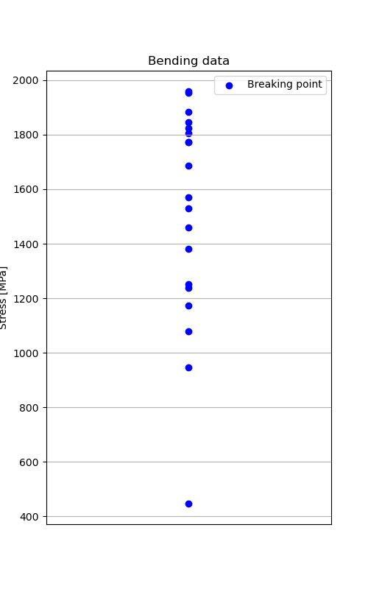
Bending tests
Lower dispersion but still some outliers
Stress [MPa]
From the high speed camera we can see that the break is probably due to a microcrack on the surface of the fiber
  Michele Arcangelo Dicorato, Mechanical tests on silicon fibers, KAGRA International Workshop 2026

Slide 15
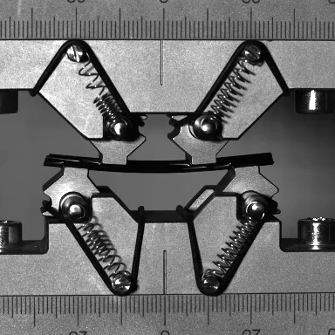
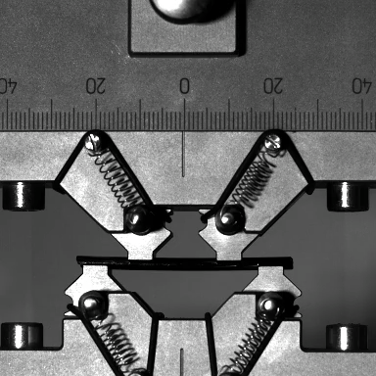
Bending tests
GOOD SAMPLE
OUTLIER
  Michele Arcangelo Dicorato, Mechanical tests on silicon fibers, KAGRA International Workshop 2026

Slide 16
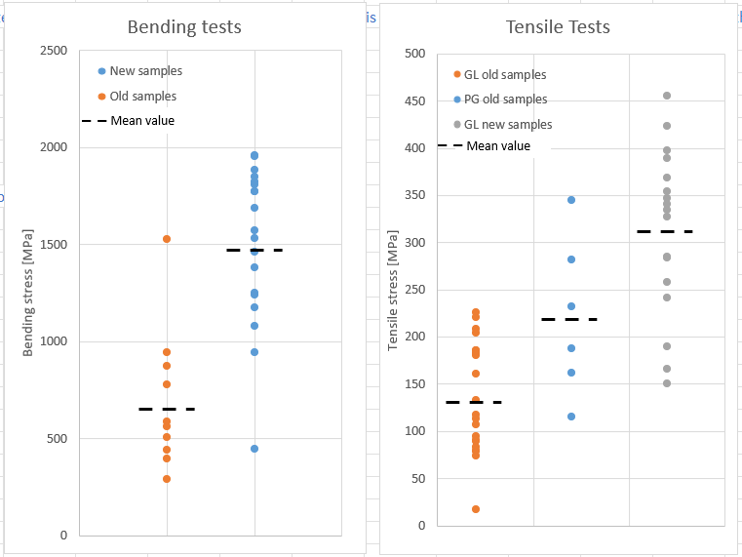
Handling – alignment comparison
  Michele Arcangelo Dicorato, Mechanical tests on silicon fibers, KAGRA International Workshop 2026

Slide 17
Summary
A big international effort is being put into research and development of suspension components for ET-LF
The float zone has been proven to be a very reliable production technique for silicon fibers
A new clamping system is under study to accurately measure the Q-factor of silicon fibers
In tensile tests alignment and shipping/handling techniques are crucial to accurately measure breaking strength of fibers
Production techniques of fibers must be improved to increase the reliability and standardize the entire process from production to the mounting
  Michele Arcangelo Dicorato, Mechanical tests on silicon fibers, KAGRA International Workshop 2026

Slide 18
Thank you ☺
  Michele Arcangelo Dicorato, Mechanical tests on silicon fibers, KAGRA International Workshop 2026

Slide 19
Supplementary slides
  Michele Arcangelo Dicorato, Mechanical tests on silicon fibers, KAGRA International Workshop 2026

Slide 20
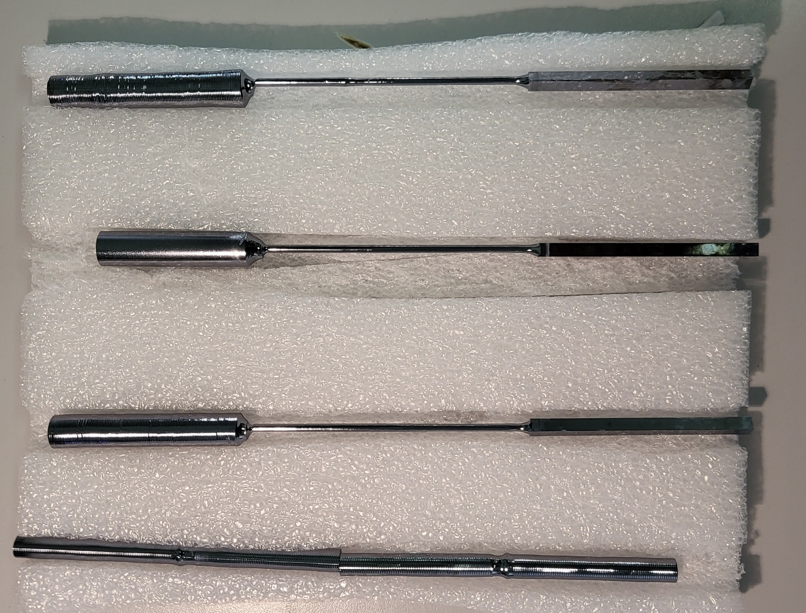
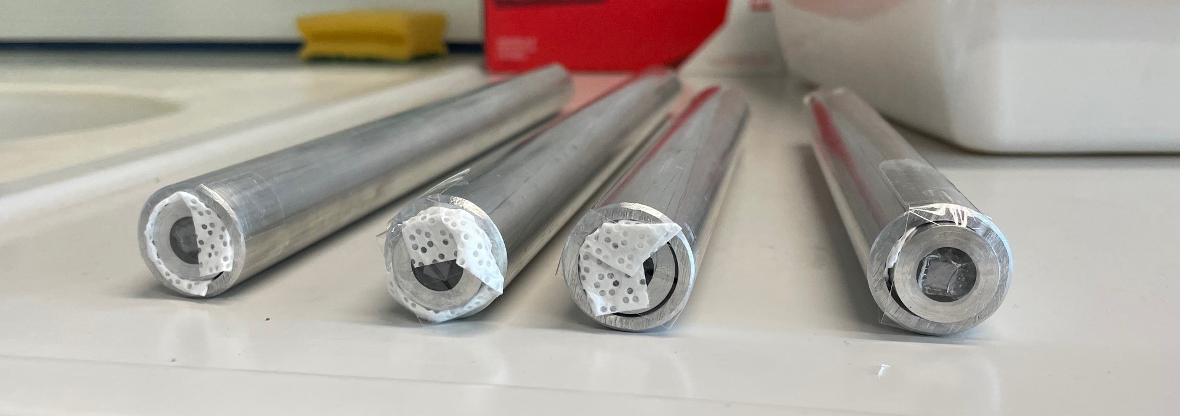
Packaging
Tensile strength depends on:
Crystalline structure
Production method
Surface quality (every scratch is a possible point of stress accumulation and thus breakage)
Metal tubes with rings and wax
Soft plastic box
  Michele Arcangelo Dicorato, Mechanical tests on silicon fibers, KAGRA International Workshop 2026

Slide 21
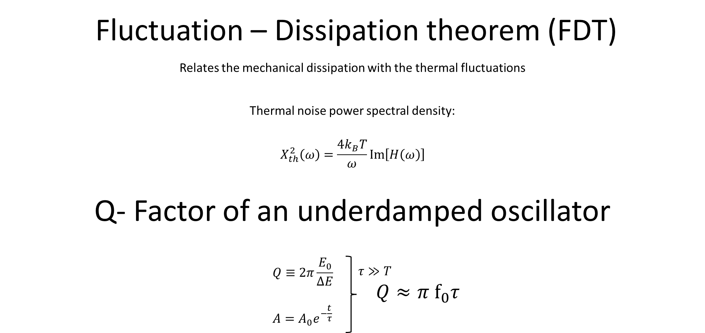
  Michele Arcangelo Dicorato, Mechanical tests on silicon fibers, KAGRA International Workshop 2026

Slide 22
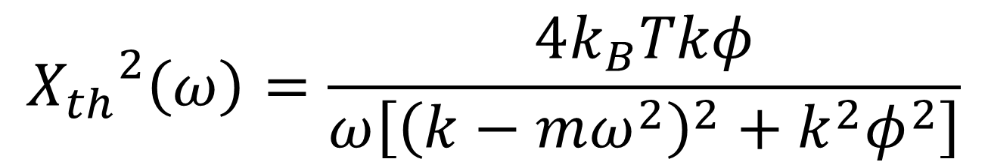
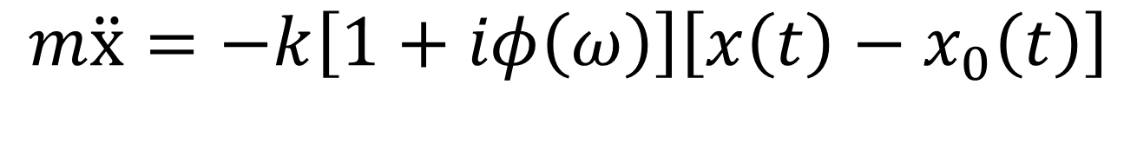
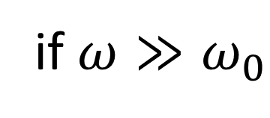
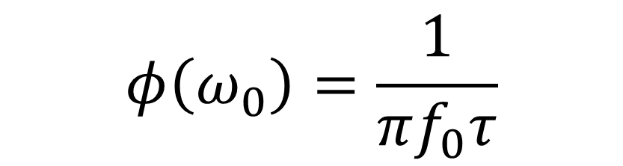
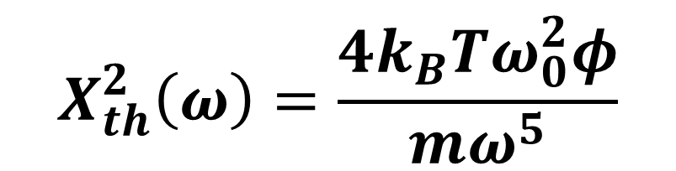
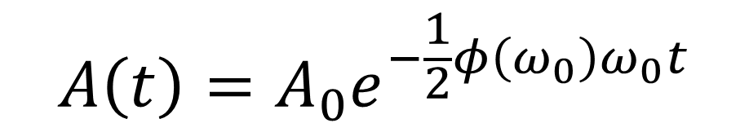
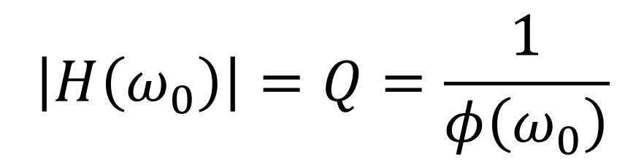
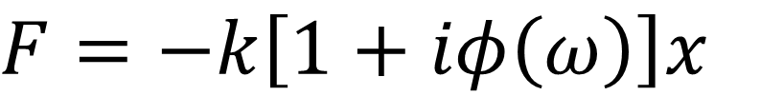

Loss-angle $ϕ$
$$A\left(t\right)=A_{0}e^{−\frac{1}{2}φ\left(ω_{0}\right)ω_{0}t}$$
$$φ\left(ω_{0}\right)=\frac{1}{πf_{0}τ}$$
$$F=−k\left[1+iφ\left(ω\right)\right]x$$
The loss-angle quantifies the mechanical dissipations of an oscillator
Measuring mechanical dissipation means evaluating the thermal noise of a system (Fluctuation-dissipation theorem)
Perturbed oscillator with mechanical dissipations
$$m\ddot{x}=−k\left[1+iφ\left(ω\right)\right]\left[x\left(t\right)−x_{0}\left(t\right)\right]$$
Thermal noise power spectral density
$$H\left(ω\right)=\frac{ω_{0}^{2}\left(1+iφ\right)}{ω_{0}^{2}−ω^{2}+iφω_{0}^{2}}$$
FDT
$${X_{th}}^{2}\left(ω\right)=\frac{4k_{B}Tkφ}{ω\left[{\left(k−mω^{2}\right)}^{2}+k^{2}φ^{2}\right]}$$
Transfer function
$$\left|H\left(ω_{0}\right)\right|=Q=\frac{1}{φ\left(ω_{0}\right)}$$
$$X_{th}^{2}\left(ω\right)=\frac{4k_{B}Tω_{0}^{2}φ}{mω^{5}}$$
Resonant peak
if $ω≫ω_{0}$
  Michele Arcangelo Dicorato, Mechanical tests on silicon fibers, KAGRA International Workshop 2026

Slide 23














Losses in a pendulum
The energy stored in gravity is lossless and dominates in heavily loaded suspension fibers. This implies that the pendulum loss is lower than that of the material used for the suspension fiber: the only mechanical loss in each cycle is $2πφ\left(ω\right)$ of the total energy stored in the oscillating rod.
$$φ_{p}=φ_{rod}\frac{E_{el}}{E_{grav}+E_{el}}≈φ_{rod}\frac{E_{el}}{E_{grav}}$$
Dilution factor
$$D=\frac{E_{el}}{E_{grav}}=\frac{k_{el}}{k_{grav}}$$
$$k_{el}=\frac{n\sqrt{TEI}}{2l^{2}}$$
$$I=\frac{π}{4}r_{rod}^{4}$$
n: number of wires
E: Young’s modulus
T: tension of the wire
$$k_{grav}=\frac{mg}{l}$$
$$φ_{p}\left(ω\right)=φ_{rod}\left(ω\right)\frac{n\sqrt{TEI}}{2mgl}$$
In the high frequency limit $x^{2}\left(ω\right){∝m}^{−1}$
$$T∝m$$
$$φ_{p}∝m^{1/2}$$
$$I∝m^{2}$$
$$φ_{p}\left(ω, n=4\right)=φ_{rod}\left(ω\right)\frac{1}{l}\sqrt{\frac{EI}{mg}}$$
Pendulum thermal noise goes like
$$x_{p}^{2}\left(ω\right){∝m}^{−1/2}$$
$$if ω≫ω_{p} x_{STN}^{2}\left(ω\right)=\frac{4k_{B}Tω_{p}^{2}φ_{p}}{mω^{5}}$$
Why large and heavy mirrors?
And also like$n^{−1/2}$
To keep the radiation pressure effect low
To allow large-sized beam spots on the mirror surfaces for lowering thermal noise
  Michele Arcangelo Dicorato, Mechanical tests on silicon fibers, KAGRA International Workshop 2026

Slide 24




Suspension thermal noise (STN)
Bulk loss-angle at 10 K:
Silicon <100> $φ_{bulk}: from 1×{10}^{−9} to 5×{10}^{−9}$
4 wires
Length: 1,2 m
Diameter: 3 mm
Mirror mass: 211 kg
Average temperature: 15 K
Pendulum mode $≃0,5 Hz$
First violin mode $≃70 Hz$
$$if ω≫ω_{p} x_{STN}^{2}\left(ω\right) =\frac{4k_{B}Tω_{p}^{2}Dφ_{bulk}}{mω^{5}}$$
  Michele Arcangelo Dicorato, Mechanical tests on silicon fibers, KAGRA International Workshop 2026

