Slide 1




MASTER THESIS PRESENTATION
Modeling of a seismic attenuation
system for gravitational wave detectors
Using Reinforcement Learning Agents
A. Kotchian(1) | M. Bawaj
(1)alessandro.kotchian@studenti.unipg.it

Slide 2
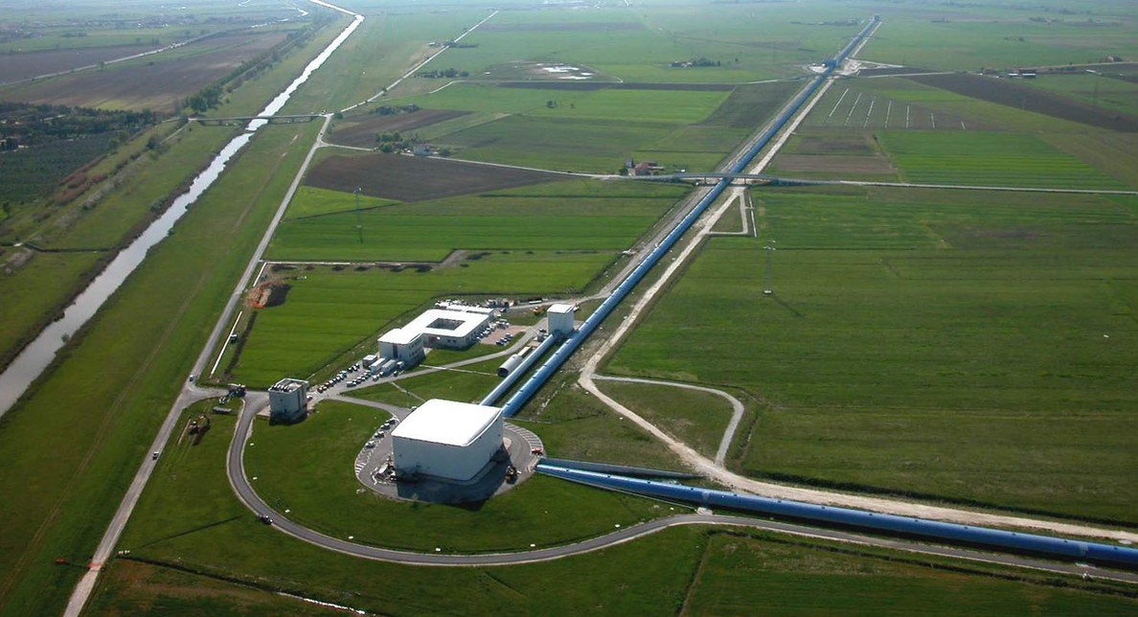
Seismic Challenge
Improving the sensitivity of ground-based interferometers is essential to observe ever further into deep space.
Current facilities like Virgo are pioneering the mitigation of low-frequency seismic disturbances.
Slide 2 / 12
Notes:
Different Technics and technology are been developed to reduce and attenuate different noise sources, (the reduction of noise sources )enhance gravitational wave detector's sensitivity and increase the observability distance.
It' s very important for 3 generation gravitational waves detectors the creation of new laboratories to find new ways to reduce noises.
Here in Perugia was inaugurated the new CAOS laboratory with the main objective to develop new technologies to reduce seismic noise.
With the same goal, this project tries to attenuate seismic noise using reinforcement learning agent.

Slide 3
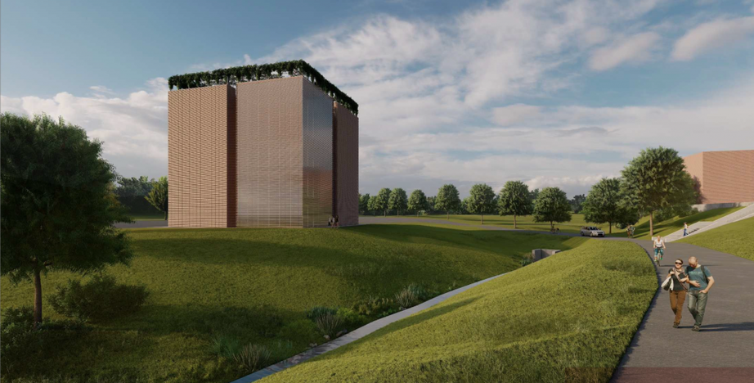

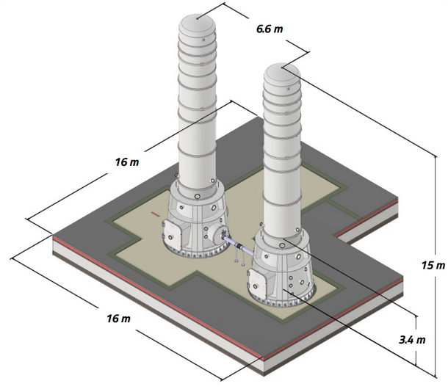
The Seismic Challenge
Technical Objective
To maximize discovery potential, we must push sensitivity targets below 10 Hz. This requires sophisticated, adaptive isolation mechanisms that go beyond passive damping.
Thanks to the creation of the CAOS laboratory, the aim is to develop new technologies to reduce seismic noise.
Slide 3 / 12

Slide 4
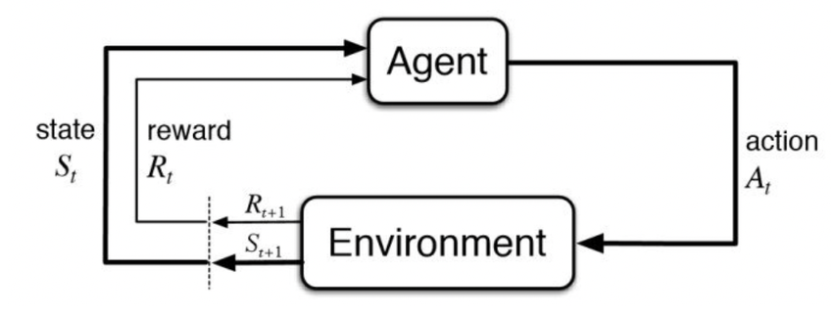
Reinforcement Learning Approach
Agent Observation: Agent watch the state of the simulated system.
Agent Actions: Agent decised how take actions.
Action on the envirorment will change the state of it.
Reward: Dynamic feedback returns a reward that tells the agent how good was its actions.
Slide 4 / 12

Slide 5
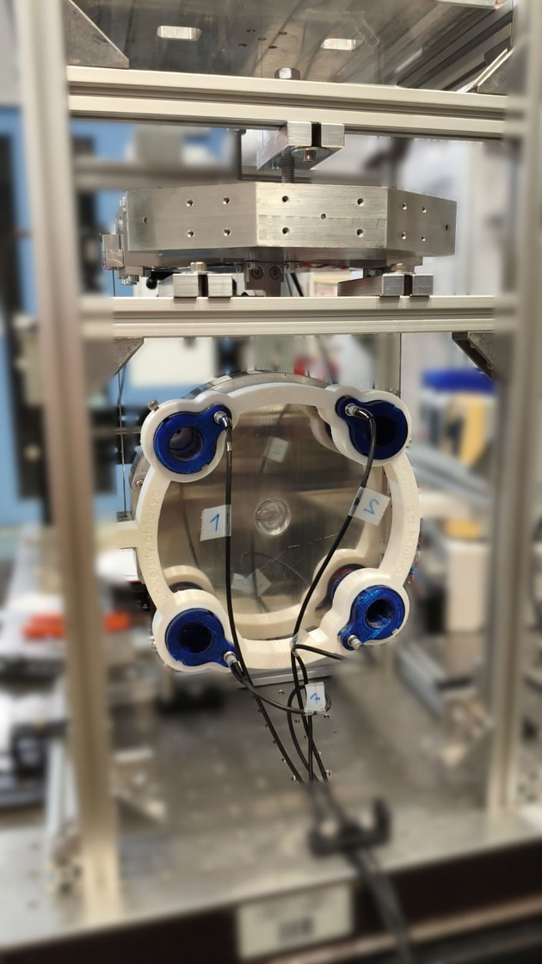
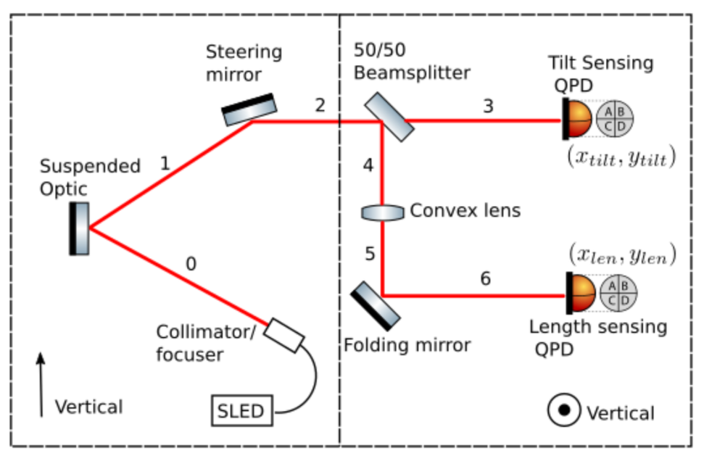
The real system
Optical Lever setup
The system is composed of a suspended optic (marionette-mirror system) and 2 QPD sensors. The beam from the collimator, hits at the center of the mirror and the suspended optic acts like an optical lever that amplifies small angular displacements.
Slide 5 / 12

Slide 6
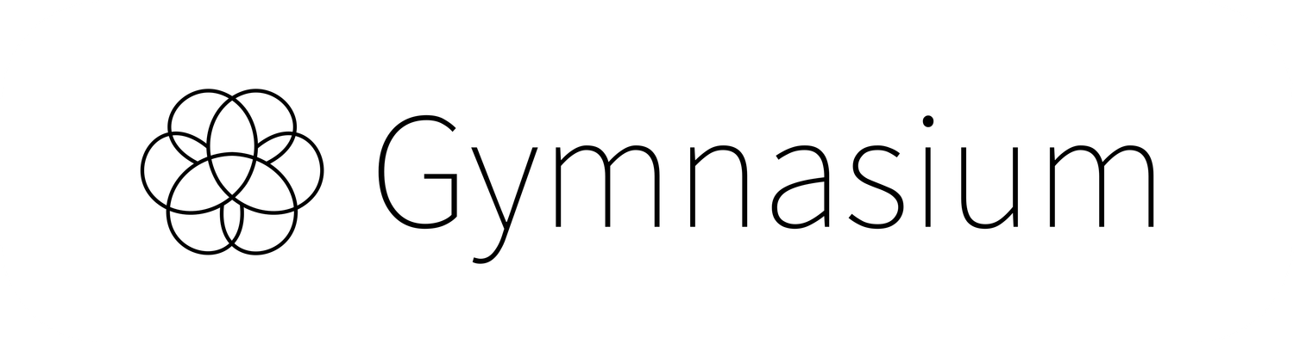
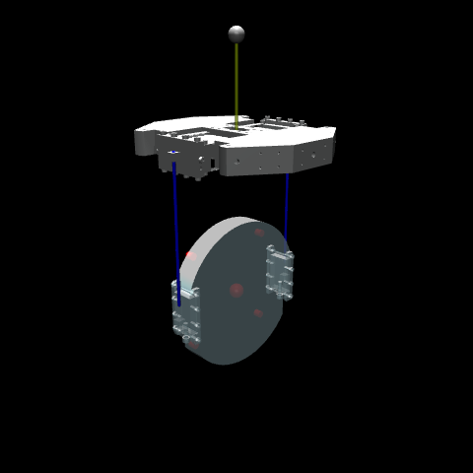
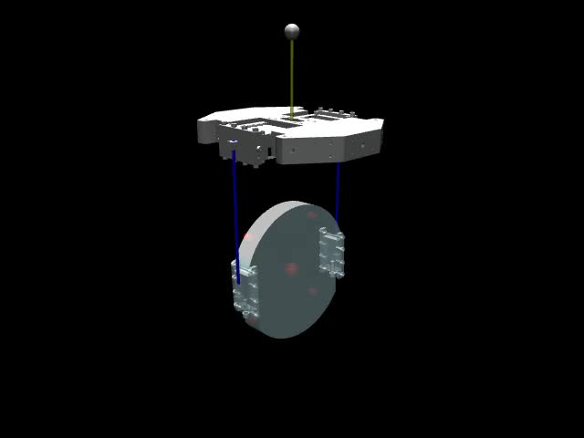
Agent-Environment
Creation of System
Creation of Agent Environment
Mujoco takes the STL file with the design of the marionette and the mirror. Then we added the virtual suspensions that simulate the real silica suspetions.
Gymnasium take Mujoco system and implement it in an environment that the agent can use to train and learn.
Slide 6 / 12

Slide 7
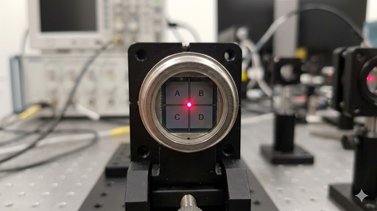
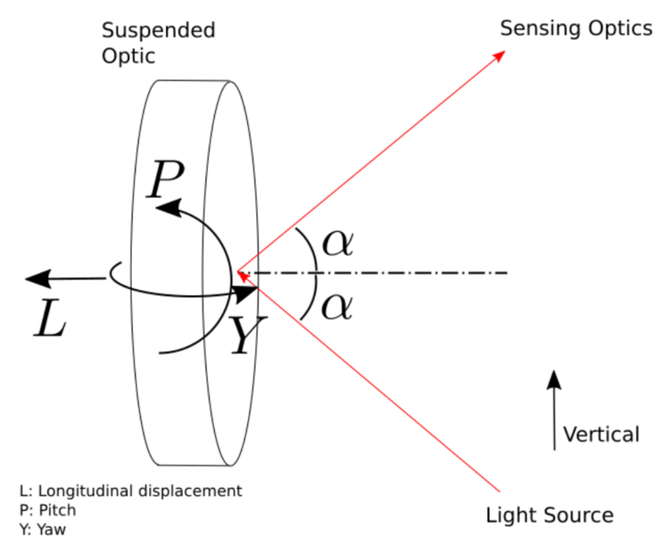
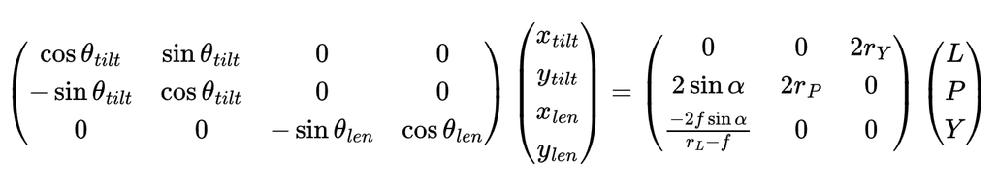
Physical system to simulate
Optical lever DoF and angle of incidence α
Optical Lever setup
NB: assuming the optical lever beamspot is NOT offset form optical axis of the optic
and angle of incidence β=0 on the horizontal plane
Relation between QPD readout and Mirror’s displasment
Slide 7 / 12

Slide 8
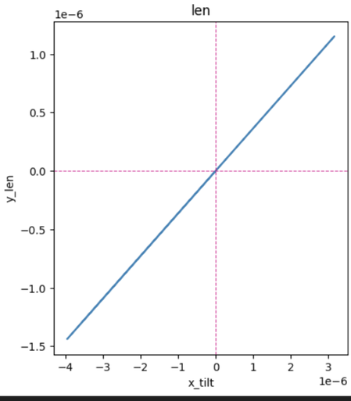
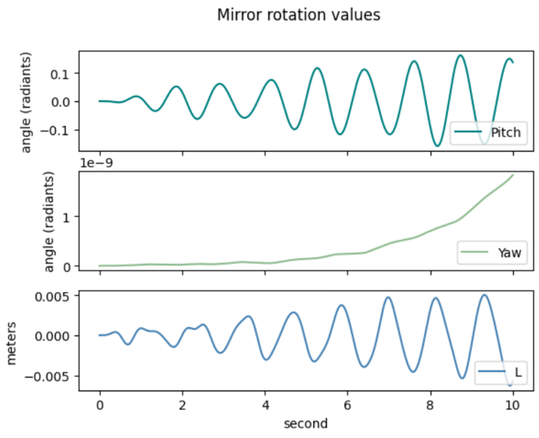
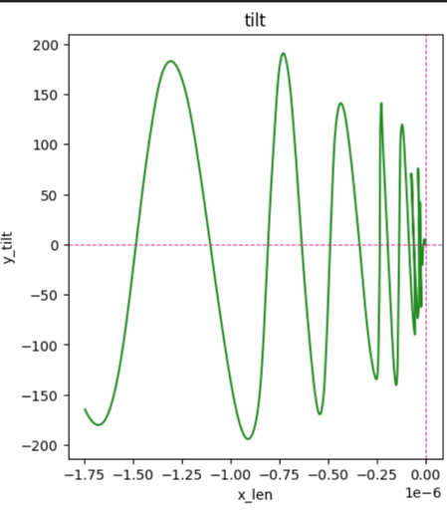
Simulation Physical Observables
Since Mujoco is a physics engine it allows to apply time-varying forces and torques in any point of the mirror and dynamically obtain all the mirror's observables.
Len
QPD
sensor
Tilt
QPD
sensor
Mirror Pitch, Yaw and L values during simulation
Slide 8 / 12
Notes:
Len -> Just Horizontal Displacement
Tilt-> x=yaw y=P+L

Slide 9



Evaluating the Agent
Optical Lever
Choising Agents
Rewards
Simulation of the sensor suite the system status. From Mujoco we can extract all degree of freedom of mirror.
Using Stable Baseline3 [1] library we can choose different agents:
TD3, DDPG, A2C, PPO, ecc...
Different rewards bases on mirror observables to train the agent to ensure stability of the system.
[1]: https://stable-baselines3.readthedocs.io/en/master/index.html
Slide 9 / 12

Slide 10
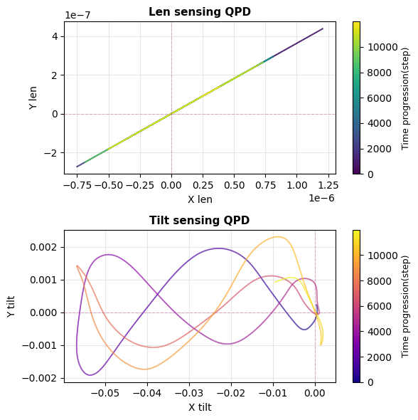

First Results of Trainings
Based only on Sensors, we create a Reward:
Distance from the center (Gaussian)
Movement penalty
(for Tilt QPD, more weight on horizontal displacement)
Centering bonus
Out of sensor penalty
Slide 10 / 12

Slide 11

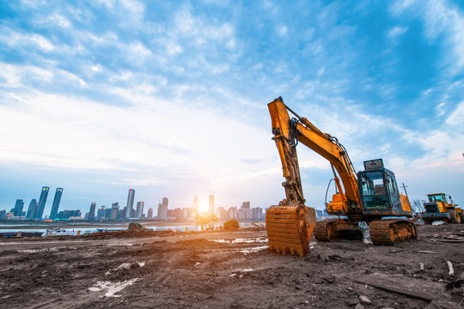

Work in progress
Implementig Marionette Observables: Using also the actuators of the marionette the agent can learn new ways to stabilize the system.
Creation of an interface for the agent: Development of the electronics to test the agent in a real setup.
Implementation of the agent in a real setup: Using a real optical lever setup to test the efficency of the agent .

Slide 12
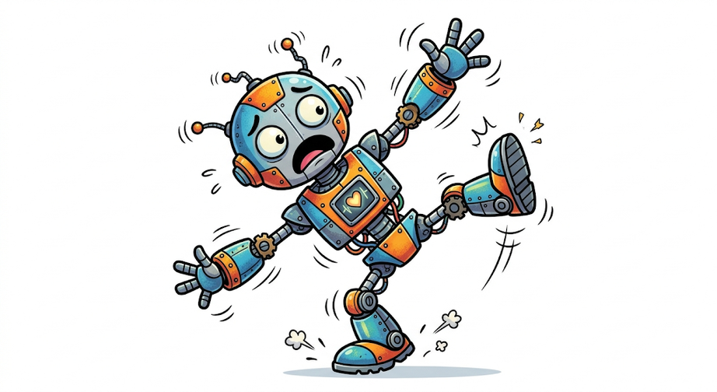
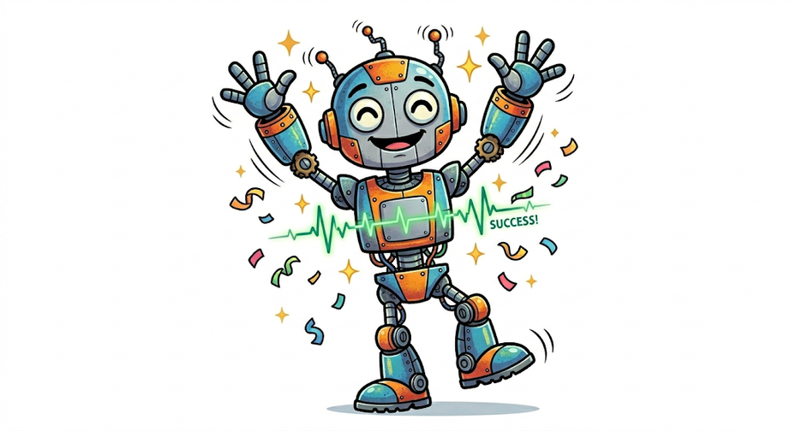
THANK YOU FOR YOUR ATTENTION
TRAINING

Slide 13



Image Sources
https://www.ligo.caltech.edu/image/ligo20170927b
Source: https://www.ligo.caltech.edu/image/ligo20170927b
https://miro.medium.com/v2/resize:fit:1400/1*kar7gqRbHR-Q-T8EPCQCVQ.jpeg
Source: medium.com
https://indico.ego-gw.it/event/819/contributions/7910/attachments/4617/8411/CAOS_VacTowers-Capoccia.pdf
Source: https://indico.ego-gw.it/event/819/contributions/7910/attachments/4617/8411/CAOS_VacTowers-Capoccia.pdf
https://gymnasium.farama.org/index.html
Source: https://gymnasium.farama.org/index.html
https://www.aei.mpg.de/535047/original-1773993106.jpg?t=ZXlKM2FXUjBhQ0k2T1RZMkxDSnZZbXBmYVdRaU9qVXpOVEEwTjMwPS0tNDFhZjBhMWFjZDM1NjU3ZDNiZTExNjI4NGJhYjExNjkyYTVlY2MxMg
Source: www.aei.mpg.de
https://www.einstein-telescope.it/2024/04/22/et-un-altro-passo-verso-la-realizzazione-del-laboratorio-caos/
Source: https://www.einstein-telescope.it/2024/04/22/et-un-altro-passo-verso-la-realizzazione-del-laboratorio-caos/

Slide 14


Image Sources
Theory_Optical_Lever
Source: https://tds.virgo-gw.eu/ql/?c=11375
Made by AI
Construction site Background Images
Source: https://stock.adobe.com/search?k=construction+site+background
Construction man Image
Source: https://stock.adobe.com/ch_it/images/3d-man-prohibiting-with-stop-sign/343733182
Mujoco
Source: https://mujoco.readthedocs.io/en/stable/overview.html

Slide 15
References
Theory_Optical_Lever
Source: Theory_Optical_Lever.pdf
Mujoco
Source: https://mujoco.readthedocs.io/en/stable/overview.html
Gymnasium
Source: https://gymnasium.farama.org/index.html
Stable Baseline3
Source: https://stable-baselines3.readthedocs.io/en/master/index.html

Slide 16
Backup Slides

Slide 17
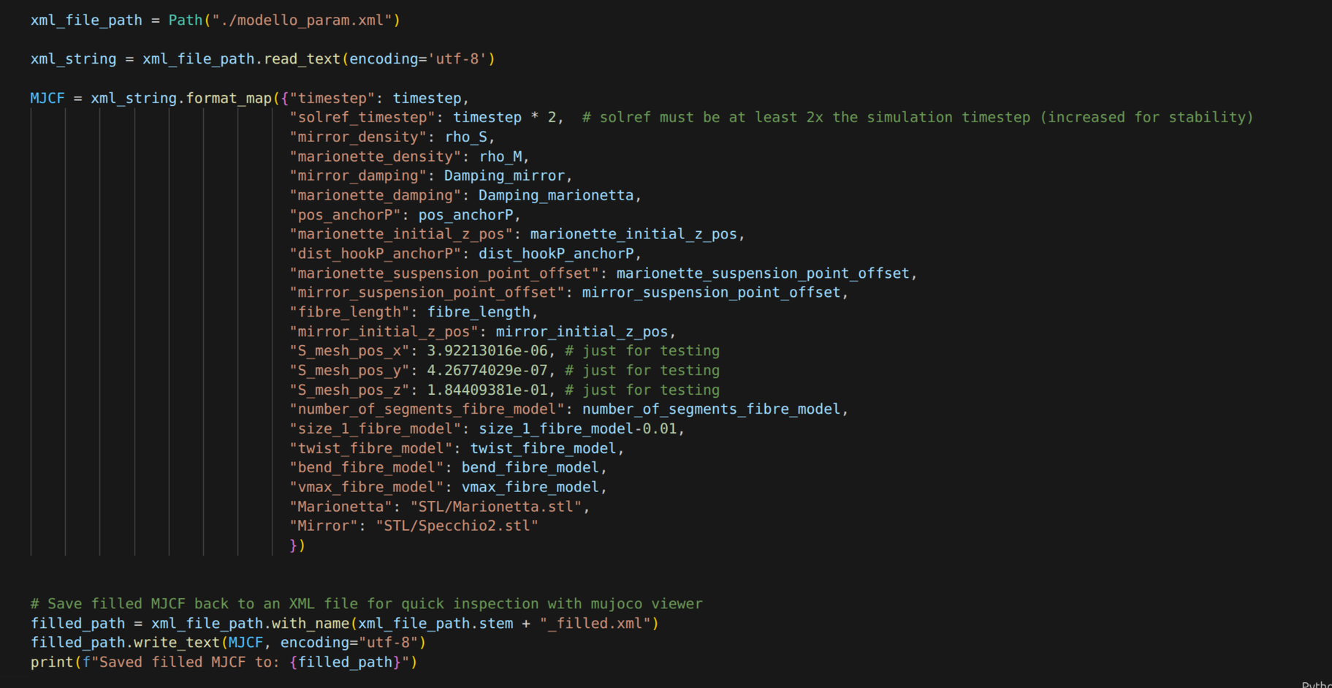
Customizable parameters of Mujoco

Slide 18
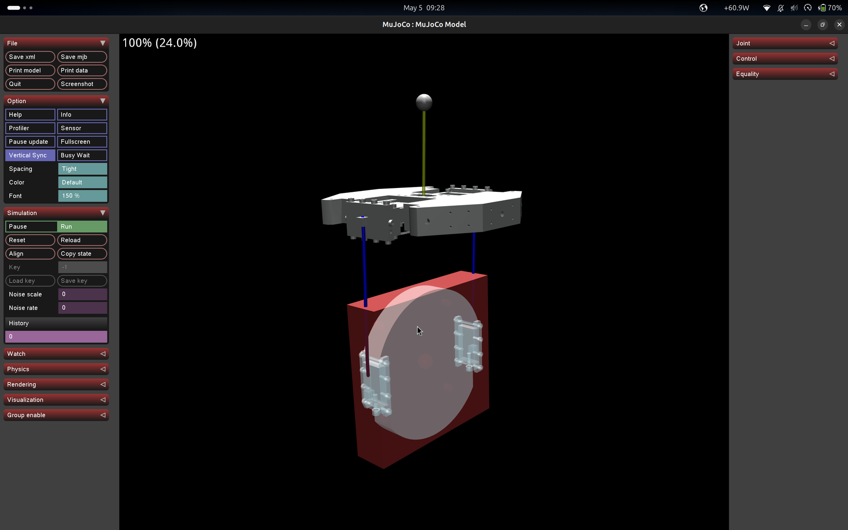
Mujoco Viewer

Slide 19
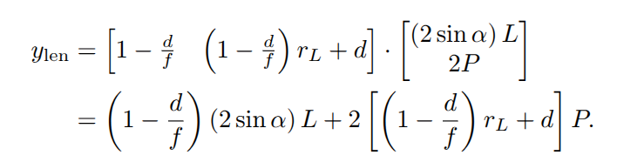

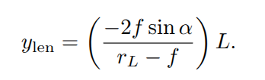
Separation of Lenght sensing

