Slide 1
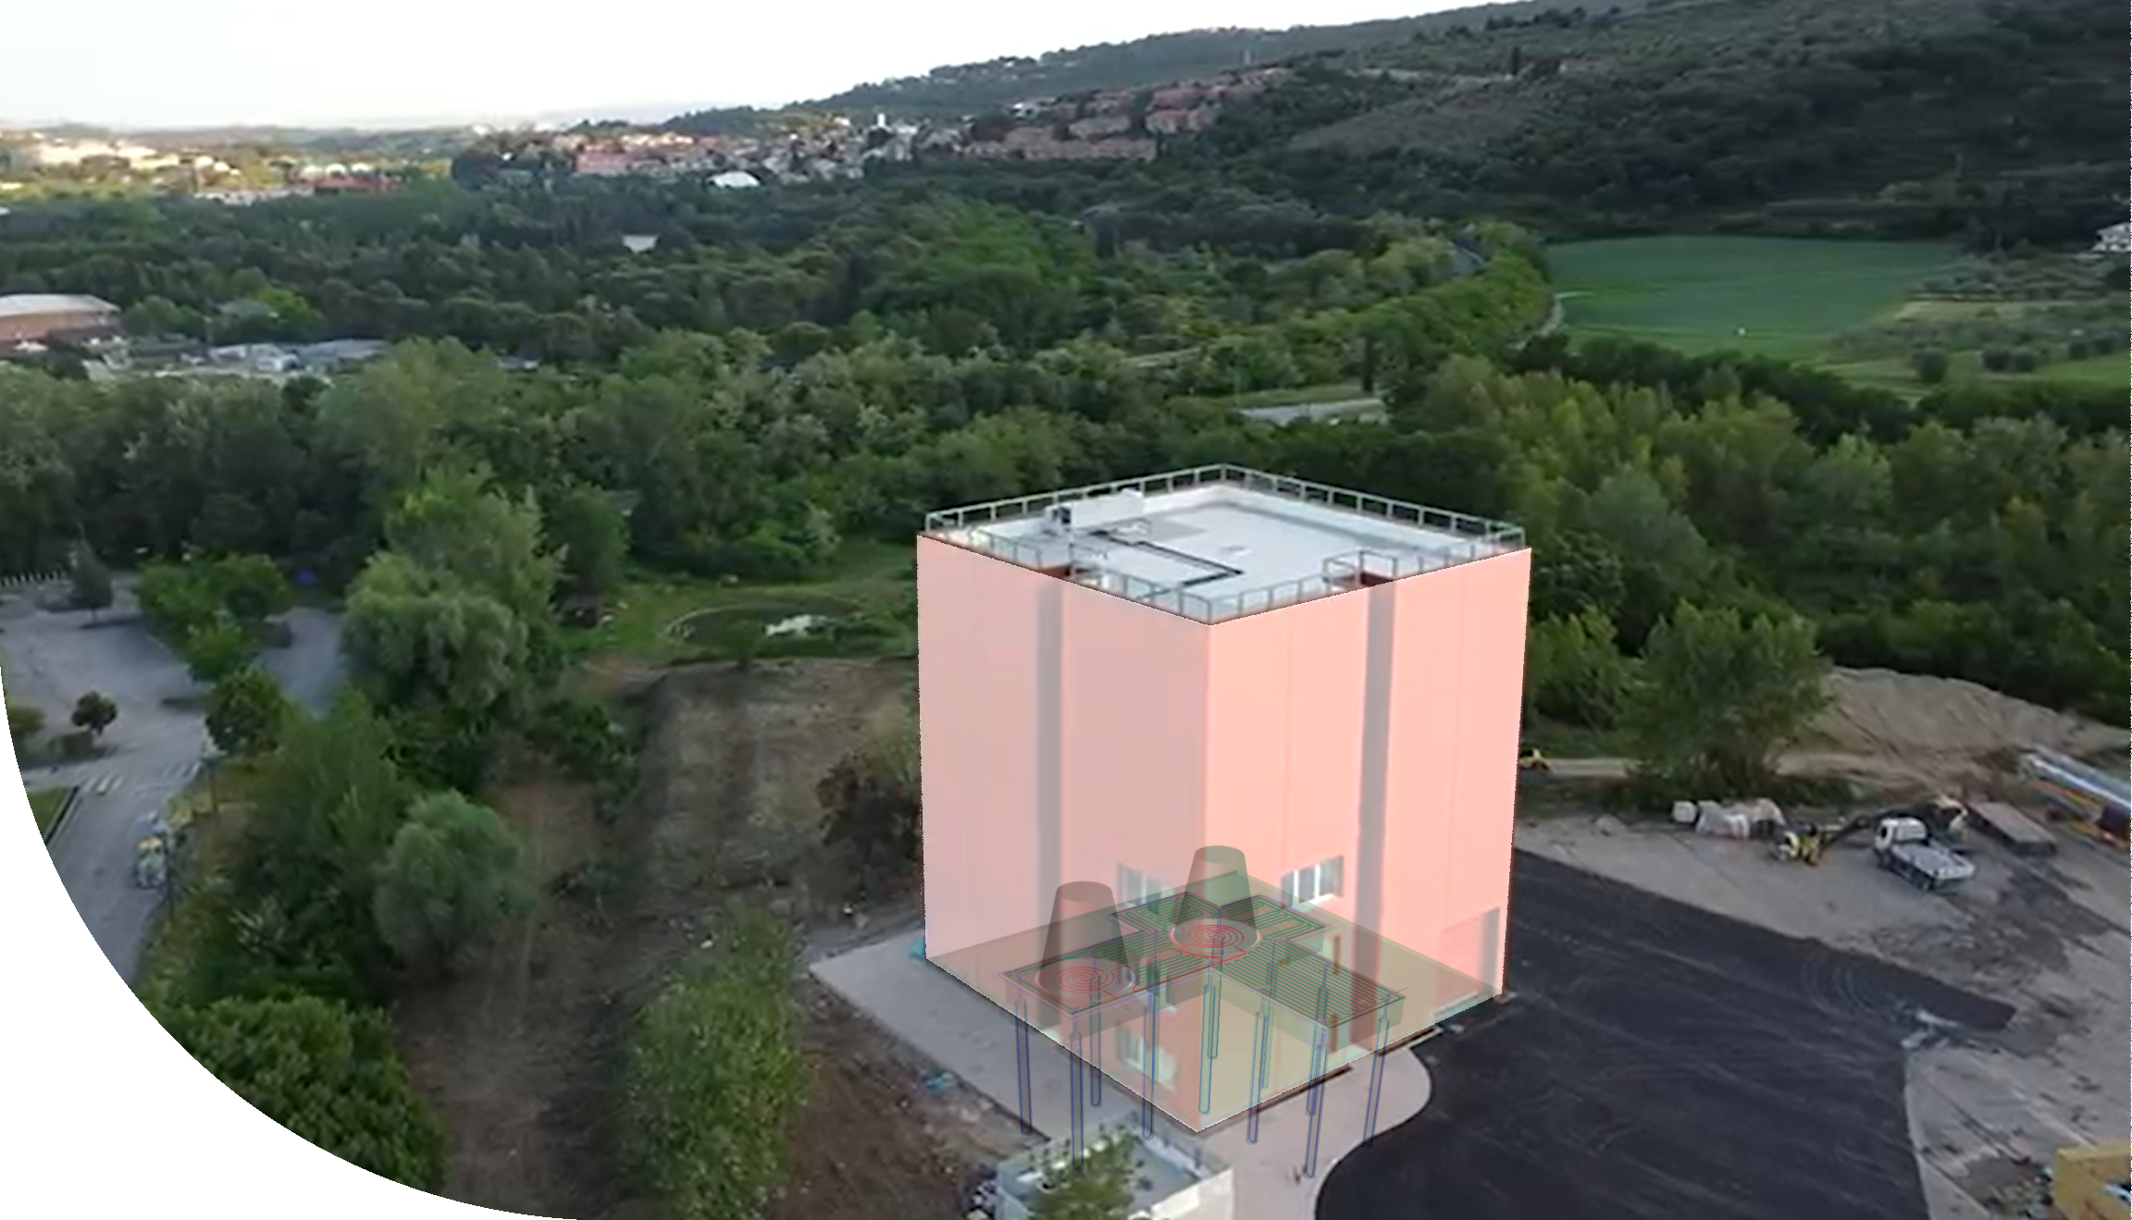
A fiber optic continuous strain sensing plant for CAOS in Perugia
Samuel Baldoni ¹, Francesco Bianchi ¹, Gabriele Capoccia ¹, Piero Chessa ², Daniele Cianelli ², Giuliano Nucciarelli ², Alessandro Parisi ², Antonfranco Piluso ², Helios Vocca ²
1. INFN-Sezione di Perugia
Via Alessandro Pascoli
06123 Perugia (PG), Italy
2. Dipartimento di Fisica e Geologia, Università di Perugia Via Alessandro Pascoli
06123 Perugia (PG), Italy
piero.chessa@unipg.it

Slide 2
Summary
Distributed acoustic sensing
A plant designed for CAOS
Implementation

Slide 3
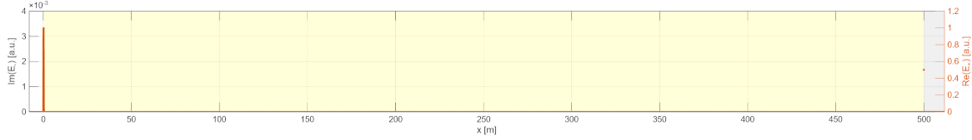
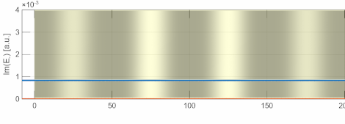
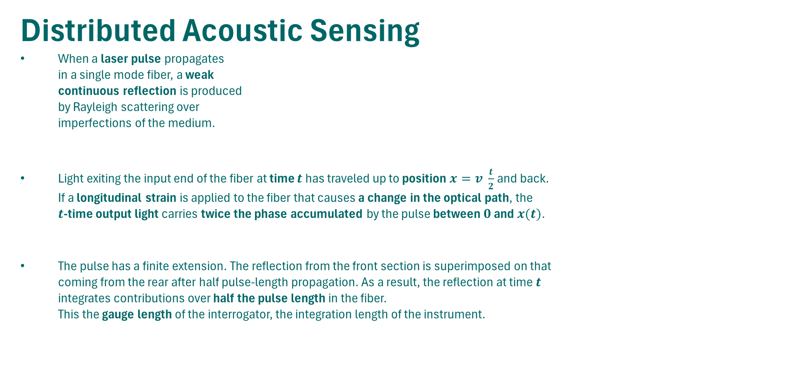

Distributed Acoustic Sensing
When a laser pulse propagates in a single mode fiber, a weak continuous reflection is produced by Rayleigh scattering over imperfections of the medium.
Light exiting the input end of the fiber at time $t$ has traveled up to position $x=v \frac{t}{2}$and back. If a longitudinal strain is applied to the fiber that causes a change in the optical path, the $t$-time output light carries twice the phase accumulated by the pulse between $0$ and $x(t)$.
The pulse has a finite extension. The reflection from the front section is superimposed on that coming from the rear after half pulse-length propagation. As a result, the reflection at time $t$ integrates contributions over half the pulse length in the fiber. This the gauge length of the interrogator, the integration length of the instrument.
Fiber length
Rayleigh basckscattering
Pulse propagation
$$x=v\frac{t}{2}$$
E(t)
Gauge length

Slide 4
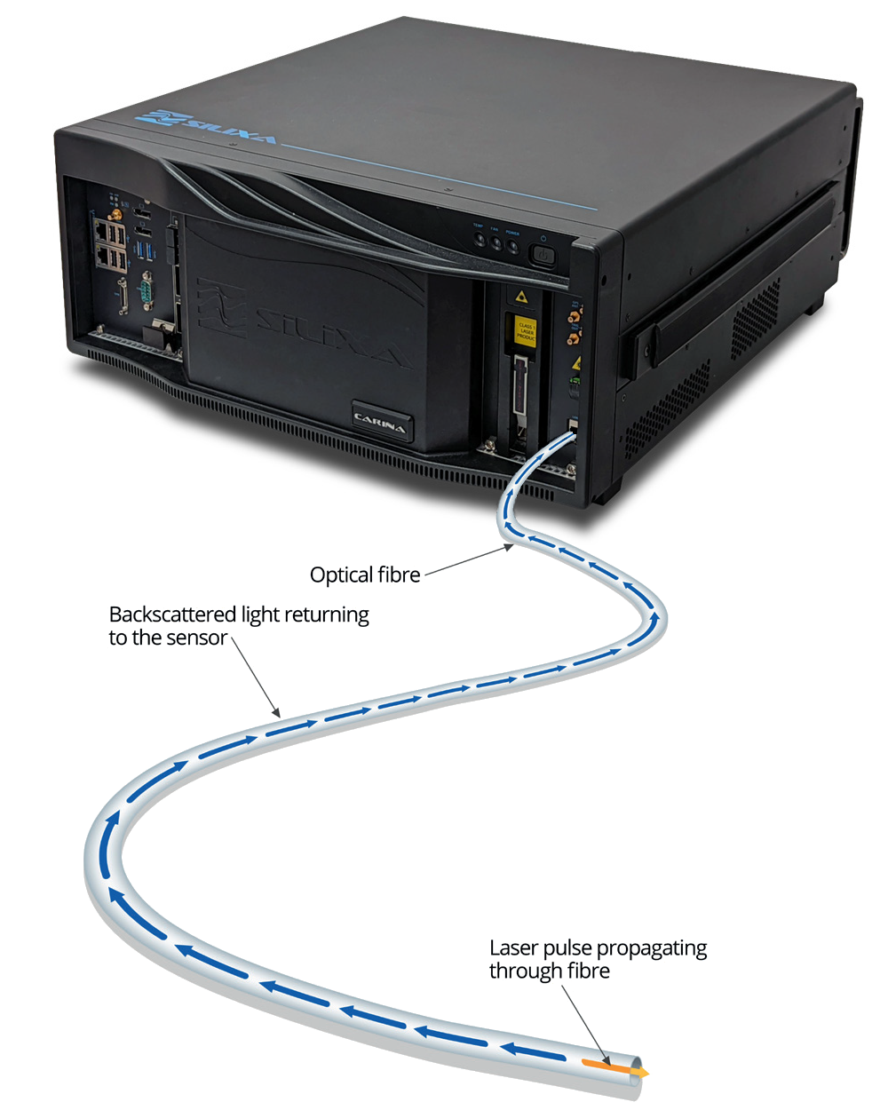
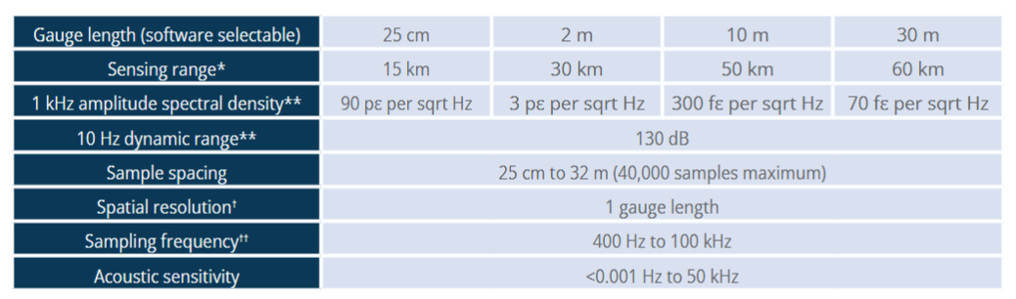
Silixa Carina
* Defined for single mode fibre.
** Median value for standard specification engineered ConstellationTM fiber, with interrogator settings optimised for a 700 m fiber length.

Slide 5

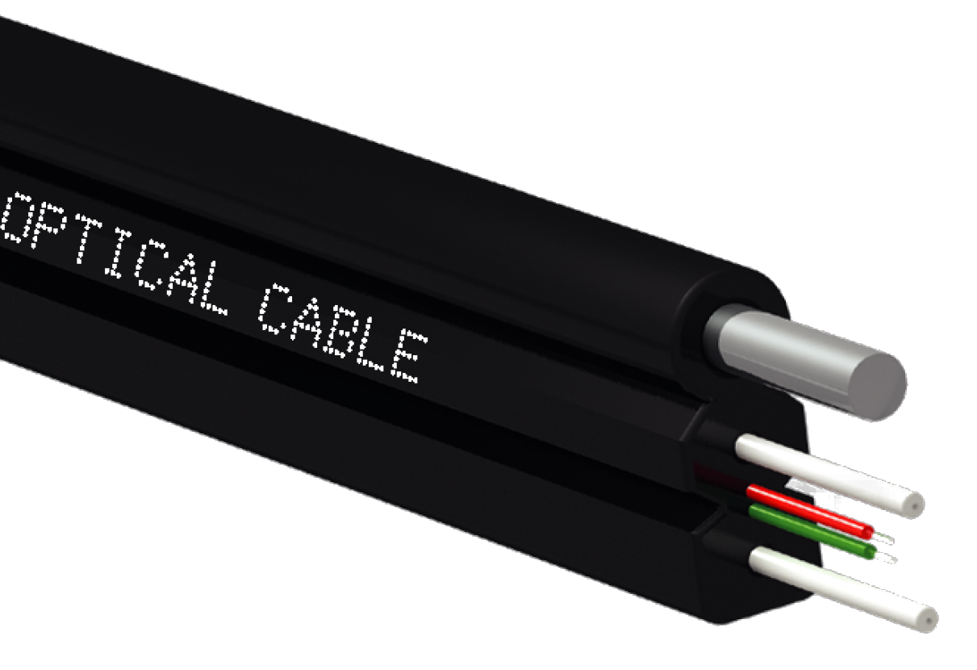
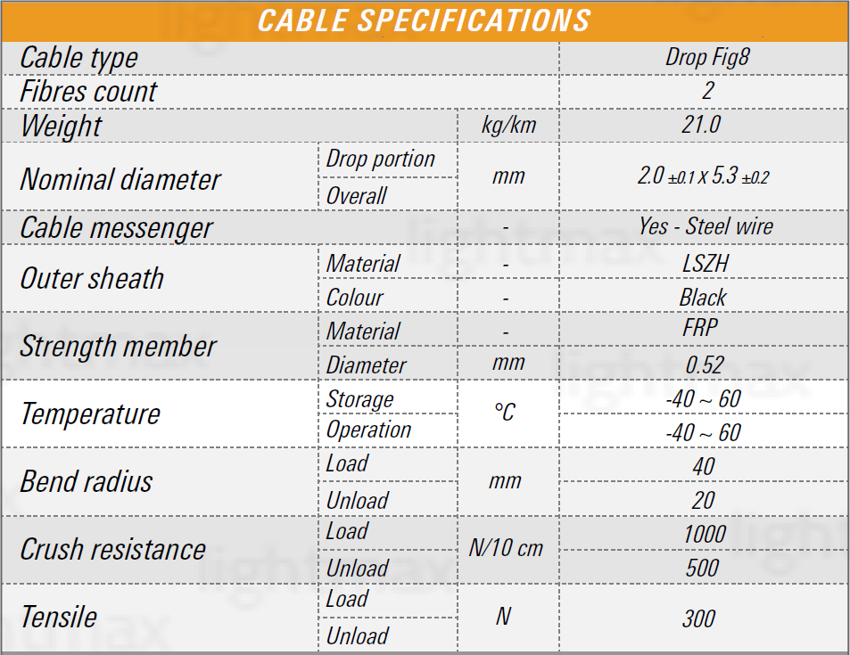
Fiber After the experience of colleagues from Istituto Nazionale di Geofisica e Vulcanologia (INGV) and Università di Milano Bicocca this cable has been chosen.
Property:
single mode,
no Teflon,
good performance with DAS interrogators,
reinforced, resistant to bending, duplex

Slide 6
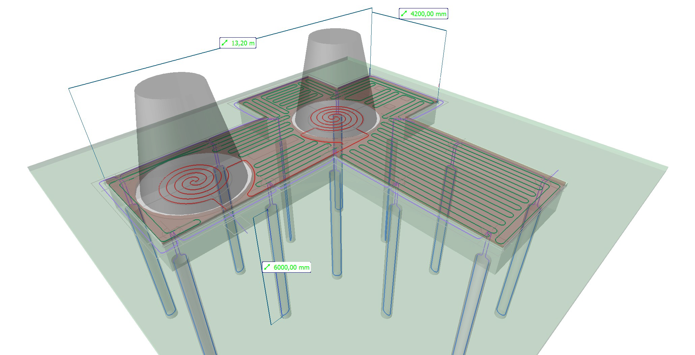
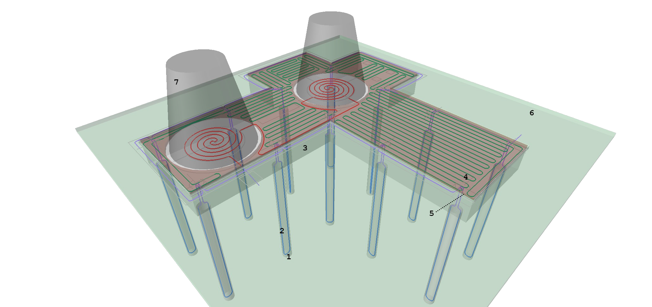
A plant designed for CAOS Fiber sensing was not integrated natively in CAOS design. We started working at the plant as the building work were starting (summer 2024). The plant had to be designed such that it could be integrated in scheduled building works or completed afterwards. No design revision or construction delay admitted.
1. Foundation pillars (6 m) 2. Vertical fibers in the pillars 3. Reinforced concrete slab (110 cm) 4. Horizontal fibers 5. Floating floor tiles (above horizontal fibers) 6. External floor (with seismic joint) 7. Vacuum tower bases.
The vacuum towers lay on the circular coronas around the red fibers.

Slide 7
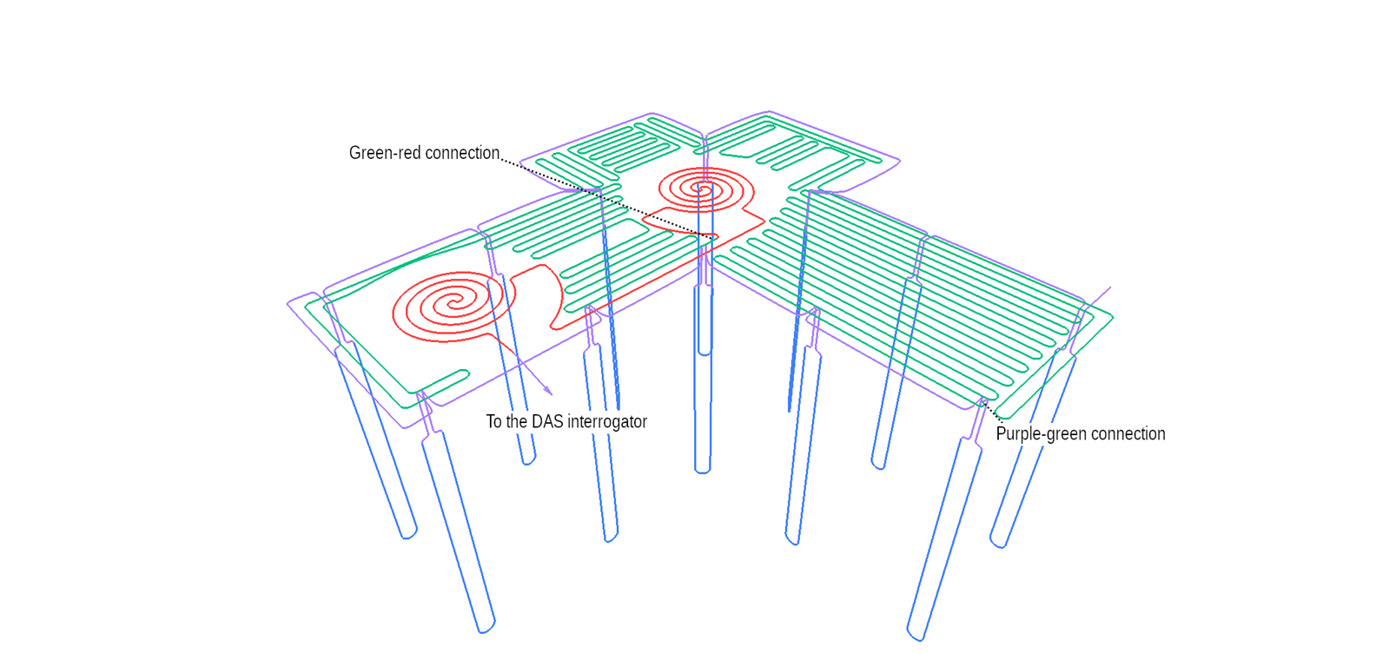
A plant designed for CAOS Fiber sensing was not integrated natively in CAOS design. We started working at the plant as the building work were starting (summer 2024). The plant had to be designed such that it could be integrated in scheduled building works or completed afterwards. No design revision or construction delay admitted.
Blue: drowned vertical fibers Purple: loose connections Green: horizontal fibers under floating floor (still not deployed) Red: horizontal fibers under the towers.

Slide 8
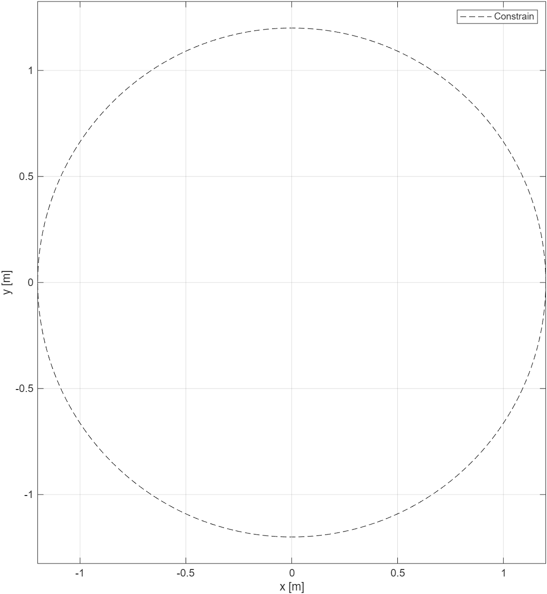
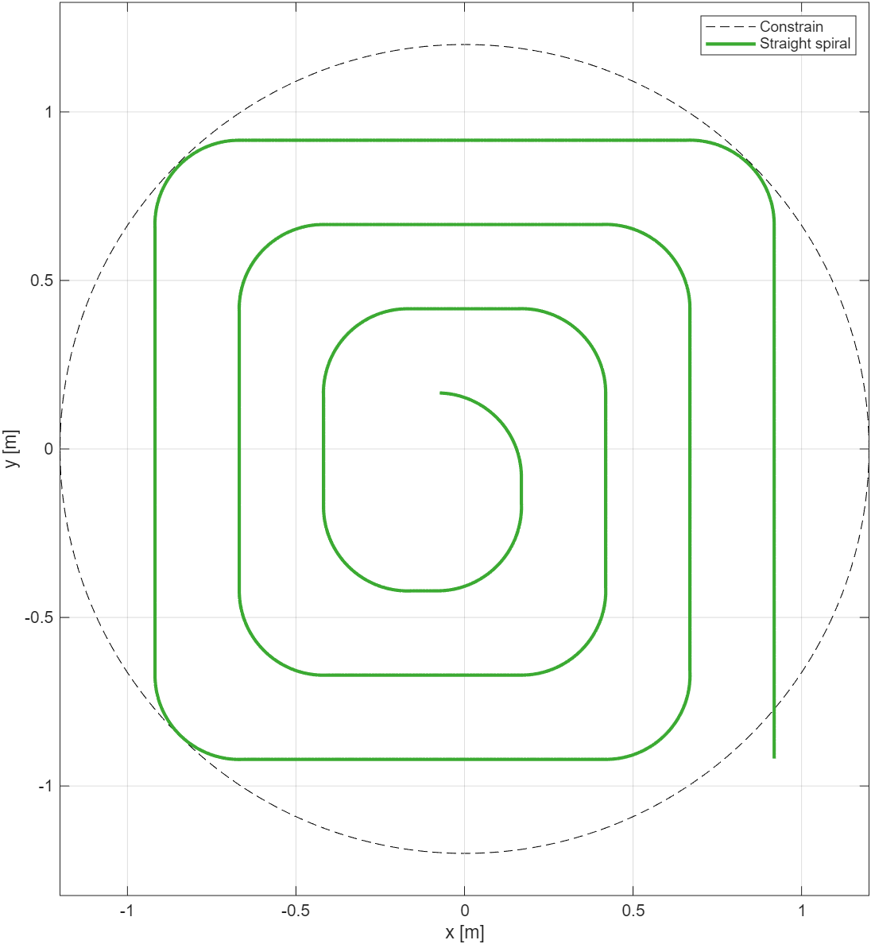
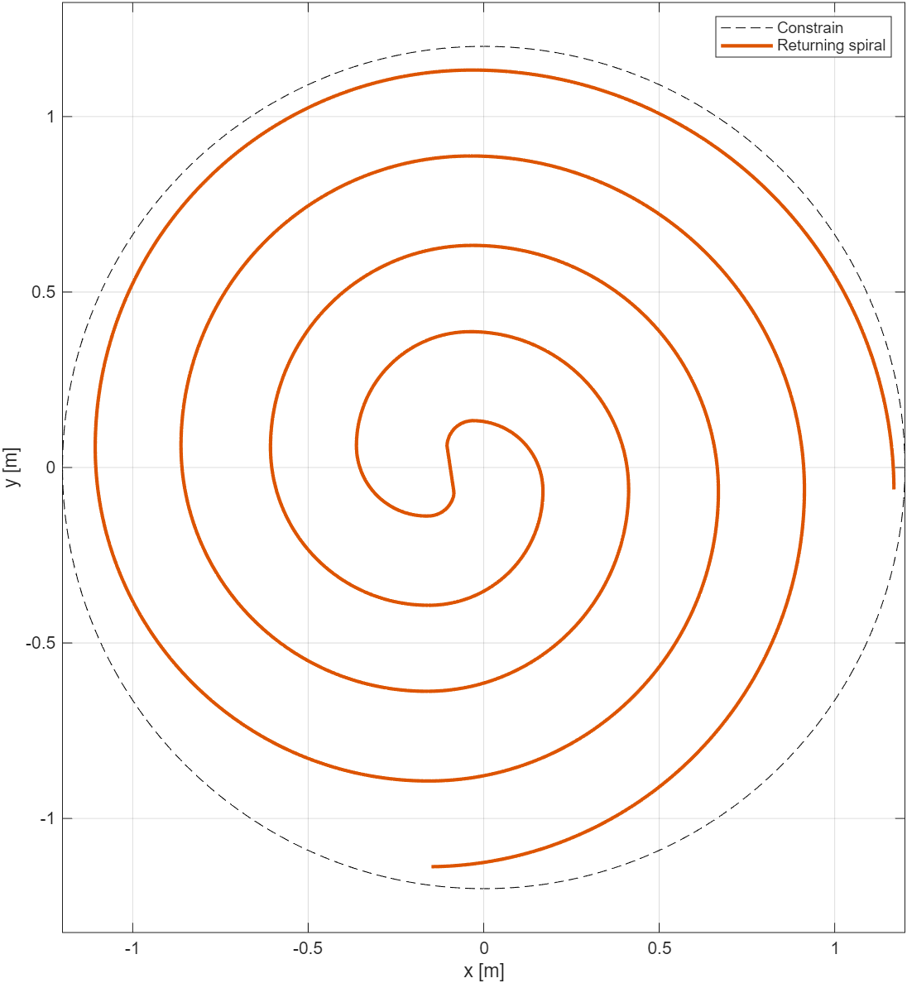
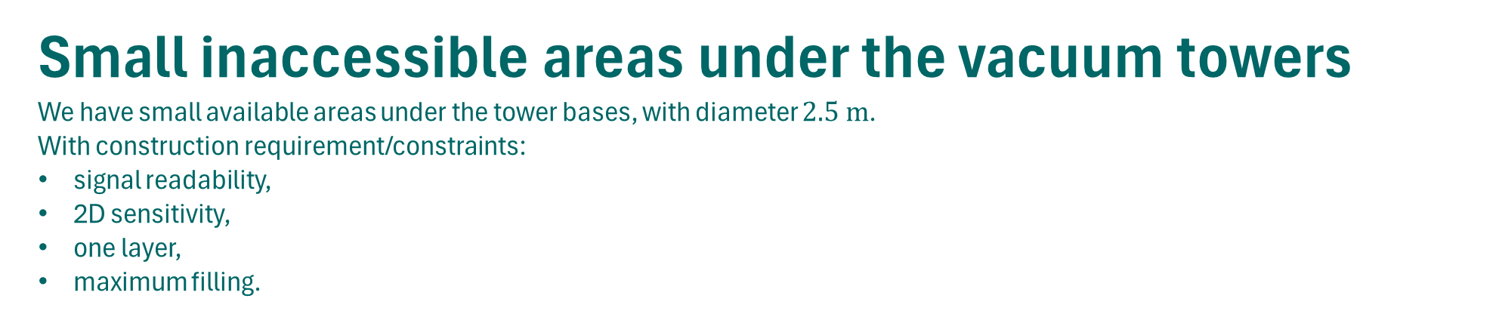
Small inaccessible areas under the vacuum towers We have small available areas under the tower bases, with diameter $2.5 m$. With construction requirement/constraints:
signal readability,
2D sensitivity,
one layer,
maximum filling.
Sensitive in one direction only
Reduced filling

Slide 9
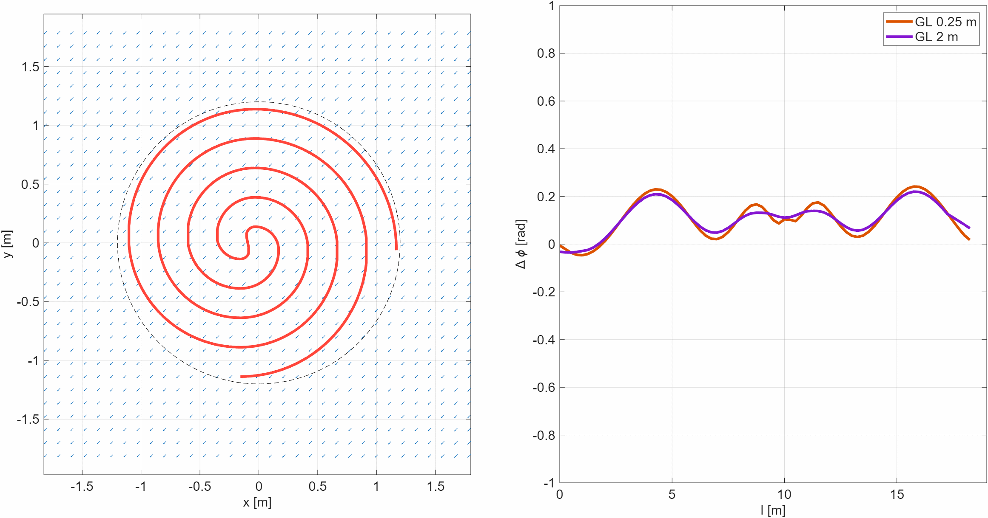
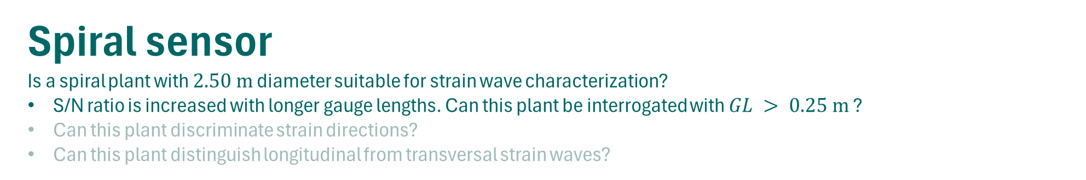
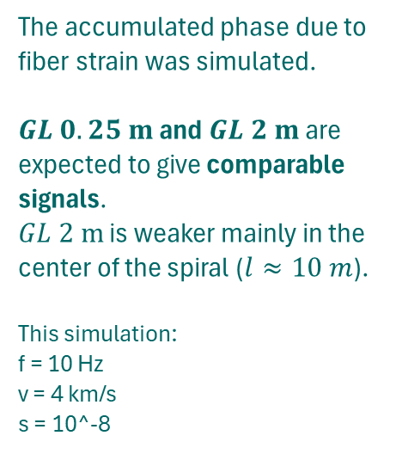
Spiral sensor Is a spiral plant with $2.50 m$ diameter suitable for strain wave characterization?
S/N ratio is increased with longer gauge lengths. Can this plant be interrogated with $GL > 0.25 m$ ?
Can this plant discriminate strain directions?
Can this plant distinguish longitudinal from transversal strain waves?
The accumulated phase due to fiber strain was simulated.
$GL 0.25 m$ and $GL 2 m$ are expected to give comparable signals. $GL 2 m$ is weaker mainly in the center of the spiral ($l≈10 m$). This simulation:
f = 10 Hz v = 4 km/s s = 10^-8

Slide 10
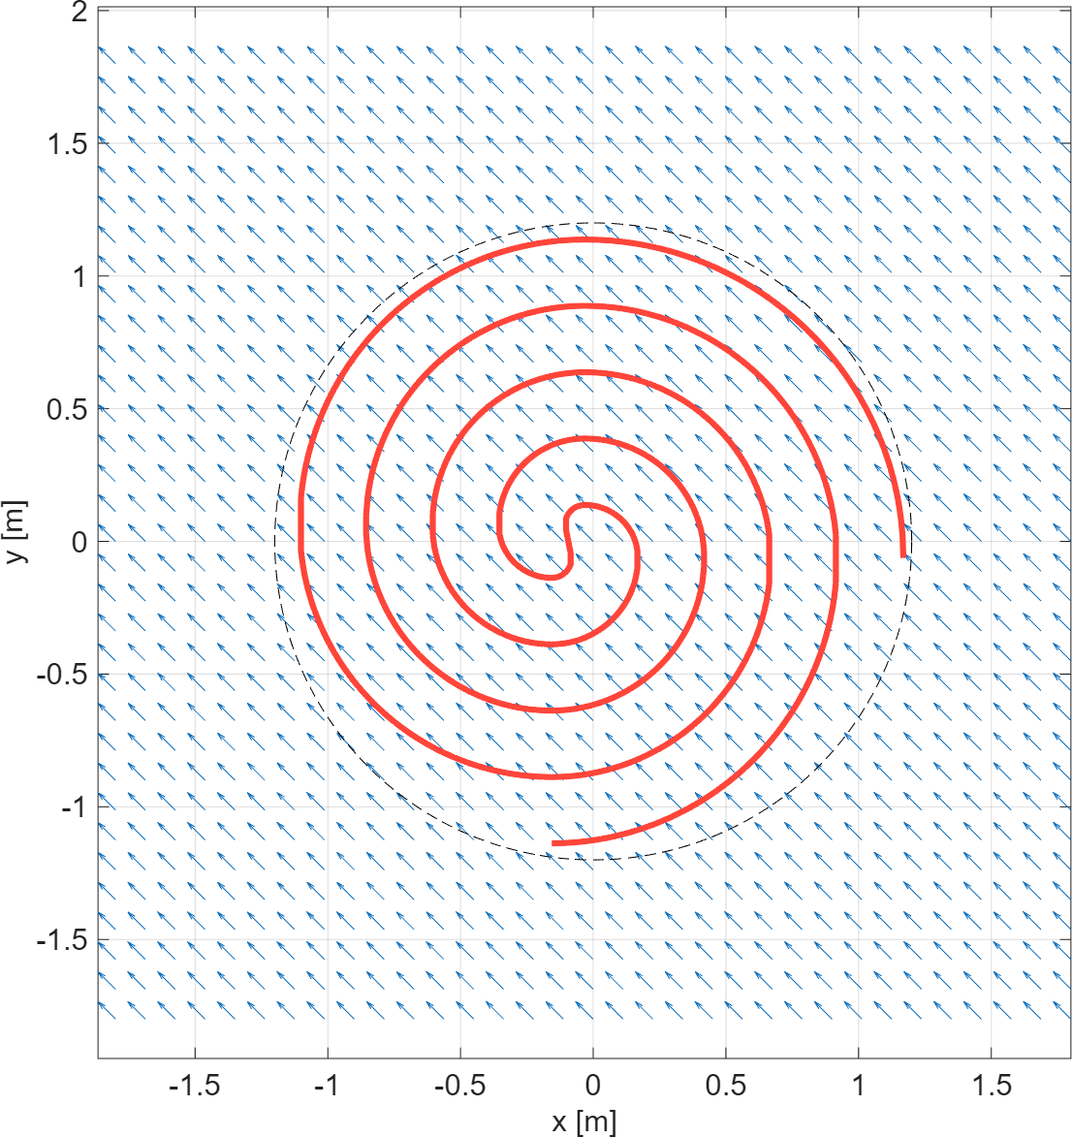
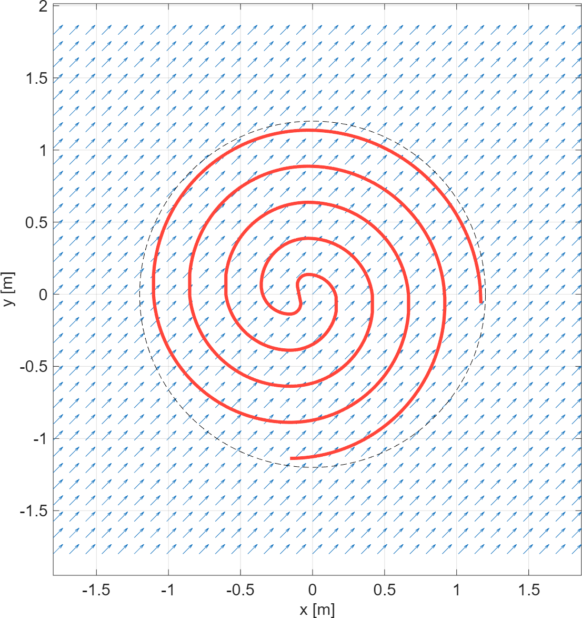
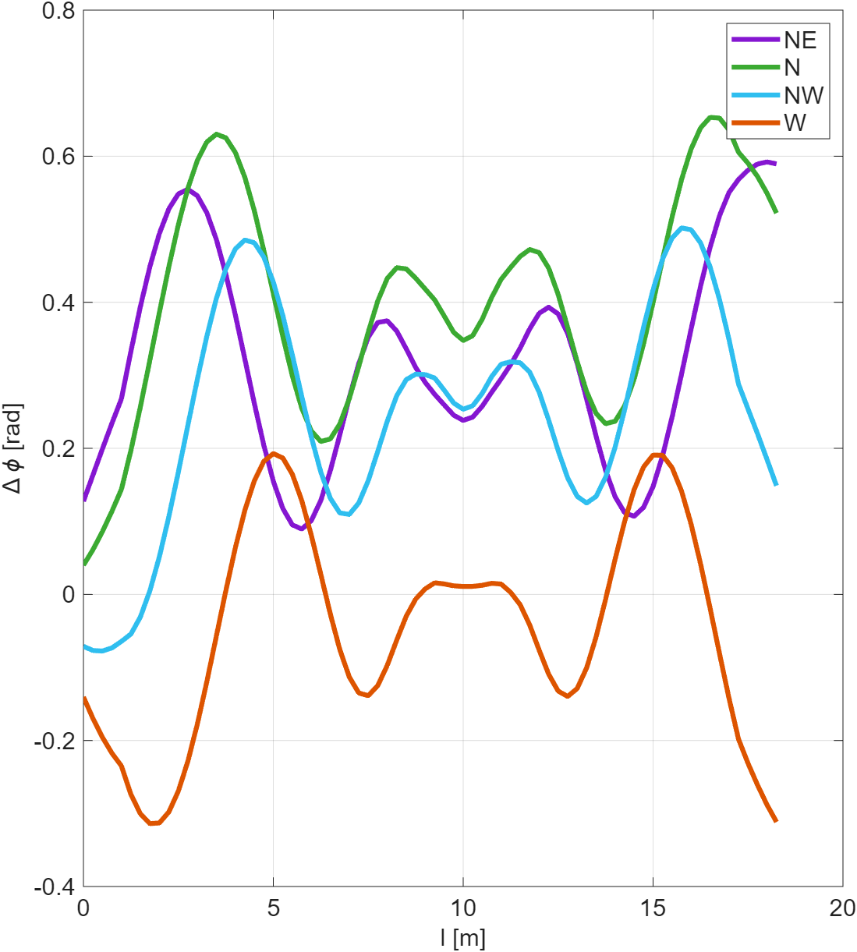
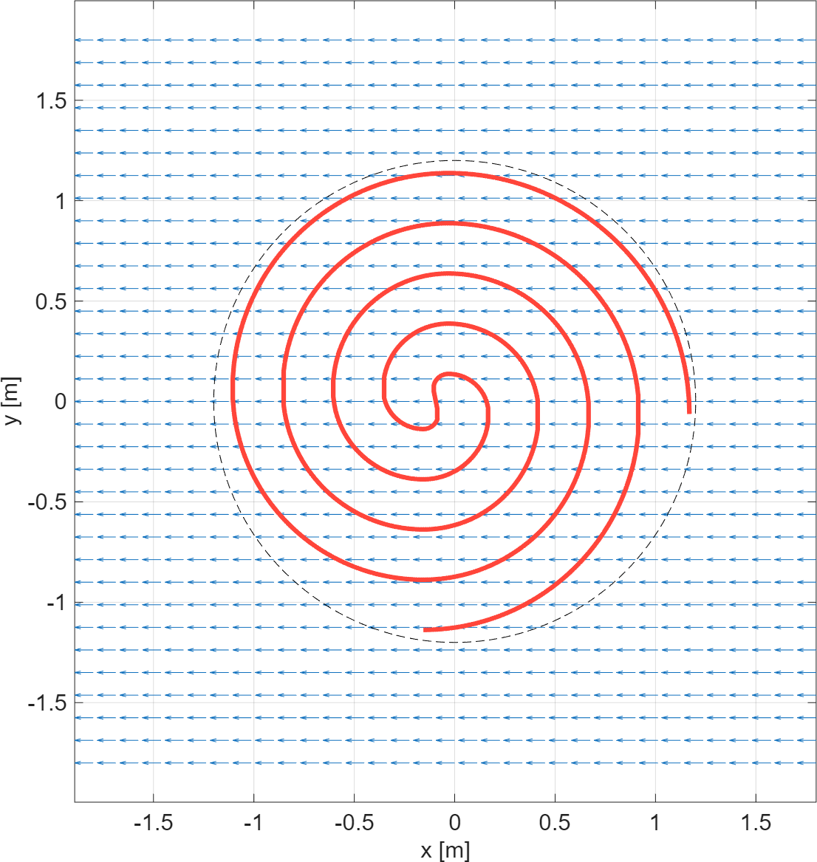
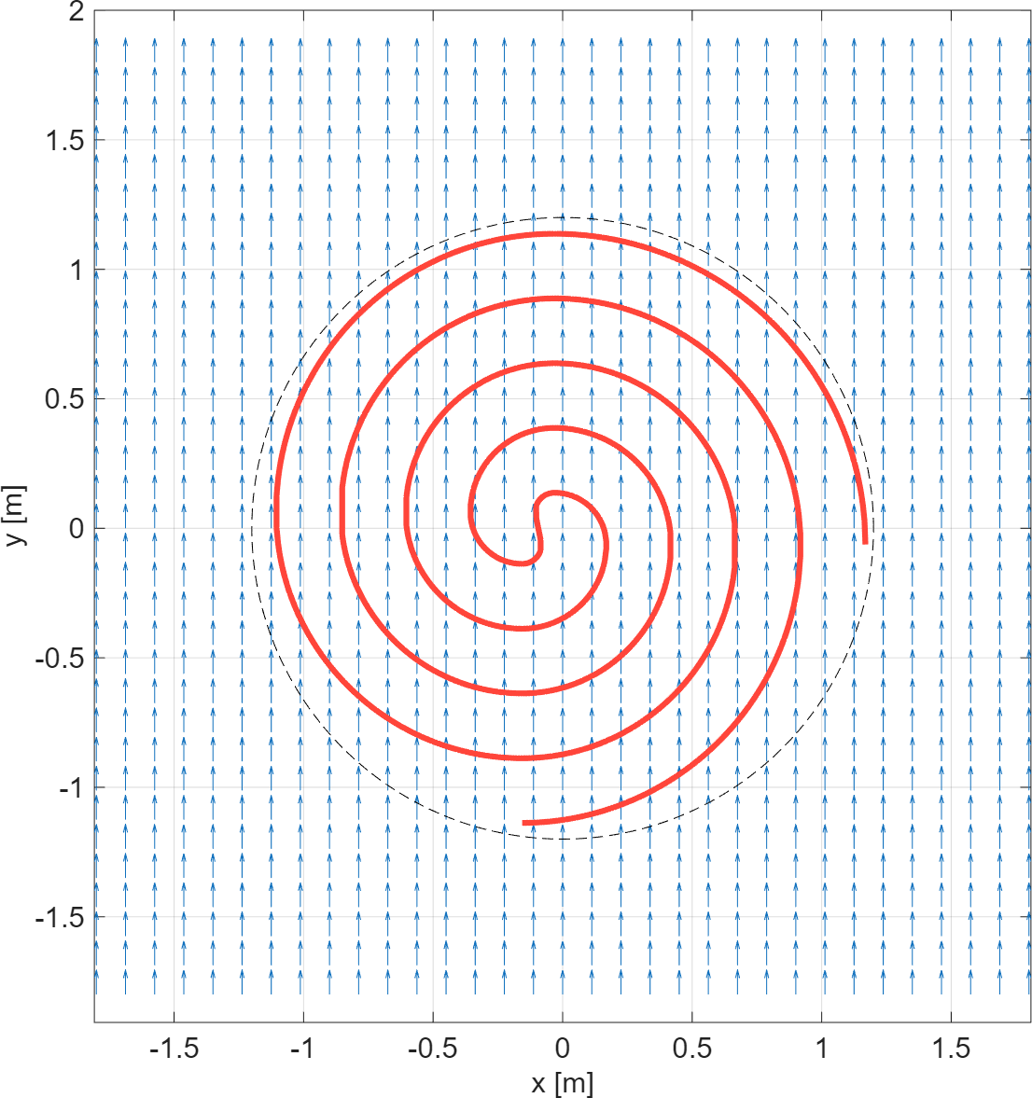
Spiral sensor Can this plant discriminate strain directions?
NW
NE
Different polarizations give different phase plots (evolving differently in time).
These simulations:
f = 10 Hz v = 4 km/s s = 10^-9
GL = 2 m
W
N

Slide 11
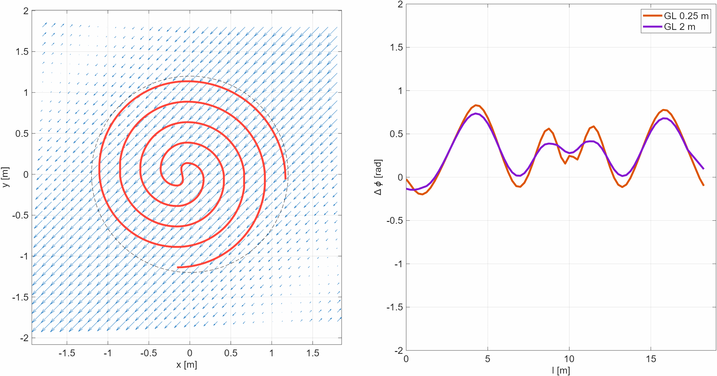
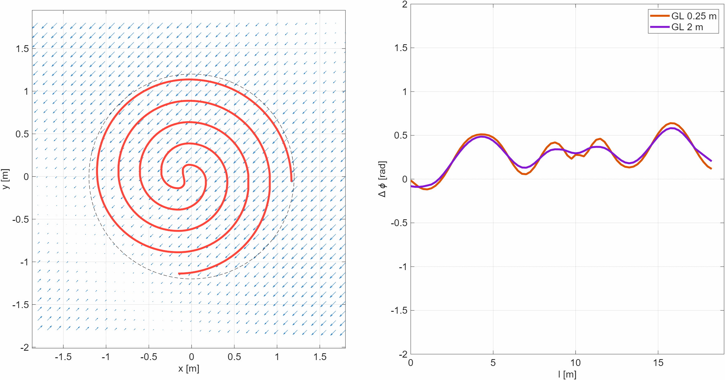
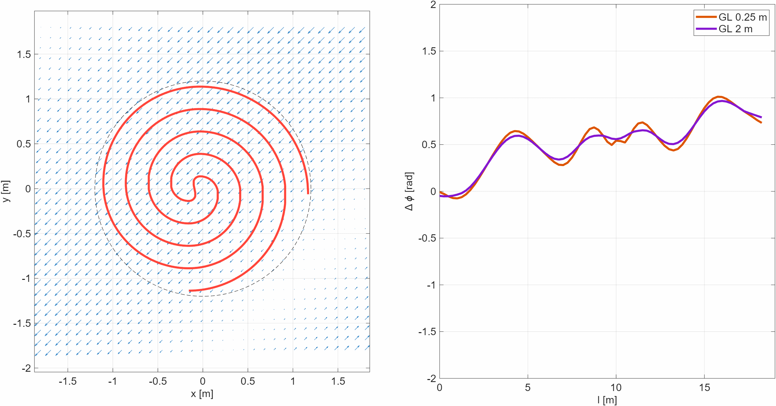
Spiral sensor Can this plant distinguish longitudinal from transversal strain waves?
Standing
Longitudinal and standing waves can exhibit very small differences.
Transverse waves produce a characteristic rising phase. These simulations:
f = 500 Hz v = 4 km/s s = 10^-9 same polarization
Longitudinal
Transversal

Slide 12
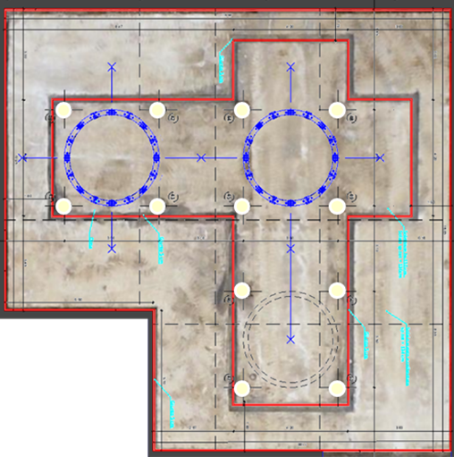
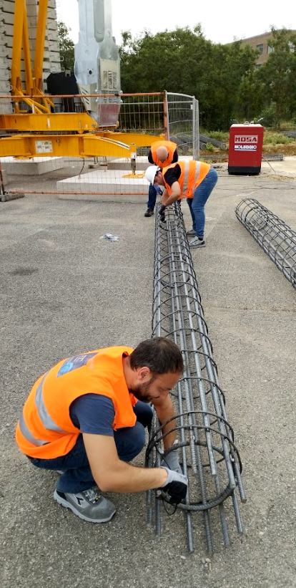
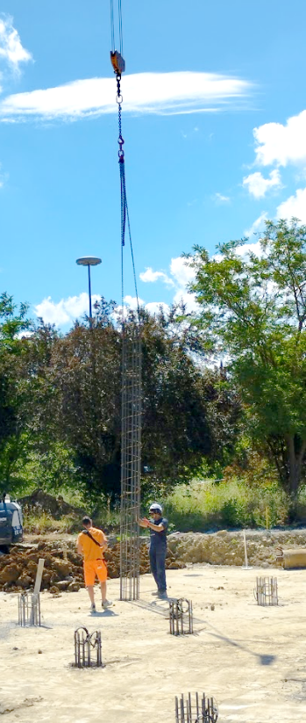
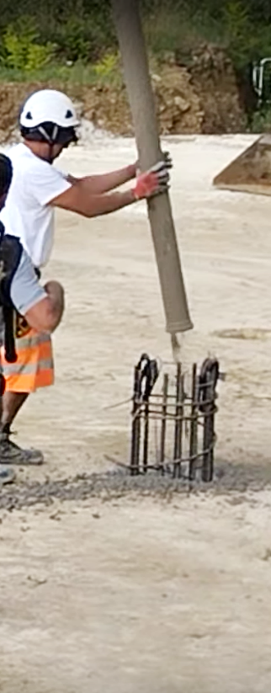
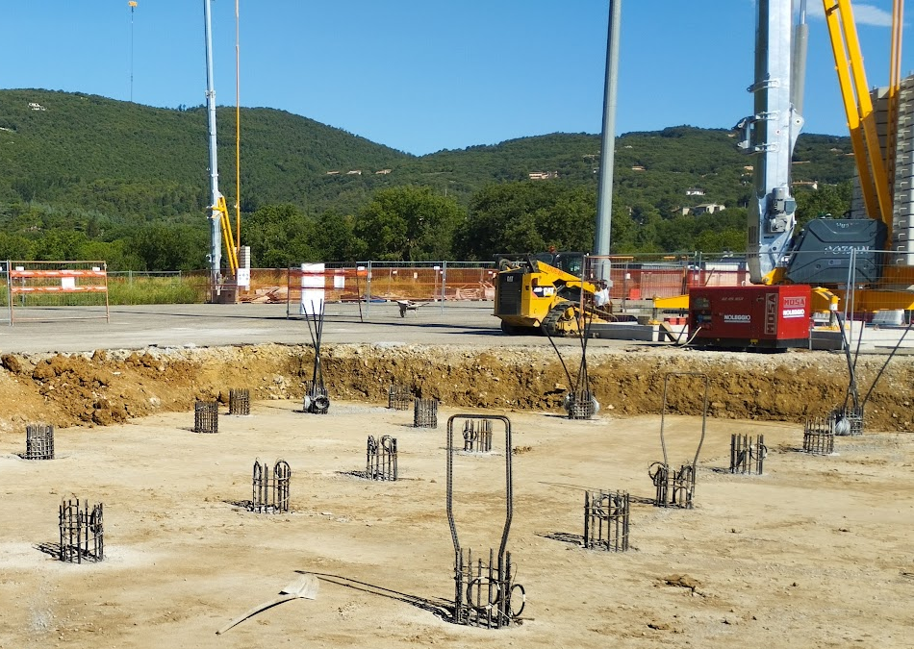

Implementation Fiber installation in foundation pillars
Yellow. Foundation pillars of the experimental area. Red. Isolating joint (ground cut).
Steel reinforcements are prepared with optical fiber (roundtrip, redundant).
Reinforcements are lowered into the drilled foundation holes.
Concrete is poured into holes. The cement weight ensures adhesion to the fiber.
Six pillars equipped with duplex fiber cable. Six with two duplex cables for further redundancy.

Slide 13
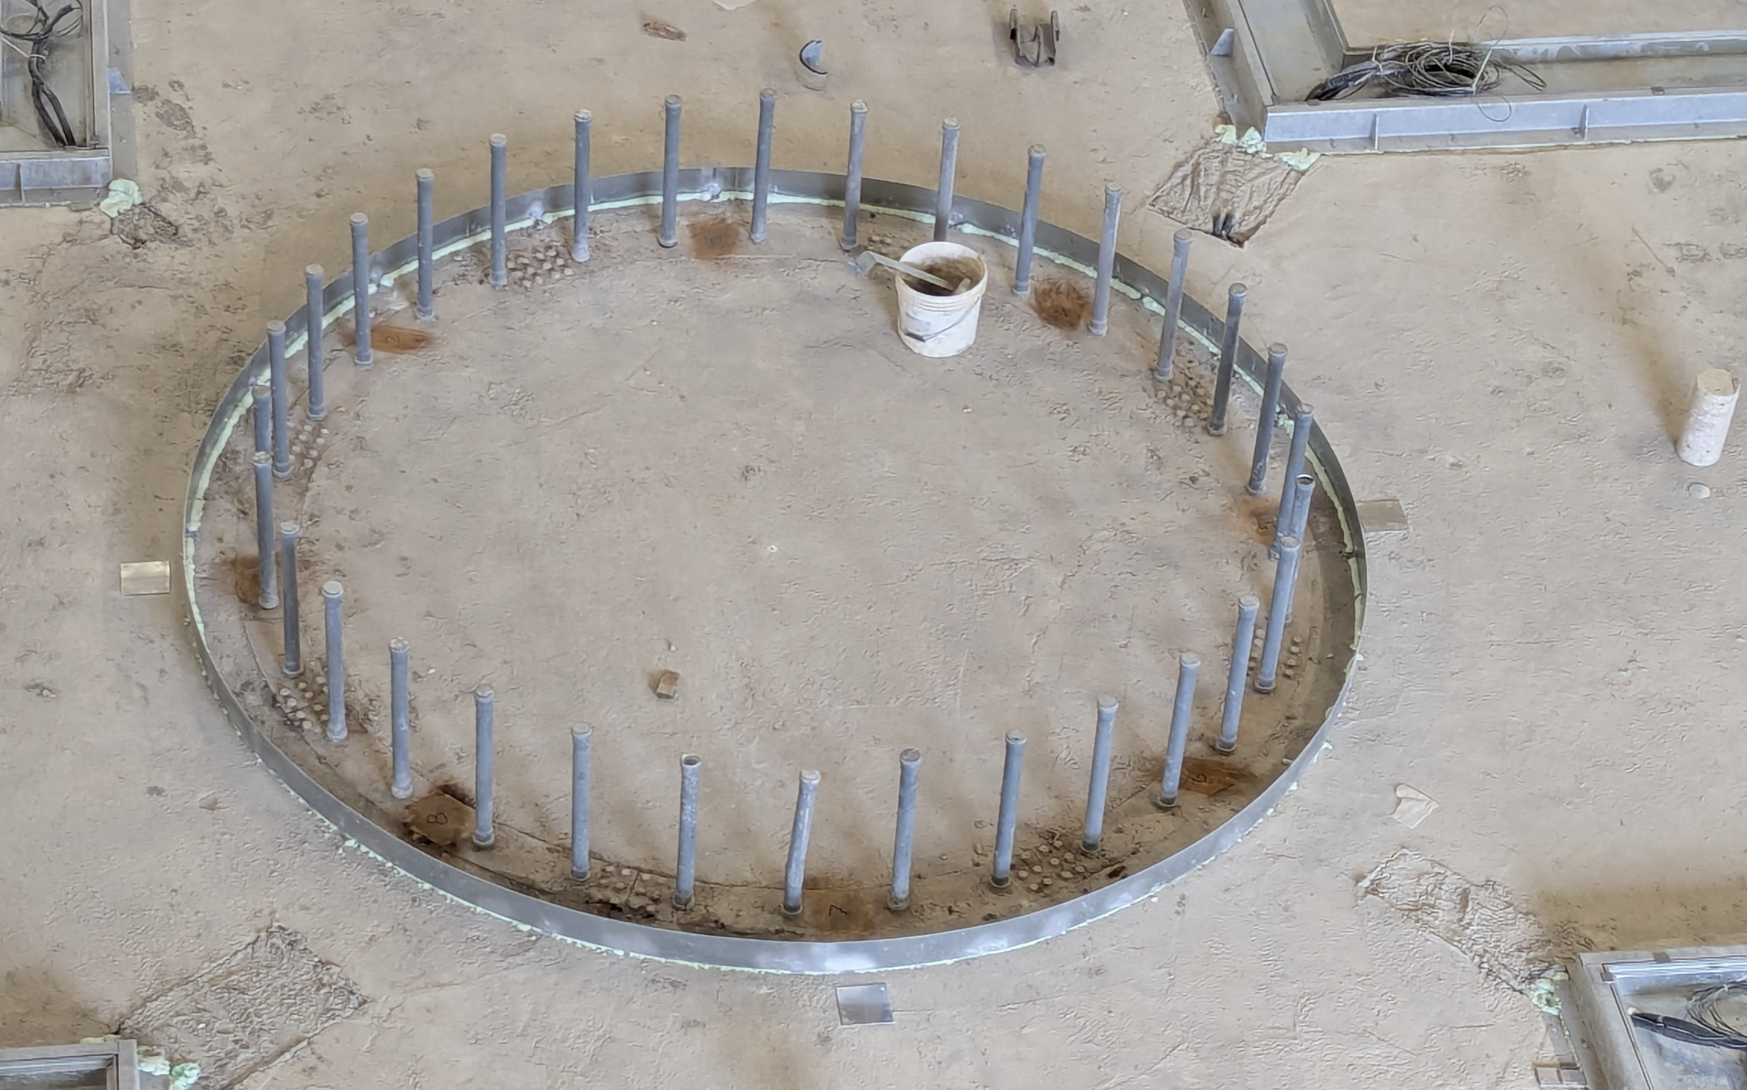
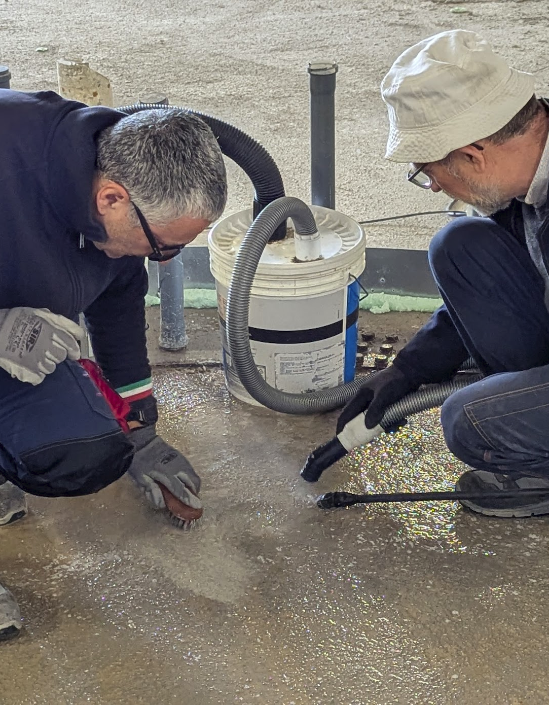
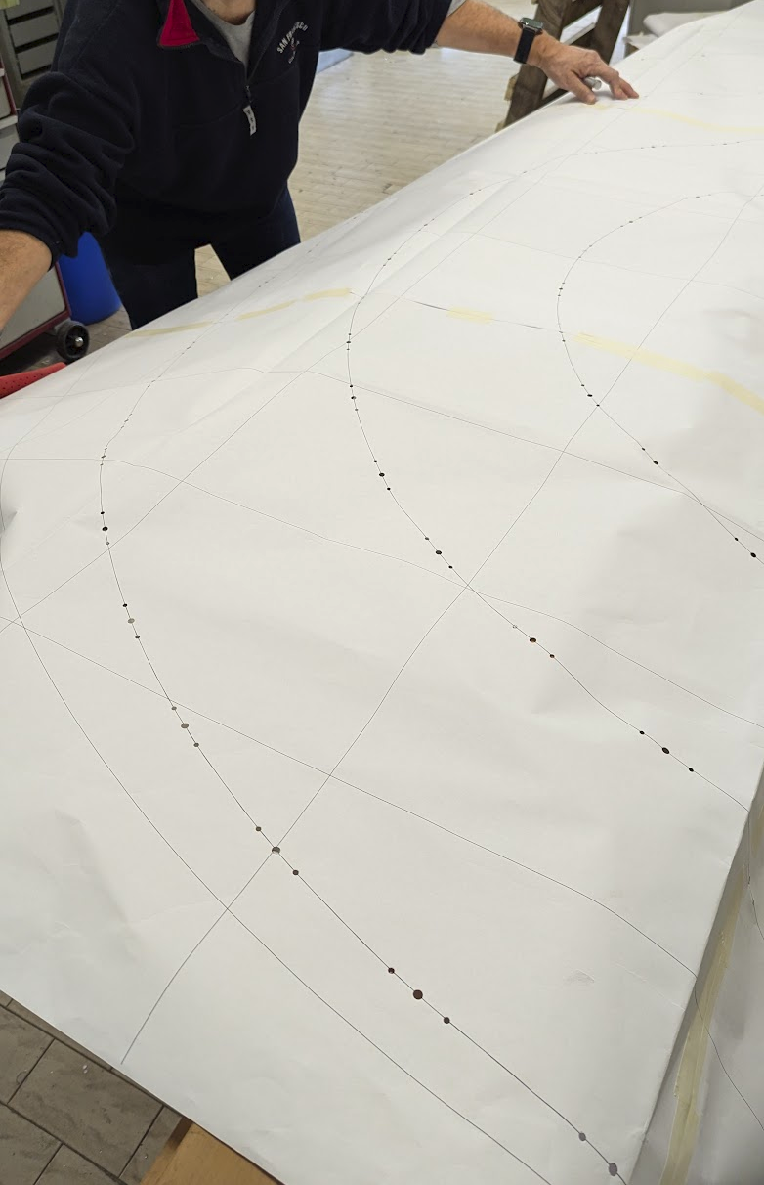
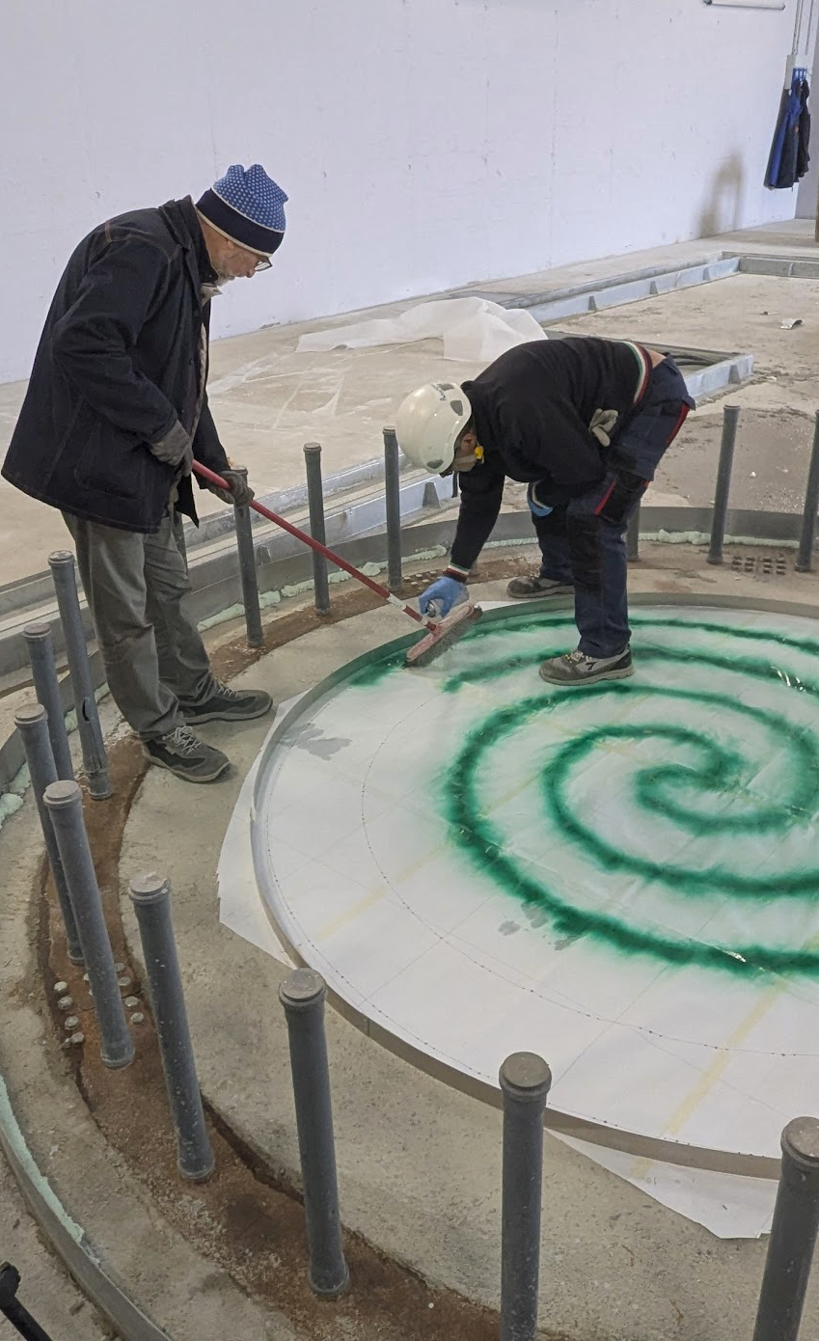
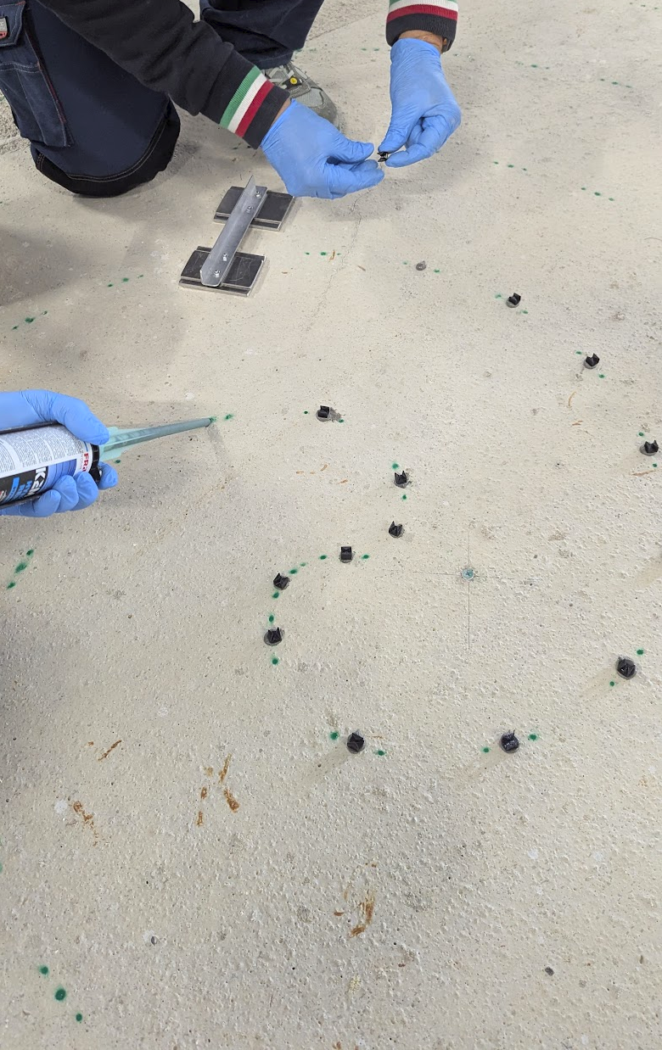
Implementation Fiber installation below the towers
Confined areas must be equipped with fiber spirals, on top of the concrete layer. Constrain: no groove cutting. Pourable, superior adhesion, non-shrinking, rigid concrete:
MAPEGROUT COLABILE ZERO + MAPECURE SRA 0.25%
(normally used for structural repairs).
Accurate surface cleaning.
Drawing preparation.
Drawing transfer.
Placeholders.

Slide 14
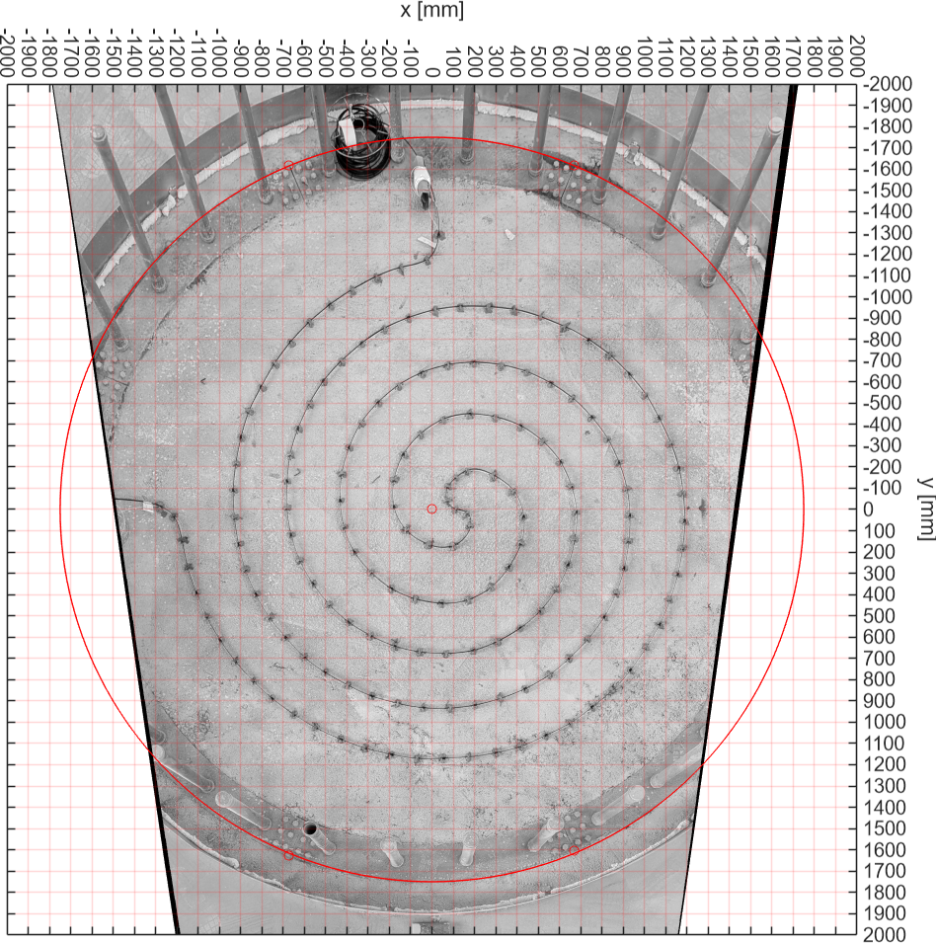
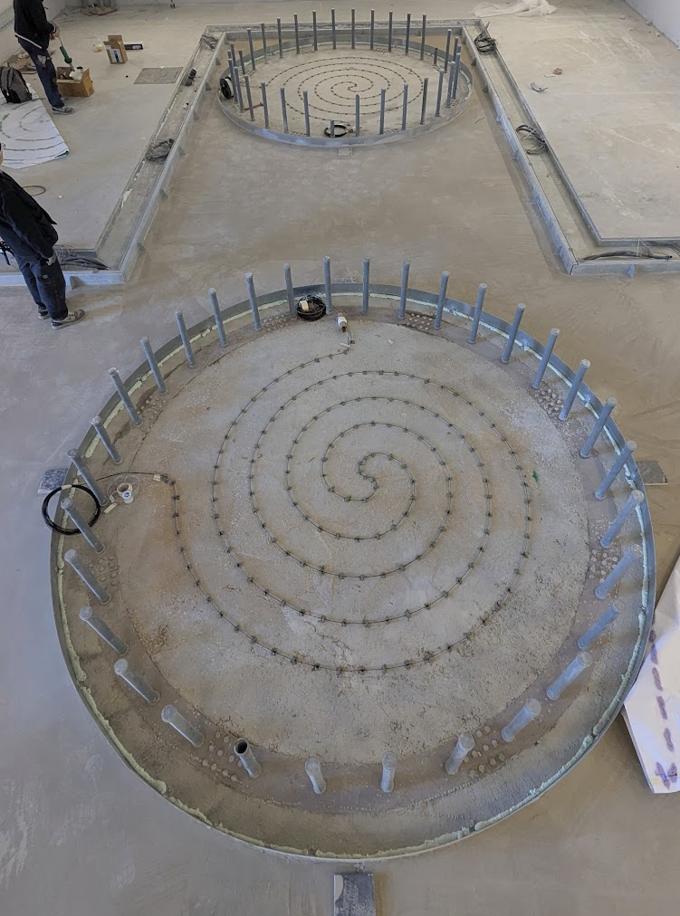
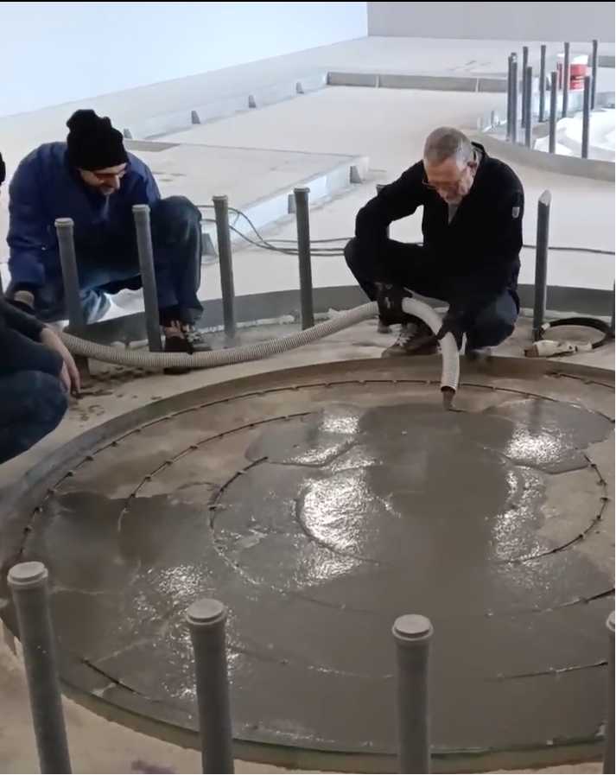
Implementation Fiber installation below the towers (2)
Fiber in place.
Embedding fibers.
And don’t forget retaining information!

Slide 15
Conclusions
None, yet.
Perspectives
This is a startup. Next part of the plant to be installed as soon as the laboratory is operational.
Starting collaborations with Silixa INGV INFN-Roma1, GSSI, Newtonian noise experts

Slide 16
Spares

Slide 17
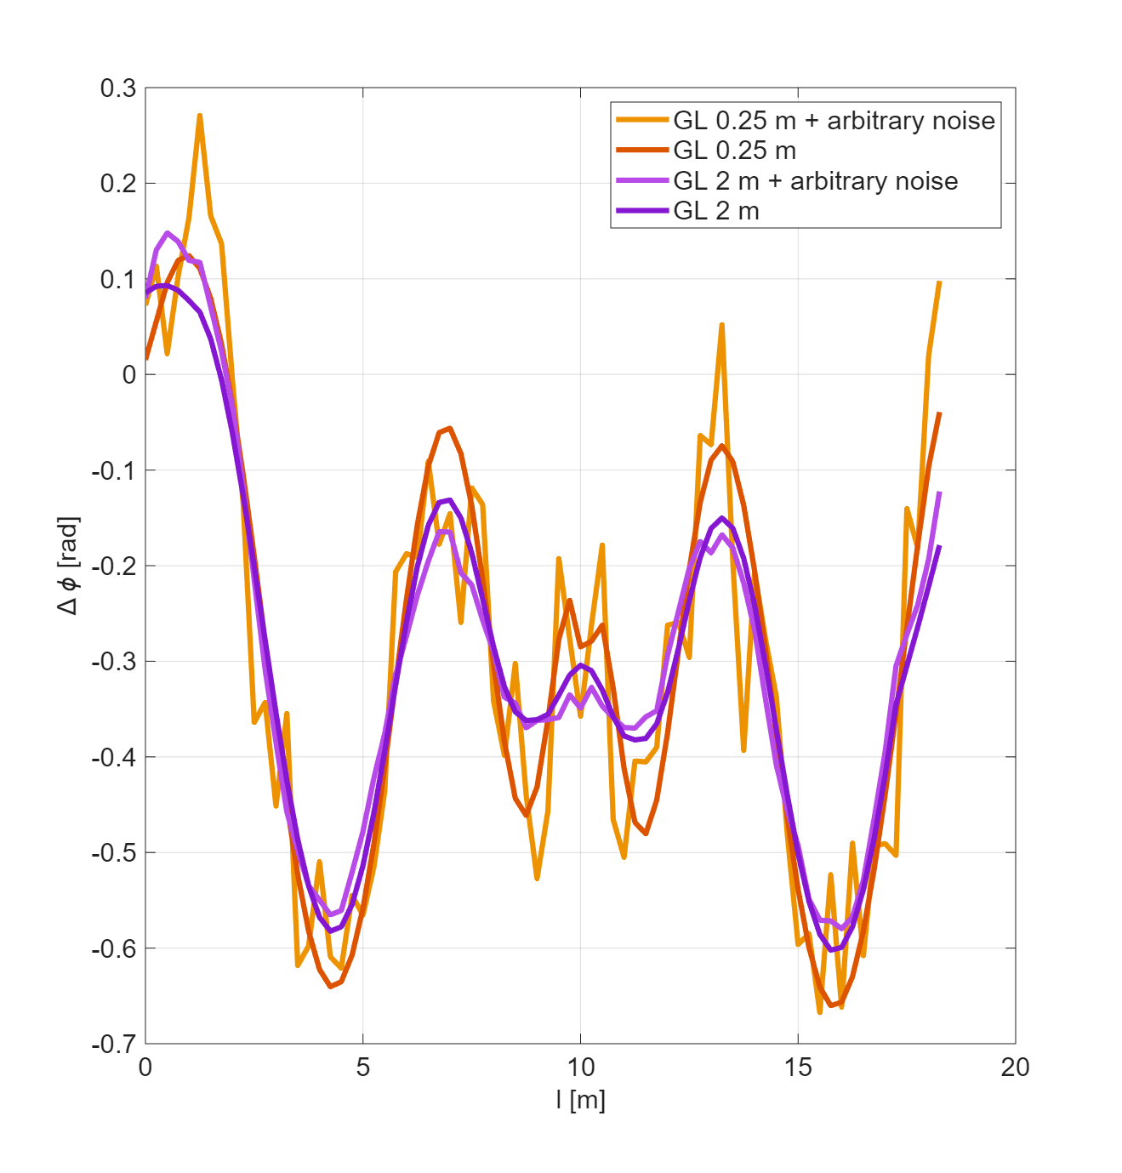
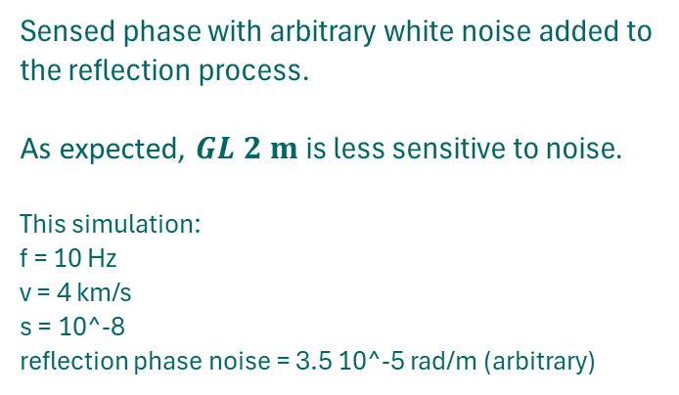
Noise Longer gauge lengths suppress noise better than short ones. Short gauge lengths have better resolution for both position and direction. What do we expect from short GL and diameter-sized GL?
Sensed phase with arbitrary white noise added to the reflection process.
As expected, $GL 2 m$ is less sensitive to noise. This simulation:
f = 10 Hz v = 4 km/s s = 10^-8
reflection phase noise = 3.5 10^-5 rad/m (arbitrary)

Slide 18

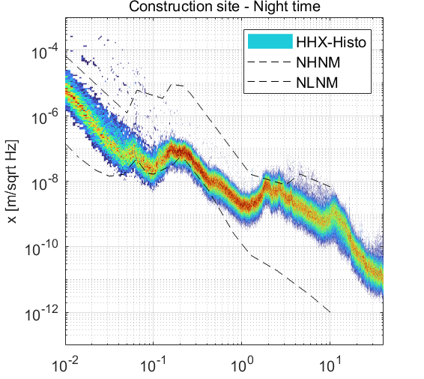
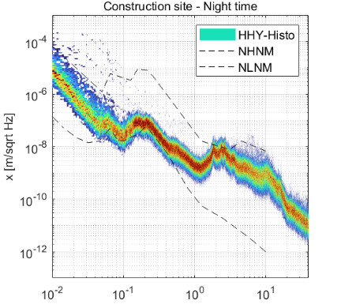
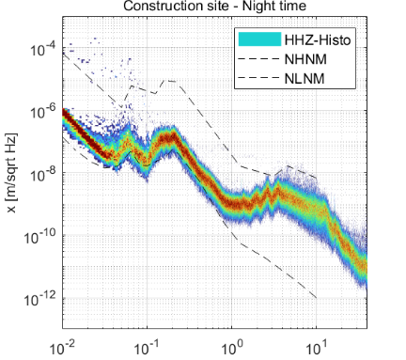
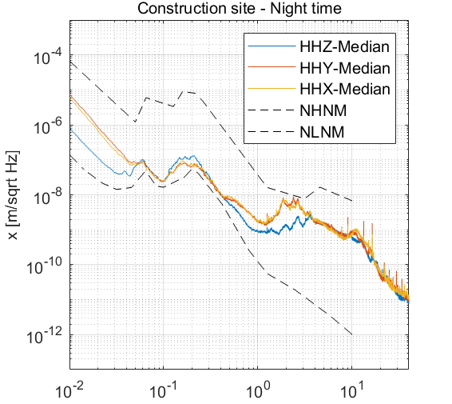
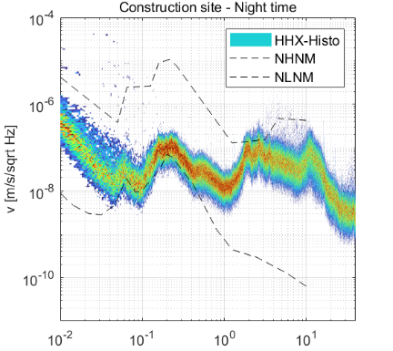
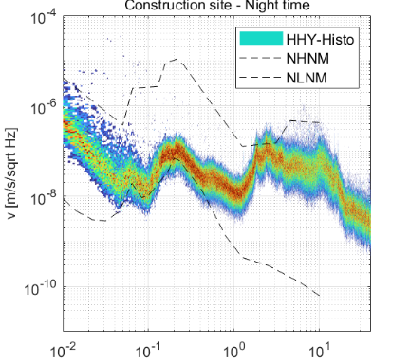
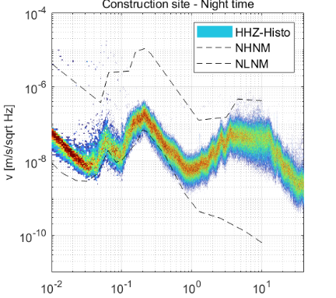
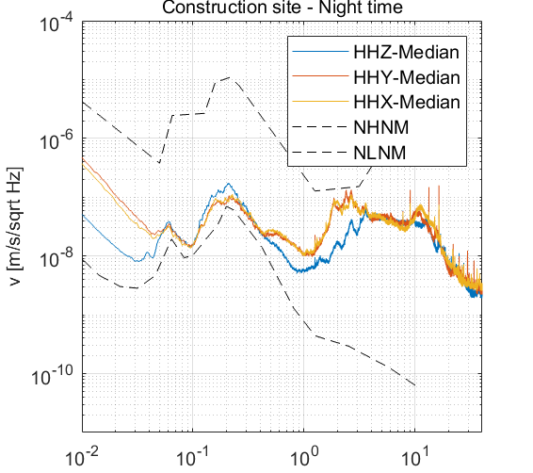
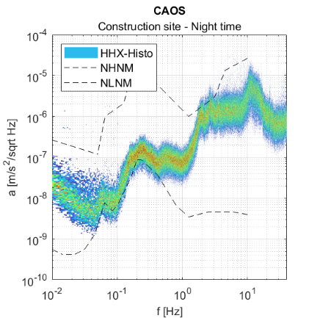



CAOS construction site 6 days, 8h in NIGHT time
HHX: East direction HHY: North direction HHZ: vertical direction
East North Vertical Medians
Acceleration Speed Displacement
| 18

Slide 19












CAOS construction site 6 days, 8h in DAY time
HHX: East direction HHY: North direction HHZ: vertical direction
East North Vertical Medians
Acceleration Speed Displacement
| 19

Slide 20












CAOS construction site 6 days, 8h in ANY time
HHX: East direction HHY: North direction HHZ: vertical direction
East North Vertical Medians
Acceleration Speed Displacement
| 20

Slide 21


CAOS construction site compared spectra
HHX: East direction HHY: North direction HHZ: vertical direction
East North Vertical Medians
Acceleration Speed Displacement
| 21

