Slide 1
Birefringence measurement and mitigation techniques
Frederic Cleva, Marc Eisenmann, Stephanie Grabielle, Clement Jacquet, Shalika Singh, Haoyu Wang, Chenjie Zhou

Slide 2
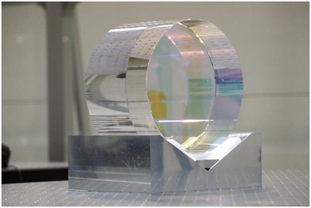
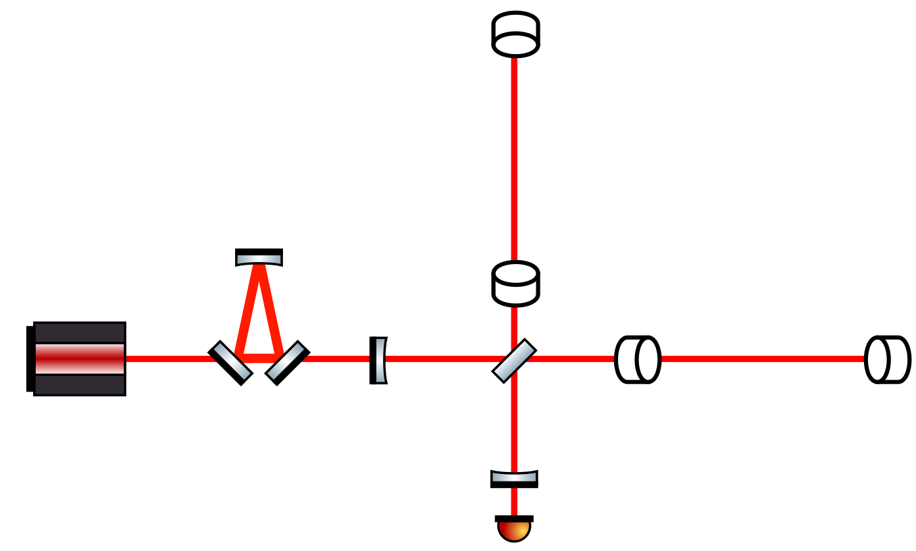
KAGRA and crystalline test-masses
KAGRA operates with Sapphire test-masses at cryogenic temperature
Sapphire test-masses
23 kg
22 cm diameter
15 cm thickness
Optical axis along c-axis

Slide 3
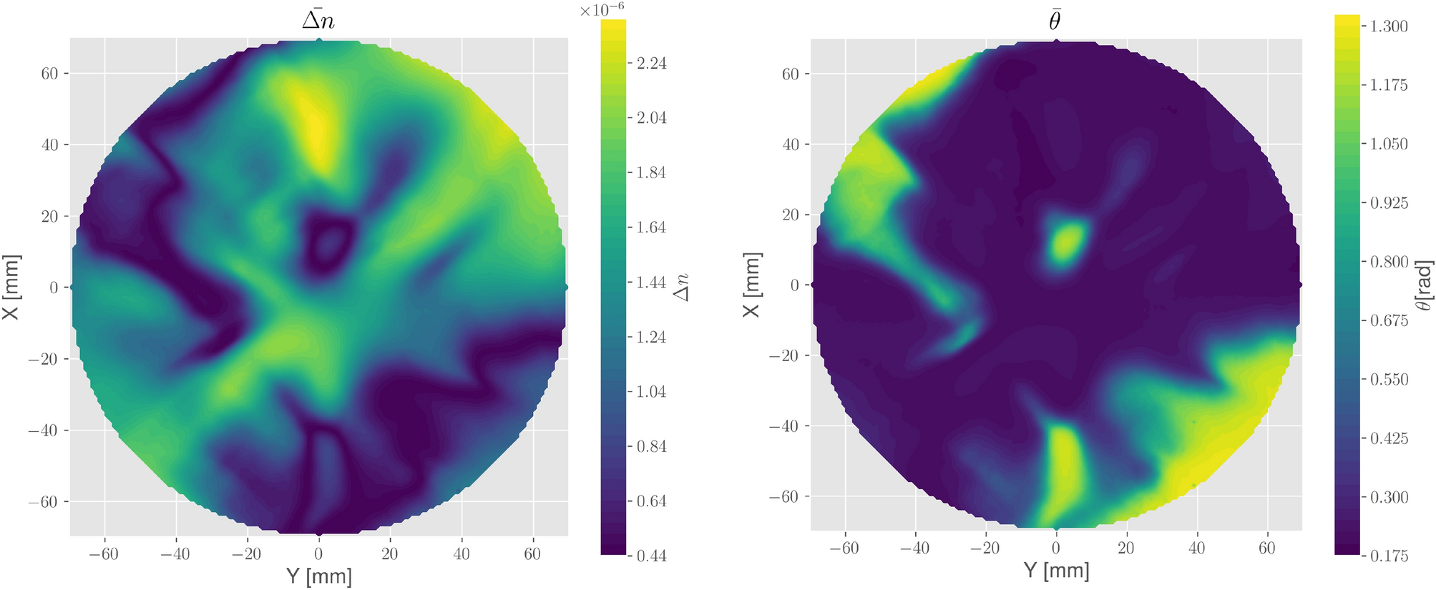
Sapphire and birefringence
Perfect sapphire along c-axis should be birefringence free
Manufacturing defects, stress, or optical axis fluctuations can generate birefringence

Slide 4
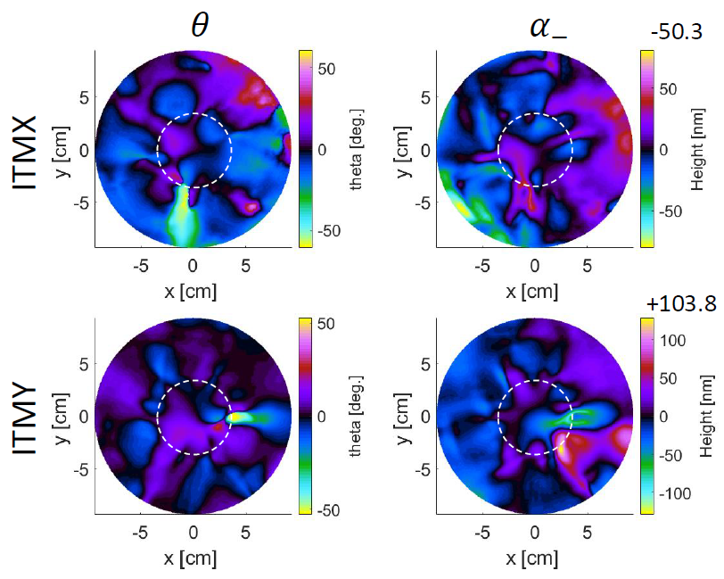
KAGRA and birefringence
The non-uniform birefringence of KAGRA test-masses generates several noises, increase optical losses and spoil controls

Slide 5
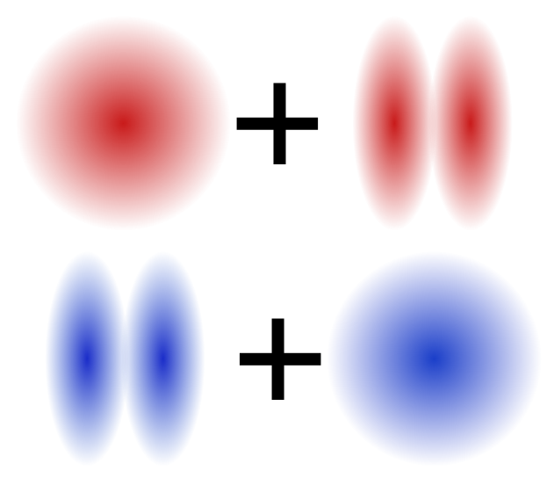
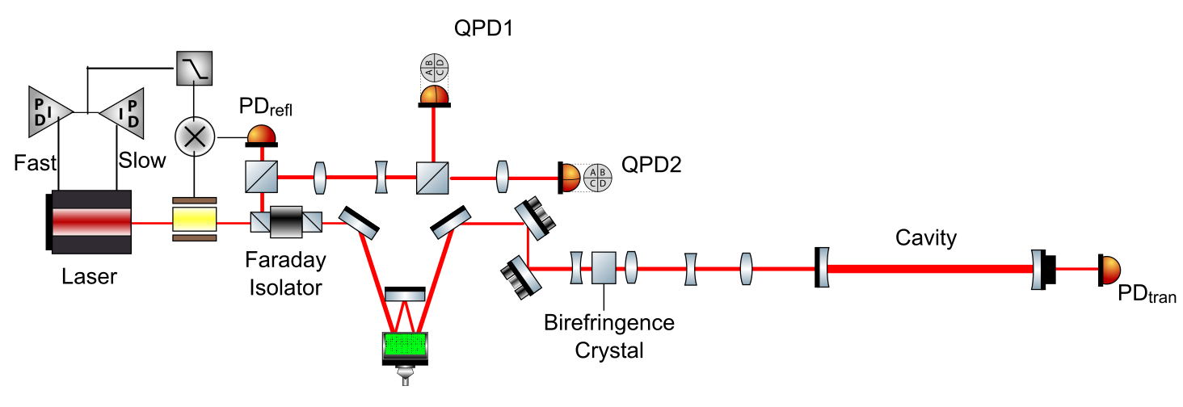
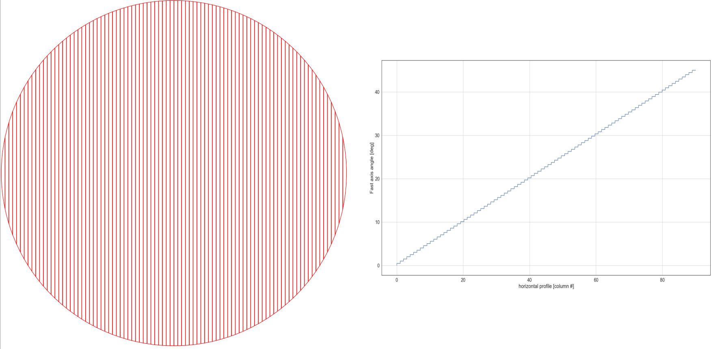
Birefringence studies in optical cavity
Birefringence can affect optical cavity control
Birefringence
Misalignment
Control
Sideband
Carrier
Custom waveplate

Slide 6
The compensation strategy
Birefringent input test-mass
Birefringence compensation system
Birefringent input test-mass
The birefringence compensation system generates the opposite polarization than the one generated by the test-mass

Slide 7

Variable polarization retarder
Each pixel of a Liquid Crystal Display (LCD) contains a liquid crystal
Light source
Polarizer
Liquid crystal
Polarizer
Liquid crystals are birefringent molecules that align with the electric field

Slide 8
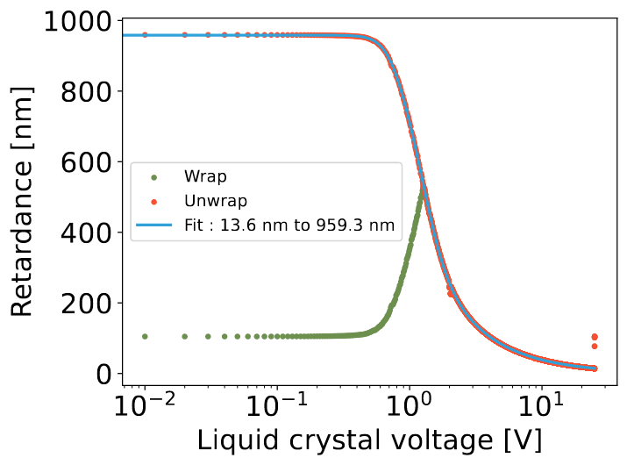
Variable polarization retarder
Each pixel of a Liquid Crystal Display (LCD) contains a liquid crystal
Non-uniform in transverse plane : high retardation
Retardation[nm]
Uniform in transverse plane : low retardation
Liquid crystals are variable polarization retarders

Slide 9
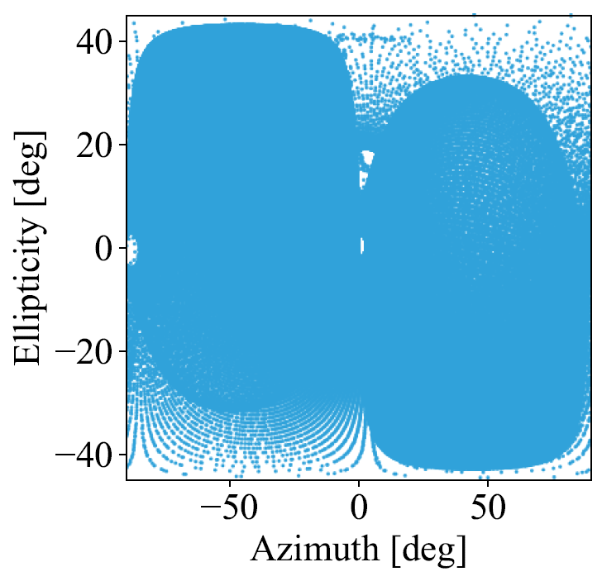
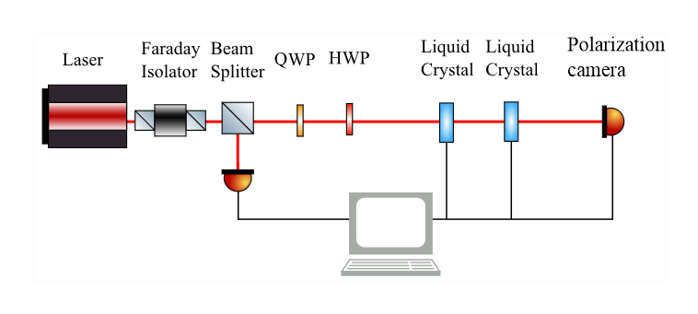
Full polarization control
Using a pair of liquid crystals (variable polarization retarders) with their axis separated by 45º it is possible to generate any polarization
The 1st liquid crystal acts on polarization rotation
The 2nd liquid crystal acts on polarization retardation

Slide 10
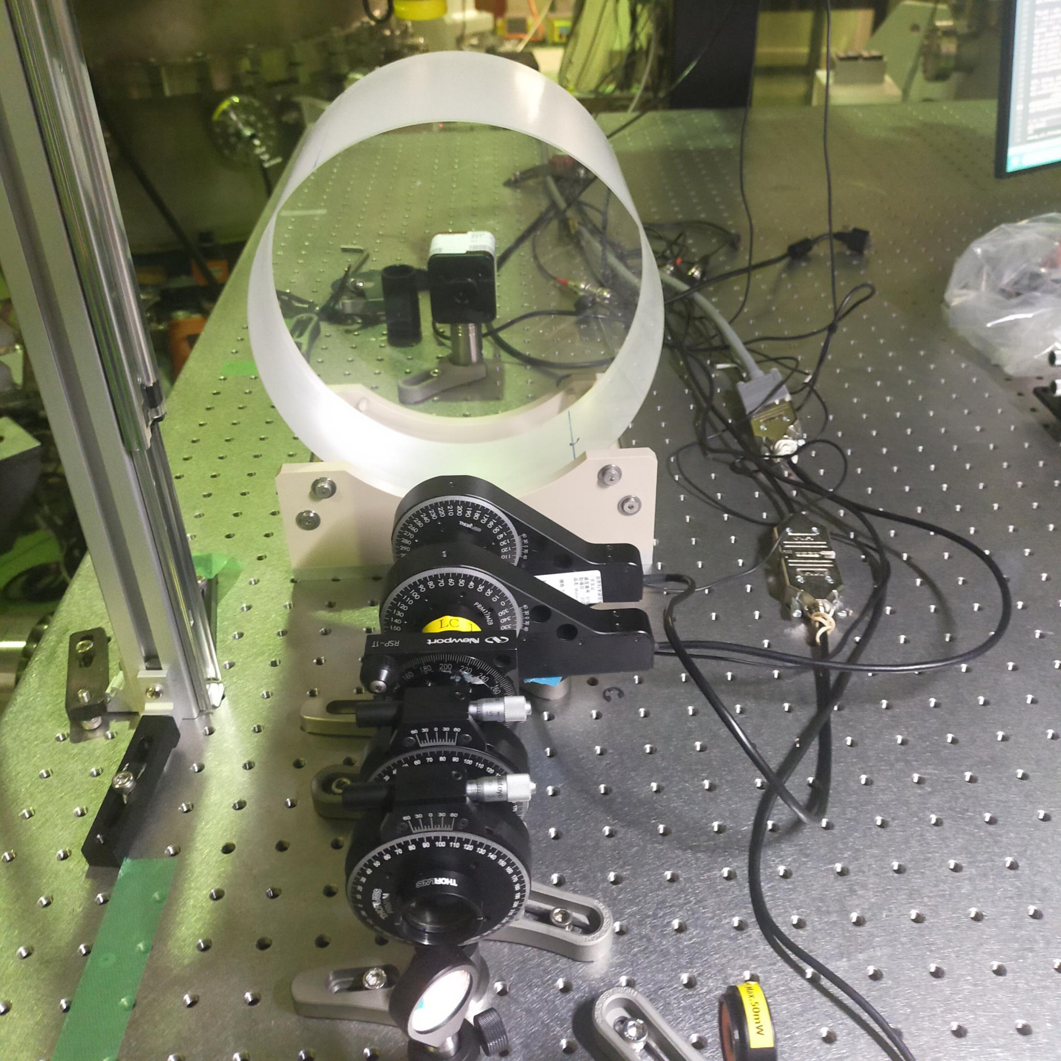
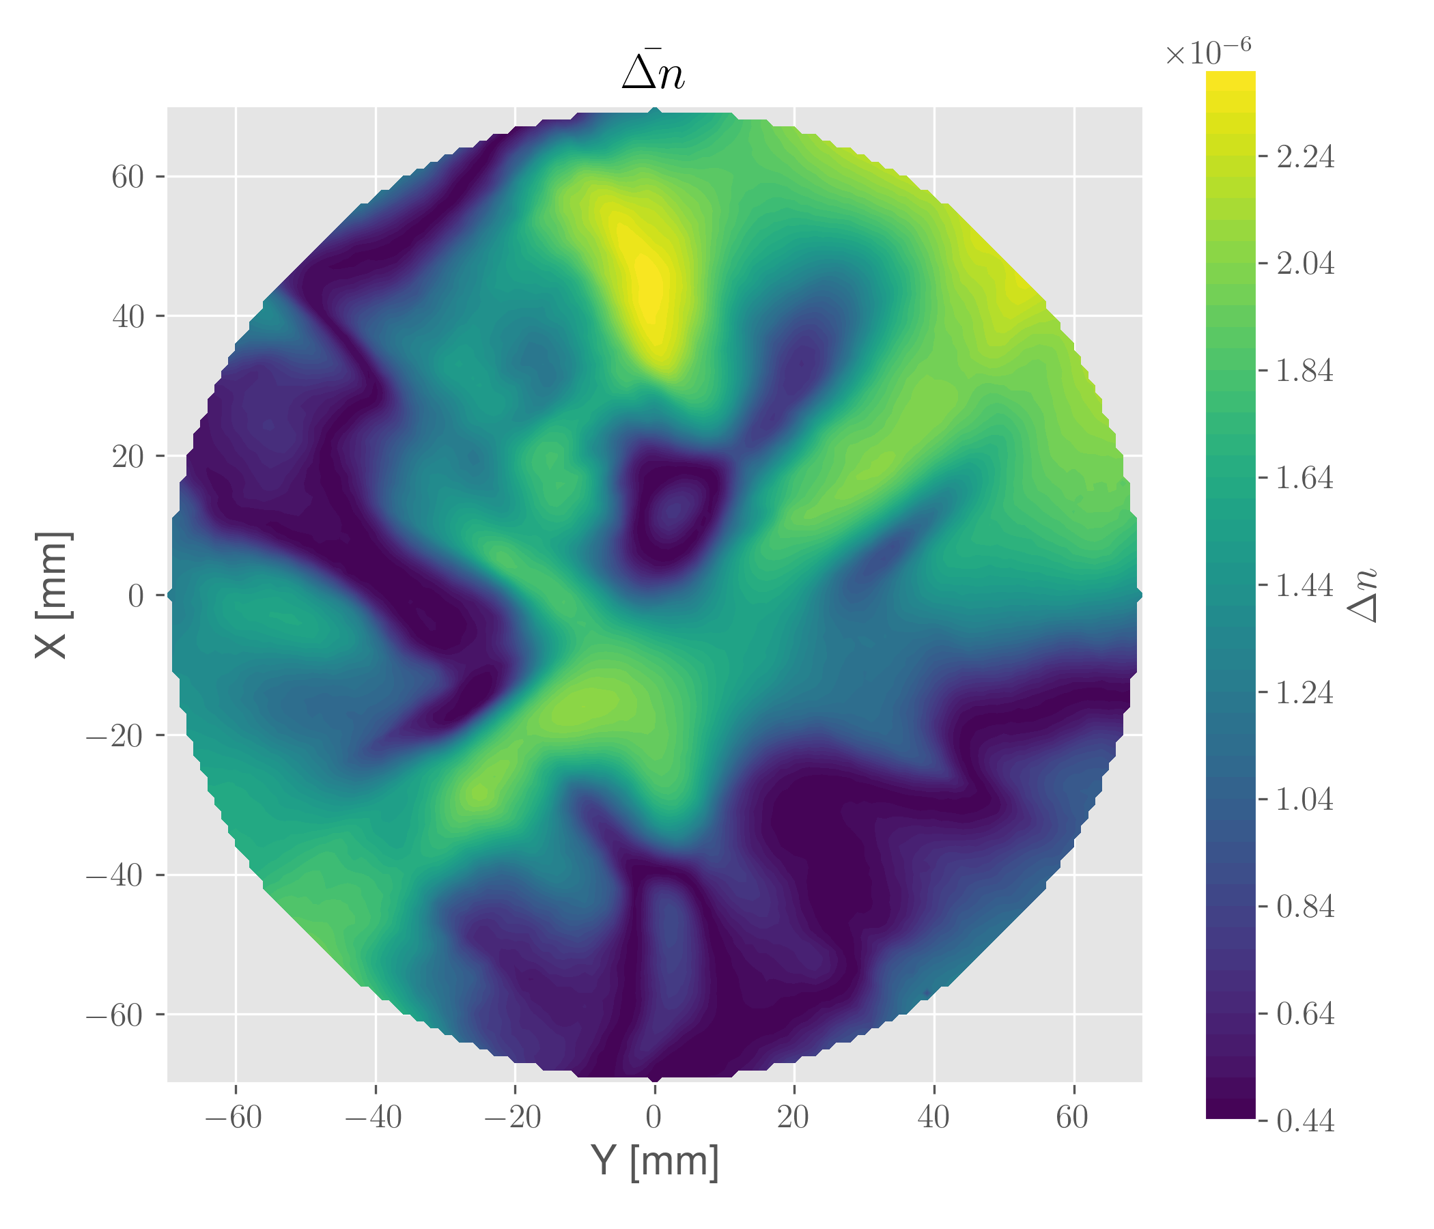
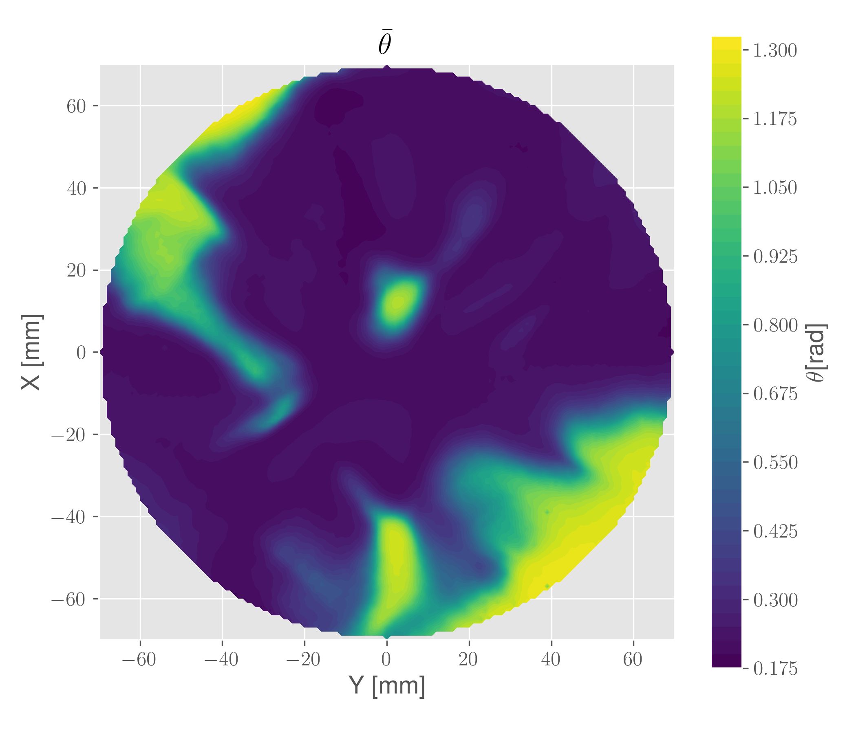
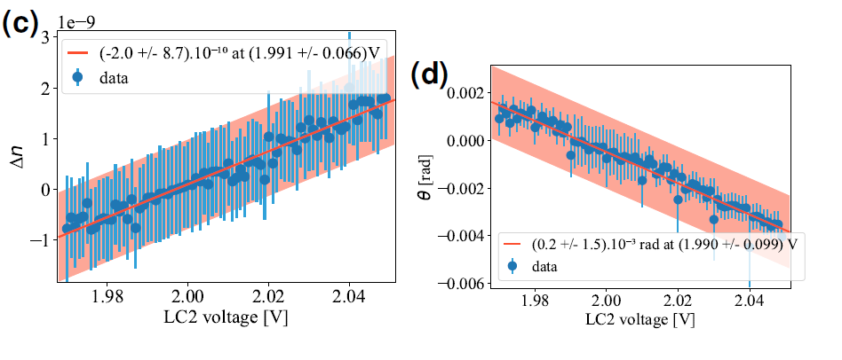
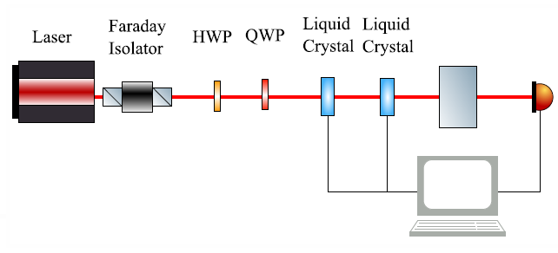
1D birefringence compensation
Achieved a reduction of birefringence by a factor 10⁵ in 1 position
https://doi.org/10.1364/OL.523753

Slide 11
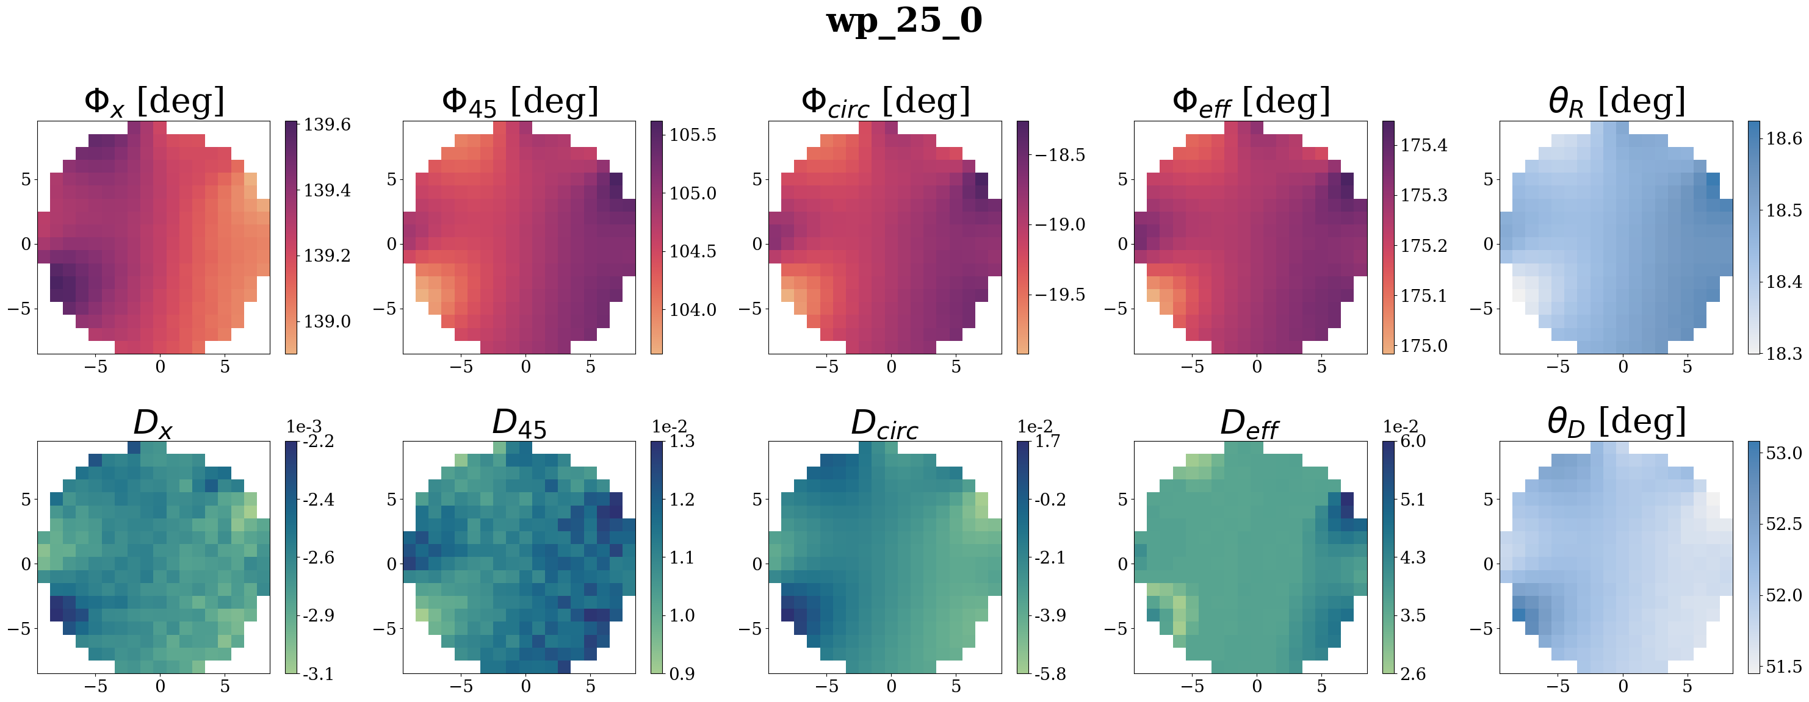
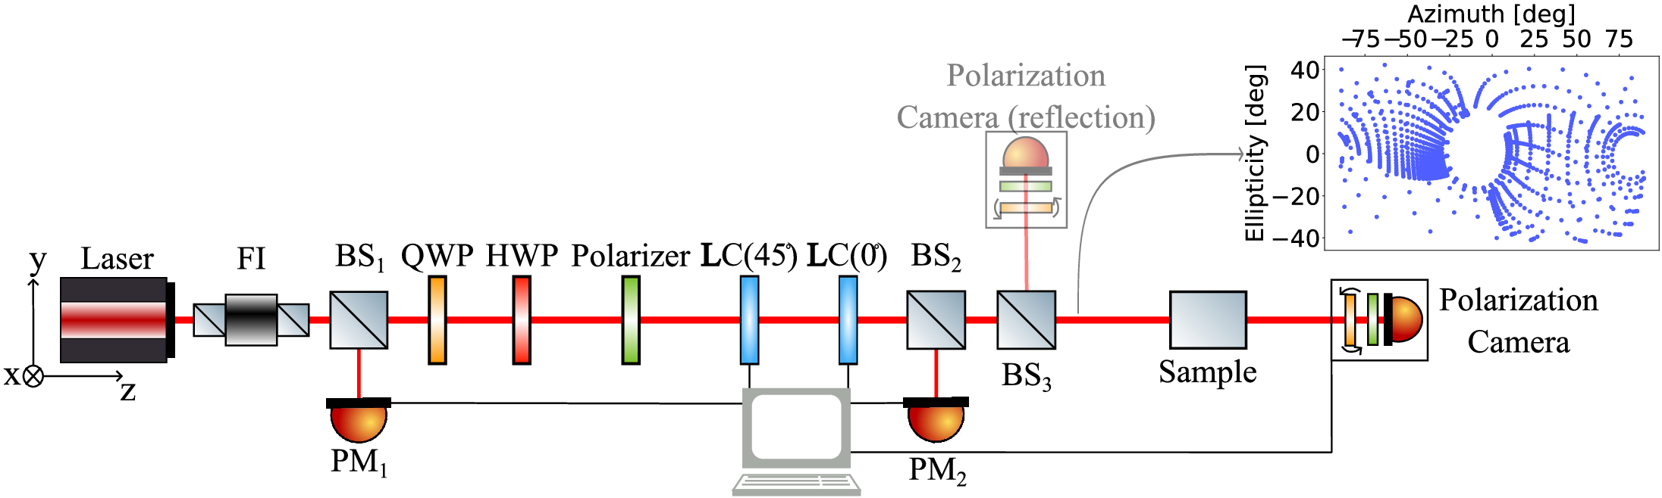



Birefringence measurement
Birefringent input test-mass
Use variable retarders to generate arbitrary polarization
Probe the Jones matrix (J) of the sample
Extract birefringence from the Jones matrix
Works for transmissive or reflective components
$$E_{in}$$
$$J$$
$$E_{out}=J.E_{in}$$
https://doi.org/10.1364/OE.558774

Slide 12
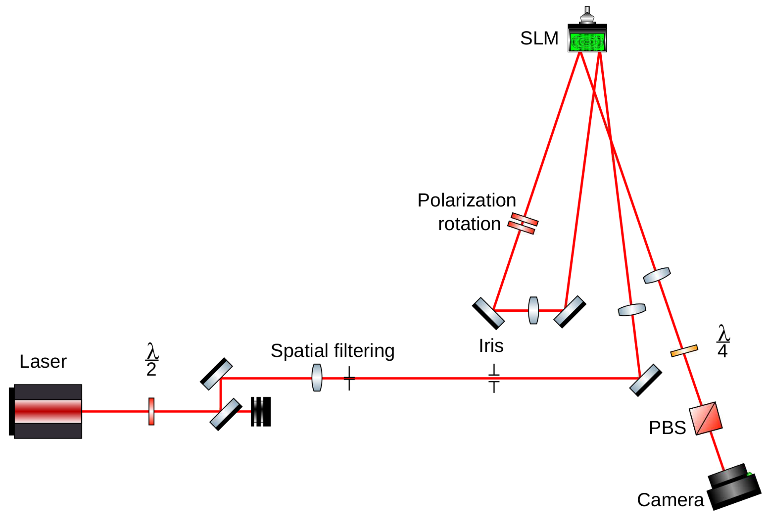
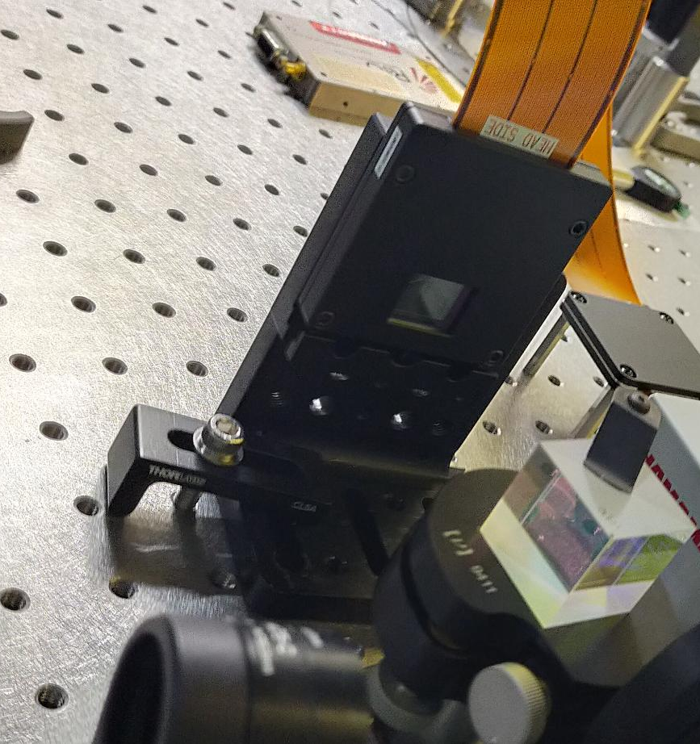
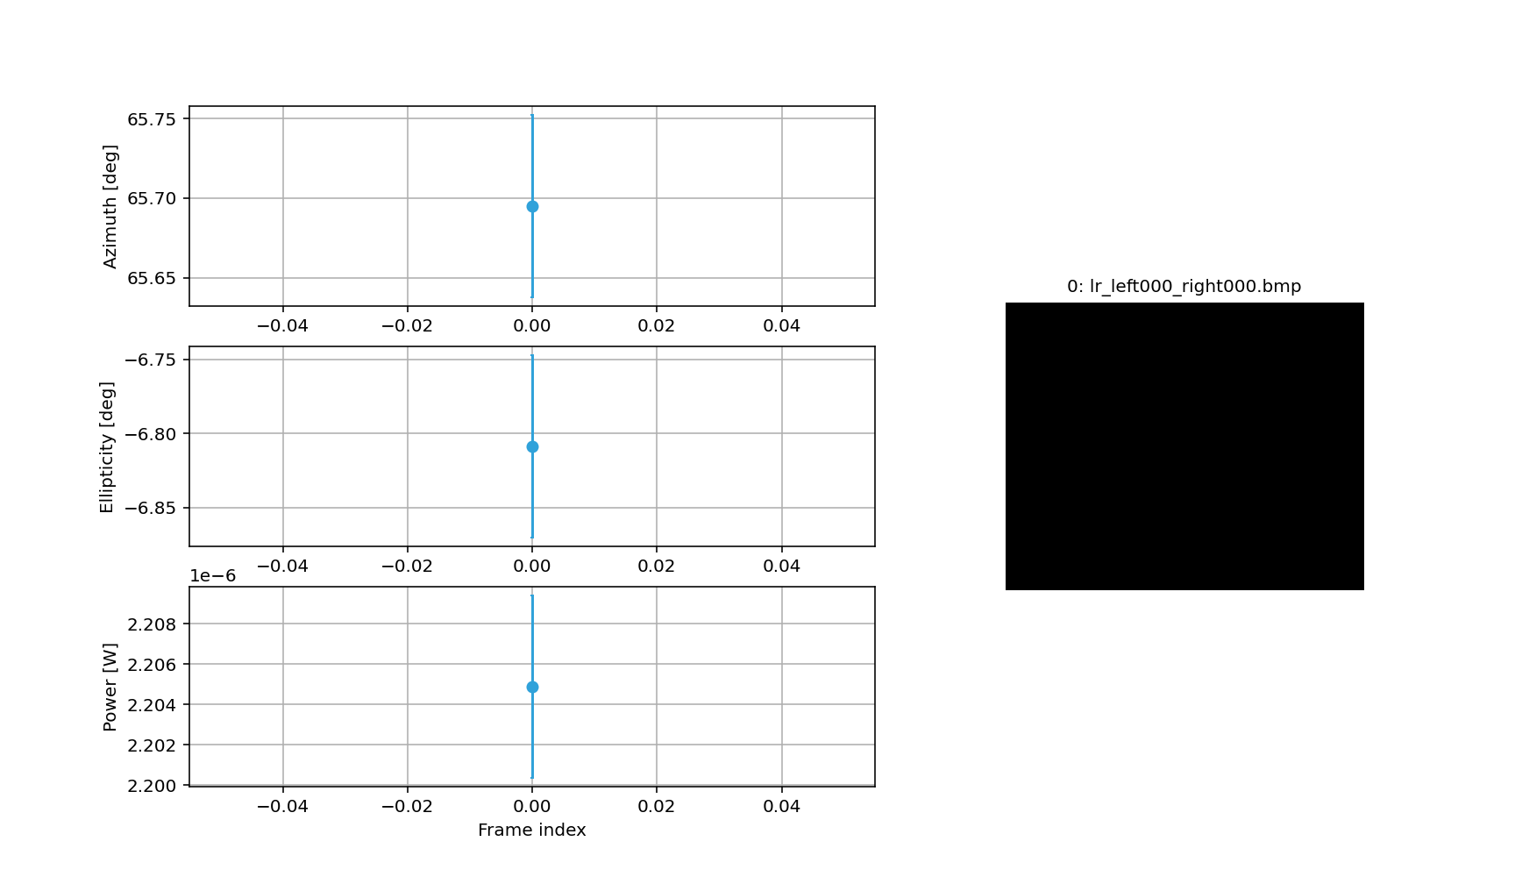
2D variable retarders
Spatial ligh modulator contains ~ 1 Mpixels
Each half of SLM acts as a variable retarder

Slide 13
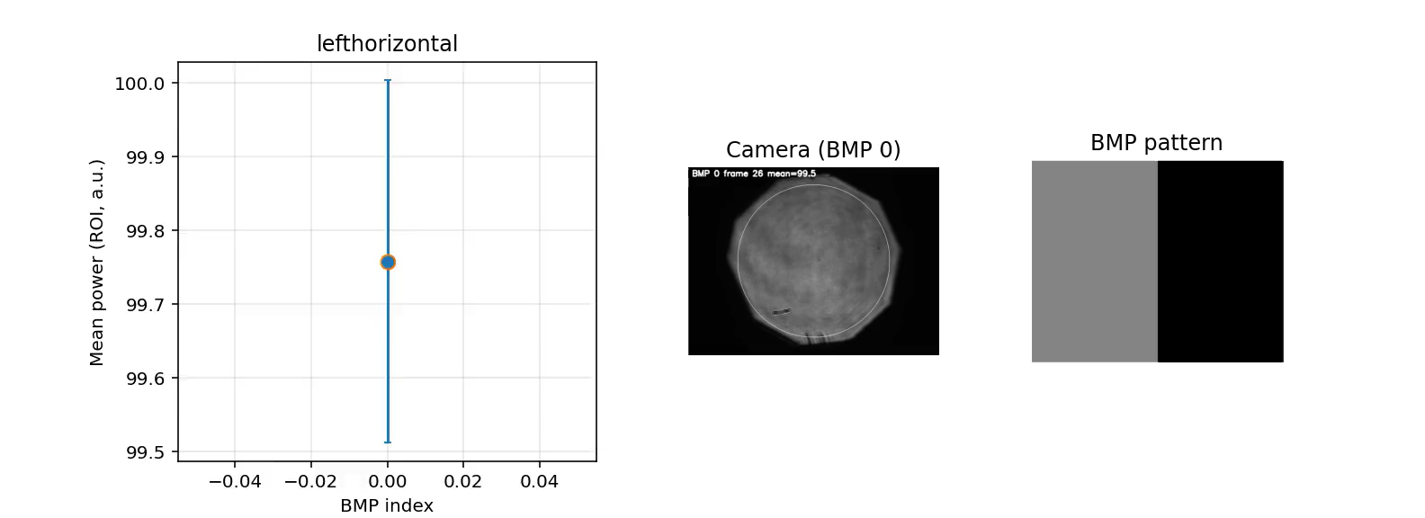
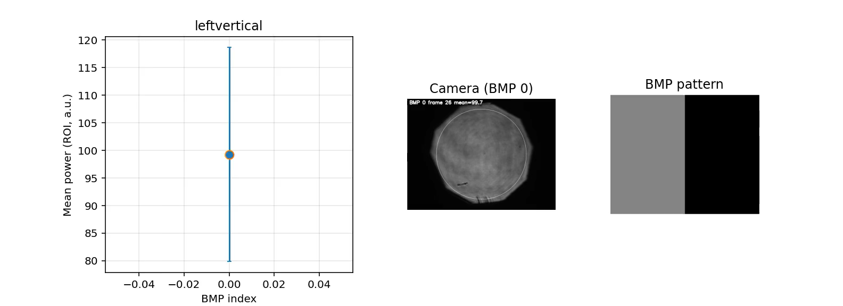
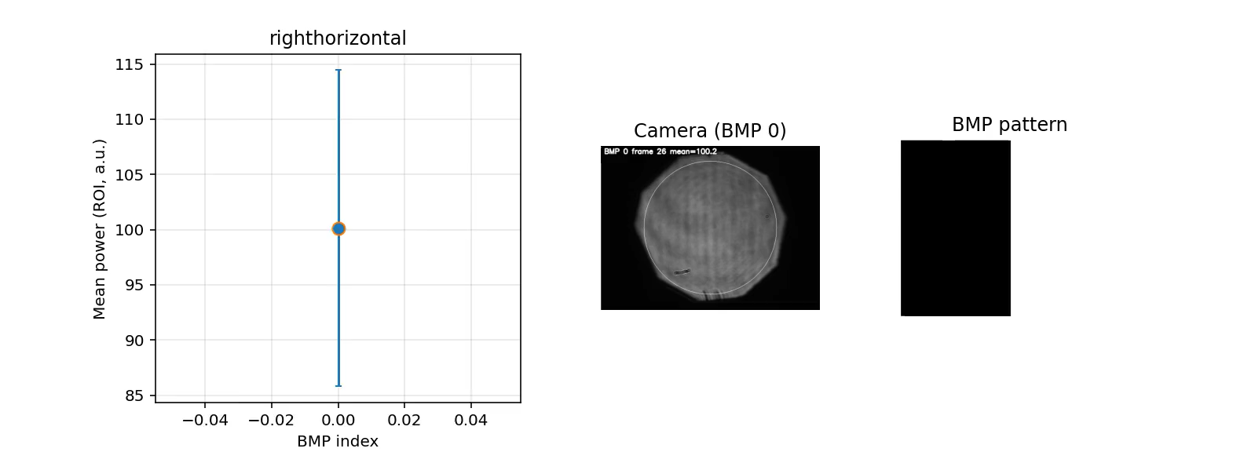
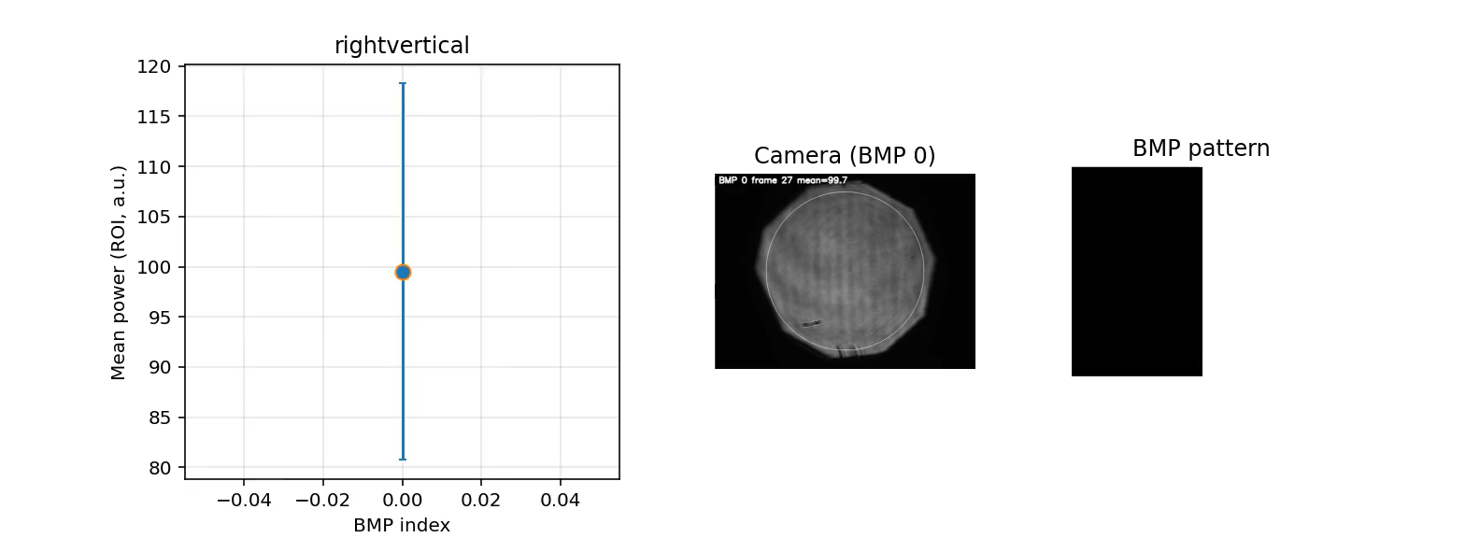
2D polarization control

Slide 14
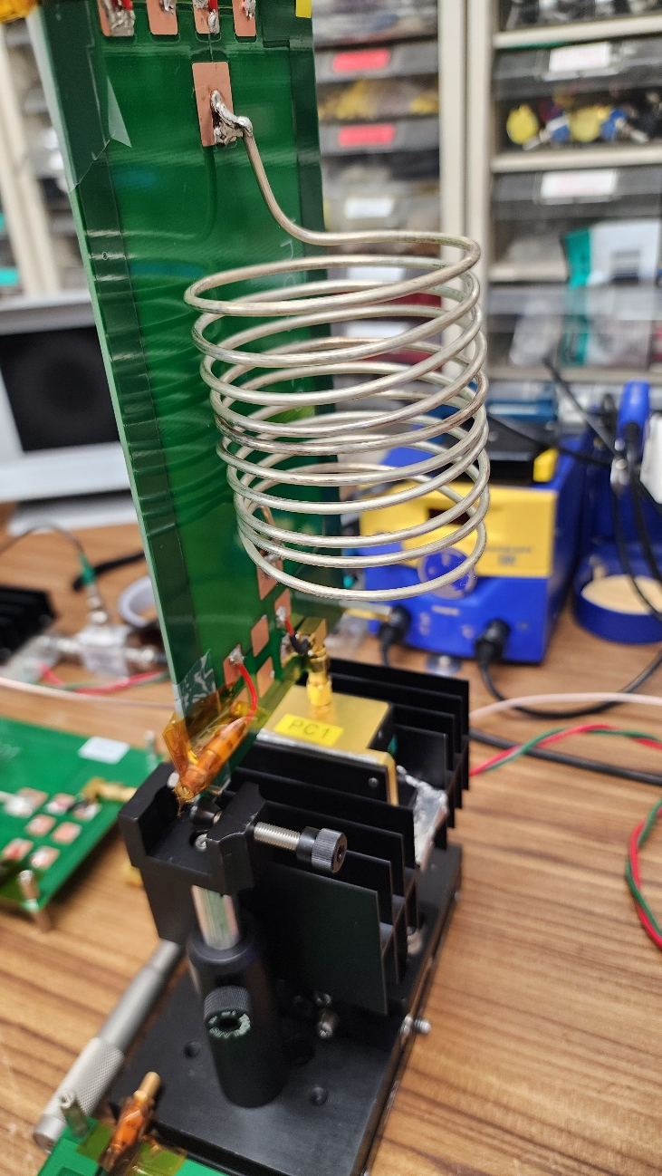
Fast polarization control
Liquid crystals are usually slow (~100 Hz)
Using crystals (eg Pockels cell) can go to MHz
Allows for higher statistics, probe time-dependent birefringence, and study impact on control sidebands

Slide 15
Birefringence compensation in KAGRA
Require stable CO2 laser power (typically 20% fluctuations out of the box)

Slide 16
Low loss variable retarder
Liquid crystal, electro-optic modulator, spatial light modulator etc… have too large optical losses and too low power tolerance to be installed inside KAGRA (at least for the main laser beam)
We are now developing low-loss non-uniform polarization control
CO2 laser

Slide 17
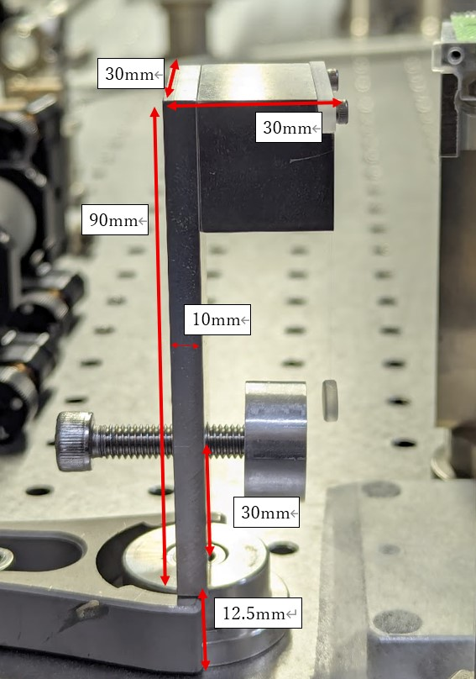
CO2 laser power stabilization

Slide 18
Conclusion
Birefringence of crystalline test-masses can limit GW detectors sensitivity
We are now tackling birefringence issues from several angles
  New birefringence measurement technique
  Static birefringence compensation
  Dynamic birefringence compensation
We aim for low-loss compensation of non-uniform birefringence in KAGRA

