Slide 1
Towards a geological model for ET-EMR
Geert-Jan Vis & Hannes Claes | On behalf of the international ET-EMR geology team
14 April 2026 | SCB Meeting | Rome

Slide 2
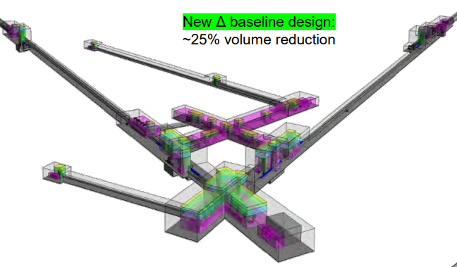
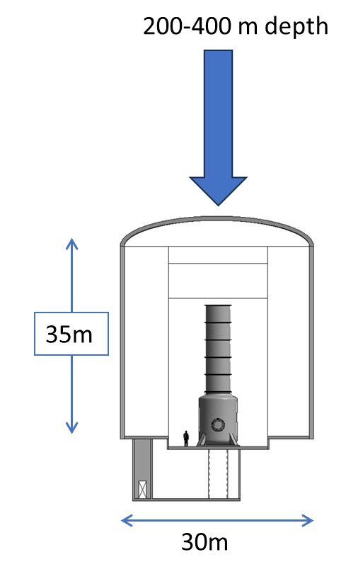
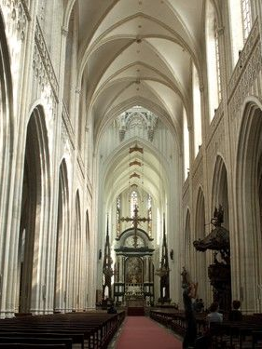
Feasibility study ET-EMR
A subsurface research infrastructure consisting of tunnels of 10 x 10 x 10 kilometres with caverns at the vertices with the size of the Notre-Dame de Paris.

Slide 3
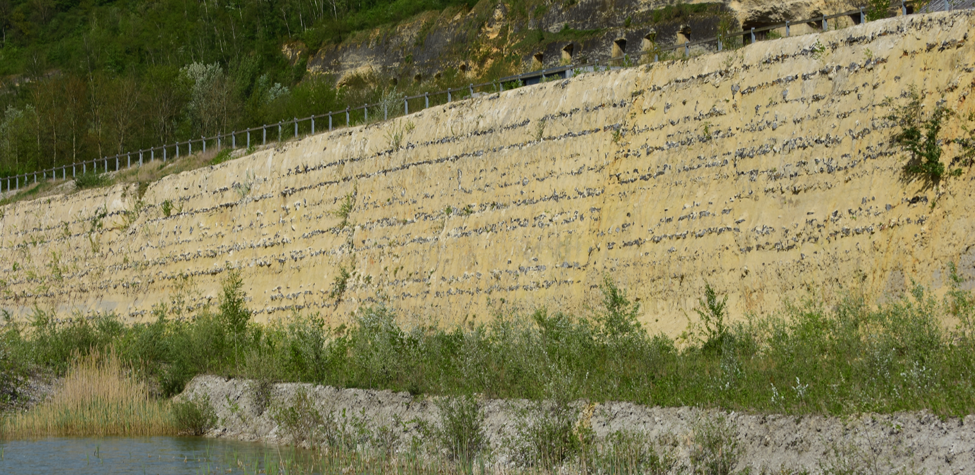
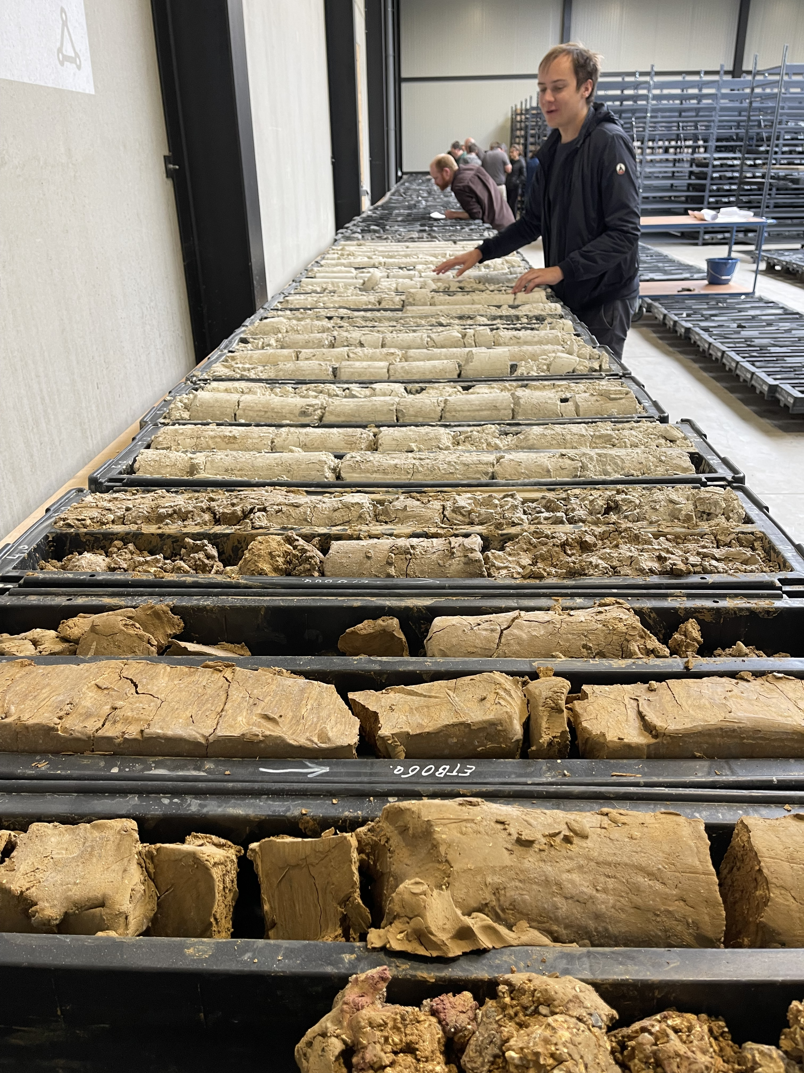
Cretaceous top layer: soft chalk, sand- & claystone

Slide 4
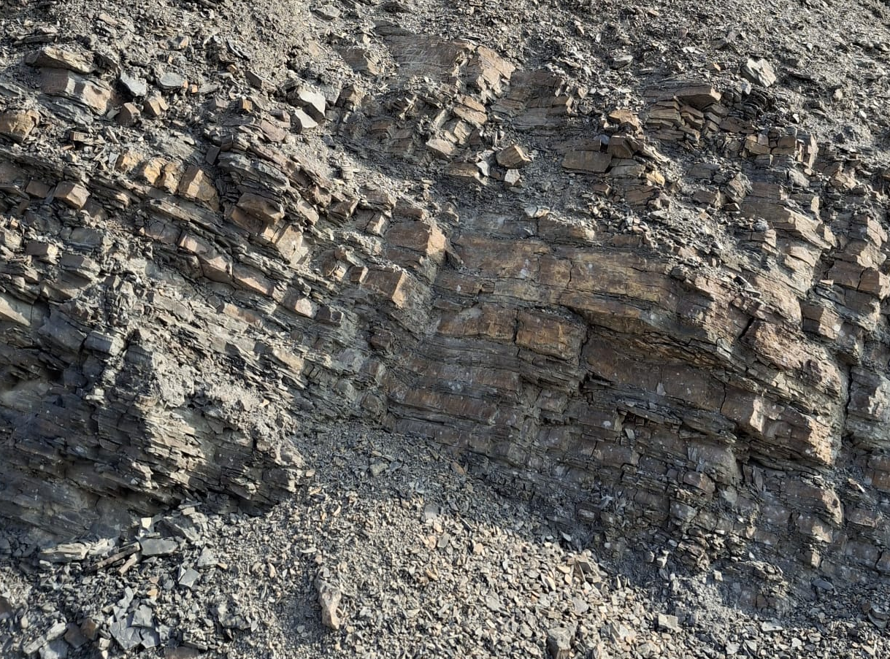
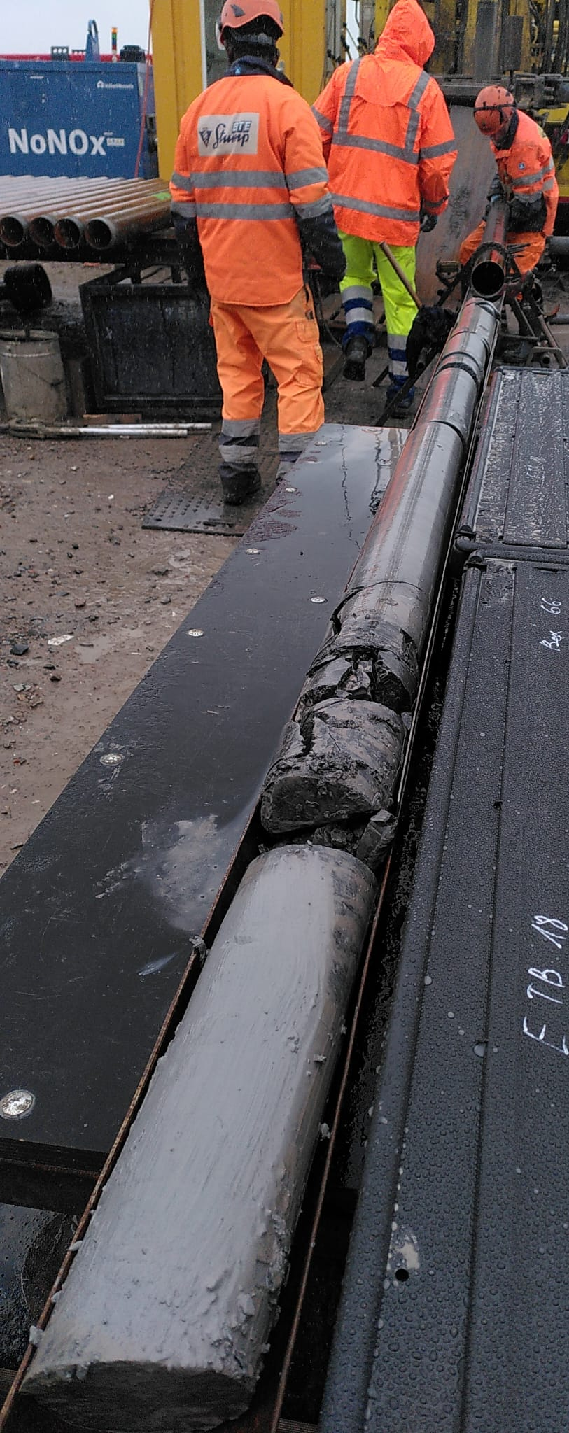
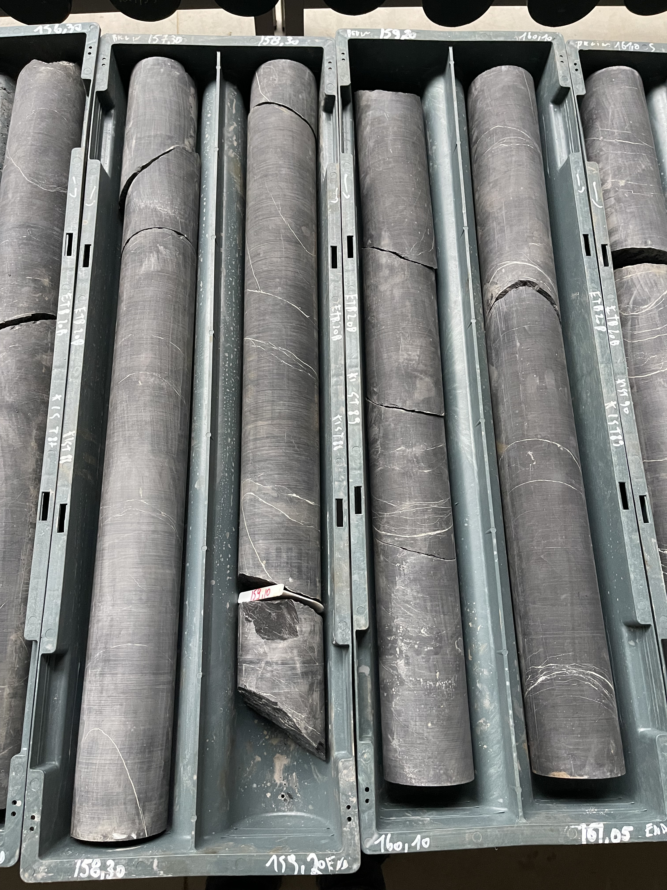
Upper Carboniferous: Namurian shale-dominated

Slide 5
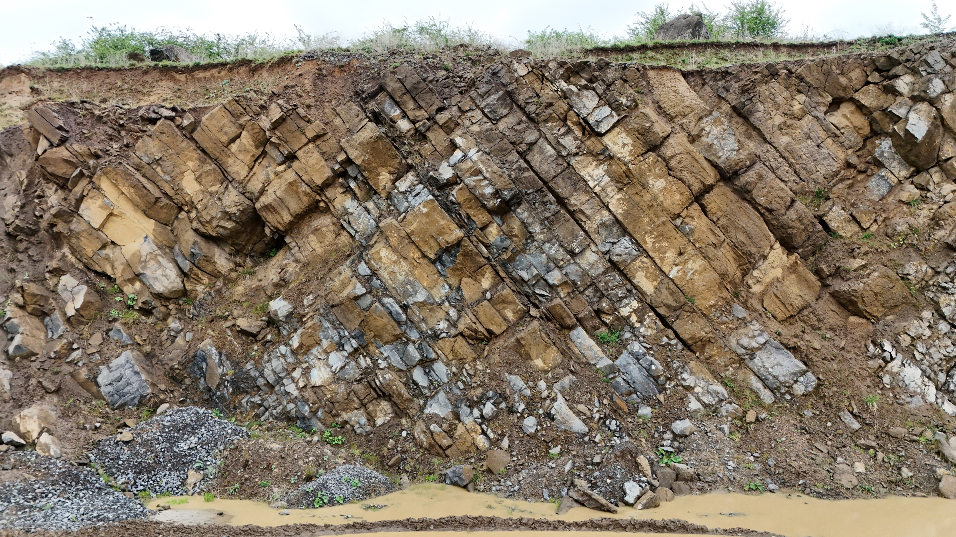
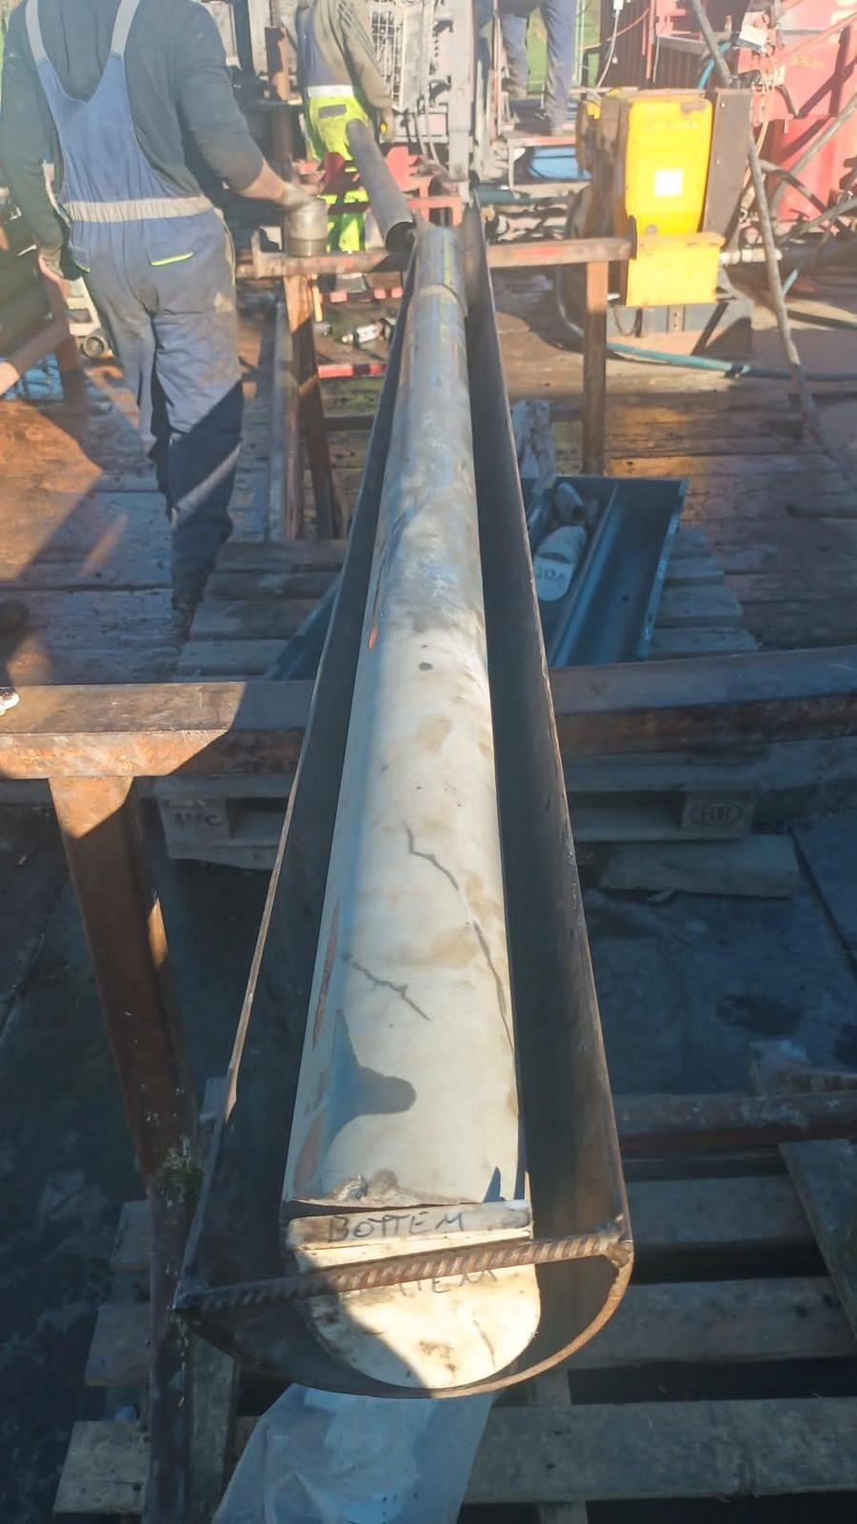
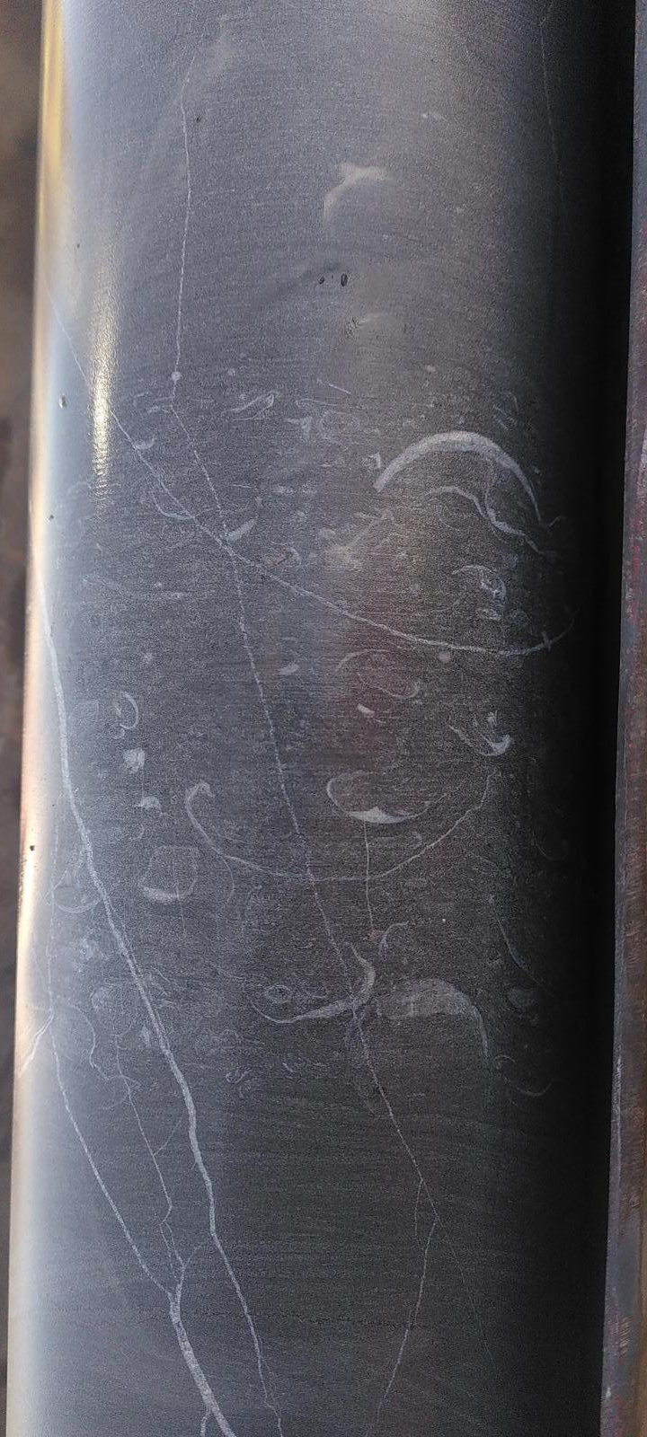
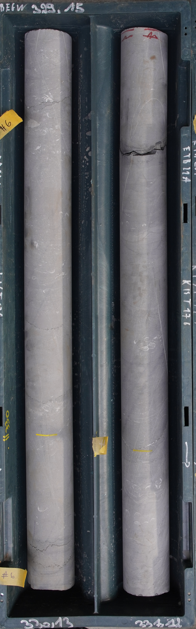
Lower Carboniferous: Dinantian carbonates

Slide 6
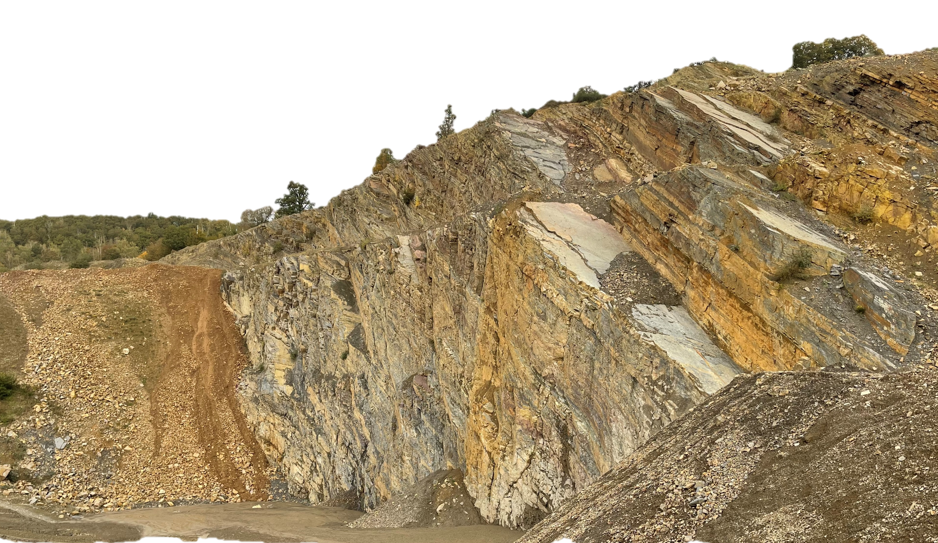
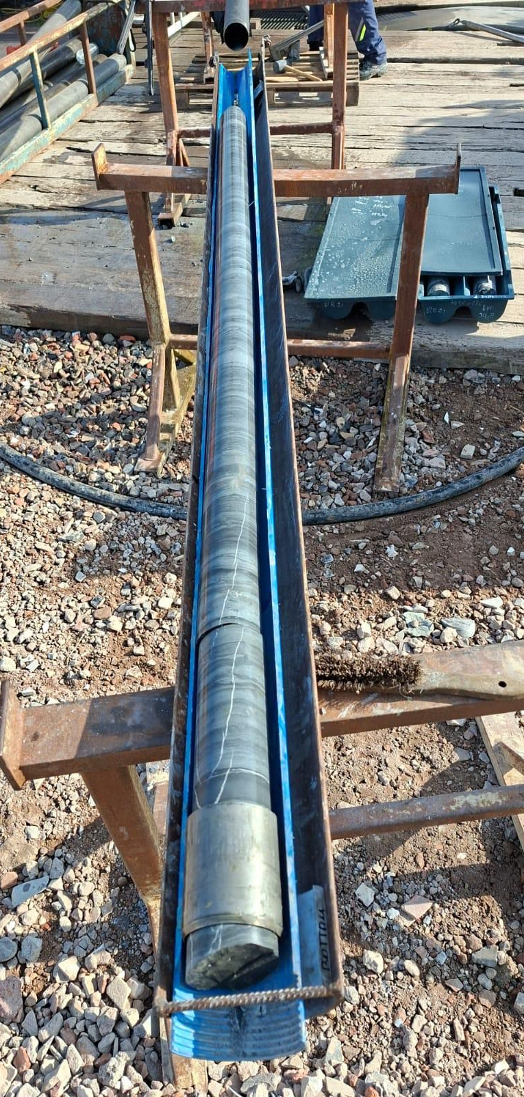
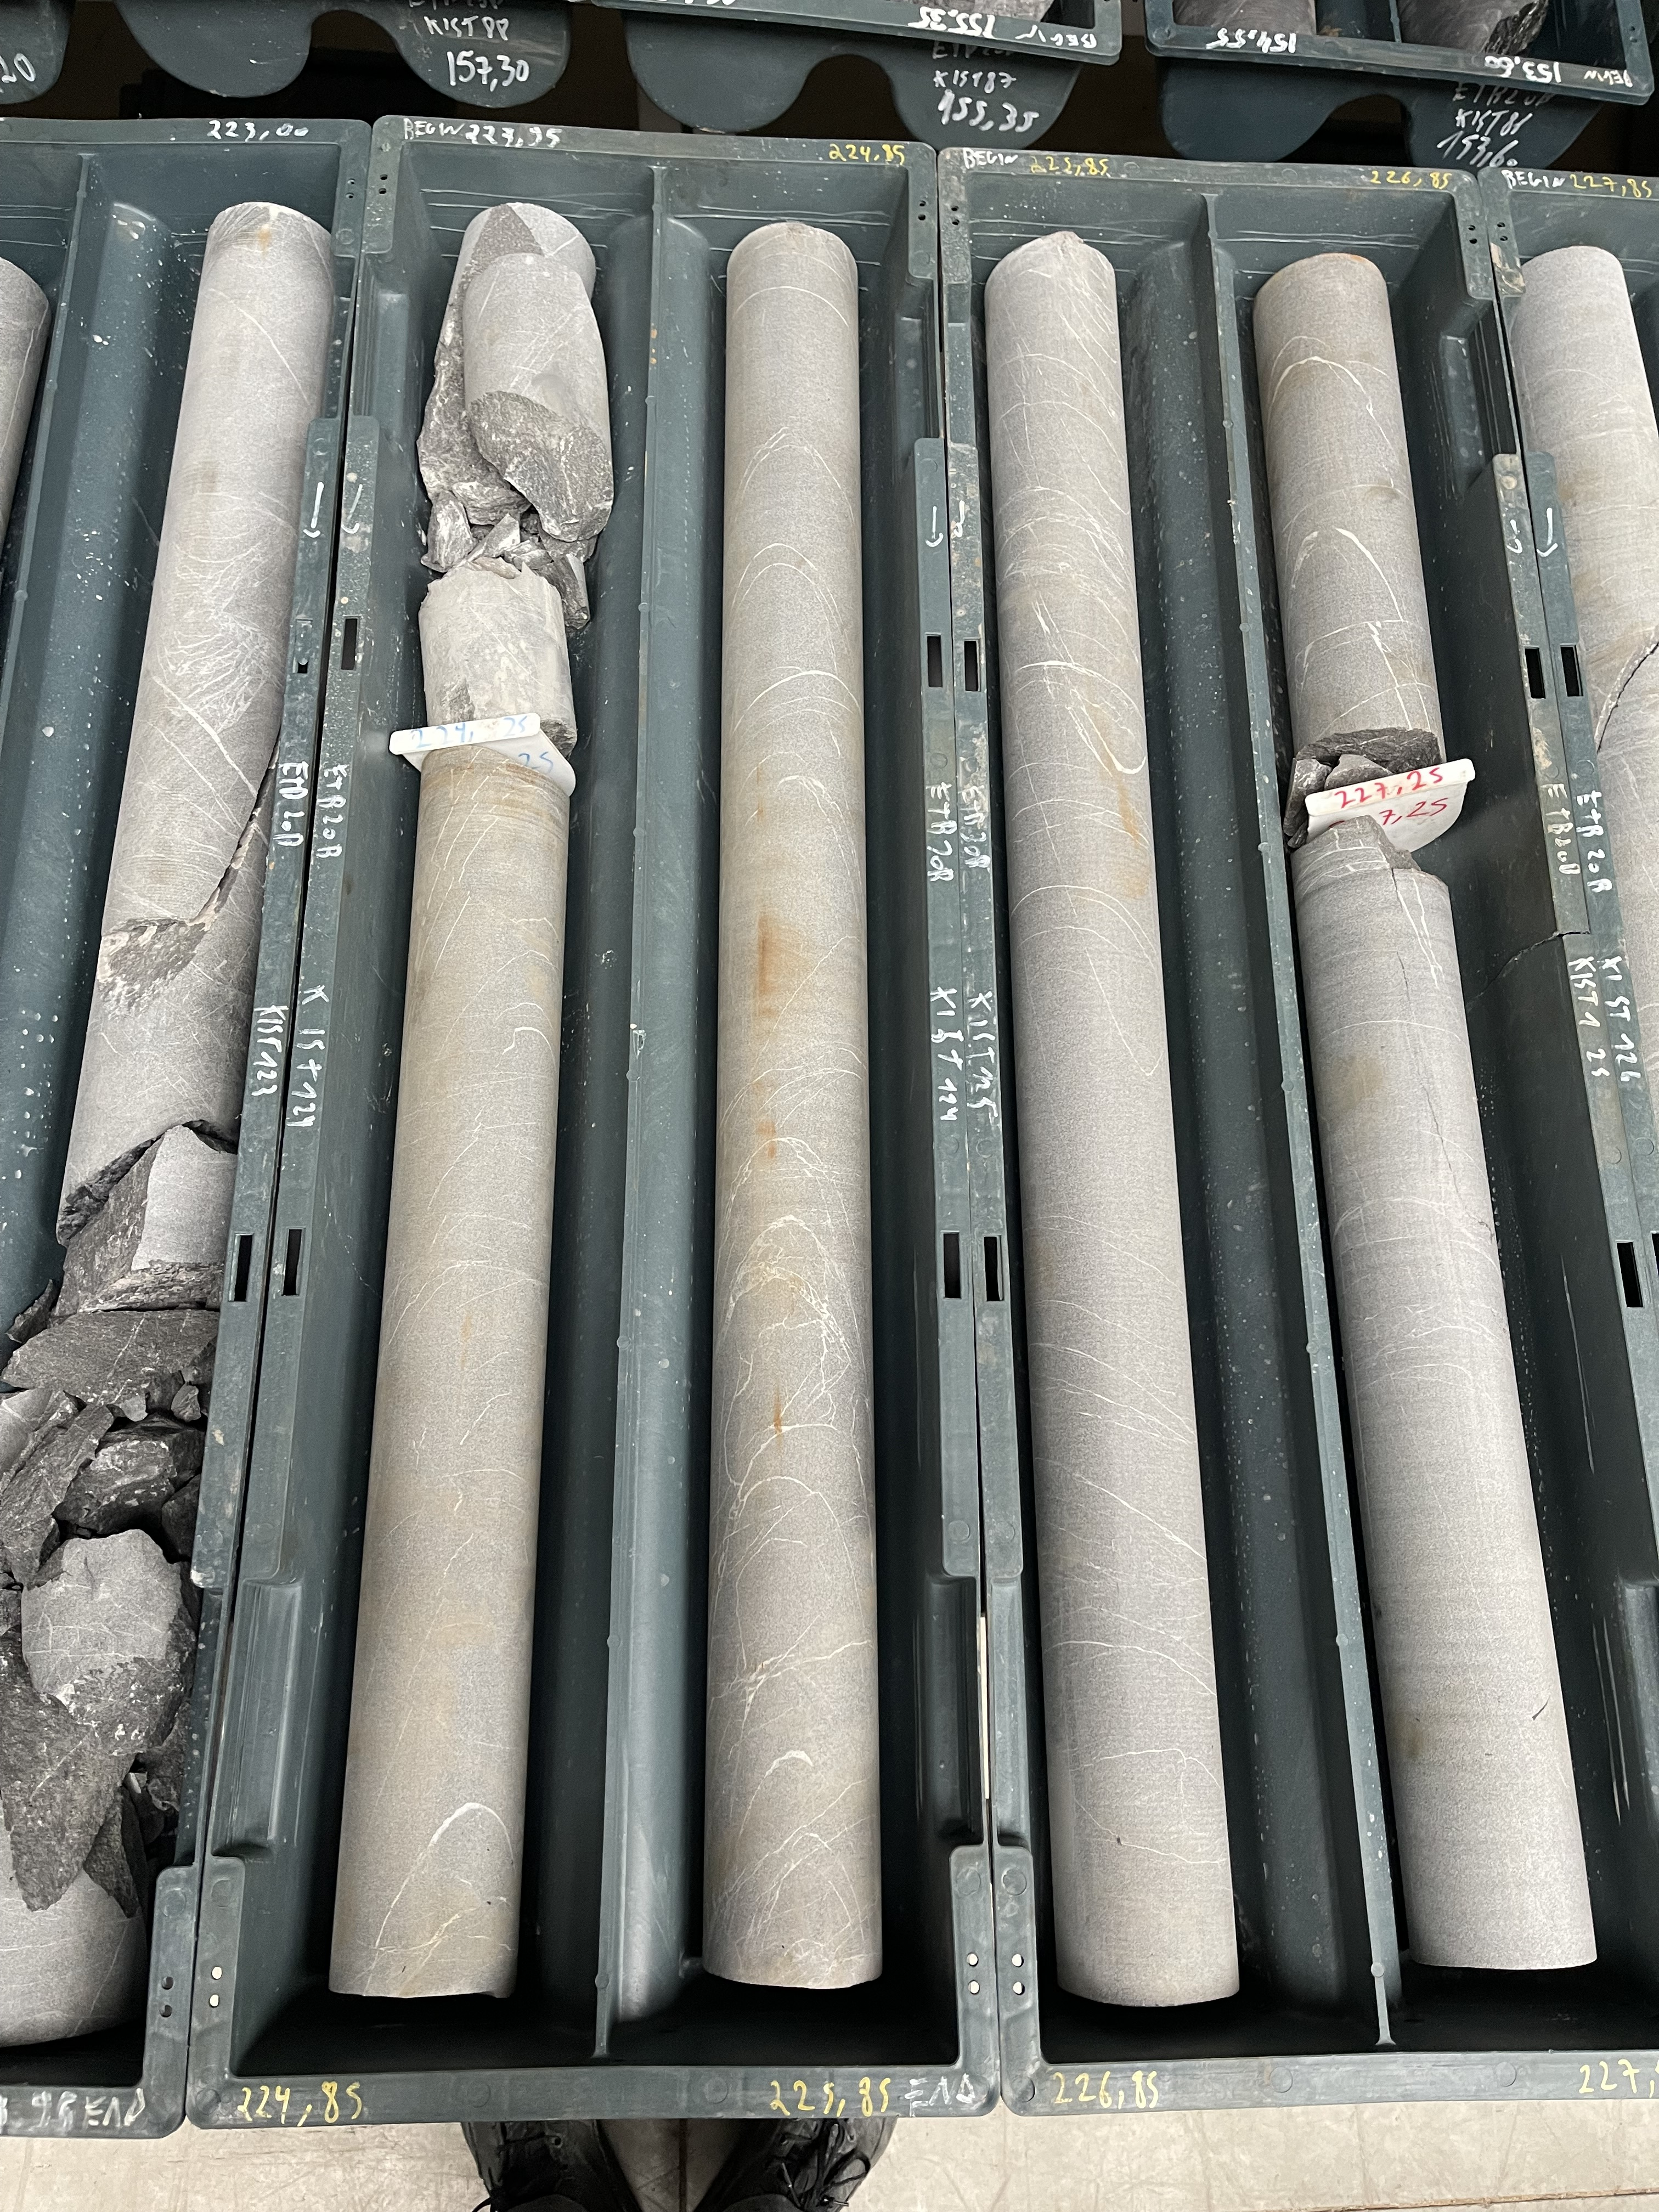
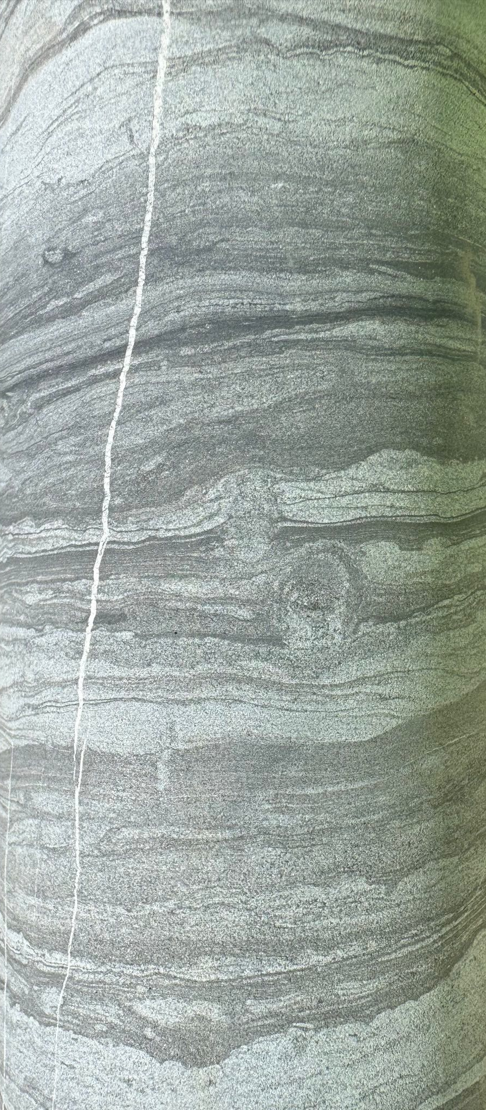
Upper Devonian: Famennian silt- and sandstones

Slide 7
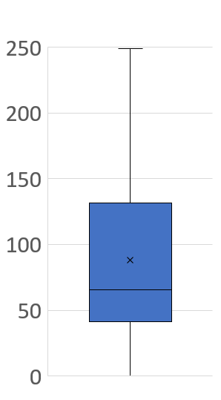
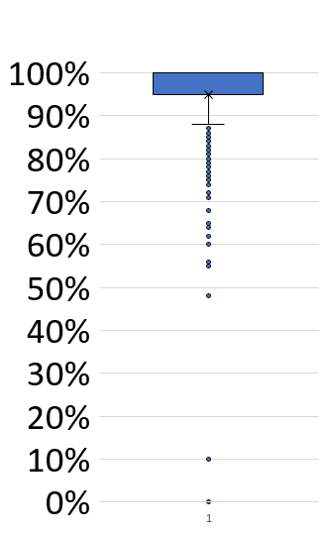
Latest preliminary results…
Beusdael RQD
Beusdael UCS (MN/m²)
90-100 Excellent
75-90 Good
100-250 Very Strong
50-75 Fair
25-50 Poor
50-100 Strong
0-25 Very poor
25-50 Moderately strong
<25 Weak

Slide 8
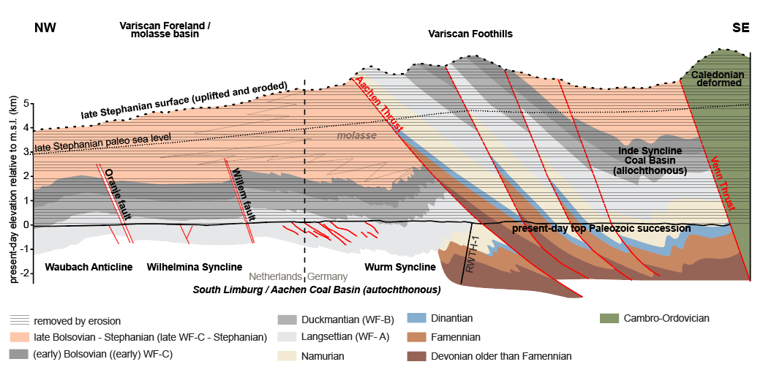
Geology of the Netherlands (2025) DOI: 10.5117/9789463728362_ch03

Slide 9
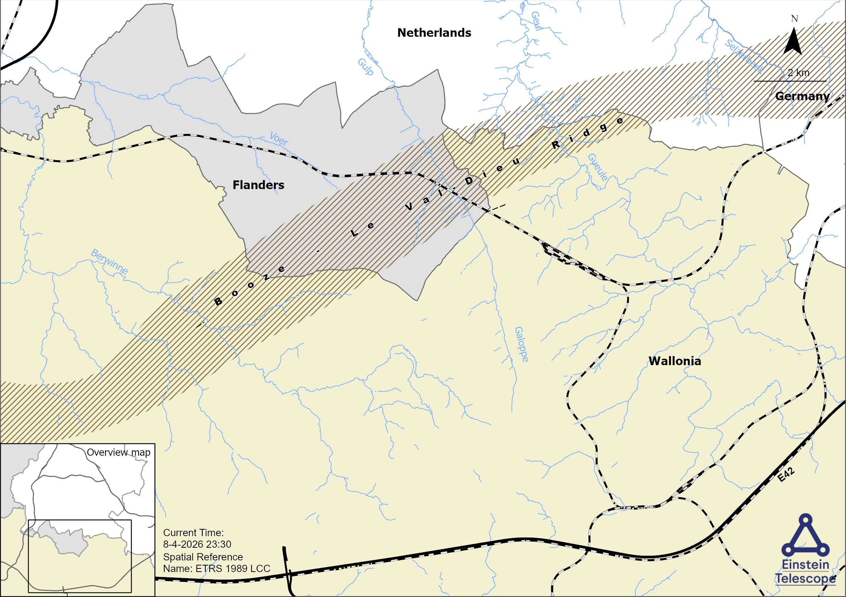

Slide 10
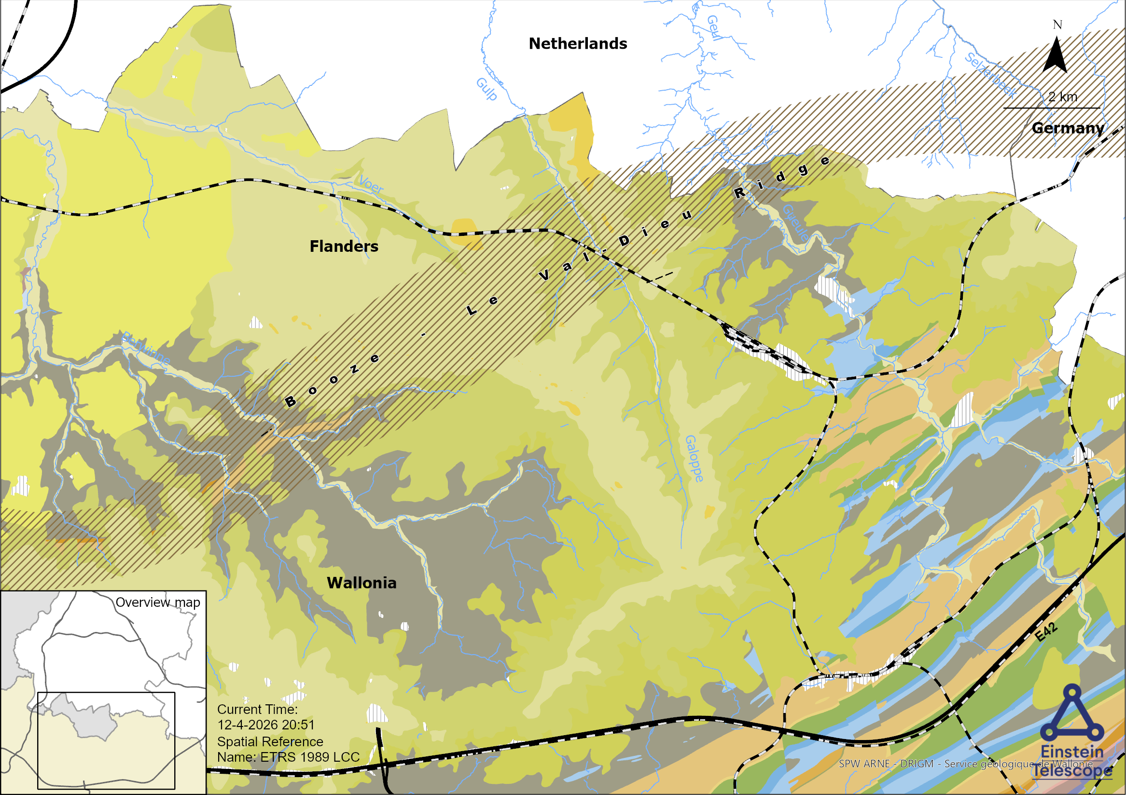
Variscan deformation

Slide 11
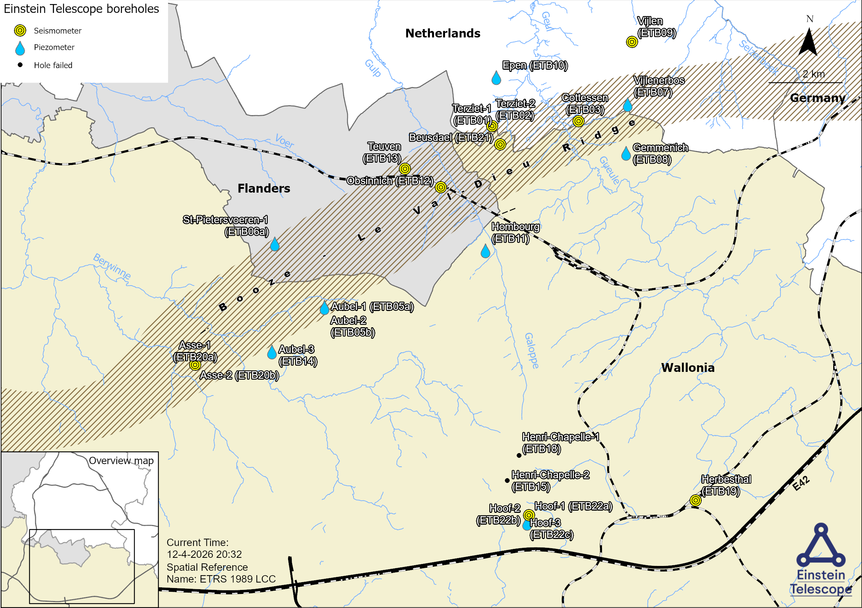
24 ET boreholes | 5000 m core

Slide 12
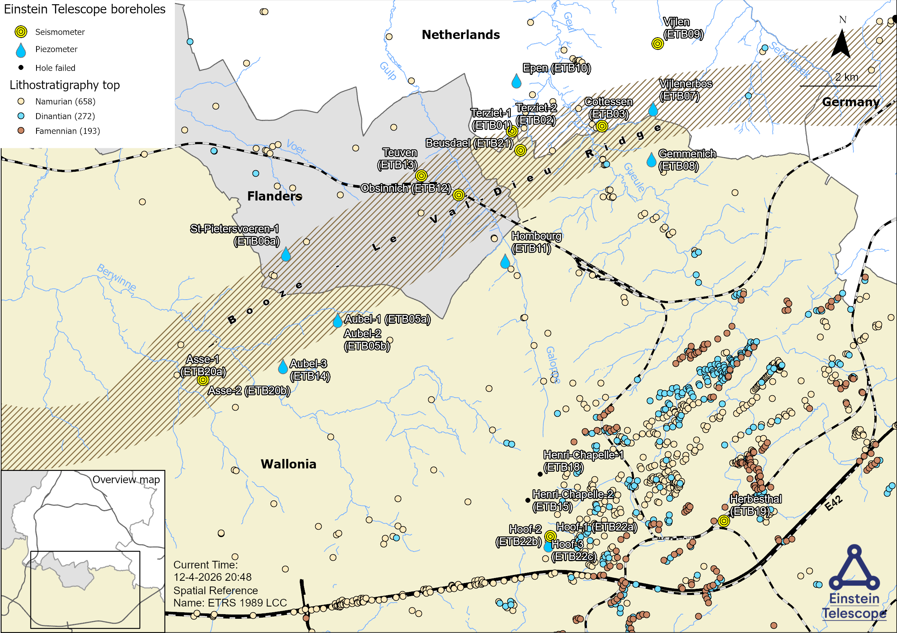
1123 legacy boreholes

Slide 13
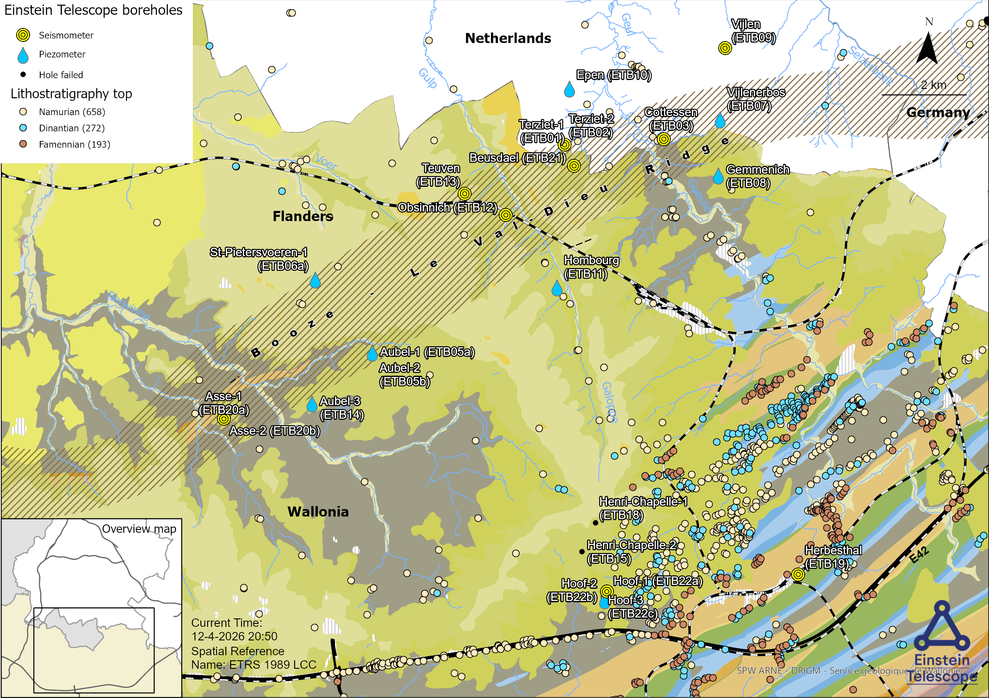

Slide 14
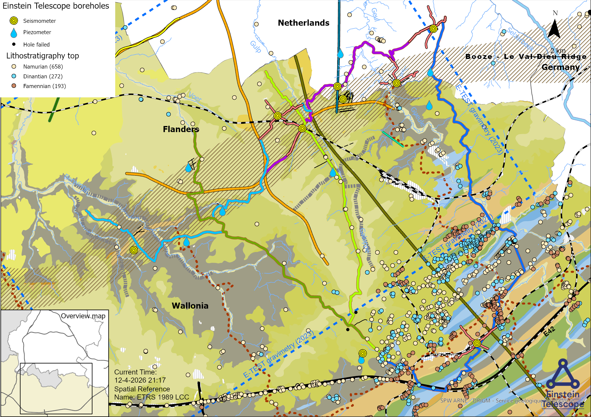
20 km ERT lines | 24 km deep ERT lines
112 km ET-EMR 2D seismic lines + legacy seismic data

Slide 15
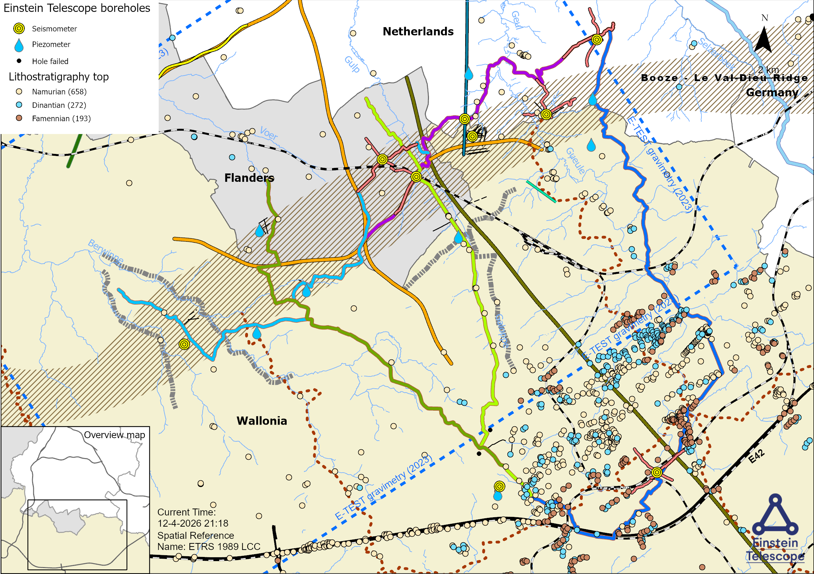
20 km ERT lines | 24 km deep ERT lines
112 km ET-EMR 2D seismic lines + legacy seismic data

Slide 16

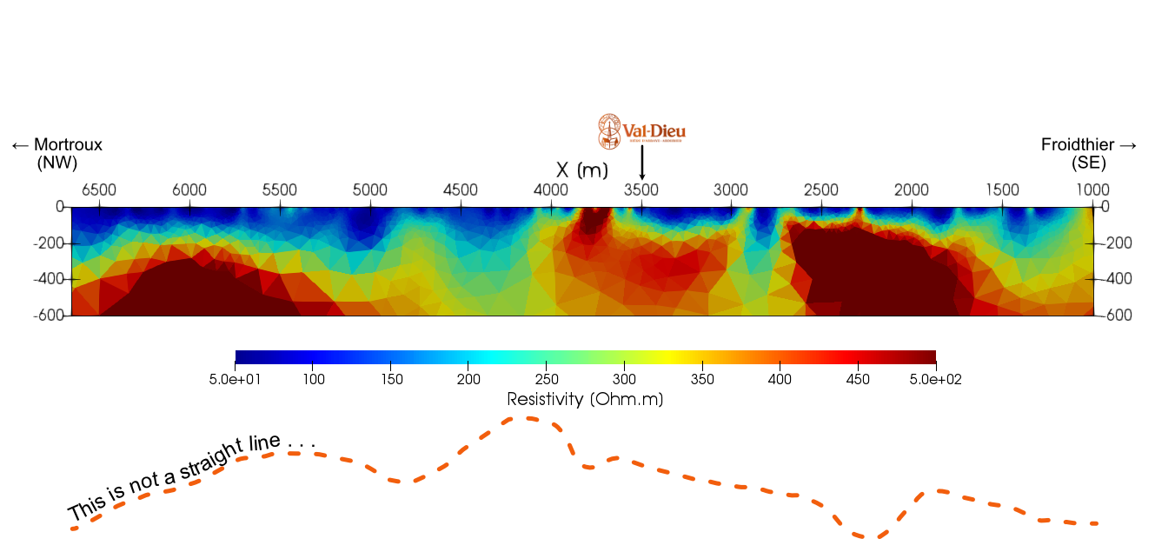
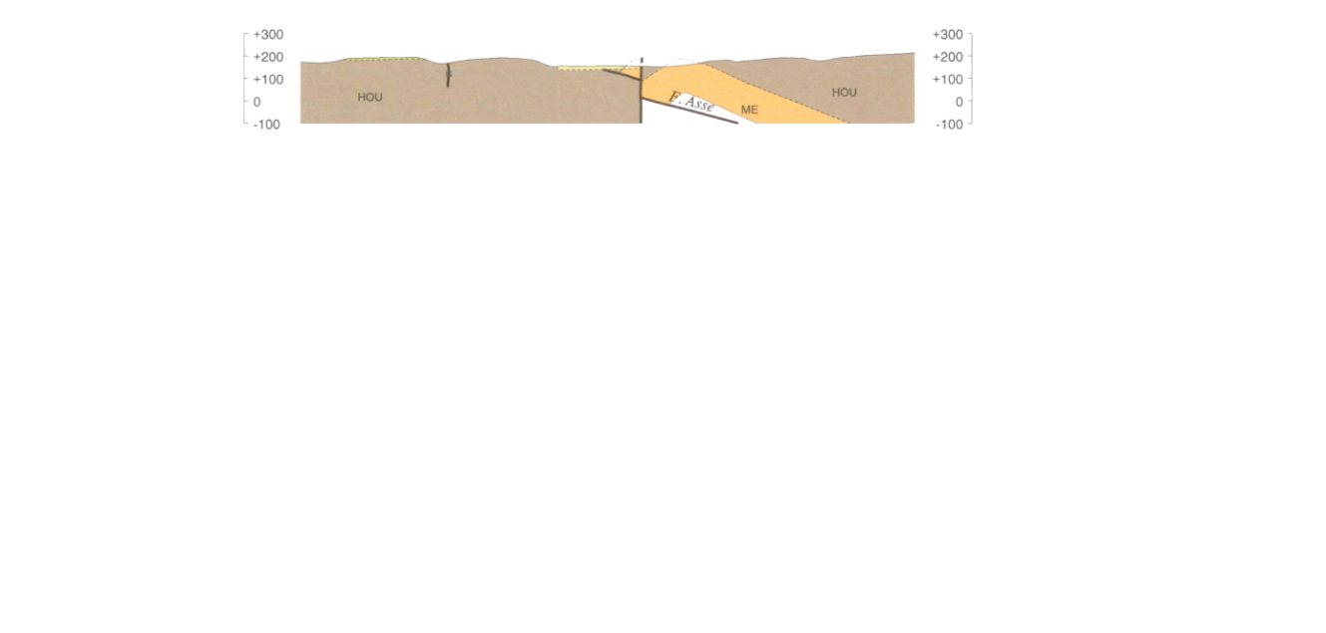
Electrical resistivity tomography (Deep ERT)
Source: Interreg E-TEST project
Results to take with caution! Inversion not fully tuned for convergence RRMS > 100 %

Slide 17
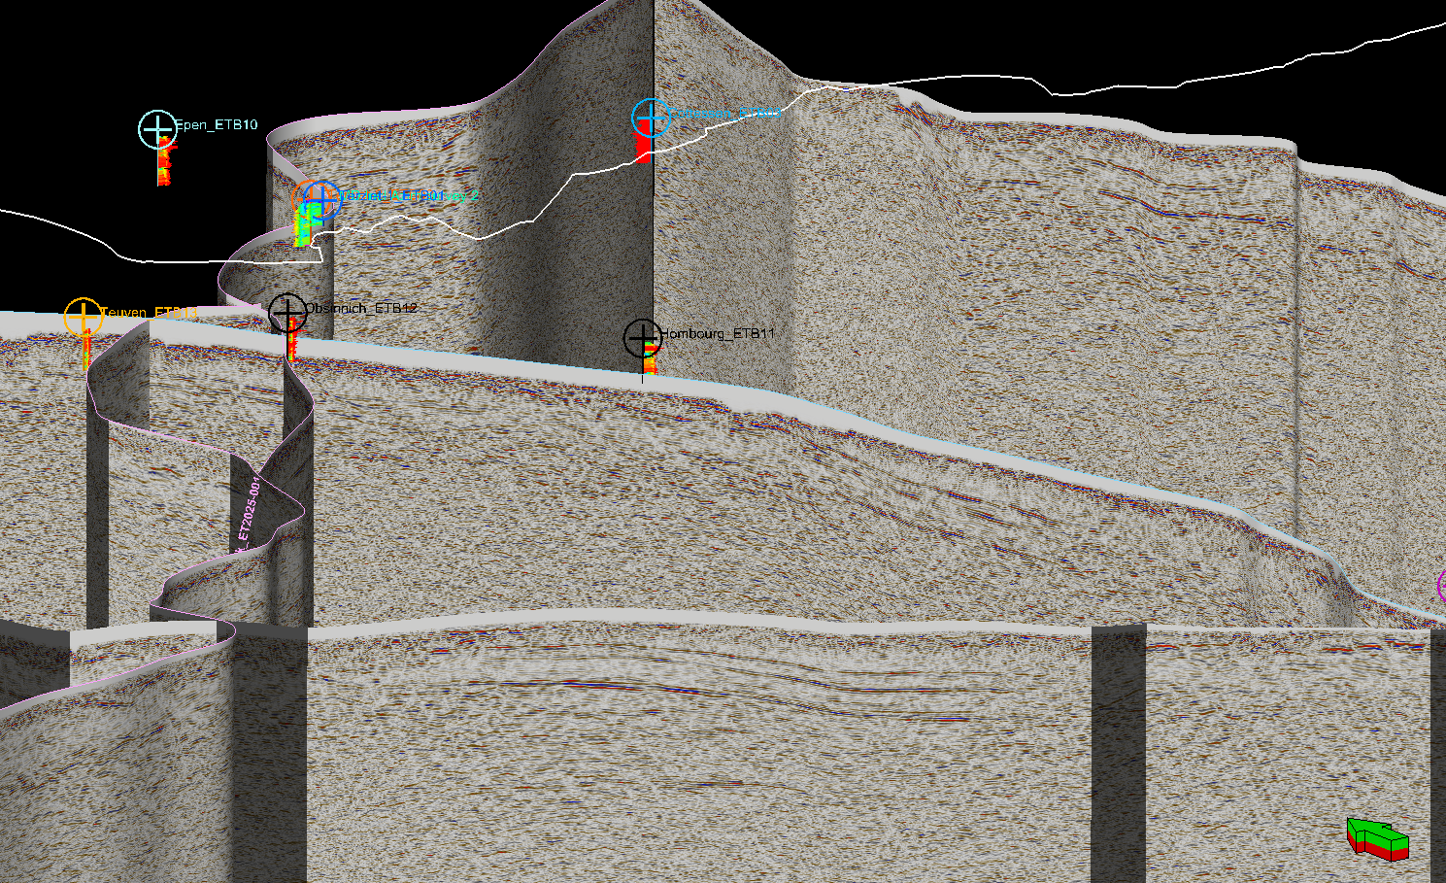
2D seismic lines ET-EMR

Slide 18
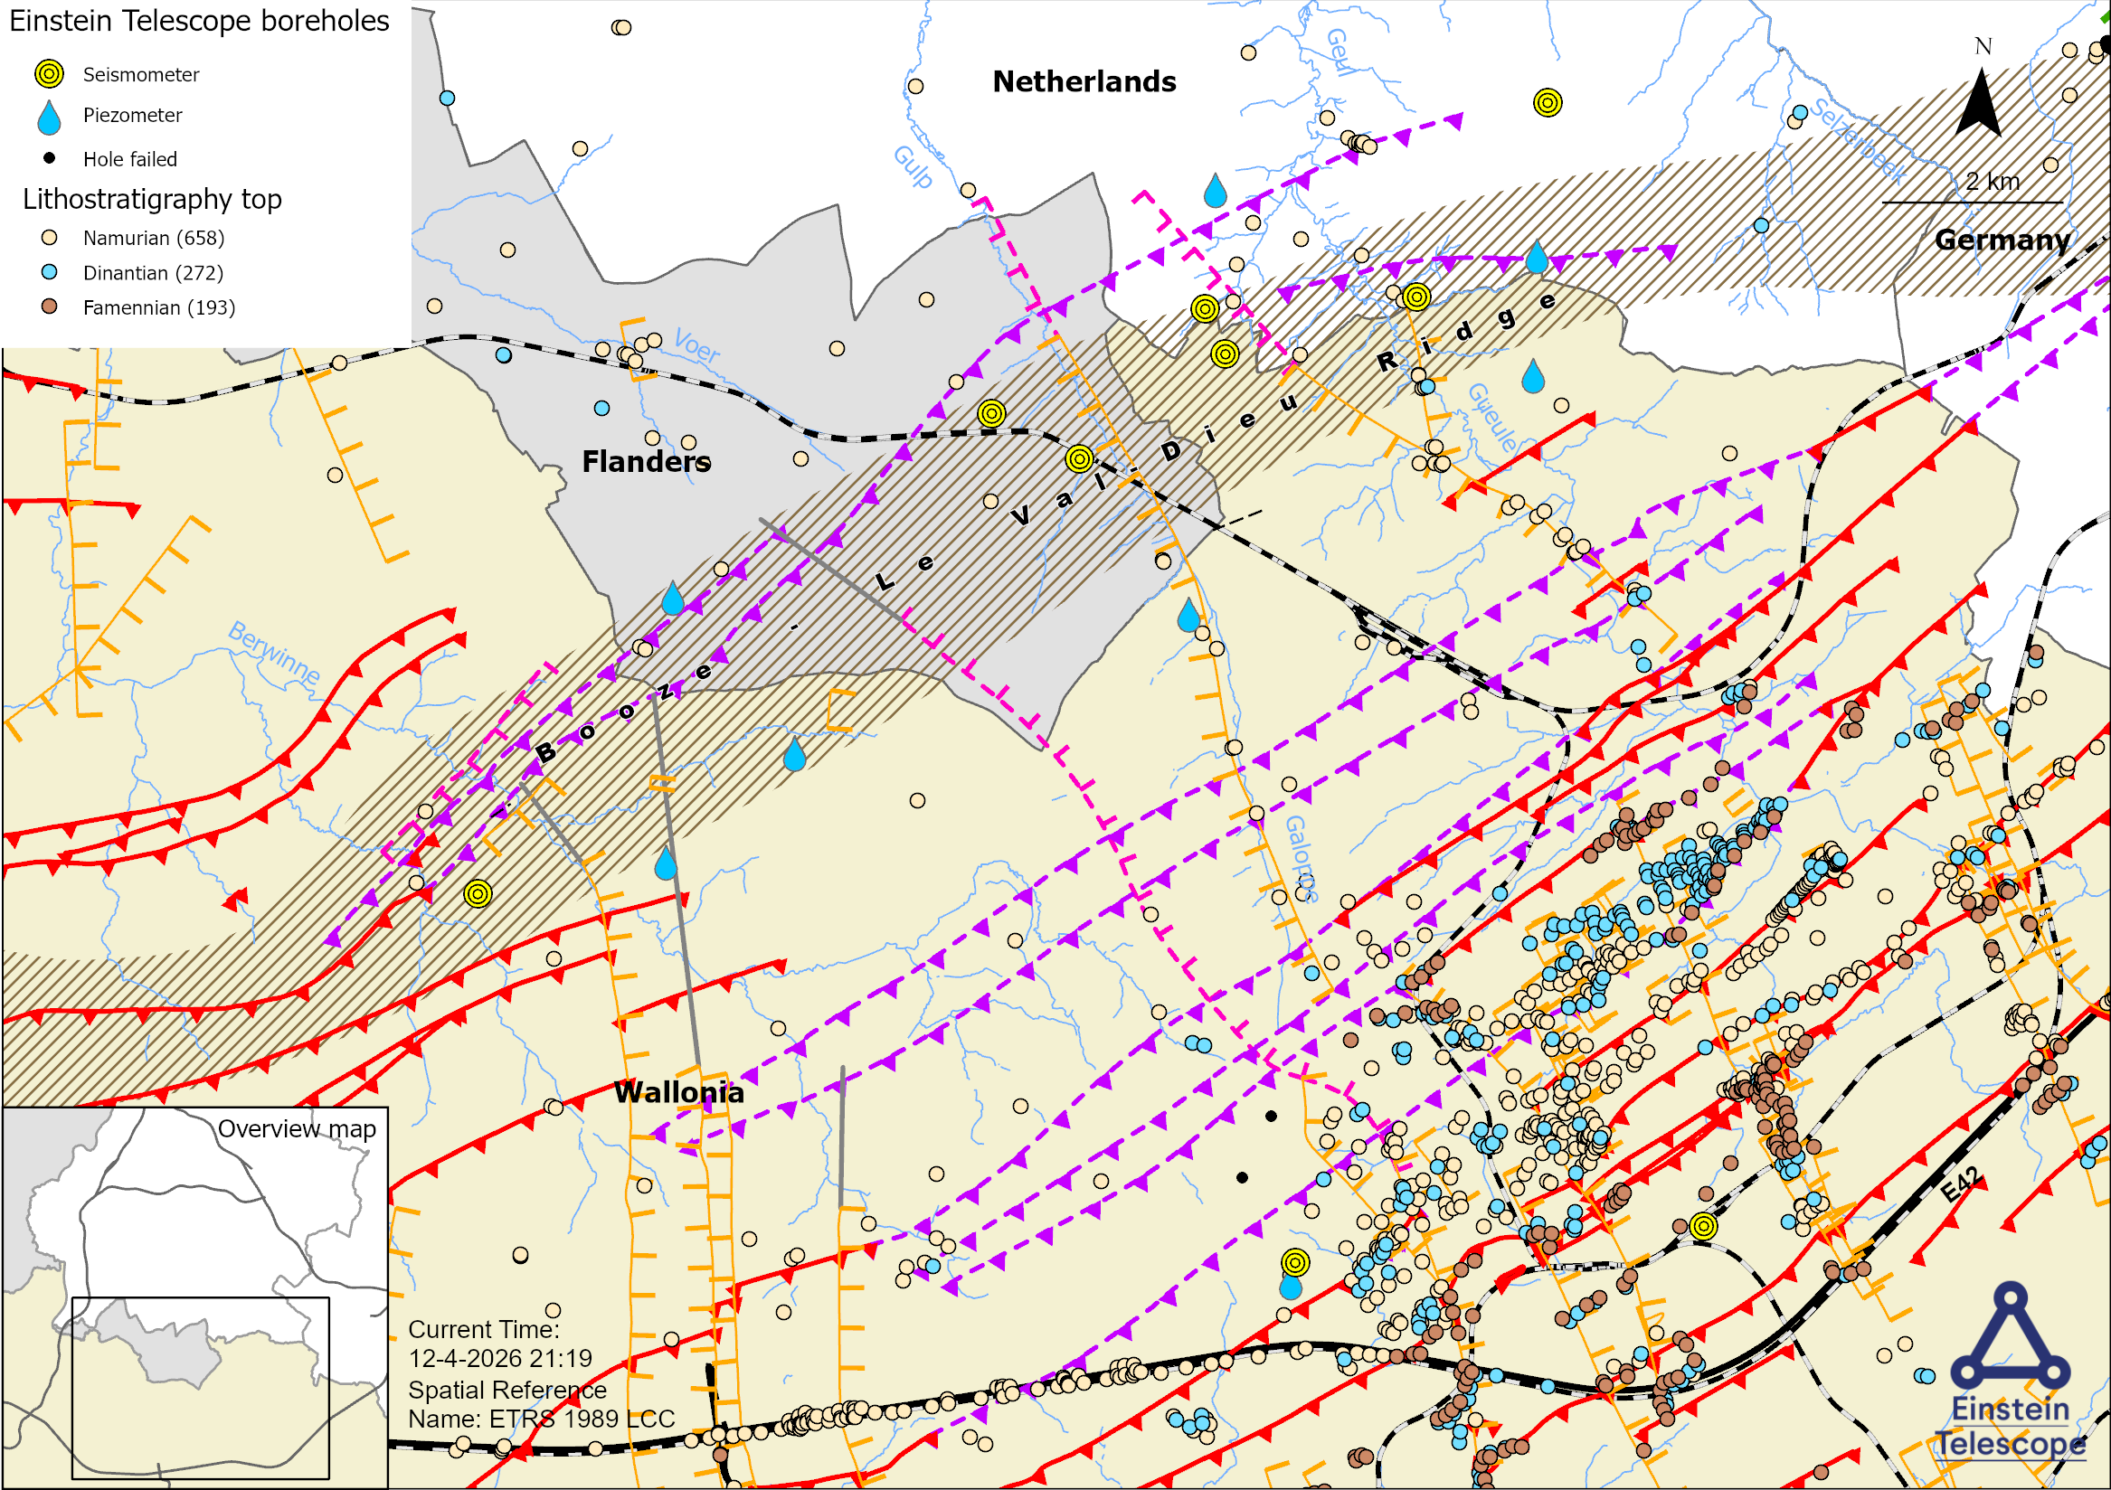

Slide 19
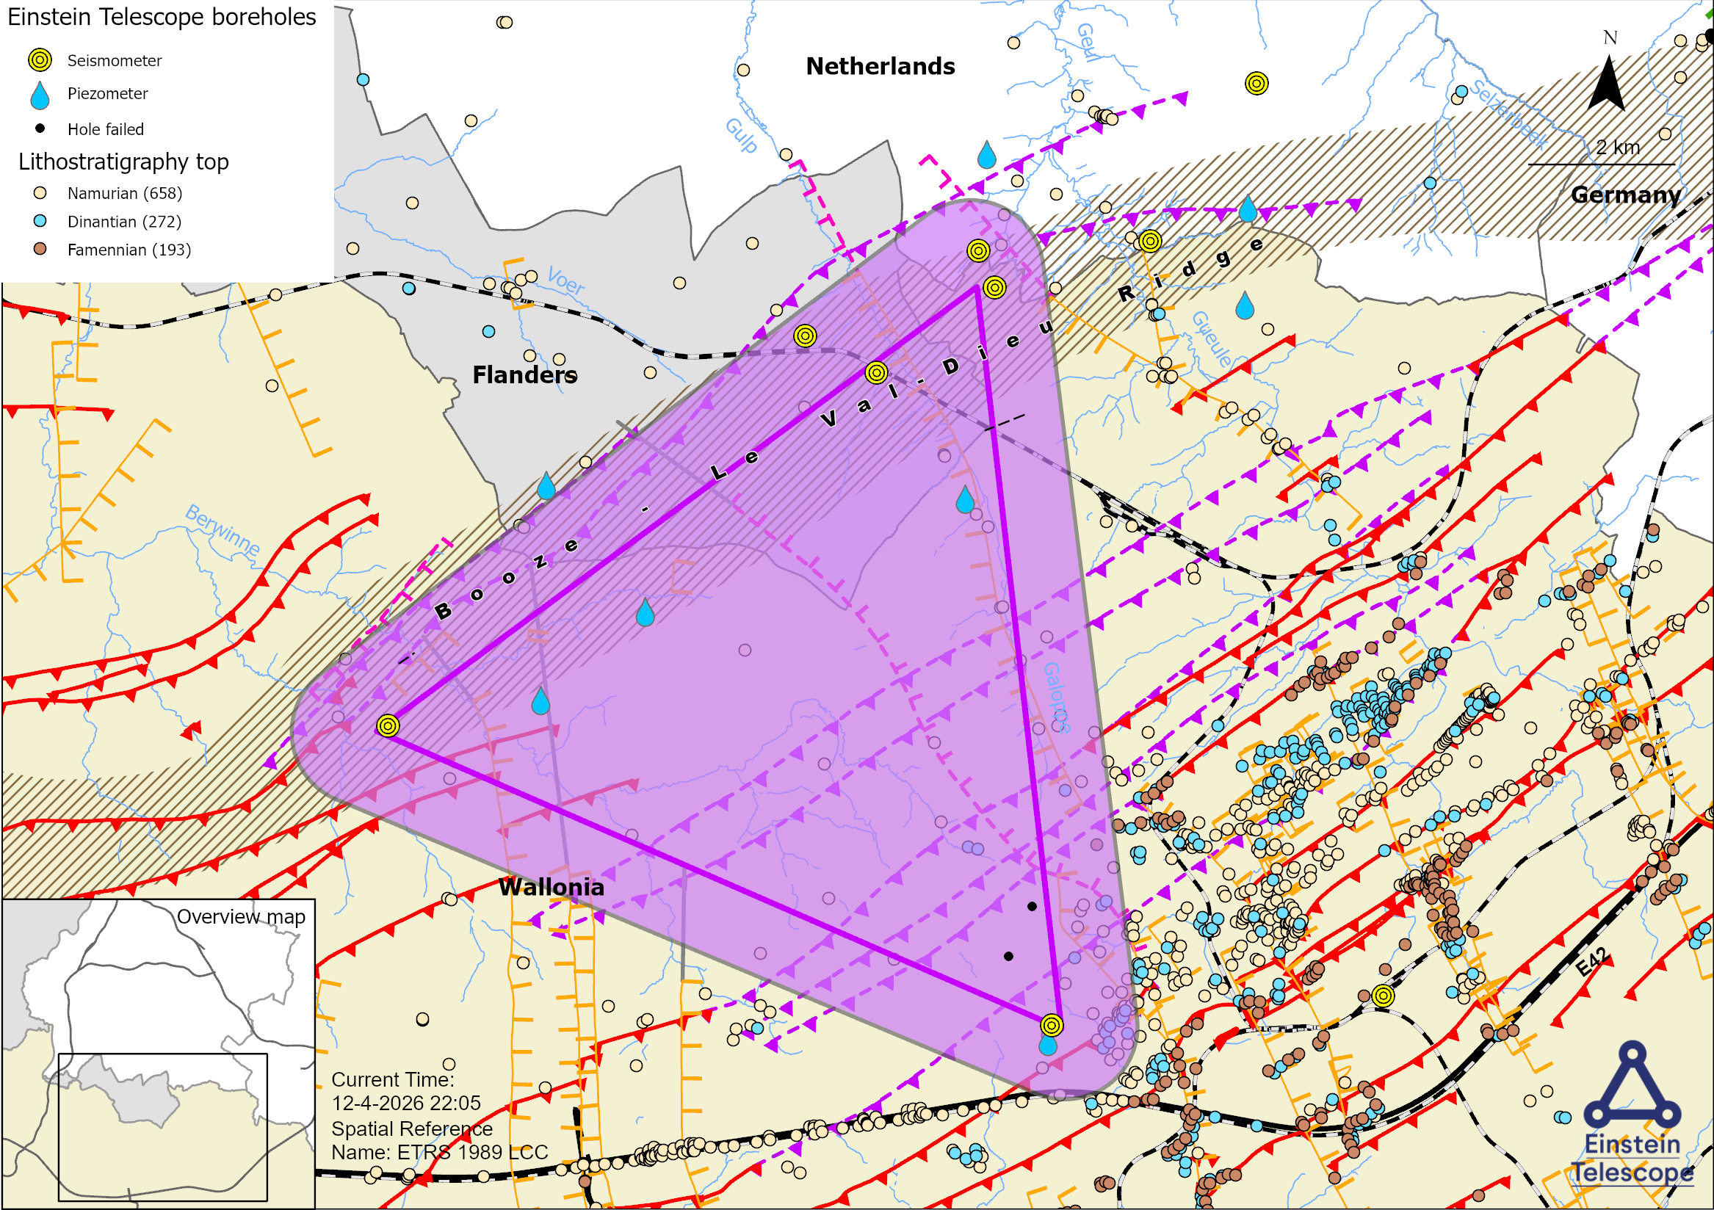

Slide 20
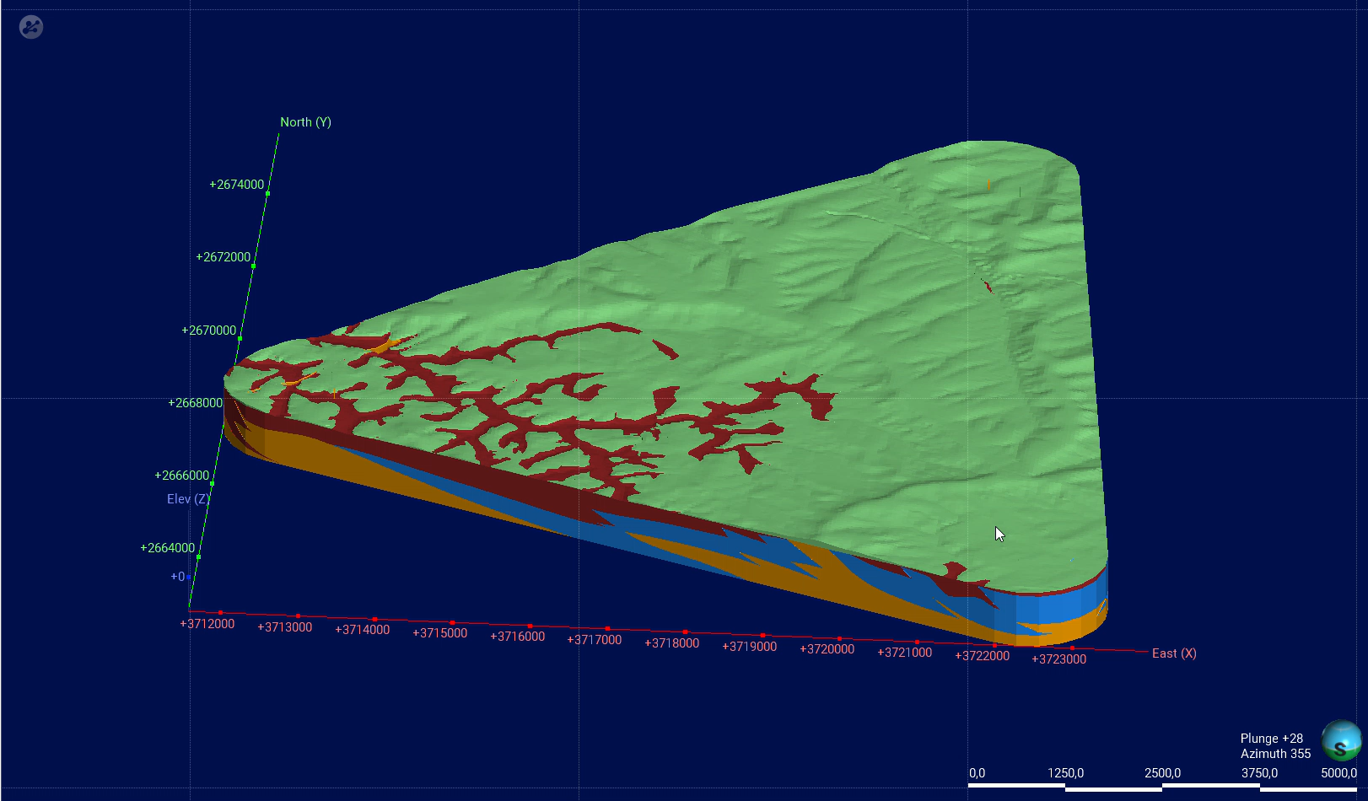
Leapfrog model

Slide 21
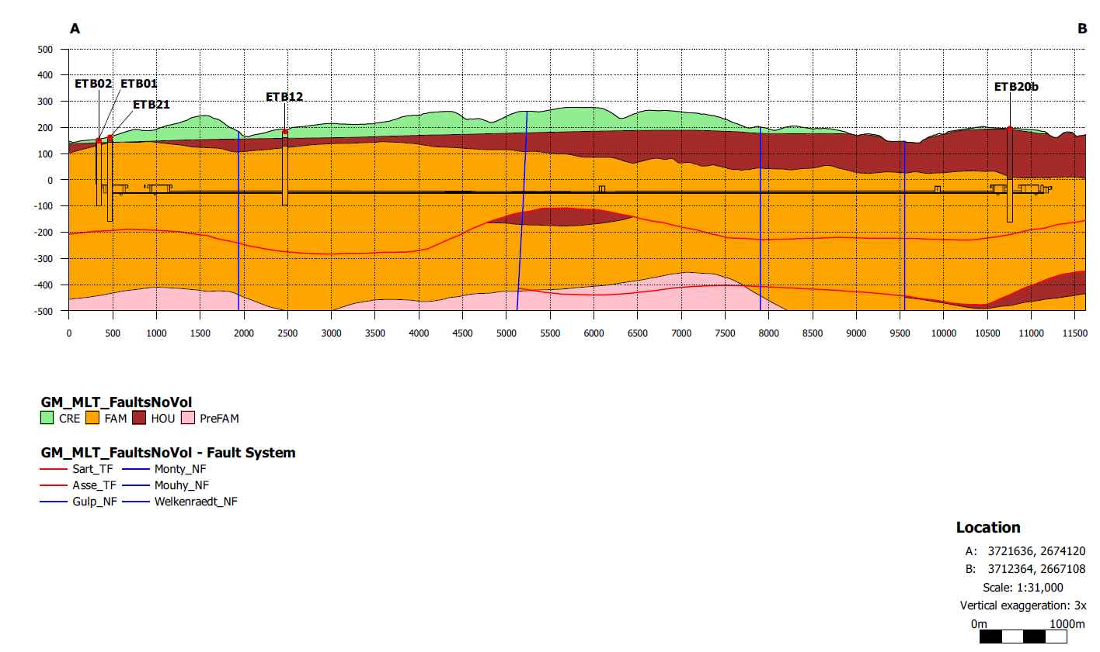
NE
Tunnel 1 (viewed from the northwest)
SW
1
3
2

Slide 22
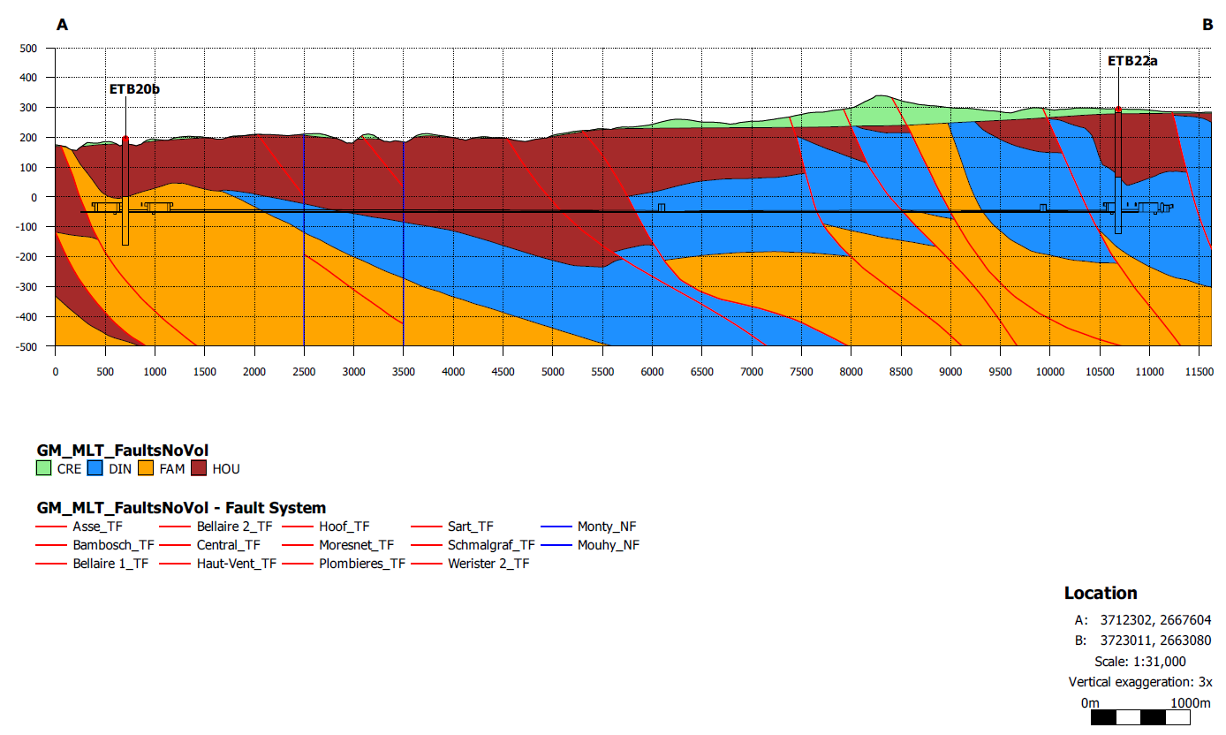
NW
Tunnel 2 (viewed from the southwest)
SE
1
3
2

Slide 23
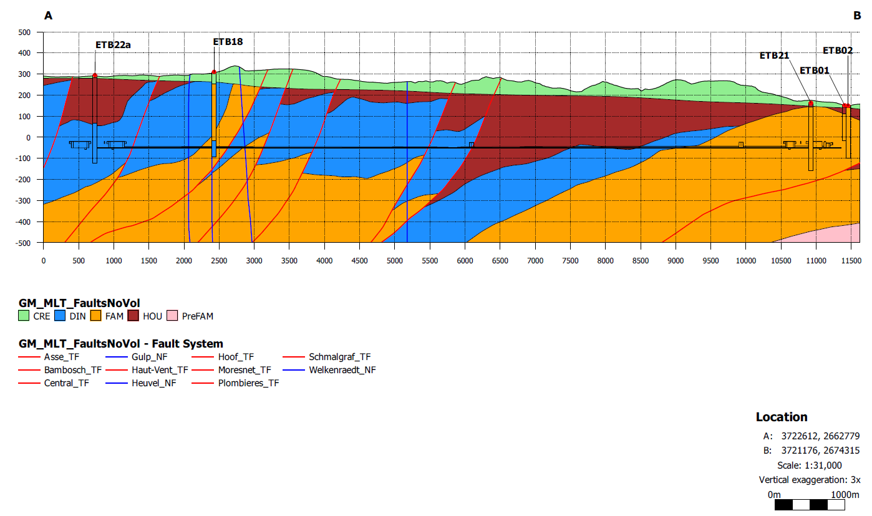
S
Tunnel 3 (viewed from the east)
N
1
3
2

Slide 24
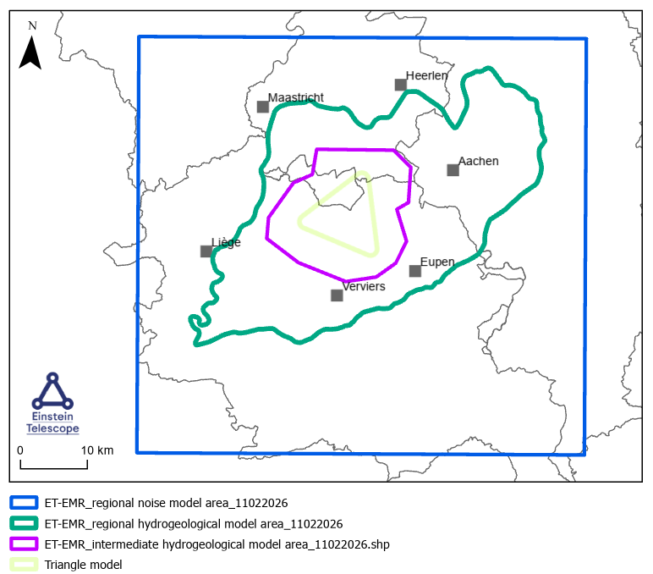
Models

Slide 25
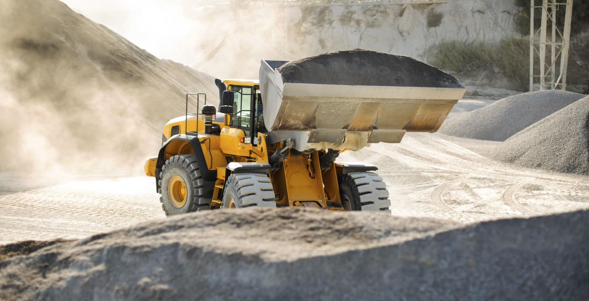
Use of excavated materials

Slide 26

Thanks for
your attention!

