Slide 1
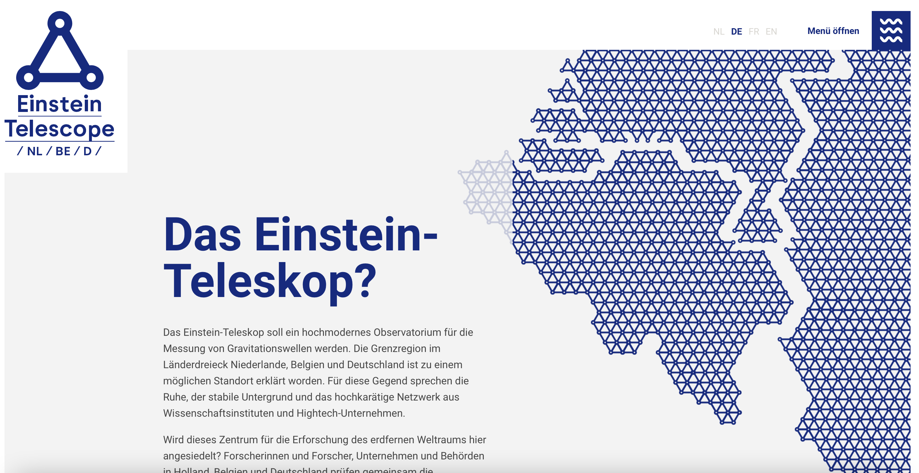
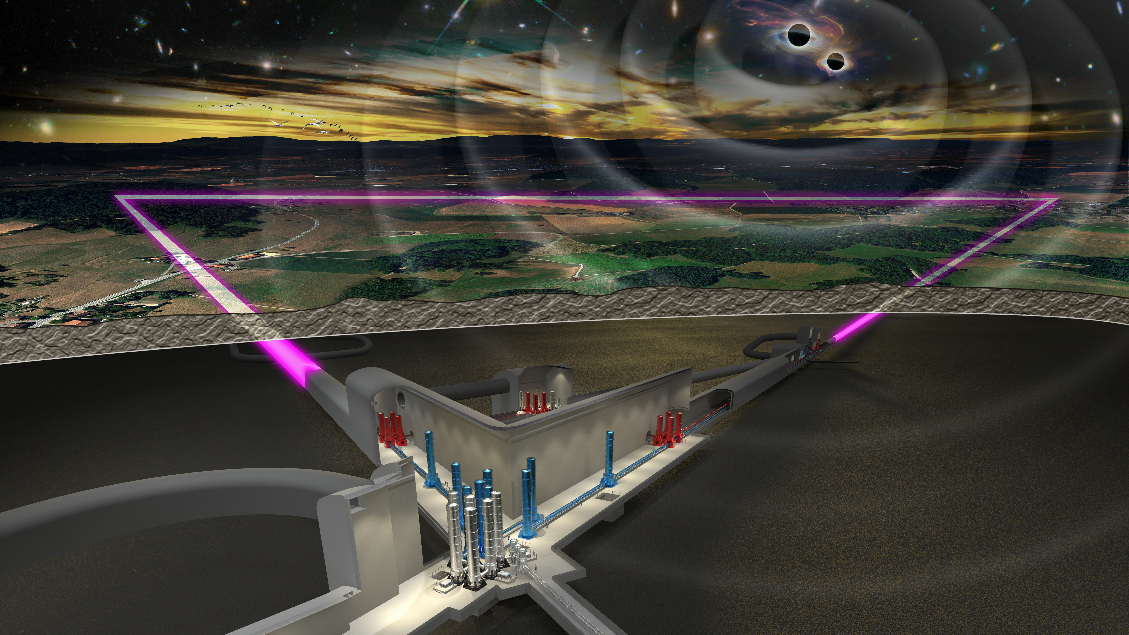
Feasibility studies & Bidbook preparations
February 4, 2026
Stan Bentvelsen - on behalf of POD
Impact of Transients on SURFACE AND UNDERGROUND seismic NOISE AT THE EMR candidate site
SCB meeting, April 14, Rome
– S Koley, M Hadrien, S Kadmiel, M. Kiehn, F Nguyen

Slide 2
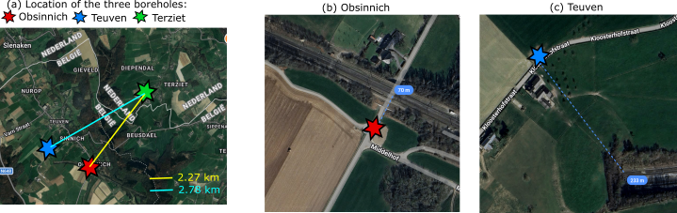
Three stations considered in the analysis: Obsinnich, Teuven, and Terziet
Obsinnich and Teuven are located at distances of about 70 m and 230 m away from freight train tracks, respectively
Both Obsinnich and Teuven are also located beside busy roads with significant traffic due to cars, buses etc
Terziet is about 2.3 kms and 2.8 kms away from Obsinnich and Teuven, respectively
Terziet is also located by the side of a local road which is not as busy as the roads in Teuven and Obsinnich

Slide 3
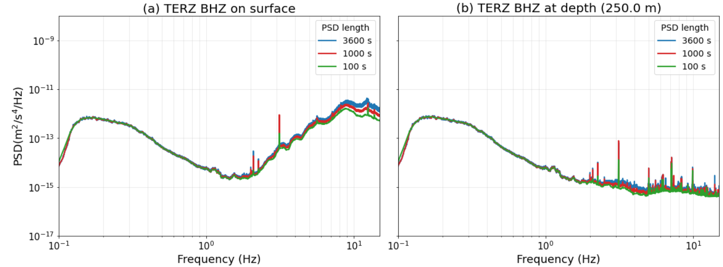
Impact of window lengths on PSD computation – Terziet
For sites where ambient noise mostly originates from far-away sources and can be treated as quasi-stationary, the window lengths used for computing PSDs should not impact the statistics (e.g. 10th , 50th , and 90th percentiles)
  Always noisy sites (by the side of highway, industrial machines)
  Sites where the noise is superposition of far away sources
Terziet fulfills this condition
  Data analyzed – Dec 04, 2025 – Jan 08, 2026 – only BHZ component shown
Figure 2: (a) 50th percentile of the PSDs estimated using 3600 s, 1000 s, and 100 s windows of ambient noise data on the surface. (b) same as (a) but corresponds to the data at depth.

Slide 4
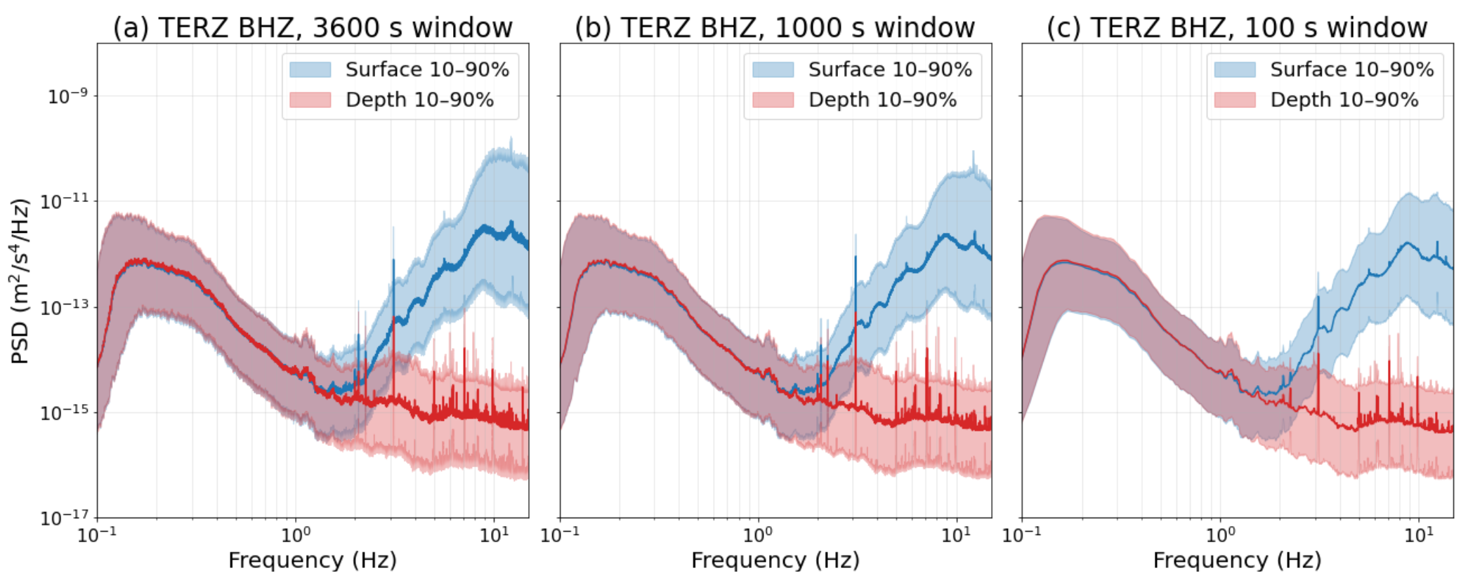
Impact of window lengths on PSD computation - Terziet
The impact of the window lengths are not felt by the 10th and 90th percentile of the PSDs, as well as the attenuation between surface and depth
A few ‘db’ difference is felt for frequencies greater than 8 Hz
Figure 3: (a) The blue and red shaded bands show the 10th and 90th percentiles of the PSDs on the surface and at depth, respectively corresponding to 3600 s windows. The solid lines correspond to the 50th percentile. (b) and (c) same as (a) but corresponds to window lengths of 1000 s and 100 s, respectively.

Slide 5
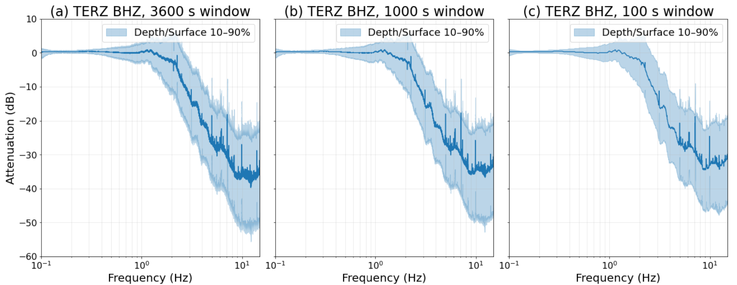
Impact of window lengths on PSD computation – Terziet surface to depth attenuation
Attenuation increases with frequency and is about 40 dB at 8 Hz
Little to no attenuation observed the secondary microseismic band (< 1Hz)
Figure 4: (a) The blue shaded band show the 10th and 90th percentiles of the attenuation of seismic power between surface and depth, corresponding to 3600 s windows. The solid lines correspond to the 50th percentile. (b) and (c) same as (a) but corresponds to window lengths of 1000 s and 100 s, respectively.

Slide 6
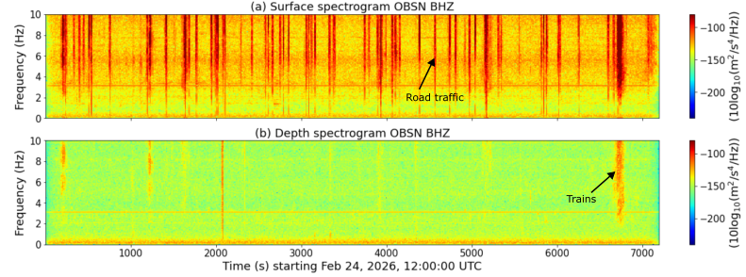
The case of Obsinnich during peak hours of the day
Obsinnich which is located just 70 m from a freight train track and few meters away from a road, has data marked with several transients due to road traffic and strong bursts from trains
  During peak hours of the day (12:00:00 UTC + ), road traffic dominates the surface seismic noise
  Majority of road traffic is attenuated, however trains do leave an imprint on the underground spectrogram
Figure 5 (a) and (b) show the spectrograms of the surface and underground seismic noise data Obsinnich corresponding to peak hours during the day on Feb 24, 2026.

Slide 7
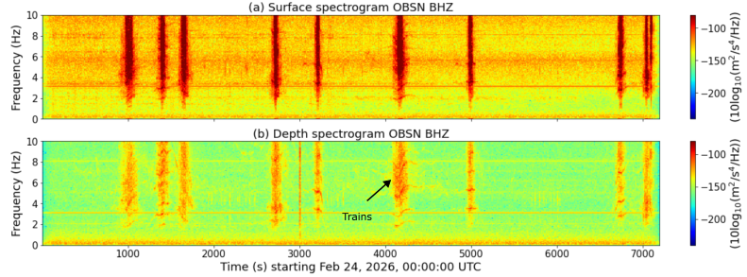
Obsinnich during night
As expected the transients originating from the road traffic are no more observed in the data, however the trains dominate both the surface and the underground spectrograms
  More of a reason why longer PSD lengths will bias the percentiles of the noise PSDs
Figure 6 (a) and (b) show the spectrograms of the surface and underground seismic noise data Obsinnich corresponding to midnight on Feb 24, 2026. Transients originating from road traffic are no longer visible, but train traffic dominates the signals. Note the surface spectrogram saturates because the colorbar is forced between (-240,-80)

Slide 8
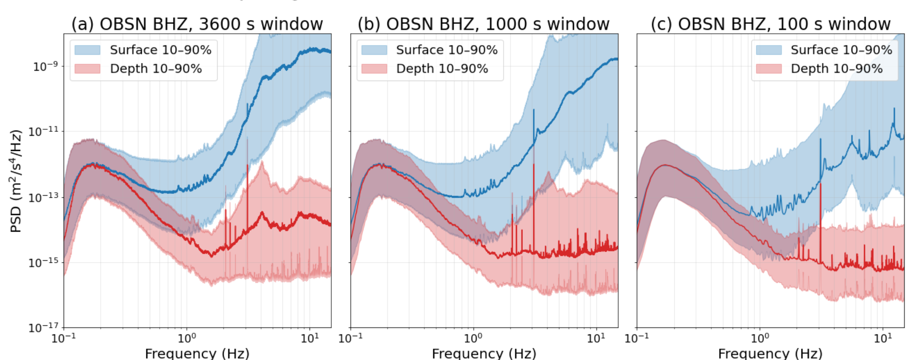
Impact of window lengths on PSD computation - Obsinnich
Data analyzed between Dec 04 – March 09, 2026
About a 10 dB reduction on the 50th percentile of the PSDs is observed when reducing window lengths to 100 s from 3600 s
For shorter windows, several windows are observed without train, reflecting the ambient noise condition similar to Terziet
Figure 8: (a) The blue and red shaded bands show the 10th and 90th percentiles of the PSDs on the surface and at depth, respectively corresponding to 3600 s windows. The solid lines correspond to the 50th percentile. (b) and (c) same as (a) but corresponds to window lengths of 1000 s and 100 s, respectively.

Slide 9
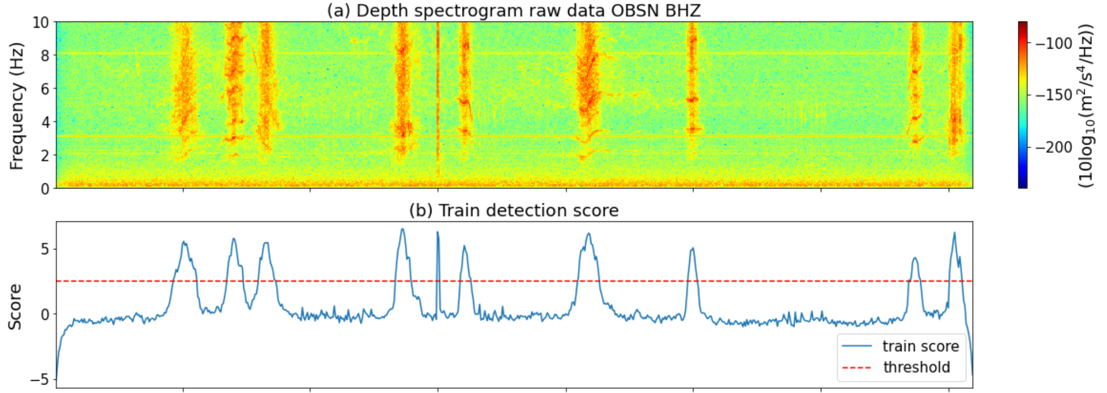

Would the impact of window length be still visible if the train signals were removed?
Train window detector
  Compute $L\left(f,t\right)=10\log{S(f,t)},$ where $S(f,t)$ is the spectrogram
  Get median over time $m\left(f\right)=median_{t}\left(L\left(f,t\right)\right)$
  Compute median absolute deviation over time $d\left(f\right)={median}_{t}(|L\left(f,t\right)−m(f)|)$
  The z score is defined as $z\left(f,t\right)= \frac{(L\left(f,t\right)−m(f))}{d(f)}$
  Set a threshold of 2.5 of z-score and get the start and end of train dominated signal
Figure 9 (a) Spectrogram of the raw data from OBSN BHZ during midnight of Feb 24, 2026 which shows several pass in the span of two hours. (b) The z-score derived from the spectrogram and a hard threshold of 2.5 is used to detected train-passing windows

Slide 10
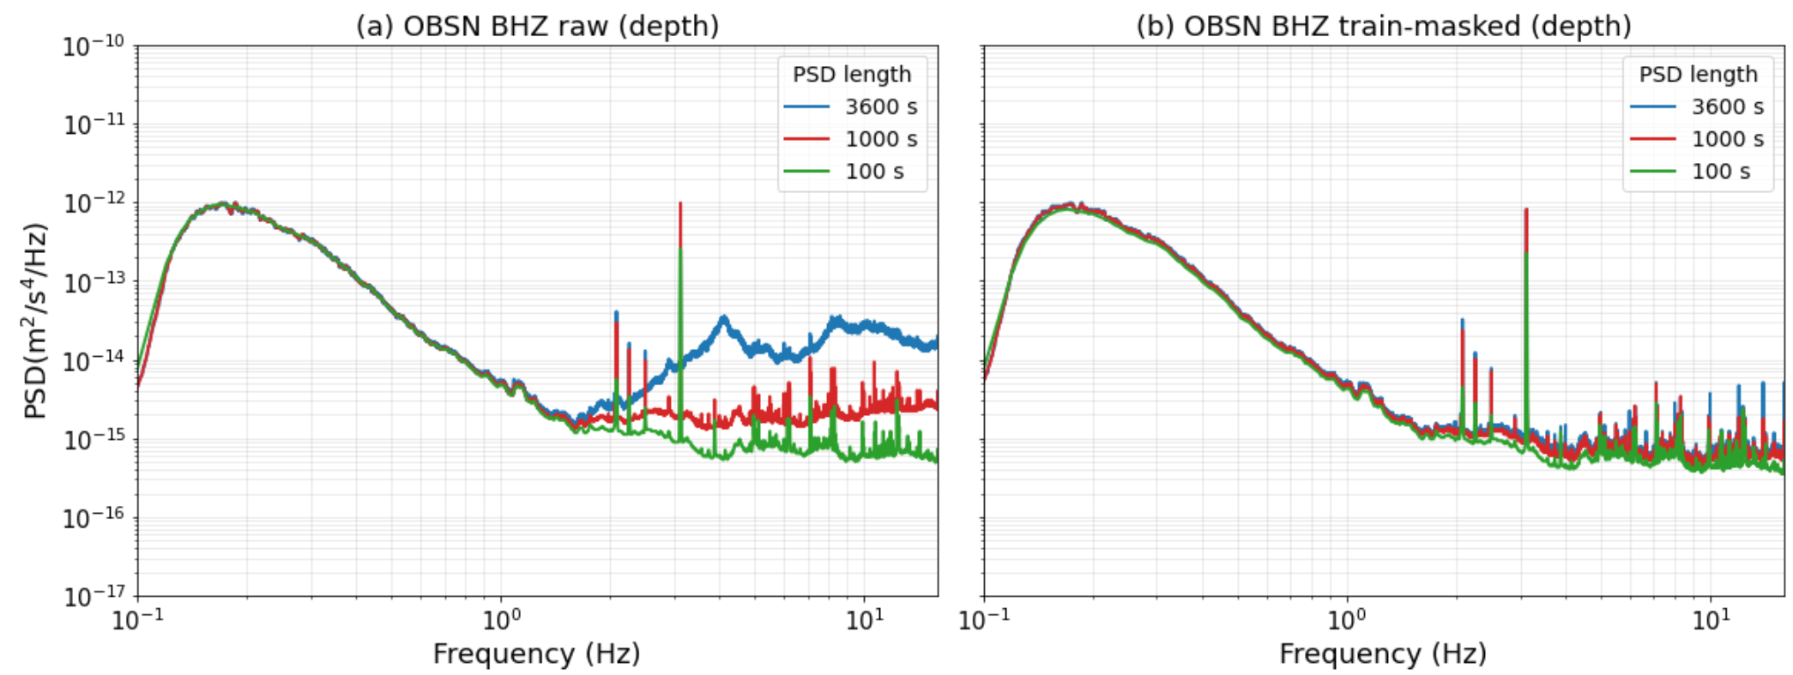
Impact of window length on PSD computation after masking train signals - Obsinnich
After removal of data stretches during a passing train, the impact of window length on the the 50th percentile of the PSD estimates is not felt
Ambient noise reaches levels similar to Terziet
Figure 10: (a) 50th percentile of the PSDs estimated using 3600 s, 1000 s, and 100 s windows of raw ambient noise data at depth. (b) same as (a) but corresponds to the train-masked data.

Slide 11
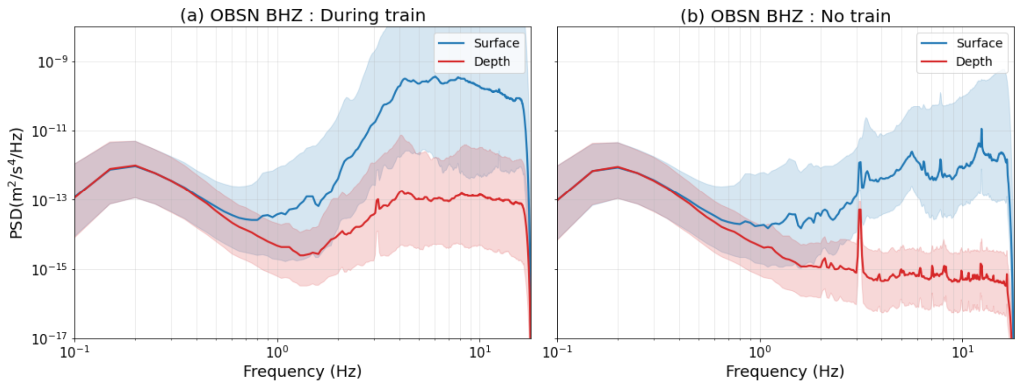
Comparing PSDs for time intervals with and without trains- Obsinnich
Spectrograms generated using 20 s windows and an overlap of 10 s between consecutive windows can be used to build statistics (10th , 50th , and 90th percentiles), which indicate the seismic levels underground
Results show that the underground seismic level is very close to Terziet when considering periods without a train passing
Figure 11: (a) The blue and red shaded bands show the 10th and 90th percentiles of the PSDs on the surface and at depth, respectively corresponding to all 20 s windows when a train is detected. The solid lines correspond to the 50th percentile. (b) same as (a) but corresponds to all 20 s windows when a train is not detected.

Slide 12
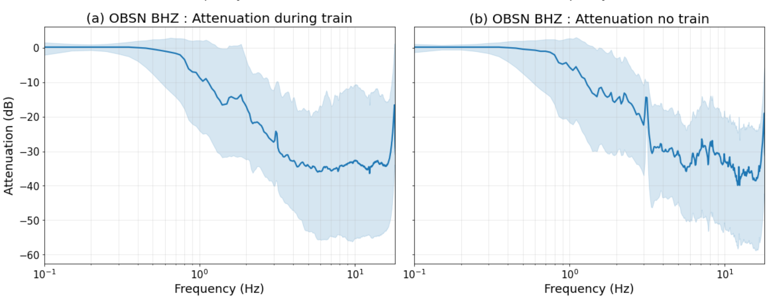
Comparing surface/depth attenuation for time intervals with and without trains- Obsinnich
Why removing the trains not reduce the apparent attenuation levels between surface and depth?
  Note from slide 6 Figure 5, the surface spectra is also characterized with strong road traffic noise (few tens of meters away), and we have not removed them
  Ideally if the remainder of the noise was from far-field; apparent attenuation would reduce
Figure 12: (a) The blue shaded band show the 10th and 90th percentiles of the attenuation of seismic power between surface and depth, corresponding to all 20 s windows when a train detected. The solid lines correspond to the 50th percentile. (b) same as (a) but corresponds to all 20 s windows when a train is not detected.

Slide 13
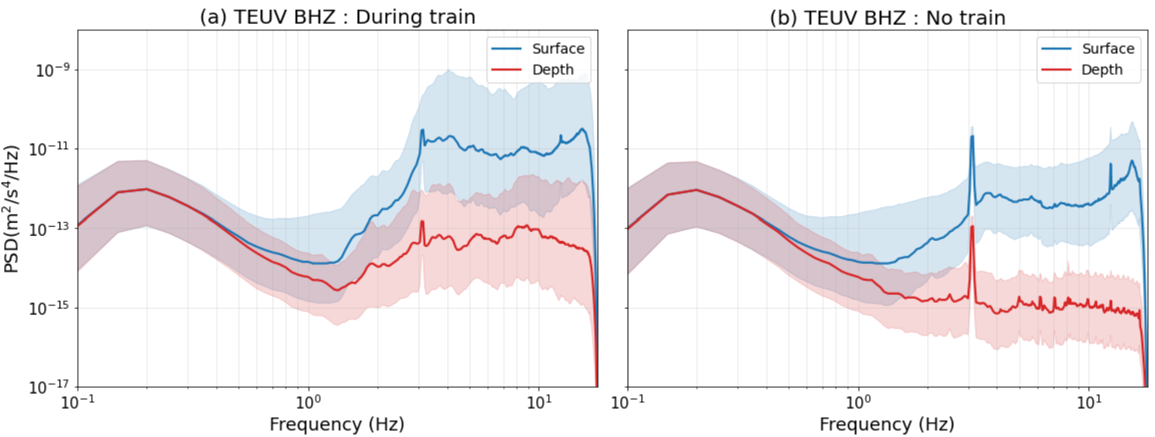
Comparing PSDs for time intervals with and without trains- Teuven
Considering the PSD statistics generated from all 20 s intervals when a train passes (Fig 15(a)), the surface noise level is about 20 dB less compared to that observed at Obsinnich – Teuven is 230 m away from the train track, while Obsinnich is just 70 m away
Results show that the underground seismic level is very close to Terziet when considering periods without a train passing – similar to Obsinnich (Fig 11(b))
Figure 13: (a) The blue and red shaded bands show the 10th and 90th percentiles of the PSDs on the surface and at depth, respectively corresponding to all 20 s windows when a train is detected. The solid lines correspond to the 50th percentile. (b) same as (a) but corresponds to all 20 s windows when a train is not detected.

Slide 14
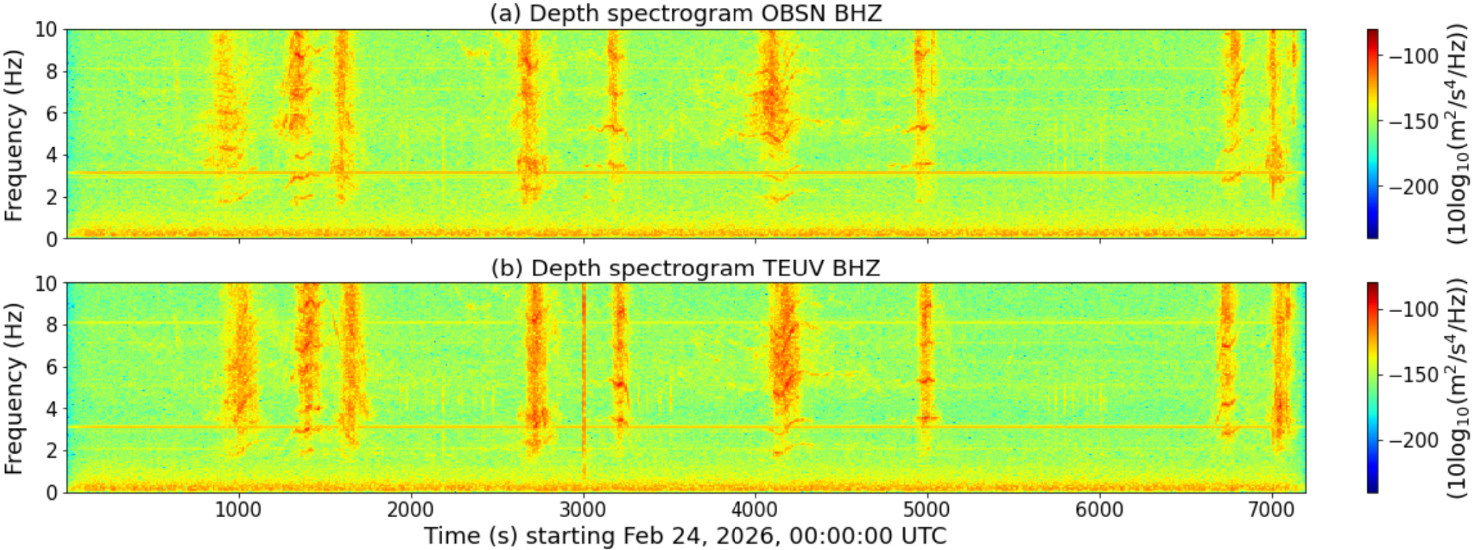
Comparing spectrograms between Obsinnich and Teuven
From power standpoint, the signals at depth look similar at both Obsinnich and Teuven
However, there are small spectral features which differ between the stations
Figure 14 (a) Spectrogram of the raw data from OBSN BHZ during midnight of Feb 24, 2026 which shows several pass in the span of two hours. (b) same as (a) but corresponds to the Teuven data at depth. Window lengths for spectrogram = 20 s and overlap of 10 s between windows.

Slide 15
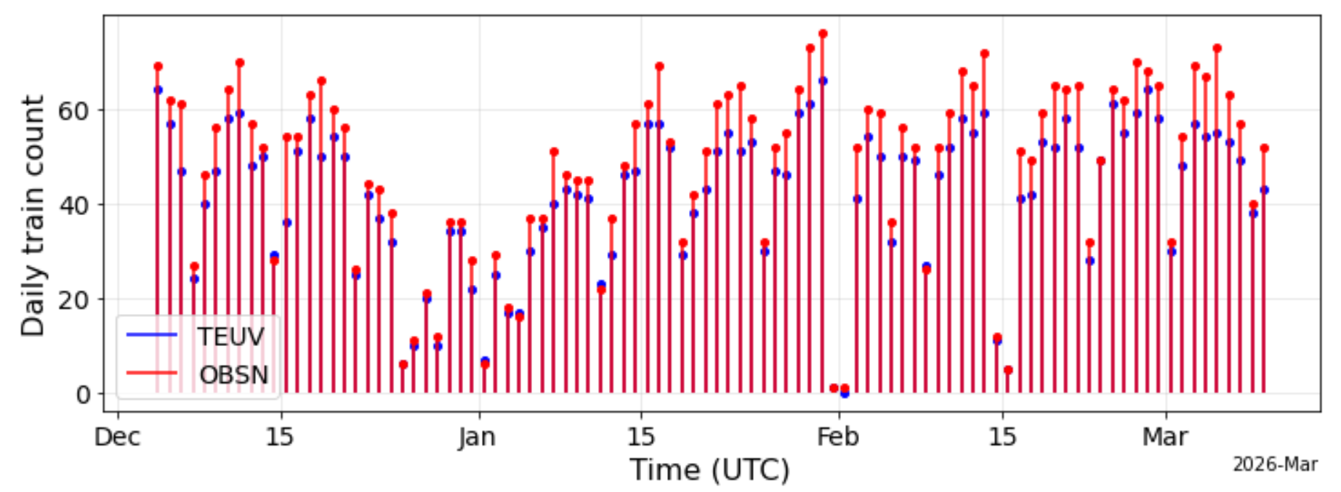
Some statistics about the train signals – total events per station
Data analysis time: Dec 04, 2025 – Mar 09, 2026 (96 days)
A total of 4593 events classified as trains from Obsinnich data.
A total of 4020 events classified as trains from Teuven data. Teuven misses about 4 – 5 events per day, as it is slightly farther away from train track
Figure 15. The blue and the red vertical lines show the number of trains detected per day corresponding to the Teuven and Obsinnich seismic data at depth.

Slide 16
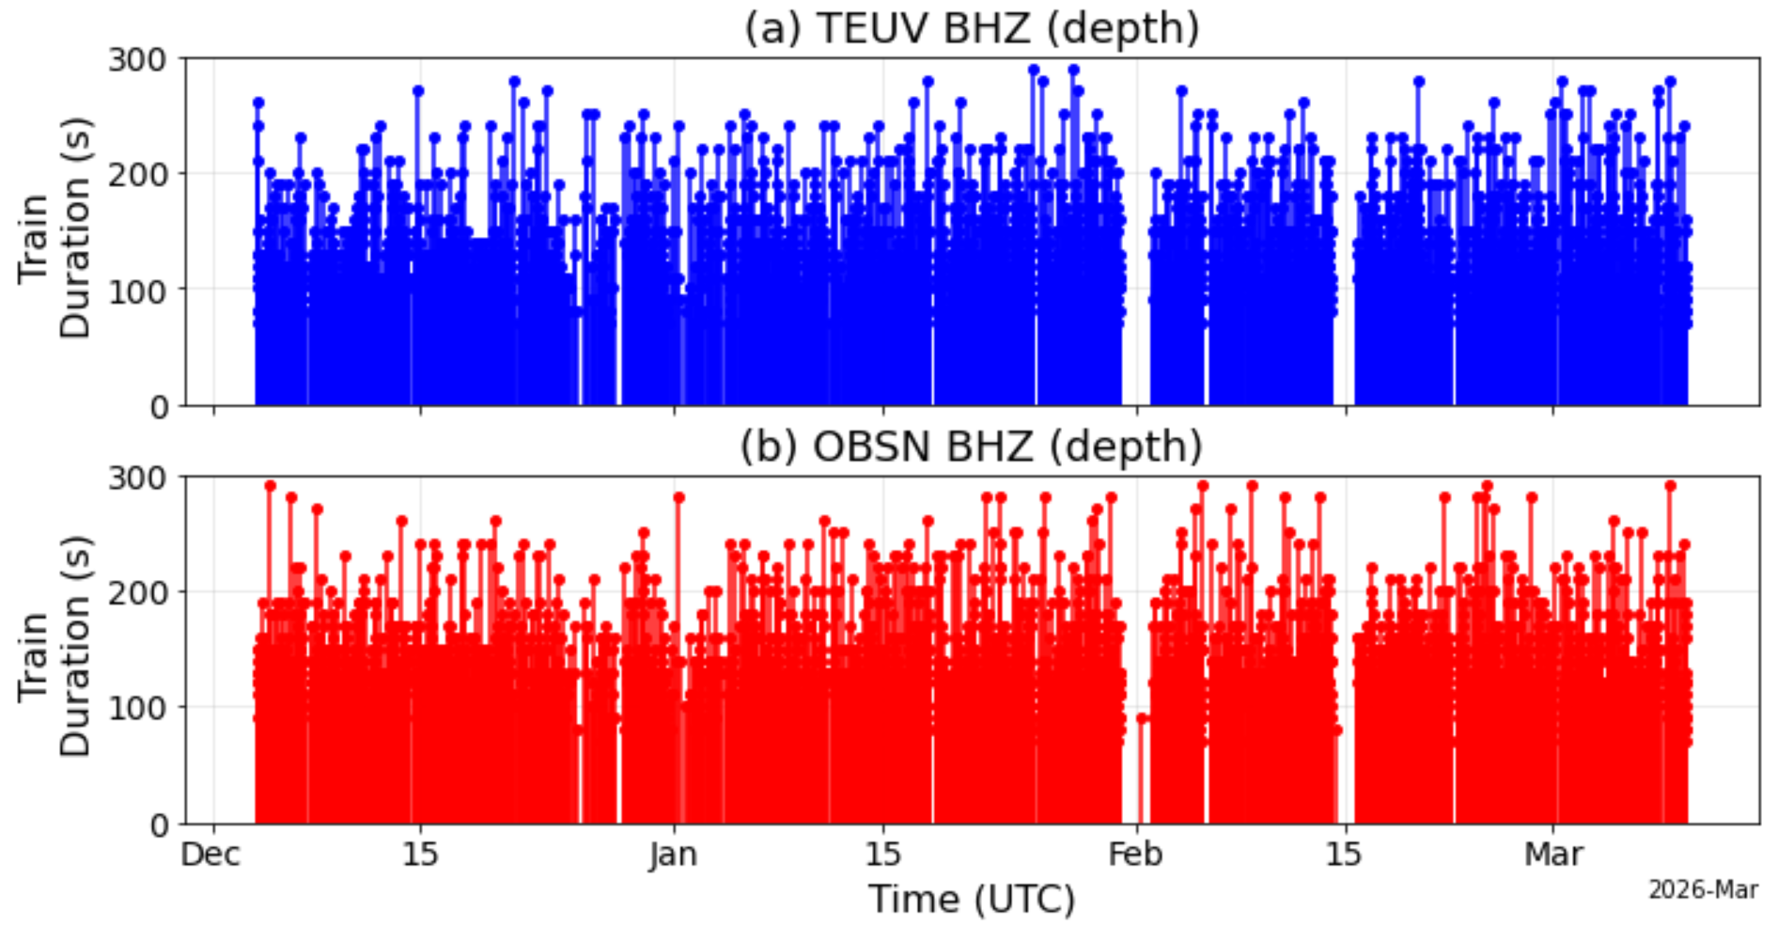
Some statistics about the train signals – duration of train signals
Each train signal spans between 100 – 200 s on average: this includes all time slices where the z-score crosses 2.5, therefore includes arrival as well as departure of the train
Teuven has about 5.77% of the data as train signals, and Obsinnich has about 6.76%
Figure 16(a) The blue vertical lines show the duration of the train signals measured at the Teuven station. (b) same as (a), but corresponds to the Obsinnich depth data

Slide 17
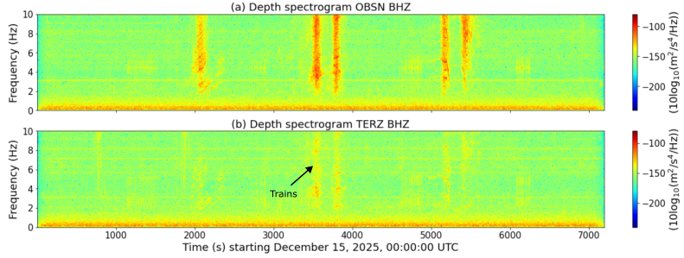
Do the noise from the freight trains propagate to Terziet?
Although Terziet is about 2.3 kms away from Obsinnich, some impact of the trains can be felt at Terziet
Figure 17 (a) Spectrogram of the raw data from OBSN BHZ during midnight of December 15, 2025 which shows several pass in the span of two hours. (b) same as (a) but corresponds to the Terziet data at depth. Window lengths for spectrogram = 20 s and overlap of 10 s between windows.

Slide 18
Conclusions
Statistics of ambient seismic noise is dependent on the analysis window for sites with strong transients
Noise generated from trains leave an imprint on the seismic noise in boreholes within a few hundred meters of train tracks
Underground seismic noise levels closely resemble Terziet in power while considering periods without a train
Approximately 5 – 6 percentage of the data comprises a passing train (most trains passing during night)
Some impact of the passing freight trains observed at Terziet which is more than 2 kms away
Outlook
Use information from Infrabel to cross-check the detected train arrival times
Correlate with length, speed and weight of the trains with observed PSDs
Quantify contribution of trains to the Terziet underground data
  Cross-correlations
  Body to surface wave content (possible with three stations)
Compute NN and assess subtraction corresponding to seismic noise from trains in a Terziet-like setting
All codes used in the analysis available at:
  https://github.com/soumenkoley/Train-Seismic-Data-analysis-ET-EMR

