Slide 1


BRINGING NOBEL PRIZE PHYSICS TO THE CLASSROOM
Emmanuel Chaniotakis,
Research and Development Department,
Ellinogermaniki Agogi,
Greece
www.frontiers-project.eu

Slide 2
The role of
FRONTIERS is a project funded by the Erasmus+ framework of the EU with duration from 2018 to 2021.
It aims to address the challenges of introducing frontier Physics in the Classroom.

Slide 3
HOW….

Slide 4







By bringing together research and educational institutions from all over Europe
Scientific Research
Science Education
Teacher Training Networks and Astrophysics Outreach
Frontiers has been funded within the framework of the European Union Erasmus+ programme

Slide 5
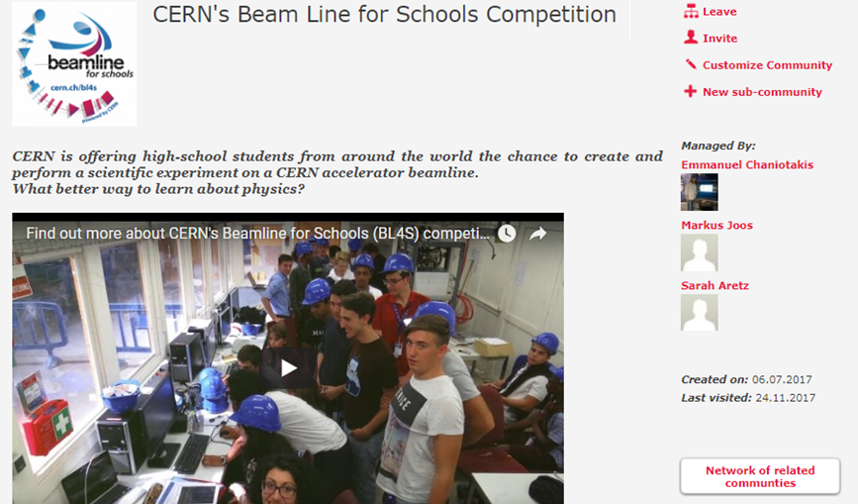
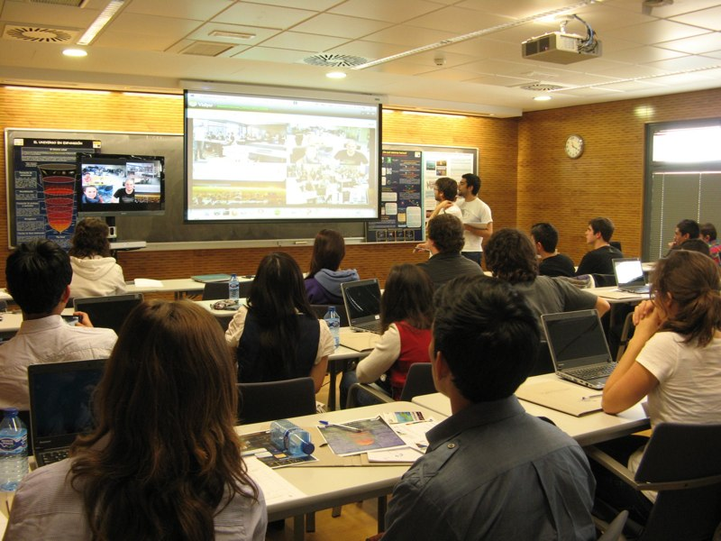
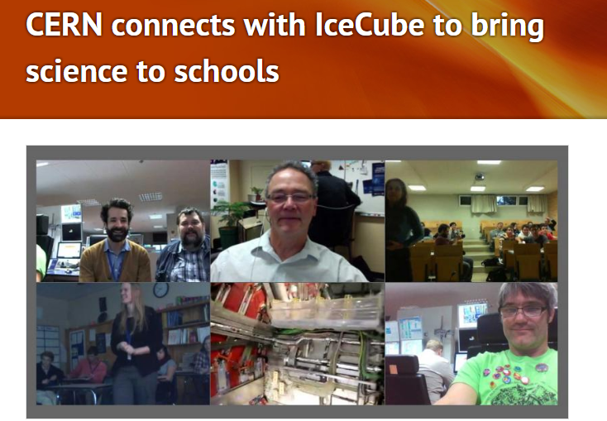
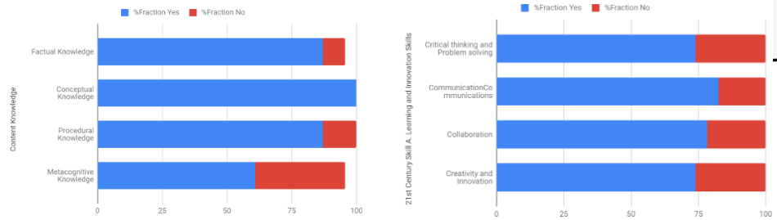
Investigating already existent outreach practices and drawing lessons learnt from them
https://zenodo.org/record/3405912#.XaD3ASjVLZ4

Slide 6
Adopting the inquiry based science education pedagogy
Learners are engaged by scientifically oriented questions.
Learners give priority to evidence which allows them to develop and evaluate explanations that address scientifically oriented questions.
Learners formulate explanations from evidence to address scientifically oriented questions.
Learners evaluate their explanations in light of alternative explanations, particularly those reflecting scientific understanding.
Learners communicate and justify their proposed explanations.

Slide 7
Adopting the inquiry-based science education pedagogy
Orienting and Asking Questions
Conclusions- Evaluation
Hypothesis Generation and Design
Analysis and Interpretation
Planning and Investigation
https://www.youtube.com/watch?v=TJQAfJwVGyk

Slide 8
Orienting and Asking Questions. The topic of the lesson is introduced, assumptions the students may have are challenged, and questions they may have are formulated.
Hypothesis Generation and Design. During which the students develop one of their questions into a hypothesis.
Planning and Investigation. In which the hypothesis previously developed is tested.
Analysis and Interpretation. Where the students analyse the data collected from their investigation and refute or confirm the hypothesis.
Conclusion and Evaluation. When the students communicate their findings.

Slide 9
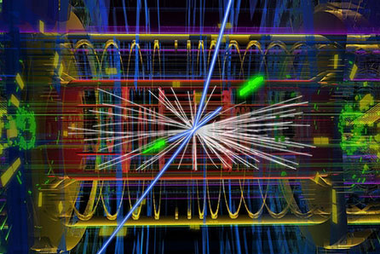
Developing the frontiers demonstrators: cutting edge educational activities for your classroom
FRONTIERS will prepare 20 demonstrator lessons that are about a modern physics topic for secondary school; ready to be used (or adapted);
follow an inquiry methodology; available @ ISE platform:
High Energy Physics
Discover the Z and Higgs Bosons
World Data Day
Magnetic Field
Let’s Accelerate particles
The ALICE Experiment at CERN
Mass- Energy Equivalence

Slide 10

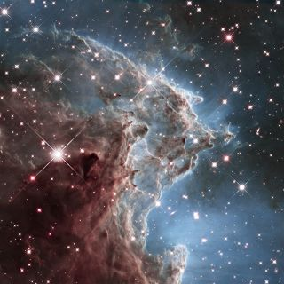
Gravitational Wave Astronomy
VIRGO Virtual Visit
VIRGO Control (Class) Room
Gravitational Wave Noise Hunting
Finding black-holes in a chirp”
The Michelson Interferometer
Earthquake Interferometer
Astrophysics – Astroparticle Physics
Black Holes
Solar Rotation
Discovering Alien Worlds
Build your own cloud chamber
Relativistic Muons and Time Dilation
Cosmic Rays
Neutrino Astronomy
Age of the Universe

Slide 11
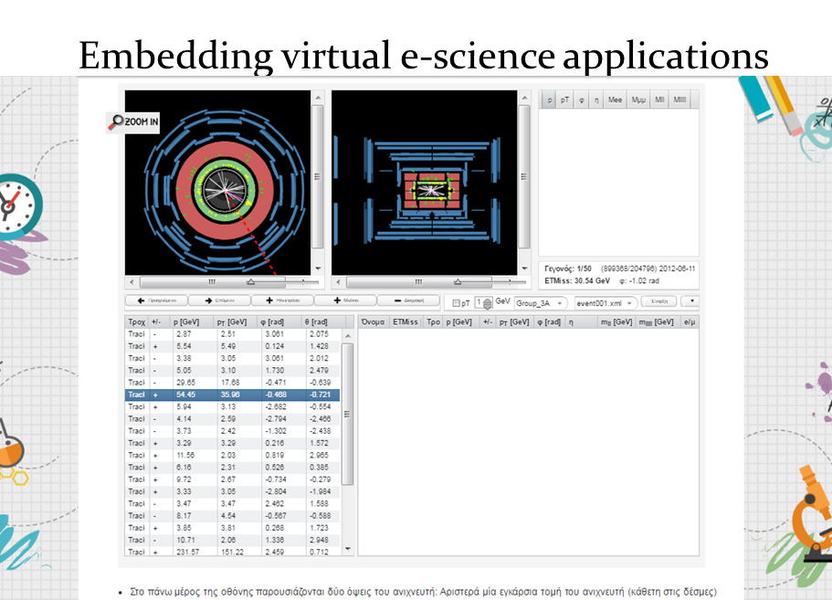
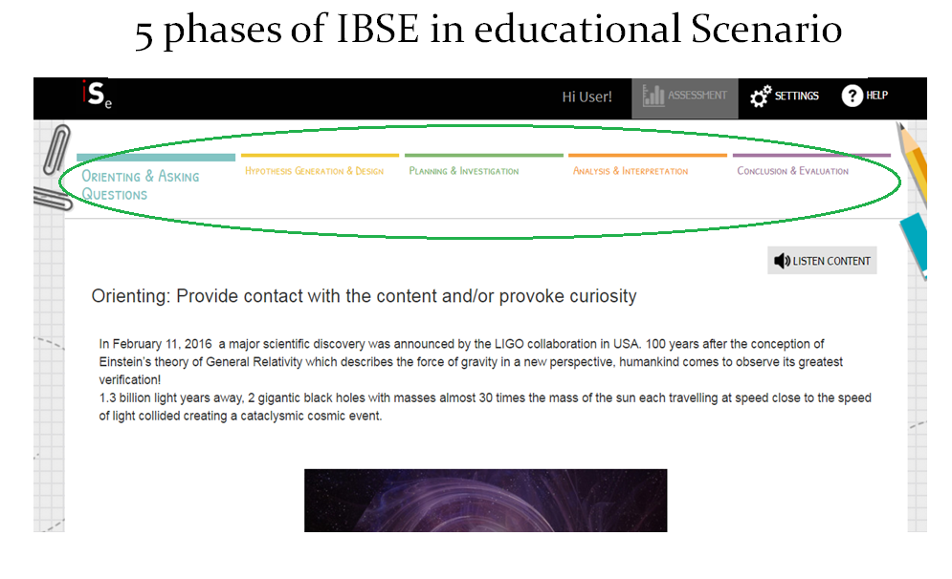
Developing cutting edge educational content
Free for everyone
Following the inquiry based science education model.
Connecting students with large research infrastructures in Physics.
Offering real data for analysis by the students.
Utilizing virtual and experiential labs for the deeper comprehension of modern Physics concepts.
Building “bridges” to connect with school curricula.

Slide 12
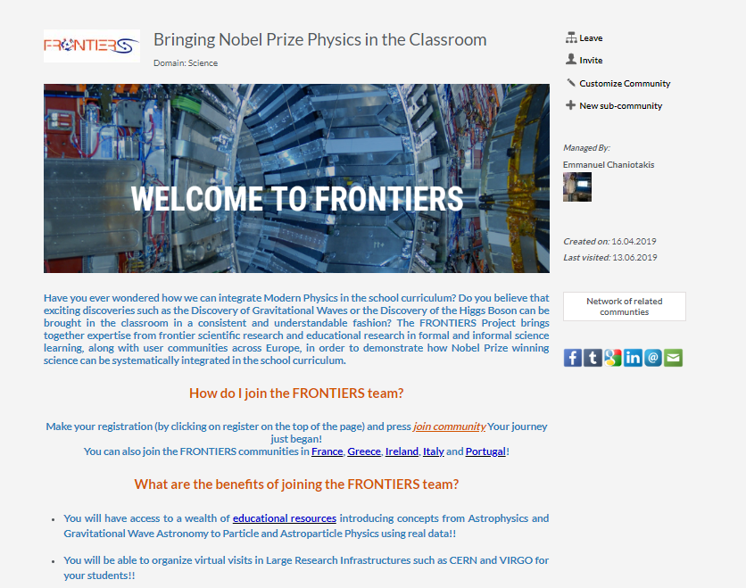
Developing national and international communities of practice for educators
Giving opportunities for immediate interaction and feedback between researchers and educators.
Useful for the exchange of good practices.
With the capacity to host educational content
Offering you the tools to create your own educational content.

Slide 13
Offering continuous training and support for the implementation of frontiers activities in your classroom.
Through the systematic organization of in situ and online training workshops for continuous professional development..
Through the organization of summer and winter schools.

Slide 14
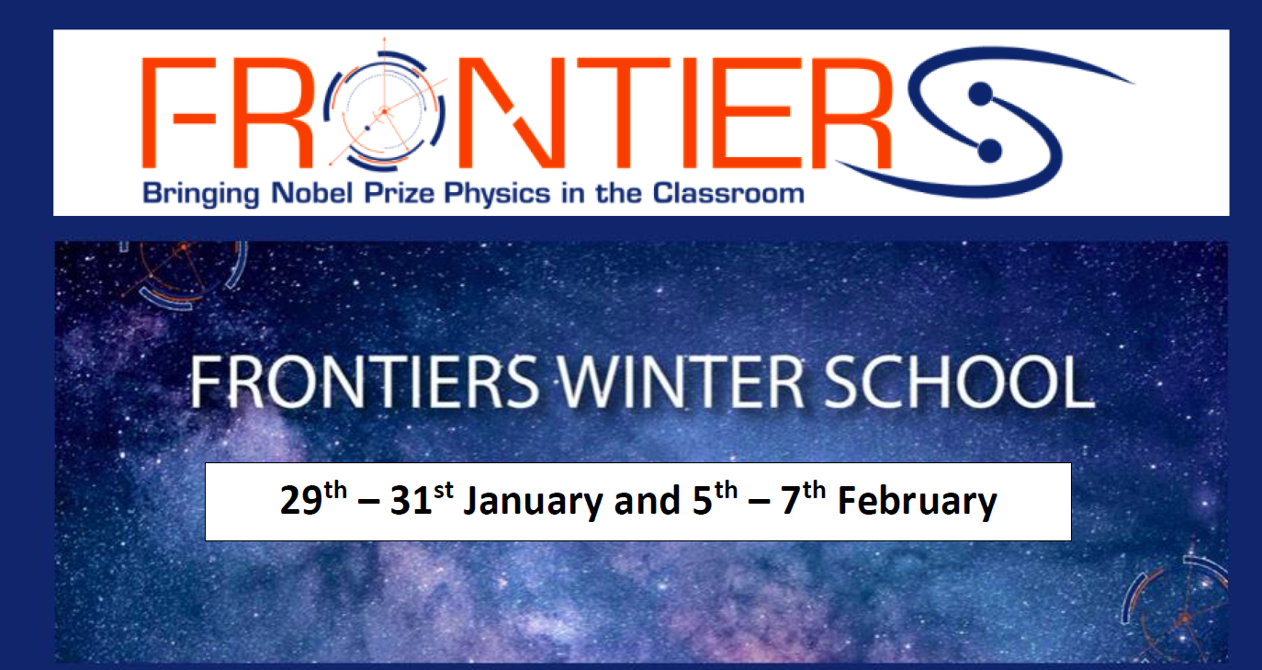
How can I learn more about the winter school?: https://esia.ea.gr/frontiers-winter-school/
What is the agenda?: https://indico.ego-gw.it/event/133/timetable/
How do I register?:
You can register here https://indico.ego-gw.it/event/133/registrations/230/
Hurry up! Some spots are still available

Slide 15
IF..
You believe that it is worthwhile to introduce topics such as the discovery of Gravitational Waves or of the Higgs Boson in your classroom in a systematic and understandable fashion.
You want your students to be able to perform virtual visits at VIRGO or CERN, to analyze real data and to interact with leading experts in Physics and Education research.
You want to receive continuous training and support in these scientific topics.
You want to become part of our international community of educators and researchers with who you will be able to interact, collaborate, exchange ideas and practices.
We invite you to become members of the FRONTIERS family!

Slide 16
How do I become a frontiers teacher?
Throughout your engagement with FRONTIERS you will be offered continuous support and training, you will receive online badges and you will be able to participate in educational competitions with great prizes!
It is done in 5 easy steps:
Subscribe to our newsletter!
Join the FRONTIERS international community and national community in Italy!
Contribute to our Facebook group!
Participate in our training workshops to be announced soon!
Implement at least one FRONTIERS activity in your classroom!

Slide 17
Thank you very much
For further details visit:
FRONTIERS website:
www.frontiers-project.eu
Facebook page:
https://www.facebook.com/frontierseu
Facebook group:
https://www.facebook.com/groups/665957563876838/
Don’t hesitate to contact us : info@frontiers-project.eu

