Slide 1
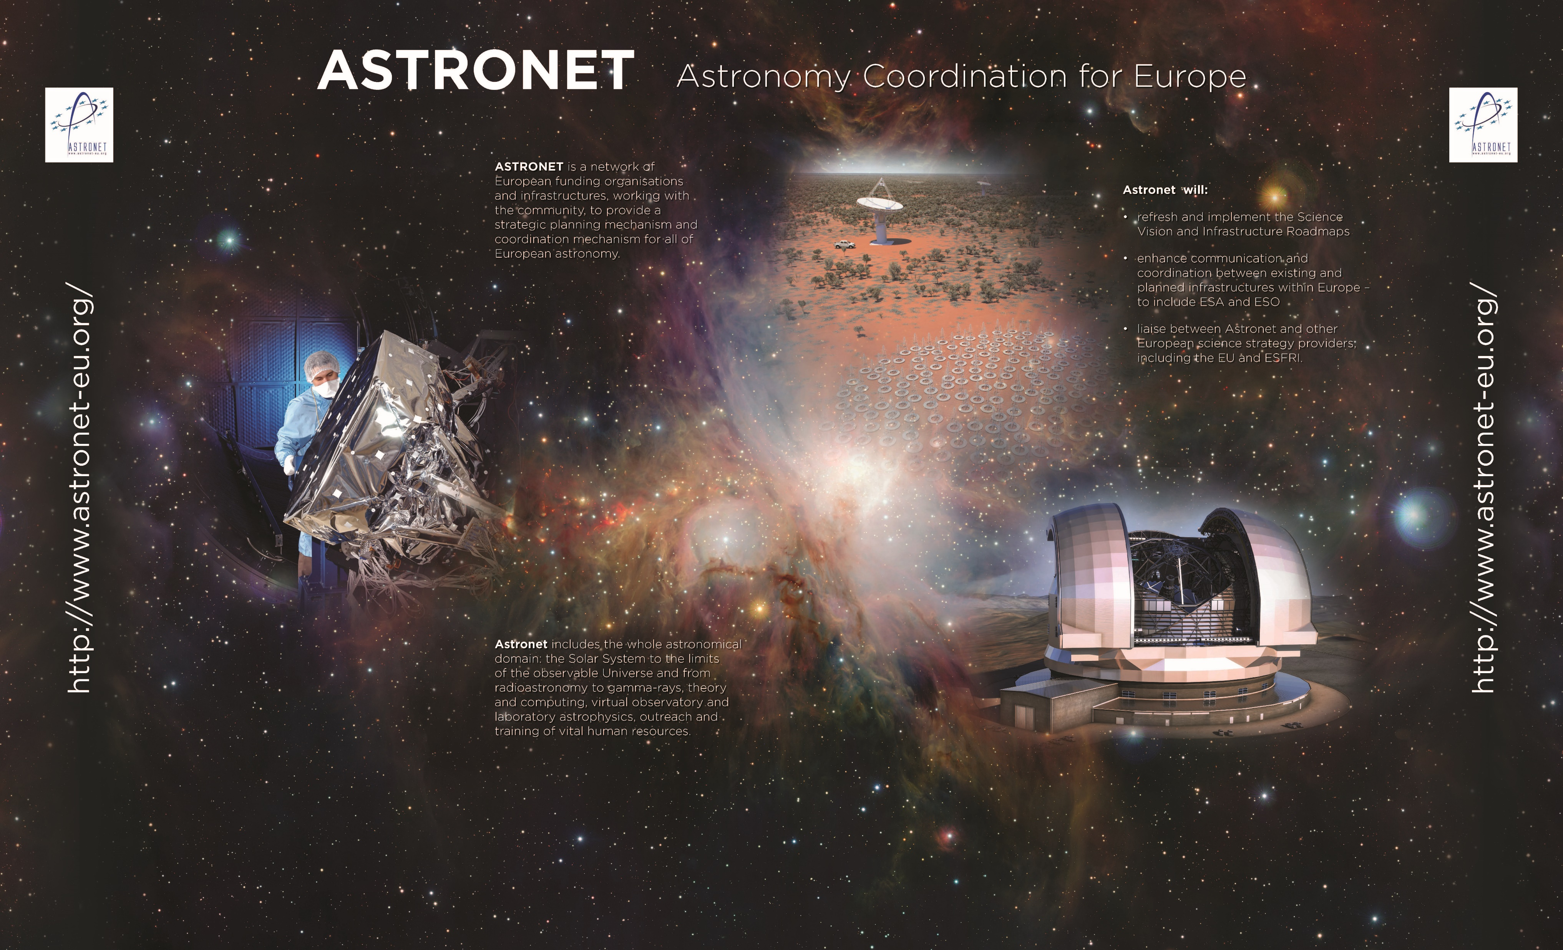
Dr Colin Vincent – ASTRONET Board Chair / STFC - UK

Slide 2
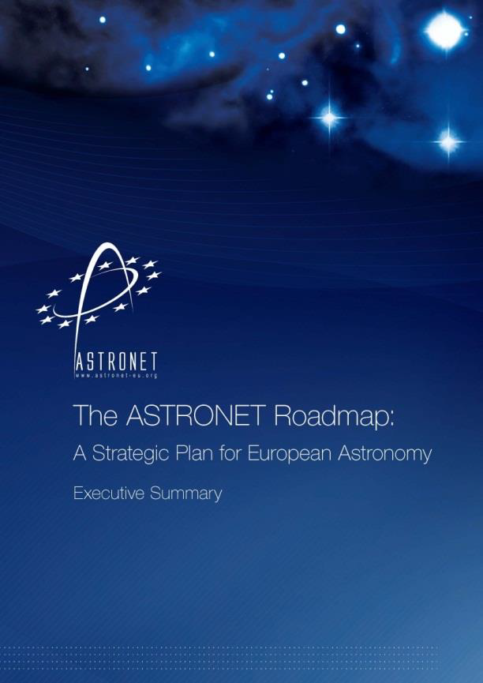
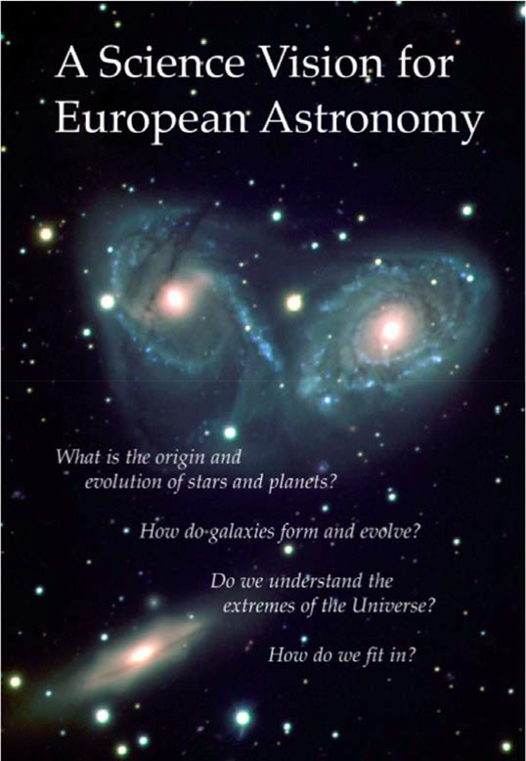
Astronet
A group of European funding agencies, community representatives and infrastructures working together as a forum for coordination for all aspects of European astronomy.

Slide 3
Astronet - Comprehensive long-term planning for the development of European astronomy
Formed in early 2000s with EU funding and responsible for 1st European Science Vision and Infrastructure Roadmap (and its revision);
Since 2016, at EU request, funded by the agencies;
Focus in last 4 years has been creation of new Science Vision, but planning for other work is commencing.

Slide 4
Multi-Messenger Science
European Astronomy covers a very diverse and extensive programme based around key scientific questions – from origin of Universe to our part within it
By nature, the approach to progressing knowledge is founded on a multi-faceted approach, be that theory working with observation or x-ray working with radio
More recently is has also been strongly extended into geophysics, computing and others
The historical view that most scientists are focussed on one wavelength or one suite of facilities is becoming less true

Slide 5
Multi-Messenger Science
The new generation of facilities are founded on very large data sets – from which a wide variety of science outcomes can be extracted
For example Rubin’s short cadence all sky surveys, or the capability of the Square Kilometre Array
Follow up from other facilities and capabilities is vital, including appropriate computing ability ( both capacity and capability), and that also means appropriate effort
Linkages for Gravitational Waves – for Example to GOTO, are starting to show the strength of this multi-facility approach. This can only increase as new capabilities come on line
Also demonstrates the need for all aspects of astrophysics to cooperate

Slide 6
ASTRONET Roadmap
Expect publication in January 2023
It will highlight the dominance of the big facilities and of space in the coming years (ELT, SKA, Voyage 2050) but also the vital role of associated capabilities, of working across traditional silos
The link to societal gain will also be strongly emphasised
There is only limited resource across the budgets of those funding astrophysics in Europe
We must ensure we plan with vision but also in harmony
Multi-Messenger science, in its widest definition will be a very important to maximise the science return on our investments

Slide 7
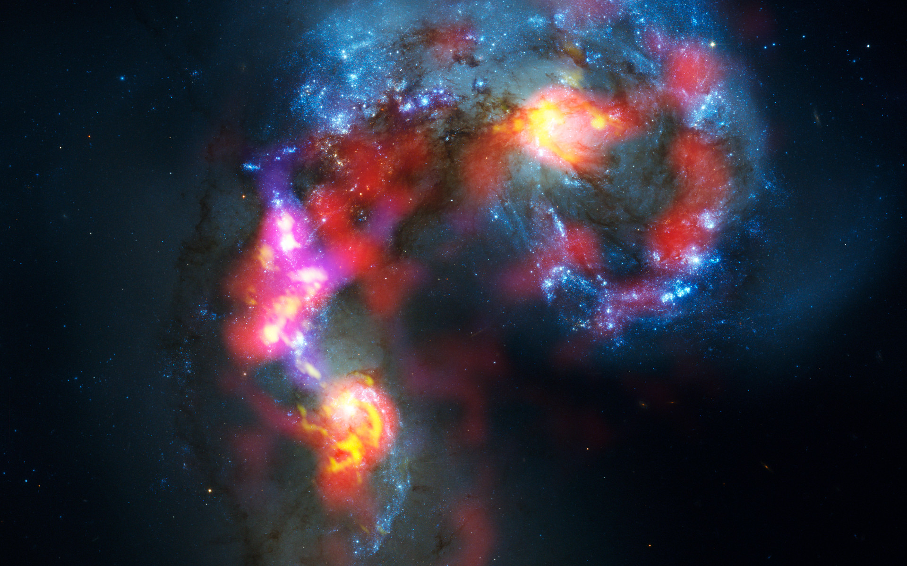
https://www.Astronet-eu.org

