Slide 1
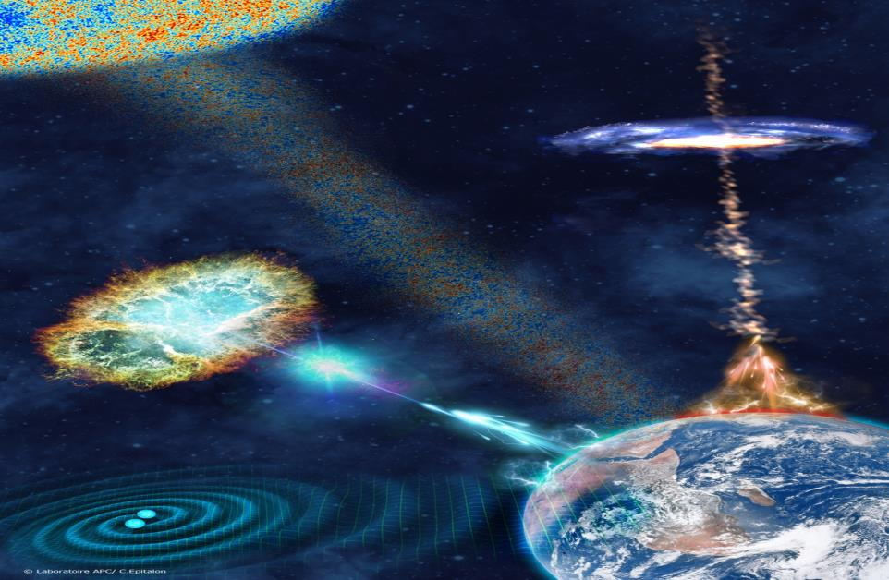
ESFRI roadmap update 2021
Job de Kleuver NWO-I/APPEC
DAWN V meeting 27 May 2019

Slide 2
ESFRI is…
The mission of ESFRI is to support a coherent and strategy-led approach to policy-making on research infrastructures in Europe, and to facilitate multilateral initiatives leading to the better use and development of research infrastructures, at EU and international level.
28 member states, 13 associated
ESFRI is not a funding body

Slide 3
ESFRI timelines
Applications can be done by Member States only!
Expectation application deadline: April/May 2020
Next update opening expected 3-5 years later
Time schedule announcement for next two updates in September 2019
BUT
National procedures differ from country to country and will lead to deadlines (much) earlier national deadline
Draft ESFRI proposal should be available January 2020

Slide 4
EINSTEIN TELESCOPE new project on ESFRI roadmap
Scientific Sound project
-Maturity project (a realistic plan, consortium, time line, access policy…)
Financial Commitment (country or agency level)
Political Commitment (country level)
Enough partners = 3 countries at least
In construction within 10 years after adoption by ESF
Based on current criteria; could change for next update!

Slide 5
PARALLEL REVIEW PROCESSES:
science and implementation
STRATEGY WORKING GROUP EVALUATES SCIENTIFIC CASE
IMPLEMENTATION GROUP (IG) ASSESSES IMPLEMENTATION
scientific excellence
pan-European relevance
socio-economic impact
e-needs
stakeholder commitment
user strategy & access policy
preparatory work
planning
governance & management
human resources policy
finances
risks

Slide 6
PARALLEL REVIEW PROCESSES:
science and implementation
STRATEGY WORKING GROUP EVALUATES SCIENTIFIC CASE
IMPLEMENTATION GROUP (IG) ASSESSES IMPLEMENTATION
scientific excellence
pan-European relevance
socio-economic impact
e-needs
stakeholder commitment
user strategy & access policy
preparatory work
planning
governance & management
human resources policy
finances
risks
GREEN = Science In LEAD
ORANGE = AGENCIES, COUNTRIES and ScIENCE INVOLVEMENT

Slide 7
Construction Proposal:
Message
“If you can measure that of which you speak and can express it by a number, you know something of your subject; but if you cannot measure it, your knowledge is meager and unsatisfactory”
→ Management is measurement
Observatory staff provide critical data and analysis that contributes to the management of the project and the ultimate success or failure (protection of the scientific scope).
Source: Joe McMullin

Slide 8
Essentials
“See first that the design is wise and just: that ascertained, pursue it resolutely; do not for one repulse forego the purpose that you resolved to effect.”
Ergo the Project management motto:
“le mieux est l’ennemi du bien” [Voltaire, 1764]
“Il meglio e l’inimico del bene” [Boccacchio, 14th cent]
“the better is the enemy of the good enough”
Source: Joe McMullin

Slide 9
Thank you!
www.appec.org
j.dekleuver@nwo.nl

Slide 10
Back up slides
Some ESFRI 2018 criteria in more detail

Slide 11
Concerning the Technical Design Report (TDR), describe if all the relevant technologies are available or if and how much Research and Development (R&D) is needed in order to assess the full technical feasibility and draw a cost-book

Slide 12
Describe the detailed planning for your RI as approved within the consortium complementing the timeline provided in PART A by specifying all phases, Work Breakdown Structure (WBS), deliverables and milestones, including investments decisions and possible updates and decommissioning

Slide 13
Explain how your RI will reach the firm decisions for implementation by the involved stakeholders and the financial commitment by a critical mass consortium within the permanence time on the ESFRI Roadmap, i.e. maximally ten years

Slide 14
Describe the project organisation for the preparation - and if able for the implementation - of your RI as approved within your consortium with clearly defined skills, responsibilities and reporting lines

Slide 15
Elaborate on the business case of your RI effectively linking the described scientific case, funding commitments, user strategy, access policy and Cost-Benefit Analysis (CBA) demonstrating the long term sustainability of the operations of your RI and explain whether and how this business case has already been reviewed

