Slide 1
loosely modeled “burst” searches
“eyes-wide-open” ----> is it “ideally” agnostic to the GW morphology ?
yes as a goal, …. not fully viable as a method
coherent analysis is an excellent starting point, but
candidate morphology is a powerful additional tool for a more efficient discrimination of signals vs glitches
e.g. blip glitches are killers of GW candidates
which classification methods ?
how to inform the GW candidate ranking ?

Slide 2
“burst” detection challenges
preparing for a significant detection:
improve discrimination against glitches and noise outliers
vetoes: excise from the search some signal parameters
demote known glitch morphologies (e.g. bin the search so to delimit the damage of some glitch family to the smallest volume of GW morphologies)
promote some loosely defined GW morphologies
preference to collection of coherent SNR from some morphological prior (e.g. flavored searches for long duration transients, for chirping-ish transients, …)
some classification method (of your choice).
careful about not loosing the needed generality of the search
the simpler is the classification machinery the better ?
the problem is entangled with the reconstruction of the morphology and extrinsic parameters of the candidate
future:
more frequent overlap of different signals and glitches (at all amplitude scales)

Slide 3
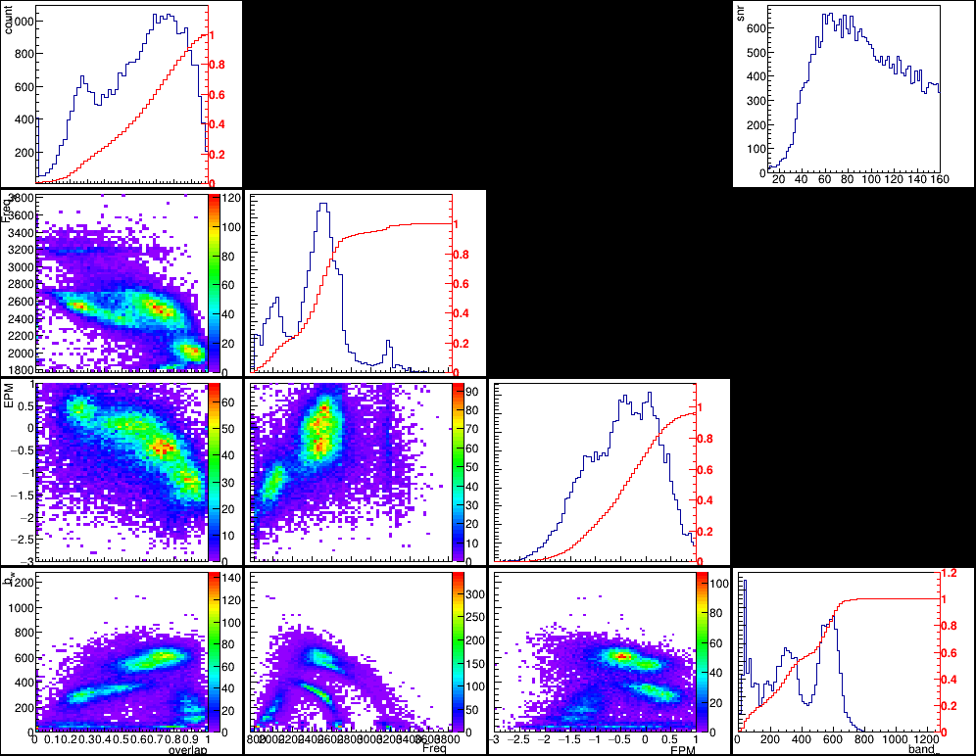
“burst” searches: interpretation challenges
interpreting the observation:
measure very general signal characteristics (mean frequency, bandwidth, duration, hrss in the network…)
calibrate with signal models
e.g. simulations informed by NR waveforms for a search for GW emission from a NS remnant after BNS merger
(A.Pucher + in progress)

Slide 4
“burst” searches: interpretation challenges
interpreting the observation:
model selection among sparse or loosely defined alternatives
coherentWB reconstruction of GW151012
investigating a sub-threshold post-merger feature
F.Salemi+
arxiv 1905.09260

Slide 6
“burst” searches: 2nd detection challenge
which agreement should we expect across different burst searches ?
background distributions of different analyses are currently independent
different analyses have different detection efficiencies for different GW morphologies

