Slide 1
Fundamental Physics Research on the Lunar Surface and
Decadal Survey for Biological and Physical Sciences in Space
Slava G. Turyshev
Jet Propulsion Laboratory, California Institute of Technology

Slide 2
Back to the Future: Lunar Mission Set During 2021 – 2028 Era
Unprecedented number of Lunar missions:
  Lunar traffic: 42+ missions are planned, including 68+ space vehicles, involving 10+ national space agencies.
  Prominent presence of private space industry, e.g., SpaceX, Moon Express, Astrobotic, Blue Origin, Sierra Nevada Corp, Masten Space Systems, etc.
Emerging trends in cislunar activities:
  Lunar surface exploration: 16+ missions will deploy a lander, a rover, or both.
  Emergence of Lunar relay orbiters: 4+ lunar relay orbiters to serve landed vehicles; navigational beacons.
  SmallSat/CubeSat missions: 16+ CubeSat and 8+ SmallSat lunar missions (many more are expected).
  Mix of crewed/robotic missions both in orbit and on the lunar surface.
  Commercially “owned” landers will deliver science instruments/tech demos on the moon.
Major technology advancements/science opportunities are expected:
  Emergence of long duration sensor networks (power permitting) on the surface.
  Increased interest in lunar far side: quite a few landers/rovers on the far side of the South Pole, etc.
  Opportunities of optical (nearside) and radio (far side) telescopes for astronomy/cosmology.
What is the role of Fundamental Physics in these activities?
  Lunar laser ranging (LLR), new CCRs, optical transceivers/telescopes, lunar radio ranging (LRR), etc.

Slide 3
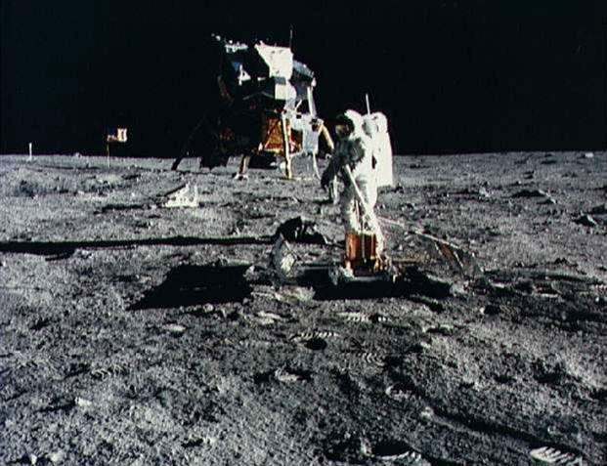
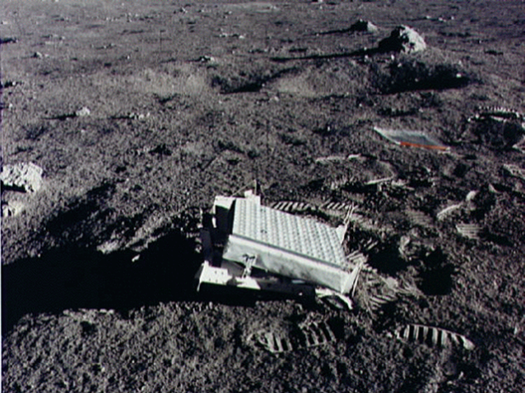
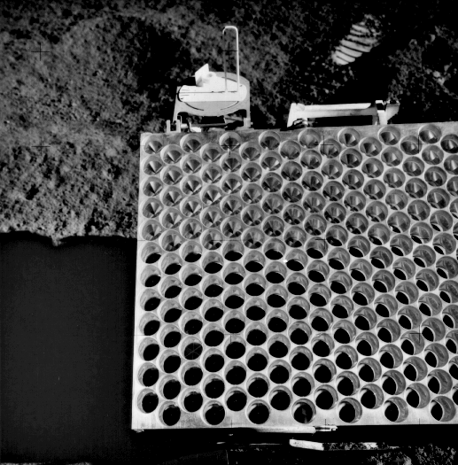
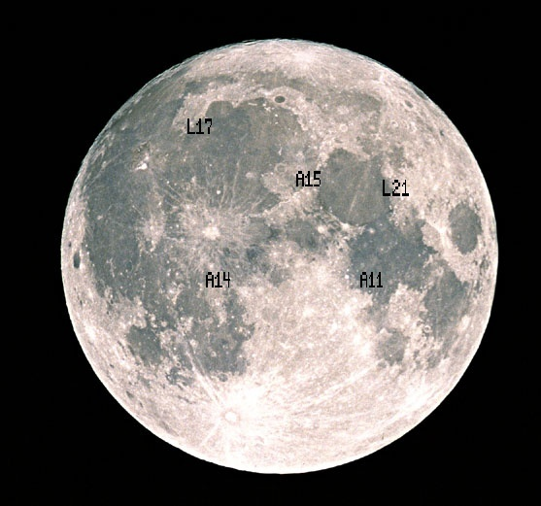
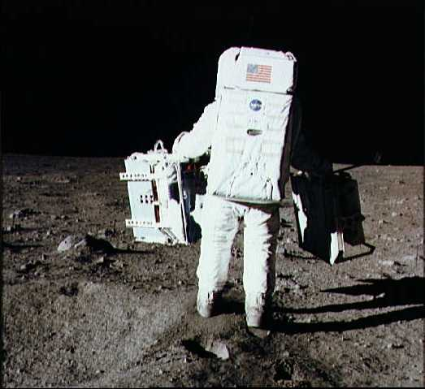
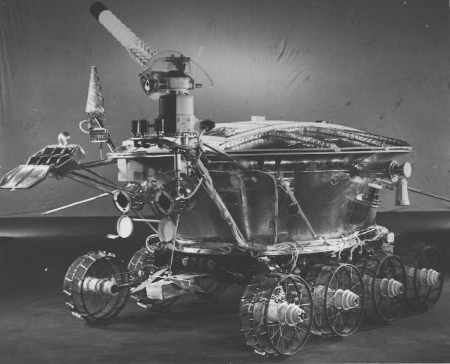
LLR is a Legacy of the Apollo Program
Apollo 11 array In 1969 initiated a shift from analyzing lunar position angles to ranges. The present-day range accuracy is ~5 mm, limited by Earth’s atmosphere.
Apollo 11
Apollo 14
Apollo 15
big telescope,
wide laser pulse
WRMS of data fit today
1.5 cm
Near-Term Goal:
WRMS post fit residuals
1 mm
Lunokhod 1 & 2
small telescope,
narrow laser pulse
Aldrin, Apollo 11
LLR is the longest running successful experiment in the history of space sciences

Slide 4
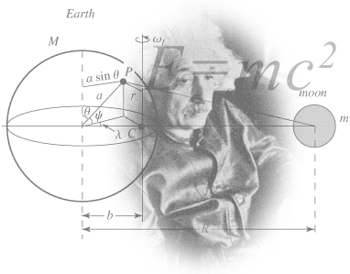
Testing General Relativity with LLR
Violation of the Equivalence Principle in PPN formalism:
EP satisfied
If 𝜂 =1, this would produce a 13.1 m displacement of lunar orbit.
By 2020, range accuracy is ∼1.4 cm, the effect was not seen.
LLR results (April 2020):
27,485 normal points through April 20, 2020,
in green and IR from OCA, APOLLO, MLRS, and HALA
– close to the Microscope (2019):
– test of the Strong Equivalence Principle
EP violated
Using Cassini ’03 result
yielded
–
Geodetic / de Sitter-Fokker precession
Hofmann & Müller CGQ 35 035015 (2018)
Biskupek et al, Universe 7, 34 (2021)

Slide 5
Advanced LLR: Anticipated Science Results & Value for Exploration
LLR and Lunar Reference Frame:
  Provides 3-D orbit/orient. of the Moon in inertial frame defined by ICRF.
  Critical for 1) establishing position & navigating s/c relative to the Moon, 2) determining position on the lunar surface.
  LLR used to determine orbit and orientation of Moon as function of time.
Anticipated/ongoing developments:
  New LLR instruments on the Moon:
    Corner-Cube Retroreflector (CCR) instruments: arrays and single CCRs,
    Laser optical transceivers.
  New LLR facilities are being developed:
    JPL’s Facility on Table Mountain Observatory, California
Science | Current (1 cm) | 1 mm | 0.1 mm
Weak EP | |Δa/a|<2.4×10⁻¹⁴ | <10⁻¹⁴ | 10⁻¹⁵
Strong EP | |η|<3.4×10⁻⁴ | 3×10⁻⁵ | 3×10⁻⁶
PPN parameter β | |β−1|<7.2×10⁻⁵ | <10⁻⁵ | 10⁻⁶
Time variation of G | 9.5×10⁻¹⁵ yr⁻¹ | 5×10⁻¹⁵ | <1×10⁻¹⁵
Inverse Square Law | |α|<3×10⁻¹² | 10⁻¹² | 10⁻¹³
Tests of GR
Lunar science

Slide 6
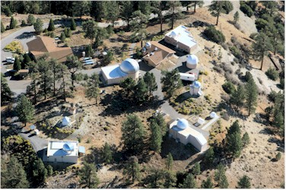
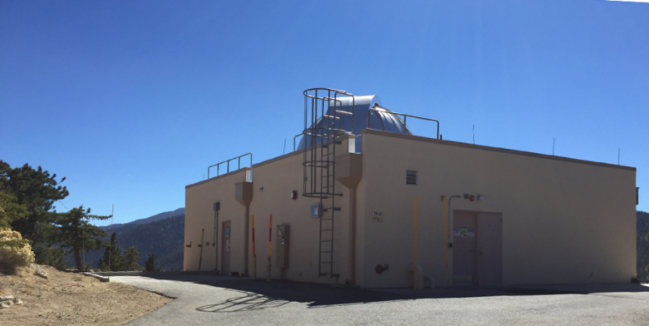
Advanced Lunar Laser Ranging (AdLLR)
New LLR facility at the JPL’s Table Mountain Observatory, CA:
  1-m telescope of the JPL’s Optical Comm. Testbed Lab. (OCTL);
  High-power (2kW average) CW laser to range the moon:
    This power is 10³ higher than is used by the LLR facility at the Apache Point Observatory (APOLLO, pulsed laser with 2W average power and 3.5-m telescope);
    TMO will pioneer differenced LLR measurements with precision <30 𝜇m (limited by Earth’s atmosphere) – a factor of 200 better than is currently possible.
New science investigations of the moon:
  AdLLR would enhance our knowledge of the deep lunar interior, beyond the GRAIL mission & current LLR efforts;
    Key new insights into origin and evolution of Moon;
    Core: shape, rotation, dissipation, free libration modes;
    Interior tidal rigidity/dissipation, regions of partial melt;
    Improved tests of relativistic gravitation.

Slide 7
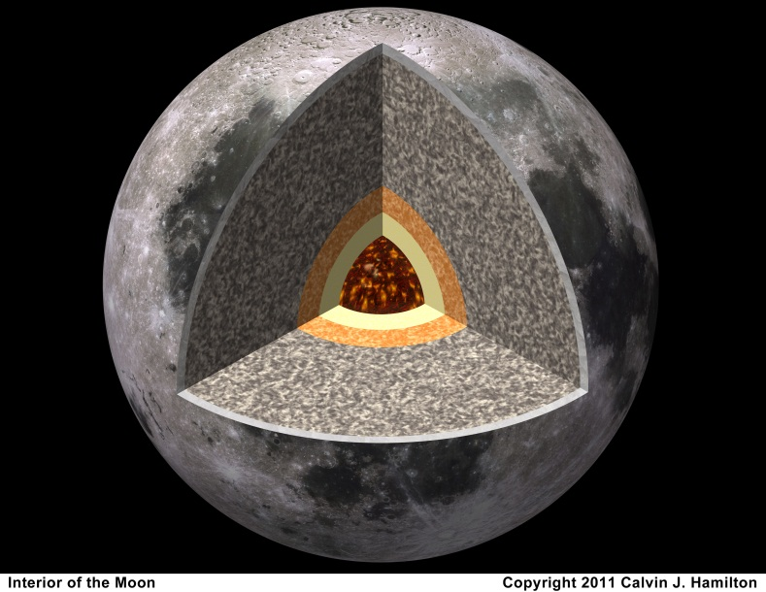
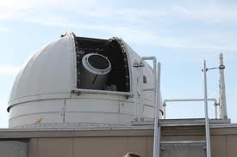
Differenced LLR: Measurement Concept
Measurement concept:
  Amplitude modulation of a CW laser with a linear frequency chirp with bandwidth of ~2GHz with range resolution of 7 cm;
  Pulse compression techniques give higher
  SNR at lower peak power (similar to RF
  radar that uses an optical carrier).
Laser ranging between TMO and the Moon:
Ranging to a CCR on Lunar Gateway/surface, could be done with ~5 mm (limited by Earth’s atmos).
Switching between CCRs on the moon and CCRs on a spacecraft in lunar orbit, can be done with accuracy ~1 cm.
Enables various investigations of the Moon (i.e., gravity field, lunar regolith, etc.)
Allows for precision NAV.
Differential LLR with COTS technology:
  1kW CW lasers modulated at GHz;
  Photon counting detectors;
  Existing corner-cube arrays
  already on the Moon.
Major progress in lunar science:
30 µm differential range precision,
limited by Earth’s atmosphere;
Focus on lunar core & deep interior:
200X accuracy gain from rotation.

Slide 8
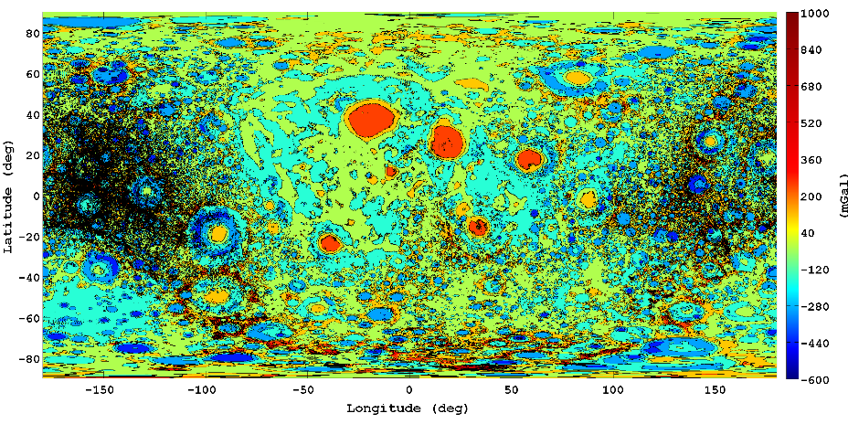
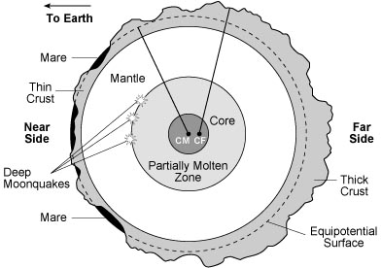
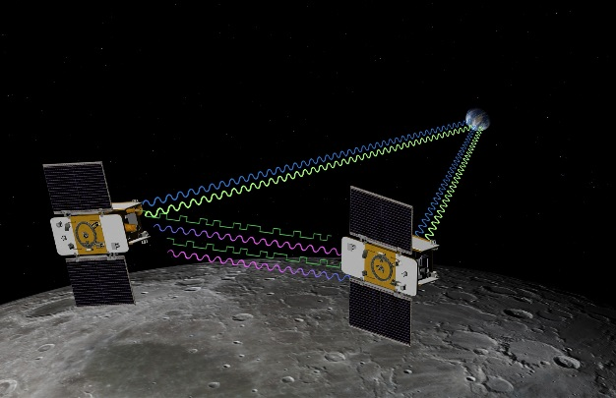
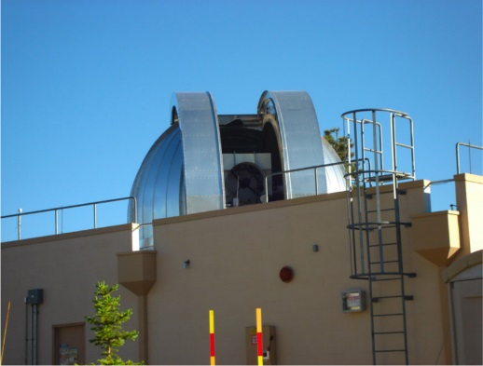
Differenced Lunar Laser Ranging (dLLR)
Improvements in LLR configuration:
Significant flux is available ~10⁴ ph/s;
Can range the moon with single corner-cube retroreflector of Apollo-type (dia 3.8 cm)
1738 km
GRAIL gravity field
Major impact on lunar science:
@LLR: lunar orientation to <0.1 mas
200X the accuracy in measuring lunar rotation vs current results from LLR and GRAIL combined;
Focus on deep lunar interior: core & properties of interior down to the last ~380 km – lunar evolution.
Properties of deep lunar interior are still uncertain

Slide 9
Watts on the Moon with a High-Power Laser Array
Night-Time Power Delivery to the Moon with
a High-Power Ground-Based Laser Array
  High power laser amplifiers are inexpensive. They may
  be combined in phased arrays with one at TMO.
  Coherent beam combination of 50-100 ground-based
  high-power CW lasers to deliver power to a panel of
  photovoltaic elements (100 m²) on the lunar surface.
  A 10x10 array of 0.3m telescopes on the Earth,
  each equipped with a high-power ~1kW laser
  could yield over 5kW continuous power supply.
  Laser beaming can supply over 5 KW of power to the
  moon at a modest cost (the least expensive solution).
Potential & Benefits
  Power delivery to any point on 1) the near side of the moon and 2) to the rim of polar craters near the
  areas with permanent darkness. (Before nuclear power is available on the moon.)
  Reliable power during 14-day-long lunar nights. Scalable solution with available technology.
  Opens paths for private space industry, aerospace community to participate in lunar exploration.
5kW “Tesla charging station” on the Moon

Slide 10
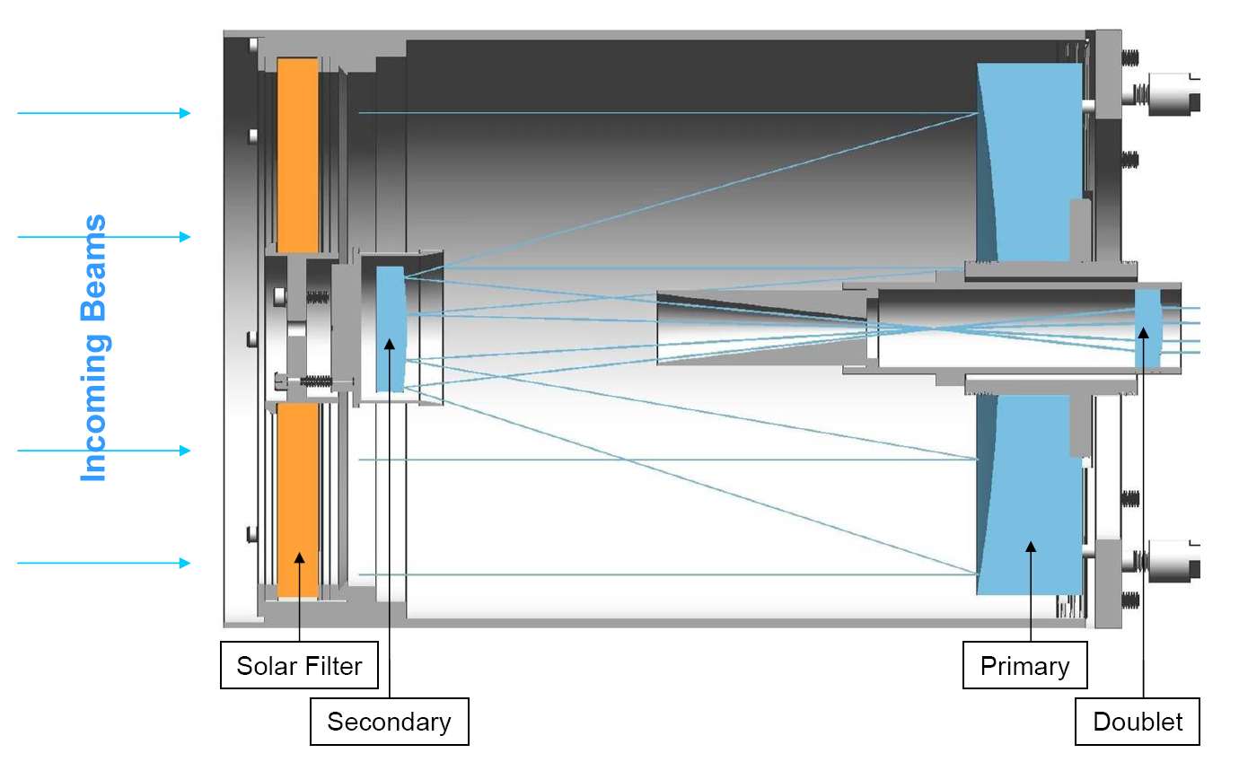
Laser Optical Transceiver (LOT): Ranging and Communication
Successful laser ranging to LRO (OCA in IR):
  2‑way laser ranging to a CCR array on LRO accurate to 3 cm (Mazarico et al, 2020)
  Paving the way for lunar laser transceivers.
Design for a LOT instrument:
  A gimbaled optical head and a body mounted opto-electronics box
    10 cm transmit/receive aperture
    4 mm sub-aperture transmit beam
LOT Capabilities
Instrumental parameter | unit | LOT
Aperture diameter | m | 0.10
Wavelength | µm | 1.06
On-board timing resolution, per photon | ns | 2
On-board timing stability, δτ/τ, in 1 ms | – | 1e-10
Ranging detector: single pixel APD | ns | 0.7
Astrometry detector: low noise sCMOS | – | 2K x 2K
Astrometric accuracy | µas | 400
Synthetic tracking architecture | – | FPGA
LOT optical channels
LOT telescope cross-section
LOT gimbaled optical head

Slide 11
LLOT Navigation & Science Capabilities
Tracking Error Source (1σ Accuracy) | units | Current X-band capability |  | Current Ka-band capability | ILRT capability
 |  | value | Int.time |  | value | Int.time
Range | m | 2 m | 10–10³ s | 0.1 | 5 mm | 10–10² s
Doppler (range-rate) | µm/s | 30 | 10–10³ s | 10 | 10 | 10–10² s
Astrometry from space | mas | 500 | 1-10 s |  | 1-10 | 3-300 s
Absolute to lunar s/c:
  SNR ~200 in 1 sec
  Range: sub-mm resolution, limited by Earth’s
  atmosphere to ~5 mm;
  Range-rate: ~5−10 μm/s, limited by Earth’s atmosph.
Differenced range @LLR:
  Switching between CCRs
  on the s/c and those on the lunar surface to take nearly-simultaneous range data;
  If two ranges are taken within 5 min, the atmospheric limit is as low as ~10 μm;
  In 100 sec, this translates to orbit determination at the level ~10 μas/s (or 50 prad/s);
  Good for navigation
Cislunar Navigation
Assumed: 0.10m aperture at 1LD distance, non-coherent detection
 | Current X-band capability | Current Ka-band capability | LOT Science Capabilities
Optical solar system science |  |  | Range 60 s | Range-rate 60 s | Angle 600 s
Gravity fields (lunar & asteroids) | 30 µm/s | 10 µm/s | 5 um | 3 µm/s
Lunar altimetry (range-Doppler) | n/a | 10 cm | 5 um | 3 µm/s
Asteroids & near-Earth objects | n/a | n/a |  |  | 0.1nrad
Tests of gravitation & ephemerides
Shapiro time delay measurements | 30 µm/s | 10 µm/s |  | < 1 µm/s
Other GR tests & ephemerides | N/A | 1 m | 5 um | 3 µm/s
Science

Slide 12
Science & Technology Advances with Upcoming Lunar Missions
Anticipated developments (2022-2027):
  New CCRs on the Moon (NGLRs, D. Currie):
    Single solid 10 cm CCRs for mm range accuracies. First deployment of these NGLRs by a CLPS provider in 2022, in Mare Crisium.
  LRR/SBI/Delta-DOR may soon be implemented (Masten PNT beacons; long-lived lunar landers).
Emerging Opportunities:
  Laser transceivers in space/surface (Comm/Nav)
  Clocks (Gateway, lunar GNSS constellations)
  High-precision laser ranging/nav from TMO:
    Lunar orbit/surface accuracy:
    Doppler to <10 µm/s; Range to <5 mm;
  Power via High-Power Ground-Based Laser Arrays
  GW detectors on the Moon
New data will benefit studies of lunar interior:
  Improve measurements of forced librations
  Measure tidal distortion (amplitude and phase)
  Lunar oscillations are due to quakes or impacts?
Improve tests of relativistic gravity:
  Time variability of the gravitational constant
  Test of strong equivalence principle
  Improve the tie between the lunar network and the radio reference frame (VLBI)
Above goals require more data, more accurate data, and unbiased measurements!
  Synergistic with emerging LRR and VLBI efforts
All these activities are directly relevant to future exploration of Mars
Missions to Lunar surface offer advances in Fundamental Physics and Lunar Science

Slide 13
Planetary, Heliophysics, Astrophysics Investigations from the Moon
Near side: Planetary science
Search for near-Earth asteroids (NEA):
  Few small (20cm) robotic optical telescopes to search for hazardous NEAs, Interstellar asteroids
  At lunar night, search in the “anti-sun” direction, inaccessible for ground-based facilities
Near side: Heliophysics
Space weather sensor network:
  To characterize lunar radiation environment
  Study fundamental physics of particle acceleration in inner heliosphere
A small low-frequency radio array:
  Dozens of antennas deployed on the moon
  Image bright emission from energetic electrons accelerated at coronal mass ejections
Far side: Cosmology & Astrophysics
  Lunar far side is the best place in the inner Solar System to monitor low-frequency radio waves — the only way of detecting some faint ‘fingerprints’ of the Big Bang.
A Low-Frequency Radio Array:
  Using HI emission/absorption signatures against the CMB as cosmological & astrophysical probe
  Mapping of the HI line brightness temperature, to determine distribution of H throughout the Universe from present day to a redshift z ~ 100.
  Objective: To constrain reionization using 21 cm observations in combination with CMB and Lyman-alpha forest data
  NASA’s Exploration infrastructure opens avenue for science exploitation of lunar far side.
Majors Science Advances via Engineering Solutions to the Power, Comm, Thermal, Dust issues

Slide 14
NASA Biological and Physical Sciences (BPS) Decadal Survey, 2023-2032
https://www.nationalacademies.org/our-work/decadal-survey-on-life-and-physical-sciences-research-in-space-2023-2032
https://surveygizmolibrary.s3.amazonaws.com/library/623127/BPSDecadalWhitePaperSolicitationCallLetterV11.pdf

Slide 15
NASA Biological and Physical Sciences (BPS) Decadal Survey, 2023-2032
2020: NASA BPS moves from Human Exploration and Operations Mission Directorate (HEOMD) to Science Mission Directorate (SMD) – creating opportunity for physics growth
BPS Decadal Survey underway with report expected in early 2023
BPS Decadal Survey Report will directly influence BPS funding allocations
  ⇒ critically important for community to respond strongly
Community response mechanism is through 5-page white papers
  Jun 17: Call for White papers released
  Oct 31: Topical White Papers due
    Science, theory, technology, experiments, programmatic recommendations, etc.
  Dec 23: Research Campaign White Papers due
    Dedicated missions, sequence of experiments
White papers are made public
Teaming encouraged, including international contributions

Slide 16
Fundamental Physics White Paper Decadal Workshops
Cold Atom Physics – Apr 23, 2021
Dusty/Complex Plasmas & Lunar Dust Physics – May 26-27, 2021
Quantum Entanglement Physics – June 3, 2021
Physics with Atom Interferometers – June 11, 2021
Physics with Optical Clocks – June 17, 2021
Fundamental Physics on the Lunar Surface – Aug 18, 2021
  White Paper Objective –> BPS Decadal priority recommendations
    BPS funds community aimed towards fundamental physics research on lunar surface
    BPS funds development of Keystone mission(s) for lunar surface
White Papers must Focus on Science, but can have many flavors
  Experiments, Theory, Technology, Missions, etc.
    Gravitational Wave Detectors and Fundamental Physics
    Lunar Laser Ranging and Fundamental Physics
    Exploration topics: positioning, navigation, timing

Slide 17
Two types of white papers:
Two types of white papers are sought:
  Topical white papers (due Oct 31, 2021) that focus on a single research area, scientific investigation or experiment. There is no specify minimum cost or maximum duration;
    i.e., GW wave detection from the moon, as a high value research topic (one-two papers)
  Research Campaign white papers (due Dec 23, 2021) that address broad or large-scale goals and may span multiple topics or disciplines, multiple missions, or multiple platforms, but that logically aggregate into a single, defined mission concept. Such proposed campaigns will have a minimum total project cost of $100M, may include a dedicated spaceflight, and will have a maximum duration of 10 years.
    i.e., Various proposals to implement a moon-based GW observatory (as many as needed)
Your white paper should articulate how the proposed science represents one or more of the following priorities:
  Science that can or must be done in space, with anticipated value to human exploration
  Science that can be done in space, with anticipated value to humans on Earth
  Science that can be done in space, because the reduced gravity environment enables cleaner analysis of fundamental research questions

Slide 18
