Slide 1
‘Tower WG’ and EGO kick-off meeting of the UHV tubes WG
05 Nov. 2021

Slide 2
Interdependent vacuum requirements
Towers WG : design of the vacuum systems hosting the super attenuator and payloads-HF, material qualifications and auxiliary systems.
interfaces with the ‘’UHV tubes‘’ via the ‘’cryostats WPIV.3 , WPIV.4 ‘’:
design pressures ( pump-down procedure, safety redundancies, ...)
coherent approach w.r.t. chosen design margin and overall facility limits
‘underground’ logistic (installation strategy, service room, ...)

Slide 3
Subjects of possible common interest
VACUUM CONTAMINANTS CONTROL (Hydrocarbons)
- Study of diagnostics to be applied during the production , qualification and operation of towers - novel cleaning treatment for tower chambers (plasma processing, … )
SPECIALIZED VACUUM TECHNOLOGIES
- Shields for charges dispersed from large Ion pumps - Affordable large metal seals - Large viewports policy and management of ‘breaking risks’
VACUUM-COMPLIANT ‘BLACK’ MATERIALS
coatings or conditioning of the inner - large walls - of towers chambers (and inter-connecting pipes ) - performant w.r.t. stray light mitigation - performant w.r.t. UHV (research on physical/chemical treatments for water outgassing reduction)
CONTROL OF DUST PARTICLES IN VACUUM CHAMBERS
- State-of-the-art methods to measure the concentration of dust particles on the walls of chambers

Slide 4
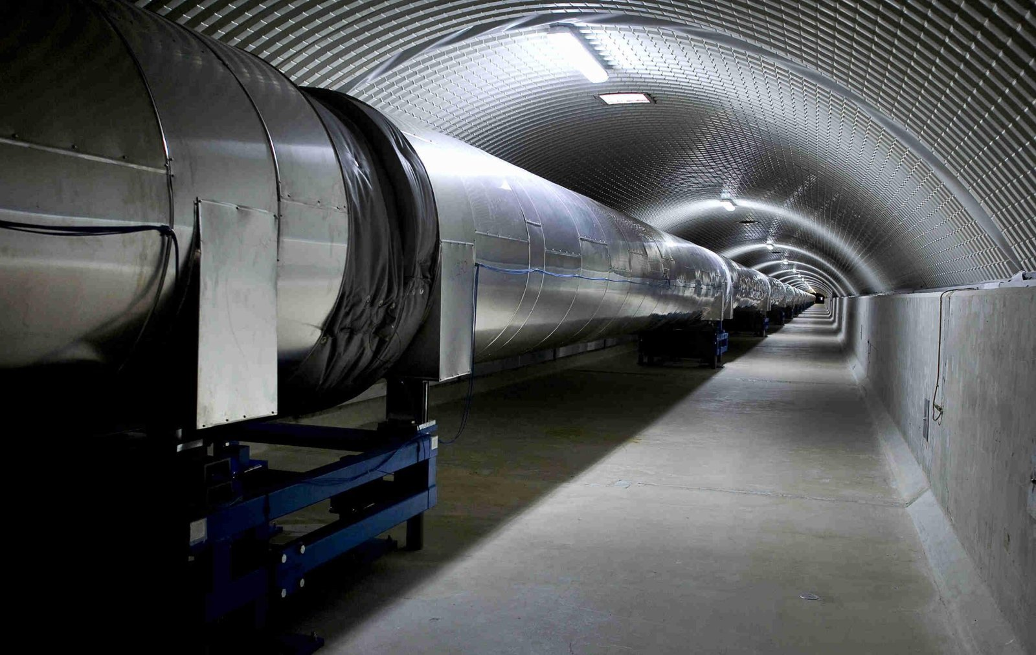
UHV tubes - Virgo experience
Diameter ! Optimization wrt noise effects possible?
Operational strategies (sectioning and dedicated large valves, maintenance needs over 50+ years, ...)
Intermediate phases foreseen ? (vacuum above the design level during ‘commissioning periods’ for instance; for ‘towers’ as well ...)
ET-0004A-19 Virgo Vacuum System

