Slide 1
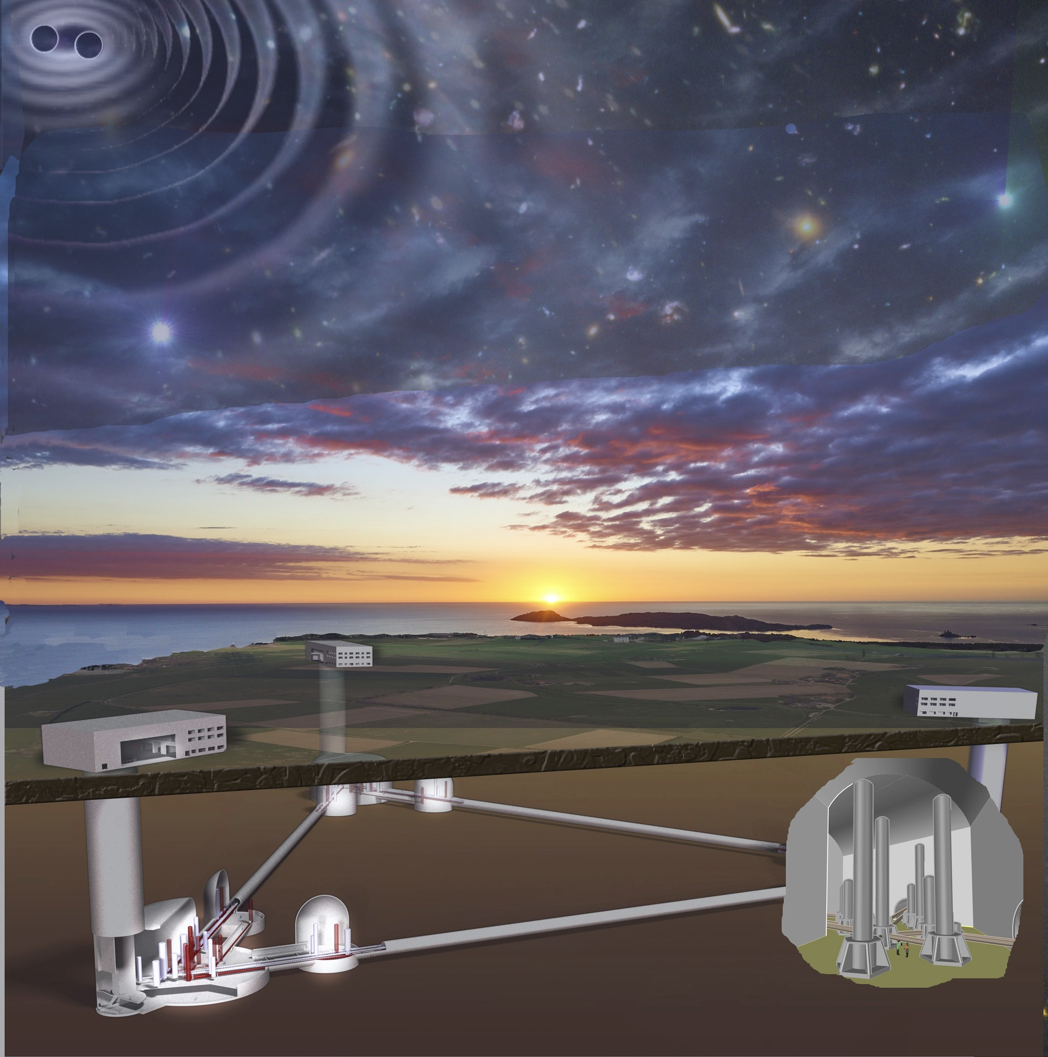
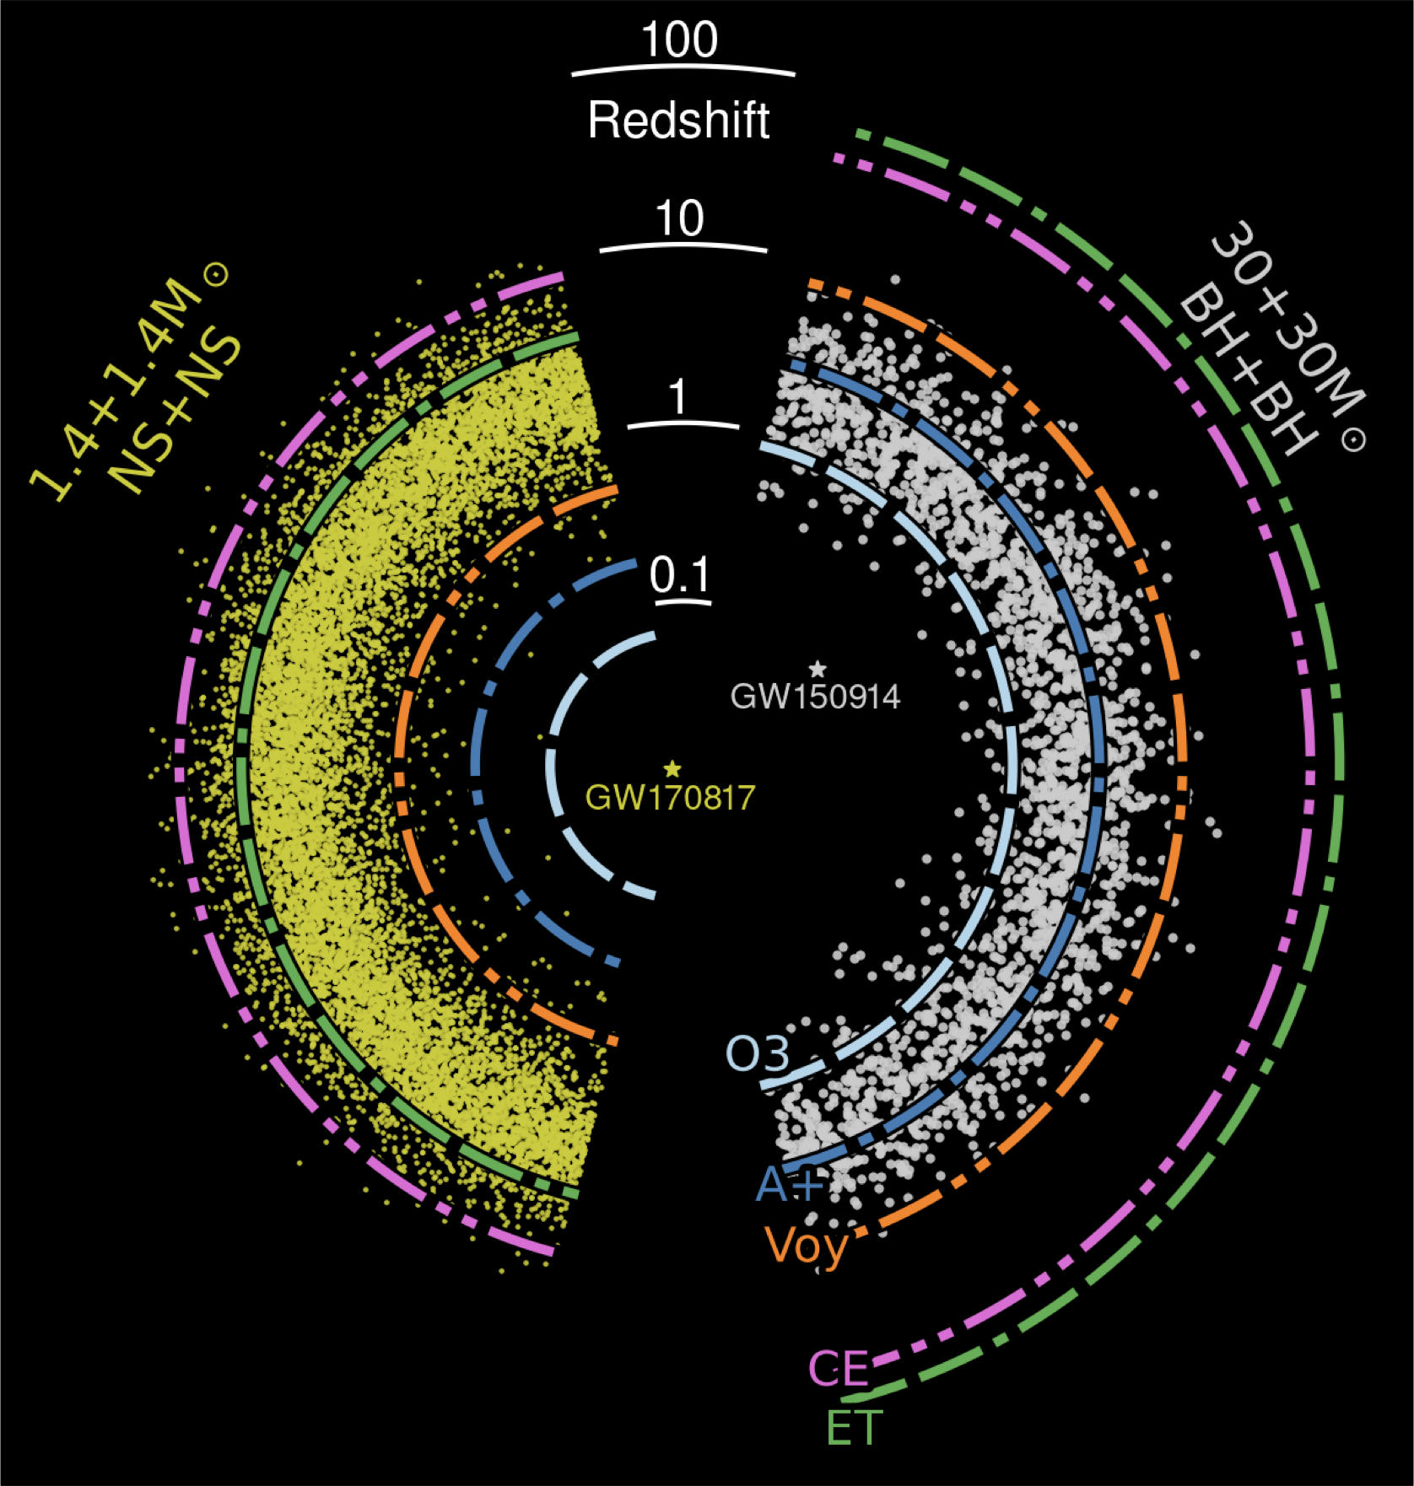
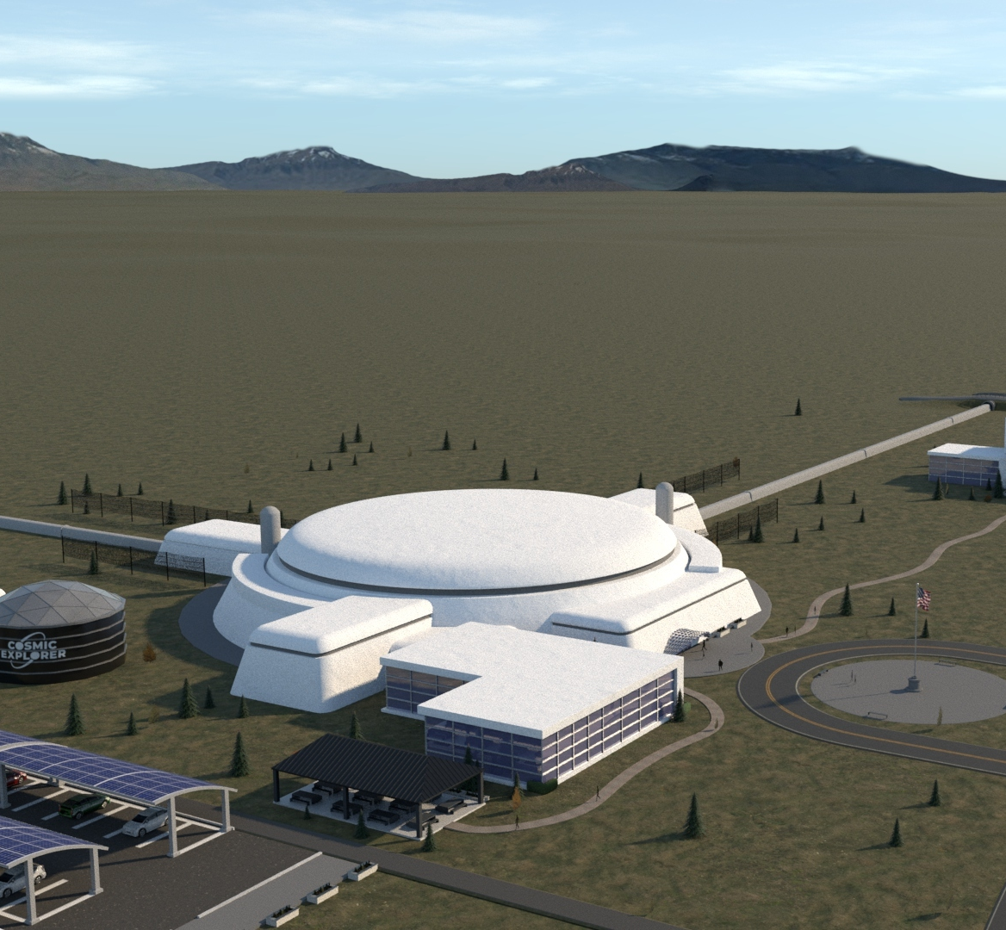
XG* Mock Data/Science Challenge
Tania Regimbau and B.S. Sathyaprakash
In collaboration with ET OSB-DA, Syracuse University and MIT
*let us use XG (for neXt generation) rather than 3G as the latter sounds ancient

Slide 2
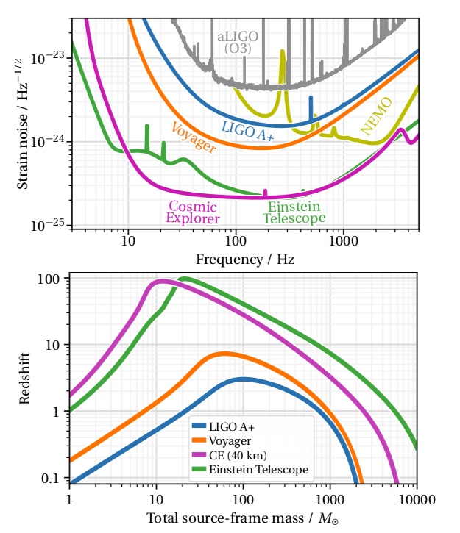
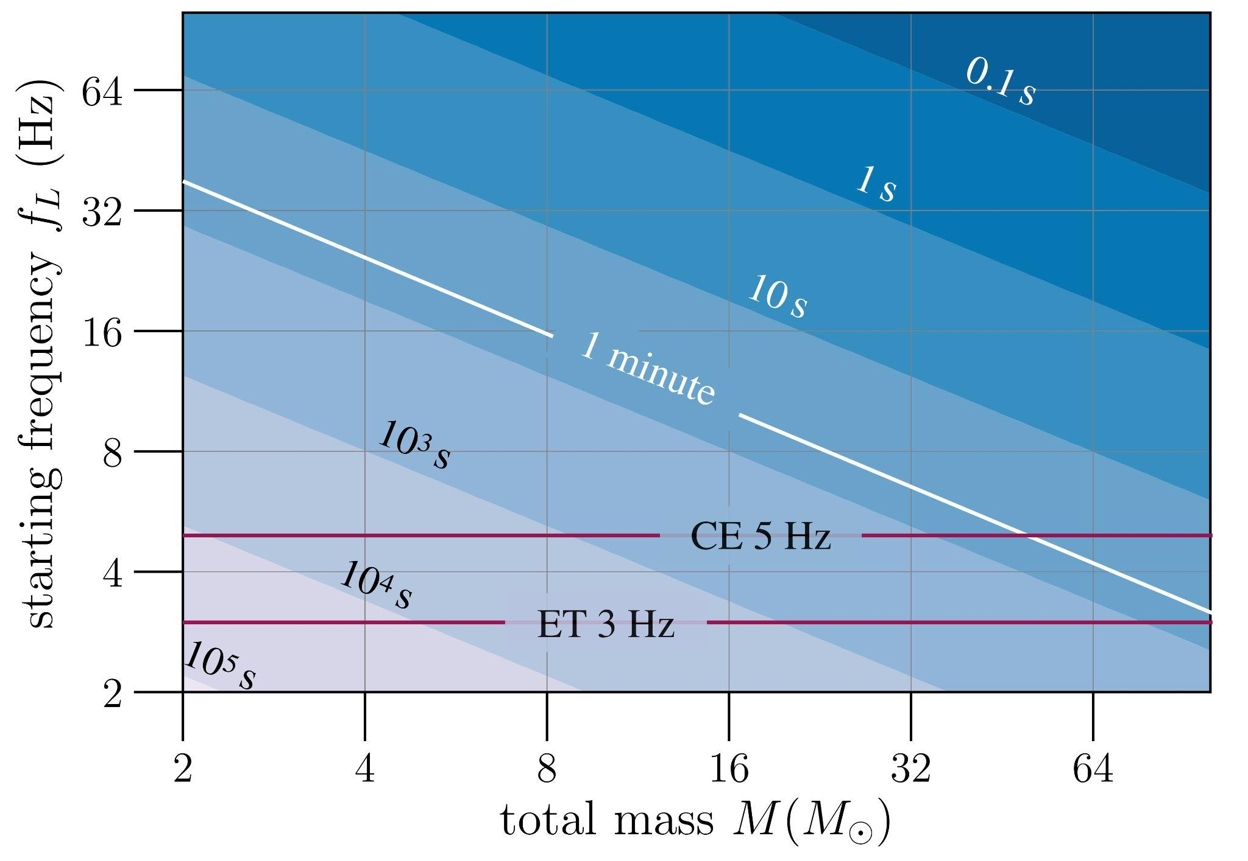
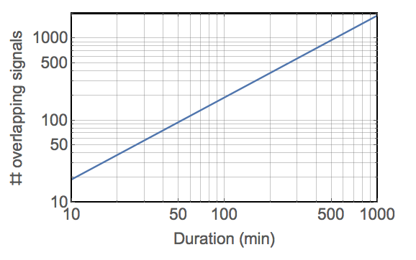
From 2G to XG
Gain of a factor of 10 and lower frequency bound
Triangle configuration for Einstein Telescope and CE40 and CE20
New possibilities (null stream, new algorithms, new computing technology, new synergies)
New challenges (long-waveforms, overlapping signals, strong foreground, correlated noise)

Slide 3
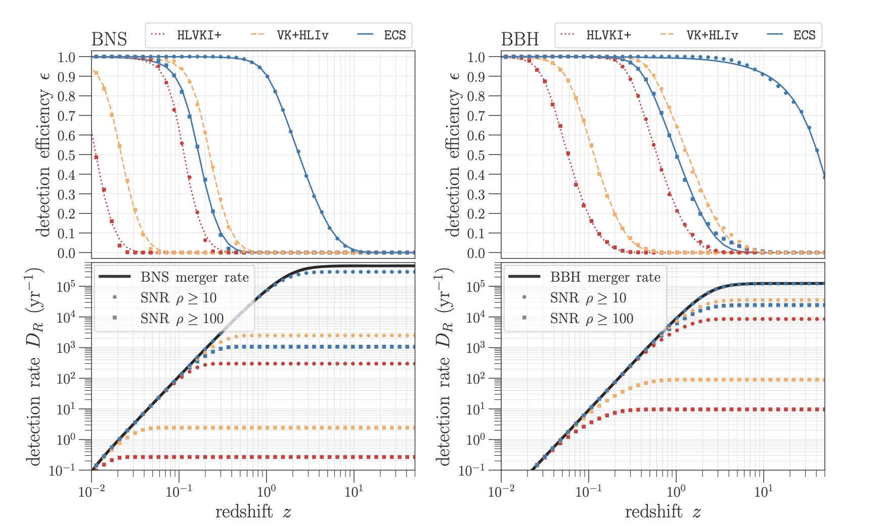
Purpose and Scope
A+ gen, Voyager gen, XG
XG observatories will detect thousands of signals every day
Weak signals, loud mergers,
BNS, NSBH, BBH, SN bursts, CW, …
Current algorithms are woefully inadequate for parameter inference
a series of progressively more difficult challenges
trigger the development of new algorithms for detection and inference

Slide 4
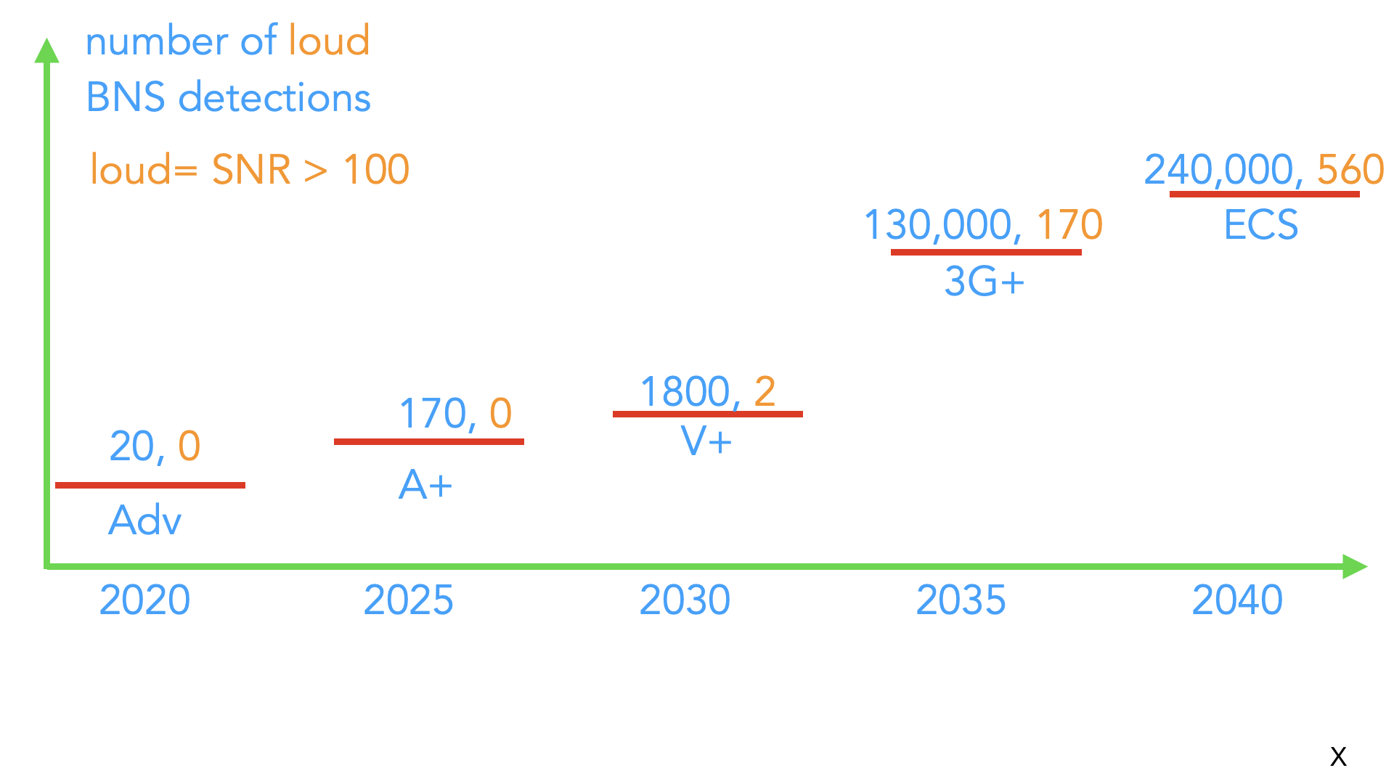
3 XG Observatories
1 XG Observatory
Voyager network

Slide 5
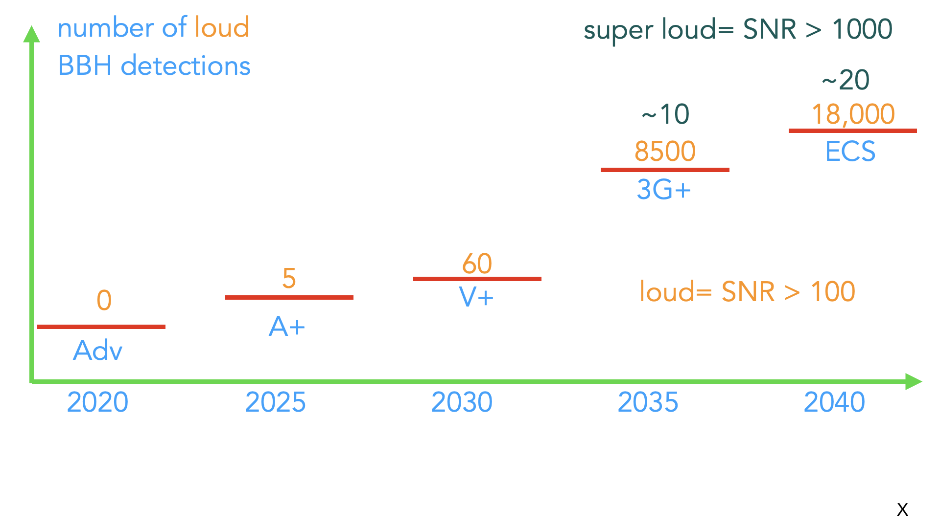
XG observatories will detect almost every BBH merger up to z~10
3 XG Observatories
1 XG Observatory
Voyager network

Slide 6
Strong Endorsement from the US Decadal Survey
… new, coordinated advances in several areas are required to unlock the workings of the dynamic universe
Strong software and theoretical foundations to numerically interpret the gravitational wave signals from merging compact objects to extract new physics in the extremes of density and gravity, and ensure easy user access to the wealth of data on the dynamic universe and to model and interpret astronomical sources whose physical conditions cannot be replicated in laboratories on Earth
New Windows on the Dynamic Universe, Astro2020 Decadal Survey

Slide 7
Mock data challenges
Goal: develop/test/optimize DA methods and parameter estimation
Realistic 3G noise
Different design sensitivity curves
Correlations between IFO channels (Janssens 2022:magnetic (PRD) ; seismic&NN (TDS))
New families of glitches
Calibration uncertainties
Signals
CBCs / CWs / SNae / Stochastic
Exotica
Need input from other divisions for specifications
Evaluation
Evaluation criteria driven by science goals
Feedback to instrument science groups

Slide 8
Previous MDCs : results
Past ET MDCs including detection+signature in the null stream
First MDC: https://arxiv.org/pdf/1201.3563
Residual background from CBC (BBH, BHNS, BNS)
Second MDC: https://arxiv.org/pdf/1404.1134.pdf
Overlapping signals (analysis with GSTLAL down to 5 Hz)
Second MDC: https://arxiv.org/pdf/1511.01592
Foreground subtraction
https://arxiv.org/pdf/2002.05365.pdf, https://arxiv.org/pdf/gr-qc/0511092
Studies on the Null stream
https://arxiv.org/pdf/2204.08533, https://arxiv.org/pdf/2205.00416
Studies on the strength of foreground
https://arxiv.org/pdf/1611.08943
Previous ET MDCs

Slide 9
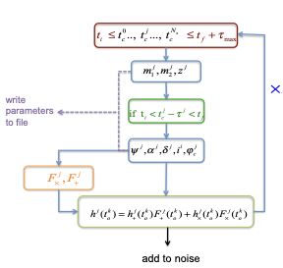
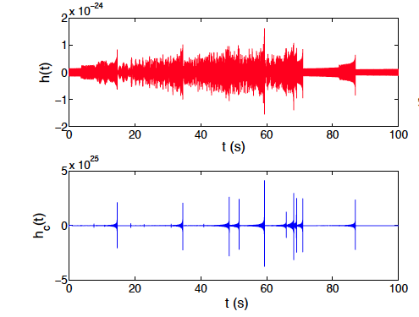
Current software : MDC_Generation
Package used for the first ET MDCs in 2012-2015. Monte Carlo techniques to generate time series on E1, E2, E3 and the null stream containing colored Gaussian noise and the GW waveforms from all the CBC up to z~10.
Previous ET MDCs
"Mock Data Challenge for the Einstein GW Telescope",
2012PhRvD..86I2001R

Slide 10
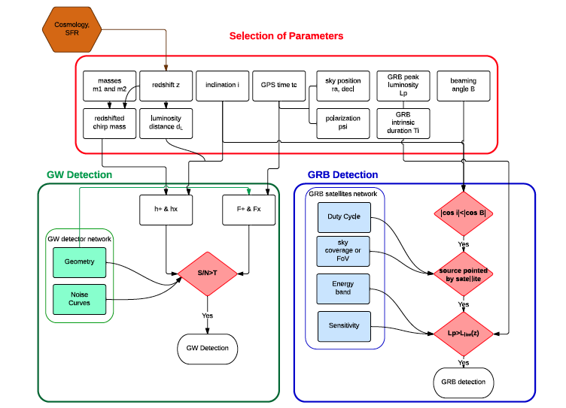
Current software : MDC_Generation
Can be (easily) extended to include other sources, more realistic noise and multimessenger
For exemple GW/GRB:
Previous ET MDCs

Slide 11
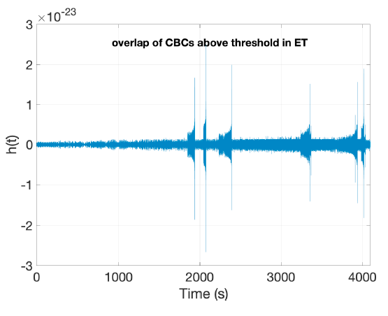
Vanilla MDC: Current Status
Test the actual tools/identify new problems:
Initial MDC dataset by the end of the summer
a month/year with only compact binaries
waveform model with no eccentricity/tidal effects
population model from Mapelli’s group
Gaussian noise
Test null stream performance
see Goncharov, Janssens papers circulated recently

Slide 12
XG MDC: 3 Challenges over 3 Years
Challenge A: Three data sets, each one year long, containing only compact binary signals: (a) binary neutron stars, (b) binary black holes, (c) neutron star-black hole binaries.
Challenge B: Three, year-long data sets, containing binary merger signals but with different cosmological parameters; also supernova bursts and continuous waves but not part of the challenge.
Challenge C: Same as Challenge B but add continuous waves and supernova burst signals to the challenge and non-general relativistic signals aimed at totally new discoveries.

Slide 13
Challenge A

Slide 14
Challenge B

Slide 15
Challenge C

Slide 16
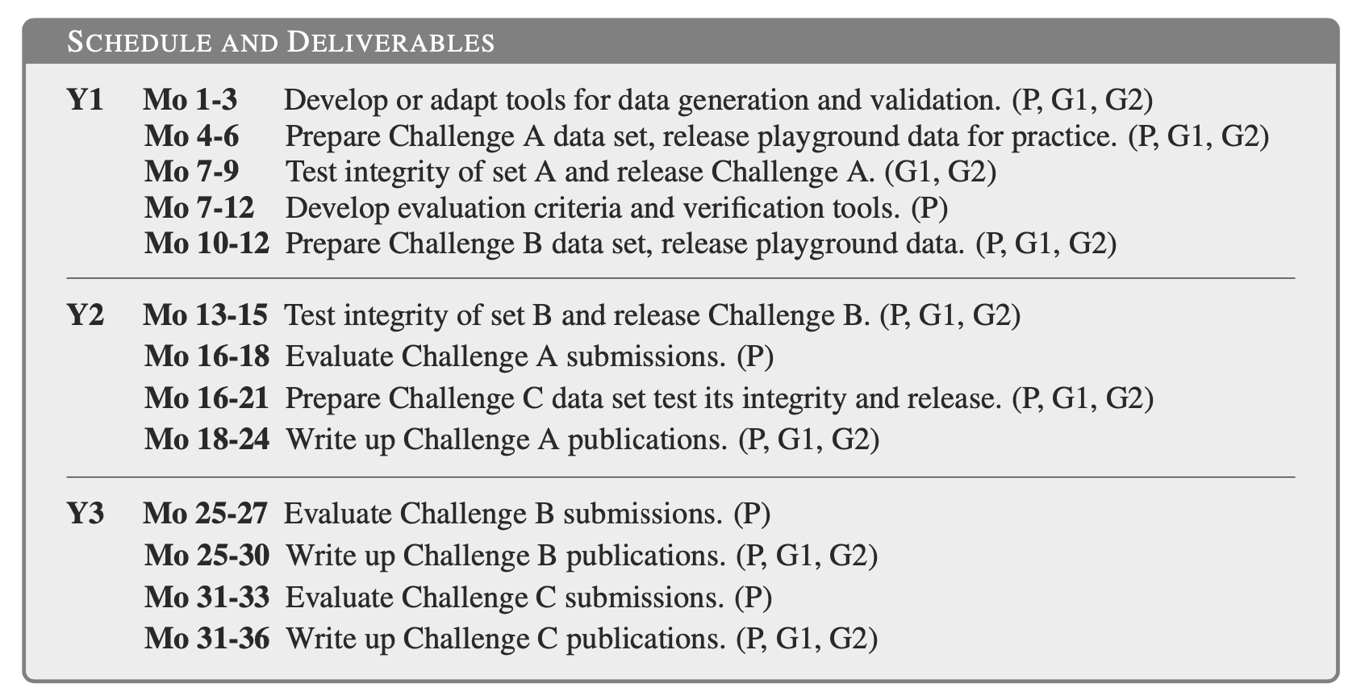
Schedule (starting September 2022)

Slide 17
Community engagement
MDCs produce only data sets
Data will be available in HDF5 and Frame formats accessible on various data grid platforms
Git repos will be used to host wiki pages, challenge descriptions and results, etc.
Community engagement is critical in the development of new algorithms
A lot to learn from other communities (LISA, transient astronomy, etc.)
Monthly calls to receive input and feedback, and provide updates on progress
Community should determine the nature of the challenge data set
Yearly 2-day workshops
MDC Kickoff Workshop, hybrid (in-person and remote) in Fall 2022
Participate and let us know what we you would like the challenges to be
Publications
MDC team will prepare overarching publications on the results of the Challenges
Individual and small group publications are encouraged and necessary for the success of this endeavour

