Slide 1
Advanced Virgo+: status and plans
Raffaele Flaminio
CNRS/LAPP
On behalf of the Virgo Collaboration

Slide 2
Advanced Virgo+: content & schedule
Two phases project
  Phase I (before O4 run/2022-23)
    Mainly an upgrade to reduce quantum noise: no mirrors change
    Reduction of technical noises
    Preparation of Phase II
  Phase II (before O5 run/2025-26)
    More invasive upgrade to reduce thermal noise: mirrors change
Approval
of Phase I

Slide 3
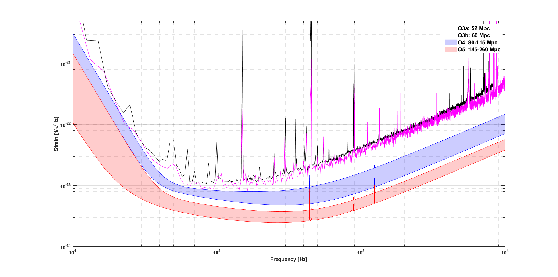
Advanced Virgo+ design sensitivity
Phase I: reduce quantum noise, hit against thermal noise. BNS range: 100 Mpc’s
Phase II: lower the thermal noise wall. BNS range: 200 Mpc’s or more

Slide 4
AdV+ Phase I

Slide 5
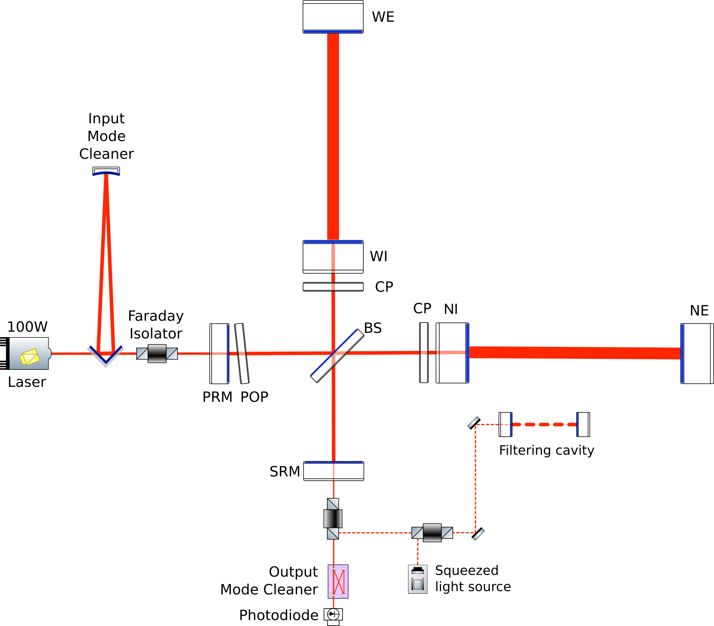
Advanced Virgo+ Phase I

Slide 6
Advanced Virgo+ Phase I
New IMC payload ✓
+
Instrumented baffle ✓
Newtonian Noise cancellation ✓
Auxiliary lasers ✓
HVAC noise reduction ✓
Air pressure
reduction in CITF
✓
Laser Upgrade ✓
SR mirror ✓
Frequency
Dependent
Squeezing
(QNR system)
✓
New OMC ✓
Scattered light mitigation ✓
New photodiode electronics

Slide 7
Advanced Virgo+ Phase I
Installation of main interferometer completed in December 2020
  ⇒ Commissioning of main interferometer started in January 2021
Installation of quantum noise reduction system completed in April 2021
  ⇒ Commissioning of quantum noise reduction system started in May 2021
Great effort done to complete the installation during the pandemic
  Wish to thank all those who continued working and travelling for Virgo during those difficult times

Slide 8
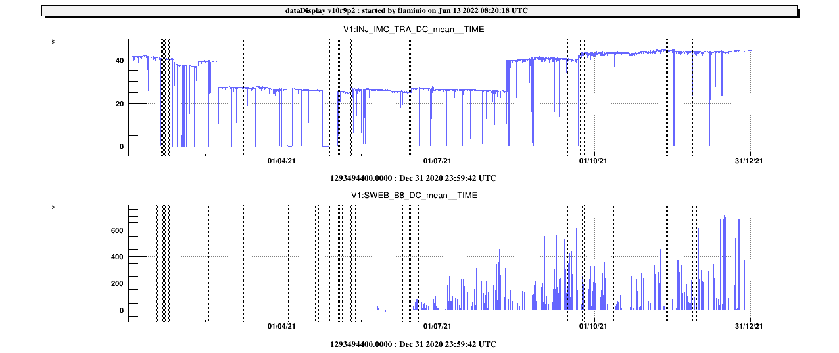
One year of commissioning: 2021
Injected power (W)
Nominal
power (40W)
Power
decrease (33W)
40
O3 power
(25W)
20
0
Ring Heaters
ON
First lock
@ 33 W
Power in the arms (a.u.)
First lock
@ “40 W”
First lock
@ “25 W”
Power in the arm during O3
(with 25W input power)
Jan | Feb | Mar | Apr | May | Jun | Jul | Aug | Sep | Oct | Nov | Dec

Slide 9
Main results in 2021
Thermal compensation system (TCS) is needed to acquire lock
  Commissioning with TCS actuators (CO2 or Ring Heaters) OFF were lost of time
Thermal compensation needed but not enough to make long locks
Locking stability dependent upon the alignment of signal recycling mirror
  Possible to obtain long locks (several hours) with good alignment
Observation of an unexpected (and varying) interferometer optical response
  Optical spring
  Cause of difficulties with ITF control
    Later simulations show that alignment of SR do impact the optical spring

Slide 10
Results in 2022
Mirrors and beams found off-centered by ~0.5 cm:
  Re-centered
Implementation of automatic alignment
  5 out of 6 degrees of freedom under control (but only 3 using the carrier field)
  Work to be completed
Locking achieved for several hours at many occasions
Main issues
  Reproducibility and reliability of locking
  Residual “motion” around the locking point

Slide 11
Results in 2022
Other interesting observations
Not good overlap of carrier and sidebands beams in the recycling cavity
  Partly (but only partly) reduced with better PR mirror centering
Interferometer bi-stabilities i.e. “jumps” from one state to another while locked
  Mitigated with tuning of RoC of the Fabry-Perot mirrors (and maybe a better mirror alignment/centering)

Slide 12
Results in 2022
Simulation shows that error in radius of curvature of PR mirror could induce optical spring in the ITF transfer function
Calculations shows that mismatching of recycling mirrors RoC’s impossible to compensate with available actuators
Currently considering the installation of an additional actuator to decouple the tuning of the recycling mirrors RoC and improve the recycling cavities matching
  Current actuators can only act at the same time on both PR and SR

Slide 13
Path towards O4
Main milestones
  First locking acquisition
  Stable and automatized interferometer locking & alignment
  First sensitivity curve & start of noise hunting
  Injection of frequency dependent squeezing & start of full noise hunting
  Good sensitivity to start O4
  Start of engineering run
  Start of O4
But real plan was and is still missing
DONE

Slide 14
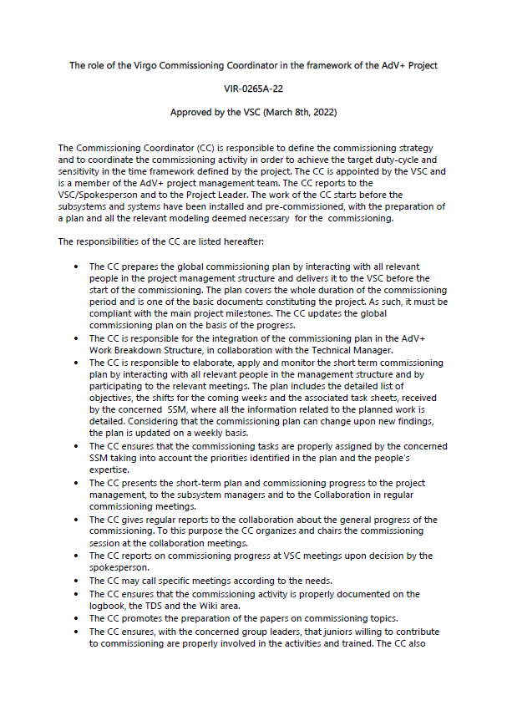
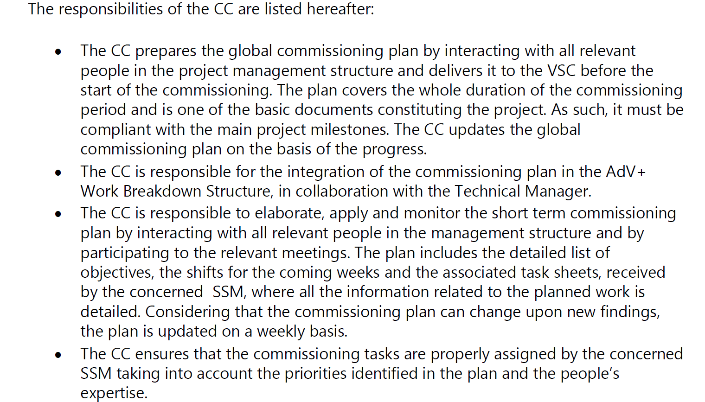
Commissioning organization
Commissioning is managed by the commissioning coordinator (CC)
  Elected by the VSC and integrated within the project
  Role of CC defined by the VSC

Slide 15
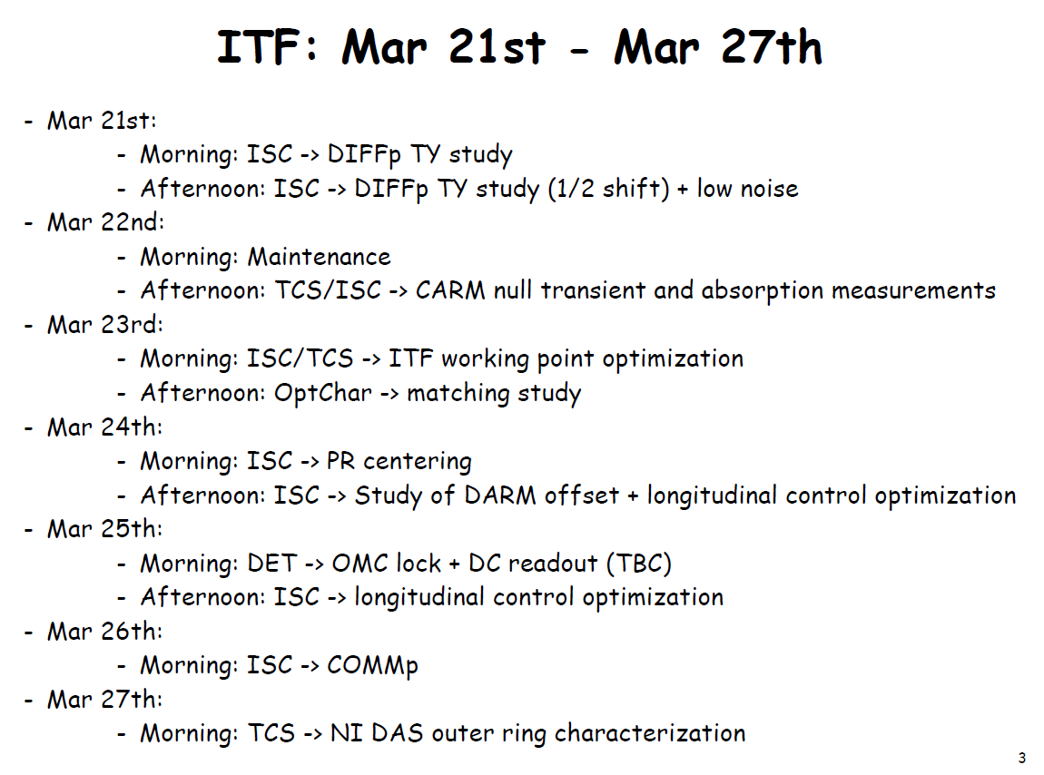
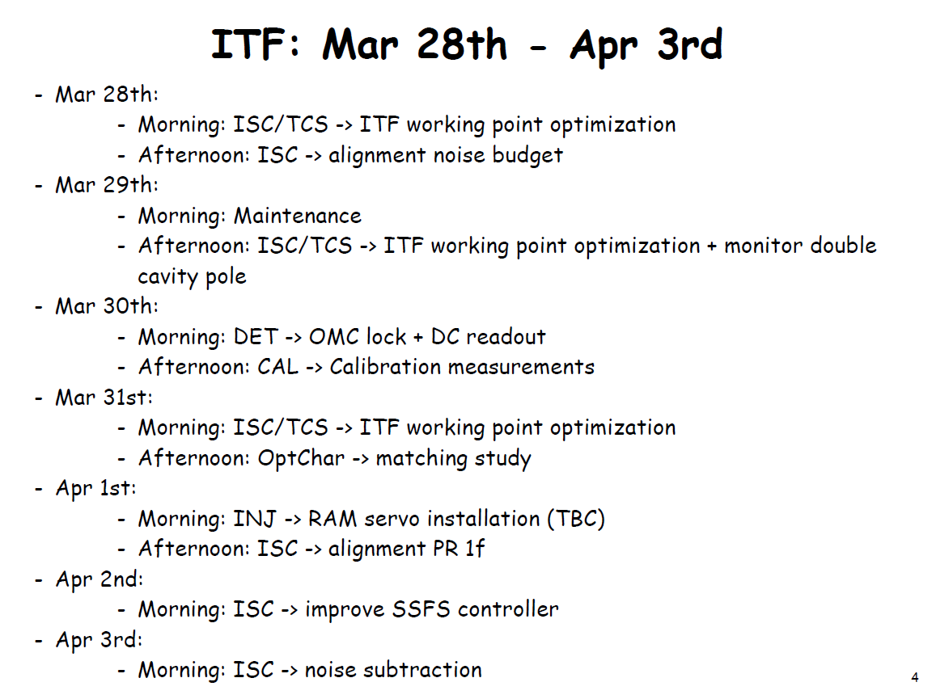
Commissioning organization
Commissioning short term plan (2-3 weeks) discussed regularly:
  Commissioning meeting (every other week)
  Management team meeting (every other week)
  Subsystem manager meeting (every other week)
Discussion based on short term shifts plan presented by the CC
  E.g.
Commissioning plan not available yet

Slide 16

Support to commissioning
Good progresses of the Quantum Noise Reduction system (QNR)
Difficulties on the Interferometer Sensing & Control (ISC)
Several people moved to ISC from QNR
and from other groups last fall
  2 from QNR (CNRS/APC & Nikhef)
  2 from INJ (EGO)
  1 PhD student (Nikhef)
A dozen people working on ISC today
  By far the largest commissioning team
  A few more people helping with simulations
QNR
ITF

Slide 17
Support to commissioning
Creation of an optical tuning working group (lead by an ex-CC) to help the coordination of a transversal activity, critical for the commissioning of the interferometer
  Placed under the subsystem Optical Simulation and Design
    Nice bridge with simulation experts
Creation of a task force made by “grey hair” experts in the field of commissioning to support the commissioning coordinator
  Composition initially proposed: 2 people from CNRS, 2 people form INFN, 2 people from NIKHEF
  Actual composition: 2 people from CNRS, 1 person from INFN
  Task force invited to participate into the discussions about commissioning
Specific review of the Interferometer Sensing & Control done by the project this year
  Six experts of commissioning helped as referee

Slide 18
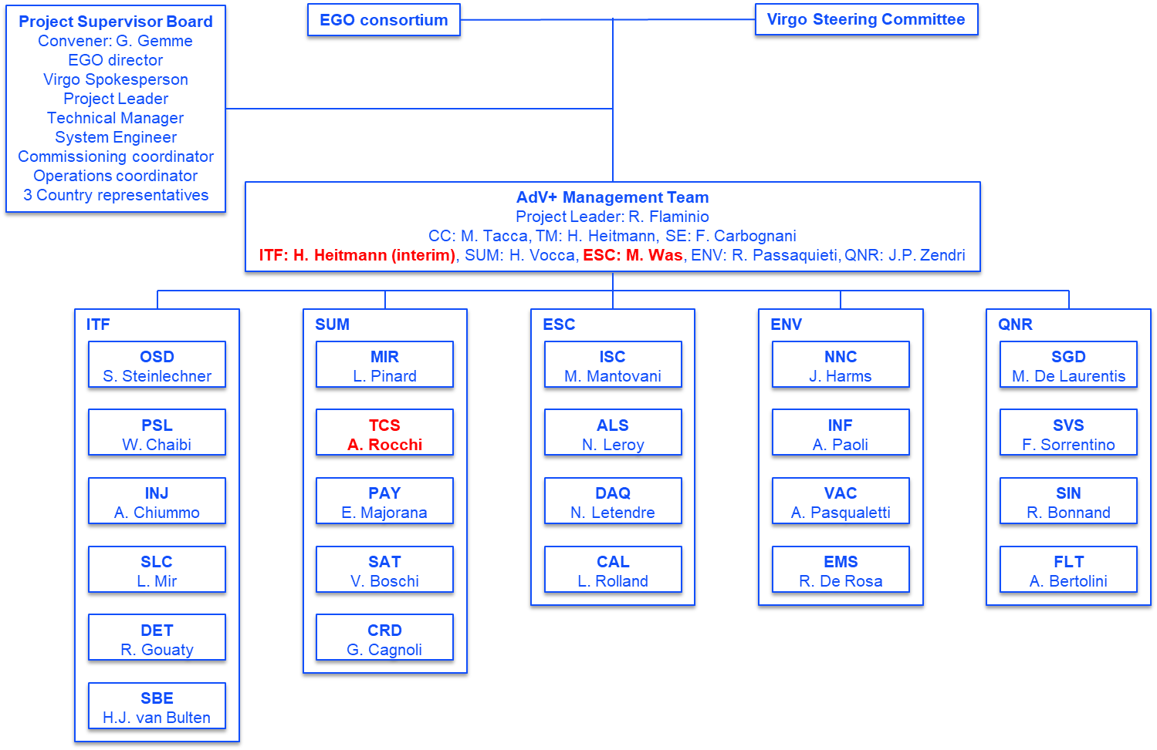
A few change in responsibilities
System manager of Electronic, Software and Control (ESC)
  B. Swinkels (NIKHEF) stepped down
    taken by other duties related to ET
  Replaced by M. Was (CNRS).
System manager of Interferometer (ITF)
  M. Was (CNRS) became ESC system manager.
  Replaced (interim) by H. Heitmann (CNRS)
Subsystem manager of Thermal Compensation (TCS)
  V. Fafone (INFN) stepped down
    Covering by several duties within Virgo
  Replaced by A. Rocchi (INFN)

Slide 19
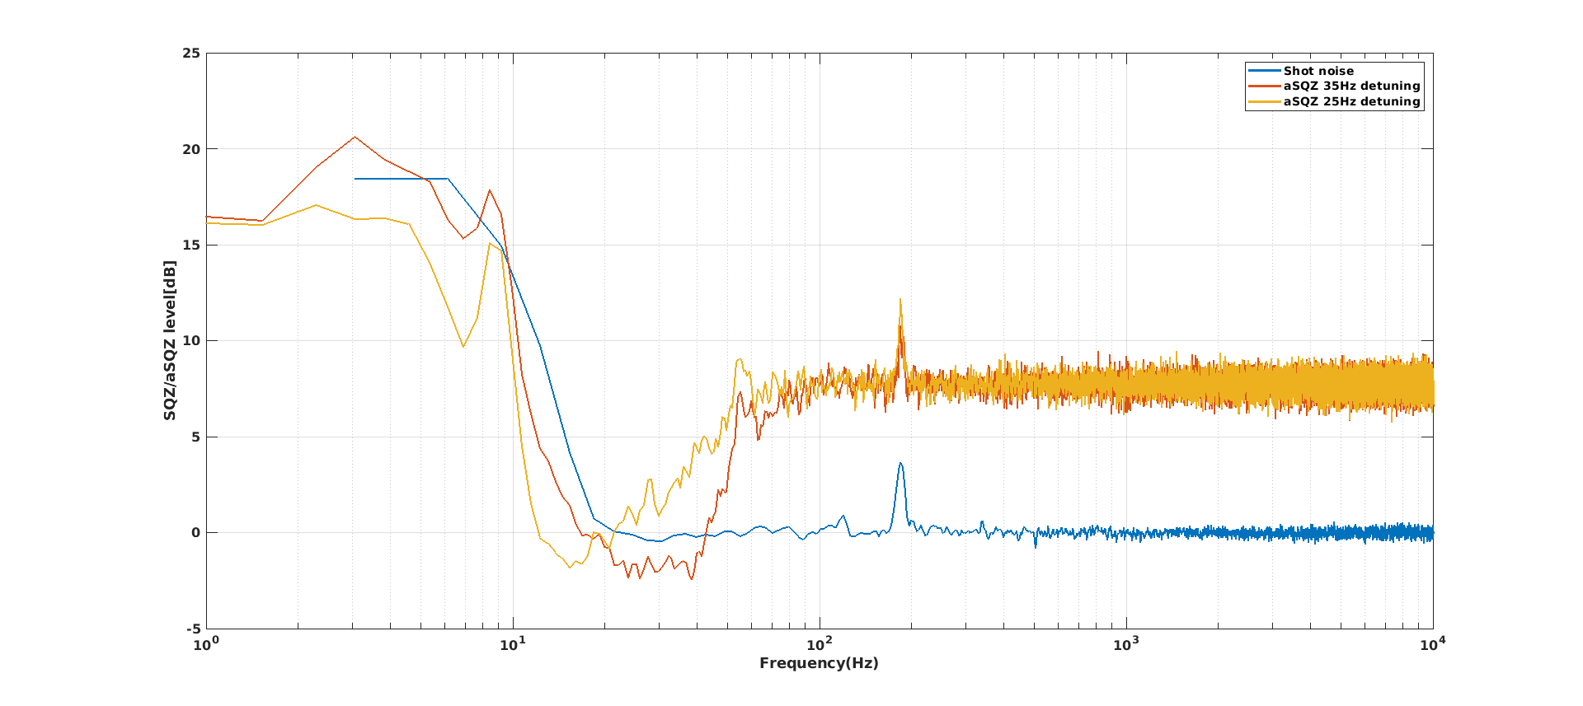
Quantum noise reduction system
Good progresses in the commissioning of this system
Main achievement
  Squeezing produced
  300 m filter cavity locked
  Frequency dependent squeezing
  measured below 20 Hz

Slide 20
AdV+ Phase II

Slide 21
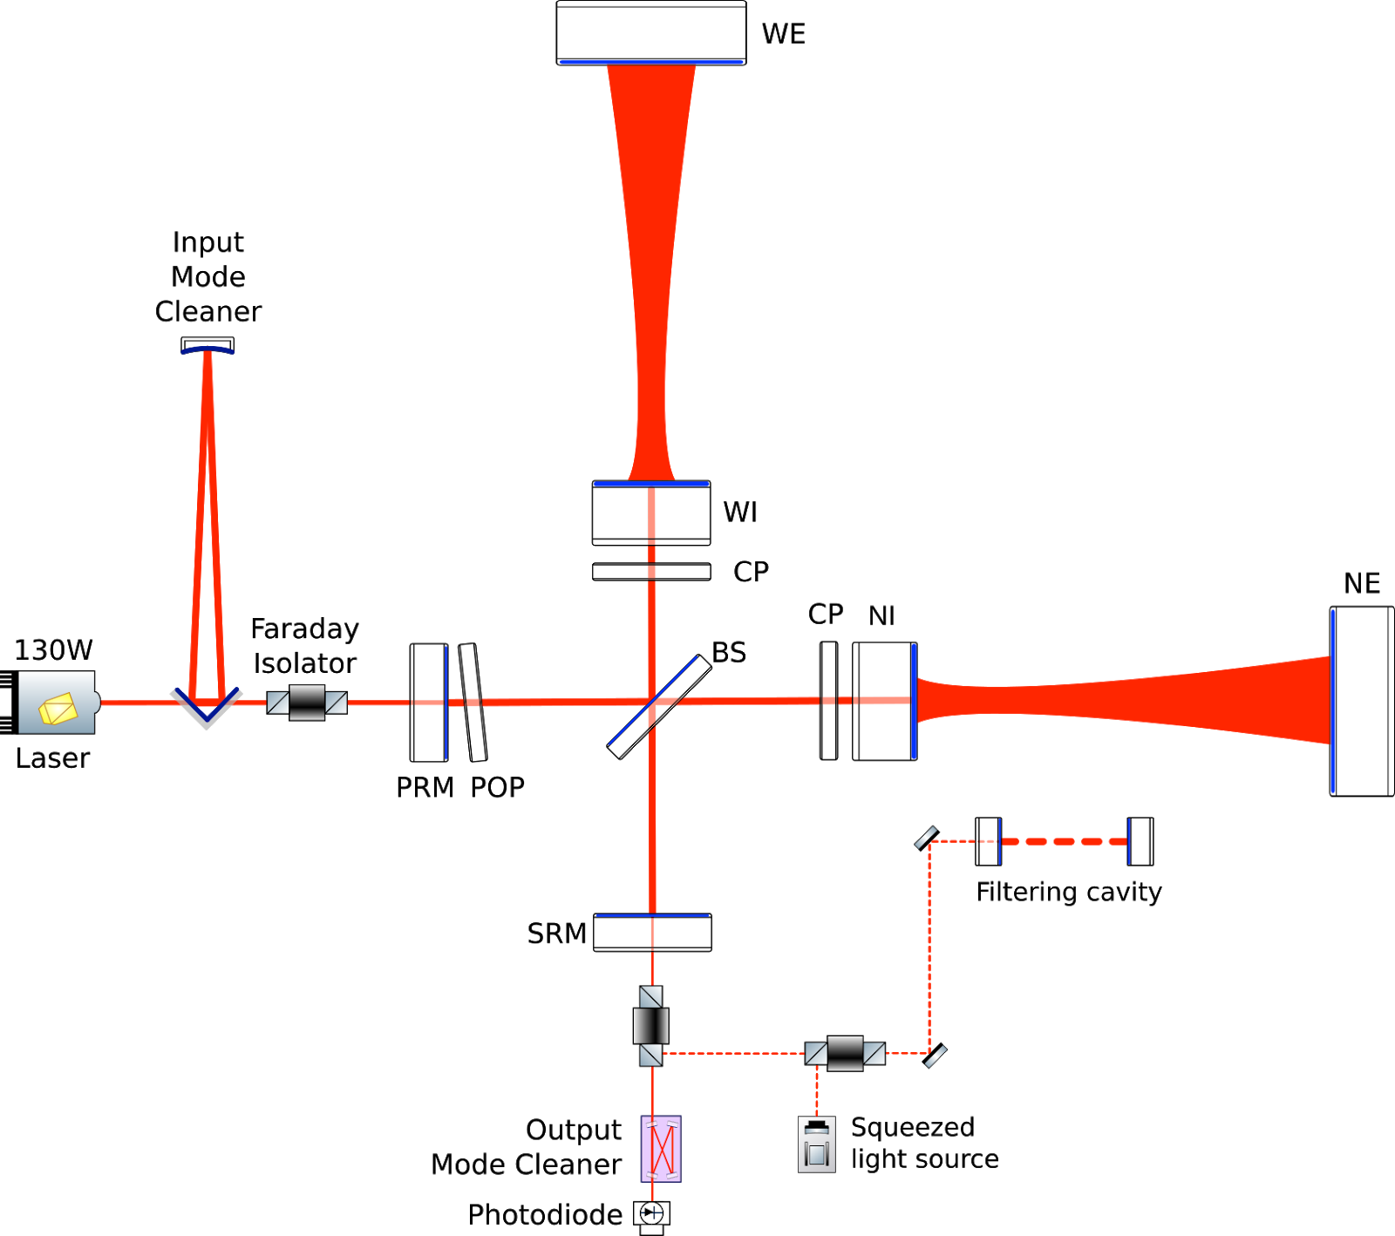
Advanced Virgo+ Phase II
Main changes
  Larger beams on end test masses
    6 cm radius ⇒ 10 cm radius
  Larger end mirrors
    35 cm diameter ⇒ 55 cm diameter
    40 kg ⇒ 100 kg
  Better mirror coatings
    Lower mechanical losses, less point defects,
    better uniformity
  New suspensions/seismic isolators for large mirrors
  Further increase of laser power
    40W ⇒ 60W ⇒ 80 W

Slide 22
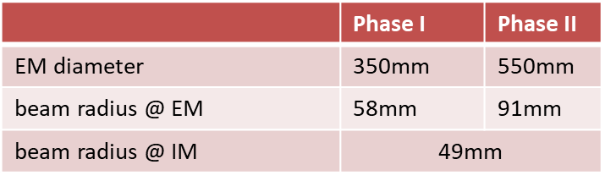
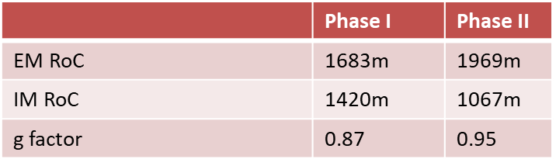
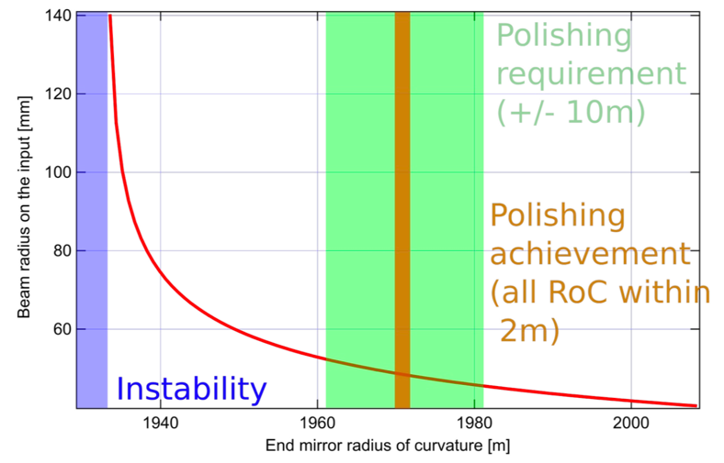
Cavities geometry
Larger g-factor
  Tighter angular control requirements during pre-alignment
    0.2 microrad
  Tight requirements RoC control
    Delta RoC~0.3 m

Slide 23
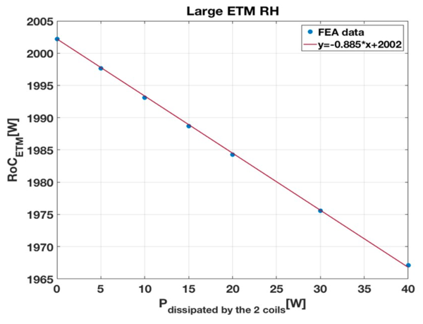
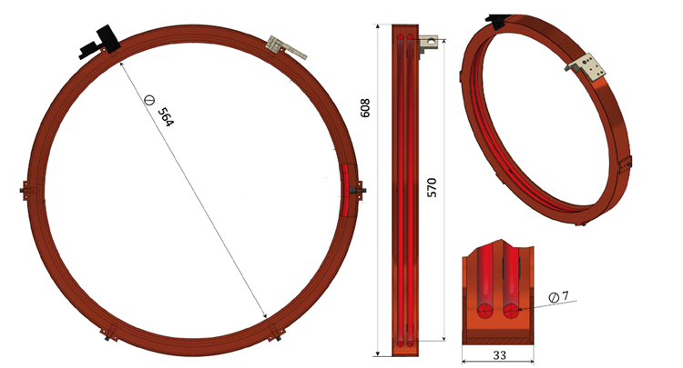
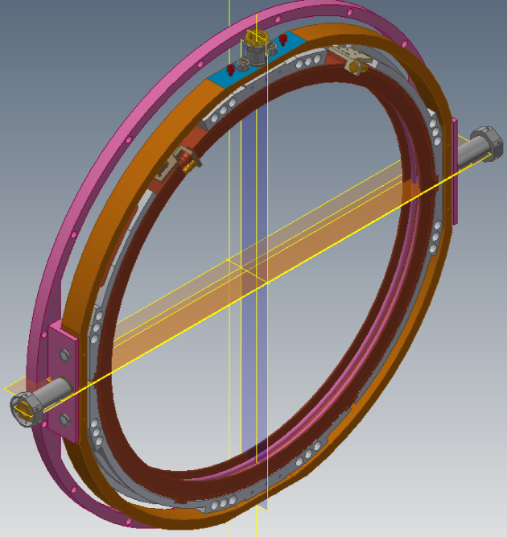
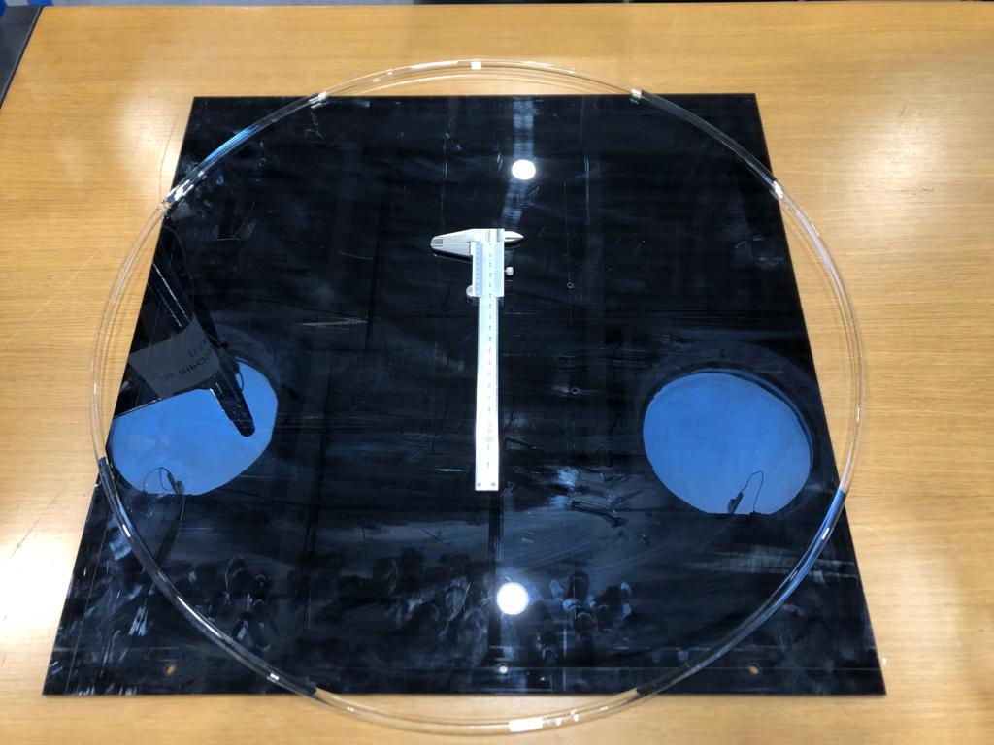
Large Ring Heaters
Goal: fine control of RoC i.e. cavity g-factor
Large ring heaters for large mirrors
  Prototype being built

Slide 24
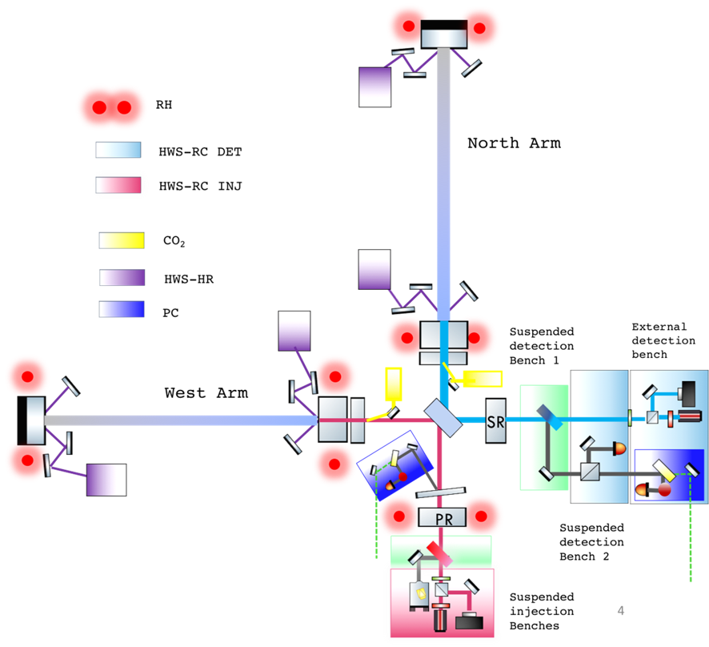
Thermal compensation system
Actuators: not only ring-heaters
  CO2 heaters
Not only actuators: Sensing
  Hartman wave-front sensing (HWS)
  Phase cameras
Several upgrades foreseen for O5
  New cameras for HWS
  Upgraded HWS telescopes for end mirrors
  Mode-cleaners for CO2 beams
  DC CO2 laser beam shapers via deformable mirror
  More remote controls
  More phase cameras

Slide 25
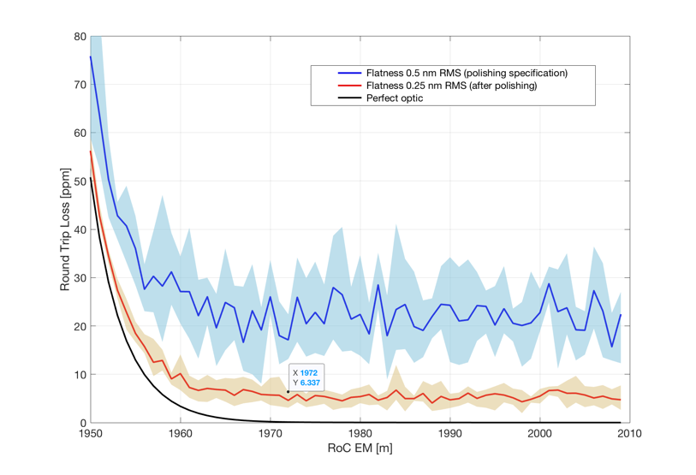
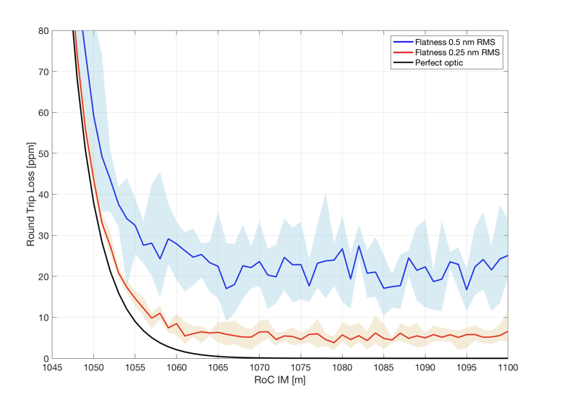
Cavities geometry
Round trip losses
  Polishing specifications
    AdV-like specifications are OK
    To be realized on 235 mm aperture (it was 150 mm for AdV)

Slide 26
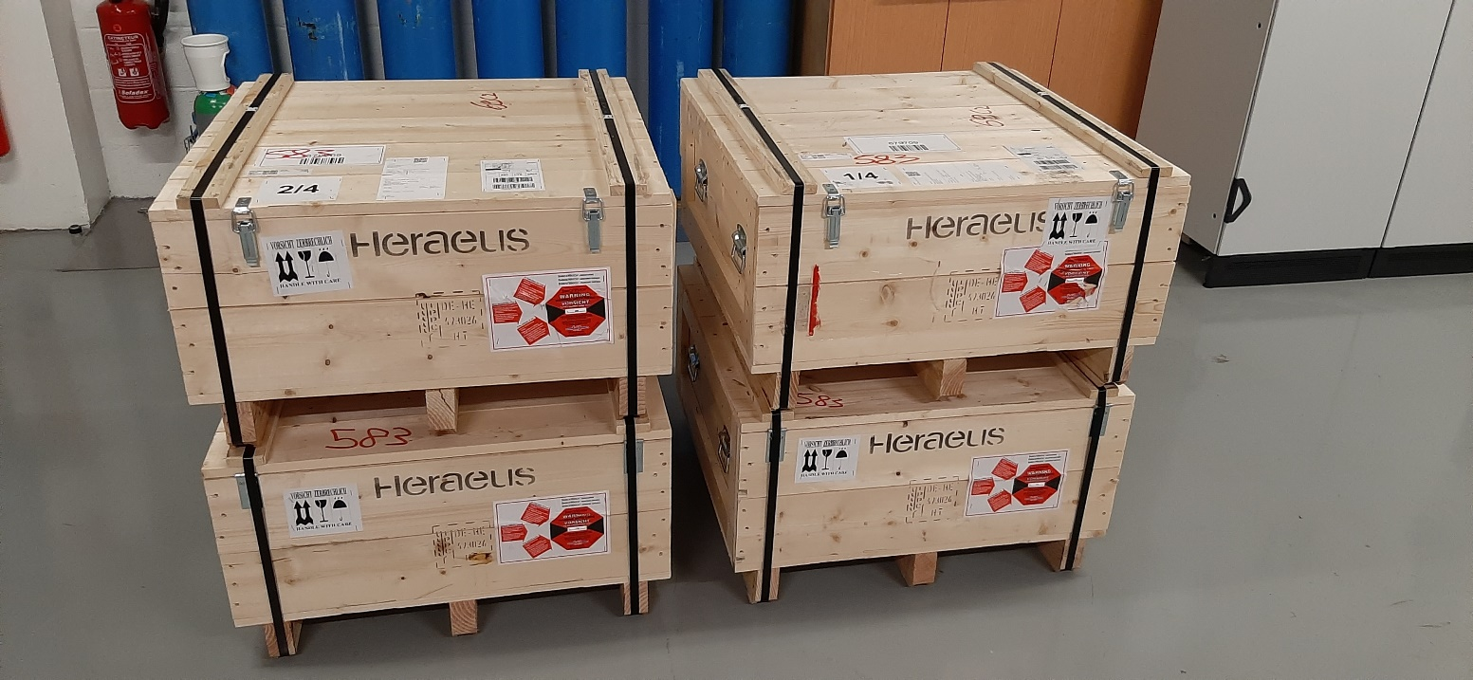
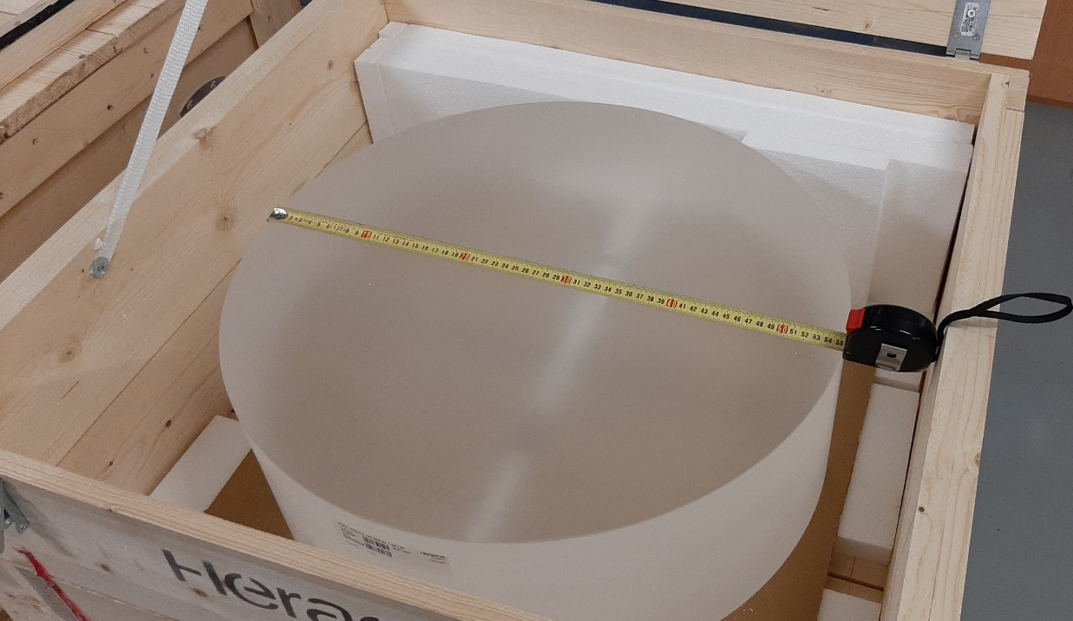
Mirrors: Substrates
Status
  Substrates acquired and received at LMA
  Call for tender for the mirrors polishing done
    Polishing started in December 2021
      One incident two weeks ago

Slide 27
Mirrors: Tools and Metrology
Several upgrades at LMA needed to prepare the realization of the large mirrors and the development of new coatings
For coating realization
  Large mirror mounts and handling tools
  Upgrade of cleaning machine
  Large silica crystallizers for annealing
  Large coater upgrade
For the metrology
  Upgrade of scattering bench
  Upgrade of absorption bench
  New reference sphere for flatness/RoC measurement
  Upgrade of profilometer (done during Phase I)
  Clean room enlargement (done during Phase I)
Total investment
1.8 M€

Slide 28
Mirrors: Coatings
Several coating formula studied in the R&D phase
  Virgo Coating R&D (G. Cagnoli)
Outcome
  LIGO and Virgo agreed to pursue together the development of TiO₂:GeO₂/SiO₂ coatings in the Grand Coater at LMA
  Joint LIGO-Virgo working group settled up
    Chair: G. Vajente (Caltech) and C. Michel (CNRS/LMA)
  First tests in the grand coater being done
  Critical path for AdV+
Final decision on the coating for O5 to be made by the end of the year
Backup plan
  Use Ti:Ta₂O₅/SiO₂ coatings

Slide 29
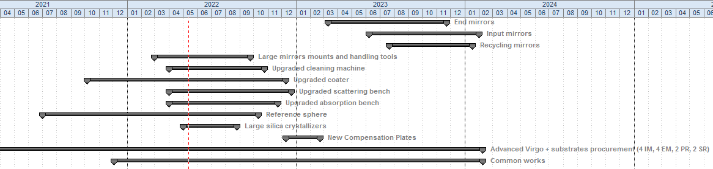
Mirrors: Schedule
Project critical path since the beginning
Tools & Metrology
Coatings
2021 | 2022 | 2023 | 2024

Slide 30
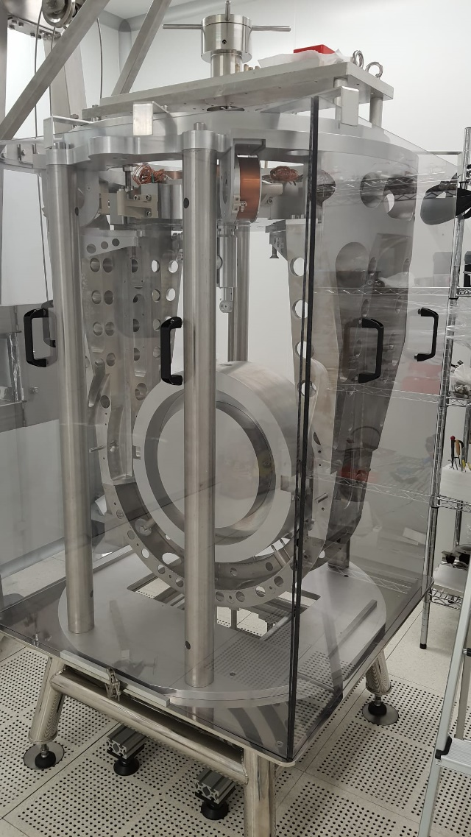
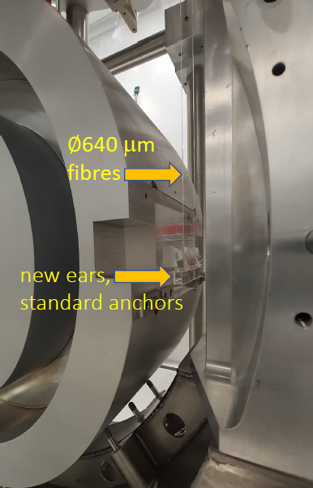
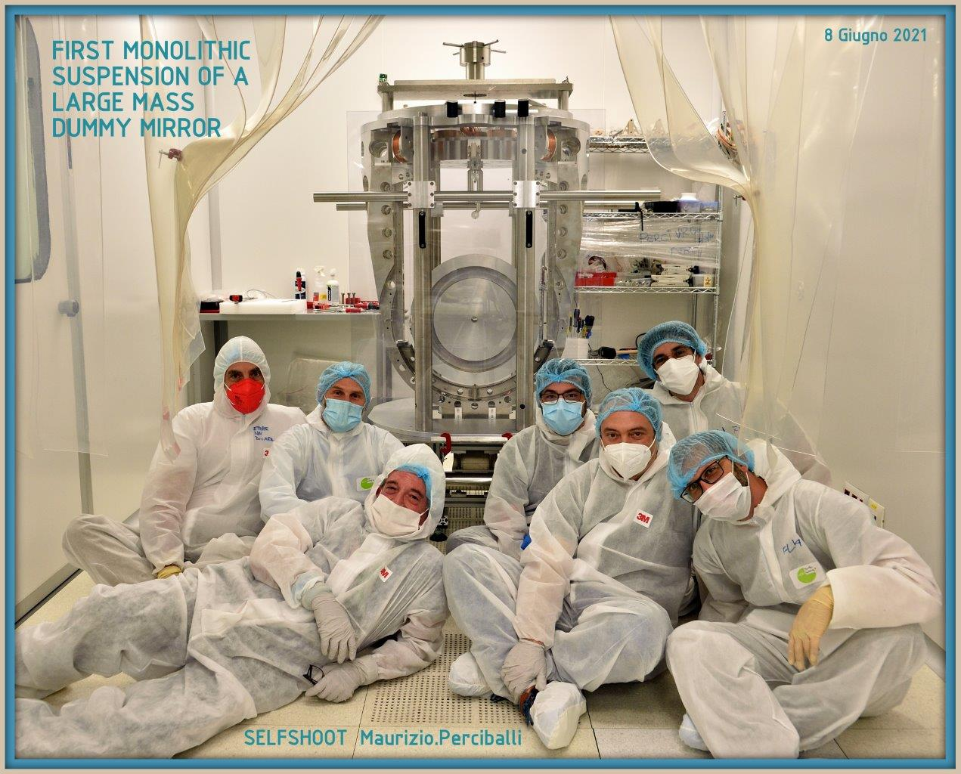
Large Payloads for Large Mirrors
Goal: suspend 100 kg mirrors
Large Payload for Large End Mirrors
  Design done
  Prototype built
  Including fused silica fibers ∅ 640 μm
  suspending 100 kg dummy mirror

Slide 31
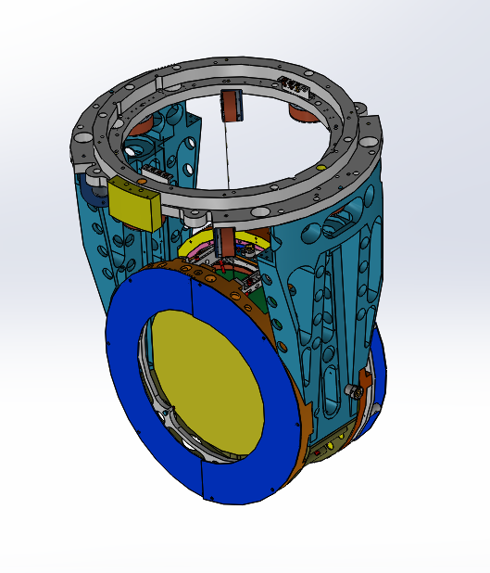
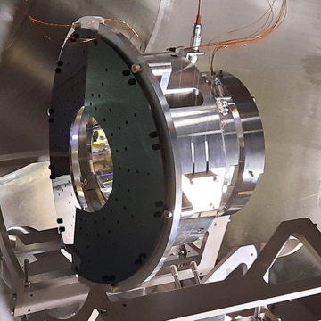
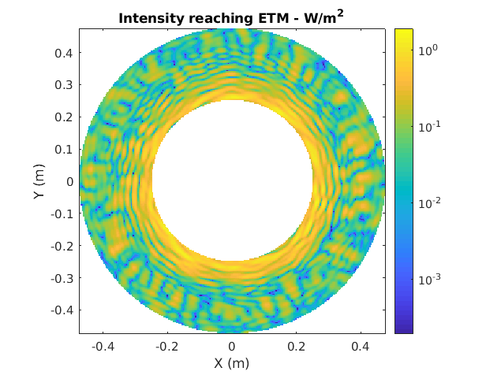
Instrumented Baffles for Large Mirrors
Goal: monitor scattered light in the arm cavities
Large payloads will be equipped with instrumented baffles

Slide 32
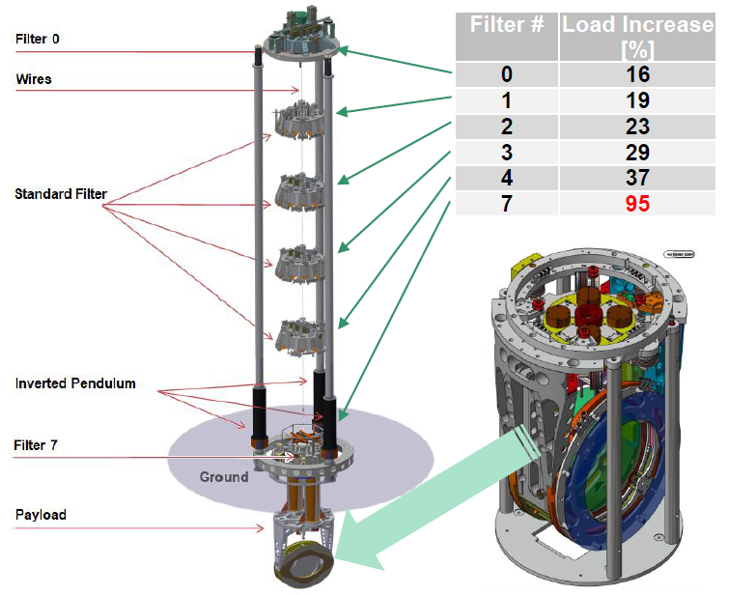
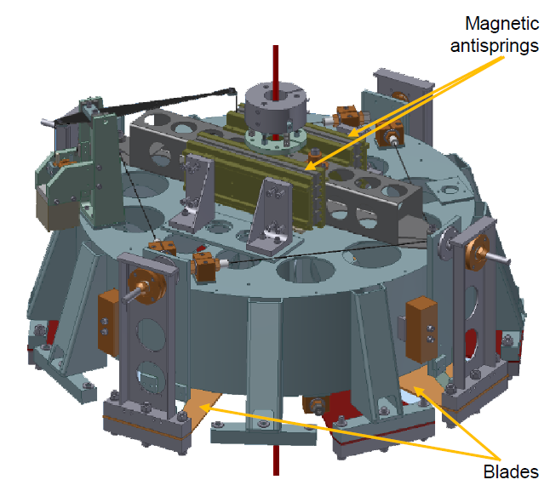
Super Attenuators for Large Payloads
Super Attenuators for Large Payloads
  Need to revisit the design of several elastic elements
  Design done
  Prototypes under construction/validation

Slide 33
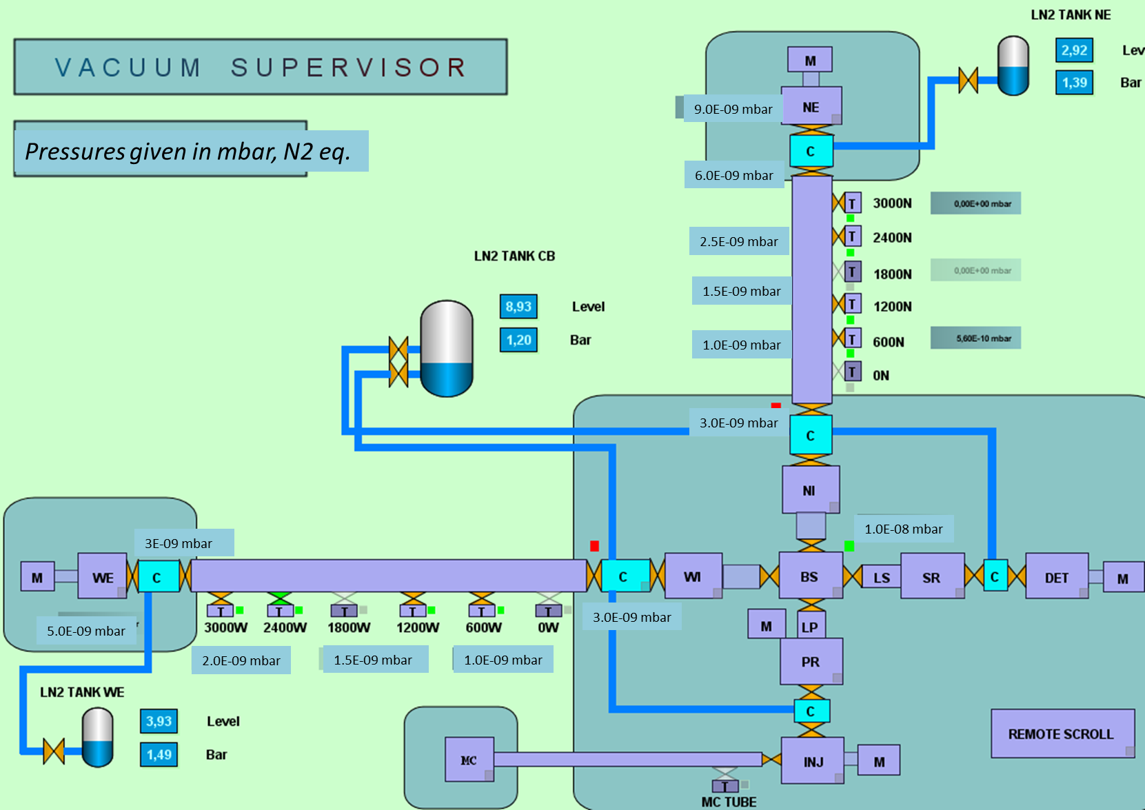
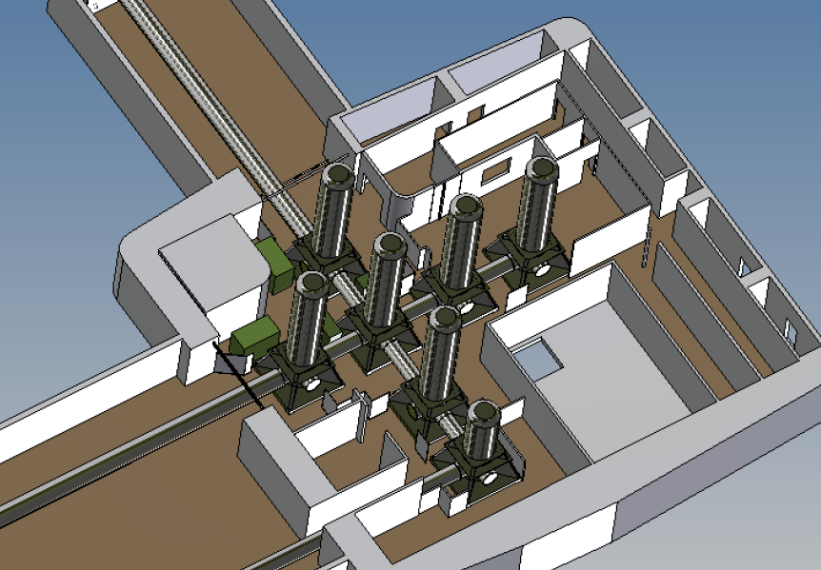
Vacuum
Several upgrades foreseen for the vacuum system
  Additional pumping stations along the tube
  Low noise ion pumps for most critical vacuum chambers
  Cryogenic pump in the central area to reduce noise
Additional stations
positions:
4
3
1
2

Slide 34
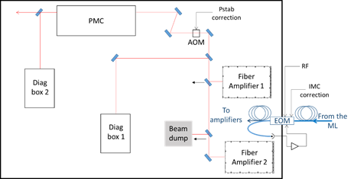
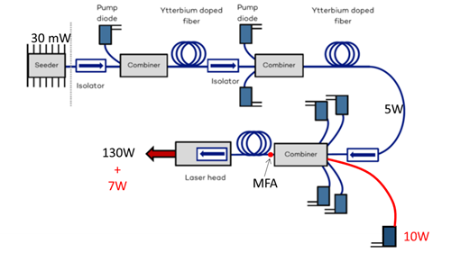
Pre-stabilized Laser
PSL upgrade
  Upgrade present Fiber Laser to higher power
  Replace present Slave laser + Fiber Amplifier (NEOVAN) with new Fiber Laser
  Goal: two high power fiber lasers on the same table (redundancy)

Slide 35
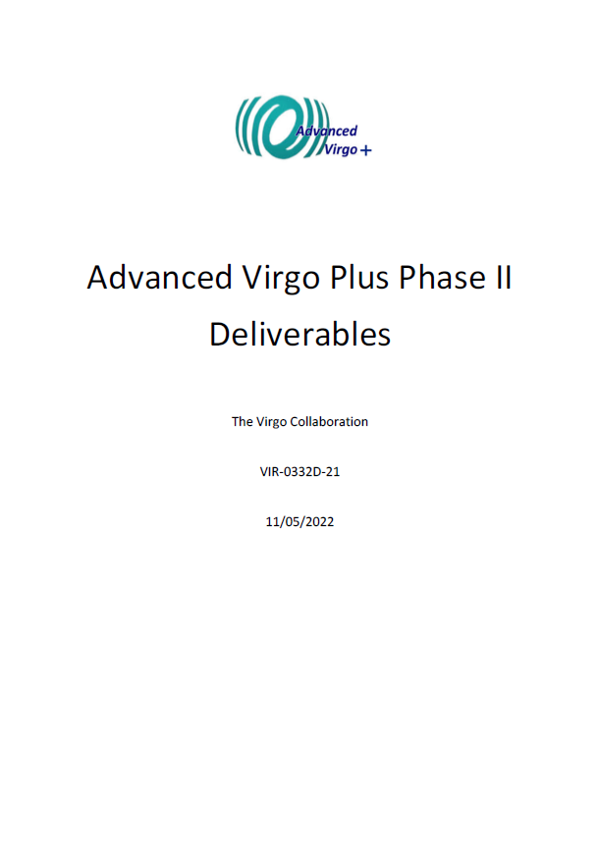
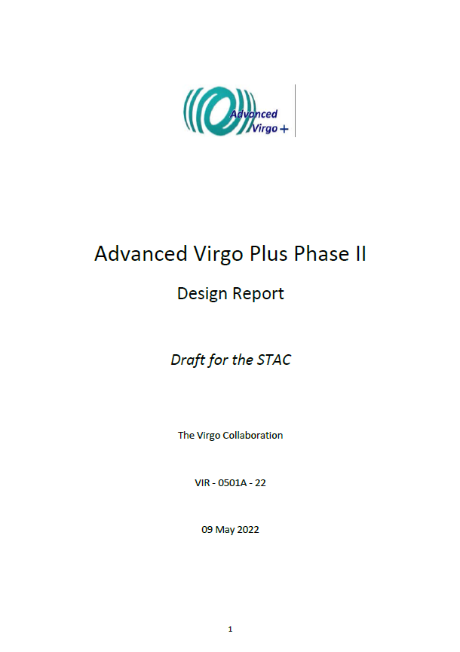
List of deliverables & Design report
Complete list of deliverables available and maintained.
Preliminary design of each deliverable done
  Draft of design report released
Most of subsystems reviewed
  OSD/MIR reviewed in 2020
  Other subsystem reviews done in 2021-22
  Few deliverables left

Slide 36
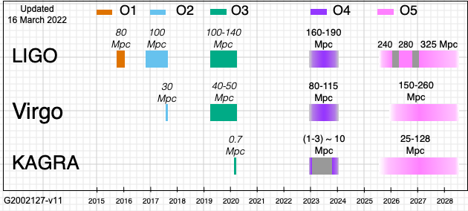
Installation & Commissioning schedule
2 years

Slide 37
Installation & Commissioning schedule
Two years stop between O4 and O5
Given the experience with the commissioning of AdV and AdV+ Phase I and the changes involved with Phase II (new mirrors and beam geometry), it is difficult to imagine less then 18 months for the commissioning of AdV+ Phase II
  Bulk of installation to be done in 6 months
    Laser
    Injection
    Two end super-attenuators
    Six payloads
    Detection super-attenuator
    Five telescopes to be changed or retuned
  Difficult to do with the present forces
    Need to involve all the collaboration

Slide 38
Conclusions
AdV+ Phase I
  Difficulties with the commissioning
  Some gain in understanding the origin of the difficulties
  Need to improve on a) work preparation and b) modeling/simulation
AdV+ Phase II
  Mirrors
    Construction in progress
    Coating pre-selection done, development in progress
    Construction of Tools & Metrology tools started
  First version of design report released (including costing, manpower, milestones and risks)
    WBS under construction
    Annexes for AdV+ Phase II MoU to be done
  Construction for the other components will start as soon as detailed WBS will be finalized

Slide 39
Spare slides

Slide 40
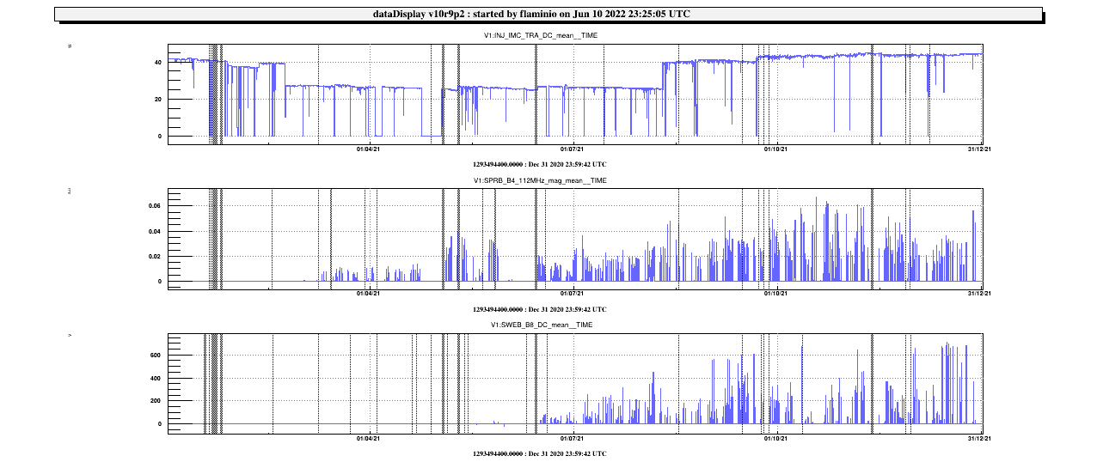
One year of commissioning: 2021
Injected power (W)
Nominal
power (40W)
Power
Decrease (33W)
40
20
0
Side band power (a.u.)
Power in the arms (a.u.)
First lock
@ “40 W”
First lock
@ 33 W
First lock
@ “25 W”
Power in the arm during O3
(with 25W input power)
Jan | Feb | Mar | Apr | May | Jun | Jul | Aug | Sep | Oct | Nov | Dec

Slide 41
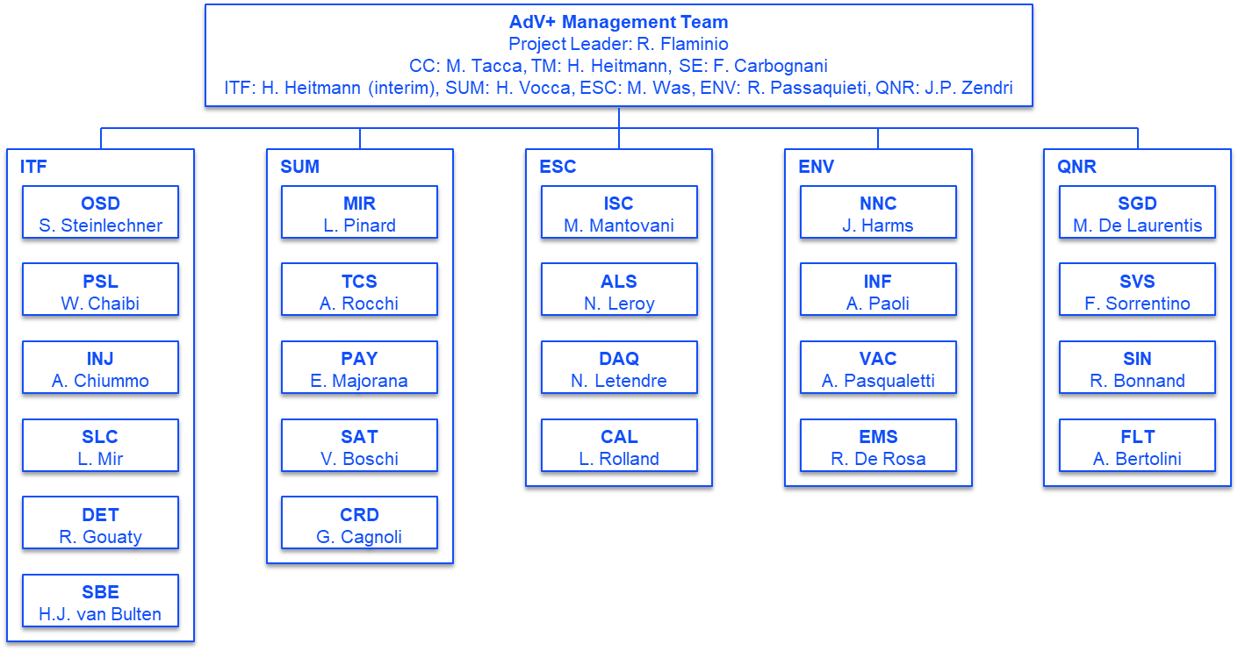
Management work
This is the work of the whole collaboration and of the EGO consortium
  Special thanks to those devoting part of their time to management (not always recognized …)

Slide 42
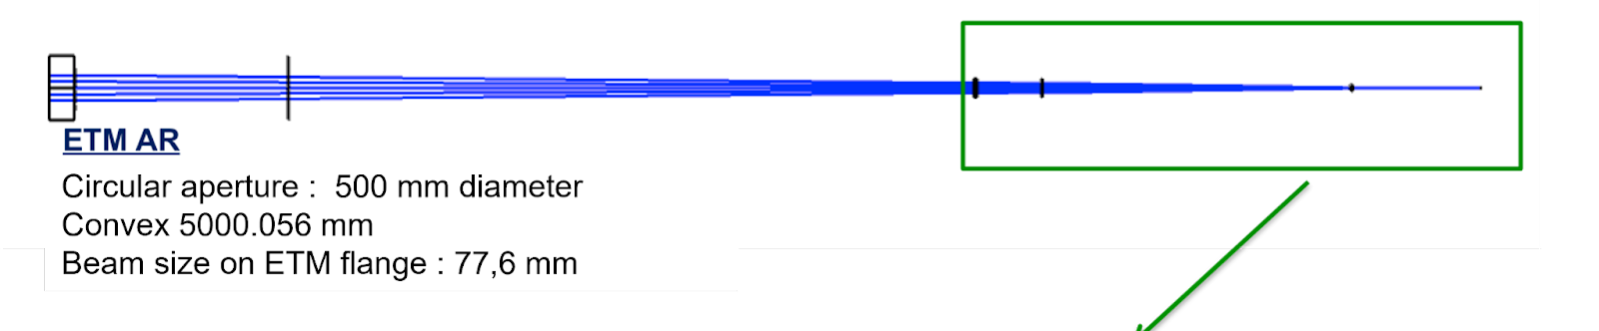
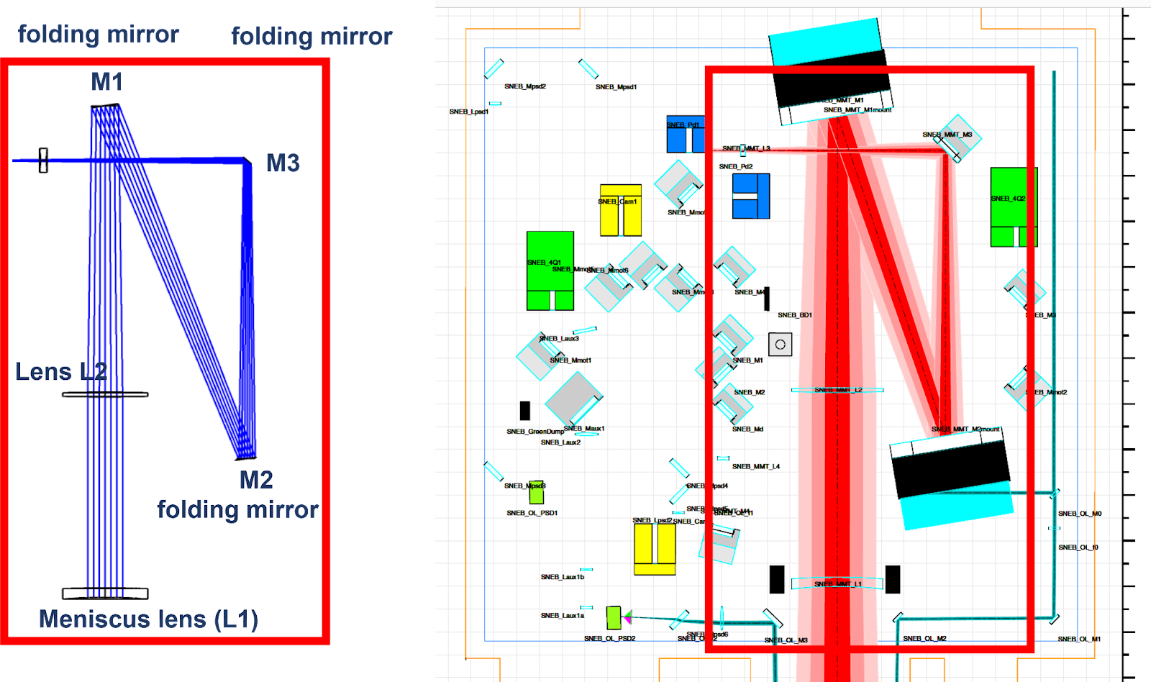
Telescopes
Need to revisit all output telescopes
Large change in end mirror telescope
  Use the back AR surface of the end mirror as lens
Limited retuning for the other telescopes
  Input telescope
  Output telescope
  Pickoff telescope

Slide 43
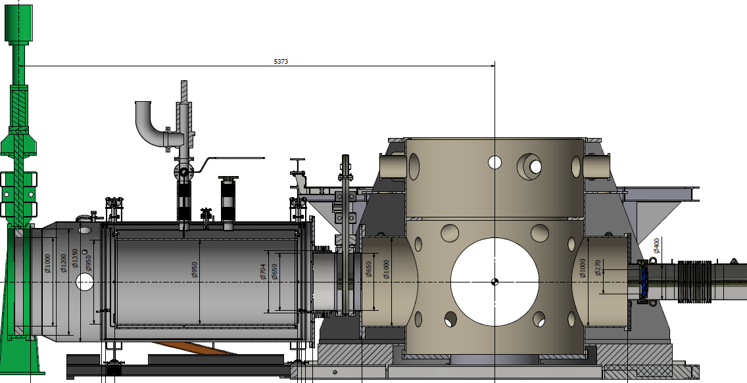
Vacuum
Enlarge end links to mitigate scattered/diffracted light risk due to large beam
  Necessity under study
SLC baffles: 600 mm aperture
Valve: 650 mm aperture
(same for thermal shields)
pipe
Bellows: 700 mm aperture
End viewport

Slide 44
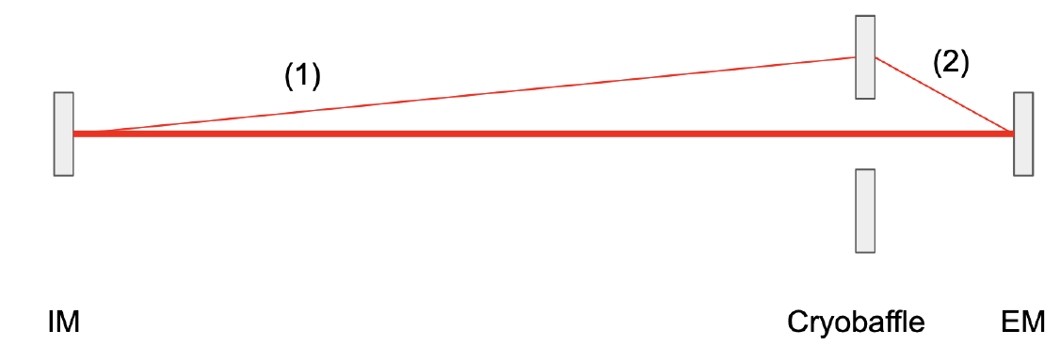
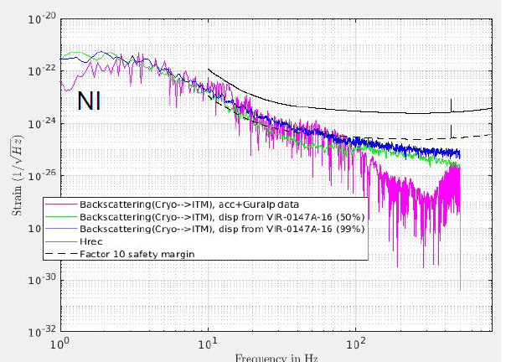
Vacuum
Question:
  Given the beam size (20 cm diameter, 2w) and the end baffle aperture (60 cm diameter) are we going to have scattered/diffracted light noise from the baffle?
Two effects considered
  Backscattering from cryo-baffle
  Diffraction from baffle edges
Results
  Effect should be negligible
  Only exception: point absorbers and
  high power in the cavities (390 kW)
    Could be solved if no point absorbers
    in O5 mirrors

