Slide 1
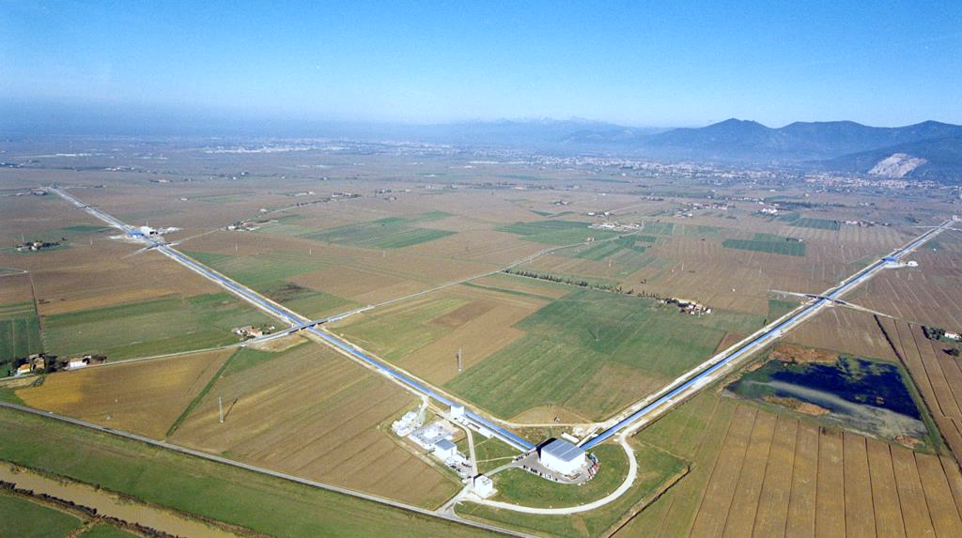
The Advanced Virgo gravitational-wave detector
Aerial view of the Virgo interferometer
Credit: Virgo Collab.
Francesco Di Renzo, EGO francesco.direnzo@ego-gw.it

Slide 2
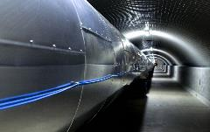
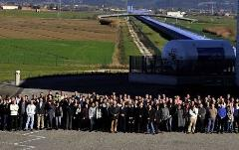
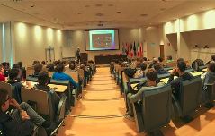
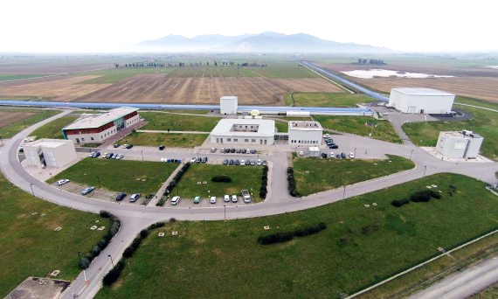
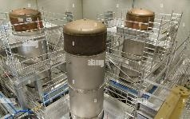
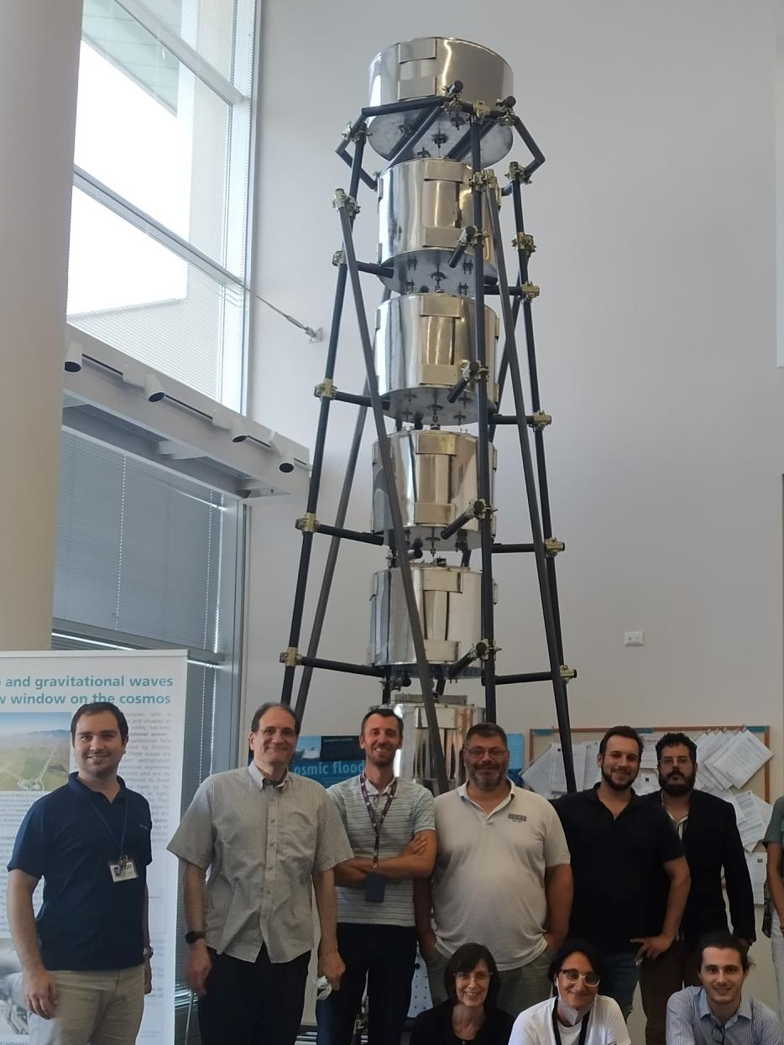
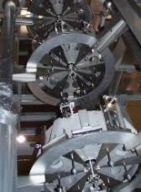
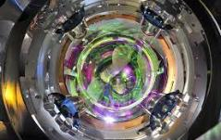
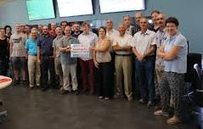
The Europan Gravitational Observatory - EGO

Slide 3
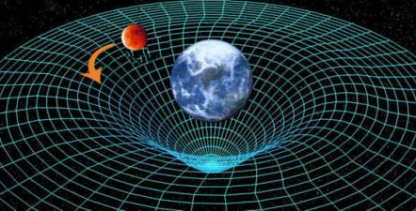
The Einstein Equation
or ‘‘spacetime tells matter how to move, matter tells spacetime how to curve’.’ John A. Wheeler.
In general relativity gravity is described by the curvature of spacetime :
$$G_{μν}=\frac{8πG}{c^{4}} T_{μν}$$
Curvature of spacetime
Distribution of mass/energy
Some constants
Linearized theory: $g_{μν}≈η_{μν}+h_{μν}$. General relativity admits propagating, wave-like solutions. In the Lorentz gauge:
$$□h_{μν}=−\frac{16πG}{c^{4}}T_{μν}+𝒪(h^{2})$$
Gravitational Waves (GW): ripples in spacetime, produced by accelerating masses, which propagates in spacetime at speed $c$.
D’Alambertian (wave operator)
Notes:
In vacuum (no T_mn), h_mn satisfies the (D’alambert) wave equation.

Slide 4
Production and free propagation of GWs
Production: accelerating mass densities:
$$h_{μν}≈\frac{2}{r}\frac{G}{c^{4}}{\ddot{I}}_{μν}$$
E.g.: for an orbiting binary system $I≈MR^{2}$, $\ddot{I}≈4MR^{2}ω_{orb.}^{2}$,
$$h≈\frac{8G}{c^{4}}\frac{M}{r}R^{2}ω_{orb.}^{2}≈\frac{8G}{c^{2}}\frac{M}{r}{\left(\frac{v}{c}\right)}^{2}∼{10}^{−21}$$
Second derivative of quadrupole moment
$$ω_{orb.}$$
$$R$$
Free propagation along “$z$-axis” in vacuum ($T_{μν}=0$):
$${□h}_{μν}=0 ⟹h_{μν}\left(t,z\right)=h_{μν}e^{i\left(kz−ωt \right)} with ω/c=k$$
Credit:Teviet Creighton
Notes:
One Gly (r ) is equal to 10^22 km. M is equal to few km, 3 in the case of the Sun

Slide 5
GW interaction in the TT frame
or how to exploit gauge freedom in our favor.
Transverse Traceless gauge, convenient to represent GW propagating degrees of freedom:
$$h_{ij}^{TT}\left(t,z\right)=\left(\begin{matrix}h_{+} & h_{×} & 0 \\ h_{×} & −h_{+} & 0 \\ 0 & 0 & 0\end{matrix}\right)\cos\left[ω\left(t−z/c\right)\right]$$
In this gauge, GWs are transverse and traceless (TT): $h_{+}$ and $h_{×}$ d.o.f.
Objects initially at rest remain at rest, even after the arrival of the wave. That is, they are “free falling”:
$${\left.\frac{d^{2}x^{i}}{{dτ}^{2}}\right|}_{τ=0}=−{\left.\left[Γ_{νρ}^{i}\left(x\right)\frac{dx^{ν}}{dτ}\frac{dx^{ρ}}{dτ}\right]\right|}_{τ=0}={\left.\left[Γ_{00}^{i}{\left(\frac{dx^{0}}{dτ}\right)}^{2}\right]\right|}_{τ=0}=0$$
Because, in this gauge, the Christoffel symbol $Γ_{00}^{i}=\frac{1}{2}\left(2∂_{0}h_{0i}−∂_{i}h_{00}\right)=0$.
Only a non-gravitational force can cause a mass to change its coordinates.
Geodesic equation
Notes:
In this picture, propagating degrees assume a particularly simple form

Slide 6
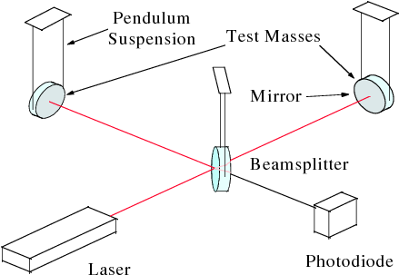
Light travel time through the detector (TT gauge)
Suspended (test) masses can be considered free in the horizontal plane ($z=0$).
We study in the TT gauge the propagation of light between them. Along one arm, the effect of a $+$ wave:
$$ds^{2}=−c^{2}dt^{2}+\left[1+h_{+}\right]dx^{2}=0$$
$$\int{dt=\frac{1}{c}\int{\sqrt{1+h_{+}}}dx≈\frac{1}{c}\int{1+\frac{1}{2}}h_{+}dx}$$
$$Δt≈h_{+}L/2c$$
Round trip back to beam-splitter:
$$Δt_{x}≈h_{+}L/c \left(Δt_{y}≈−h_{+}L/c \right)$$
Difference between $x$ and $y$ round-trip times:
$$Δτ≈2h_{+}L/c \left(Δφ≈2h_{+}L 2π/λ_{L}\right)$$
Light-like interval
$$y$$
$$x$$
Opposite sign along $y$

Slide 7
Il rivelatore “in movimento”

Slide 8
Antimatter web comics break
antimatterwebcomics.com

Slide 9
GW detectors: a simple Michelson interferometer
Laser light is split in two orthogonal paths by a beam-splitter (BS). These are reflected back toward the BS by mirrors at the ends of the arms;
When recombined at the BS, they interfere. If the arms are exactly the same length (up to $nλ_{L}$), the light returns entirely toward the laser: destructive interference;
If the arms differ by an amount that is not an integer number of wavelengths, then the destructive interference will be incomplete: light passes to the photodiode (PD)
Estimated sensitivity (I):
$$h≈\frac{ΔL}{L}∼\frac{λ_{L}}{L}∼{10}^{−9}$$
Symmetric port
Antisymmetric port
Nd:YAG laser:
$λ_{L}=1064$ nm
$L∼1$ km
Notes:
Lambda = 1064 nm, L = 1 km

Slide 10
GW detectors: a simple Michelson interferometer
Estimated sensitivity (II):
Use photons instead of lengths. The rate at which photons arrive to the PD follows a Poisson statistic:
$$ΔL ≈\frac{N_{ph.}^{1/2}}{N_{ph.}}λ_{L}$$
where:
$$N_{ph.}=\frac{P_{L}}{hcλ_{L}}τ∼\frac{P_{L}}{hcλ_{L}}\frac{1}{f_{gw}}$$
For $P_{L}=1$ W, $f_{gw}=300$ Hz:
$$h≈\frac{ΔL}{L}∼\frac{N_{ph.}^{−1/2}λ_{L}}{L}∼{10}^{−17}$$
Number fluctuation
Readout time
Symmetric port
Antisymmetric port
Notes:
STD of a Poisson variate: square root of. 10^18 photons

Slide 11
GW detectors: a Fabry-Pérot Mich. interferometer
A Fabry-Pérot interferometer is comprised of two mirrors along an optical axis which form a cavity;
If the separation between the two mirrors is correctly tuned, there is a build-up of light power;
In TT frame: if the light is “detuned” by a GW, a huge amount of power leaks out of the cavity;
In detector frame: light bounces back and forth a huge number of times, increasing the “lengthening” effect of the GW on detector arms.
Estimated sensitivity:
$$h≈\frac{ΔL}{λ_{gw}}∼\frac{N_{ph.}^{−1/2}λ_{L}}{λ_{gw}}∼{10}^{−20}$$
Fabry-Pérot cavity
Partially reflective input test mass
Max effective length
Notes:
Lambda = 1064 nm, L = 1 km

Slide 12
GW detectors: power recycled F.-P. Mich. interf.
Power recycling: a mirror (PRM) is added between the laser and the beam splitter, which creates an effective cavity between the recycling mirror and the compound mirror representing the Fabry-Pérot Michelson interferometer.
By tuning this cavity for a power build-up, we can increase the light power stored into the compound interferometer interferometer (up to $∼$MW in the arms).
This reduces the shot noise but increases the radiation pressure noise…
Notes:
This light would be wasted otherwise

Slide 13
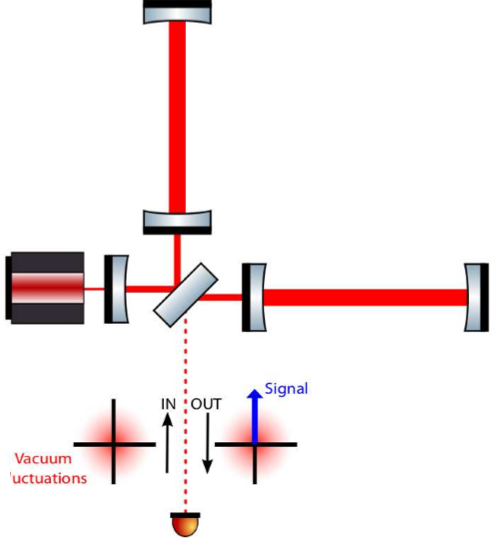
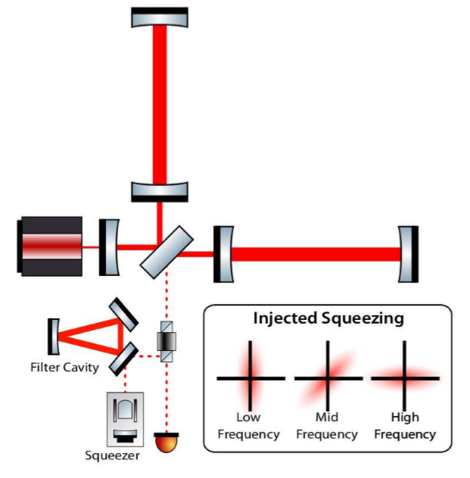
GW detectors: dual recycled F.-P. Mich. interf. w. SQZ
Signal recycling: inserting a signal recycling mirror (SRM) between the beam splitter and the output port, we can recycle the signal sidebands leaving the interferometer towards the output port. This will increase the sensitivity at particular frequencies.
Squeezed light: quantum squeezing of the light can be used to reduce the effect of the shot noise and improve sensitivity.

Slide 14
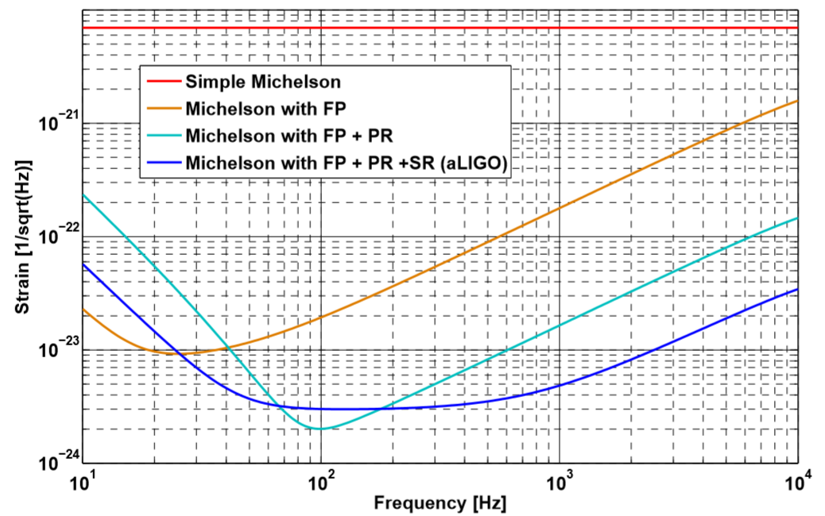
GW detectors: optical layout recap

Slide 15
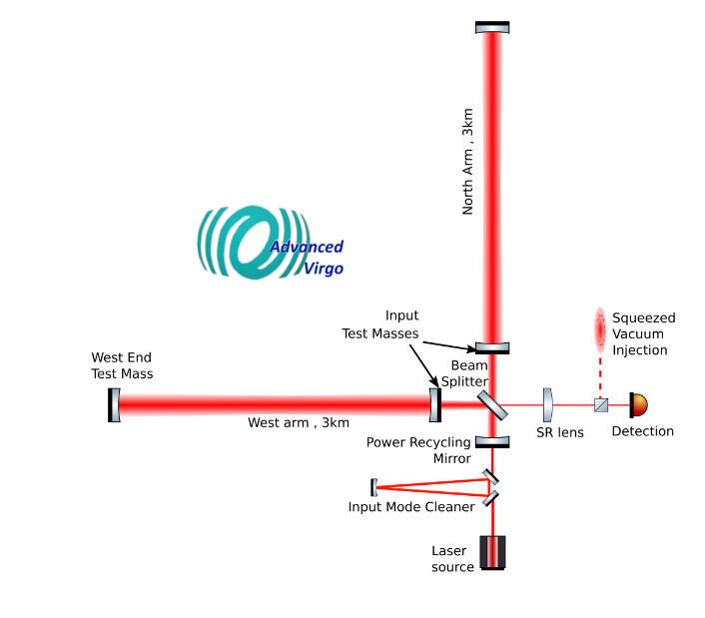
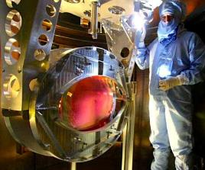
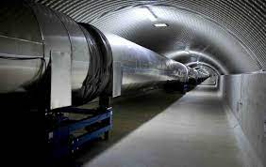
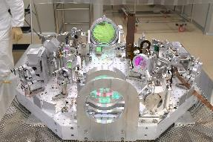
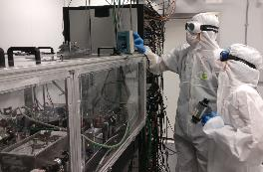
The Advanced Virgo detector

Slide 16
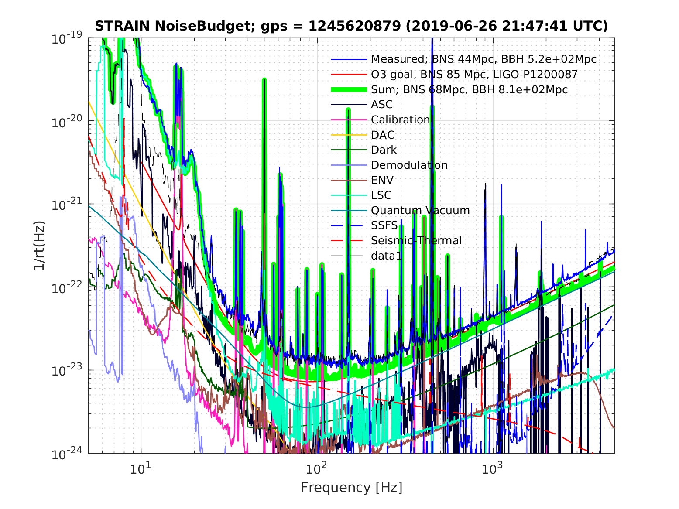
Noise budget: fundamental vs. actual

Slide 17
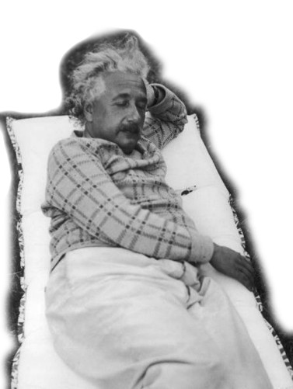
Thank you for the attention!

