Slide 1
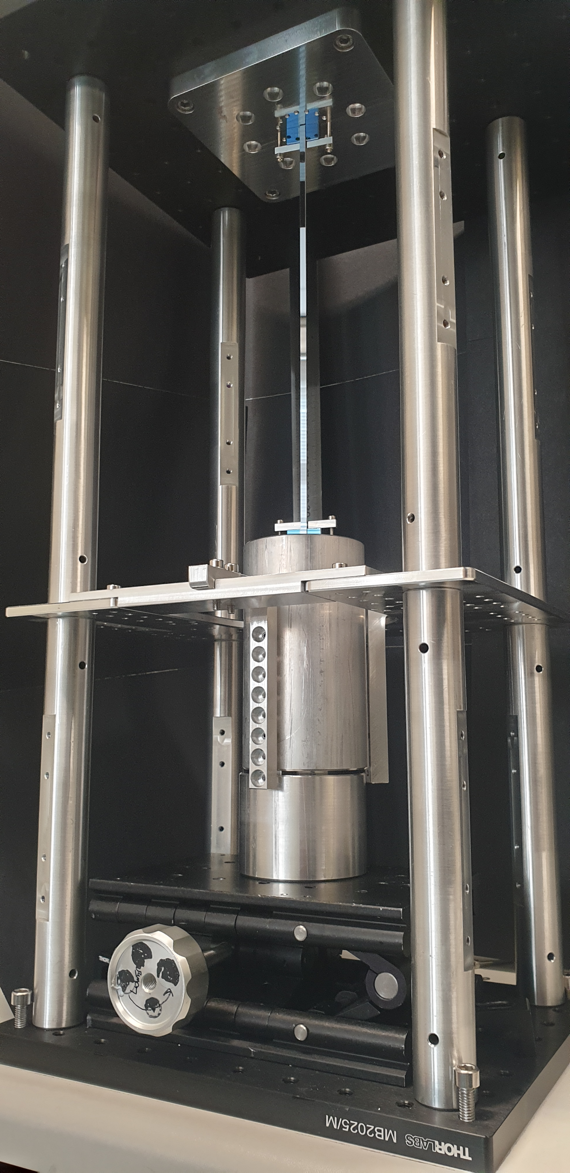
Silicon suspensions for ET-LF
ET ISB Workshop October 2022, L’Aquila
Graeme Eddolls
on behalf of ET suspensions working group

Slide 2

HEAT EXTRACTION
Focus of my thesis
THERMAL NOISE
STRENGTH
JOINTING AND SHAPING

Slide 3
Suspension thermal noise
Fibre/ribbon stress
Fibre/ribbon area
Mass
Length
Dilution
Surface loss
Bulk loss
Bond loss
Bond area
Bond stress
Thermoelastic
Resonant modes
Temperature
Thermal expansion
Thermal conductivity
Specific heat
Young’s modulus
STRENGTH
JOINTING AND SHAPING
THERMAL NOISE
HEAT EXTRACTION
No easy win
e.g. thick fibres =
heat extraction
low stress
dilution → 1

Slide 4
Heat extraction

Slide 5
Heat extraction
Extraction
(assuming conduction only at low T)
Coating absorption
18 kW x ? ppm
Environmental ambient load
ITM absorption
Total heat load ≈ 100mW - 1 W

Slide 6
Heat extraction – 3 cases
Assume
20 K TM, 4 K PUM
1.2 m length
Touloukian conservative “low κ case”,
curve 19 silicon (1x10¹⁵ B atoms/cm,15 Ωm)
Also consider Touloukian “high κ case”
curve 27 (4x10¹⁴ B atoms/cm,35 Ωm)
Low power
133 mW (A. Amato) [1]
Medium power
550 mW (“KAGRA optimistic” [1] [2])
High power
1 W (“KAGRA conservative” [1] [2])
[1] Angelucci et al, Status of the ET Tower Vacuum, ET-LF Cryostat and ET-LF Payload Cooling Design, 2022
[2] A Khalaidovski et al, Evaluation of heat extraction through sapphire fibers for the GW observatory KAGRA, Class. Quantum Grav., 31, 105004, 2022.

Slide 7

Scenario | Fibre radius, r (μm) | Ribbon thickness (5:1 ratio), t (μm) | Stress (MPa) | Safety factor
Low power (133 mW) | 645 | 512 | 375 | 0.3 ☹
Medium power (550 mW) | 1312 | 1040 | 91 | 1.3 😐
High power (1 W) | 1770 | 1403 | 50 | 2.4 😐
Strength limited (Safety factor = 3) | 1976 | 1566 | 40 | 3 😐
Strength limited (Safety factor = 6) | 2794 | 2215 | 20 | 6 ☺
Best case, curve 27 Low power (133 mw) | 292* 1496 (boundary limit) | 232* 1496 (boundary limit) | 70 (fibre) 44 (ribbon) | 1.7 (fibre) 😐 2.7 (ribbon) 😐
 |  | Reference | 120 | 6 (aLIGO/AdV)
*Found to be boundary limited for curve 27 (Touloukian high case) Taking C_{v} (4 K) = 49.6, C_{v} (20 K) = 7940 curve 19 = 267 μm (4 K), 61 μm (20 K) curve 27 = 1496 μm (4K), 287 μm (20 K) Isotopic silicon = 3740 μm (4 K), 2670 μm (20 K)
$$Lm = \frac{3κ}{C_{v}v}$$
Notes:
*These are simplistic assumptions and theoretical calculations – more work is required*
Interesting play off on boundary scattering – we have to worry about k, high purity silicon. For boundary limiting here for curve 27, while k is low, Cv is also very low, which increases Lm.
We use Lm > r (not 2 x r or d) because of statistical averaging of phonon scatter throughout fibre
V = Casimir speed = 5660
Traffic light system

Slide 8
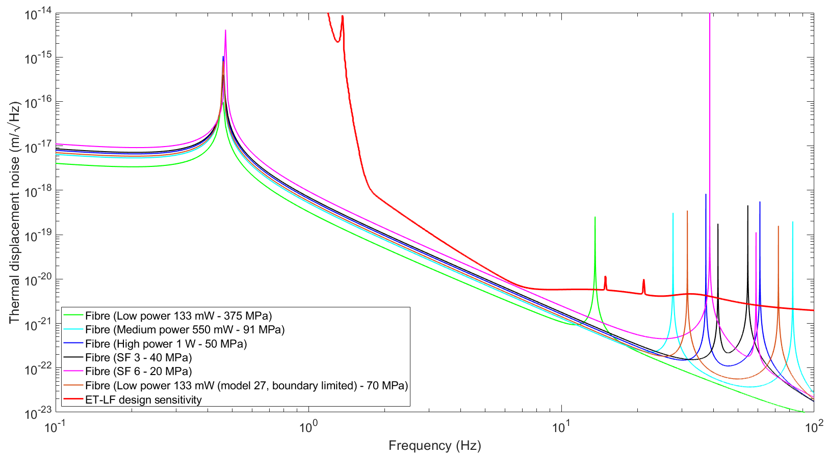
Suspension thermal noise only
Silicon fibres
No jointing loss included*
Total ET-D noise
Notes:
High conductivity, established data
Heavily boundary limited, unrealistic stress
(1.8 GPa ignoring boundary limit)

Slide 9
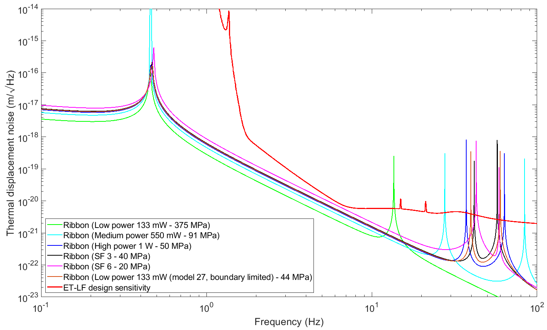
Suspension thermal noise only
Silicon ribbons
No jointing loss included*
Total ET-D noise

Slide 10
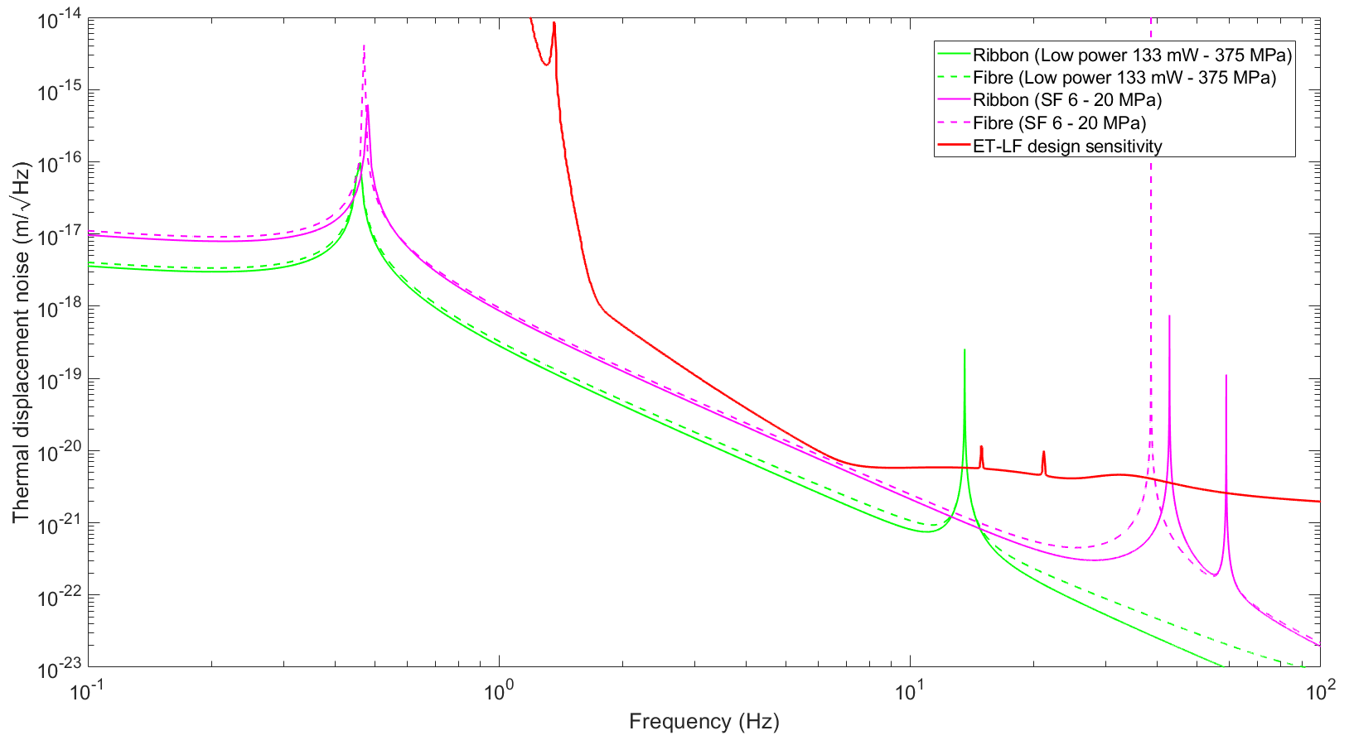
What about dilution?
Ribbon > fibre in thin bending direction
Higher noise in transverse direction (problem?)
Cross-coupling must be analysed
Notes:
*CAUTION* Ribbons ultimately weren’t used in aLIGO because it was found that necked ribbon dilution was significantly lower than theoretical

Slide 11
What is the current status of silicon?

Slide 12
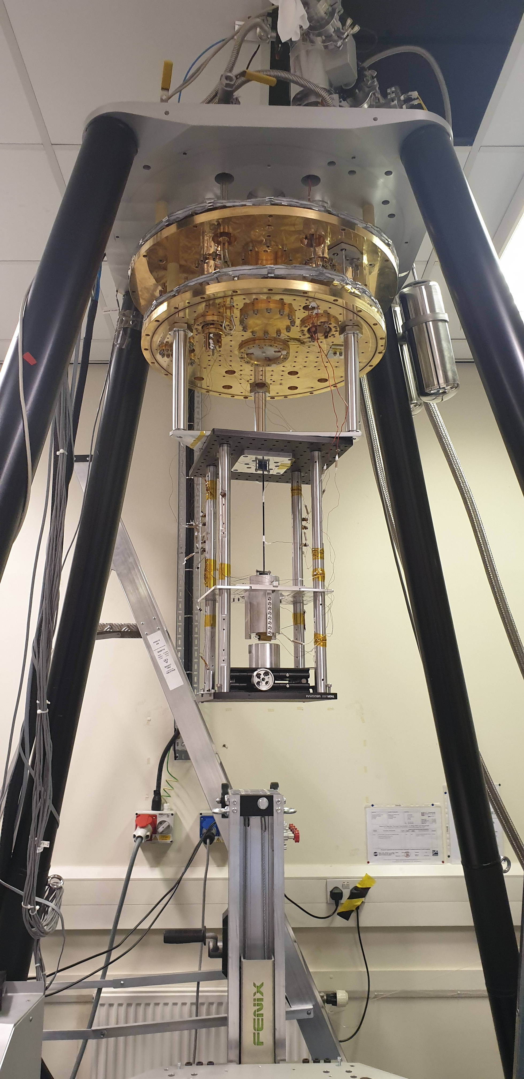
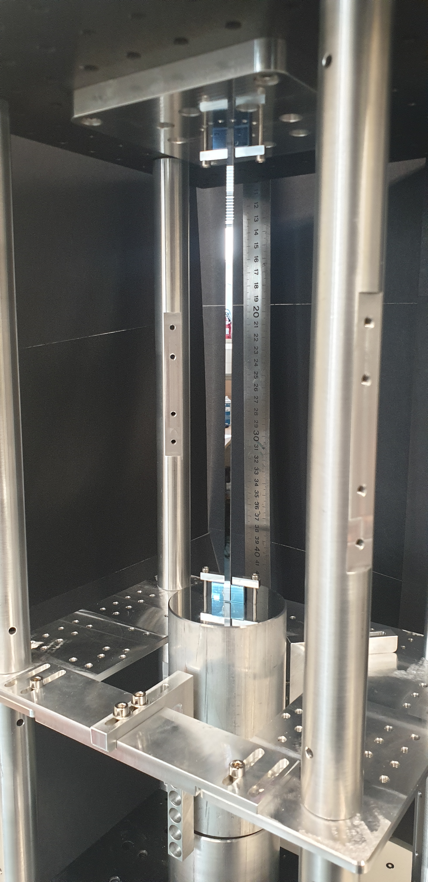
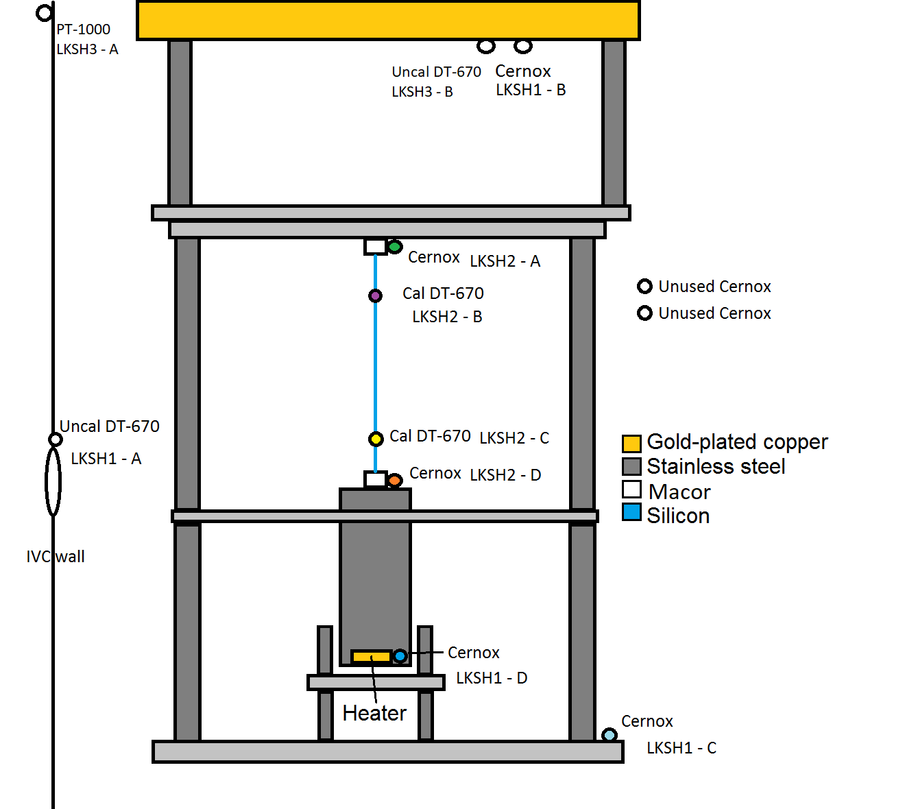
Glasgow silicon suspension
Silicon ribbon
Hydroxy-catalysis (HC) bonds
Silicon block
1 kg aluminium mass
Notes:
6% working load, SF 16

Slide 13
Silicon jointing and shaping

Slide 14
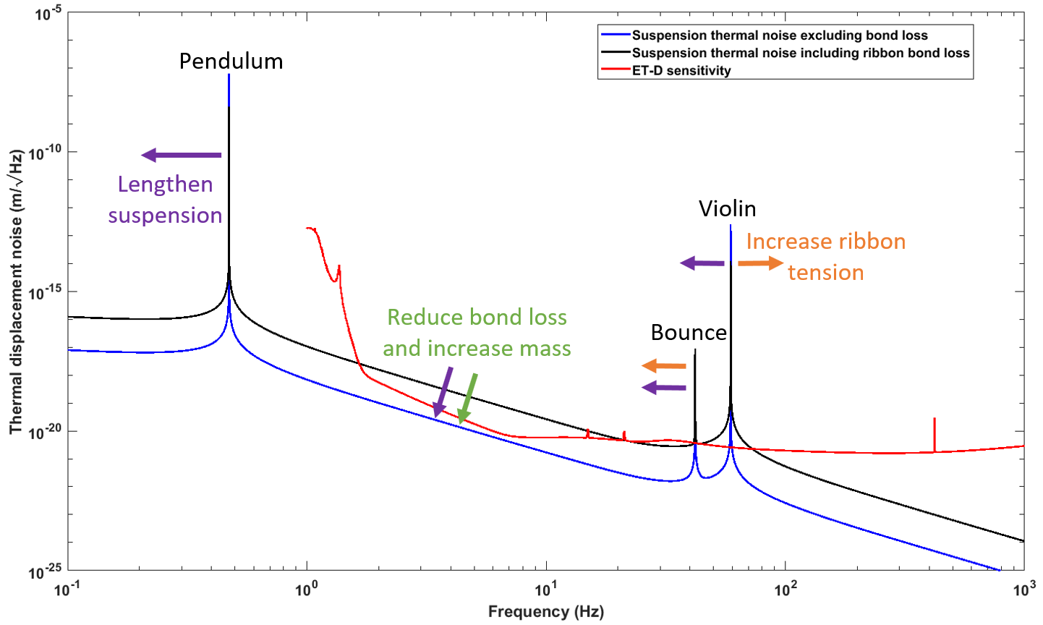
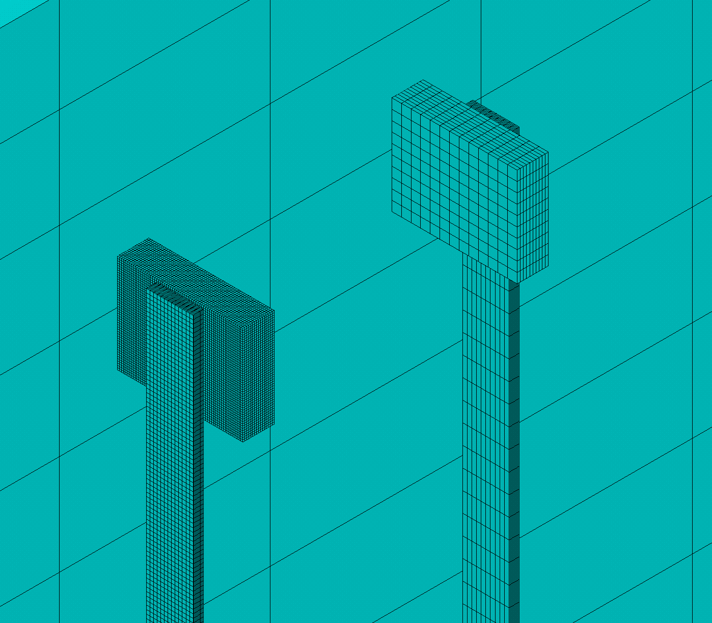
Increase stress
(bonded only)
HC bond
Silicon
ear
Silicon ribbon
Safety factor 3
Notes:
Jointing/bonding must be carefully analysed
We found increasing stress, increases suspension TN for our particular geometry for bonded model

Slide 15
Jointing and shaping
Jointing techniques
Hydroxy-catalysis bonds
Gallium or indium bonding
Direct bonding
Gold layer jointing (U. Gibson)
Joining geometry
Tension
Compression (nailhead joints)
  Detailed, representative, direct modelling
  required
Multilmaterial
Dilution reduction
Practicality
Ability to debond
Welding/repair
Joint strength
Thermal noise
Push energy away from joint (silicon shaping?)
High stresses > stiffer ribbon > may drive energy into bond/ear region
Shaping and joint loss may ultimately drive design
Notes:
Nailhead cons – not modelled directly, small-scale modelling, issues with Virgo high Q

Slide 16
Silicon strength

Slide 17
Silicon strength - comparison of different surface treatments 1
Wet oxidised
Chemical
etched
Chemomechanical
polished (CMP)
controls
Si₃N₄
coated
120 MPa
Data/image from [3]
[3] A V Cumming et al, Silicon mirror suspensions for gravitational wave detectors, Class. Quantum Grav., 31, 025017, 2013.
Notes:
Oxidised silicon – yes its strong, and it shows that you can increase strength but surface loss found to be bad (1 order of magnitude worse)
We are currently using numbers from the very best sources, not representative of *real* geometries yet

Slide 18
Silicon strength - comparison of different surface treatments 2
120 MPa
Laser cut controls
Chemo-
mechanical
polished (CMP)
Argon ion
etched
Wet chemical etched
Notes:
Outliers mean one has to increase safety factor.
Further more, due to silicon’s brittleness/short extension range, it means with 4 ribbon/fibre suspensions tolerancing is even tighter, meaning there is far greater ability to exceed the working stress of the ribbons/fibres and break the suspension

Slide 19
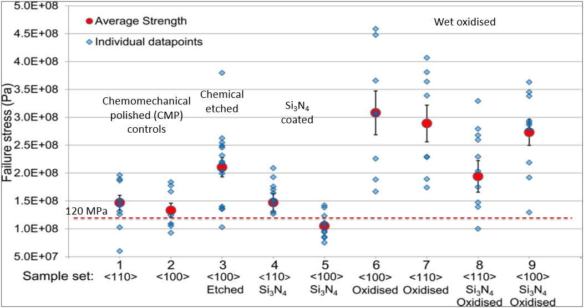
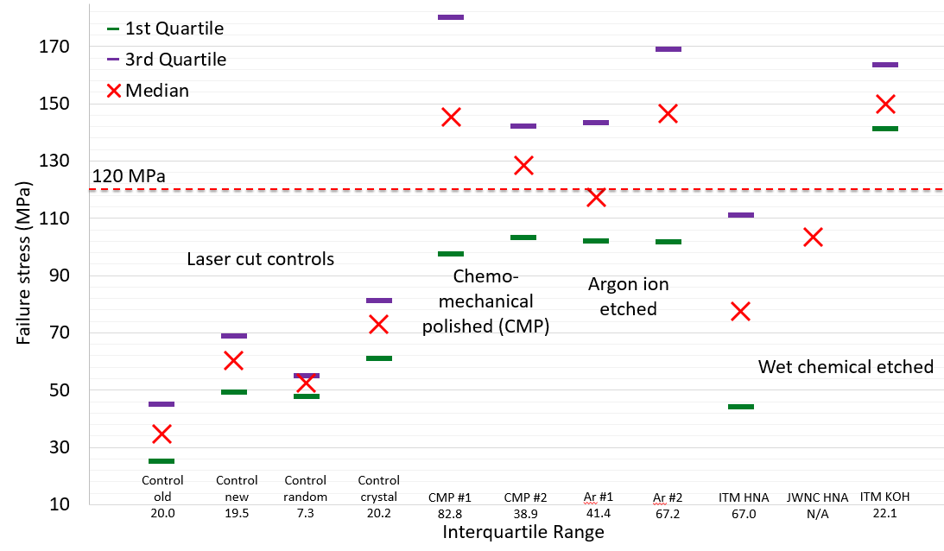
Silicon strength
Literature values often quoted (100s MPa-GPa)
Safety factors must be included (aLIGO/AdV ≈ 6)
Brittle materials generally require higher safety factor
120 MPa used as realistic reference stress
Some production and/or surface treatment methods
  Crystal growth
  CO₂ silica-clad laser pulling/recrystallisation (U. Gibson)
  IKZ Berlin float zone and pedestal growth
  Machining followed by surface treatment
    Grinding, dicing, laser cutting, etc
    Chemical etching, polishing, argon ion etching, coating
All surface treatments must be practical, repeatable and scalable
Material loss must be minimised for any strength treatment since this is the next dominant noise source after jointing, only really have control over the surface loss
Notes:
Oxidised silicon – yes its strong, and it shows that you can increase strength but surface loss found to be very poor
We are currently using numbers from the very best sources, not representative of *real* geometries yet

Slide 20
Key takeaways
Silicon suspensions currently strength limited
After jointing loss, material loss (surface and bulk) is dominant noise source with less significant thermoelastic due to cryogenic temperatures. Surface loss is locked to strength
Current analysis show heat extraction is not dominating compared to strength, however more work required for boundary scattering effects and experimental verification
Experiment and modelling results on real silicon suspension shows jointing loss and resulting mechanical design must be carefully considered. Jointing and shaping of silicon may ultimately may drive mechanical design
As stress increases, dissipation dilution increases but more energy pushed toward ends of the fibre/ribbon (i.e. into a joint region). Care required for particular geometries, as demonstrated in real silicon suspension, highlighting the need for detailed, representative modelling
To match surface loss in a fibre with HC bond loss, the mechanical design needs sum of all bonds in suspension to contain ≈ 1 millionth of the elastic energy of the system.
Notes:
Surface loss about 1e-9
Bond loss about 1e-3

Slide 21
Questions?
Materials for ET-LF Core Optics and Suspensions - Parallel session discussions
Wednesday 19th Oct
Core Optics: Coatings (9am - 10.30am)
Suspensions: Strength and Engineering (11am - 12.30pm)
Thursday 20th Oct
Core Optics: Heat Extraction and Sapphire updates (3.30pm - 5pm)
Suspensions: Heat Extraction and Thermal Noise (5pm - 7pm)
Notes:
Surface loss about 1e-9
Bond loss about 1e-3

Slide 22
Discussion points - Heat extraction and TN
Realistic number for silicon substrate from the state-of-the-art:
  the state-of-the-art about the diameter of silicon substrate is around 40cm
  taking into account the previous point, a 200 kg silicon substrate will have a really strange aspect ratio
  non-uniformity: it would be necessary to have clear data also regarding the non-uniformity of the optical absorptions and all the other parameters of interest along the diameter of a large substrate (40cm)
  limit on thickness: is there any limit due to production problems
  the need of specific laboratory for the production of silicon substrate in increasing
Publication on extra heat: in the near future there will be a publication with a full description of the extra heating mechanisms inside the cryostat due to the presence of many components: 500mW
Boundary scattering:
  Limiting factor for high conductivities and at low temperatures (due to low C_{v})
  Better calculations required
Heat extraction vs strength:
  Needs constantly reviewed due to play off between the two
  Experimentation required to better understand boundary scattering in real fibre/ribbon geometries?
Strength increases > thinner fibres > boundary scattering limitations come into play?
120 K operation?

Slide 23
Discussion points – Strength and jointing/shaping
Geometry of silicon rods, two possible candidates
  Cylindrical fibre or rectangular ribbon?
Surface treatment technique or production could be one of the decision factors on the geometry to be used
Length of silicon rods:
  tune the vertical frequencies for control reason
  what are the frequencies required by the control division
  verify the need to use a "blade / spring" (KAGRA style) to reduce the vertical frequencies of the suspension
  the total length of the suspension will be one of the parameters to be taken into consideration for sizing the cryostat. At present the expected dimensions are: height 6m; diameter 4.20 m
Safety factor: 6 (as starting point: state-of-the-art)
the diameter will decide the vertical frequencies to check with the control division
  the safety factor could be reduced in the future:
    improving the production and polishing technique of silicon rods and thus increasing the breaking strength and reducing its statistical dispersion
    improving the assembly technique and better evaluating/understanding the allowable misalignment margins without the silicon rods breaking
    length and thickness will define the dilution factor
  improve breaking strength statistics as silicon rod production improves
Jointing methods and resultant geometries?
Double and single suspension stage: could be interesting the evaluation of a double (LIGO style) or single (VIRGO style) stages suspension for ET-LF??

