Slide 1

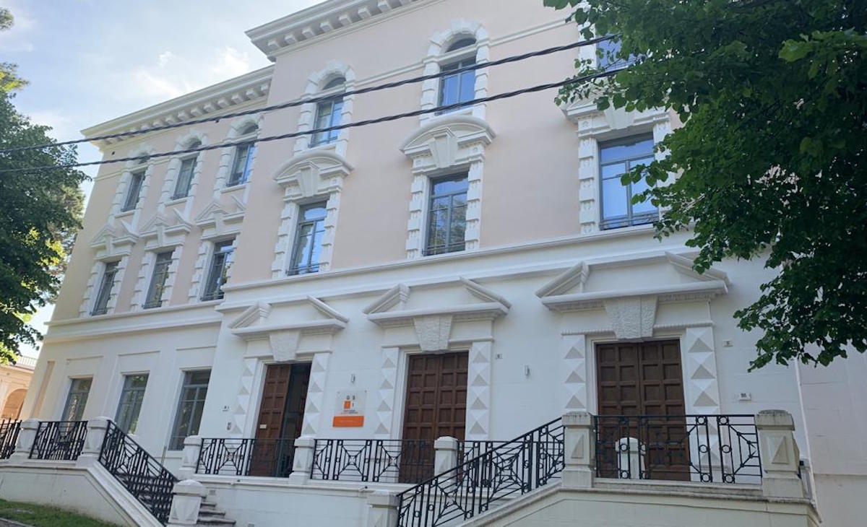
ET-ISB DIV IV Vac&Cryo for ET and the ET Cryo-Mirror
Fulvio Ricci
INFN Sezione di Roma
on behalf of the WP-IV group

Slide 2
Talk content
Status of the ET Tower Vacuum, ET-LF Cryostat and ET-LF Payload Cooling Design
Document on ET-TDS since October 10th, 2022
https://apps.et-gw.eu/tds/?content=3&r=18011
Marco Angelucci 1, Katharina Battes 2, Lennard Busch 3, Roberto Cimino 1, Angelo Cruciani 4, Christian Day 2, Julien Gargiulo 6, Steffen Grohmann 3, Stefan Hanke 2, Xhesika Koroveshi 3, Andrea Liedl 1, Xueli Luo 2, Ettore Majorana 4,5, Luca Naticchioni 4, Antonio Pasqualetti 6, Paola Puppo 4, Piero Rapagnani 4,5, Fulvio Ricci 4, Luisa Spallino 1, Achim Stahl 7
1 LNF-INFN, 00044 Frascati (Rome), Italy
2 Inst. for Technical Physics, KIT, 76344 Eggenstein-Leopoldshafen, Germany
3 Inst. for Tech. Thermodynamics and Refrigeration, KIT, 76131 Karlsruhe, Germany
4 INFN, Sezione di Roma, I-00185 Roma, Italy
5 Università degli studi di Roma Sapienza, I-00185 Roma, Italy
6 European Gravitational Observatory, I-56061 Cascina (Pi), Italy
7 RWTH Aachen University, 52056 Aachen, Germany

Slide 3
Document Content
What is not inside:
The beam pipe vacuum is not addressed, as it is not in the scope of the ISB activities.
What is inside:
Tower vacuum
ET-LF cryostat, geometrical constraints
Concept of the cryopumping
Cryogenic infrastructure requirements
Two options for the ET-LF payload design and cooling discussed in terms of
suspension thermal noise,
cool-down
steady-state operation.

Slide 4
Tower Vacuum
ET-LF tower vacuum influences the the cryostat design
We need to assess
  the gas load,
  how to manage,
  define the interfaces
  A first tool to assess the gas load is ready: the outgassing database
  Based on data on literature and specific measurements done in the ET labs ( standardised procedure needed)
  The aim is:
to collect and categorize the outgassing data for single materials
to assembly candidates for the installation inside the tower vacuum chambers (coils, motors, mounts, complete ‘filters’, . . . )
Credits to EGO => Gargiulo/Pasqualetti/Buggiani

Slide 5

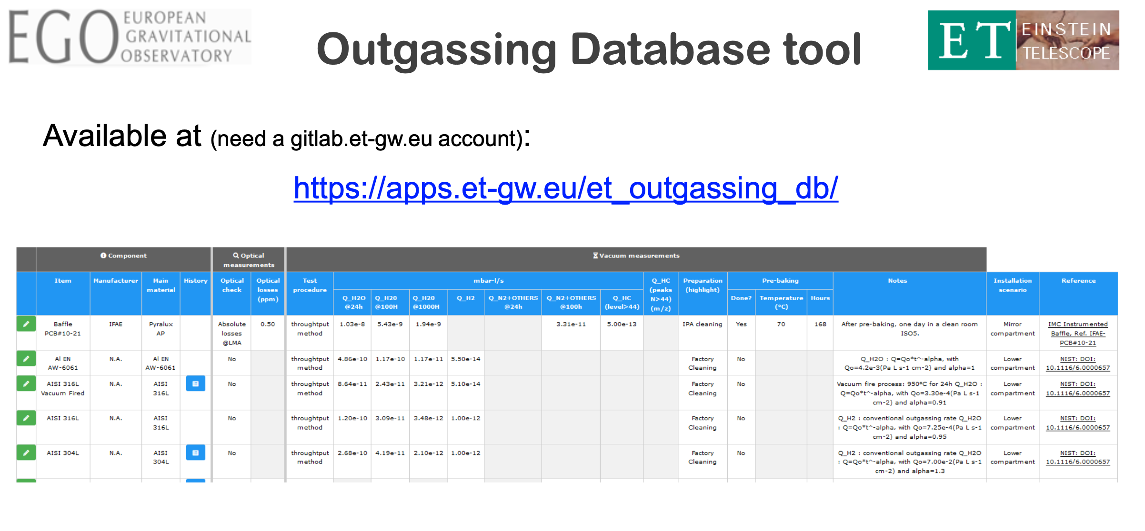
Credits: J. Gargiulo
https://apps.et-gw.eu/et_outgassing_db/

Slide 6
Following Steps
Attentive estimates of gas loads needed:
towers are unbaked and frequently vented: study of the transitory phase of vacuum recovery needed.
Steps to evaluate the gas load:
a) an “initial” gas budget as a basis for discussion, based on the current experience shared among the WPs expertise;
b) a “preliminary” budget using the first data that will begin to populate the database and the preliminary design options chosen for the towers and in-vacuum parts;
c) the “consolidated” budget in a mature stage, when most of the systems of the towers and ancillary equipment will be defined.
Full-scale tests of major assemblies required

Slide 7
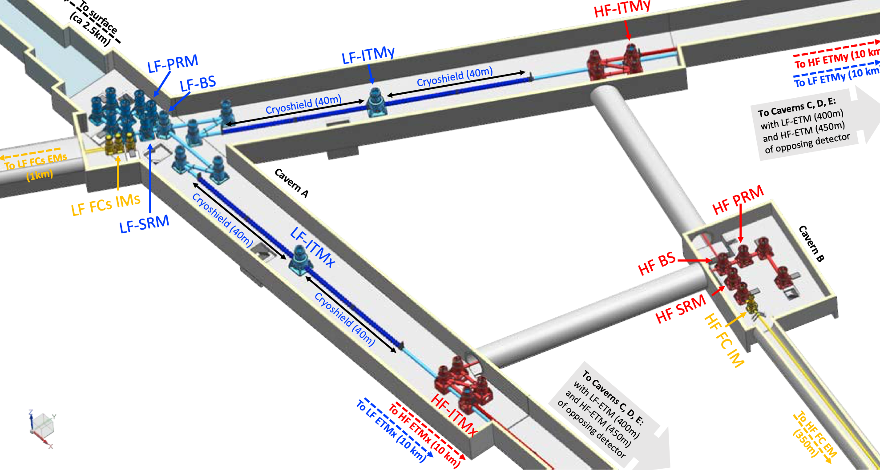
ET VACUUM Towers: cleaness
Ten’s of vertical vacuum towers hosting the optical elements
  ET-LF tower basements ➔cryostat, ET-HF basements ➔ UHV chamber
Absolute cleanness: any residual particles of dust along the light path and near the monolithic suspensions ➔ let us make an effort in translate this requirement in a quantitative language➔ define a method to check the cleanness➔
XX residual particles/m² ??? XX residual particles/m³ ???

Slide 8
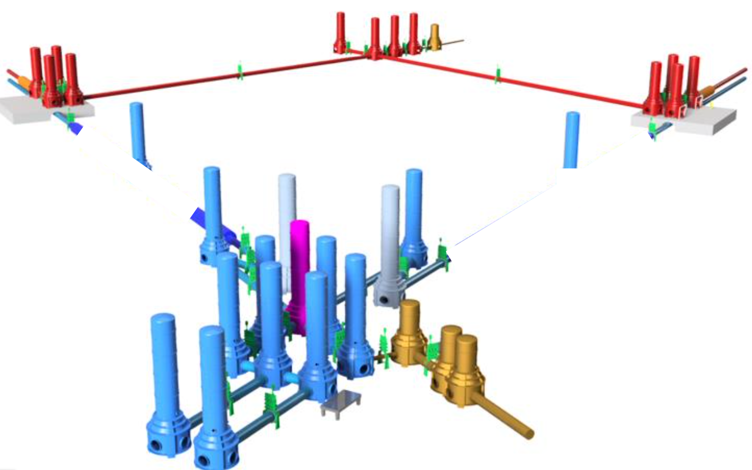
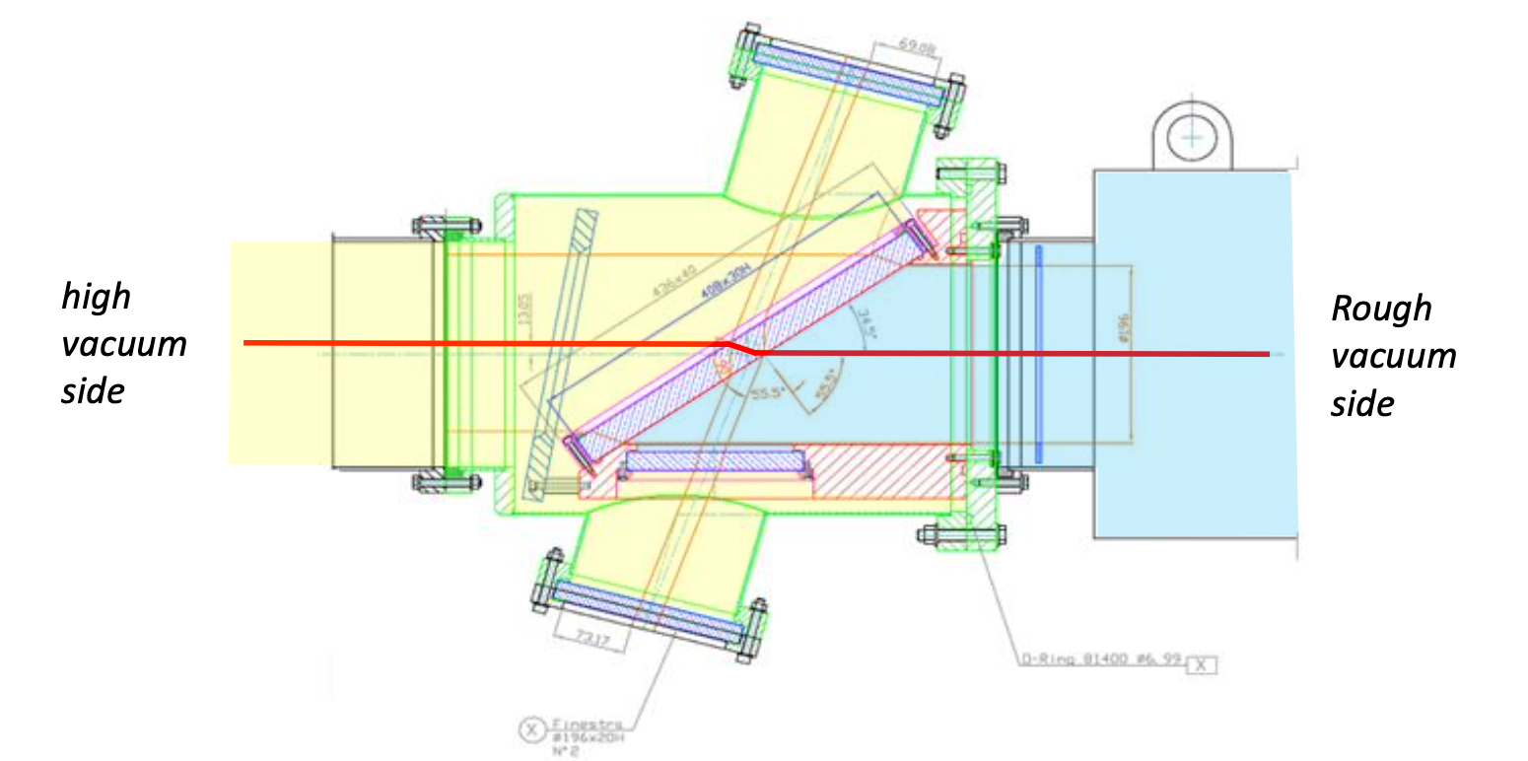
ET VACUUM Towers: few categories
1 Detector ➔ ~ 42 towers
a) HF towers: low 10⁻⁹ mbar range, unbaked. Note: vacuum level in HF tubes is highly demanding;
b) LF towers: low 10⁻⁹ mbar range, unbaked. Note: many gas species are a potential risk for deposition on mirrors;
c) Upper compartments: 10⁻⁷ mbar range, unbaked, water prevalent;
d) Other auxiliary chambers, typically lower-rated concerning residual pressure.
Standardisation to reduce cost and make easier the mantainance
ET VACUUM Towers: the interface
Vacuum tight glass separation are in use to allow beam passage between chambers at much different vacuum levels.
May become a disturbance for the experiment (or for vacuum if removed).
Not a valid solution for critical areas / beams
Even more critic if connected to the ET-LF cryostat

Slide 9
Further Remarks on Tower Vacuum
Too many towers in ET ask for a rapid recovery of the vacuum to keep a high duty cycle of the machine
. Large and quiet pumping speed, such as that potentially provided by cryopumps.
Independent venting of the “tower vacuum” and the “cryostat vacuum” should be avoided.
The lower bound time scale for interventions and/or vacuum recovery in the LF cryostats is on the order of a month.

Slide 10
Cryostat Interfaces
Reduction of outgassing
Pumping requirements
Minimisation of
conductance
Design of shielding
Frost formation and
recovery
Resulting local
pressures

Slide 11
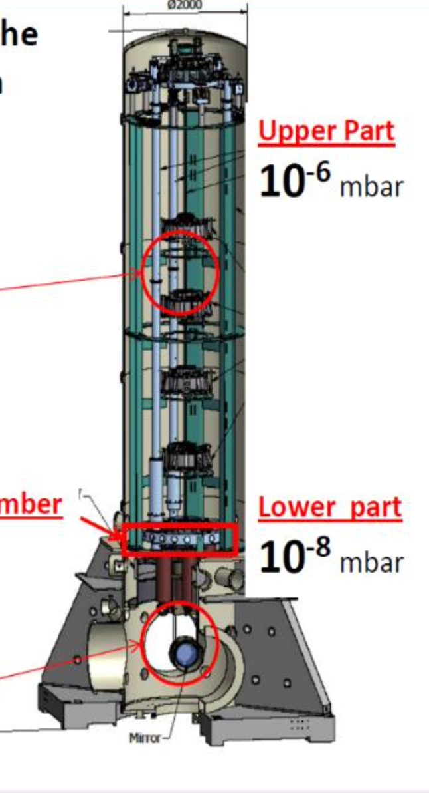
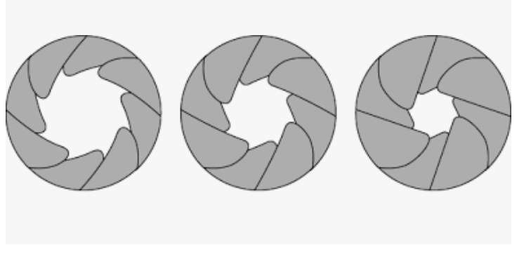
Room temperature Vacuum / Cryostat Interface -I
Schetch
of a Virgo Tower
Similar
concept for
ET: two vacuum zones
improved of a factor 10 at least
LF detector interface: Tower (upper compartment) to cryostat
Vacuum of the upper part of the LF-Tower 2-3 times worse that that of the cryostat
Transition for the up-down undisturbed cross of the suspension wire+cable (no-contact)
Solution under study
☹ starting point AdVirgo experience: 12 mm diameter ☹)
Different approach
Use of a dynamic aperture ranging from 12/18 mm to 0.5 mm
+
Increase the differential pumping speed with dedicated cryopump
Interface
Payload

Slide 12
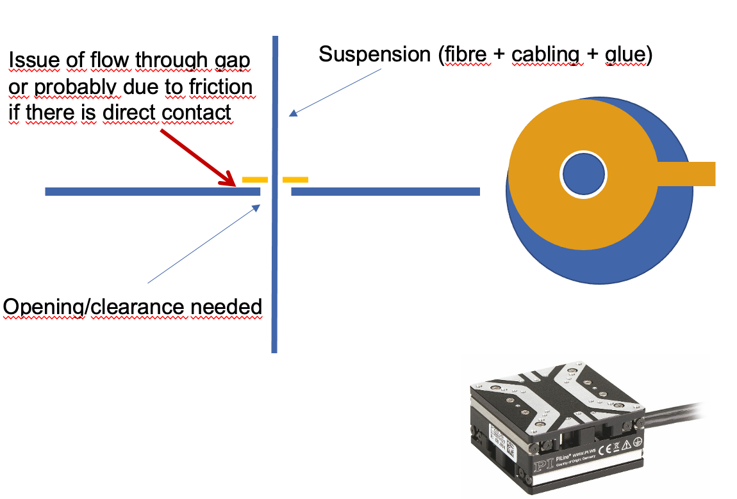
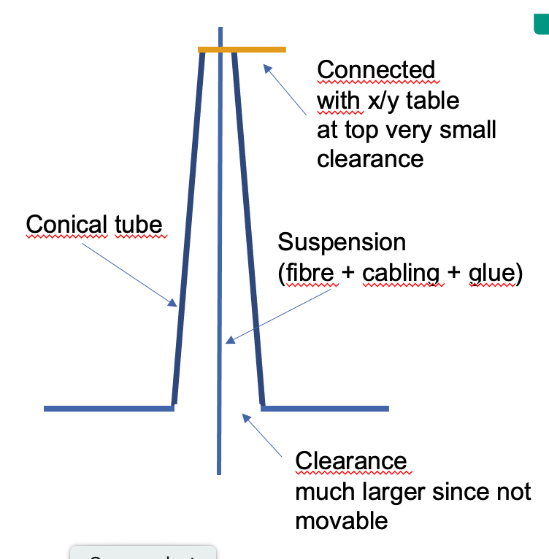
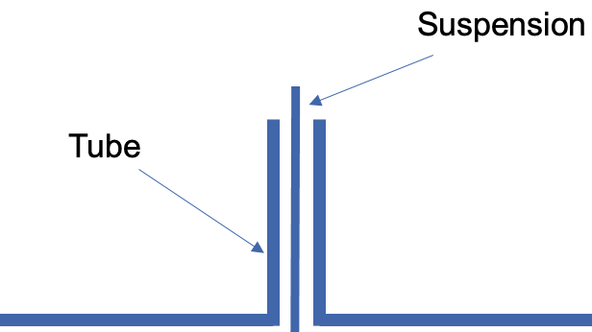
Studies on Conductance Minimisation
Orifice solution + variable conductance
Cylindrical tube

Slide 13
Calculated gas flows from tower to mirror
 | Radius suspension | Radius opening | Radius opening 2 | Clearance | Orifice/tube length | Transmission surface | Transmission probability | Conductance | Gas flow to mirror
 | r_{i} | r_{o} | r_{o2} | dr | l | A | P | C | Q
 | (mm) |  |  |  |  | (m²) |  | (m³/s) | (Pa m³/s)
orifice | 6 | 12 |  | 6 | 0.5 | 3.39E-04 | 0.95 | 1.41E-01 | 1.41E-06
 | 6 | 7 |  | 1 | 0.5 | 4.08E-05 | 0.80 | 1.43E-02 | 1.43E-07
 | 6 | 6.5 |  | 0.5 | 0.5 | 1.96E-05 | 0.70 | 6.03E-03 | 6.03E-08
tube | 6 | 12 |  | 6 | 300 | 3.39E-04 | 0.055 | 8.19E-03 | 8.19E-08
 | 6 | 12 |  | 6 | 500 | 3.39E-04 | 0.035 | 5.21E-03 | 5.21E-08
 | 6 | 12 |  | 6 | 800 | 3.39E-04 | 0.025 | 3.72E-03 | 3.72E-08
 | 6 | 12 |  | 6 | 1000 | 3.39E-04 | 0.020 | 2.97E-03 | 2.97E-08
cone | 6 | 7 | 12 | 1 | 300 | 4.08E-05 | 0.067 | 1.21E-03 | 1.21E-08
 | 6 | 6.5 | 12 | 0.5 | 300 | 1.96E-05 | 0.070 | 6.01E-04 | 6.01E-09
 | 6 | 6.5 | 12 | 0.5 | 500 | 1.96E-05 | 0.043 | 3.70E-04 | 3.70E-09
 | 6 | 6.5 | 12 | 0.5 | 800 | 1.96E-05 | 0.028 | 2.37E-04 | 2.37E-09
 | 6 | 6.5 | 12 | 0.5 | 1000 | 1.96E-05 | 0.022 | 1.91E-04 | 1.91E-09
Credits S. Henke see talk at GWDVac‘22 Workshop Elba

Slide 14
Room temperature Vacuum / Cryostat Interface - II
ET-LF interface: Cryopumps connecting the main tower to beam pipe and to adjacent towers
Once in operation the vacuum towers are connected to the vacuum pipes via cryopumps.
In the Virgo jargon these are called cryotraps
In the ET-LF case crypumps/cryptraps play two roles:
Reduce the thermal input due to the radiation emitted by the warm surfaces and seen by the cold surfaces of the cryostat and the mirror
Reduce the molecules exchange between towers and long pipes and between adiacents towers and that hosting the test mass

Slide 15
Cryopumps for ET-HF
HF tower ➔ cryotraps limit the gas flow into the beam pipe arms
Vacuum requirements :
p _{HF,Tower} > p _{Beam Pipe}
H₂ ~ 1 × 10 ⁻¹⁰ mbar,
H₂O + others ~1 × 10 ⁻¹¹ mbar
Relaxed requirement for vacuum in the HF towers ~1 × 10 ⁻⁹ mbar

Slide 16
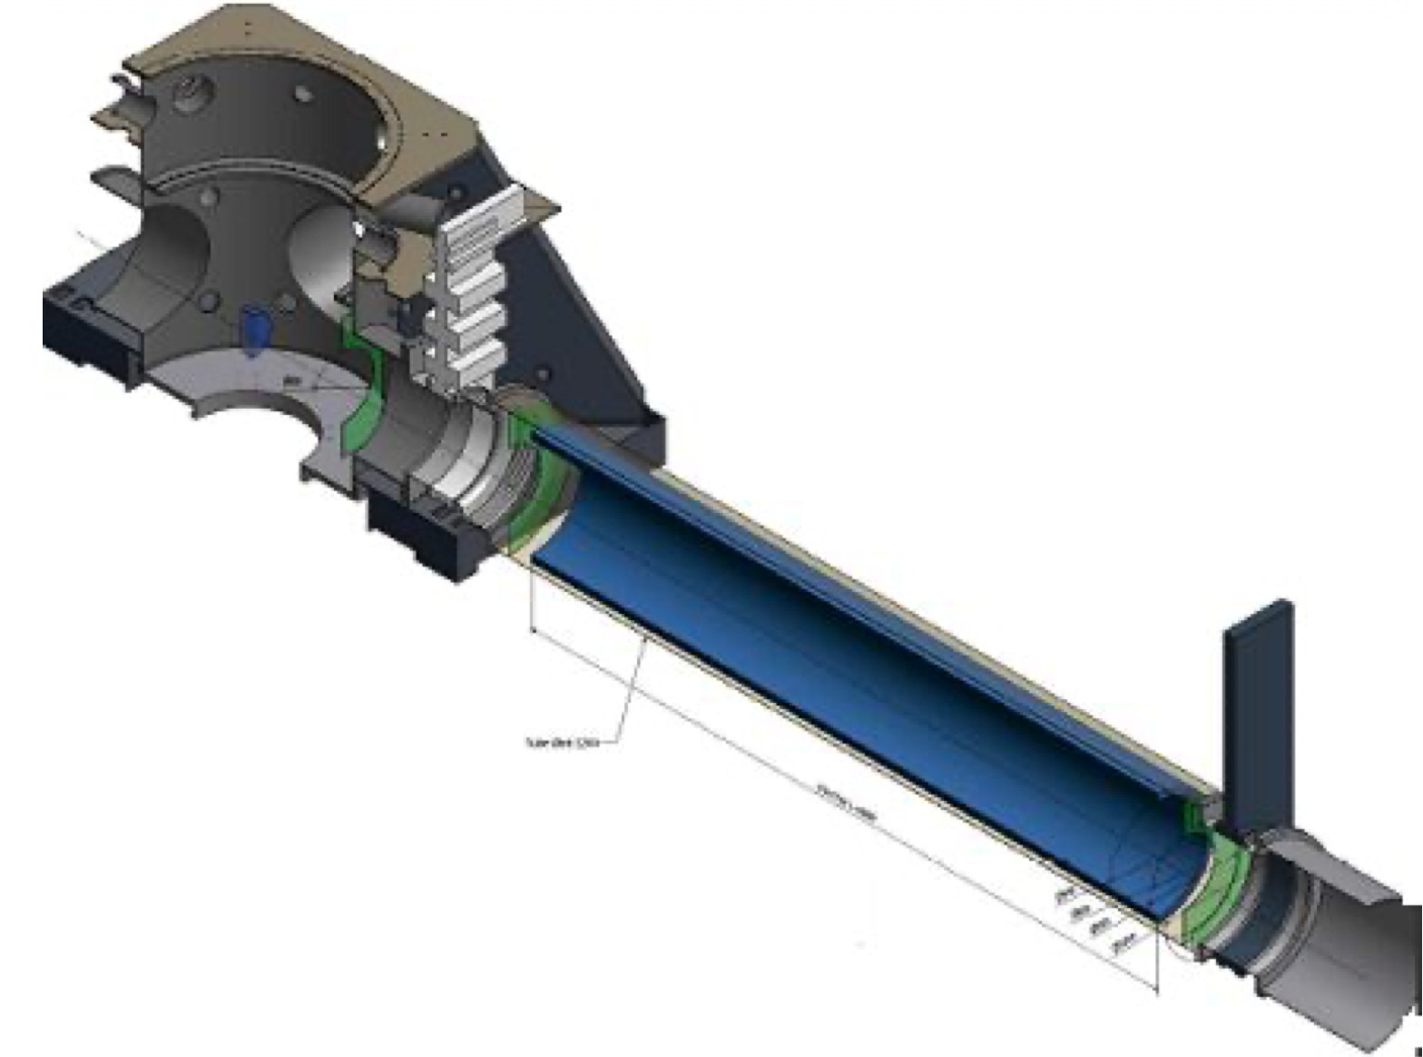
Cryopumps studies
Cryopump have to be operated at around 3.5 K for cryo-condensation of hydrogen, or at about 10K for the case of pumping by cryosorption at a suitable sorbent.
To reduce the cost, cryopumps could be designed with integrated pumping units for hydrogen and water pumping in one unit, but at different lengths.
Preliminary simulation (simple payload – no cryostat screens) shows that hydrogen pumping integrated in the cryopump at the adjacent tower side of the cryostat fulfils the requirement for hydrogen pumping of the main tower area (Hanke S, Battes K, Day C and Luo X https://apps.et-gw.eu/tds/?content=3&r=18001)

Slide 17
Mirror electrostatic charging and frosting
Elecrostatic charging:
LIGO solution: some tenth of mbar of a N₂ plasma for a long time (∼ 1 h)
Frosting:
KAGRA solution : use hetaers at the level of the marionette
Alternative solution proposed in ET:
use of electrons of variable energy (∼10 eV to 100 eV)
  fully compatible with the cryogenic environment
  minimal effects on mirror quality due to the low mean free path of low energy electrons
  very efficient in inducing non-thermal desorption of condensed molecules from a cold surface
proof of principle has been recently published
Spallino L et al. 2022 Phys. Rev. D 105 042003 URL https://doi.org/10.1103/PhysRevD.105. 042003

Slide 18
The Cryostat and Its Impact on the Infrastructures
Basic choices
access from below for assembly and integration, as in Virgo,
single cryostat vacuum.
Why?
It simplifies a lot the cryostat design and the assembly, reduces the cost and allows the integration procedures developed in Virgo to be used.
Consequences of this choice:
large rooms below the main galleries hosting the ET-LF towers
large enough clean rooms under each TM tower;
all connections and feedthroughs must be above the payload chamber.

Slide 19
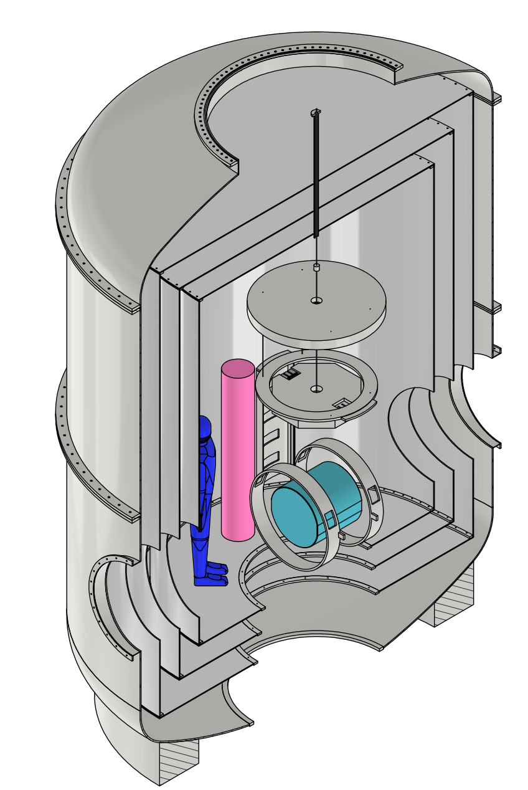
Conceptual design of the cryostat - II
Clearance is needed around the payload for integration and additional instrumentation (extra vibration attenuators) close to the mirror
The inner chamber may be passive or actively cooled, depending on the results of our evaluation of the residual noise generated by the cooling system.
Re-enforcements on the vacuum vessel and/or the thermal shields may be required to prevent low resonant frequencies.
Super-insulation
Standard multi-layer insulation to reduce the heat flux may not be acceptable

Slide 20
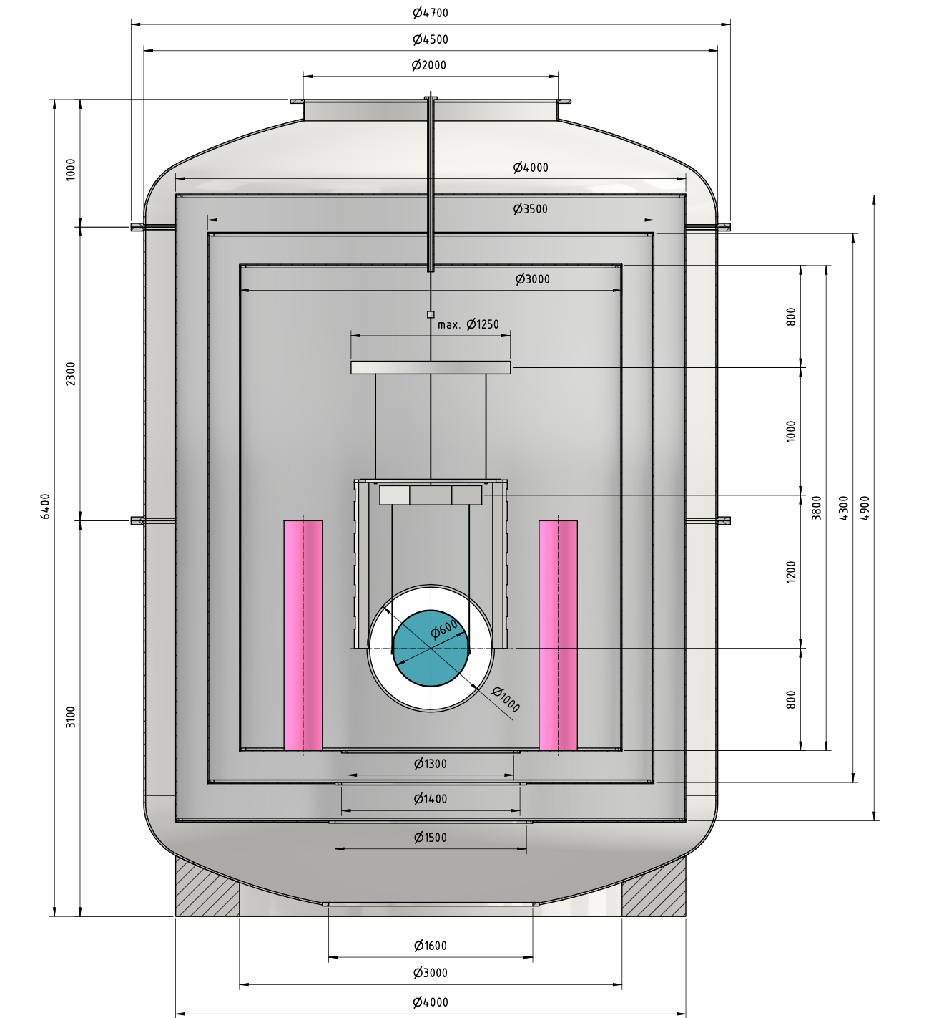
Conceptual design of the cryostat - II
Inner chamber:
3.0 m diameter
3.8 m height
Payload
1.25 m max diamater
600 mm diameter mirror
Payload Vertical Dimensions
1.2 m length from mirror to marionette
1.0 m for the marionette suspension from the platform
0.8 m for the operator to act on the junction box from the super-attenuator to the platform
External Dimensions
6.4 m overall height up to the upper tower interface
4.7 m maximum diameter
2 m flange for the connection to the upper tower
1.6 m flange for the bottom access of payload and the part of the bottom thermal screens

Slide 21
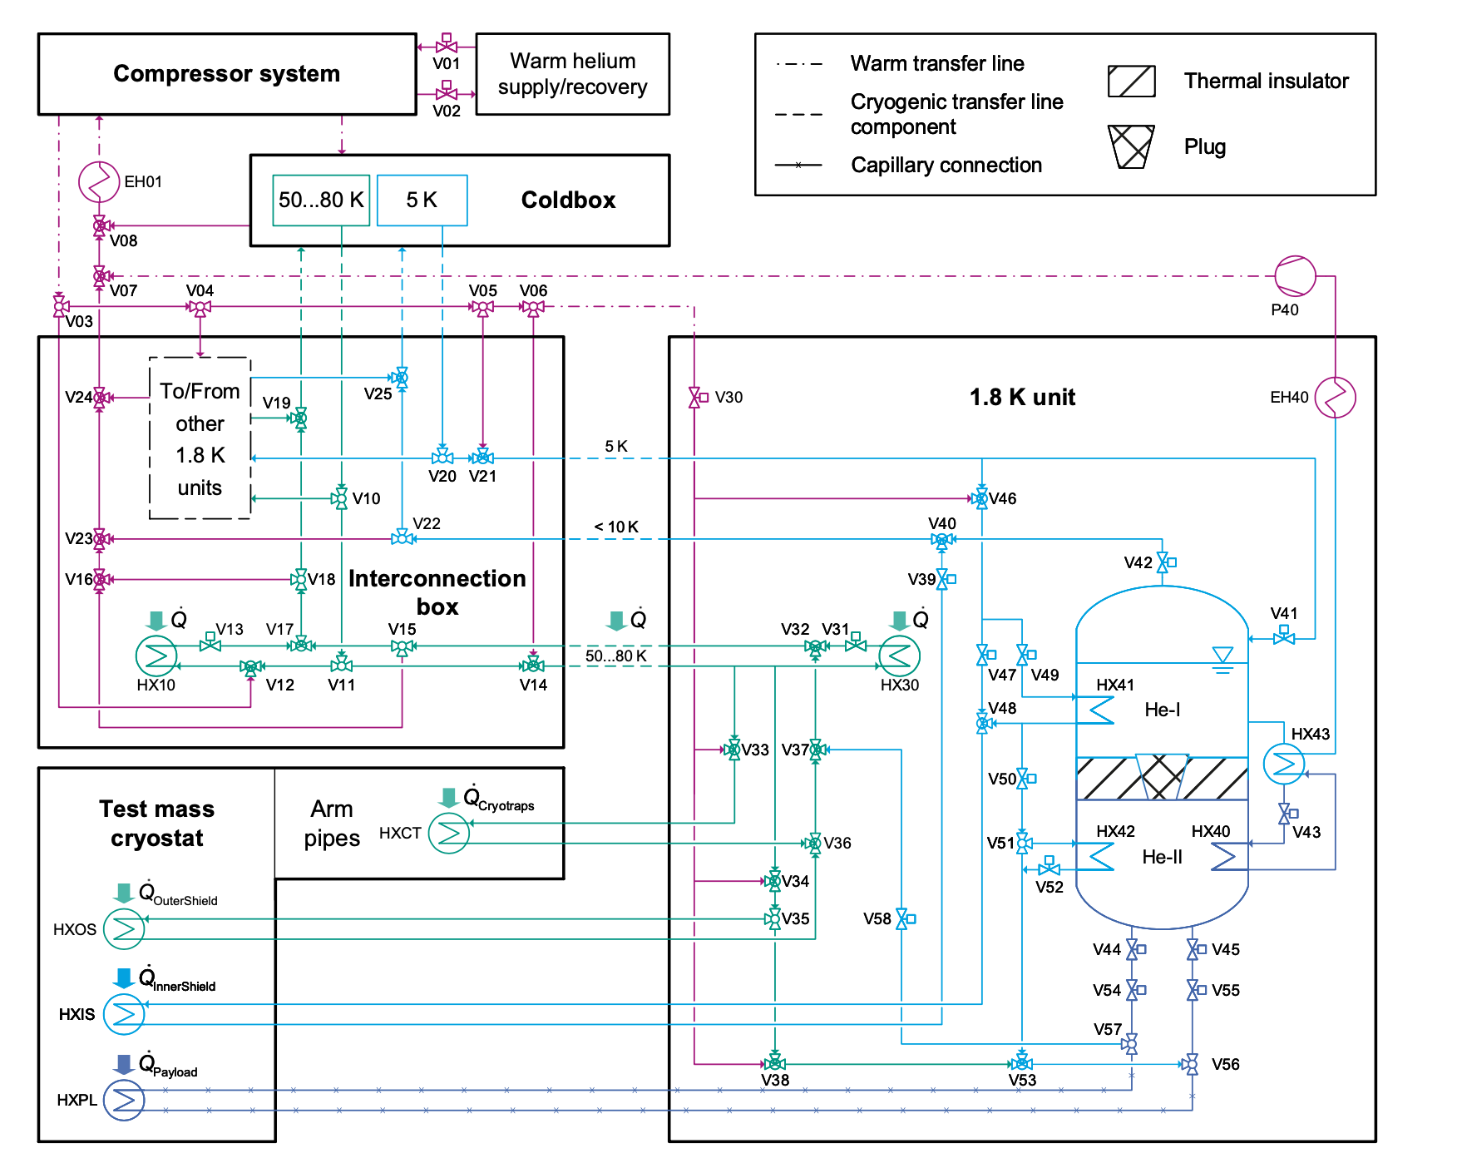
Cryogenic Infrastructures
Busch L and Grohmann S 2022 IOP Conference Series: Materials Science and Engineering 1240 012095 URL https://doi.org/10.1088/1757-899x/1240/1/012095
First conceptual layout completed
Colors indicate different helium temperature levels:
blue ≈ 2 K
cyan ≈ 5 K
green = 50 - 80 K) purple = 80 - 300 K)
The system can provide
cooling capacity at 80 K for cryopumps (designed for pumping water) and all the outer thermal shields in cryostats and transfer lines
refrigeration power via supercritical He (5-6 bar) to cool the inner thermal shield of the TM cryostat at T ≈ 5K
  The inner shield must be cooled prior to the payload in order to avoid frost on the optics.
superfluid He II down to T ≈ 1.8 K to cool marionette or platform

Slide 22
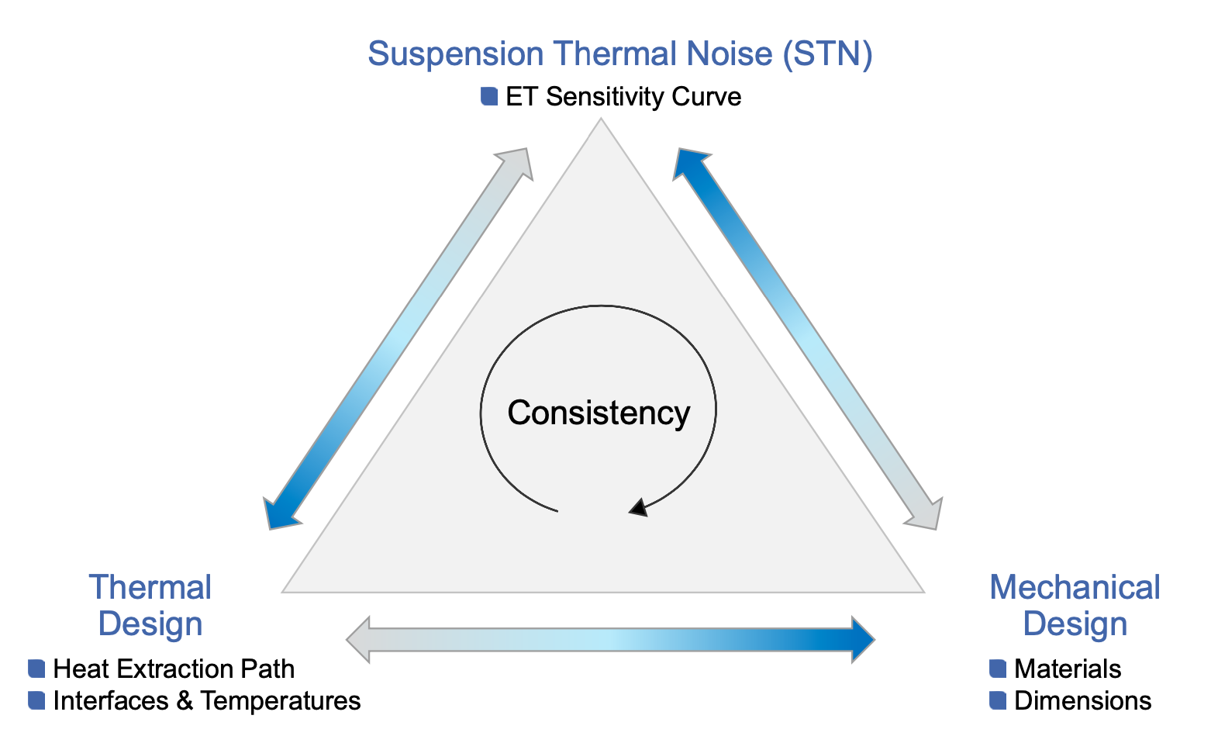
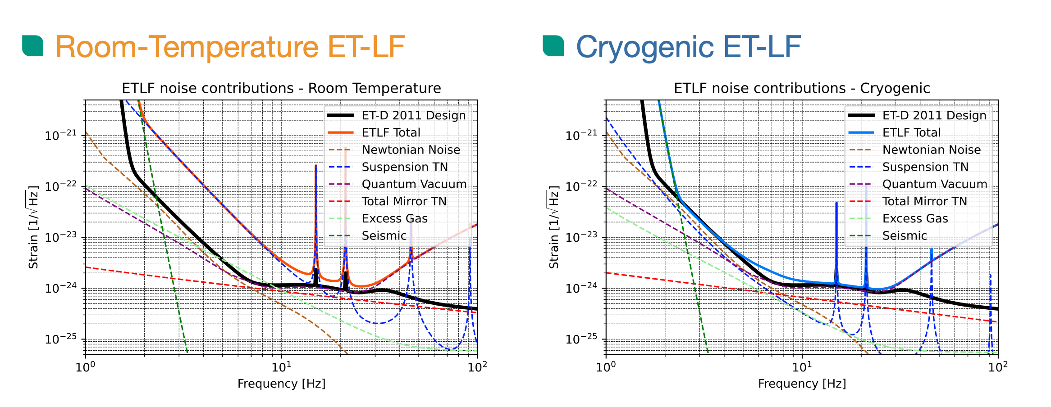
Cooling of the ET-LF Payload
Suspension Thermal Noise is the reference criterion for the design optimization of the payload
Cryogenics reduces the Suspension Thermal Noise contribution at the level of that of the Newtonian Noise to the overall ET sensitivity curve

Slide 23
Heat load on the inner chamber of the cryostat
Experience shows that heat loads in cryostats cannot be calculated precisely, typically caused by the sum of non-idealities in thermal insulation.
Considering the size (volume and surfaces) and complexity of the ET-LF cryostat including the need for optical access, a conservative assumption of 0.5 W heat load shall be used for the design of cooling systems.
For comparison, KAGRA assumes 1.0 W heat load on its cryogenic detectors, only partially caused by the higher absorption in its sapphire mirrors.

Slide 24
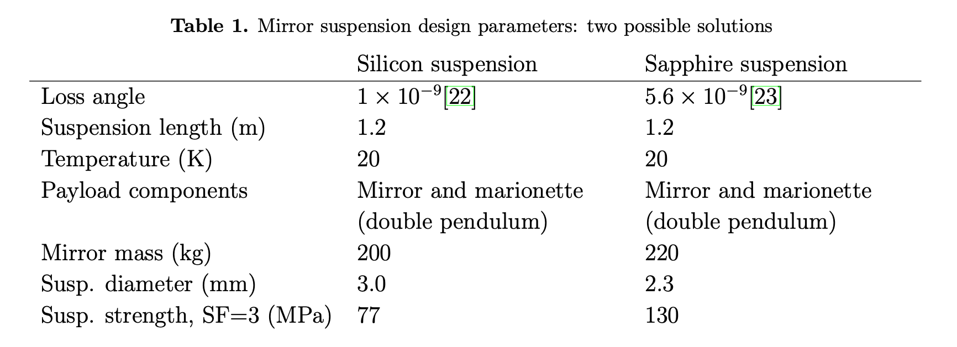
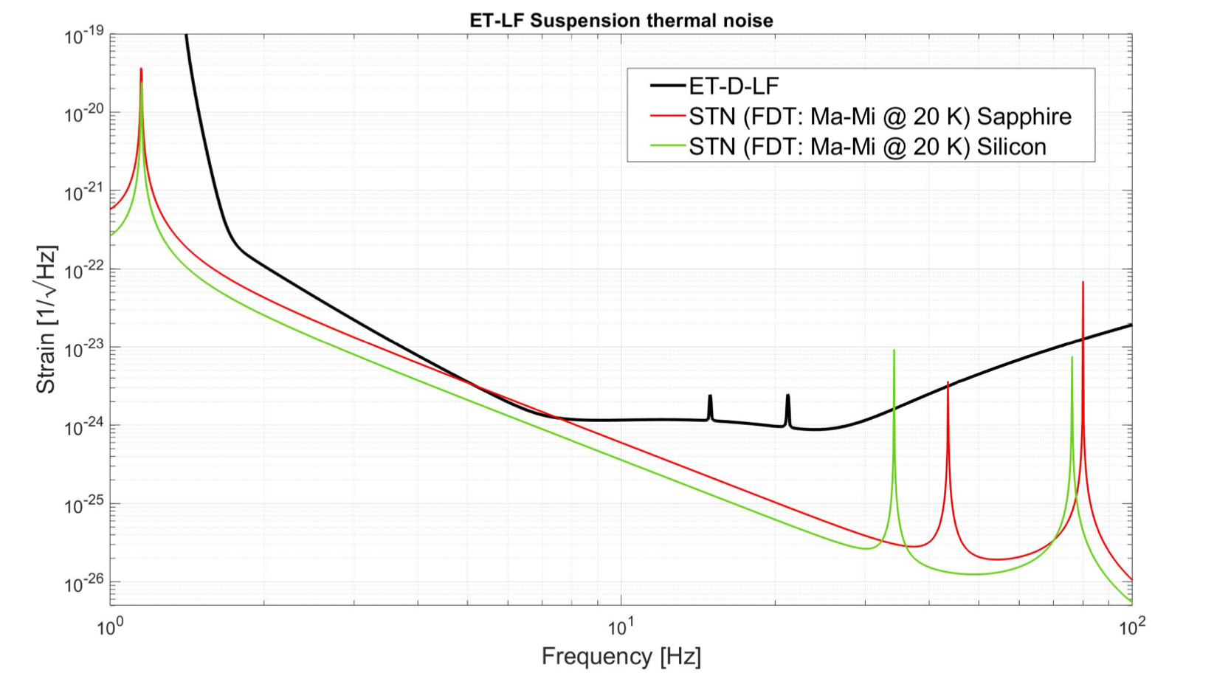
Payload
parameters
Dimensions of the mirror suspension dimensions impact on
suspension thermal noise, i.e. the ET-LF sensitivity,
achievable mirror temperature,
cryostat dimensions
Constraints due to the tensile strength of the chosen material
Breaking Strength Values (@ 300 K)
Silicon 200 - 300 MPa
Sapphire 400 MPa

Slide 25
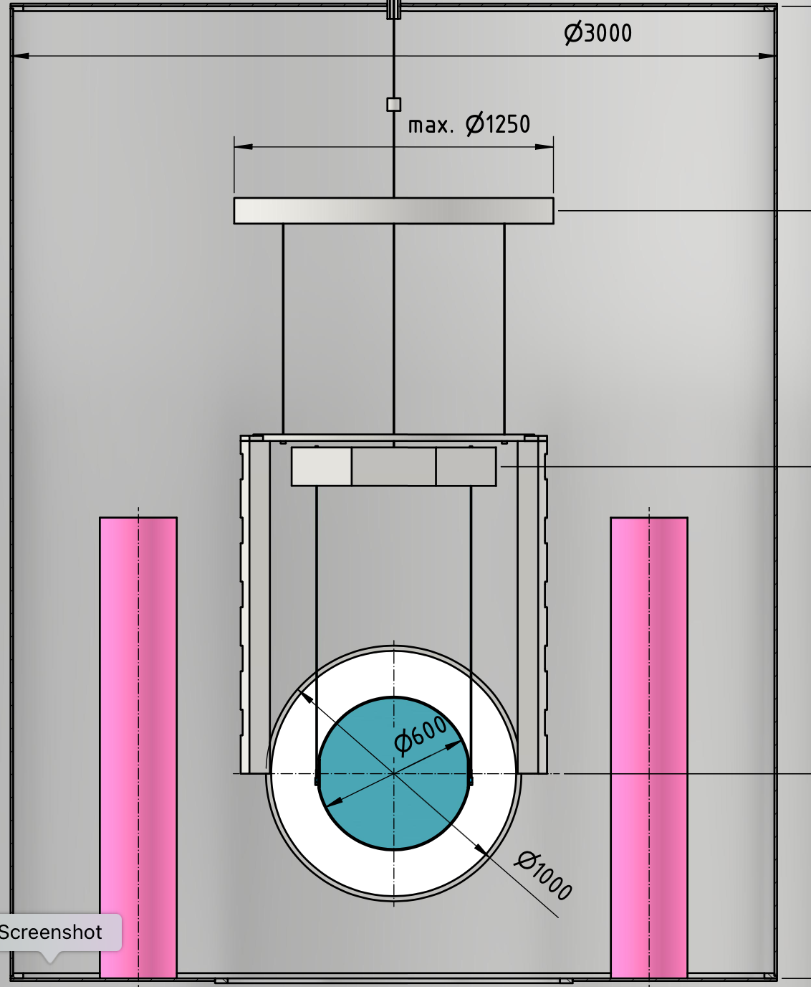
Payload cooling: constraints
a) Mechanical simulation shows that soft aluminium heat links cannot be attached to the marionette directly: they spoil the Thermal Noise requirement
b) Thermal simulation shows that with a titanium suspension (e.g. 3mm diameter , 0.8 m long) between platform and marionette the cooling is completely ineffective

Slide 26
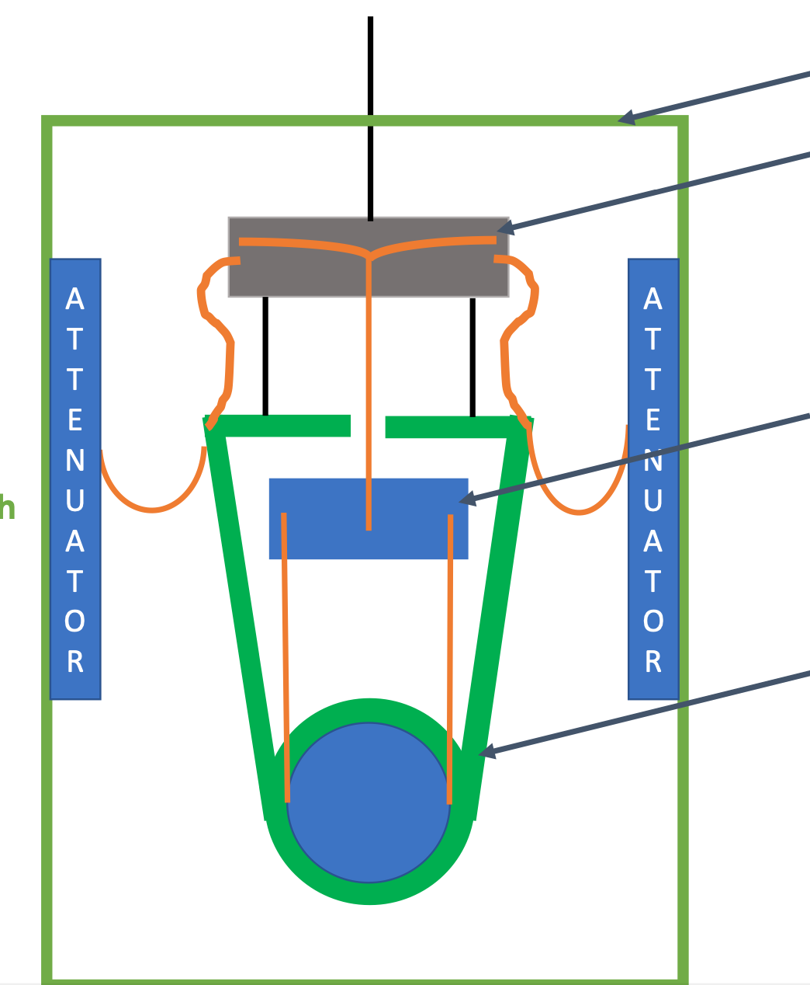
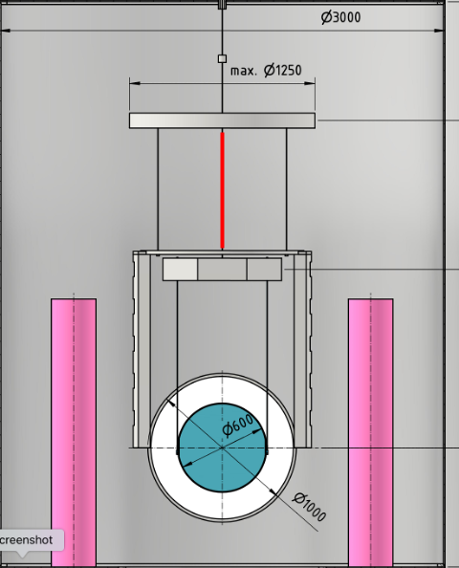
First possible cooling configuration
(to be tested)
using a high-conductivity material also for the marionette suspension, providing low mechanical losses thanks to the very high Q of crystalline materials (silicon or sapphire), and reaching the platform via soft heat links.
Cryostat Inner Chamber
Platform
Double pendulum
Cryostat Platform (PF) with Blades
Platform with blades for vertical attenuation
Heat links on the screen
Screen connected to PF with 3 wires (for angular control)
Marionette
Actuation cage with baffles,…..

Slide 27
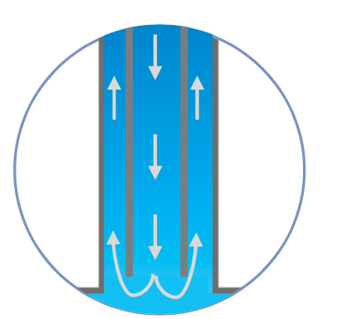
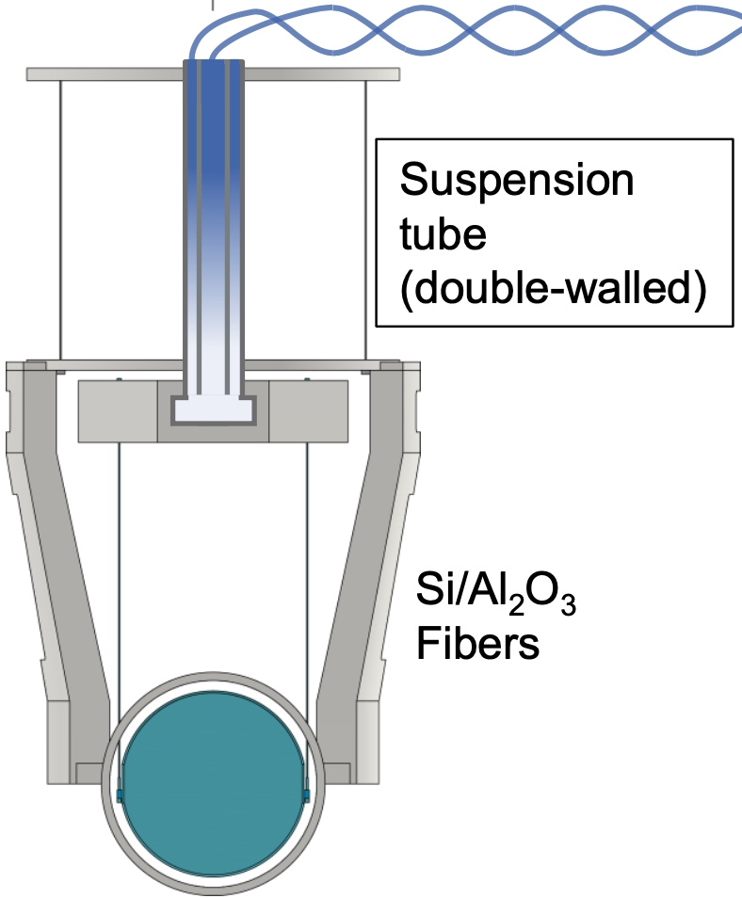
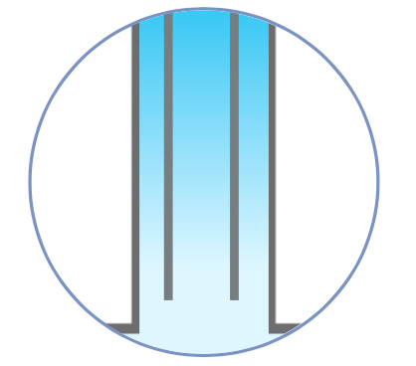
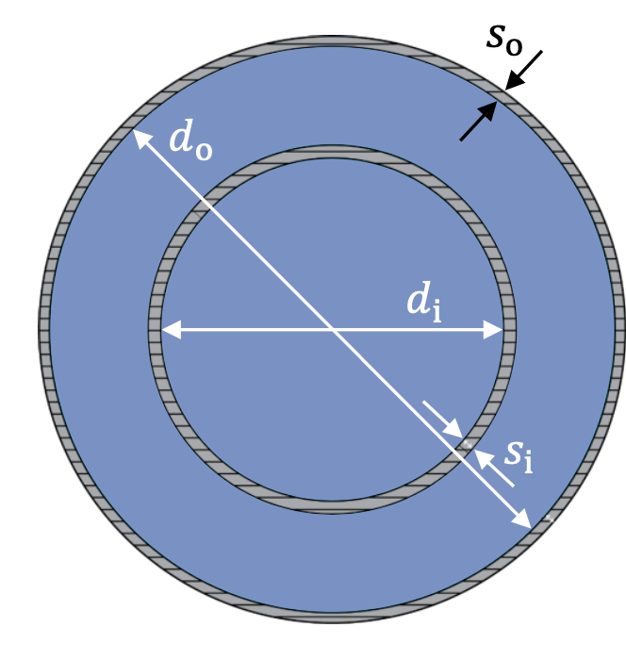
Second possible cooling configuration
(to be tested)
Take advantage of quantum properties of He II
He-II fills the marionette suspension tube made of titanium, (relatively high quality factor @2 K)
Marionette@ ~2 K
He-II reaches the platform via a set of supply capillaries.
He I flow during the cool down
Capillaries filled of He II
Double walled tube made of titanium
He-II no macroscopic flow in the steady-state
𝐿o = 1 m
𝑑o = 8.3 mm
𝑠o = 0.43 mm
𝑑i, 𝑠i: adjustable

Slide 28
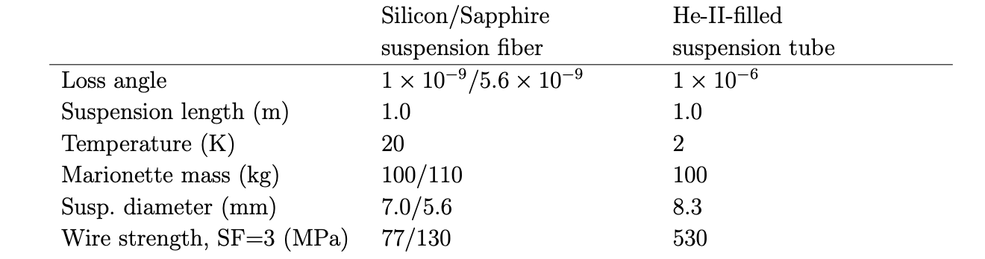
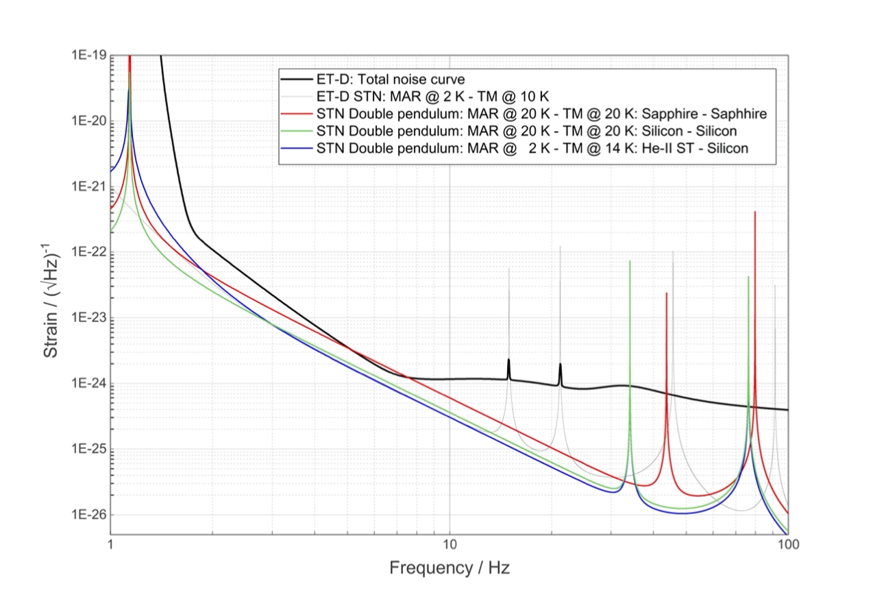

Slide 29
No conclusion: instead point to be discussed during the parallel section
“Initial” gas budget as a basis for discussion, based on the current experience shared among the WPs expertise
Cooling concept: discussion on the two proposals and consequent R&D actions to validate the solutions
Suspension thermal noise, i.e. the ET-LF sensitivity,
Interface of the cryostat with adjacent towers: how many and where we plan to install
LF detector interface with the upper vacuum hosting the super-attenuator : Tower (upper compartment) to cryostat and passage between the tower vacuum and the cryostat vacuum
Cryostat dimensions.
Cryopumps: how many, locations, dimensions and which type
Extra point regarding Cryo-system and Vacuum Cryoplant on surface and interface with infrastructure

Slide 30
EXTRA SLIDES

