Slide 1
Einstein Telescope Beam pipes requirements
Einstein Telescope Beam pipe requirements
Parallel sections
Contribution from many people….
Aniello Grado
ISB Workshop 17th October 2022, ET Vacuum& Cryo – WP IV.2
ISB Workshop 17th October 2022, ET Vacuum& Cryo – WP IV.2

Slide 2
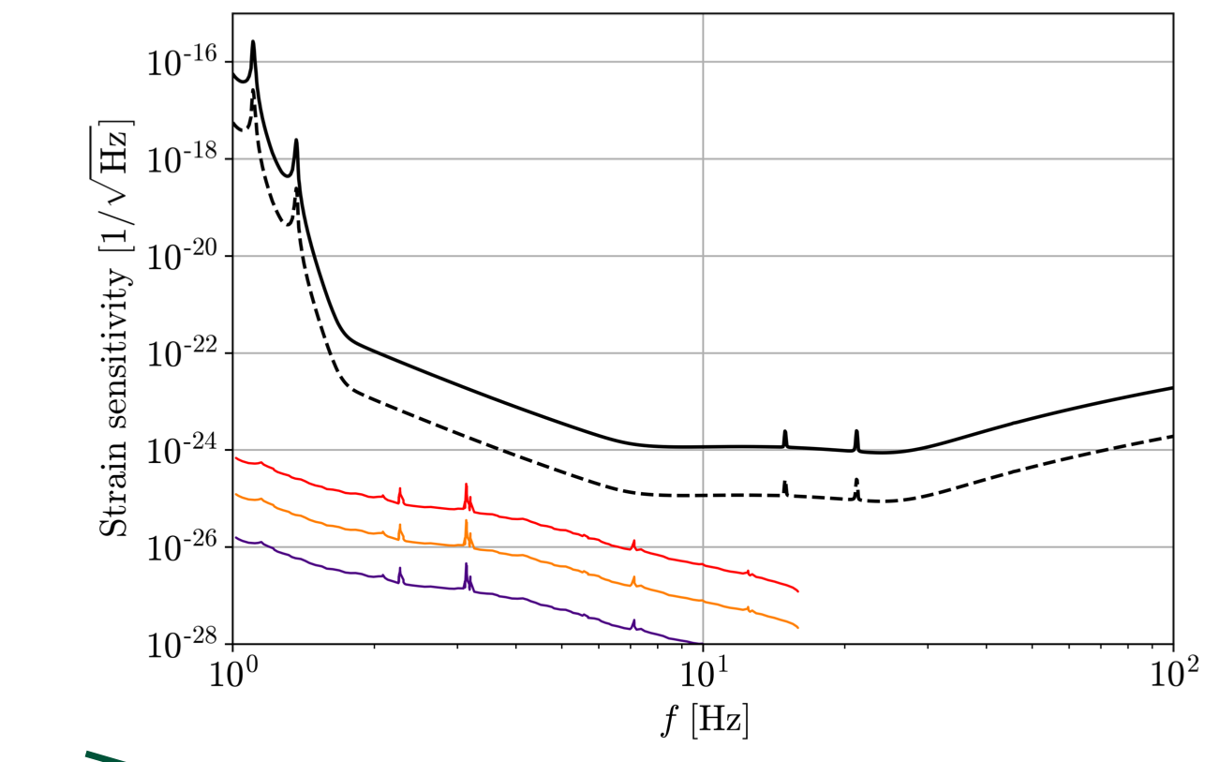
BAFFLES
If we assume that:
we need ~ 2000 baffles
cost of each baffle (to be assessed)
We find a way to put them in place without welding (spring in whatever is helical or conical baffle)
we aspect that the cost/benefit is so that we can install baffles and reduce the risk connected with unexpected scattered light
For corrugated tube we certainly need baffles

Slide 3
TUBE DIAMETER
We assume a tunnel 6.5 m straight inner diameter (constraint)
We need to know (from safety group) the space necessary for safety issues
In the space left CERN will evaluate the possibility to accommodate a 1 m or 1.2 m tube including all the installation operation.
Why 1m or 1.2 m ? Because we want to have room for future upgrade on the mirror size (for HF)
Maximum allowed mirror size vs tube diameter will be assessed by Mario’s group

Slide 4
Dust
We need to put requirements on size and number of allowed particles dust we can have inside the tube.
Two effects were discussed:
Particle going trough the beam
Particle contaminating the baffles and increasing the light scattering
These requirement has a strong impact on the production/installation procedure and on cleaning.
Tests can be done at CERN on the pilot sector

Slide 5
Pressure
We assume a minimum margin of 10 for the noise induced by residual gas fluctuation.
Then we can derive the specific outgassing rate we need to achieve
taking into account contribution to the gas load from welding and baffles
These numbers will be verified on the pilot sector @ CERN
Action: we will produce a document with detailed arguments on the tube diameter choice (ranging from 1 to 1.2 m)

Slide 6
A lot of interesting discussion
Discovering some interesting issue….
we will have regular meetings (biweekly or monthly) on vacuum requirements (be prepared to be involved ☺☺☺).
First document by March 2023

