Slide 1
Materials for ET-LF Core optics and Suspensions
ISB workshop October 2022 – Parallel session 1
A. Amato

Slide 2
Core Optics – Tasks for Workshop
Parameters
Define better estimate about substrate production (diameter, absorption, …)
Define the missing data for R&D (both substrate and coatings)
AlGaAs: time and costs – Is it a real option?
Heat Extraction
Absorbed power with measured absorption
Safety factor = 6 -> “fibre” size?
Fibres TN, Bounce frequencies, …?
Core Optics - ISB workshop October 2022

Slide 3
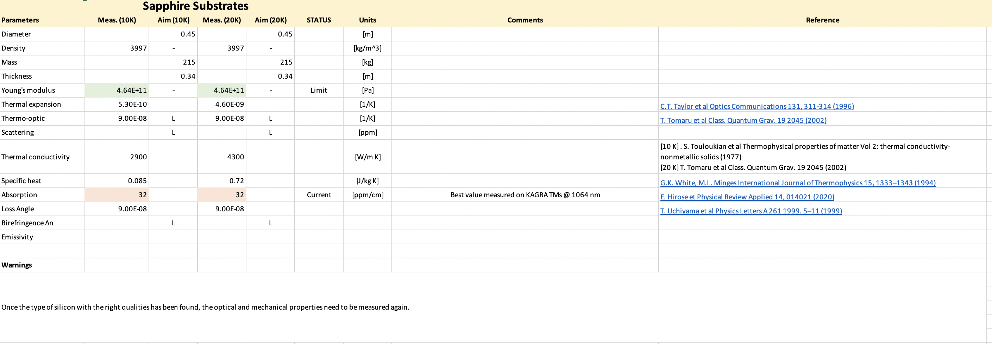
Summary
PARAMETERS:
We need to keep record of the evolution of the parameters + desired parameters
A new database will be created.
DRAFT
Materials Parallel Session 1 - ISB workshop October 2022

Slide 4
Suspension – Jointing and Strength
Jointing methods dominant noise source
Require ability to lower joint loss and/or shape silicon to drive energy from lossy joint regions crucial to design
≈1 millionth energy in all bonds for joints to match next dominant loss mechanism (surface)
Accurate, representative modelling required to determine joint thermal noise contribution
1.2 m length confirmed between cryogenics and suspensions group
Some techniques compatible with this length but work required to demonstrate this in practice
Caution: Increasing stress may being vertical/bounce mode <30 Hz
Safety factor of 6 decided with current reference stress at 120 MPa for silicon
More work required to strengthen silicon/reduce SF, without increasing surface loss
Caution: current surface loss value (1e-9 is best measured value – not necessarily representative of real ribbon/fibre)
Core Optics - ISB workshop October 2022

Slide 5
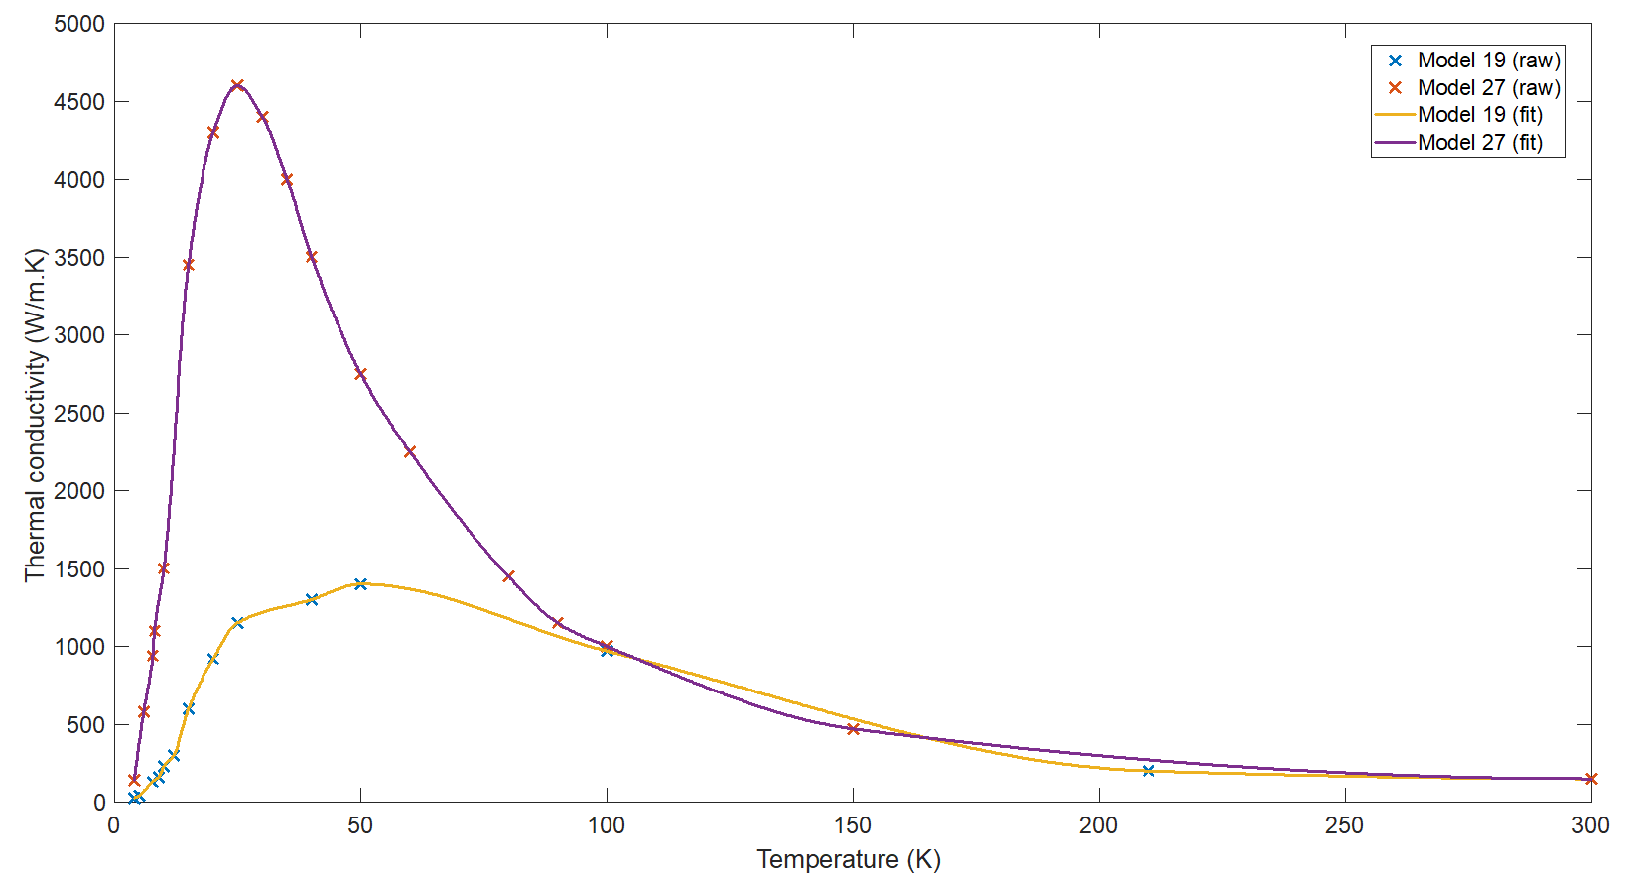
Suspension – Heat Extraction and STN (and errata!)
Decided suspension TN calculations based on 0.5 W heat load
Suspension TN calculations correct but incorrect conductivities used for model 19 and 27
Forgot to divide integrated κ over PUM-TM temperature range giving artificially high κ
Old values κ_{curve 19} = 6300 W/m.K κ_{curve 27} = 37000 W/m.K
Corrected values κ_{curve 19} = 400 W/m.K κ_{curve 27} = 2300 W/m.K (mean value used by A. Amato ≈1300 W/m.K)
Core Optics - ISB workshop October 2022

Slide 6
Suspension – Heat Extraction and STN (and errata!)
Scenario | Fibre radius, r (μm) | Ribbon thickness (5:1 ratio), t (μm) | Stress (MPa) | Safety factor
Medium power (550 mW) – curve 19 “Low κ” | 1312 / 5750 | 1040 / 4558 | 91 / 4.7 | 1.3 😐 / 25 ☺
Medium power (550 mW) – curve 27 “High κ” | 1976 / 2382 | 1566 / 1888 | 40 / 27.5 | 3 😐 / 4.4 😐
Strength limited (Safety factor = 3) | 1976 | 1566 | 40 | 3 😐
Strength limited (Safety factor = 6) | 2794 | 2215 | 20 | 6 ☺
 | Old incorrect value | Reference | 120 | 6 (aLIGO/AdV)
This slightly modifies the conclusions presented in my plenary
Core Optics - ISB workshop October 2022

Slide 7
Summary
$$E=160 GPa$$
$$m=200 kg$$
Thermal Resistance
Fiber Length
Safety Factor from T
$$Stress=\frac{mg}{4S}$$
$$SF=\frac{BS}{Stress}=1.8$$
$$SF=6$$
$$R=2.8 mm$$
Fibers Size
$$P=4\frac{ΔT}{R_{T}} and R_{T}=\frac{L}{κS}$$
$$S=\frac{PL}{4κΔT}=7.2x{10}^{−6}m^{2}→R=1.5 mm$$
4 K
Fiber Surface
Thermal Cond.
20 K
$$P=0.5W$$
$$L=1.2 m$$
$$ΔT=16 K$$
$κ=1300 W/mK$ (averaged integrated value)
Breaking strength
BS = 120 MPa
Simplified STN
$$n_{x}^{2}=−\frac{4k_{B}T}{ω}⋅ℑm\left\{H\right\}$$
$$≈−\frac{4k_{B}T}{ω}⋅\frac{4kD_{dil}φ}{m^{2}ω^{4}}$$
$$→n_{x}=2.7⋅{10}^{−21}\frac{m}{\sqrt{Hz}}@10Hz→strain=5.5⋅{10}^{−25}\frac{1}{\sqrt{Hz}} @10 Hz$$
With
$$k=\frac{Tension}{L−2λ}; φ=1⋅{10}^{−9}$$
Bending distance and Dilution Factor
$$λ=\sqrt{\frac{EI}{T}}=12.8 cm→D_{dil}=\frac{λ}{L−2λ}=0.13$$
$$λ$$
$$Plenary updated strain=2.7⋅{10}^{−25}\frac{1}{\sqrt{Hz}} @10 Hz$$
Materials Parallel Session 1 - ISB workshop October 2022

Slide 8
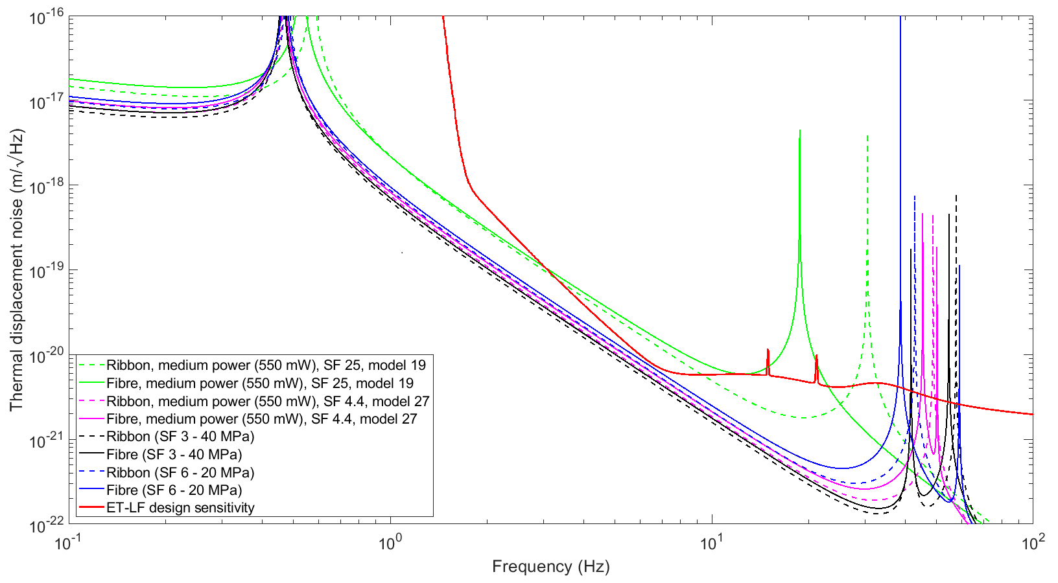
Total ET-D noise
Heat dominated for Touloukian’s curve 19 (“low κ” case)
Strength dominated (SF 6) for Touloukian’s curve 27 (“high κ” case)
Priority: experimentally measure and verify conductivity of real silicon ribbons
Caution: higher κ means strength must improve (and must not forget boundary scattering for high κ)
Same caveats as before: Suspension thermal noise only No jointing loss included

