Slide 1
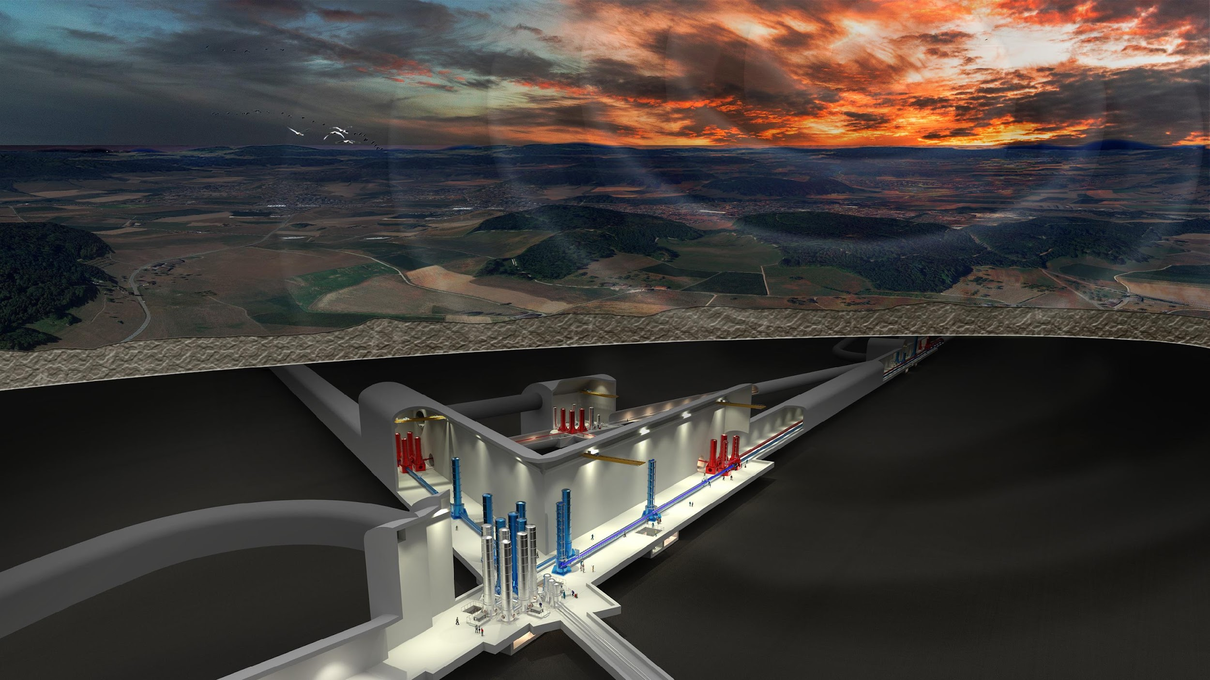
SPB plan

Slide 2
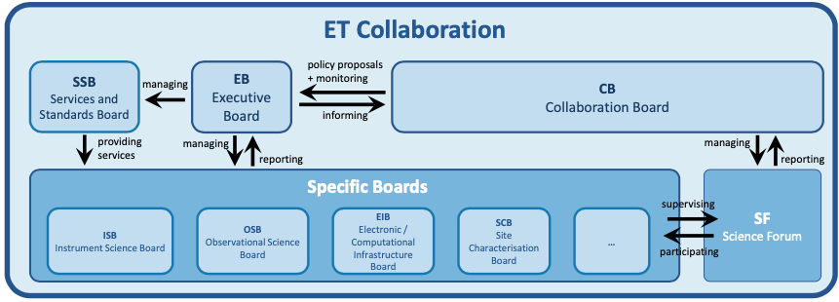
ET Collaboration: Structure
Executive Board (EB)
Collaboration Board (CB)
Science Forum (SF)
Specific Collaboration Boards
Service and Standards Boards and Committees

Slide 3
Proto-council
Advisory Bodies
Scientific and Technical Advisory Committee
Program Advisory Board
Policy & monitoring
ET Collaboration
CERN
MOA CERN-INFN-Nikhef
P. Chiggiato
TDR ET Vacuum Pipe
monitoring
Providing services
Policy proposals+
monitoring
CB
Collaboration Board
EB
Executive Board
Deliverables:
Beam pipe vacuum
Site Preparation
Civil Infrastructure
monitoring
Informing
reporting
delivering
managing
managing
reporting
INFRA-DEV
M. Martinez
WP1 Coordination and Management
WP2 Organization , Governance, Legal
WP3 Financial Architecture
WP4 Site Preparation
WP5 Project Office/Engineering Dept.
WP6Technical Design
WP7Transfer of Technology
WP8 Computing and Data Access
WP9 Sustainable Development Strategy
WP10 Education, Outreach, Citizen Engagement
SSB
Services and Standards Board
SF
Science Forum
reporting
Requirements
& competences
managing
Providing services
participating
supervisioning
Communication Office
Strategy
ISB
Instrument Science Board
EIB
Electronics/Computational Infrastructure Board
OSB
Observational Science Board
SCB
Site Characterisation Board
Project Office
setting
Engineering Department
ET Observatory
Specific Boards

Slide 4
SCB/SPB: General Mission
The SCB/SPB must lead the effort on the Einstein Telescope site related activities
It must coordinate the activities to acquire the required characteristics for each site proposing to host the Einstein Telescope;
Collect, organize and/or produce all the characterizations and documentation needed for a fair comparison of the sites;
Propose a common framework and common basis for the evaluation of the candidate sites.

Slide 5
SCB/SPB: Structure
Site Characterization/Preparation Board
WD1 Physical variables and characterization
WD2 Geology
WD3 Bidbooks
WD4 Cost timing and risk assessment
(with ISB/Infra-Osb)
WD5 Legal and site preservation
WD6 Socio-Economic and environmental impact
WP1.1 Seismic measurements
WP2.1 Geology and Hydro-Geology
PD
WP1.2 Magnetic measurements
WP2.2 Geotechnical aspects
WP1.2 Other Env. measurements
ET Coll.

Slide 6
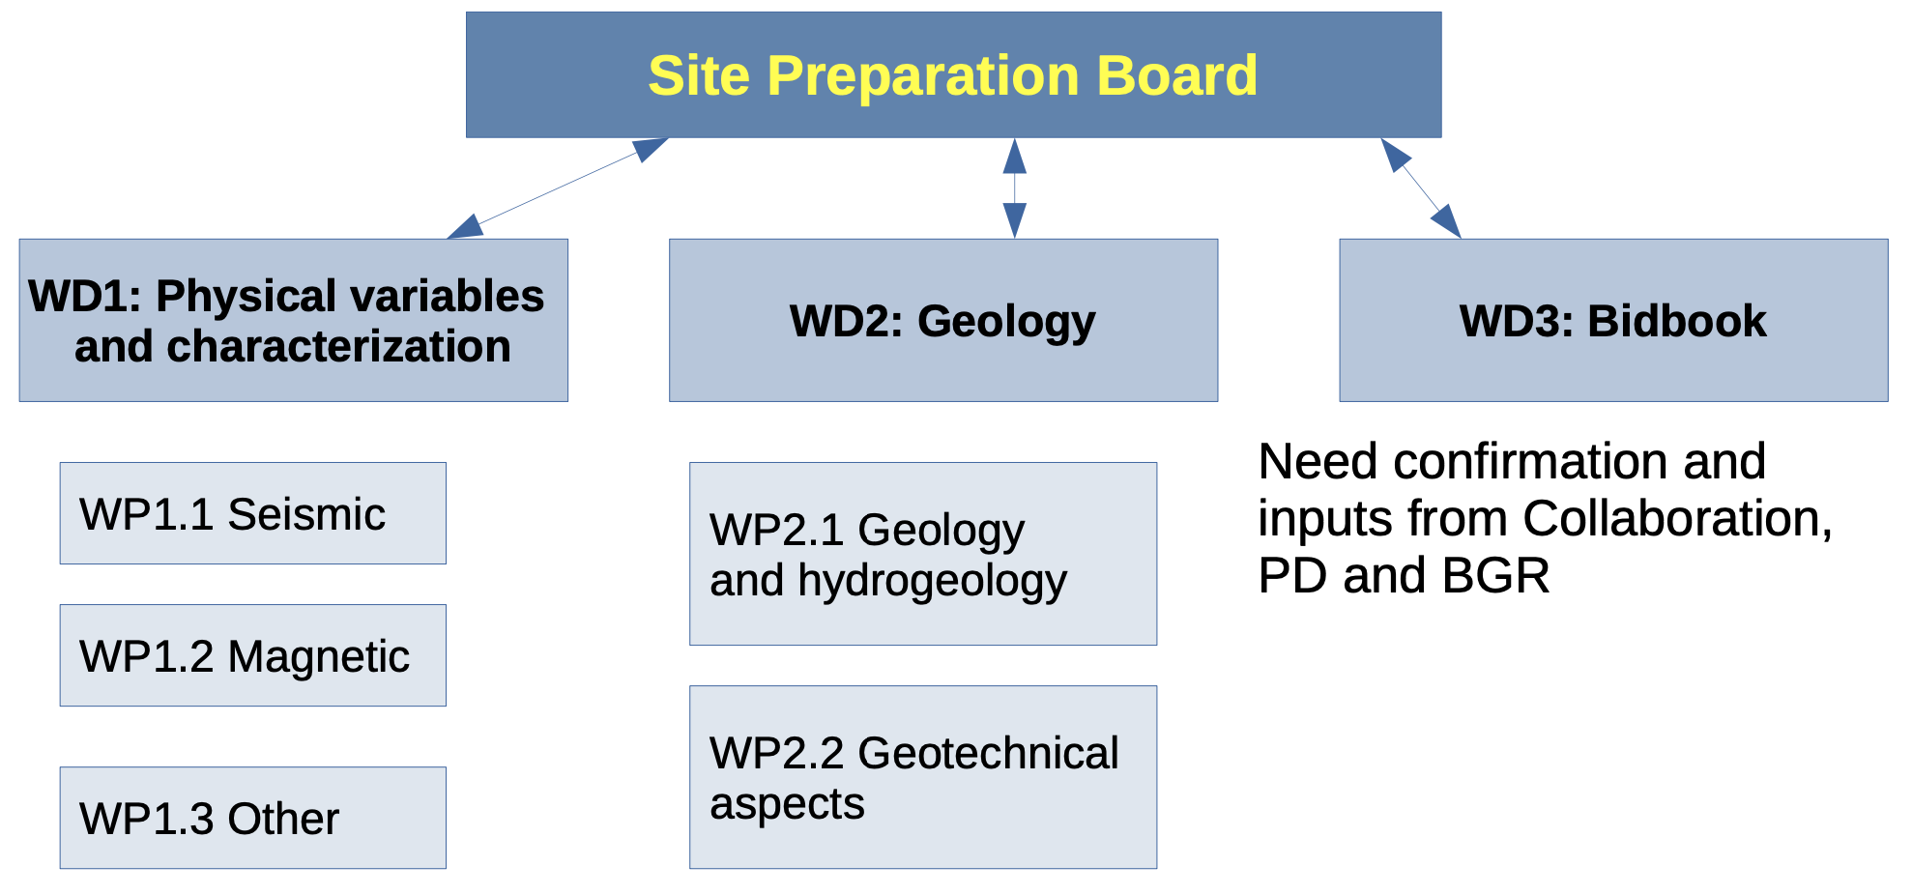
Implementation of new SCB Structure
Site Characterization Board
L. Naticchioni (INFN/Rome, I)
S. Kadmiel (KNMI, NL)
L. Casini (UniSS, I)
Frederic Nguyen (Liège, B) Wim Walk (Nikhef, NL)

Slide 7
WD1 Physical Variables
WP1.1 Seismic noise
WP1.2 Gravimetric characterization
WP1.1 Seismic
WP1.3 Geodynamic
WP1.2 Magnetic
WP1.4 Magnetic noise
WP1.3 Other
WP1.5 Other Env. noise

Slide 8
WD2 Geology
WP2.1
Structural Geology
WP2.1 Geology and Hydrogeology
WP 2.2
Hydrogeology
WP2.2 Geotechnics
WP 2.3
Geophysics
WP 2.4
Geotechnics

Slide 9
Integration of new ET members
Implementation of new board structure
Ri-definition of activity plan after the new fundings from Netherlands and Italy
Census of all interested people (from ET DB)
Different skills and availability
General Form with Division Structure to RU Coordinator (OSB style)
in parallel

Slide 10
Division Chairs
WD1 Luca Naticchioni (INFN/Rome, I), Shahar Kadmiel (KNMI, NL)
WD2 Leonardo Casini (UniSS, I), Frederic Nguyen (Liege, B), Wim Walk (Nikhef, NL)
WD3 …, … (input/discussions with BGR, PD & ET Coll.)
WD4 …, … (from ISB ?)
WD5 …, … (experts from institutes or industries)
WD6 …, … (experts from institutes or industries)

Slide 11
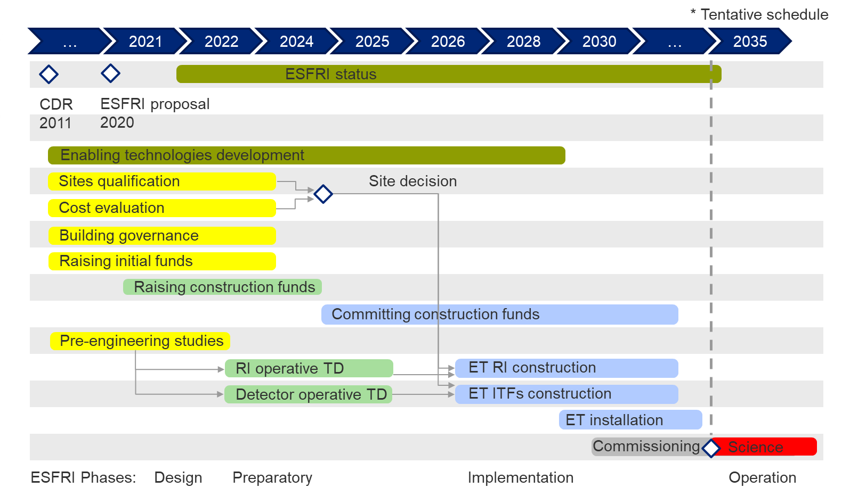
ESFRI Proposal Timing (superseded by ET-PP)
Site selection Q3 2024
Bid Books early 2024
Pre-engineering study needed to give common inputs to the national host teams: end 2022
Cost evaluation standards:
End 2022
RI operative TD: end 2025
Detector operative TD: end 2025

Slide 12
ET-PP Timing
WP4 Gantt chart. Starting date assumed to be 1-Sept-2022.
2023
2024
2025
2026

Slide 13
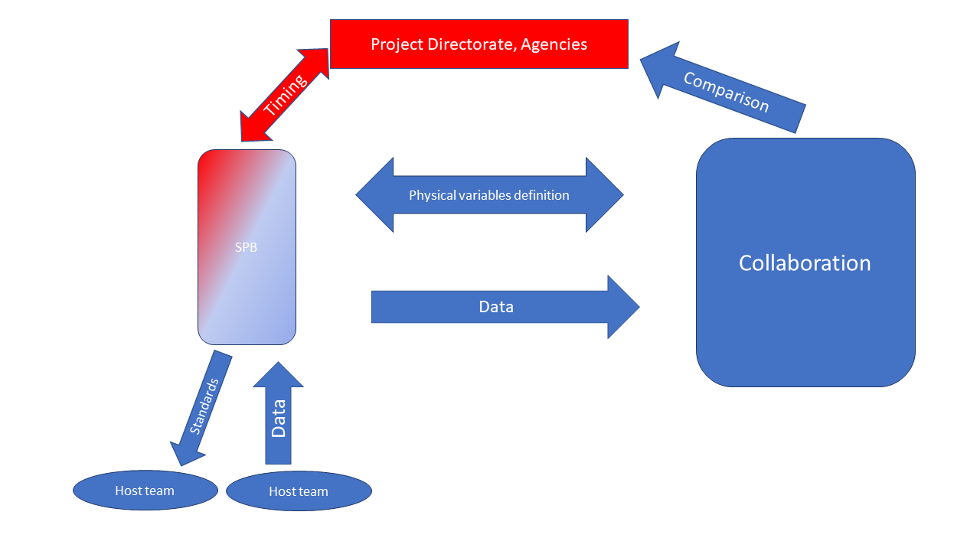
Milestones and Deliverables: WD1
M1.1 Updated list a set of physical variable to be acquired
(same as ET-PP/M4.1 - M3)
M1.2 Updated list of standard to collect data - M6
(instrumentations and so on)
D1.1 Complete quantification of all the aspects impacting the ET performance for each site
(same as ET-PP/D4.3 - M28)

Slide 14
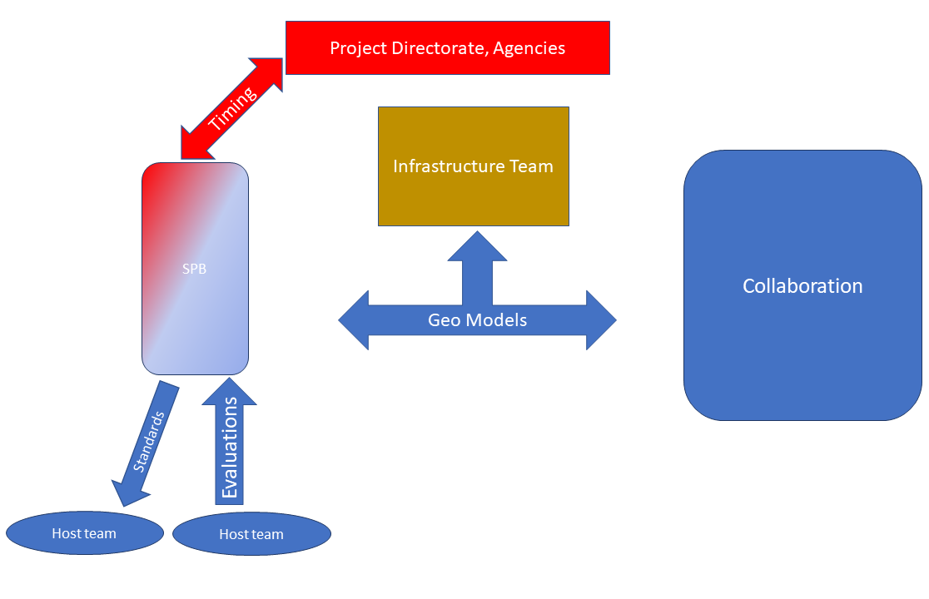
Milestones and Deliverables: WD2
M2.1 Definition of a minimal set of geological, geophysical and geotechnical investigations - M6
D2.1 3D map (with uncertainties!) of the sub-surface of the volume enclosed by ET (same as ET-PP/D4.4 - M30)
D2.2 Reports on hydrogeology and so on –using a common or at least comparable format– to be used for site comparison - M40

Slide 15
Milestones and Deliverables: WD3
M3.1 Define Bidbook standard format and content, i.e. needed legal documentation, procedures to realize the infrastructure, timing, cost (according with the Infrastructure team, Collaboration, Host teams), financial plan, … - M12?
D3.1 Bidbook template - M18?
D3.2 List of required documents - M18?
Note: this requires input/discussions with BGR, PD & ET Collaboration

Slide 16
Milestones and Deliverables: WD4
M4.1 - M24 NN compensation and all action needed to mitigate site “effects” on ET (to be discussed with ISB/OSB)
M4.2 - M36 Plan, cost and timing estimation for waste disposal, land-acquisition, logistics, surface infrastructures (buildings, services, …)
D4.1 Updated cost and schedule estimates of the excavations. Including, if necessary: instrumentation for Newtonian Noise cancellation; costs of debris removal; costs of land acquisition, permitting, etc … (same as ET-PP/D4.5 - M42)

Slide 17
Milestones and Deliverables: WD5
D5.1- M10 A list of required legal documents, needed for the realization of the ET infrastructure
(same as ET-PP/D4.1 - M10)
D5.2 - M12 Report describing the consolidated strategy to preserve the site quality.

Slide 18
Milestones and Deliverables: WD6
D6.1 - M15 Document containing a set of standards in the computation of the socio-economic-environmental impact
common multipliers in the computation of the economic impact, or multipliers based on shared criteria
definition of a set of common categories to define the social impact
definition of a set of common categories to define the environmental impact
(same as ET-PP/D4.2 - M15)

Slide 19
Milestones (months from ET-PP start date, Sept. 1st)
Milestone name – Date (in months)/Lead Institution
M4.1 – M3/UW : Document detailing the site-specific characteristics that impact ET sensitivity and its duty cycle => REPORT
M4.2 – M10/UW : Common methodology to estimate impact of site characteristics on ET sensitivity and operation and, if required, a scheme to compensate it => REPORT
My take: Both Milestones should be formulated in close collaboration with the ISB and OSB and we should start the discussions with these boards soon.

Slide 20
ET-PP Deliverables (months from ET-PP start date, Sept. 1st)
Deliverable name – Date (in months)/Lead Institution
D4.1- M10/Nikhef: Scan of legal procedures, permitting and land acquisitions, i.e. the steps to be taken prior to starting excavations
D4.2 - M15/INFN: Updated socio-economic impact studies. Scan of accessibility, quality of life etc.
D4.3 - M28/UW: Complete quantification of all the aspects impacting the ET performance for each site
D4.4 - M30/INFN: Report on 3D geology, hydrology, etc. model with localisation of the ET infrastructure
D4.5 - M42/Nikhef: Updated cost and schedule estimates of the excavations, including, if necessary: instrumentation for Newtonian Noise cancellation; costs of debris removal; costs of land acquisition, permitting, etc.

Slide 21
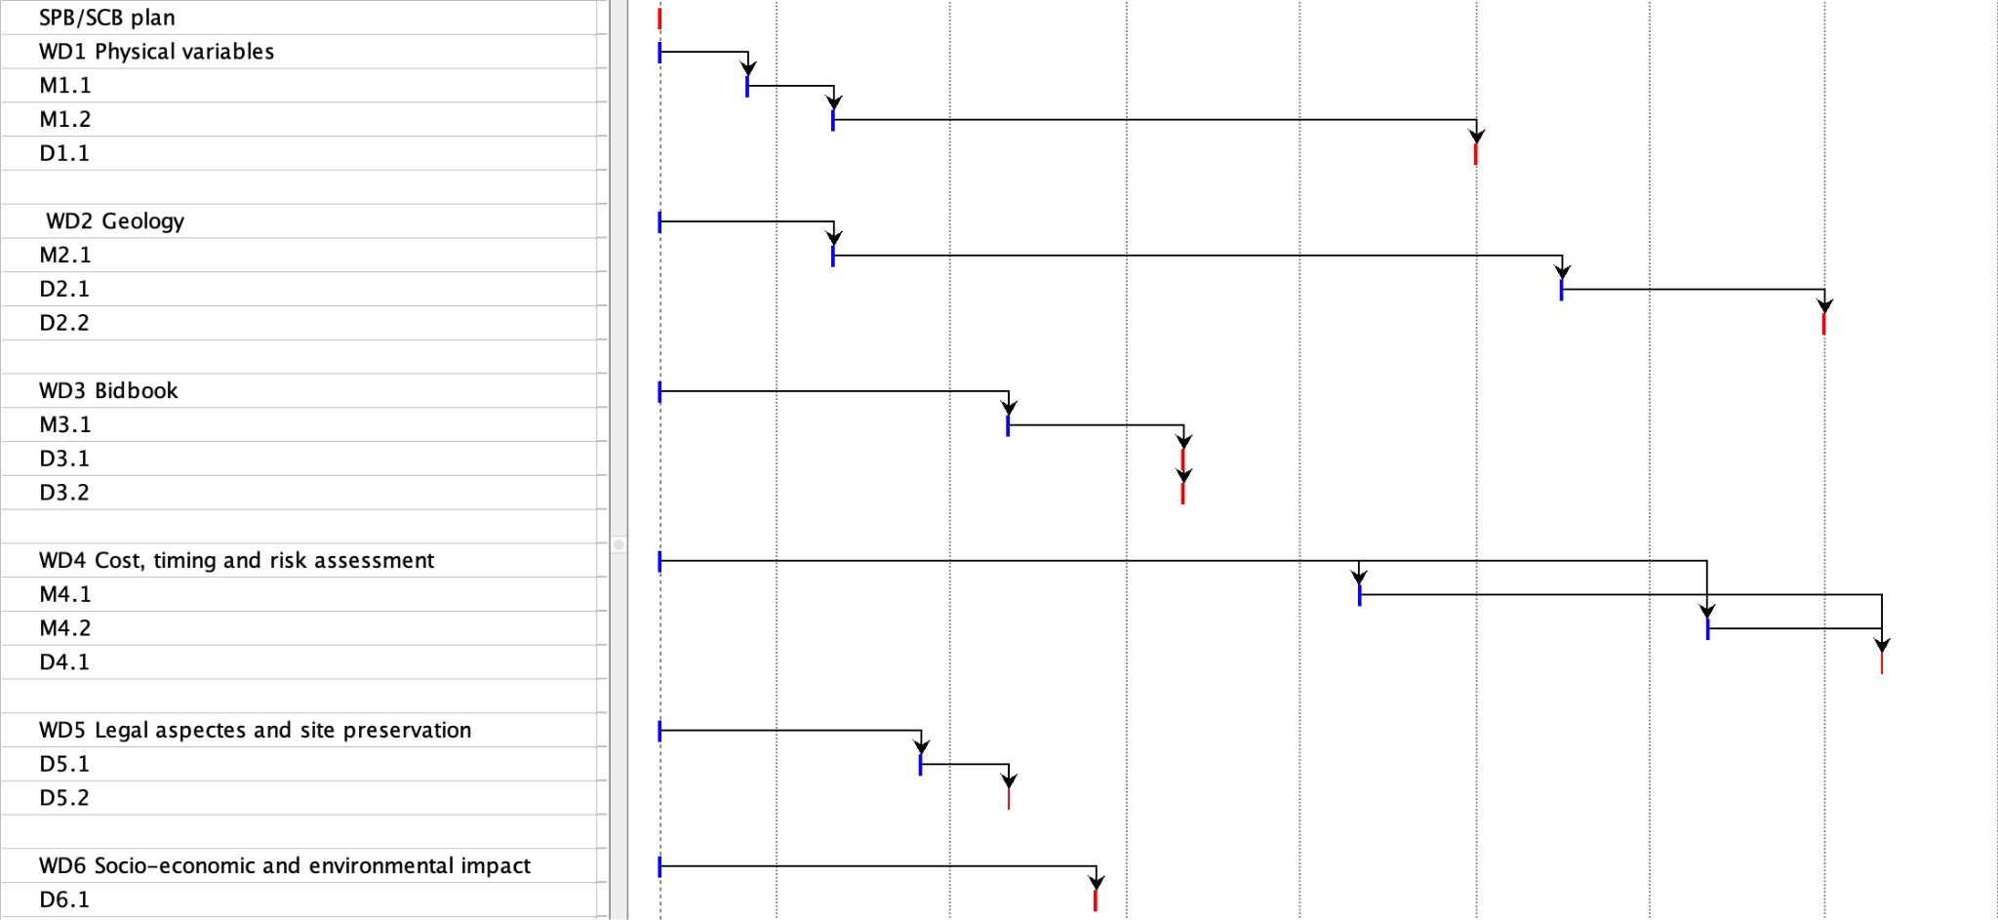
SPB/SCB Timing
2023
2024
2025
2026
ET-PP/M4.1
ET-PP/D4.3
ET-PP/D4.4
ET-PP/D4.5
ET-PP/D4.1
ET-PP/D4.2

Slide 22
Issues to be addressed soon
Discussions with ISB/OSB on relevant parameters/requirements (Jan Harms workshop July 11th a very good start)
ET geometry i.e. ∆ versus ∟ (urgent)
Approach to update notably civil engineering costs: with or without the involvement of civil engineering parties?
Bidbook approach (less urgent i.e. needed early 2024?)

Slide 23
Next Steps
Meeting with WD chairs to define WP’s structure, milestones, deliverables and timeline
Next SPB biweekly meetings dedicated to WD1 and WD2
Appoint remaining WDx chairs
Meeting with WDx chairs to define WP’s structure, milestones, deliverables timeline
SPB meeting dedicated to WDx
End of Sept. – beginning of Oct.

