Slide 1
Synergies Overlaps Contacts
WP 4
Site Preparation
↑
↓
WP 1-3 & 5-10
ET-PP/INFRADEV Barcelona Meeting 19-20 July 2022, WP4 Site Preparation input

Slide 2
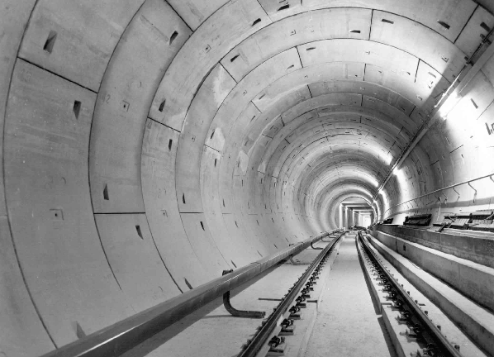
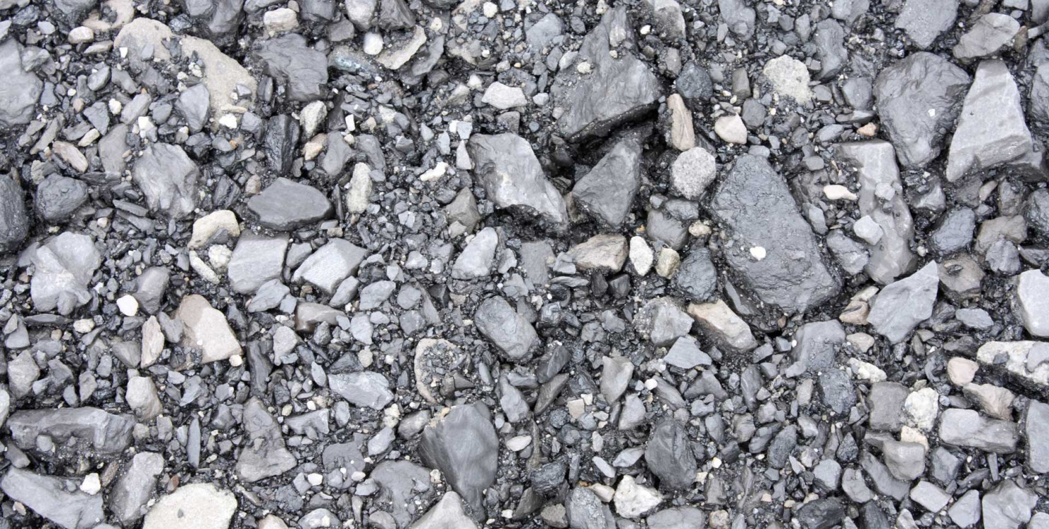
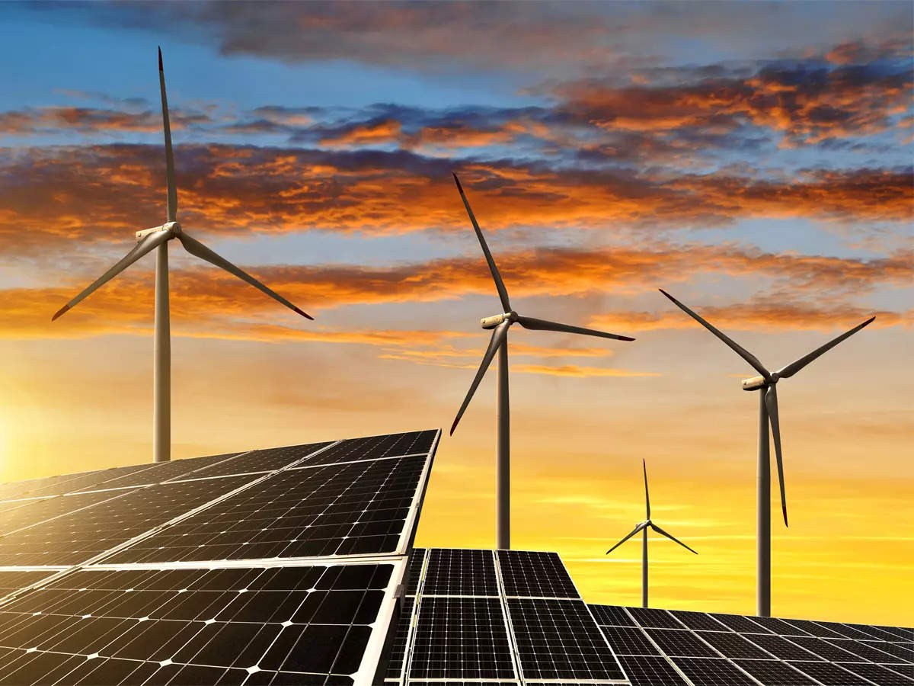
WP9: Sustainable Development Strategy
concrete
water
cuttings
energy

Slide 3
WP7: Innovation and Industrial engagement
Early
Contractor
Involvement
???

Slide 4
WP2: Organization, Governance and Legal Aspects
Legal entity: Desirable to establish legal entity.
In view of (large) contracts (VAT?)
In view of incidents: water pollution, sinkholes, ...
Final ET RI layout:
What can we do to speed this process up?
Also impacting overall costs: initial investment as well as annual exploitation budget
Site selection: BGR input needed:
Bidbook format/procedure
Opinions on single-site ↔ multi-site i.e. overall cost considerations
…
∆/∟

Slide 5
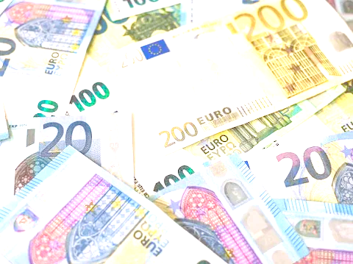
WP3: Financial Architecture
Possible addendum to Bidbook? “fair sharing of costs and scientific, industrial and socio-economic returns among all participating parties in the ET consortium”

Slide 6
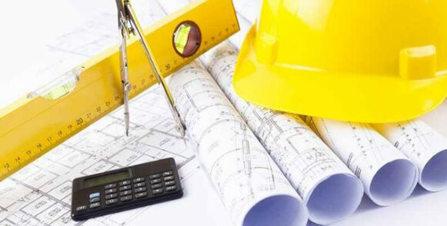
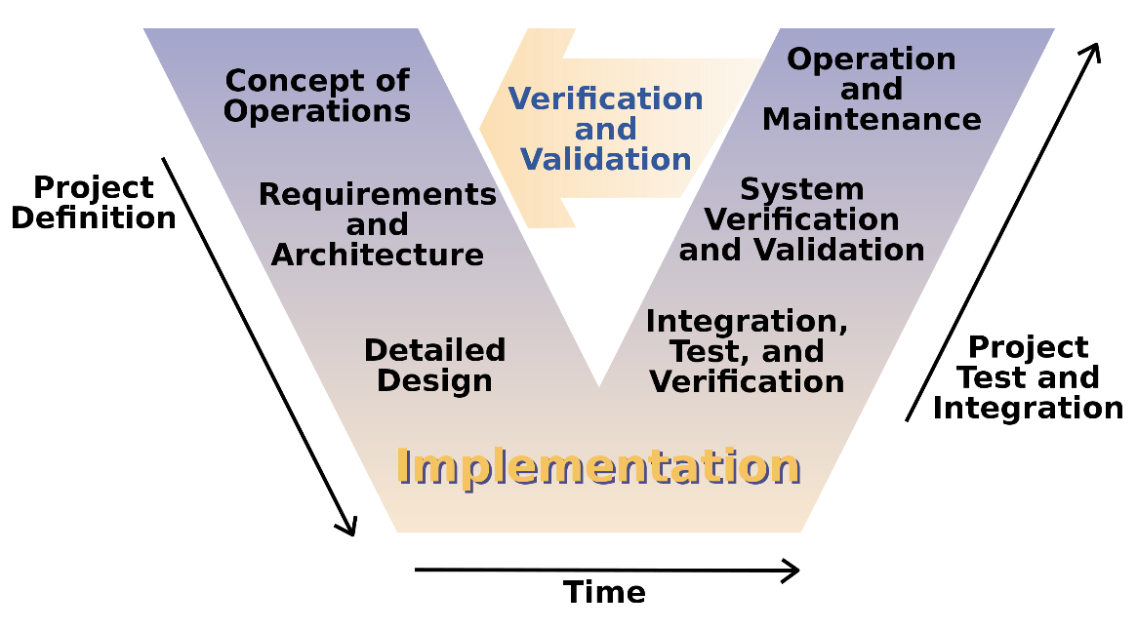
WP5: Project Office and Engineering Department
WP6: Technical Design
Civil engineering: Obvious synergy (sub-surface, but also …) this requires close collaboration
Technical design: A hell lot of work ahead of us … we are all short of engineers/technicians

Slide 7
WP8: Computing and Data Access
WP4 needs:
Convergence towards common data formats
Storage and access to the relevant data (seismic campaigns, EM, ERT, magnetic, gravimetric, …)
(modest) computing needs

Slide 8
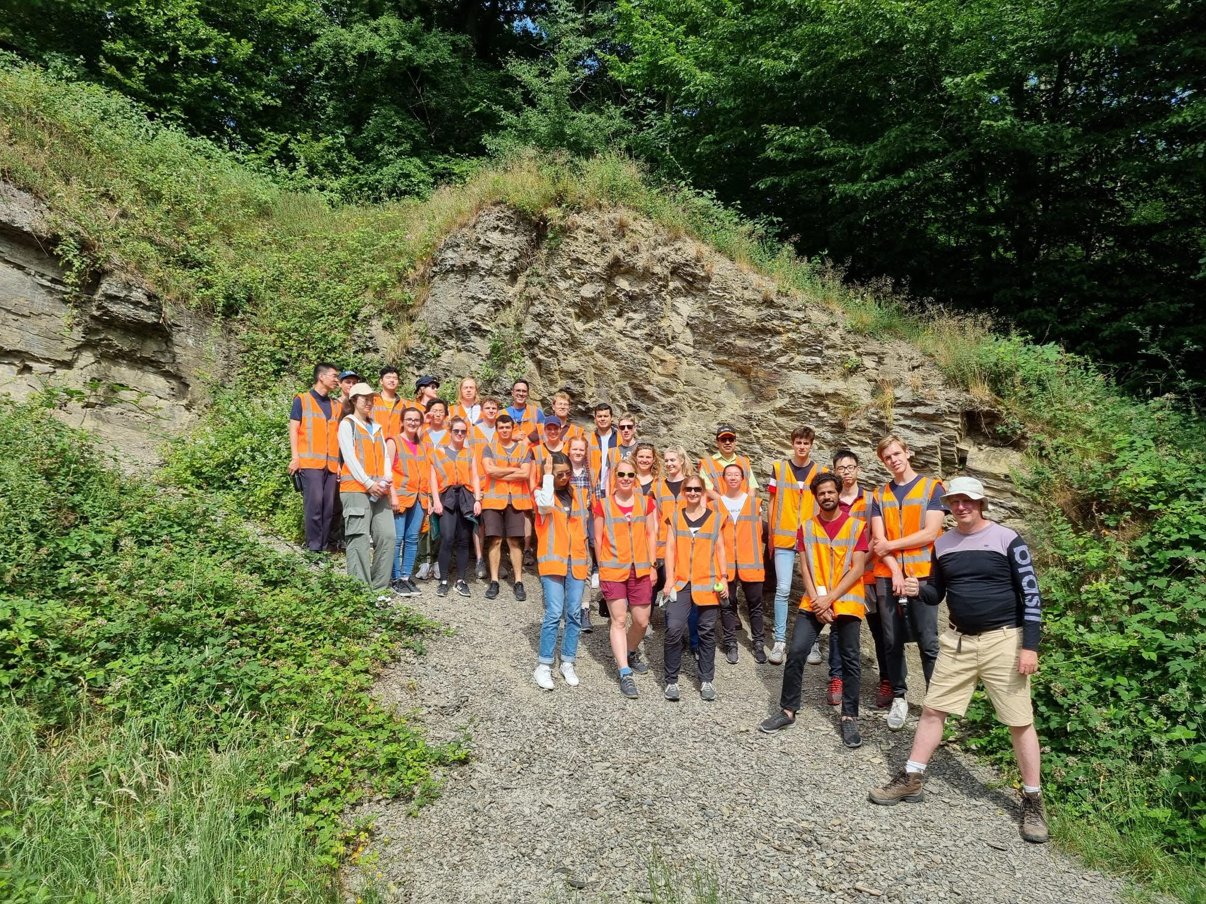
WP10: Education, Outreach & Citizen Engagement
WP4 can (and does) offer/engage:
Field work to students: high-school and university alike Desirable to establish legal entity.
‘Town meetings’ for local municipalities
Geology students

