Slide 1

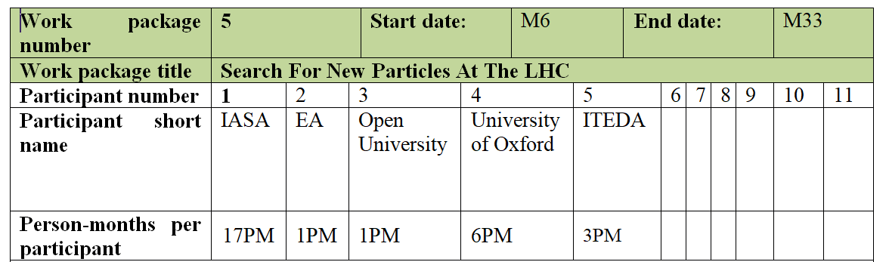
The IASA team
C.Kourkoumelis
S.Angelidakis
D.Fassouliotis
S.Vourakis
WP5
Search For New Particles At The LHC

Slide 2
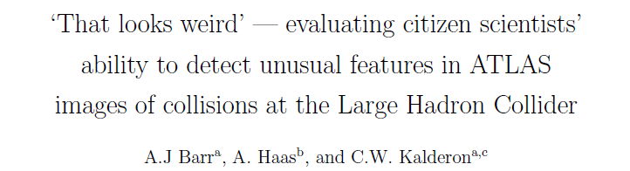
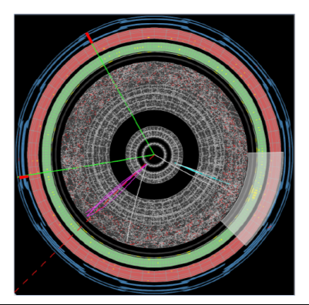
WP5 is based on the Zooniverse experience
HiggsHunters.org
Step 1
32,000 volunteers
Classified 39,000 images
Looked for BSM decays of Higgs with displaced vertices

Slide 3
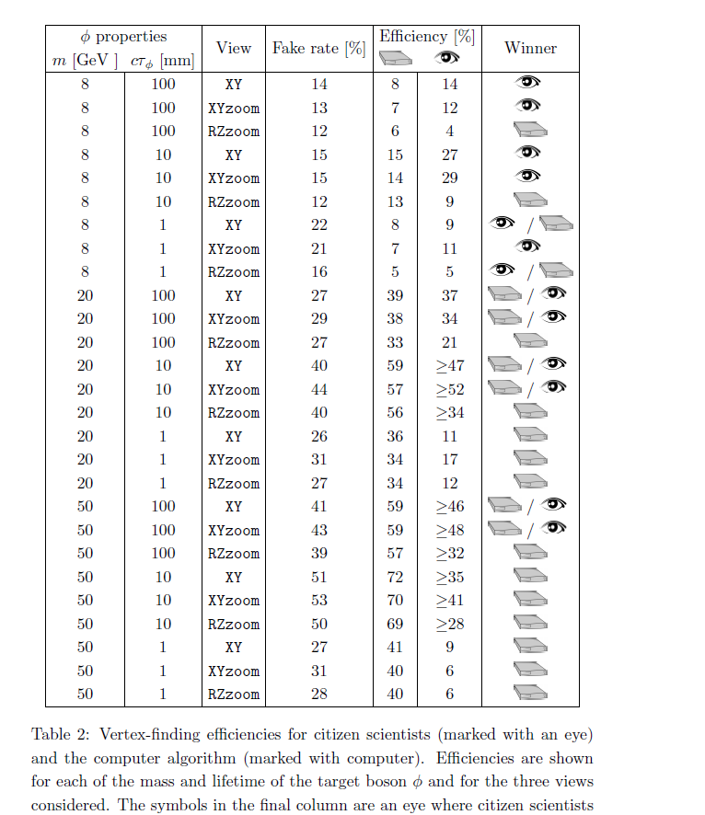
Step 2
Compare eye classifications to computer algorithm (machine learning)
S

Slide 4
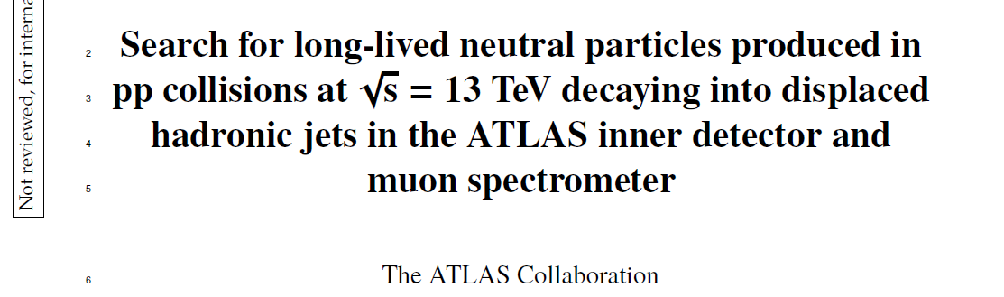
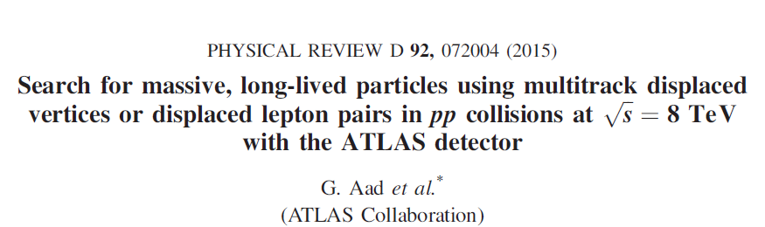
Several Physics scenarios BSM predict Long-Lived particles which
appear as Displaced Vertices in the LHC detectors

Slide 5
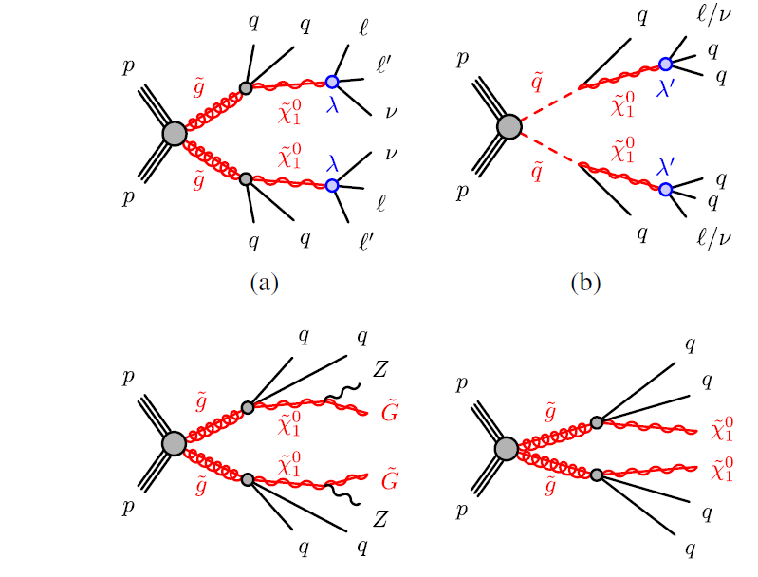
Examples of undiscovered particle decays

Slide 6
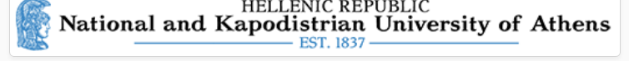
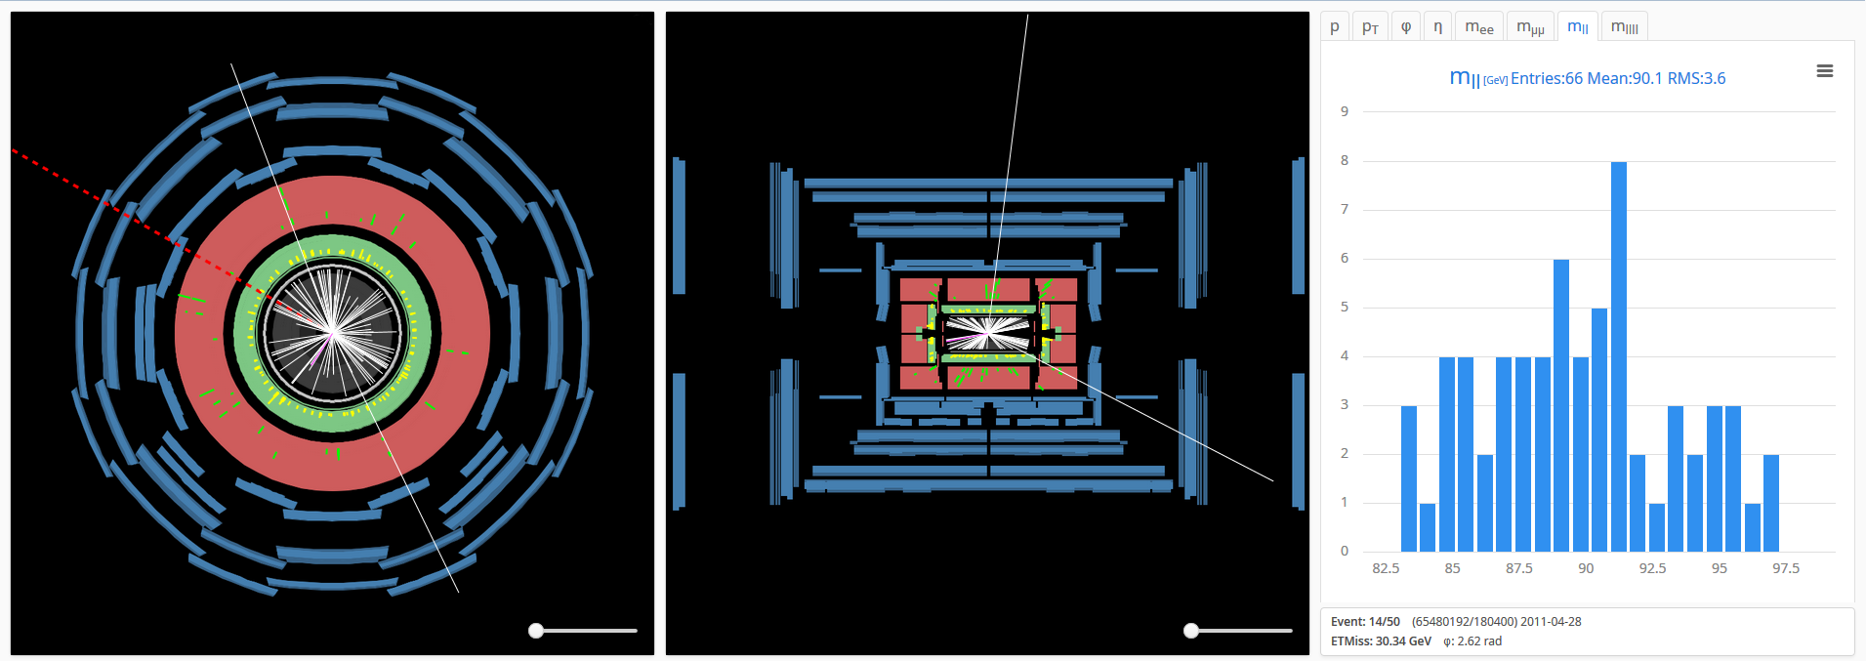
WP5: Search For New Particles At The LHC
The new Zooniverse platform will include event displays (with HYPATIA) and not just images.
The citizen will interact with the event displays: look for the displaced vertices and then select tracks and calculate invariant masses in order to eventually “look for bumps” →new particles
*The HYPATIA tool is developed by our group and used in schools all over the world

Slide 7
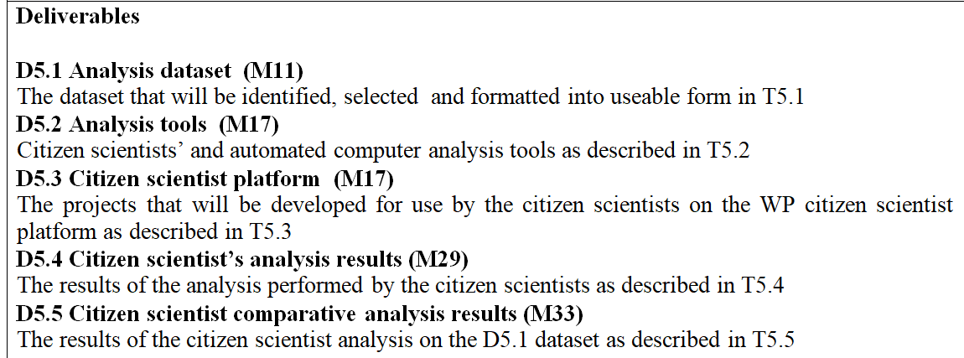
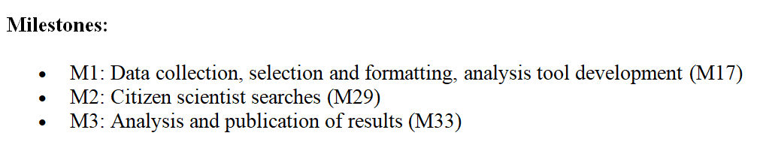
WP5: Roadmap

Slide 8
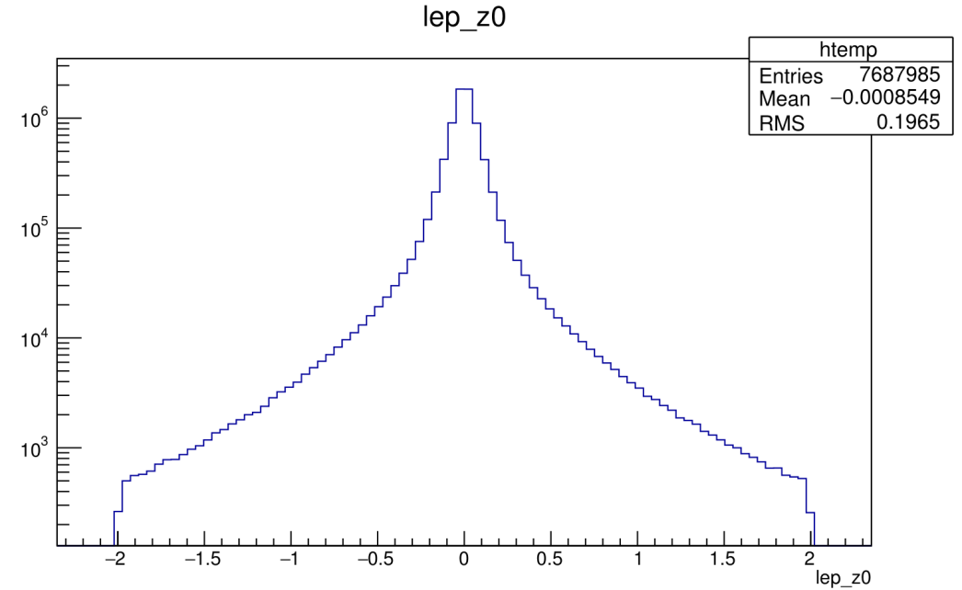
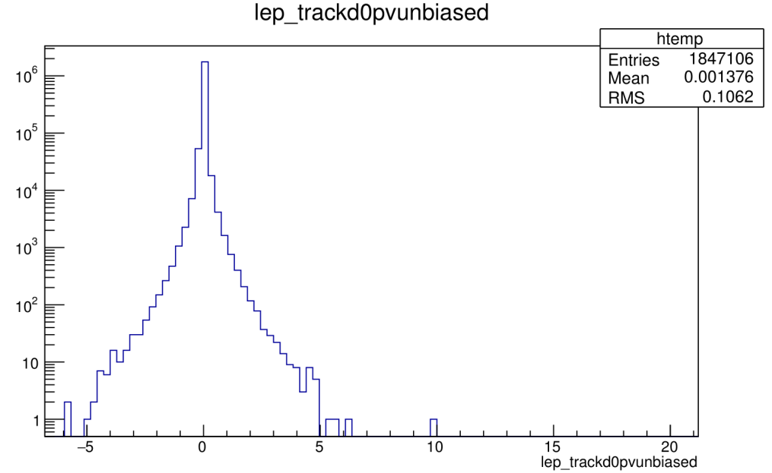
WP5: Roadmap
Although WP5 is scheduled to start on M6 we have already started working on it in order to identify the key persons, relevant data sets etc.

