Slide 1
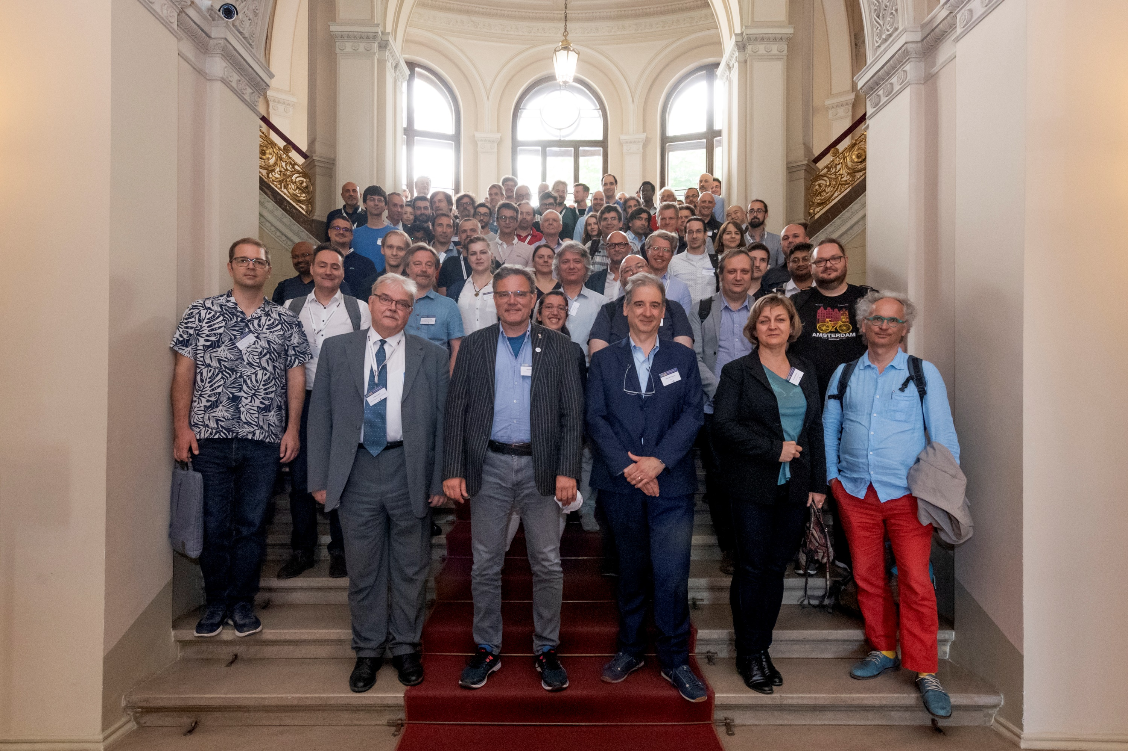
Einstein Telescope Collaboration
Image taken @ XII. ET Symposium
7th + 8th June 2022
Budapest
ET Annual Meeting
Cascina November 2022
Harald Lück
Institute für Gravitationsphysik
of the Leibniz Universität Hannover;
Albert Einstein Institut
Max-Planck Institut für Gravitationsphysik

Slide 2
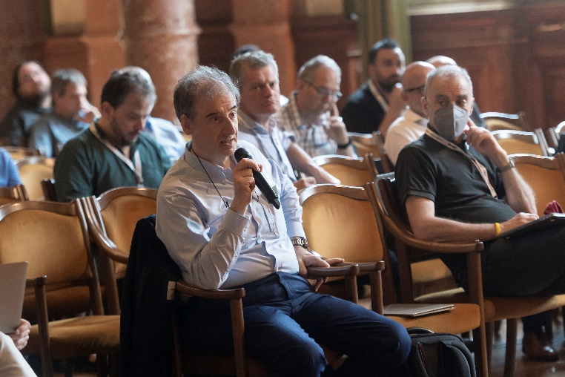
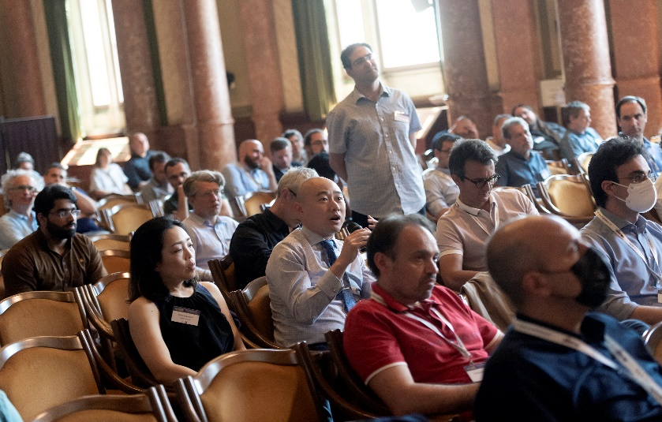
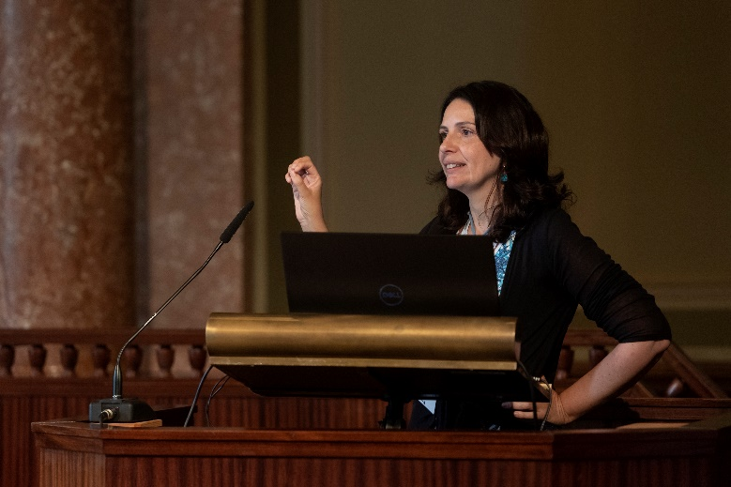
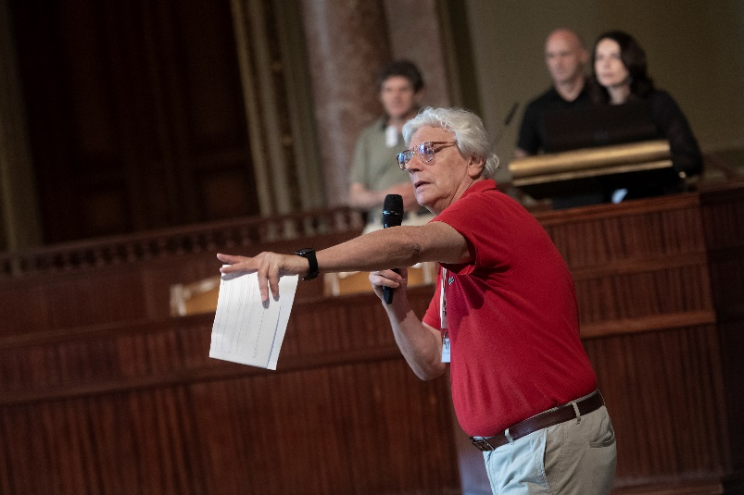
ET Collaboration formed five months ago
https://indico.ego-gw.it/event/411/
Birth of the ET Collaboration XII ET Symposium, Budapest on June 7th - 8th

Slide 3
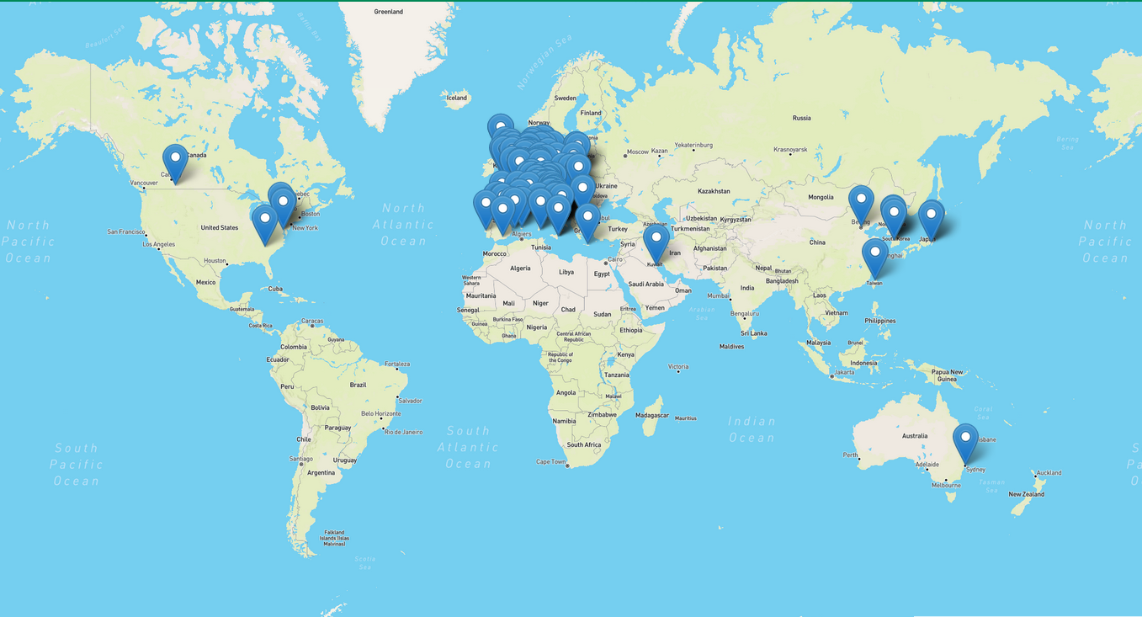
The Einstein Telescope Collaboration
ET Member distribution
Documentation System (https://apps.et-gw.eu/tds/)
Collaboration Wiki (https://wiki.et-gw.eu)
79 Research Units
1312 members (15.11.2022 15:21)
Member Database is almost ready
Total: 200 Institutions
in 23 Countries
Notes:
Collaboration consists of 79 research Units with about 1300 members;
Concentrated in Europe

Slide 4
ET Member Database
https://apps.et-gw.eu/etmd/
Notes:
You all should go to the ET MDB to activate and update your accounts
Assign/update your FRTE contribution.
Members w/o permanent contract, specify duration of your contract → define end of ET membership

Slide 5
ET Membership distribution
In this graphic: Members are associated
to Countries by RU membership
+Poland!

Slide 6
Research Units – size distribution
The size of Research Units varies widely
Members in RU
average size =17
RU#
Notes:
Big variation in RU size.
Average size =17

Slide 7
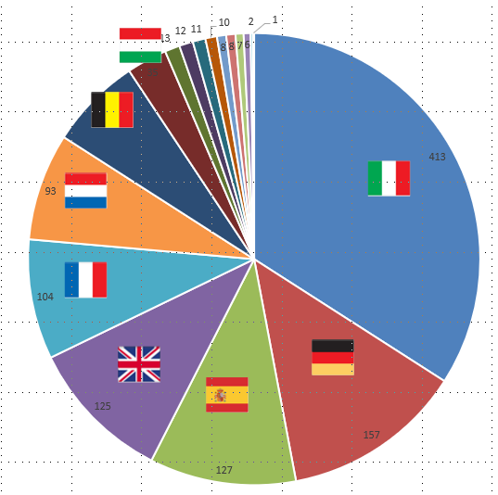
National distribution of RUs?
CB Composition
Currently 1 representative per RU on CB
Will change in summer 2023 to
1 CB member / 5 FRTE
Members/Country

Slide 8
ET Membership (positions)
ET Member Database not complete yet
→ Large percentage of „Others“

Slide 9
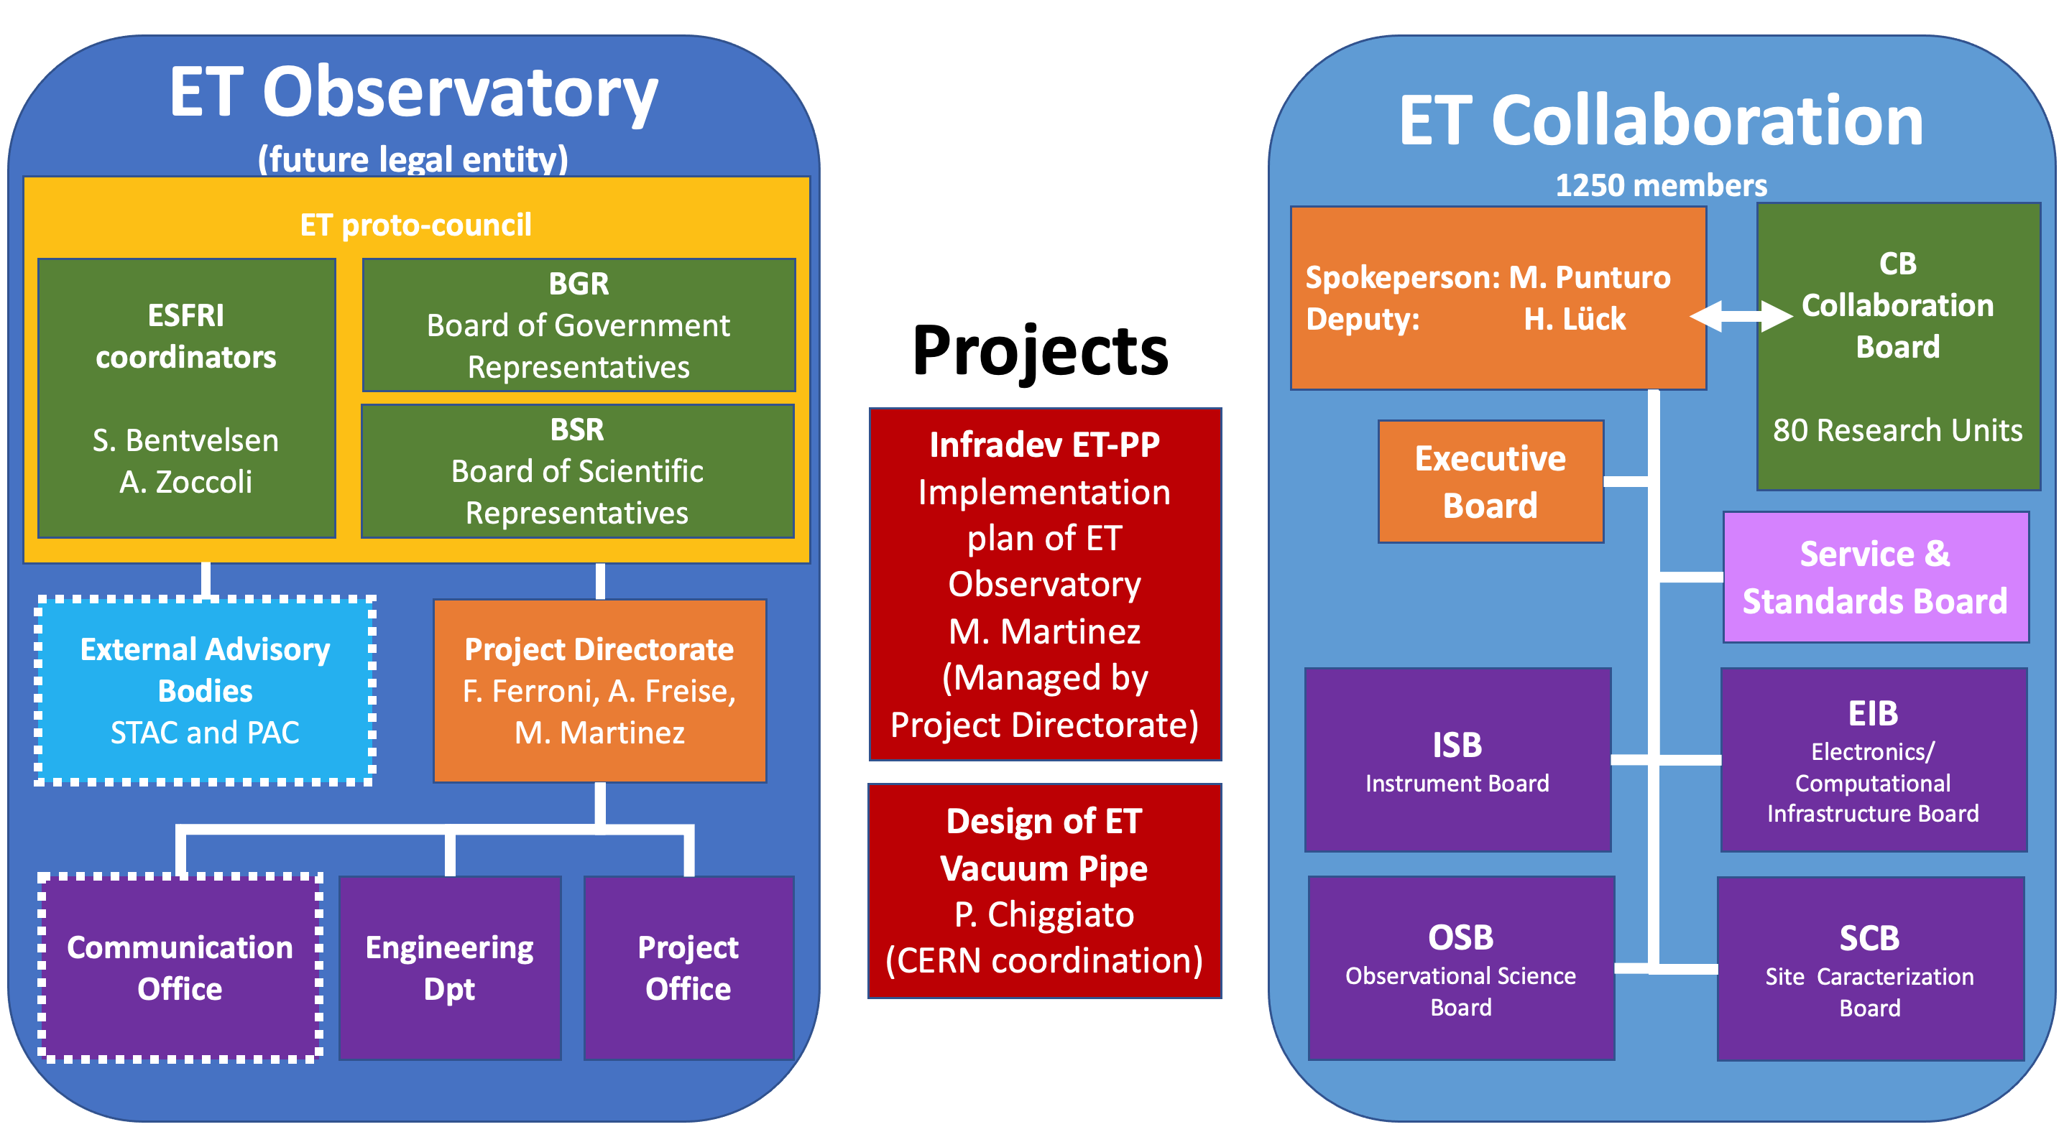
ET Organisation
Graphic Credit: P Verdier

Slide 10
Proto-Council
Advisory Bodies
STAC: Scientific and Technical Advisory Committee
Program Advisory Board
ESFRI Coordinators
Stan Bentvelsen, Antonio Zoccoli
BGR (Board Governm. Represent.)
Policy & monitoring
BSR (Board Scient. Represent.)
Project Directorate
A. Freise, F. Ferroni, M. Martinez
ET Collaboration
M. Punturo, H. Lück
CERN
MOA CERN-INFN-Nikhef
P. Chiggiato
TDR ET Vacuum Pipe
monitoring
Policy proposals +
monitoring
CB
Collaboration Board
Providing services
EB
Executive Board
Deliverables:
Beam pipe vacuum
Site Preparation
Civil Infrastructure
Informing
monitoring
reporting
managing
managing
reporting
delivering
SSB
Services and Standards Board
INFRA-DEV
M. Martinez
WP1 Coordination and Management
WP2 Organization , Governance, Legal
WP3 Financial Architecture
WP4 Site Preparation
WP5 Project Office/Engineering Dept.
WP6Technical Design
WP7Transfer of Technology
WP8 Computing and Data Access
WP9 Sustainable Development Strategy
WP10 Education, Outreach, Citizen Engagement
SF
Science Forum
reporting
Requirements
& competences
managing
Providing services
Strategy
participating
supervisioning
Communication Office
Setting
up
ISB
Instrument Science Board
EIB
Electronics/ Computational Infrastructure Board
OSB
Observational Science Board
SCB
Site Characterisation Board
Project Office
Engineering Department
ET Observatory
Specific Boards
Notes:
Collaboration formed at the XII. ET Symposium
Complex organigram
Roughly divided into an observatory side (comparable to LIGO Lab or EGO), the Collaboration and external advisory bodies
The ET observatory → legal entity
Observatory has a Project Directorate managing affairs and building up the governance (Andreas Freise, Fernando Ferroni and Mario Martinez)
Mario leading the INFRA-DEV project. EU financed for the preparatory phase of ESFRI projects (ESFRI project as of June 2021)
for setting up organizational structure
Project directorate responsible for the most expensive and important items:
Civil infrastructure (~ 1 Billion), site preparation and selection preparation, Beam pipe vacuum
CERN has taken on responsibility for leading the beam pipe vacuum efforts leading to an TDR and a new cost stimate.
ET = CERN Recognized experiment. Preparing MOU with CERN
Project directorate has started process of setting up a project office, engineering office and communication office.
→ Collaboration

Slide 11
ET Collaboration Services & Standards Board
SSB creation Committee:
CB Chair
Patrice Verdier
Ik Siong Heng
Ema Dimastrogiovanni
Mario Spera
Archisman Ghosh
M. Punturo, H. Lück
H. Lück
EB
Executive Board
Policy proposals +
monitoring
CB
Collaboration Board
Informing
managing
managing
reporting
Services and Standards Board
SSB
Services and Standards Board
SF
Science Forum
reporting
ET Core Program
managing
Election, Voting and Membership
Providing services
participating
supervisioning
Communication and Education
ISB
Instrument Science Board
EIB
Electronics/ Computational Infrastructure Board
OSB
Observational Science Board
SCB
Site Characterisation Board
Diversity, Equity, Inclusion, Access and Ethics
Speakers and Awards
Editorial Committee
Specific Boards
CAD Committee
Notes:
SSB not yet formed.
Got a small team of volunteers to form it.
We will need contributions from the whole collaboration to form the committees

Slide 12
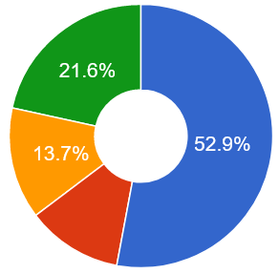
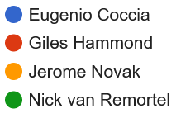
Election of new CB Chair
Four candidates for election:
New Chair: Eugenio Coccia
Former Director of GSSI
Now director of IFEA Barcelona
Gender ratio: Potential for improvement
>50%
Notes:
One step election because simple majority was reached by Eugenio

Slide 13
CB Composition
Currently one CB Member / RU
Gender ratio:
female/male= 13/66 = 16%
= f/m ratio of senior/faculty Physicists in Europe
1
Next meeting:
Thursday, November 17th @ ET annual meeting
Handover to the new CB Chair
1
(https://physicsworld.com/a/gender-gap-in-physics-amongst-highest-in-science/
https://www.genderportal.eu/resources/number-women-physics-departments-simulation-analysis)

Slide 14
ET Collaboration
M. Punturo, H. Lück
EB
Executive Board
Policy proposals +
monitoring
CB
Collaboration Board
Bylaws committee:
Harald Lück
Michele Maggiore
Viviana Fafone
Patrice Verdier
Samaya Nissanke
Informing
managing
managing
reporting
SSB
Services and Standards Board
Patrice Verdier, Stefano Bagnasco (Collaboration) Achim Stahl, Sergi Girona, Nadia Tonello (Observatory through INFRA DEV)
SF
Science Forum
reporting
managing
Providing services
participating
supervisioning
Marica Branchesi Michele Maggiore
Ed Porter
Domenico D'Urso Frank Linde
Gianluca Gemme
Stefan Hild
ISB
Instrument Science Board
EIB
Electronics/ Computational Infrastructure Board
OSB
Observational Science Board
SCB
Site Characterisation Board
Specific Boards
Notes:
Collaboration has got a Parliament (Collaboration Board) and a Government (Executive Board)
ET Collaboration is composed of Research Units (locally grouped). The RU leaders = members of the CB
Solitary members can exceptionally become members through Science Forum (not populated at the moment)
Specific Boards are formed (in a minute)
A Service and Standards Board still needs to be formed (click)
Urgent because we need committees like
speakers board, election & voting committee, editorial committee, meetings committee etc.

Slide 15
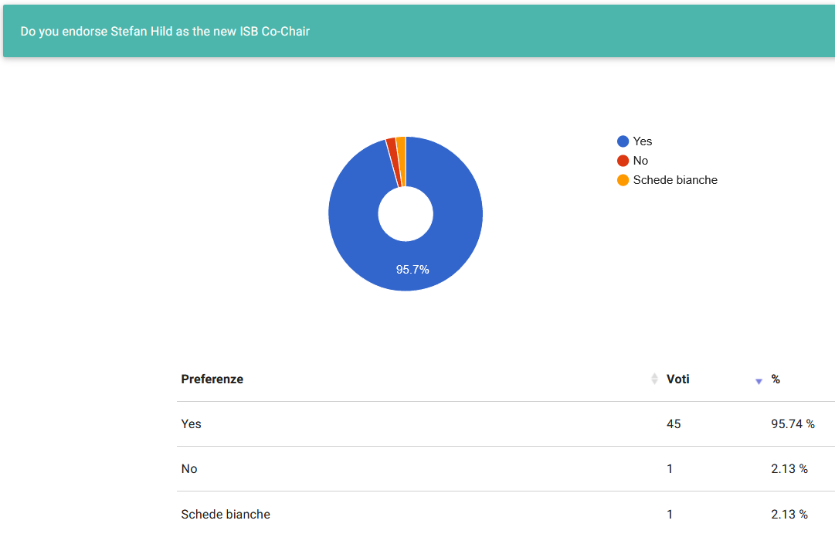
CB Endorsement of new ISB Co-Chair
A vote for the endorsement of a new ISB Co-Chair was held.
ISB and EB proposed Stefan Hild as new Co-Chair
Vote result:
45 (+2): Yes, I endorse the proposal
1 : No, I don‘t endorse the proposal
(2 votes sent by mail)
The ET Collaboration board endorses
Stefan Hild as Co-Chair of the ET ISB
Notes:
Giles
Nick
Achim
Tomek
Peter Levai
Samaya
Stefan (woudl agree if there is no other good option)

Slide 16
ET Bylaws
Bylaws committee:
Harald Lück
Michele Maggiore
Viviana Fafone
Patrice Verdier
Samaya Nissanke
Preamble
Scope of the Collaboration
Collaboration Structure
Collaboration Membership
Membership Categories
Qualification for Membership; Duties of Collaboration Members
Member Rights
Becoming a Member
Legacy Members
Membership Termination
Role Incompatibilities
The Collaboration Board (CB)
Collaboration board activities
Collaboration Board Composition
Motions and Voting
ET Science Forum
Forum of National Representatives
Collaboration Spokesperson and Deputy Spokesperson
Executive Board
Specific Collaboration Boards
Instrument Science Board (ISB)
Observational Science Board (OSB)
Site Characterization Board (SCB)
Electronic / Computation Infrastructure Board (EIB)
ET Collaboration
Bylaws
May 2022
§
DRAFT
TDS Link
Collaboration Services and Standards Board
Basic Structure
ET Core Program Committee (CPC
ET Early Career Scientists Support Committee (ECSS
Diversity, Equity, Inclusion, Access and Ethics Committee (DEIAEC)
Speakers and Awards Committee (SAC)
Editorial Committee (EC
Collaboration Agreement Document Committee (CADC)
Standards and Conduct Committee (SACC)
Elections, Voting and Membership Committee (EVMC)
Meetings and Symposia Committee (MSC)
Collaboration
Common funds
A) – G) Appendices
Notes:
Draft of Bylaws available, defining the rules that govern the Collaboration
Will be completed and elaborated asap.
Bylaws are public, see link in presentation file

Slide 17
Forum of National Representatives
Bylaws:

Slide 18
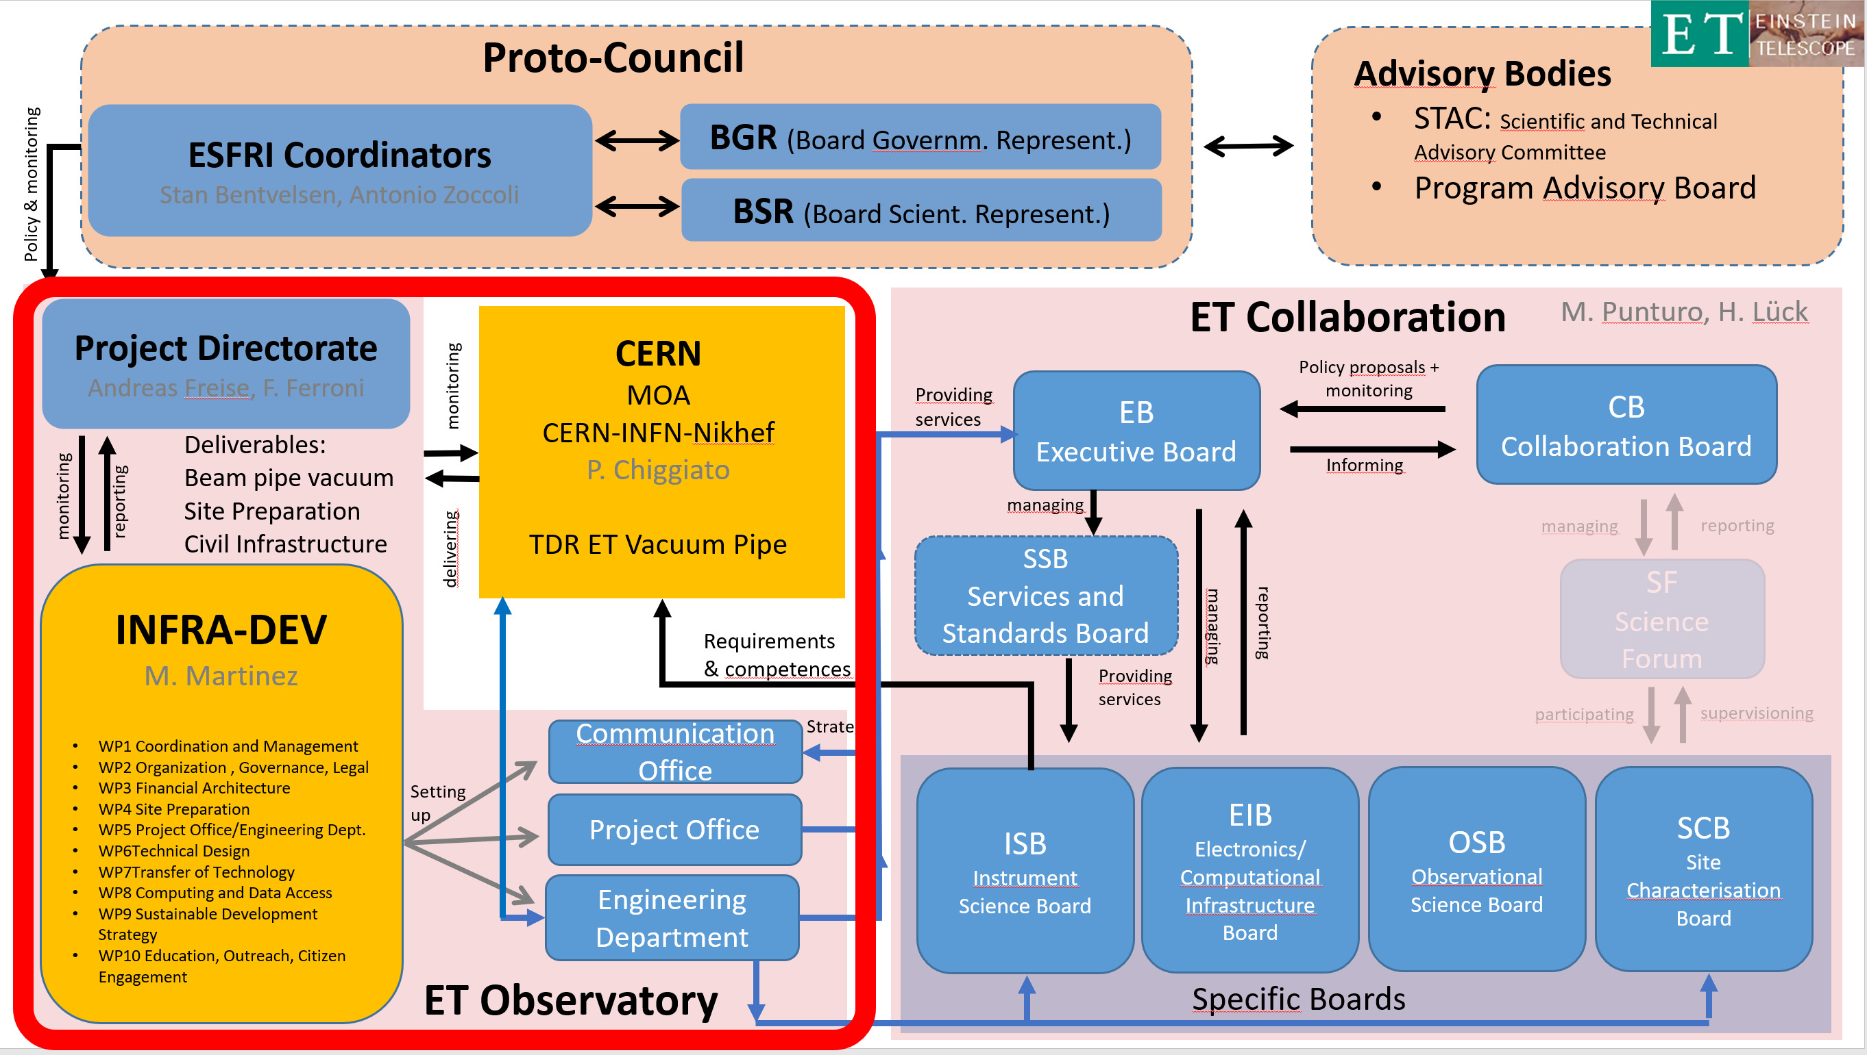
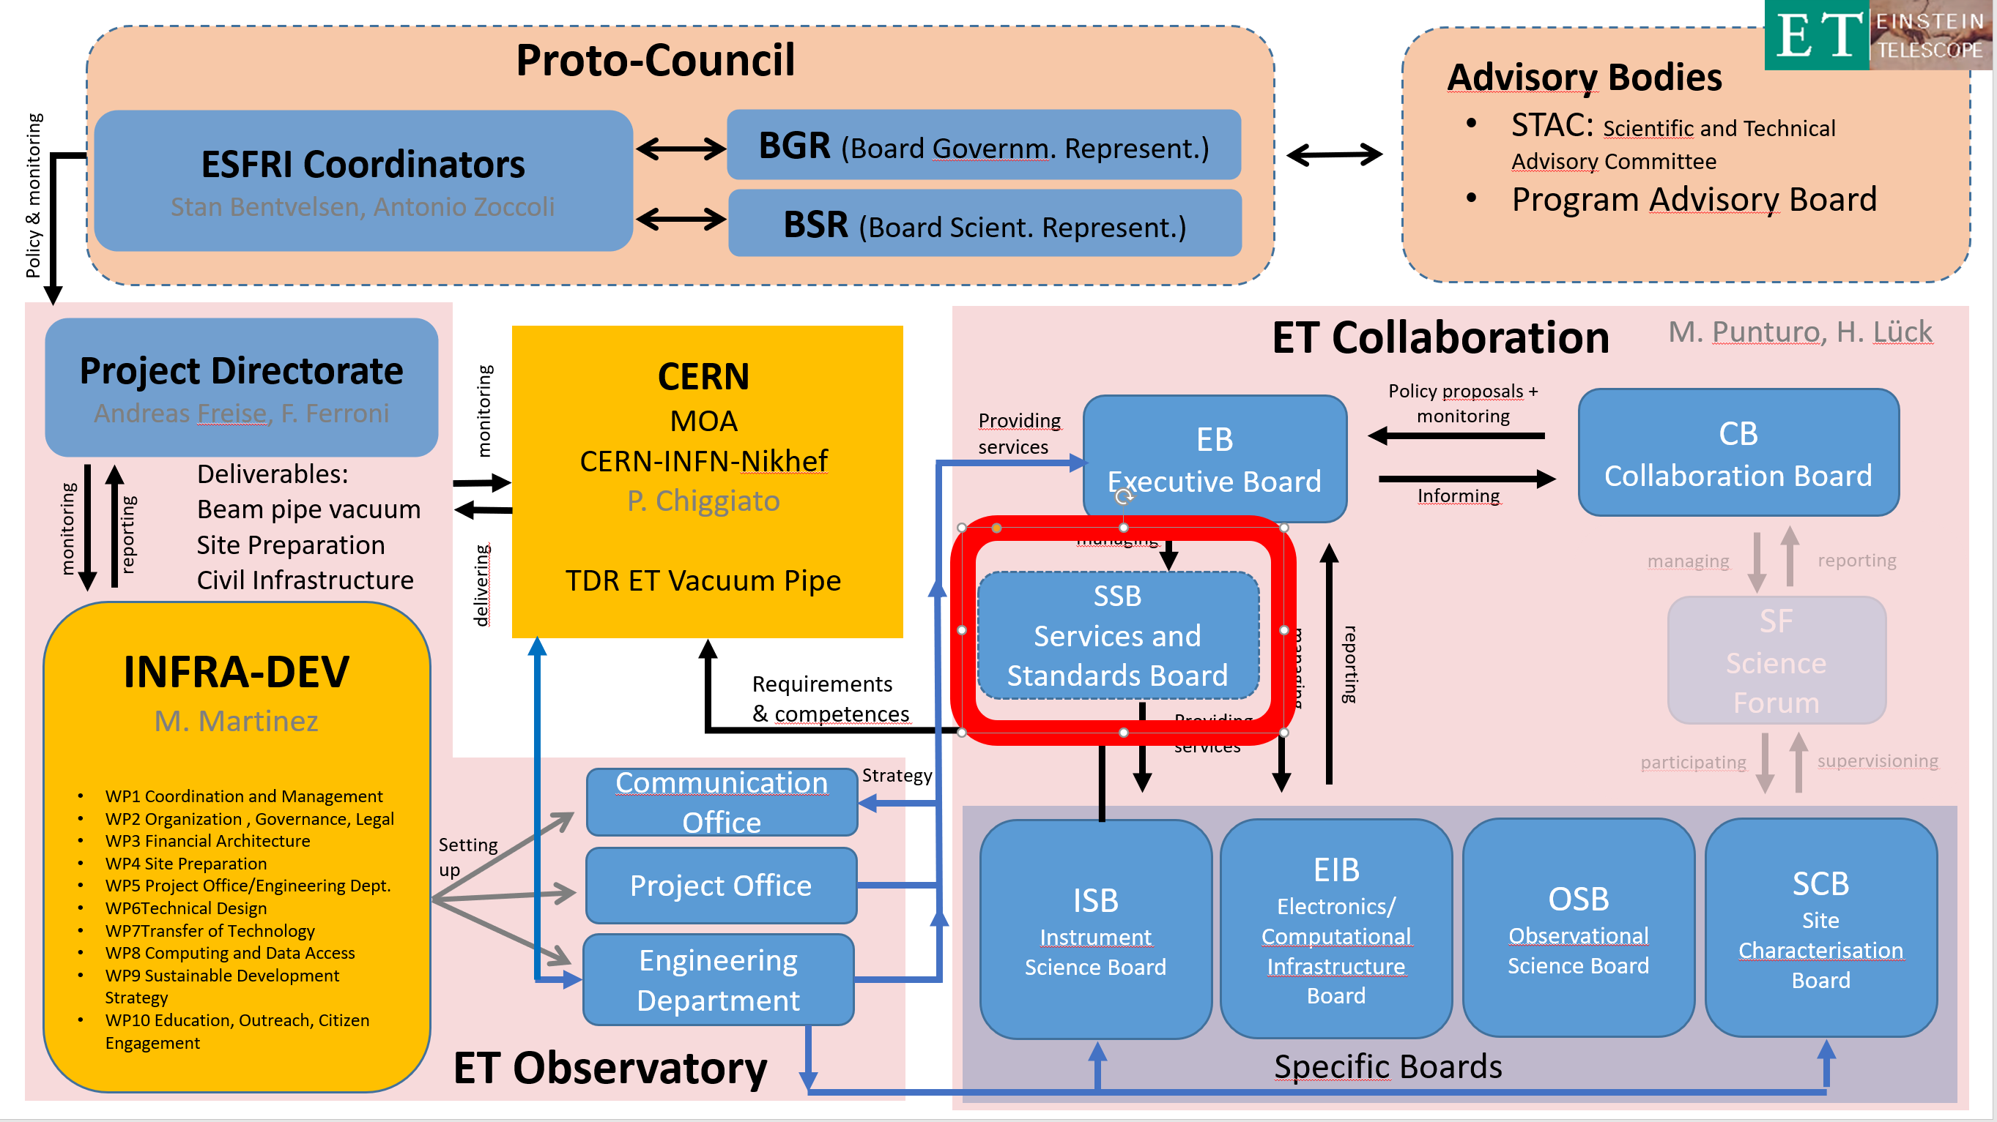
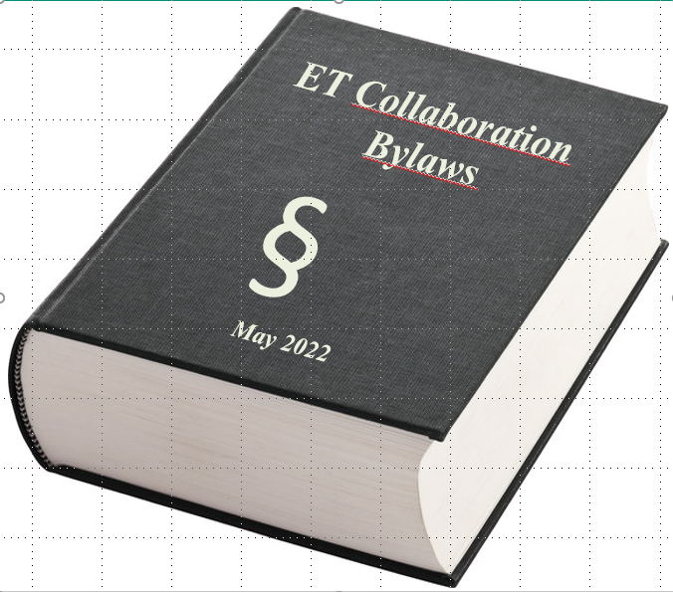
Next steps of the Collaboration/Observatory
Define TDRs & consolidate timelines
Build Project Office, Engineering department
Develop PBS & WBS
Collaboration: Set up „Service&Standards Board“ and committees
Update /Finish Bylaws
Characterise Sites, prepare bidbooks
EB
ISB
SPB
EIB
OSB
Div1
Div2
Div3
…
WP1
WP2
…
ET design
MacroSystem1
MacroSystem2
Macrosystem3
…
System1
System2
System3
…
Subsystem1
Subsystem2
…
Element1
Element2
Notes:
https://de.m.wikipedia.org/wiki/Datei:European_Parliament_Strasbourg_Hemicycle_-_Diliff.jpg
https://www.nytimes.com/interactive/2021/12/28/books/best-book-winners.html
https://www.presseportal.de/pm/8146/1092761

