Slide 1
REINFORCE
5 March
S. Katsanevas, EGO Director

Slide 2
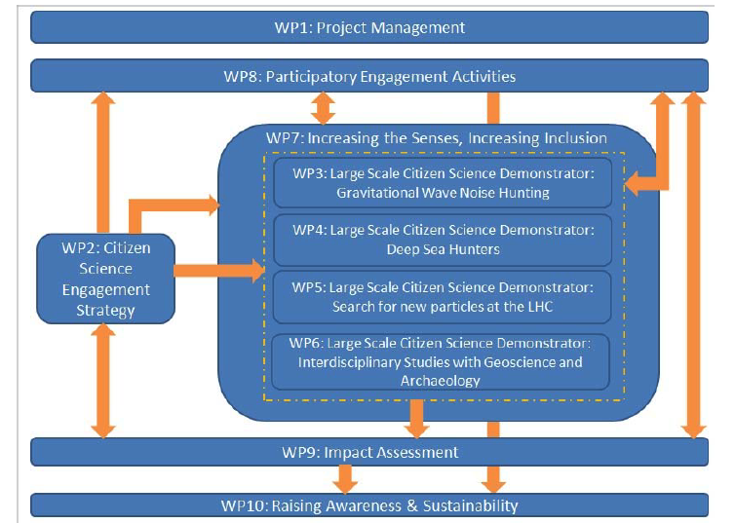
The
Work Packages

Slide 3
Organisational
Structure IV

Slide 4
WP1 Management
Workpackages
Project Coordination and Reporting (M1-M36), (Lead: EGO)
The scientific co-ordination of the project will be performed by the Project Committee that is led by the Project Coordinator.
The work includes the preparation of an Ethics Handbook (D1.2) and the processes to monitor the application of the foreseen ethics requirements during the pilots. Results in: D1.1, D1.2.
Set-up and Operation of the Project Office (M1-M3), (Lead: EGO) The management of financial and administrative issues is addressed by this task. Results in: D1.1, D1.3.
Communication and Meetings (M1-M36), (Lead: EGO) In this task, all project partners are engaged to participate in online and/or offline project management meetings. Results in: D1.3.
Quality control and Management Assessment (M1-M36) (Lead: EGO) Results in: D1.1, D1.2, D1.3 and D1.4.
Deliverables
Project Handbook, Quality Plan & Risk Management (M3, EGO):
Ethics Handbook and Data Management Plan (M8, ZSI):
Periodic Report (M12, M24, M36, EGO)
Quality Assurance Report (M17, M36, EGO)

Slide 5
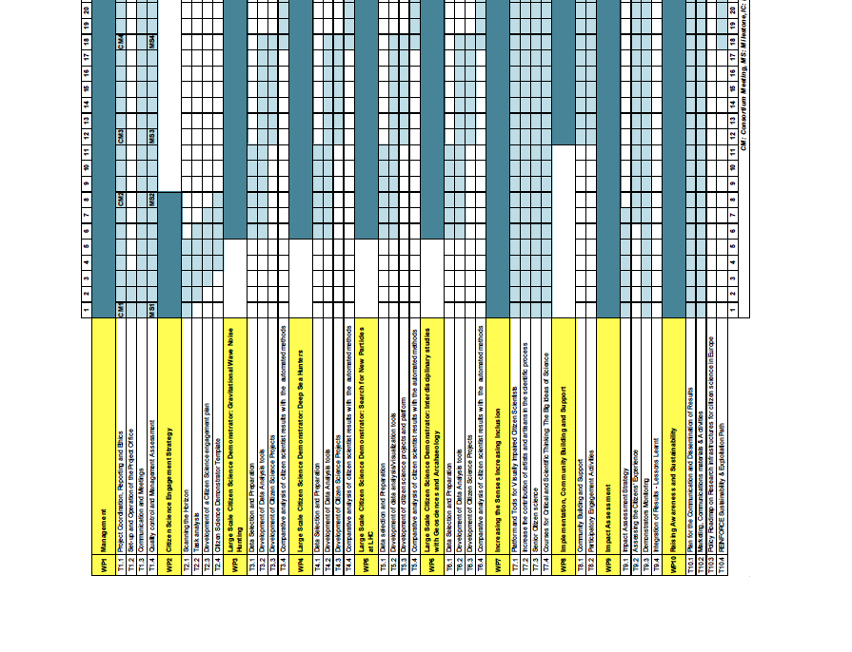
The
Timeline

Slide 6
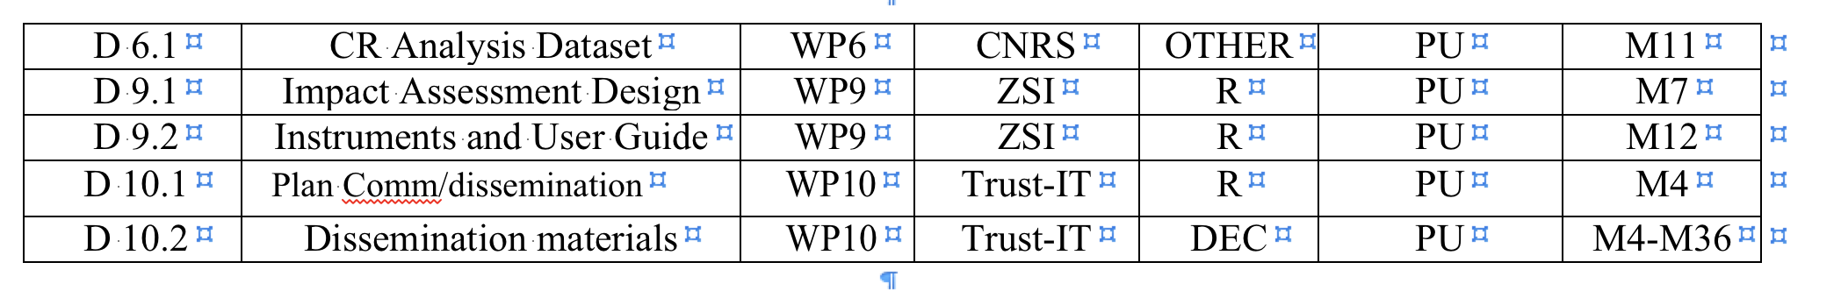
1St year deliverables
Timeline
M3-M4
M7-M8
M11-M12
Propose 2 GA meetings:
M6-M11

Slide 7
Actions
Recruitments
  Project Manager: Francesca Spaguolo (starting 1st of April)
  IT Engineer for MMA and Citizen’s Science platform (Open till 15th of March)
  Physicist/engineer for Citizen’s science platform (Open till 15th of March)
F2F Meetings
  Paris 14-15 May
  Argentina 10-15 December
Workshop sonification 20-22 April (virus permitting)
Deliverables:
  M1: Preparation of Ethics Handbook (D1.2) or 43H ➔ OK
  M3: Project Handbook, Quality Plan & Risk Management ➔ in progress
Sense and Sensibility in Science

