Slide 1
Einstein Telescope
Bjorn Vink

Slide 2
General Geology EMR
Geological impressions below the Cretaceous Overburden

Slide 3
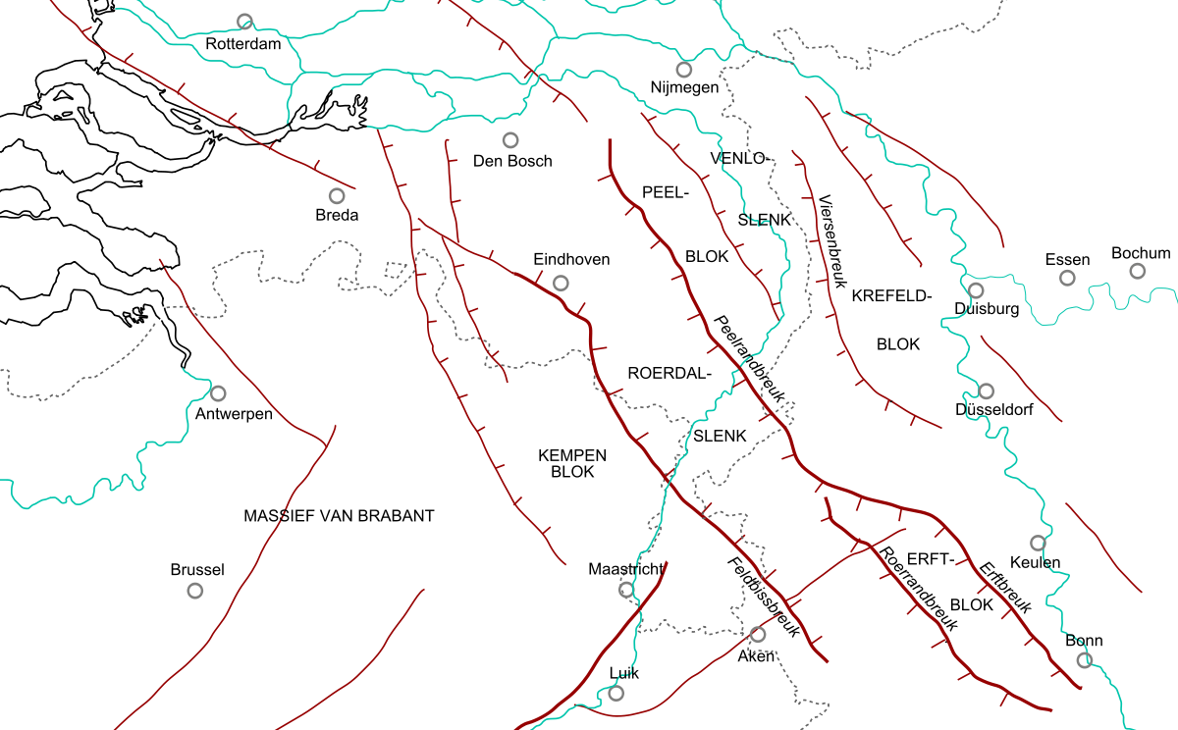
Area interest

Slide 4
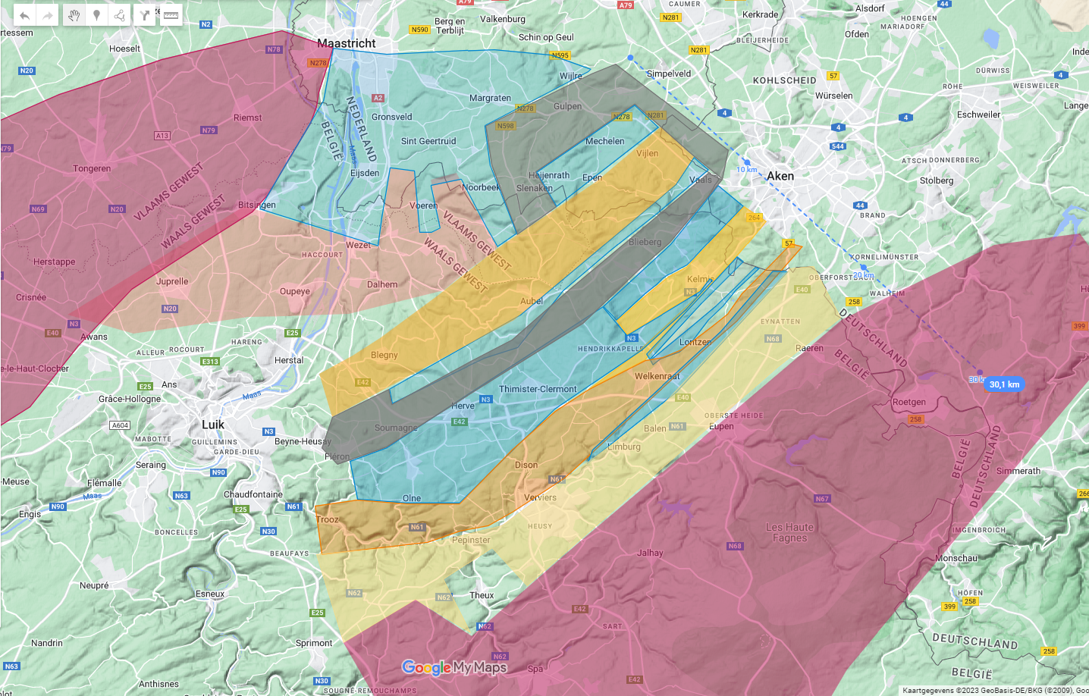
Probable geological formations @ ET-level ~ –100 m sea level
Paleozoic rock covered by Cretaceous & Cenozoic deposits.
Everywhere, also in the valleys!
Typical Dutch issue
Lower Carboniferous
Cambro/Silurian
?
Middle Devonian
&/or Silurian
Upper-Devonian
Upper Carboniferous
Lower Devonian
Cambrium/Ordovicium
Ardennes

Slide 5
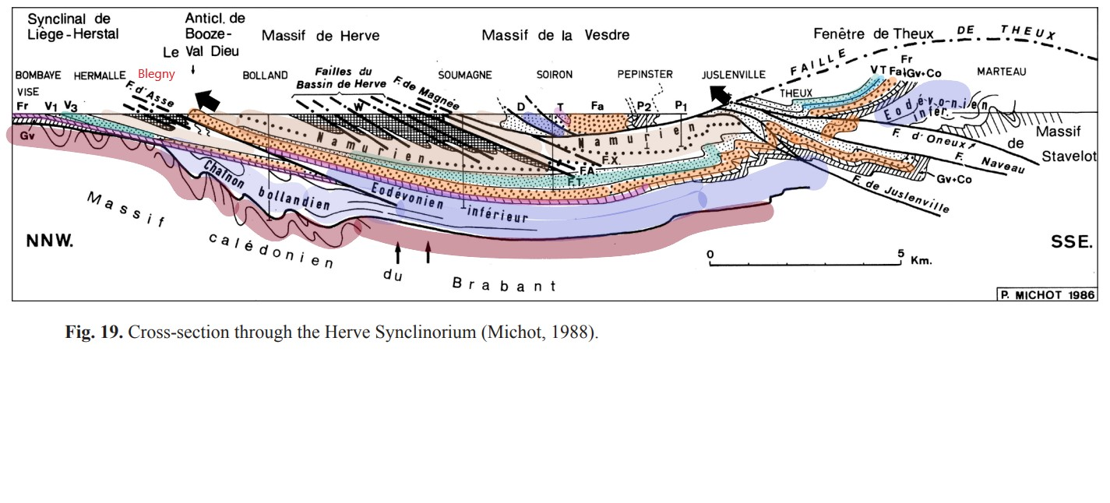
Possible cross-section (Michot, 1988)

Slide 6
Rocktypes
chalk sands
limestone
dolomite
Coal seems
shale, limestone,
sandstone,
& volcanic?
quartzitic sandstone, shales
Coal seems
shales, sandstone
quartzites
schist
shales

Slide 7
Based on outcrops & some boreholes, ERT, seismics
Some Faults
To be surveyed
Map is far from
Complete and
Just an indication
Old Borehole
ET borehole

Slide 8
Some modeling made 20 years ago,
Added recent boreholes
and unknown borehole info
Maastricht
Visé

Slide 9
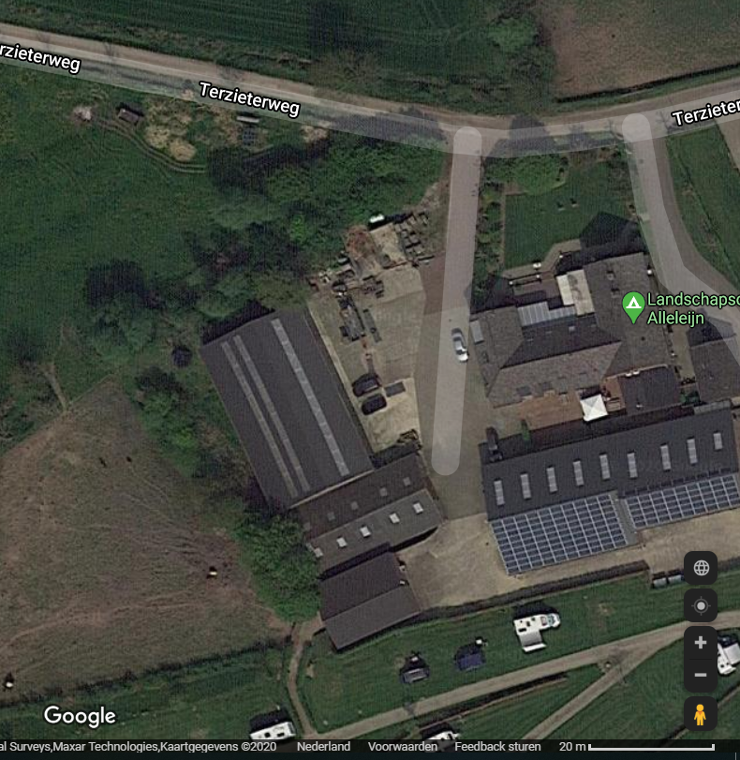
Geert-Jan Vis TNO, comments on Boreholes Terziet
Cretaceous
Carboniferous
(Namurian)
What is this?
(Chokier)
Terziet-02
Terzieterbeek
~65 m
Famennian
Terziet-01
FAULT ZONE?
FAULT ZONE?
Terziet-01-2017
Large difference in GR-character on short distance between Terziet-01 and -02: Terzieterbeek stream represent a fault line or other disturbance in the subsurface?
Terziet-02
2019

Slide 10
Conclusions,
1 This is an area with complex geology, with potential chances and risks.
2 A lot of surveys should be carried out in a smart way.
3 It’s quite a challenge to perform the surveys in a short timeframe. .

Slide 11
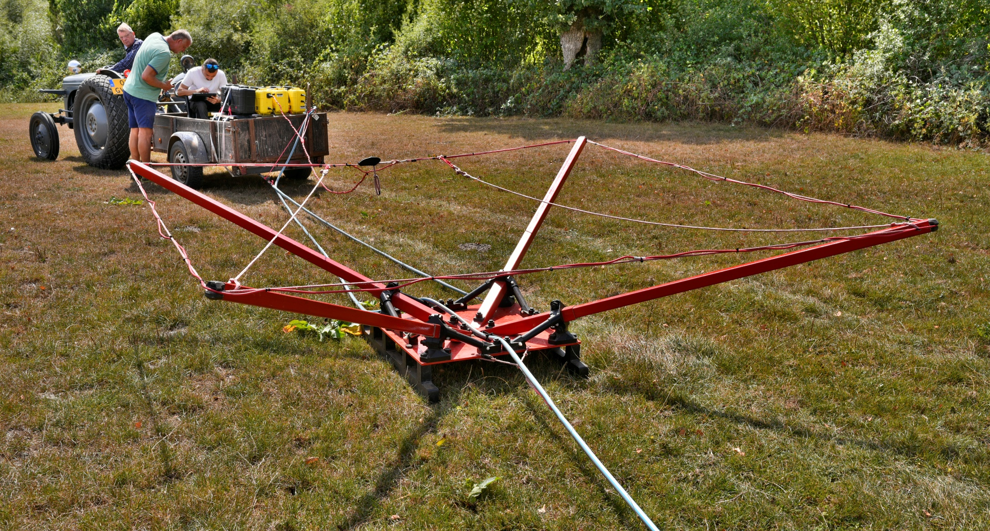
Any questions?
Yes we test any adhoc innovation… (1922 meets 2022)
With great help of local experts and available remaining refurbished -laundry- equipement

Slide 12
Thank you very much

