Slide 1
EMR site investigation wrap-up
Frank Linde
Frédéric Nguyen
Bjorn Vink
Wim Walk

Slide 2
Converging from multiple efforts to joint and concerted effort
Central person at Nikhef
Regular EMR meetings
Centralized information and planning (important for permitting)
Balanced efforts between academics and companies
Seeking funds in 3 countries
Involvement from geological services and seismological services

Slide 3
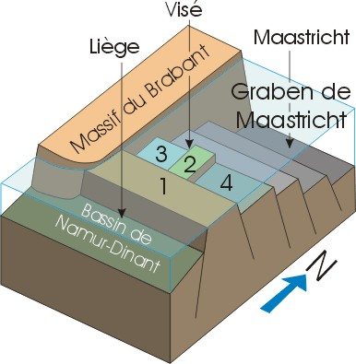
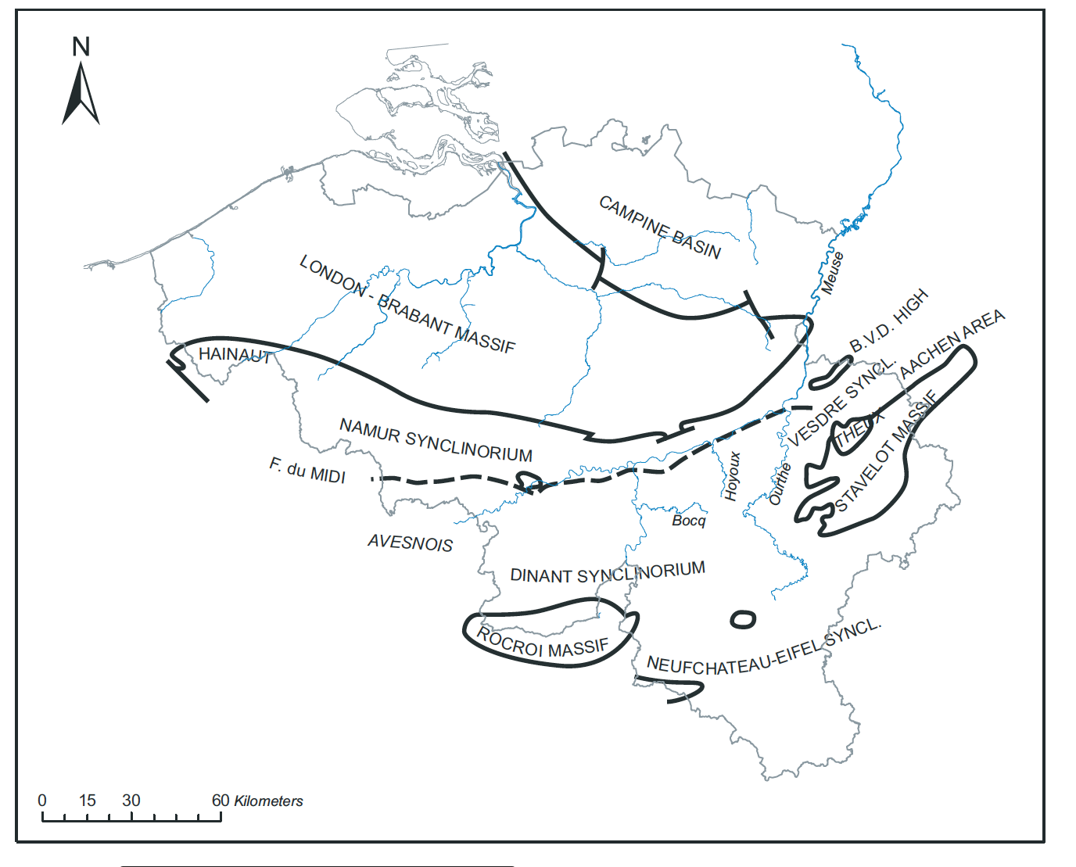
What we learned so far that help us in terms of site investigation
BVD (illustration needed)
Target rock for caverns is Famenian
BVD large structure which is uplifted with little to no limestones above but :
No hard limit from a structrual point of view
Little knowledge on its heterogeneity
Need a third location for corner point
Need to quantify heterogeneity of geotechnical and hydrogeological parameters along tunnels

Slide 4
What we learned so far that help us in terms of site investigation
Seismic refraction
Seismic reflection
Passive seismic interferometry (from 50 to 200 sensors)
ERT/IP : Deep (GPS synchronised), azimuthal and ”standard”
Efficient but low resolution, can be combined with surface waves
Challenging (ongoing DMT / FUGRO analysis, Mechatronics, EBN experience) > lessons learned early 2023
Efficient both for seismic noise and imaging
Sensitive to Houiller/Famenian contact and to variations within Famenian
EM extension (same properties) more challenging due to urbanised area

Slide 5
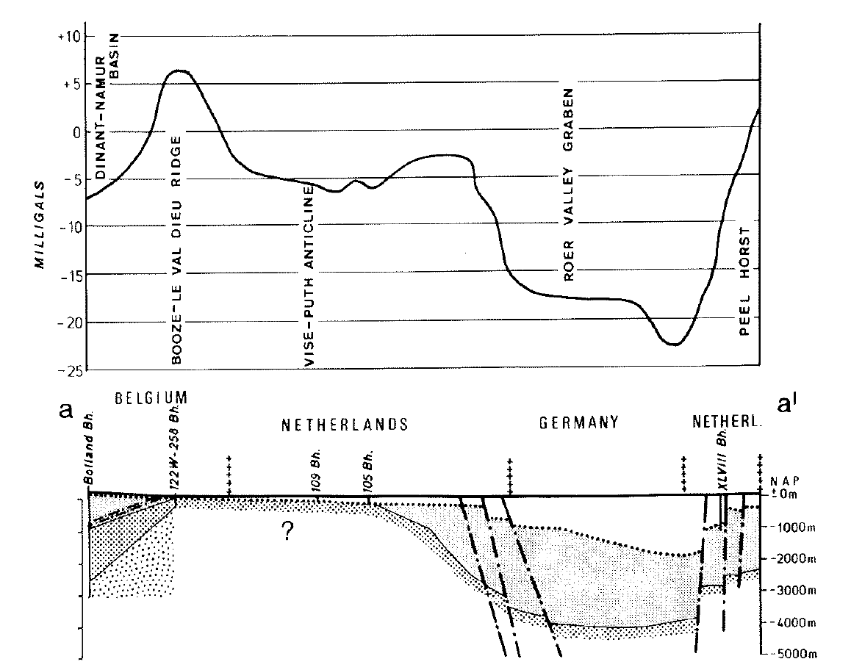
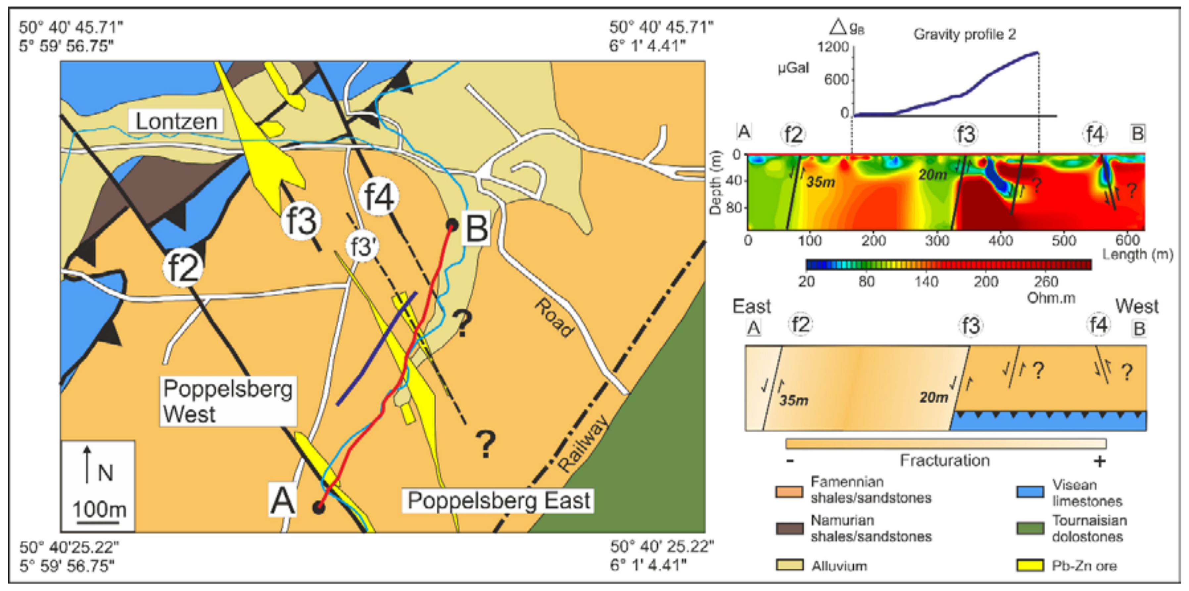
What we learned so far that help us in terms of site investigation
Gravimetry (from global map and other surveys) > literature shows that it is effective
Large scale Bouguer anomaly and nearby survey (south) show that efficient

Slide 6
What we learned so far that help us in terms of site investigation
Boreholes : Terziet 2019, Cottessen 2022, Banholt 2022
Geotechnical parameters, hydraulic parameters
Fault and fracture mapping
Aubel 2023 : single offer received after tendering
Relatively high hydraulic conductivity values (ranging between 1.10 ⁻⁵ and 7.10 ⁻⁷ m/s)

Slide 7
Urgently needed
Structural information on B.V.D to sit 2 corner points
Hydrogeological information representative of the depth at several locations (first piezometers Aubel)
Corner points to start further detailed studies
Windmills (+other sources) study accounting for geological heterogeneity (including lateral) for NN
Magnetic field monitoring
Seismic noise measurements at depth at several locations (Terziet, Cottessen)
Combining all information in Geo Building Information Modelling for design and cost update

