Slide 1
Definition of the legal steps to be taken and the permits to be obtained for the construction of the Einstein Telescope in the EMR region
SPB workshop – Maastricht – 25/01/23
Ph. Orban (with information from Amberg/Tractebel)

Slide 2
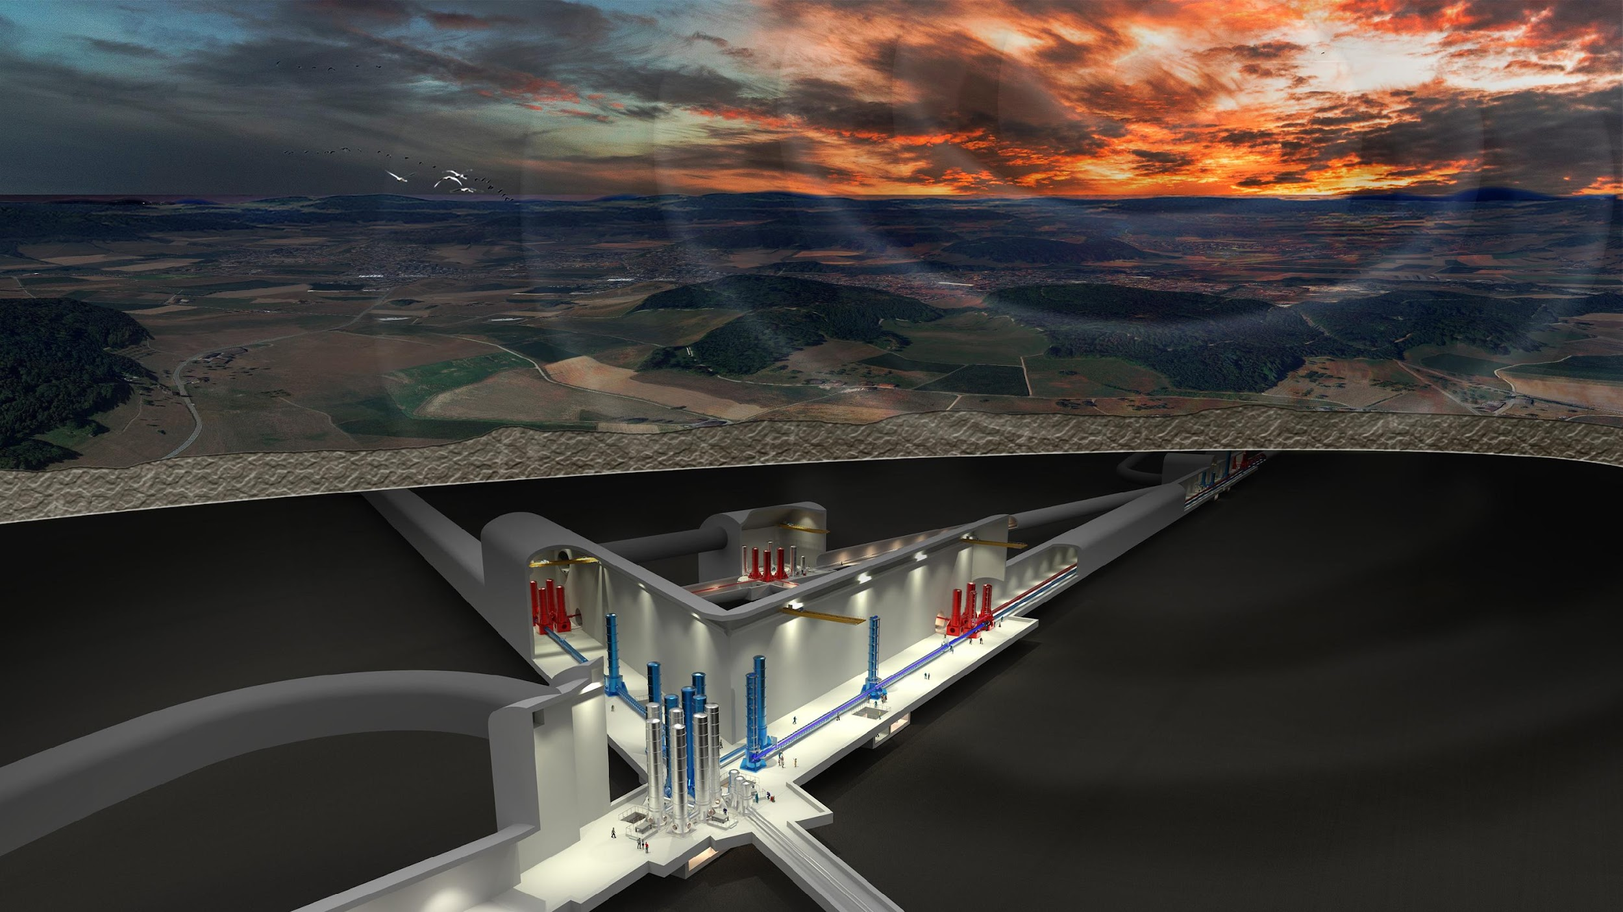
Context
Large construction including underground and surface infrastructures
=> What rights are required to use the subsurface and the surface
=> What permits are required
Potential impacts during the construction and exploitation
=> What legislations must be respected?

Slide 3
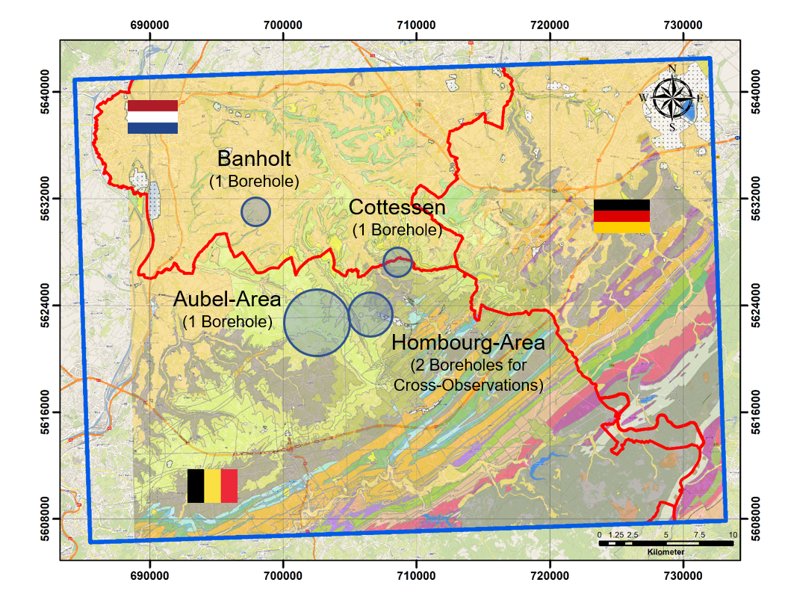
Context
Transboundary project
=> Different national (or even regional) legislations to consider

Slide 4
Objectives
Mapping of public decisions and permits to acquire before start of civil engineering incl. related risks;
Required studies
Timeline to obtain permits
Required permits
Feasibility and associated risks
Mapping of private decisions and legal contracts to acquire before the start of civil engineering.
Mapping of ownership relationship and right of use
Ownership acquisition or usage right
Feasibility and associated risks
Global timeline including the most important steps, decision moment and risks related to legal issues and permits;

Slide 5
Partnership and organization
Association of two engineering compagnies and two lawyers' offices
Final meeting scheduled beginning of February 2023
Main assumptions :
Focus on the Netherland, Flemish and Walloon region
Large-scale study, not site specific

Slide 6
Examples of deliverables
List of contractual agreements to be obtained before the start of civil engineering works (For each region/country)
Example for private owner and the Walloon region
 | Mode of acquisition | Duration | Extent of the right (ground/subground) | Characteristics (advantages, disadvantages, cost, ...)
Property rights
Co-ownership rights
Conventional easement
Legal easement
Usufruct
Emphyteusis right
Superficies

Slide 7
Examples of deliverables
List of public authorizations to be obtained and public procedures to be followed before the start of civil engineering works (For each region/country)
 | Scope of application (including possible exemption) | Competent authority | Procedure, including appeals | Criteria for the obtention | Timelines
Planning permit
Environmental permit
Heritage permit (German-speaking Community)
Authorization to derogate from the nature conservation law
Authorization to modify/create a municipal roadway
Authorization to modify/create a regional roadway
Domain authorization (municipal domain)
Domain authorization (regional domain)
Exploration or exploitation of underground resources permit
Soil quality control certificate
Ground control certificate
Obligations regarding the management of industrial waste
Authorization for the construction and operation of a gaseous products transport facility
Obligations regarding the safety of elevators
Obligations regarding the use of explosives
Authorization regarding electrical installations
Authorization regarding fire prevention and safety
Obligations related to the use of hazardous substances within the meaning of the cooperation agreement of 16/02/2016 (Seveso)
Authorization for exceptional transport
Expropriation in the public interest

Slide 8
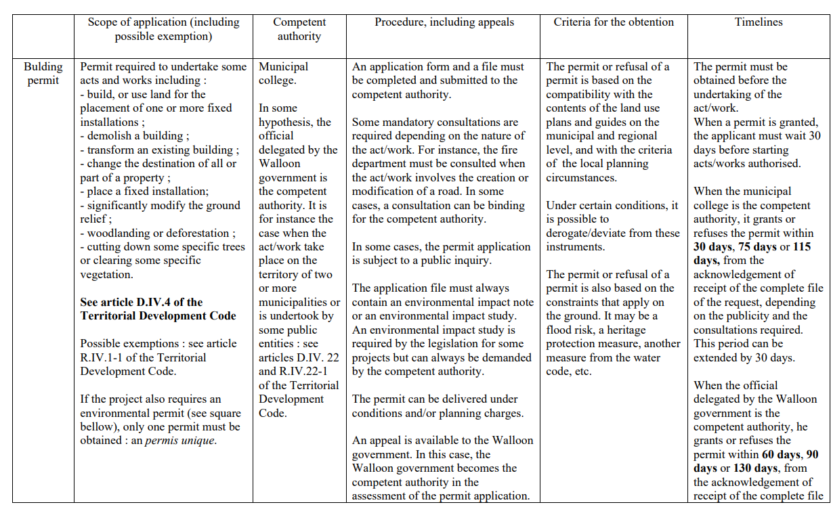
Examples of deliverables
List of public authorizations to be obtained and public procedures to be followed before the start of civil engineering works (For each region/country)

Slide 9
Examples of deliverables
Global timeline : Engineering steps
Opportunity Study
Due Diligence
Conceptual design
Tendering
Specifications of the project
Construction
Execution design
Construction
Identification of all stakeholders
Feasibility study
Master plan
Basic & Detailed design
Project design (depending on contract type)
Cost estimation & Schedule
Cost estimation & Schedule
Environmental and urbanistic permits
Call for tenders
Offer analysis and negotiation
Final acceptance
Acceptance of the works
As Built documentation
Opportunity Study
Due Diligence
Conceptual design
Tendering
Specifications of the project
Construction
Execution design
Construction
Identification of all stakeholders
Feasibility study
Master plan
Basic & Detailed design
Project design (depending on contract type)
Cost estimation & Schedule
Cost estimation & Schedule
Environmental and urbanistic permits
Call for tenders
Offer analysis and negotiation
Final acceptance
Acceptance of the works
As Built documentation
Tendering
Tendering
Permitting
Permits files
Impact studies
Delivery of permits
Permitting
Construction
Construction

Slide 10
Examples of deliverables
Global timeline : Engineering steps
Opportunity study
Main goals:
Identify needs and objectives of the project
Identify specific requirements
Define funding aspects and legal aspects
Define what are the options to achieve the requirements
Define the main geometry of the project

Slide 11
Examples of deliverables
Global timeline : Engineering steps - Feasibility study
Main goals:
Identify technical, geotechnical, urbanistic, environmental, legislative and financial constraints that will impact the project
Analyse and compare different design options
Decide on the most optimal solution
Elaborate a master plan with a consolidated technical and financial analysis
Also in this phase, Start thinking about contract type: Standard, D&B, PPP, etc.
~ 4 months
~ 4 months
~ 3 months

Slide 12
Examples of deliverables
Global timeline : Engineering steps - Basic and Detailed Design
Main goals:
Design the infrastructure
Stability
Environment
Safety
Construction details
Deliverables:
detailed plan views,
detailed longitudinal profiles,
detailed cross-sections,
detail drawings,
descriptive notes by discipline, with starting points, standards in effect, calculations and simulations, argumentation and conclusions,
a detailed estimate of the investment cost
a precise estimate of operating costs and revenues,
timeframes for completion and phasing,
expropriation plans.
~ 9 months

Slide 13
Examples of deliverables
Global timeline : Engineering steps - Urbanistic and environmental Permits
Main goals:
Obtain the permits based on the basic and detailed design
Phase 1: Request
Phase 2: Impact study (external)
Phase 3: Updating design
Phase 4: Permits delivrance
…
~ 18-24 months

Slide 14
Examples of deliverables
Global timeline : Engineering steps - Tendering
Main goals:
Prepare call for tenders
Technical aspects
Admin aspects
Define procurement strategy
Prepare negotiation phase
Publish RFQ & RFP
Analyse offer and negotiate
Awarding
~ 12 months
~ 9 months

Slide 15
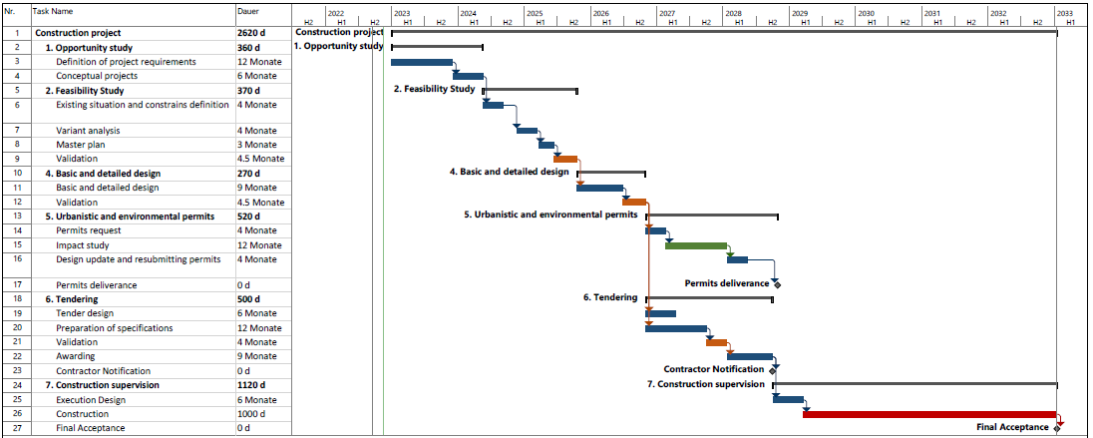
Examples of deliverables
Global timeline
From Feasibility Study to Start of Construction: between 3,5 and 4,5 years

