Slide 1
ETO: the beampipe project (Summary of the Beampipe for GWT workshop at CERN, 27-29 March 2023)
CARLO SCARCIA (on behalf of ET vacuum team at CERN)
XIII ET Symposium, Cagliari, 8-12 May 2023

Slide 2
Motivation: New generation, new (vacuum) requirements
2nd GENERATION
3rd GENERATION
Einstein Telescope/
Cosmic Explorer
Residual gas noise:
< 1 × 10⁻²⁵ Hz^{-1/2}
P_{H2} ≈ 10⁻¹⁰ mbar
P_{H2O} ≈ 10⁻¹¹ mbar
P_{(>100 amu)} < 10⁻¹⁴ mbar
LIGO / VIRGO
Residual gas noise:
< 1 × 10⁻²⁴ Hz^{-1/2}
P_{H2} ≈ 10⁻⁹ mbar
P_{H2O} ≈ 10⁻¹⁰ mbar
P_{(>100 amu)} < 10⁻¹⁴ mbar
x10 better sensitivity
≈
x10 lower pressures
(noise ∝ P^{1/2})

Slide 3
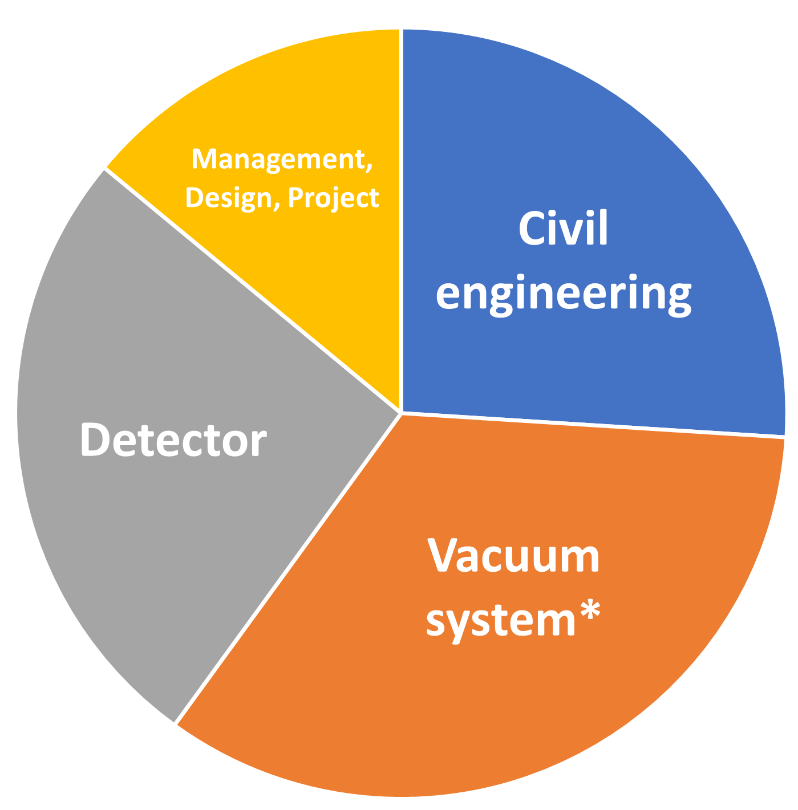
Motivation: vacuum systems impact on budget
If LIGO/VIRGO vacuum system costs are scaled to ET/CE dimensions:
Cost estimates
Cosmic Explorer
(2 x L- 40km) ^{[1]}
Cost estimates
Einstein Telescope
(Δ - 10km) ^{[2]}
Vacuum system* cost
estimated to 1/3 of the total budget
(≈ 570 M€/M$)
*including vacuum towers

Slide 4
CERN contribution to beampipe studies for GWT
Nikhef
MIT
INFN
Agreement
INFN - Nikhef - IFAE - CERN
ET vacuum team at CERN
Caltech
IFAE
LoI CERN - LIGO
LIGO
CNRS
(LAPP & IJClab)
NIST
W&M
JLab
U. of Ghent
U. of Antwerp

Slide 5
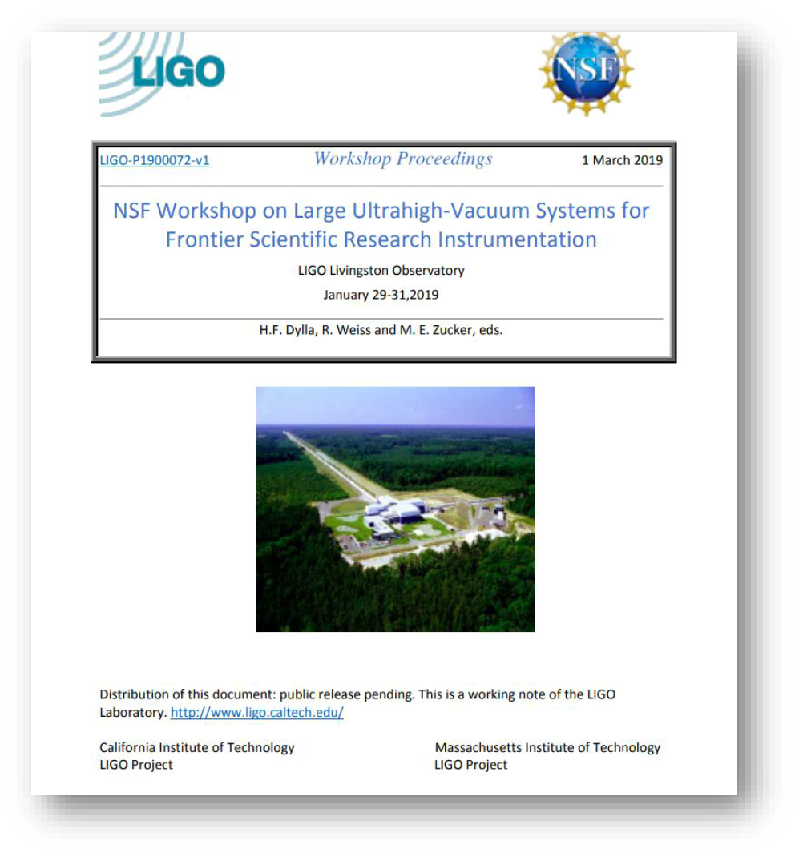
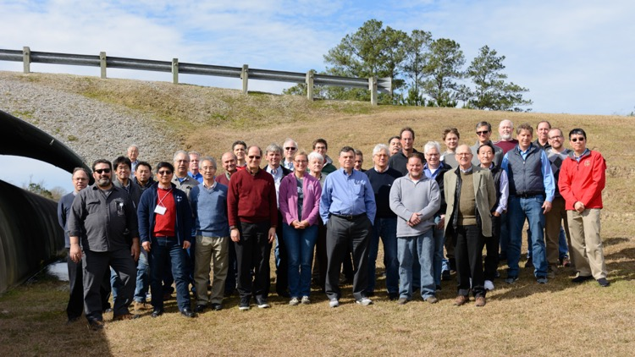
The objective of the workshop
Credit: LIGO
The workshop held at CERN continued and reviewed the exploration of cost-effective designs, materials, and techniques for the next generation of gravitational wave detectors, building on the solutions proposed at the Livingstone workshop (2019).

Slide 6
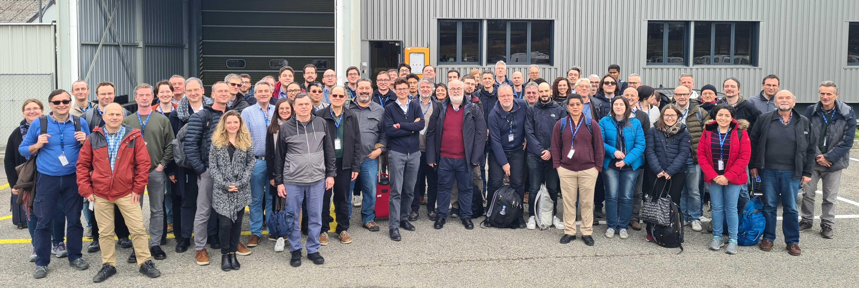
Beampipes for GWT workshop in numbers
85 participants
21 institutes/universities
(US & EU)
10 companies
3 days
26 talks
3 topical discussions
Contributions (video and material)
Credit: CERN

Slide 7
Beampipes for GWT workshop: main topics

Slide 8
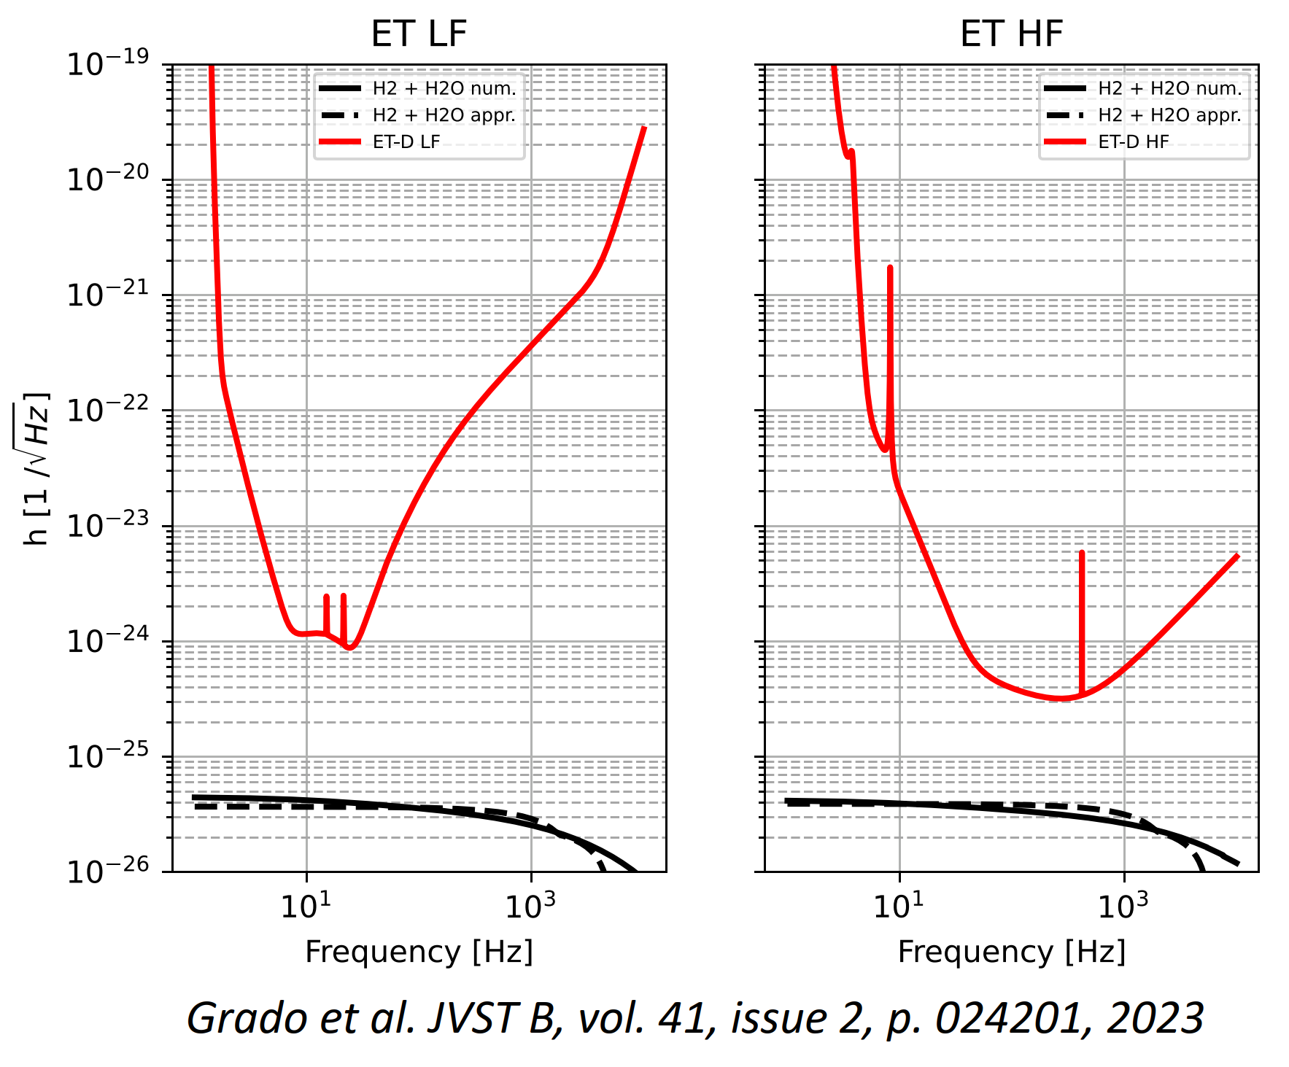
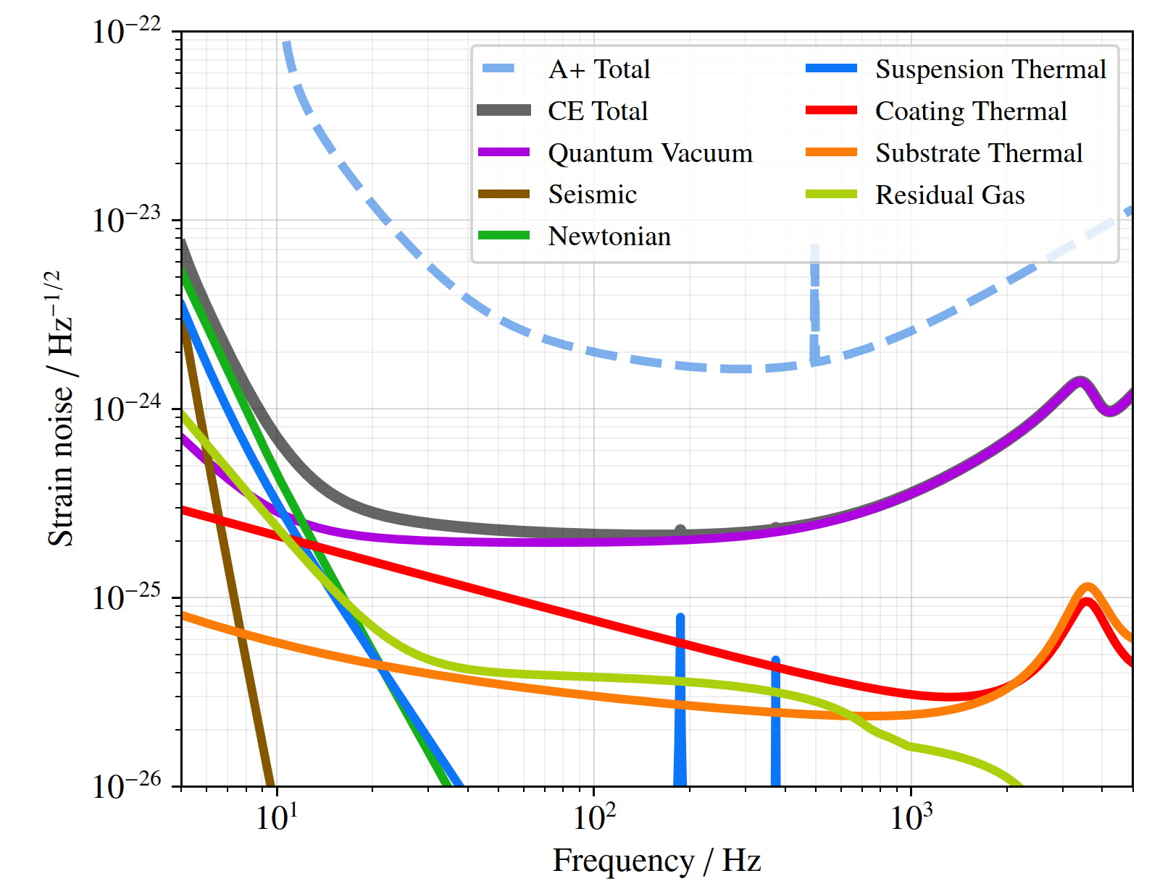
Overview of 2G GWD vacuum systems and challenges/status of ET and CE
Vacuum requirements for GWT
Overview of 2G vacuum systems and present experience
Status of ET and CE projects and plannings
Vacuum studies among the ET collaborators
Credit: Grado et al. JVST B, vol. 41, issue 2, p. 024201, 2023
Credit: Cosmic Explorer collaboration,
Cosmic Explorer Technical Report CE–P2100003–v7

Slide 9
Materials: beampipe structural material
Currently, steel is under consideration as structural material for the beampipes.
Einstein Telescope
Cosmic Explorer
Austenitic stainless steel
(304L)
Mechanical properties
Formability and weldability
Corrosion resistance
(native)
Vacuum performance
(requires HT heat treatment)
Cost
(raw material)
Non ferromagnetic
(µ_{R} ≈ 1)
Ferritic stainless steel
Mechanical properties
Formability and weldability
Corrosion resistance
(native)
Vacuum performance
(native)
Cost
(raw material, 30-50% less than austenitic)
Ferromagnetic
(µ_{R} > 200)
Mild steel
Mechanical
properties
Formability and weldability
Corrosion resistance
(requires treatment)
Vacuum performance
(native)
Cost
(raw material, 80-85% less than austenitic)
Ferromagnetic
(µ_{R} ≈ 100- 200)

Slide 10
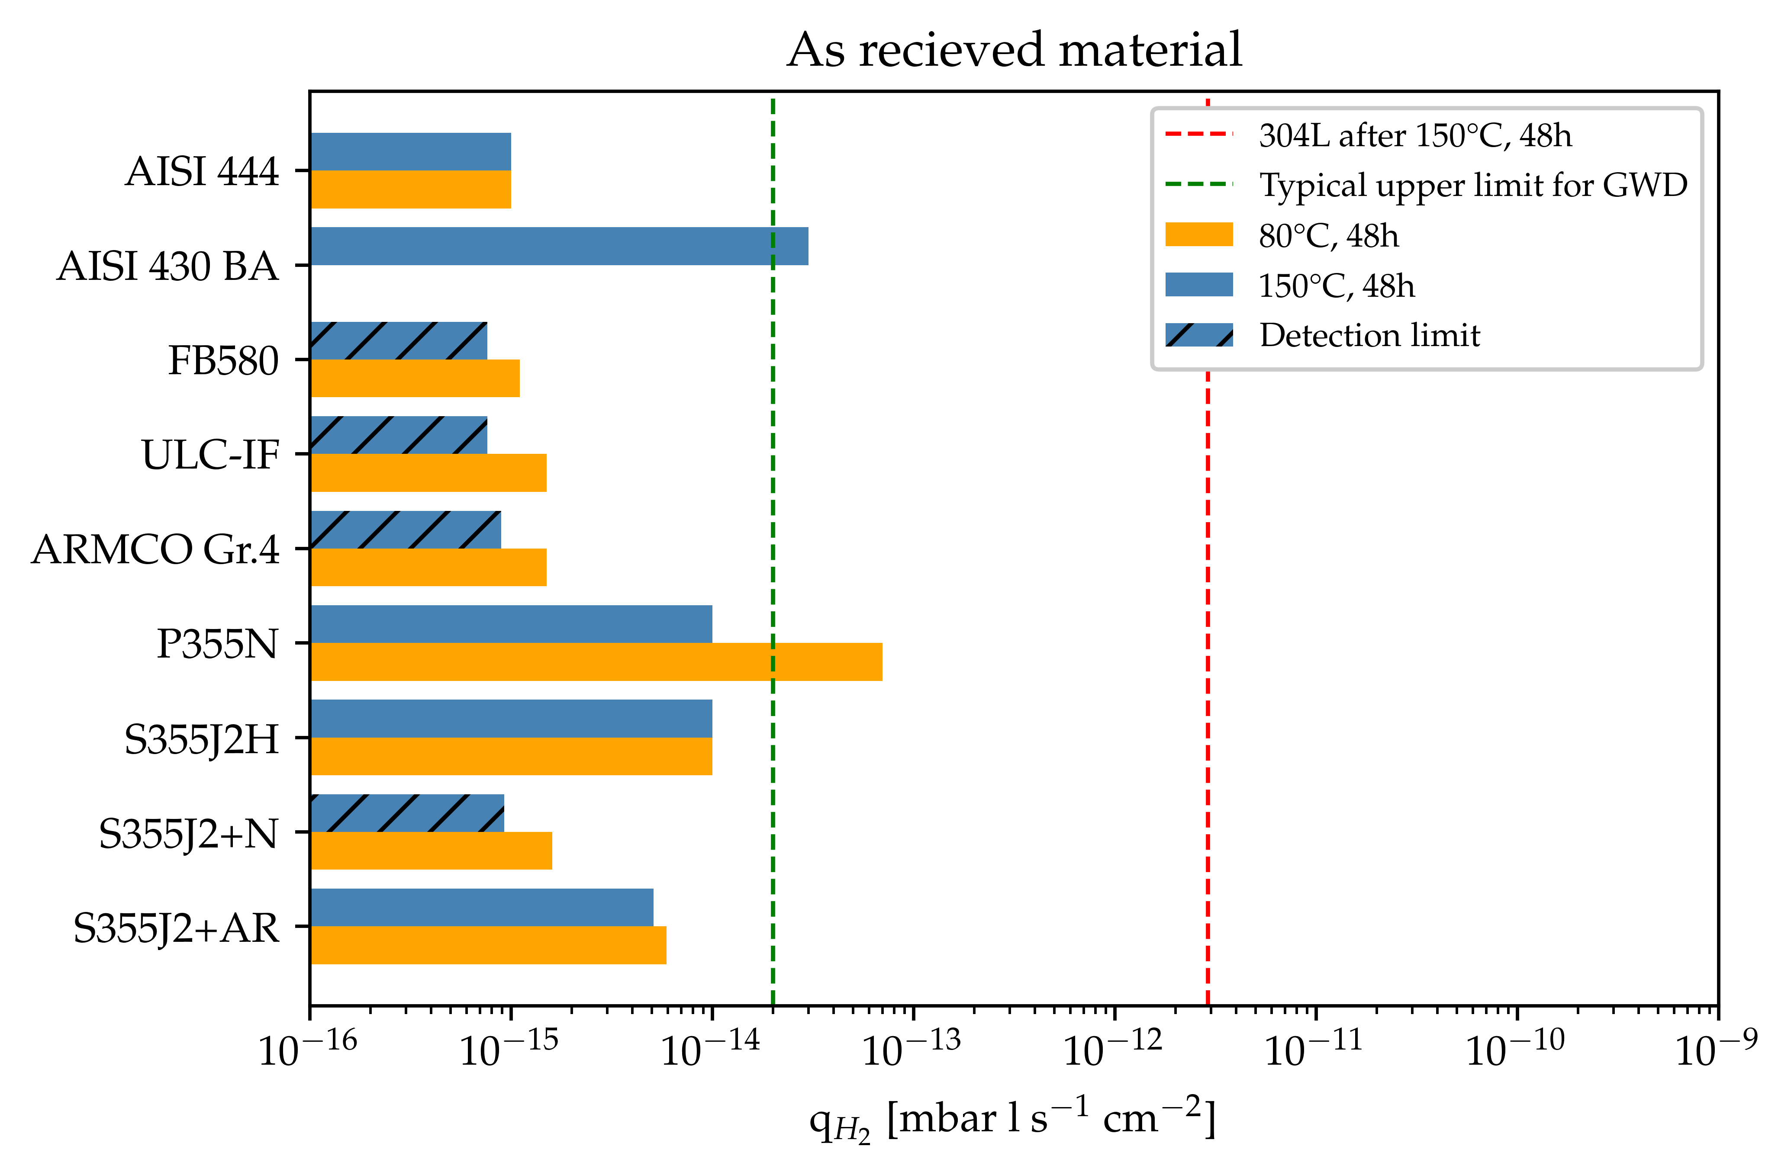
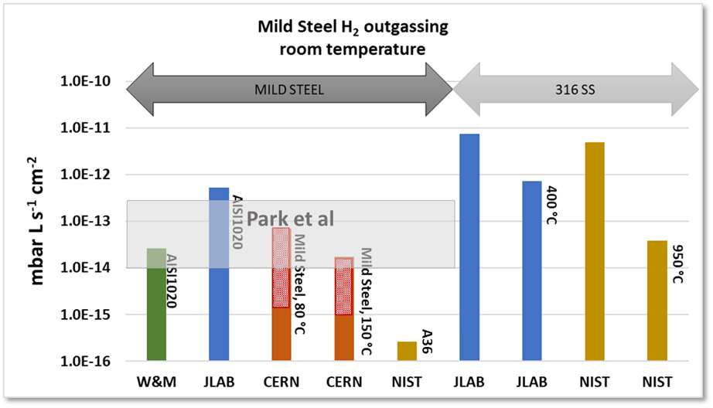
Materials: H₂ outgassing rate
Vacuum studies across five institutes demonstrates that, without high-temperature treatments, ferritic alloys outperform austenitic stainless steel in H₂ outgassing.
As received material
Credit: W&M, JLab, CERN, NIST
Credit: CERN
PRELIMINARY DATA, DO NOT SHARE WITHOUT CONSENT

Slide 11
Design: beampipe profile
Einstein Telescope
Cosmic Explorer
Optimized baseline
(LIGO/VIRGO like)
3-4 mm thick tube reinforced with stiffeners + bellows
Known solution, needs to be adapted to ET requirements
Corrugated
1-1.5 mm thick tube
No bellows
No reinforcement
Low kg/m of material
Less power input if direct joule effect bake-out
Double wall
Very thin tube shielded by outer tube with differential vacuum in between or foam
No external insulation
Less power input if joule effect bake-out
Design not yet mature
Commercial
tube for gas pipelines
10-13 mm thick tube
Very cost effective
Limited to mild steel only
Direct joule effect bake-out not applicable

Slide 12
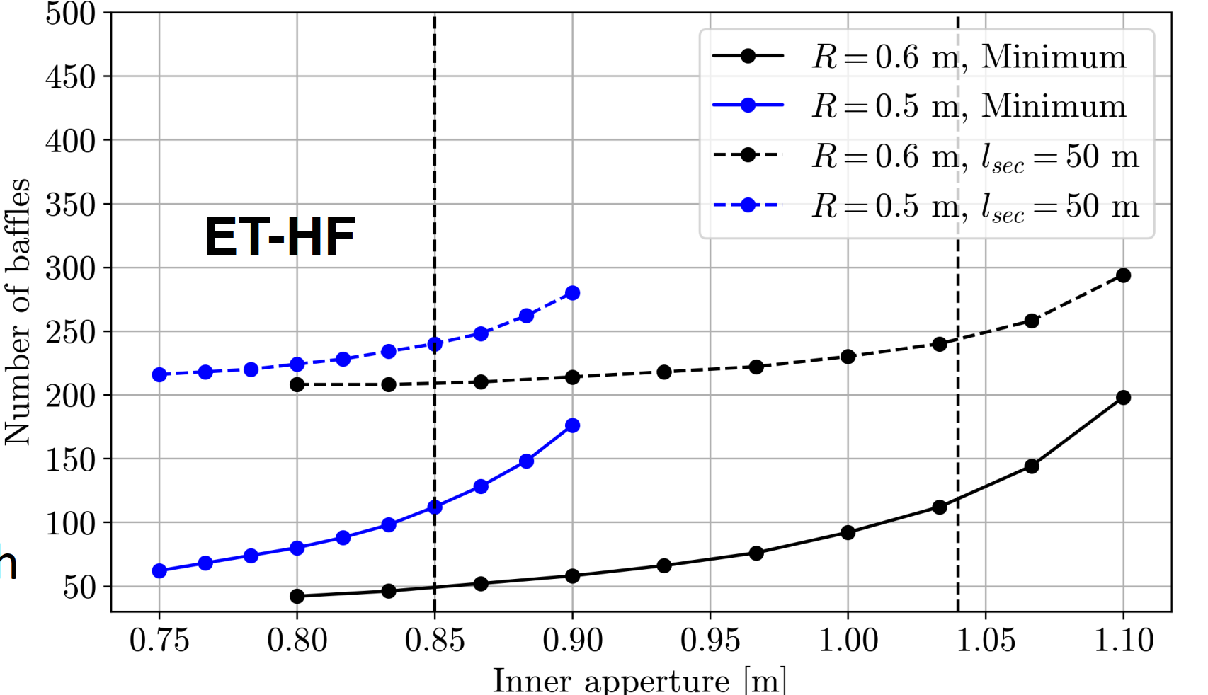
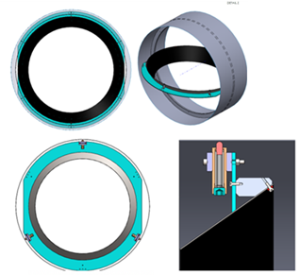
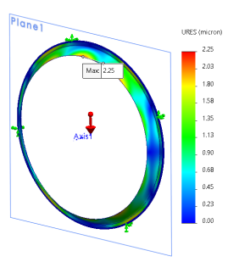
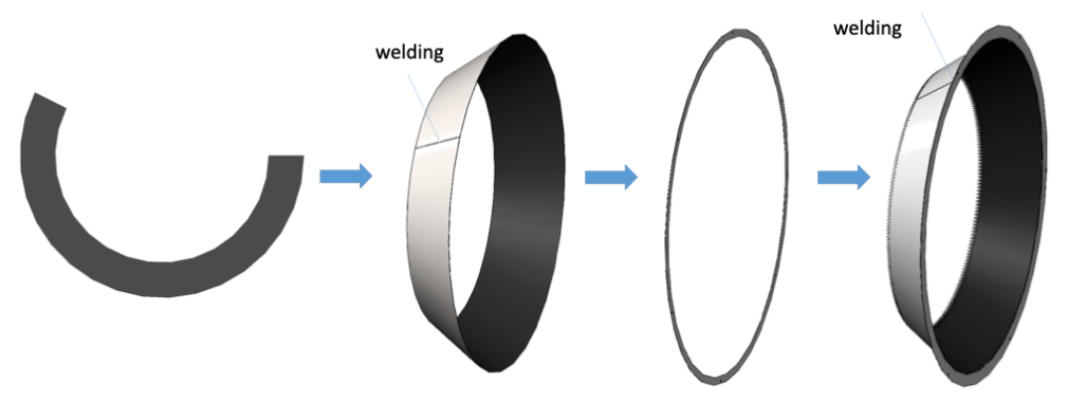
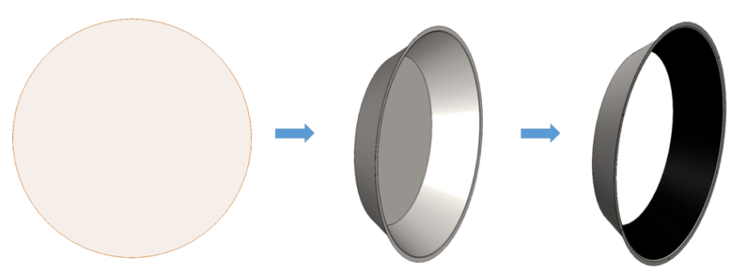
Design: optical baffles
Optical baffles layout, design, manufacturing and material options investigated by IFAE.
Layout
Designs
& installation
Modal &
thermal analysis
Materials &
manufacturing

Slide 13
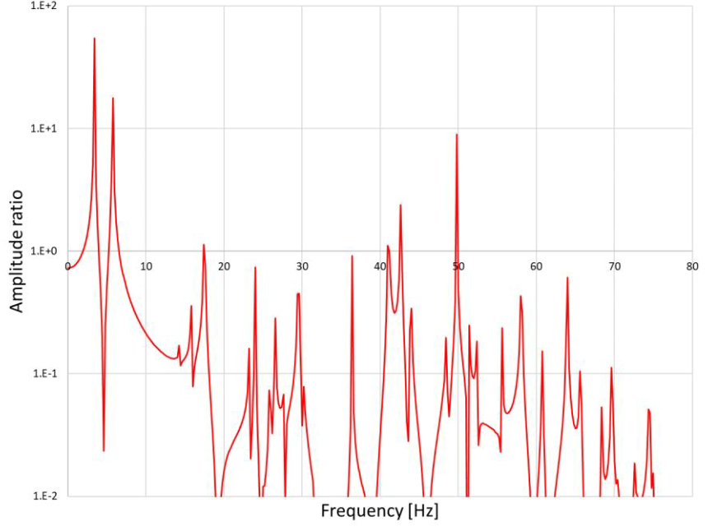
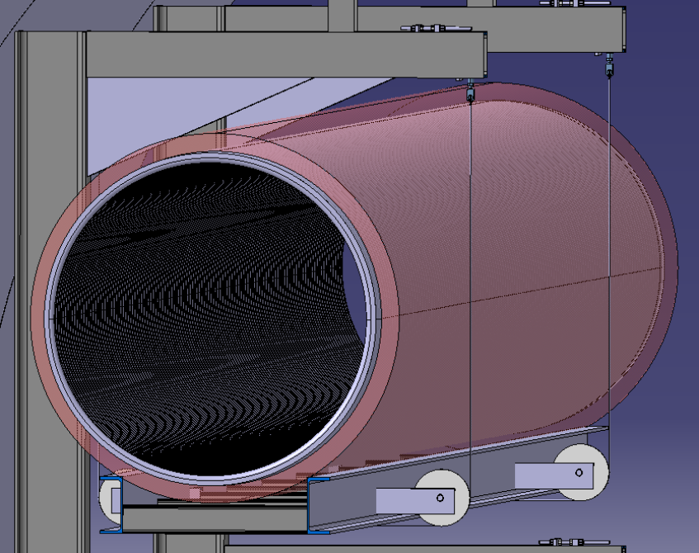
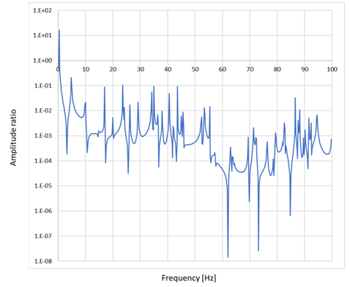
Design: supporting system and ground to baffle transfer function
An example from CERN support option:
Baffle position
Transfer function in vertical direction
Credits: CERN
Transfer function in horizontal direction

Slide 14
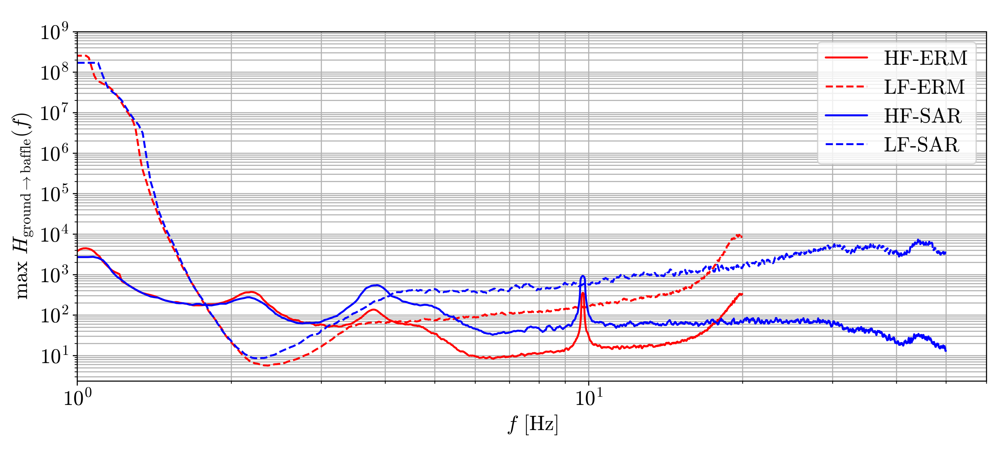
Design: supporting system and ground to baffle transfer function
An example from CERN support option:
Transfer function in vertical direction
Credits: IFAE
If not compliant with respect to critical frequencies:
Support design or position change
Dumping system design
Credit: CERN

Slide 15
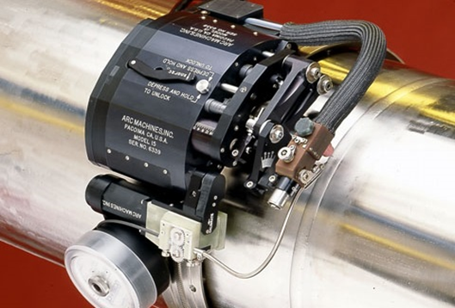
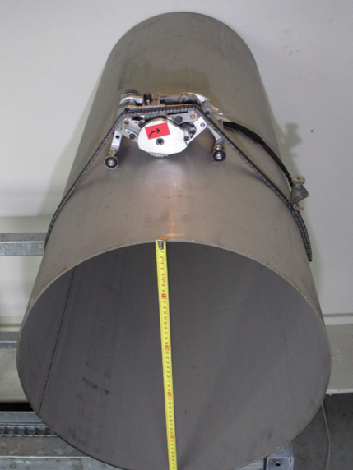
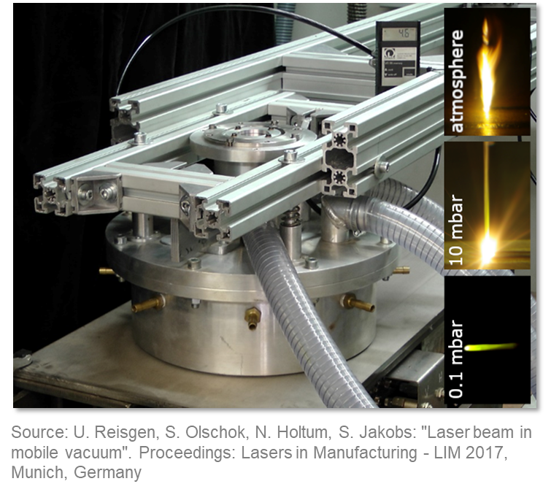
Manufacturing: welding techniques
New ways to tackle productivity rate and welding quality.
FEF GmbH, RWTH Aachen, Werkhuizen Hengelhoef and APERAM collaborated for the preliminary design of a forming-welding machine:
Laser beam welding under movable vacuum (30 mbar)
Possibility to weld realistically up to 500 m long sections
Possibility to integrate continuous QC monitoring (ultrasonic or X-ray imaging)
Credit: Arc Machines Inc.
Space between ET beampipes very limited.
New compact and customizable orbital welding tools integrating laser seam tracker and endoscopes.
In case of a repair during operation, use of light and compact orbital milling machine.
→ Minimum space required 40/50 cm between two stacked tubes (insulation included)

Slide 16
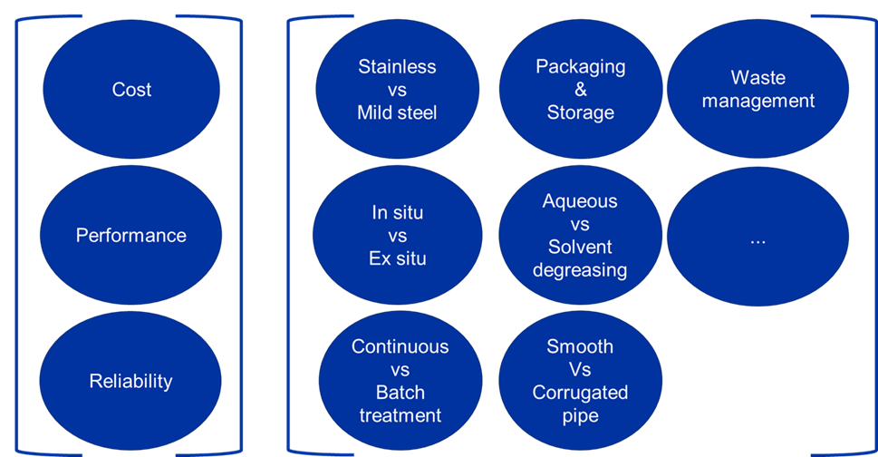
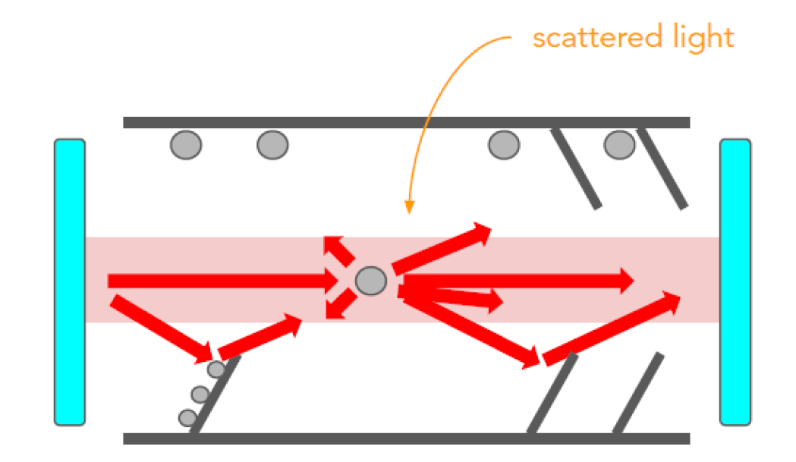
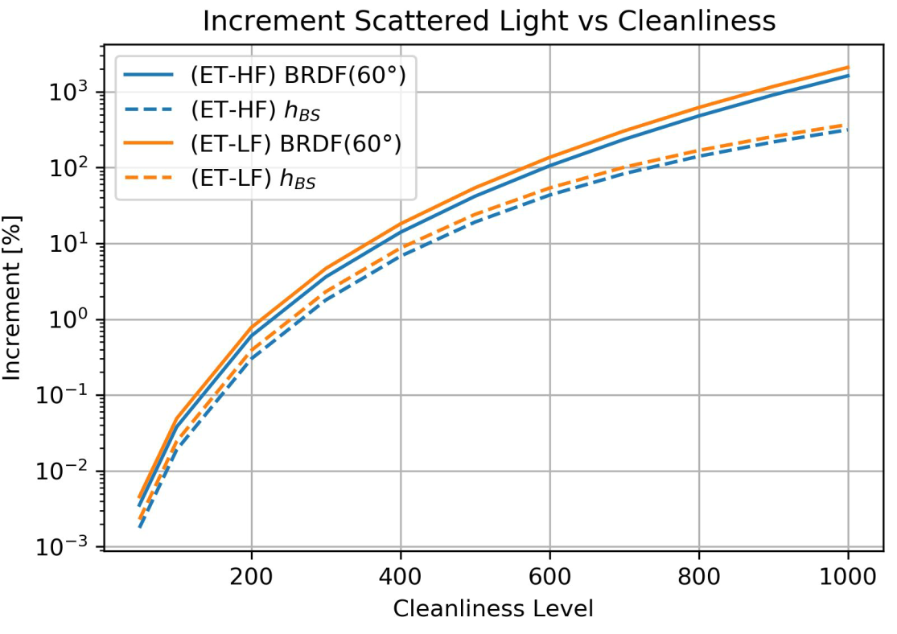
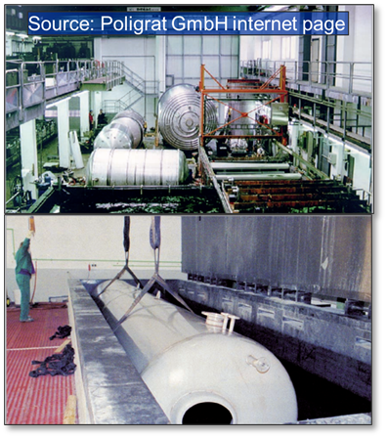
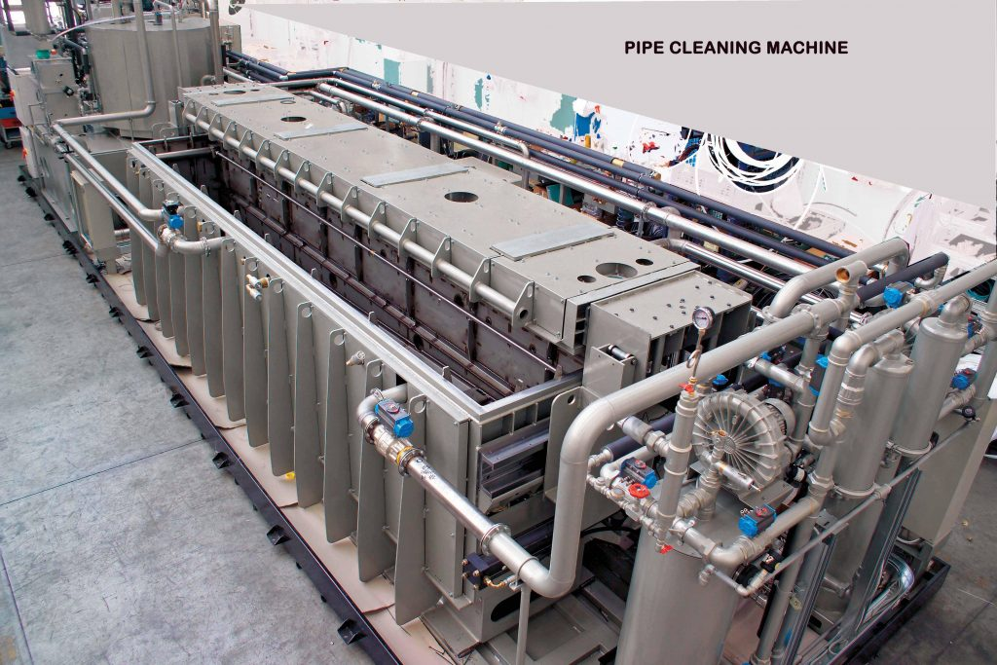
Post-treatments: cleaning and surface cleanliness
Assessment matrix for the design of an in-situ cleaning facility
Study of dust particle contribution to noise
Credit: CERN
Exploration of industrial cleaning facilities and procedures for
ET beampipes
Source: FIRBIMATIC SPA internet page
Credit: INFN Padova

Slide 17
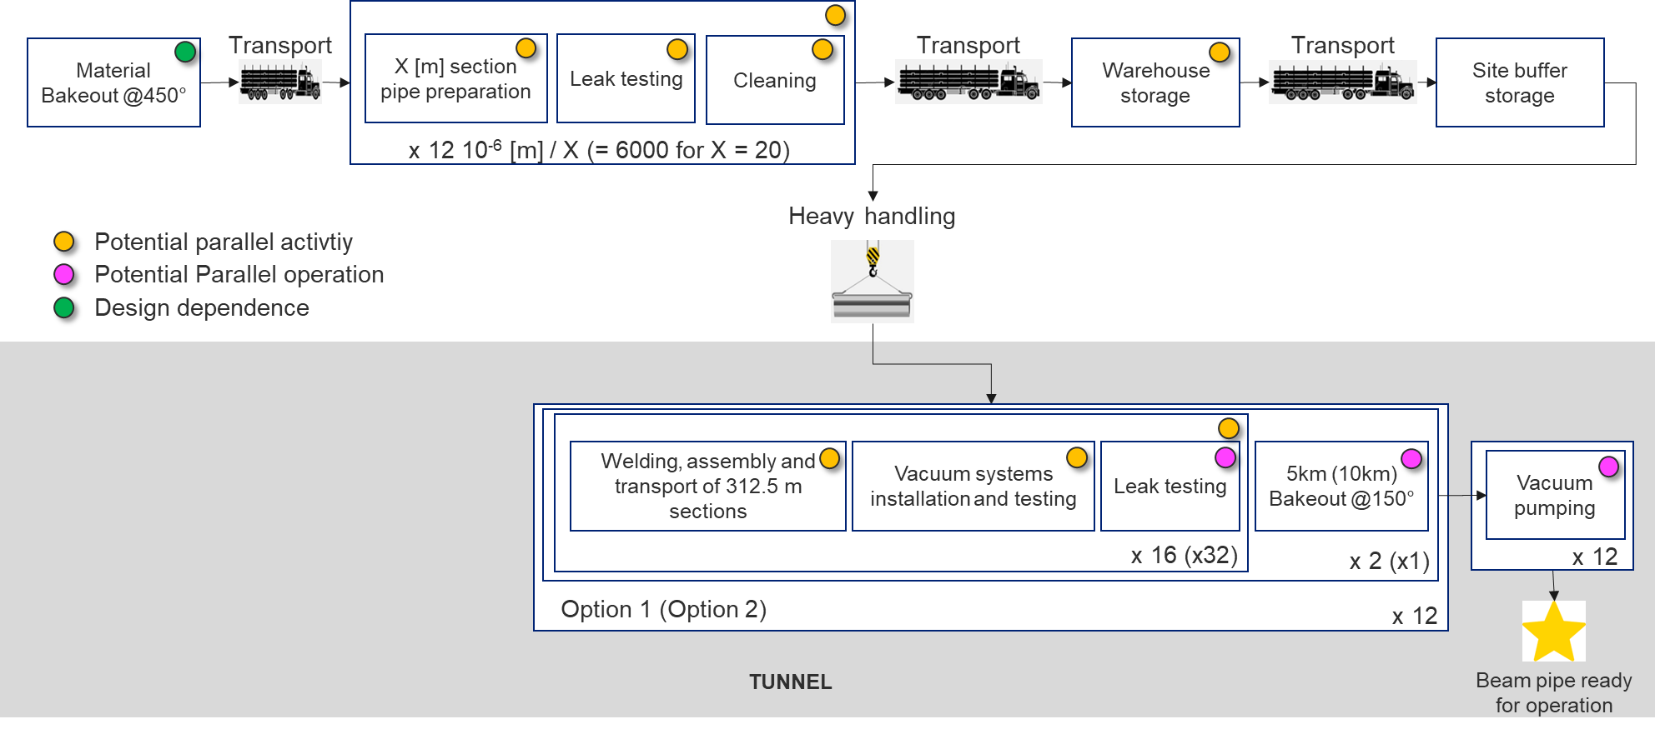
Logistic: tube manufacturing
Off-site, in-site or.. underground?
Off-site
Reduced cost for infrastructure
Need of storage in-site
proper sized transport plan
Credit: CERN

Slide 18
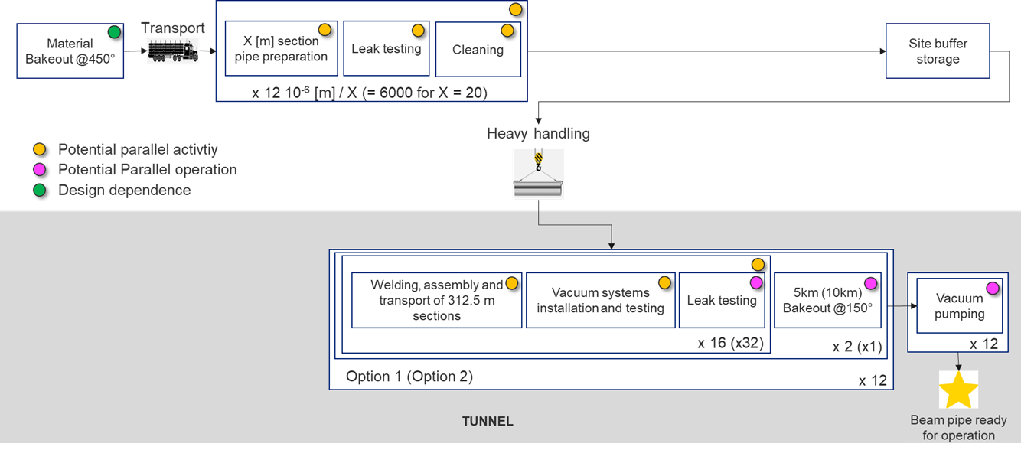
Logistic: tube manufacturing
Off-site, in-site or.. underground?
Off-site
Reduced cost for infrastructure
Need of storage in-site
proper sized transport plan
In-site
Flexible production
Reduced transportation
Limited or no storage
Require manpower and dedicated infrastructure
Credit: CERN

Slide 19
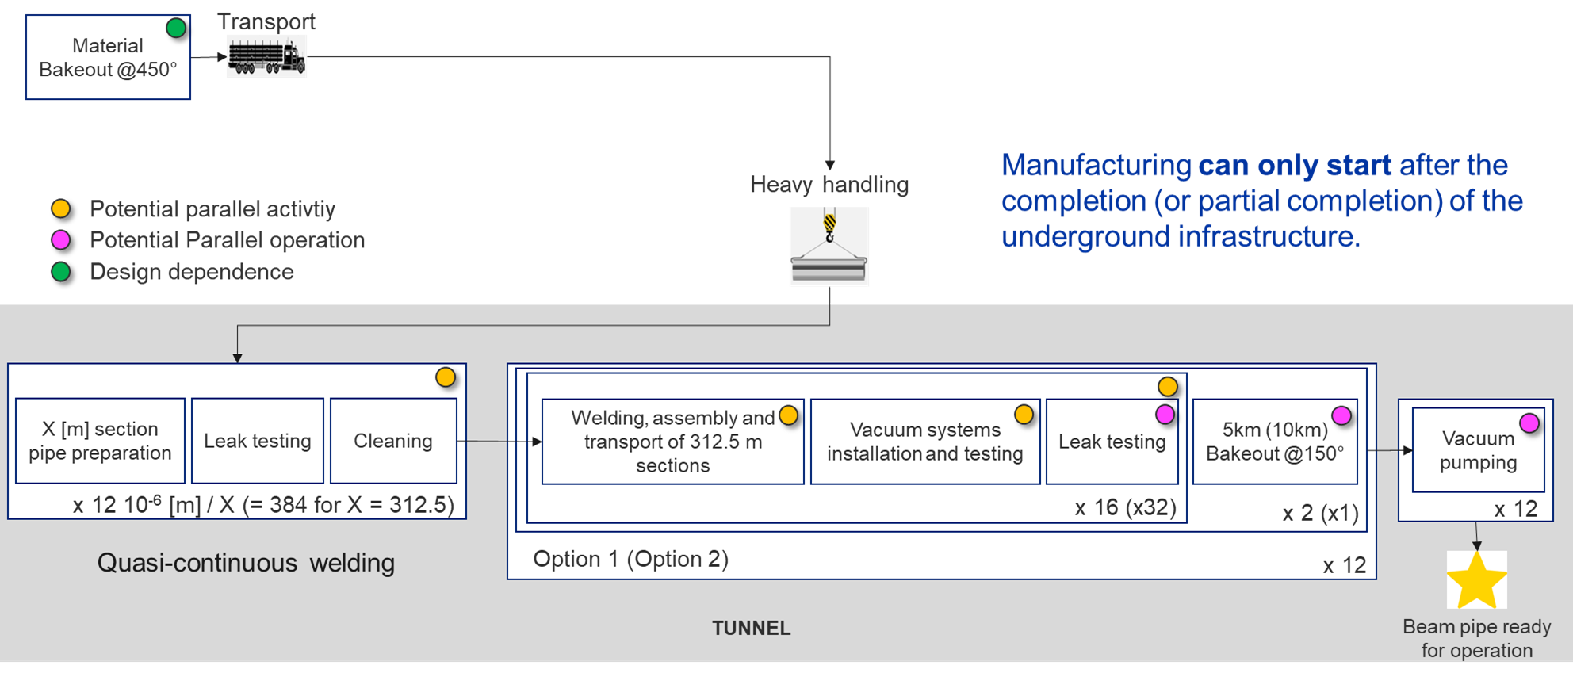
Logistic: tube manufacturing
Off-site, in-site or.. underground?
Off-site
Reduced cost for infrastructure
Need of storage in-site
proper sized transport plan
In-site
Flexible production
Reduced transportation
Limited or no storage
Require manpower and dedicated infrastructure
Underground
Flexible production
No ground surface transportation
No storage
Tunnel integration
Cleaning / optical baffle installation
Credit: CERN

Slide 20
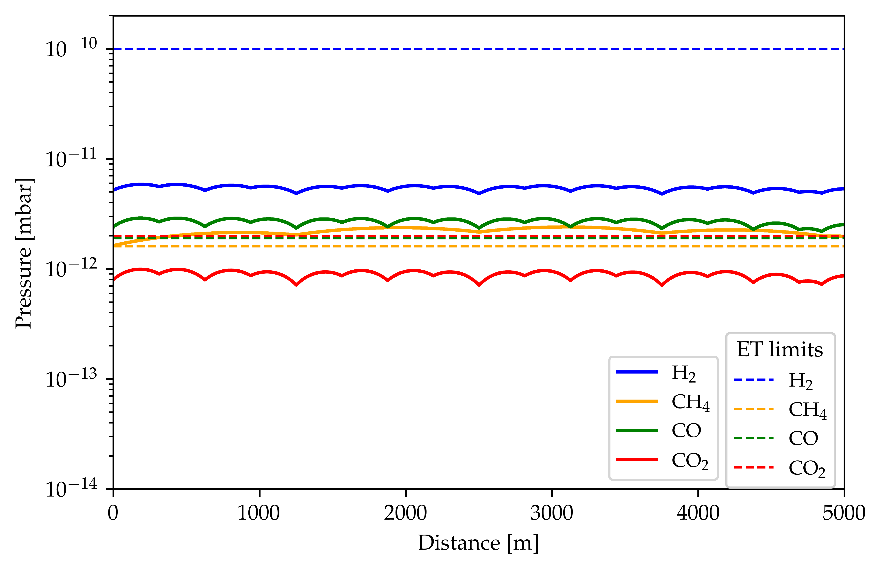
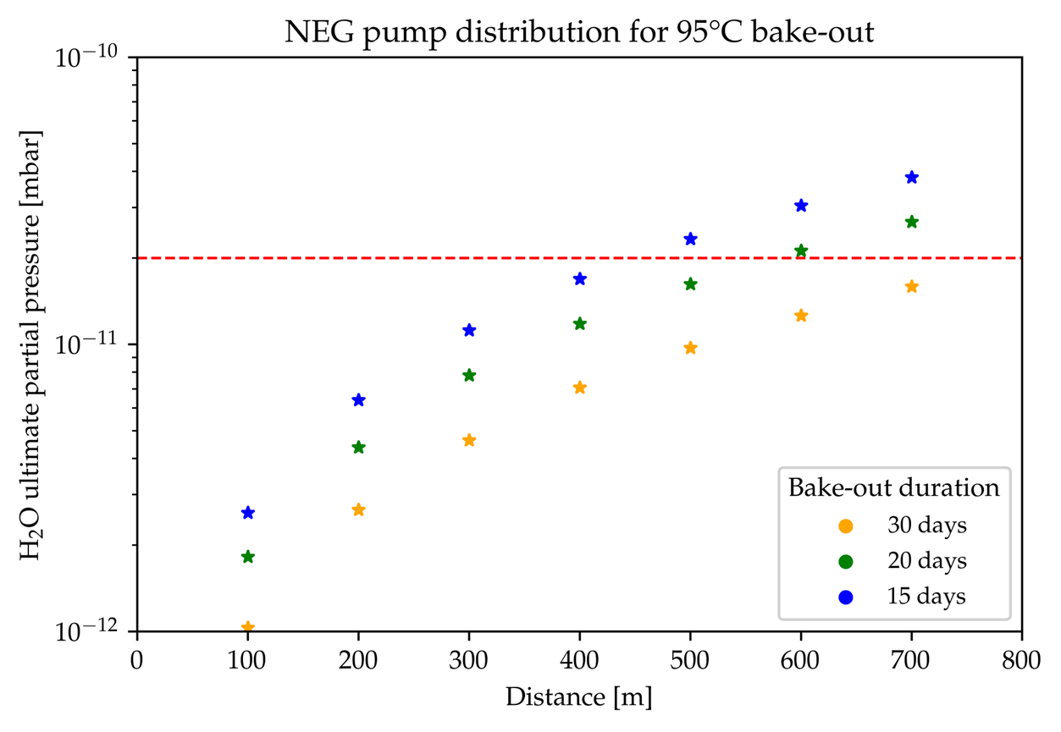
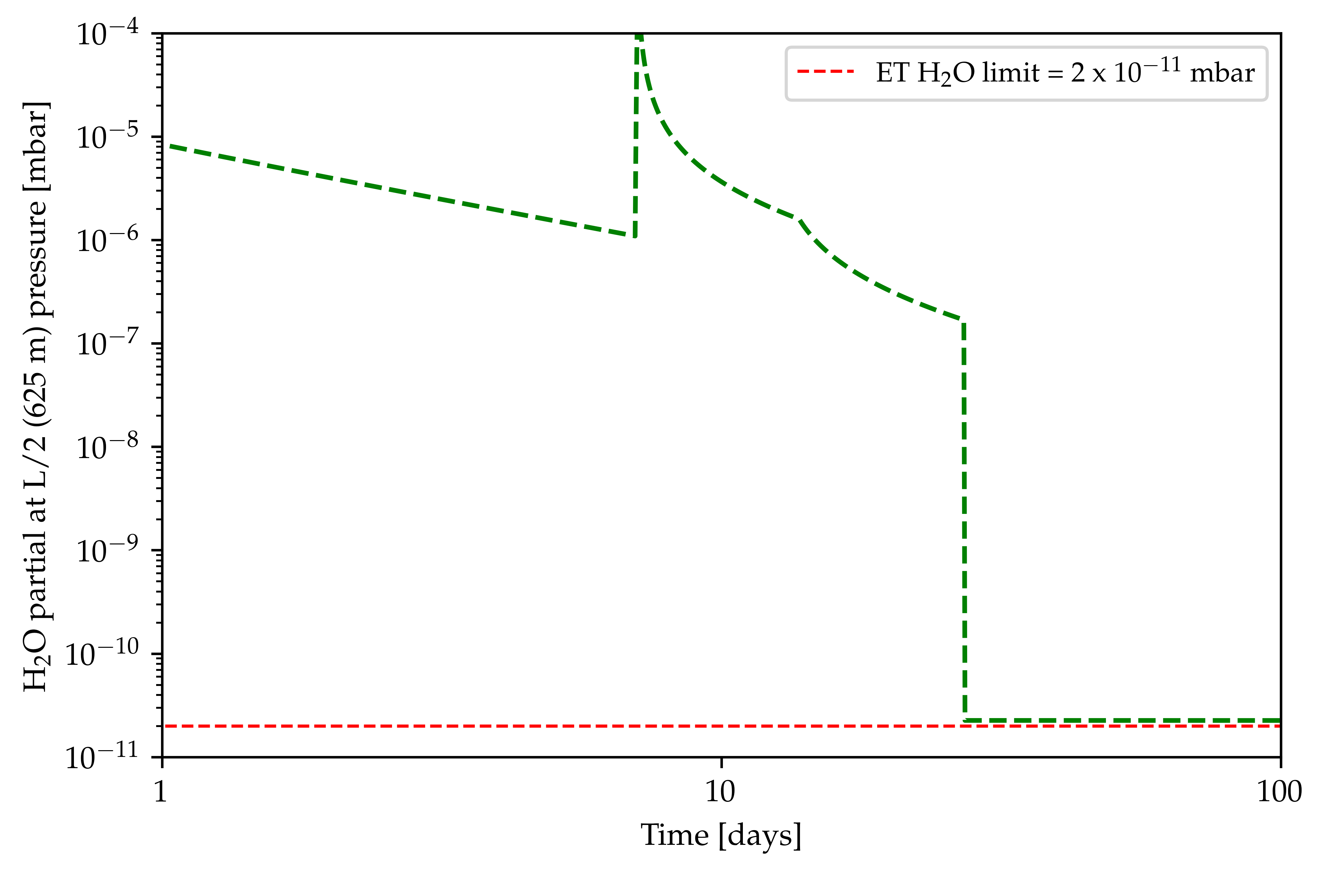
Vacuum: layout and parameters optimization
Parametric model has been created to optimize pumps layout and bake-out temperature/duration in function of:
Beampipe material.
Required final partial pressure.
Sectorization
…
Credit: CERN
Notes:
Soon it is going to be modify to take all inputs (including insulation material and thickness) as free parameters and extract the best optimization, looking forward for cost assessment integration.

Slide 21
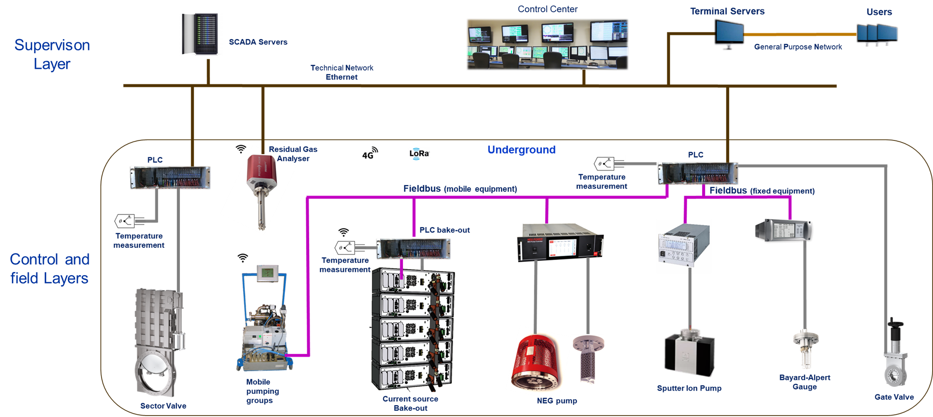
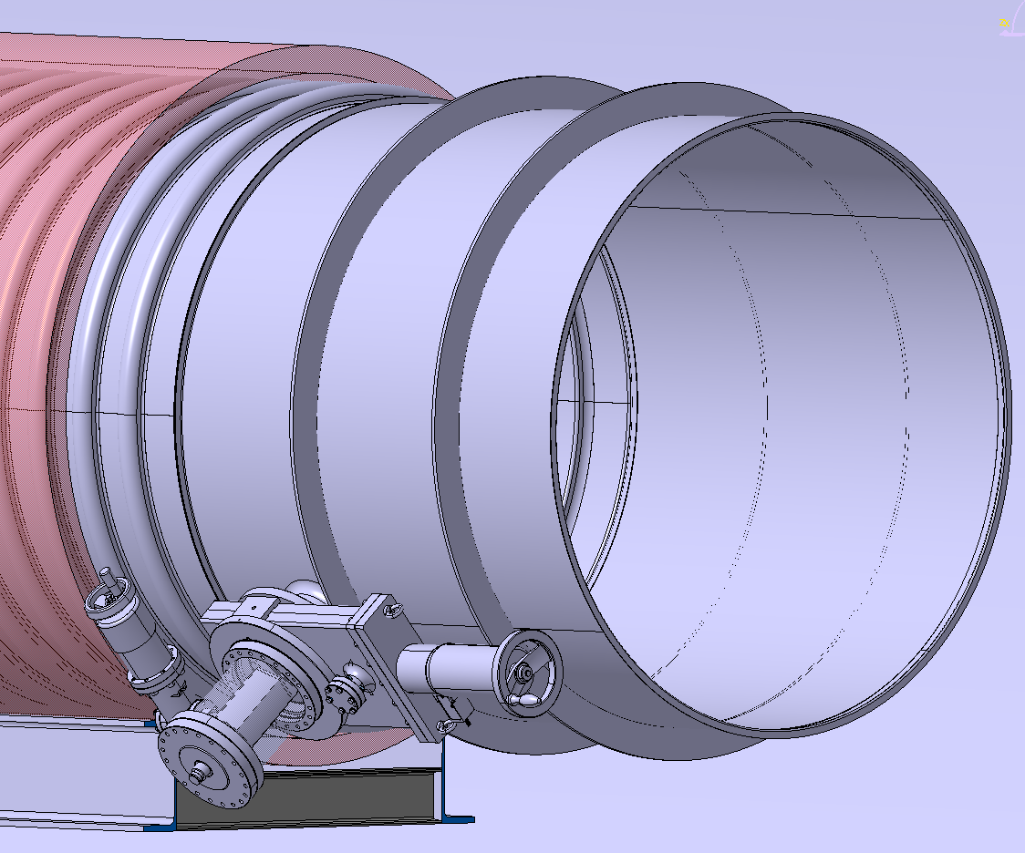
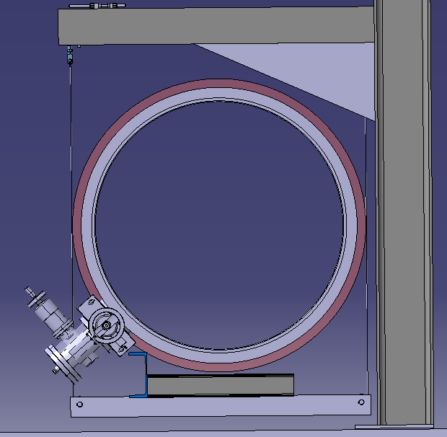
Vacuum: Interfaces (cryogenics, control and monitoring, installation)
Credit: CERN
Credit: CERN
ET-LF cryo-traps at the interface between beampipe and experimental areas are under development at KIT

Slide 22
Beampipes for GWT workshop: Topical discussions
Topical discussion 1: Materials
Chairs, S. Sgobba (CERN) & D. Henkel (Material Forensics LLC)
Summary
Material and grades selection, processing from ores to coils
Metallurgical characterization and cost analysis.
Topical discussion 2: Design & Manufacturing
Chairs, C. Garion (CERN) & G. Deleglise (CNRS)
Summary
Conceptual design and manufacturing from coils to installation in the tunnel.
Support systems, vibration modes and interfaces with other services.
Welding, cleaning, leak detection, quality assurance and in-situ installation.
Topical discussion 3: Vacuum
Chairs, G. Bregliozzi (CERN) & A. Pasqualetti (EGO)
Summary
Sectorization, pumps and gauges and integration with beampipe.
Installation, pump-down and bakeout to final commissioning.
Operational aspects, control and monitoring system.

Slide 23
Outlook: CERN pre-pilot sector prototypes
CHARACTERISTICS:
Ø 400 mm x 2100 mm
Thickness < 2 mm
Corrugated solution
Pumping speeds scaled to ET dimensions
OBJECTIVE:
Ultimate pressure and outgassing rates measurements after low temperature-long duration bake-out.
Materials
Austenitic
stainless
steel
Ferritic
stainless
steel
Structural
mild
steel
AISI
304L
(Vacuum fired)
AISI
444
S315MC

Slide 24
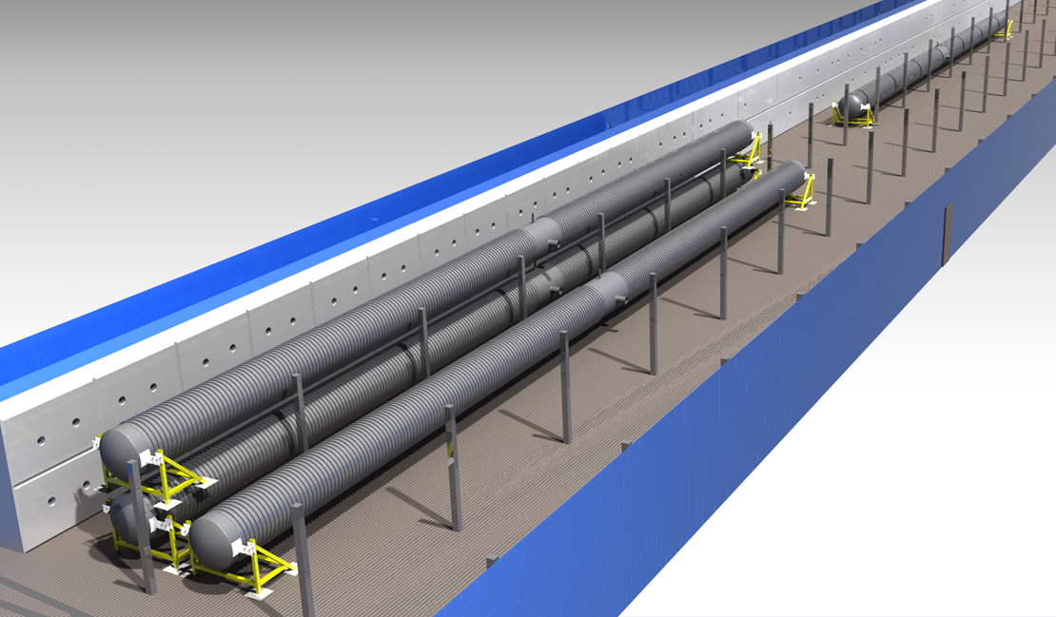
Outlook: CERN pilot sectors
Up to 4 tubes Ø 1 m x 50 m
Corrugated or VIRGO-like solution (stacked or adjacent)
Possibility to test different materials
Pumping speeds scaled to ET dimensions
The installation will serve to test:
Installation and alignment of supports and tubes.
Welding and assembly tools and methods.
Leak detection scenarios
Ultimate pressure and outgassing measurement after bake-out.
We are open for other experimental measurements:
Dust concentration and displacement inside the tube.
Installation and alignment of baffles inside the tube.
Vibration transfer function studies.
Preliminary schedule
Main deliverable: provide design report by end 2025

Slide 25
Thanks for you attention!
Questions?
To stay updated on CERN activities:
ET vacuum group at CERN

Slide 26
References
[1] Cosmic Explorer collaboration, Cosmic Explorer Technical Report CE–P2100003–v7, Oct. 2021
[2] ET collaboration, Einstein Telescope preliminary cost book, 2020

