Slide 1
NGSA
New Generation Super-Attenuator
status report
A. Bertocco, M. Bruno, R. De Rosa, L. Di Fiore, D. D’Urso,
F. Frasconi, A. Gennai, L. Lucchesi, F. Pilo, D. Rozza,
P. Ruggi, V. Sipala, I. Tosta e Melo, L. Trozzo

Slide 2
NGSA
The NGSA project, started at the beginning of 2022, is a competitive proposal, approved and funded by INFN commission 5.
The project is expected to last 3 years
The research group includes 3 INFN research units: (INFN-Pisa, INFN-Napoli, INFN-LNS/UniSS) and a participation by EGO.
It is strictly connected to Einstein Telescope (ET): it is devoted to the study of a seismic isolation system for 3rd generation GW antennas.
Talk summary
Introduction
Goal and organization of NGSA
Present status of the project
Next steps and perspectives

Slide 3
Introduction
Object of NGSA project is the development of a new vibration isolation system (Superattenuator) for the mirrors of the ET (LF) gravitational Wave antenna.
Presently, are in preparation the 3rd generation GW antennas:
  Einstein Telescope (ET) in Europe
  Cosmic Explorer (CE) in the USA
The goal is to improve the sensitivity by more than one order of magnitude extending the detection band to the low frequency, down to 2-3 Hz, with respect to the 2nd generation detectors
Seismic vibration is one of the most relevant noise limiting the low frequency ET sensitivity ➔ to reduce this noise, underground operation and an improved seismic isolation system will be required.

Slide 4
Introduction
Reaching the ET design sensitivity is an ambitious task requiring enormous technological development on all the aspect of the detector
We will focus on seismic isolation, starting from the Virgo heritage
The Virgo Super-Attenuator is the best seismic isolator in the world. It is the result of years of R&D in INFN and was crucial to allow the extension of the antenna detection band down to 10 Hz.
The SA is made by a pre-isolator (inverted-pendulum), a passive filter chain and a Payload (mirror and control elements). The total length is about 9 m.
The ET-LF design sensitivity requires an improvement by a factor 10⁵ around 2-3 Hz with respect to the present Virgo sensitivity
INFN holds a consolidated leadership on this subject
Keeping and improving this expertise will be essential for the development of ET.

Slide 5
From Virgo to ET
In the current ET design a SA with a total length of 17 m is assumed.
This implies very large caverns ( ̴ 30 m in height), with big cost and complexity.
Improving the length doesn’t improve vertical isolation
Further difficulties come form the need to hang a cryogenic payload with a total mass of about 600 kg.
In order to fulfill the ET requirements, while keeping the total SA length around 10÷12 m, a dedicated R&D program is needed
Reducing the height of the SA tower will have a huge impact on excavation cost and SA reliability.
This is the main goal of the NGSA project

Slide 6
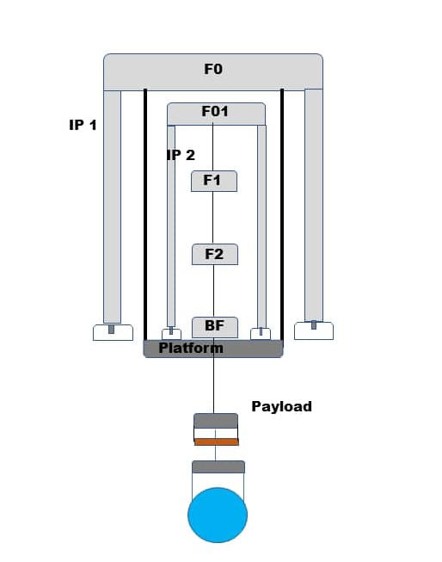
How can we improve seismic isolation keeping a shorter SA
Improving pre-isolation
Active per-isolation
Two-fold inverted pendulum (NGSA)
2) Improving passive filter chain
Optimization of filter chain masses and length distribution (NGSA)
Improved Magnetic Anti-Spring for vertical isolation (NGSA)
New filter concepts (see talk by
F. Fidecaro in this session)
To keep in mind:
Tilt and vertical to longitudinal Cross talk
Noise of control systems

Slide 7
From AdV SA to ET-NIP SA
Complex, heavy cryogenic payload ( ̴ 600 kg) will be surrounded by a big cryostat
The legs of the inverted pendulums must start above the cryostat
Shorter IPs legs ( ̴̴ 4 m)
Larger SA total mass
Cryostat

Slide 8

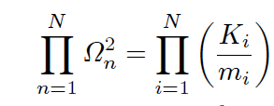


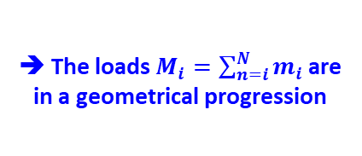
Optimization of filter chain
The starting point is a quite old paper based on an analytical approach with a simplified model (point-like masses):
“Optimization of multipendular seismic suspensions for interferometric gravitational-wave detectors”,
A. Bove, L. Di Fiore, E. Calloni and A. Grado, Europhys. Lett., 40 (6), pp. 601-606 (1997)
K_{i} = stiffness between i-th and (i-1)-th stage
m_{i} = mass of i-th stage
For horizontal motion:
A N stages system presents N resonance frequencies
It can be shown that:
For horizontal motion:
Optimizing the TF is equivalent to minimize the product of the resonant frequencies, whit some parameters fixed:
Pendulum total length , mirror mass m_{N} = m and total mass
It can be shown that:
$$l_{i}=\frac{L}{N}$$
The minimum of a(l_{i}) is for:
➔ All the wires have the same length
➔ The loads $M_{i}=\sum_{n=i}^{N}{m_{i}}$are in a geometrical progression
The minimum of b(l_{i}) is for:
with

Slide 9
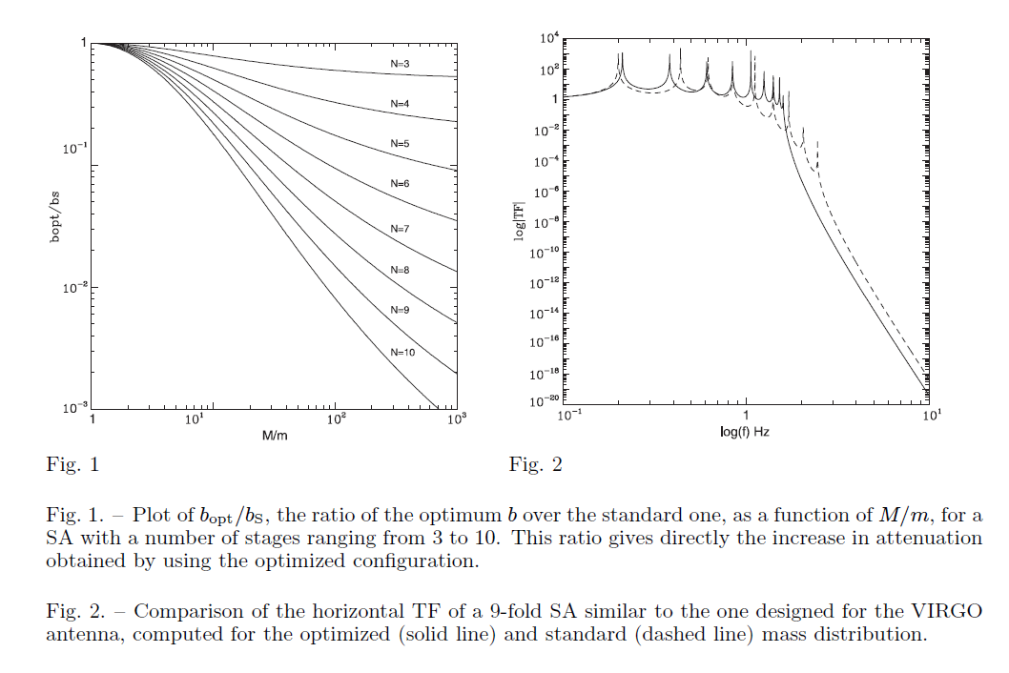
The analytic optimal mass distribution gives a starting point for the design
A complete 6 DOF model (Octopus) is then used for a complete design considering solid bodies and cross-talks

Slide 10
NGSA (New Generation Super-Attenuator)
The project is organized in two parallel research lines:
Traditional solution: optimized SA, starting form the AdV SA architecture:
optimization of the mass distribution along the isolation chain
improvement of the performance of the Magnetic Anti-Springs (MAS) of the single filters
the goal is to keep the total SA length around 12 m
if necessary, an active pre-isolator platforms, at the base of the IP, will be considered
Innovative solution: two-stage Nested Inverted Pendulum (NIP)
Better horizontal attenuation of the pre-isolator but never experimentally demonstrated.
Open questions to be addressed: reliability, stability, control systems, cross talks and vertical and angular noise suppression.
A dedicate prototype (in 1:2 scale) will be realized to experimentally validate this configuration
Goal is to keep the total SA length around 10 m
Final goal, after comparison of the two alternatives, will be the definition of a Conceptual Design of the SA for the ET Antenna.

Slide 11
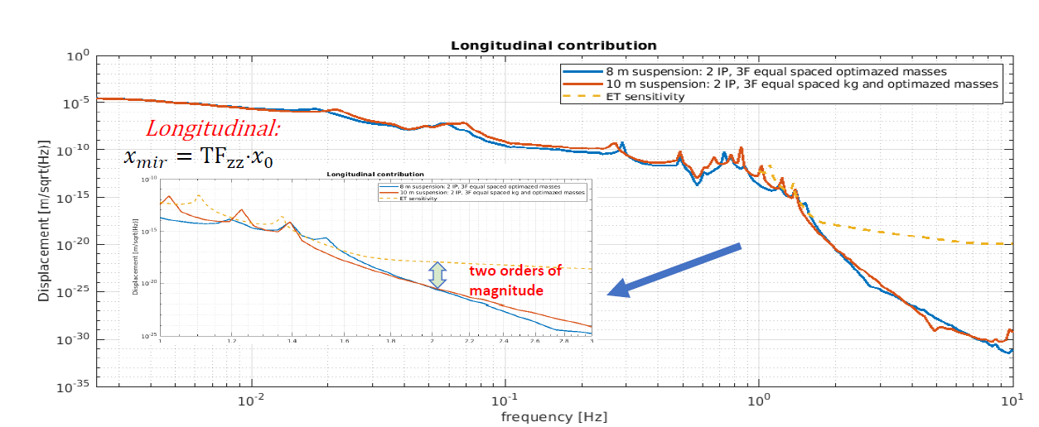
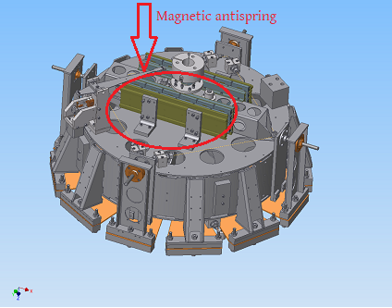
NGSA project Organizzation : WP
The project is organized in 4 WP:
WP1 – Simulation and optimization of the Superattenuator
Coordinator: L. Trozzo (INFN-NA)
WP2 – Mechanical filter with improved Magnetic Anti-Spring (MAS)
Coordinator: F. Frasconi (INFN-PI)
WP3 – Development and test of a Nested Inverted Pendulum (NIP)
Coordinator: R. De Rosa (INFN-NA)
WP4 – Sensing and Control (S&C)
Coordinator: A. Gennai (INFN PI)

Slide 12
WP1 – Simulation and optimization of the Superattenuator
We performed preliminary simulation of three different configurations
CASE A:
I.Total length:8 m
II.Total mass: 2650 Kg
CASE B:
I.Total length:10 m
II.Total mass: 2650 Kg
CASE C:
I.Total length:10 m
II.Total mass: 3250 Kg
In all cases:
Payload mass is 600 kg
Filter MASs are based on the AdV technology (ferrite magnets)
The mass distribution is optimized
A → B Length: 8 → 10 m
B → C Mass : 2650 → 3250 kg

Slide 13
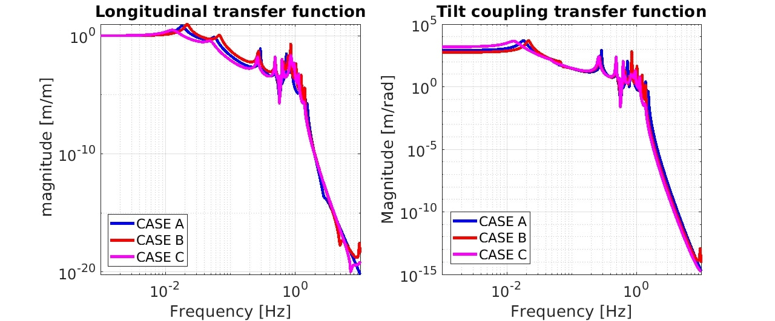
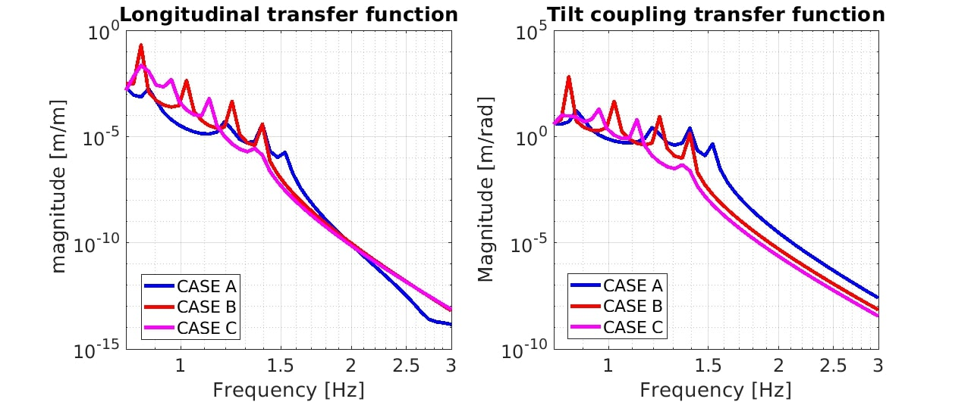
Evaluation of Longitudinal and Tilt coupling transfer functions
@2𝐻𝑧∶6 10⁻¹¹

Slide 14
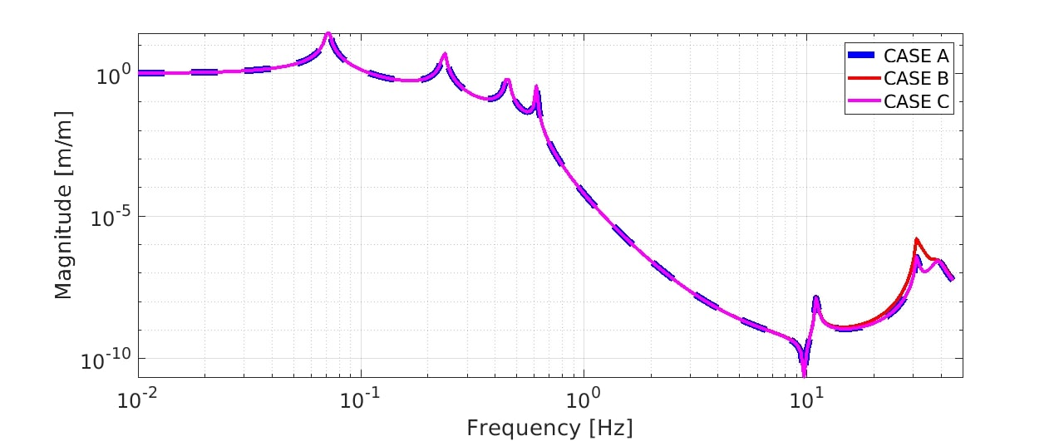
Evaluation of vertical transfer functions
As expected, the vertical TF only depends on the filtering by the Magnetic Anti-Springs (MAG) that are the same for the three cases (based on present AdV technology)

Slide 15
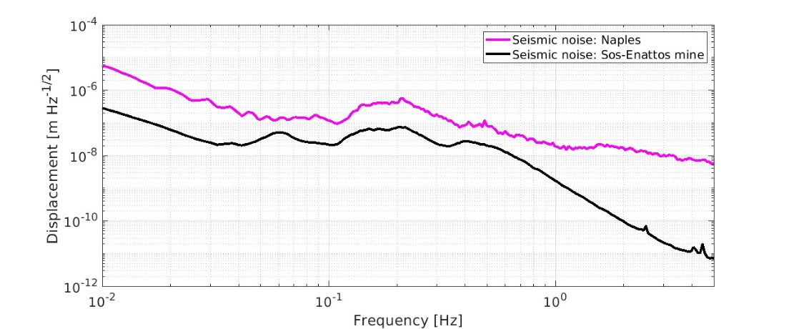
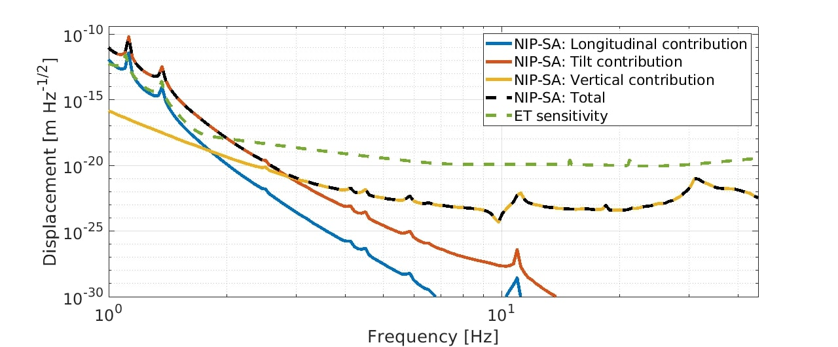

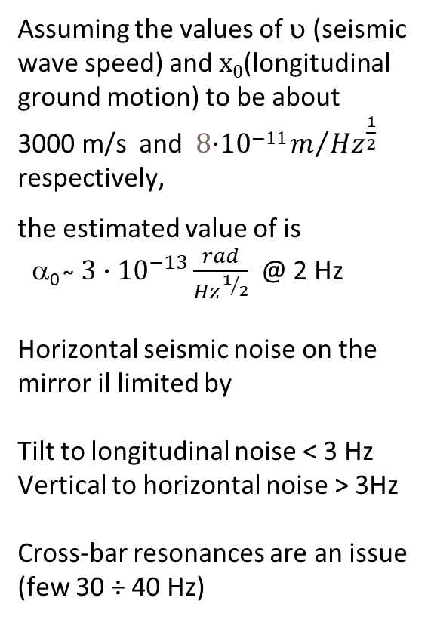
$$α_{0}=\frac{ω}{v}x_{0}$$
Tilt lower limit
Assuming the values of υ (seismic wave speed) and x₀(longitudinal ground motion) to be about
3000 m/s and 8·10⁻¹¹ $m/{{Hz}^{\frac{1}{2}}}$ respectively,
the estimated value of is
α₀ ̴ $3∙{10}^{−13}\frac{rad}{{Hz}^{1/2}}$ @ 2 Hz
Horizontal seismic noise on the mirror il limited by
Tilt to longitudinal noise < 3 Hz
Vertical to horizontal noise > 3Hz
Cross-bar resonances are an issue (few 30 ÷ 40 Hz)
Case B

Slide 16
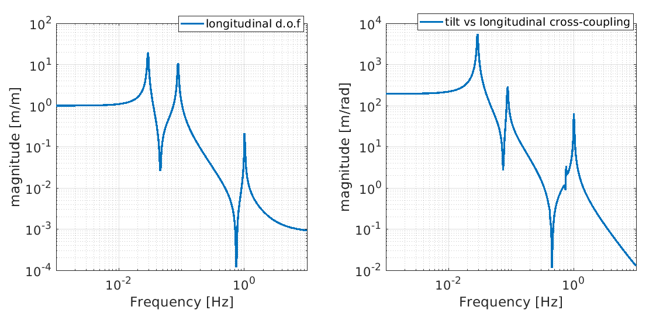
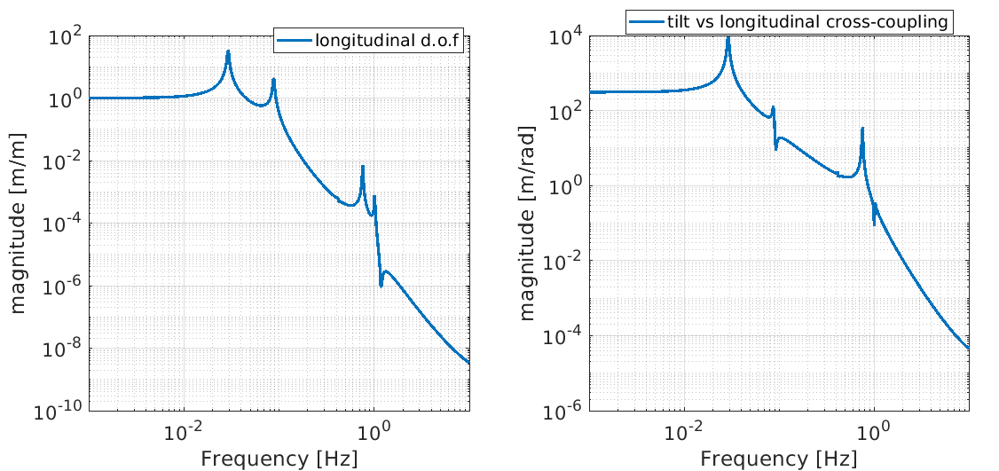
WP1 – Simulation and design of the NIP prototype
TF examples
Masses, flex-joints, legs, etc. have been defined
Al the TFs have been computed with Octopus
This was the starting point for the mechanical design of the prototype
Simulation tools are crucial to evaluate the effect of mechanical design choices on system performance
Ground to F0 TFs
IP
Ground to Ma TF
F0
MA
GR

Slide 17
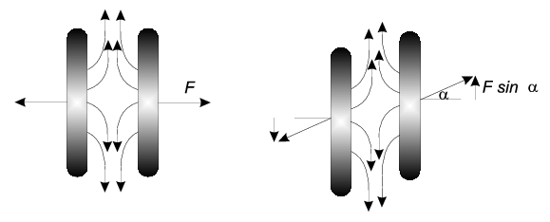
WP2 – Mechanical filter with improved Magnetic Anti-Spring (MAS)
The goal is to improve the present MAS design
The ides is to replace ferrite magnets (0.35 T) with rare earth (SmCo or NeFeB) magnets (0.8 T)
The advantage is the larger Magnetic flux density providing:
Large anti-stiffness with a reduced volume
Lower filter resonance
New cross-bar design to move its resonances at higher frequency

Slide 18
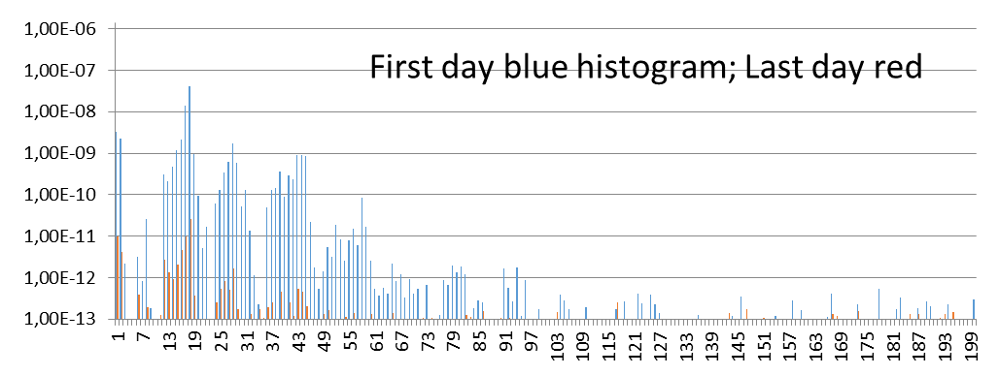
WP2 – Selection and test of rare-earth magnets
Three sets (100 magnets each set) of permanent magnets (Rare Earth) have been tested for UHV compatibility with very good results:
- NdFeB encapsulated with Nickel coating
- SmCo without any coating
- SmCo encapsulated with Nickel coating (BEST RESULTS)
All magnets have a cylindrical shape (10.5 mm in diameter and 5 mm thick; B ≈ 0.8 T along the cylindrical axis of the magnet)
Residual Gas Analysis: time evolution of
Precise analysis of data (collected during the tests) in progress.
Additional test for a better comparison is starting
Partial Pressure [mbar] vs Atomic Mass Number

Slide 19
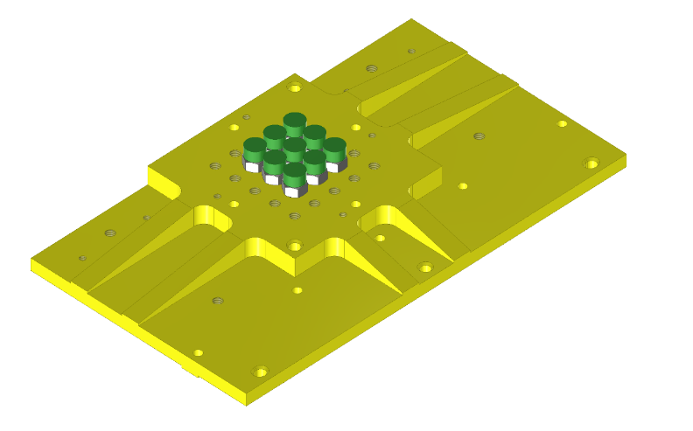
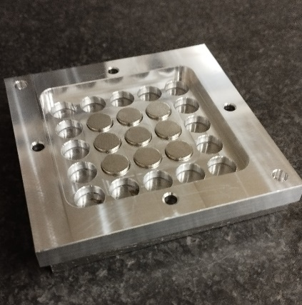
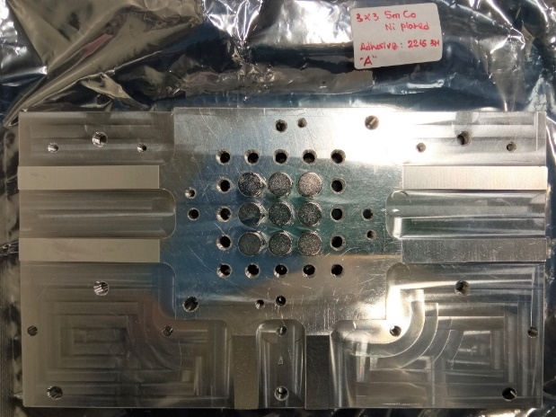
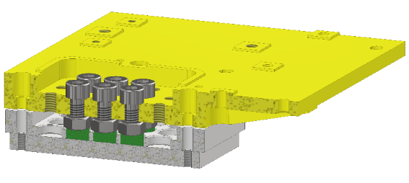
WP2 - New Magnetic Anti-Spring (MAS) Prototype
Mechanical support for the testing machine (@INFN Pisa Laboratory) ready for the first prototype of the MAS
Gluing of the first SmCo magnets (encapsulated) on the aluminum support has been done. Two different glues used: (A) 3M 2216 grey ; (B) HYSOL 9394 AERO – Outgassing test ongoing
Preparation of the magnet testing machine: to be used for the optimization geometry of MAS
MAS Prototype
Preliminary set-up of encapsulated SmCo magnets on aluminum support for the magnet test machine at INFN Pisa Laboratory
Outgassing test of the complete set-up validating the assembling process and materials (magnets, Al support and glue – sample A) is in progress

Slide 20
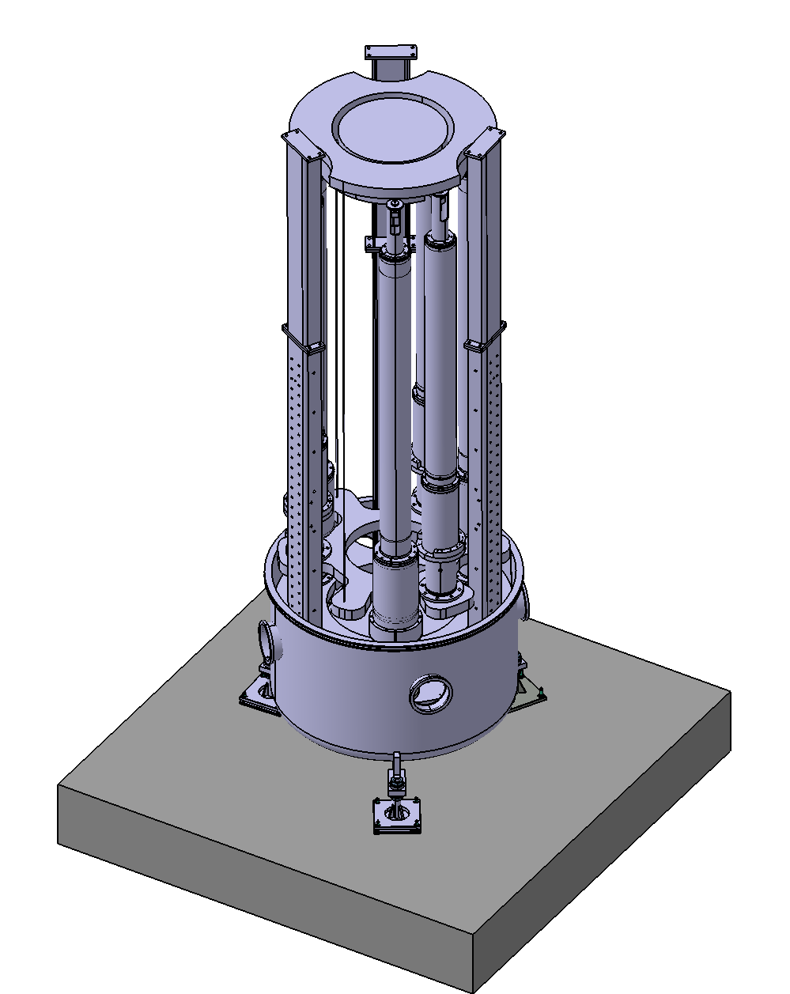
WP3 – Development and test of a Nested Inverted Pendulum (NIP)
The goal is to built and test a NIP prototype in 1:2 scale, to be tested in the Gravitational Physics Laboratory at INFN-Napoli
Total mass 1200 kg
Legs of about 1.7 and 1.4 m (excluding flex joints)
Dummy mass = 600 kg
The design is based on preliminary studies with Octopus
The mechanical design is quite advanced
(it is supported by Octopus and FEM simulations

Slide 21
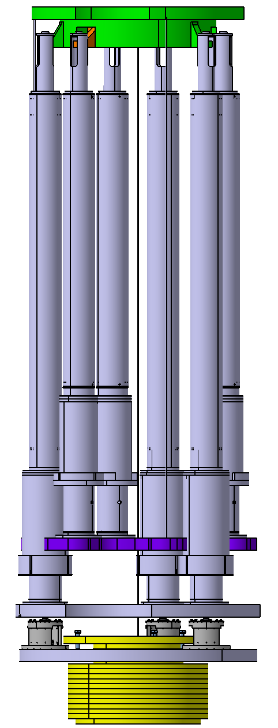
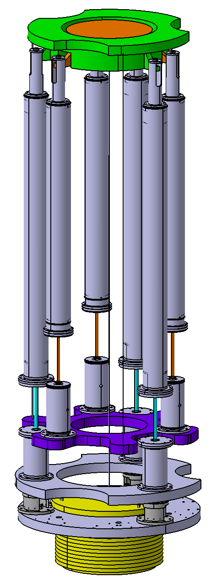
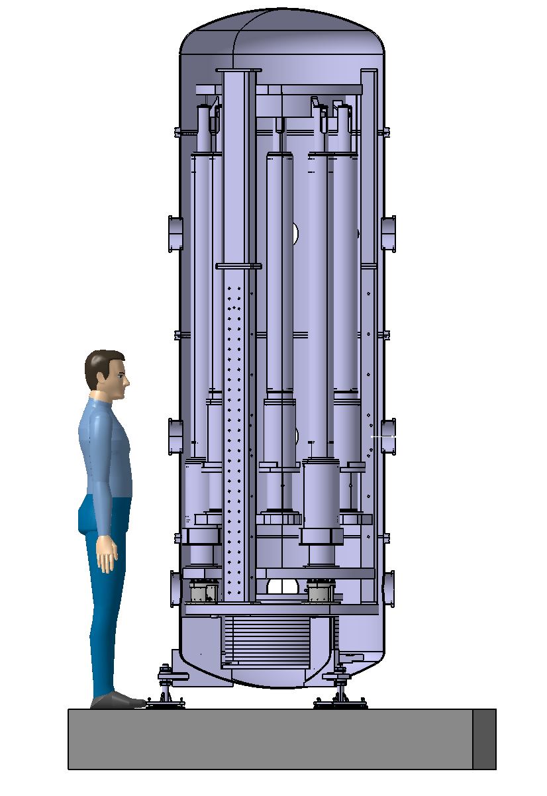
IP 1
IP 2
IP legs
Flex joints
Platfporm
MA

Slide 22
The design is quite advanced:
Vacuum chamber base and feet (order placed for construction)
Base ring
Flex joints and legs
IP top stage (in progress)
Platform (in progress)
FO (in progress)
Dummy test mass
To do:
Sensors supports and interfaces
Wire supports and junctions
Safety structure
We plan to complete the design in the next to months and start construction mechanical components
Installation should start at the beginning of 2024, as soon as the new ET Napoli lab (ETIC infrastructure) will be ready

Slide 23
WP4 – Sensing and Control (S&C)
WE have a first list of type and of sensors, actuators, motors, ADC and DAC channels.
DAC_A 24 bit, 2 channels per card - DAC_B 16 bit, 6 channels per card
National instrument input/output hardware based on LabView software has been identified for the data acquisition and control and ordered:
  Crate, CPU and most relevant components/boards arrived @ INFN Pisa
  DAC board is still missing. Delivery announced for the end of June 2023
  Preliminary configuration and arrangement in progress
  Development and training of LabView in progress waiting for the DAC board
  Preparation of some “acceptance” tests for the HW configuration selected

Slide 24
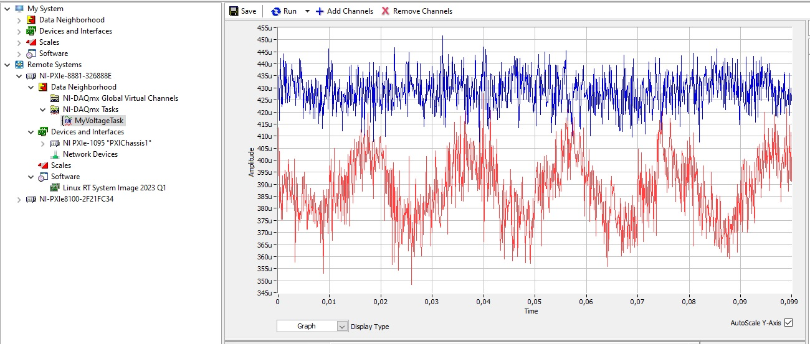
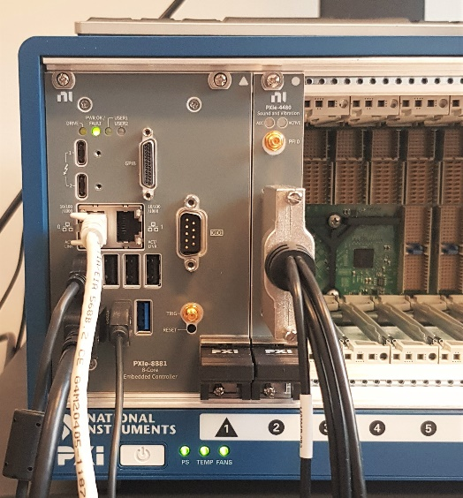
WP4 – Sensing and Control (S&C)
ELECTRONIC SETTINGUP
Waiting for digital-to-analog converter module, we checked that we are able to correctly read analog input channels and that we are able to run simple applications on core controller running LabView Real-Time.
- Controller NI PXIe-880 Xeon 8-Core – LabVIEW RT
- Module AI 6 channels 24-bit PXIe-4480 1.25 MS/s
- Module AO (Analog Output), 2 channels 24-bit, PXIe 4463 (to be delivered: June 30th, 2023). Order placed in February 2022. Most of material shipped within the end of 2022 but this module is still missing. Risk for future orders.

Slide 25
Conclusions
The NGSA is devoted to the development of a new generation seismic isolation system with the goal to reduce the full height od the SA with respect to the present reference solution
The project is organized in two research line:
  Optimized SA with the AdV architecture and improved MAS
  New architecture SA with a two stage NIP (+ optimized chain and improved MAS)
A NIP prototype (in 1:2 scale) is under development and will be tested for checking reliability and performance
The final outcome will be a conceptual design of the Seismic isolation system for the Einstein Telescope (ET)
Results are expected by the end of 2024

Slide 26

Thank you for your attention

