Slide 1
OmniSens in Ventilated Caverns: Moving from the 2020 design to isolation system requirements
Conor Mow-Lowry
Alessandro Bertolini, Pooya Saffarieh, Nathan Holland, Michele Valentini, Jesse van Dongen, Alexandra Mitchell and others

Slide 2
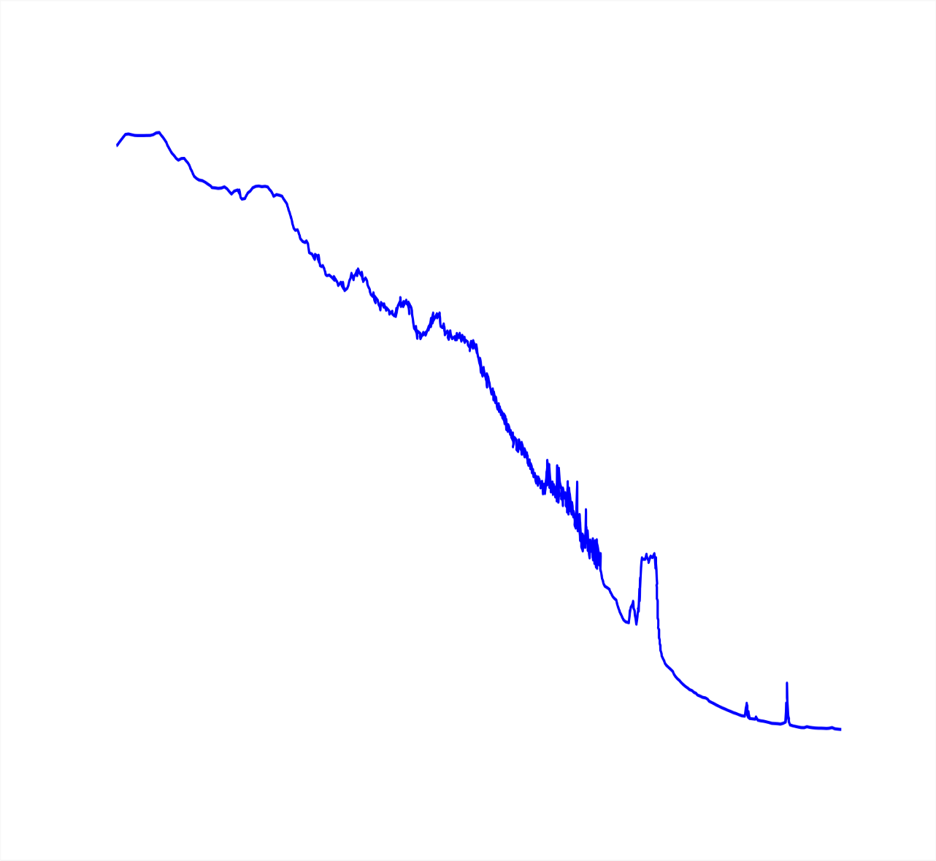
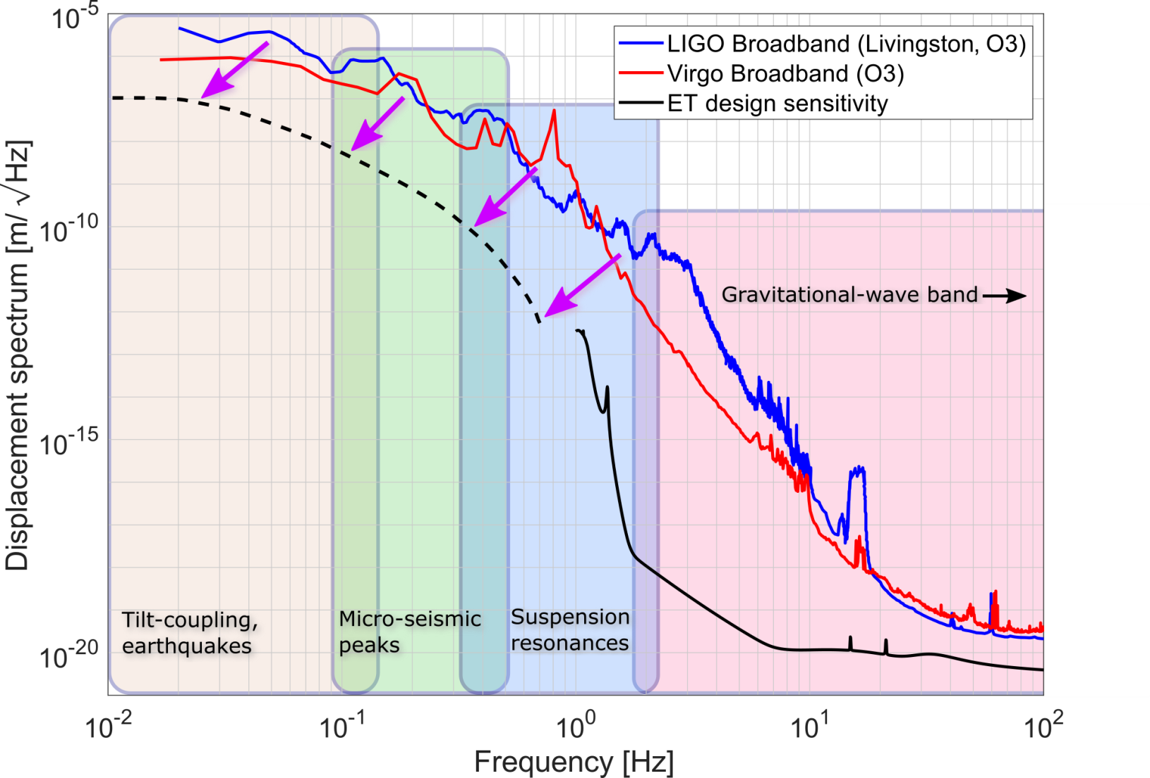

Slide 3
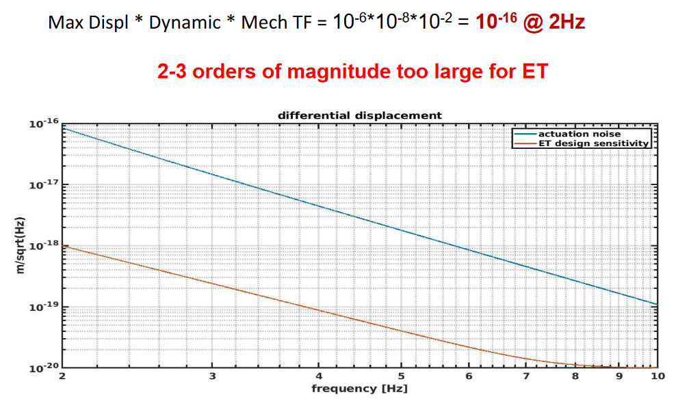
First target: actuation noise
There is a simple recipe for actuation noise. Using Virgo numbers:
This is the focus for OmniSens
Ruggi, ET-ISB workshop
actuation noise does not seem less ‘fundamental’ then thermal noise

Slide 4
ET isolation in the 2020 design update
Seismic platform not specified
Only length-to-length transmissibility included
No spectral analysis or local control noise
No clear flow of requirements apart from 3Hz displacement
2020 ET-suspension transmissibilities can be found at:
https://gitlab.et-gw.eu/et/isb/active-noise-mitigation/suspensionmodels/-/tree/master/etSuspensionChain/designDocCurves

Slide 5
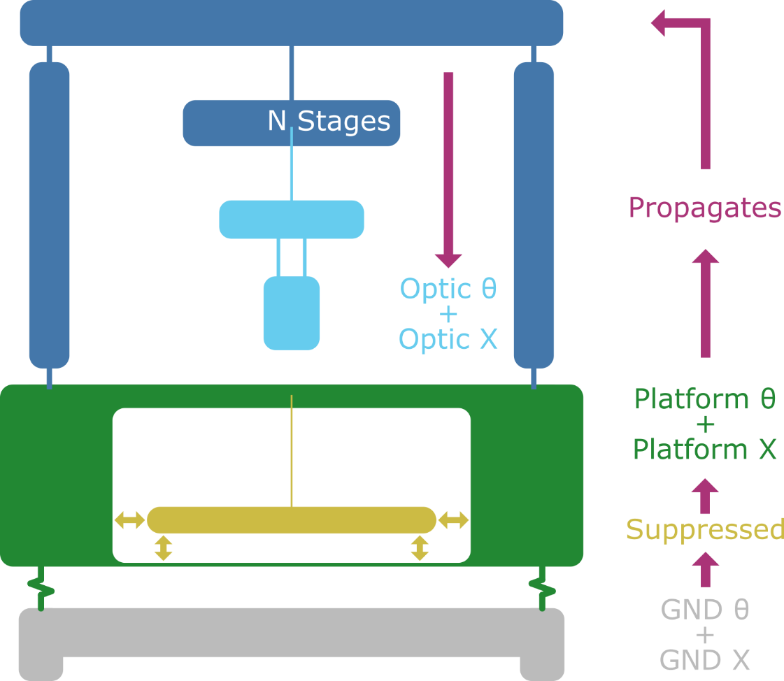
Requires a MIMO, controlled model

Slide 6
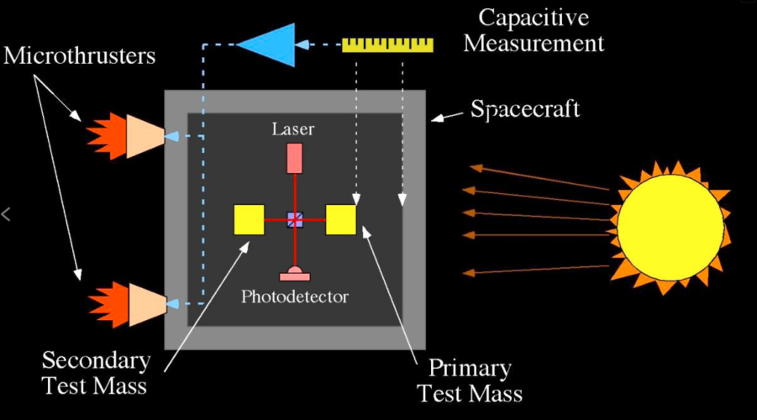
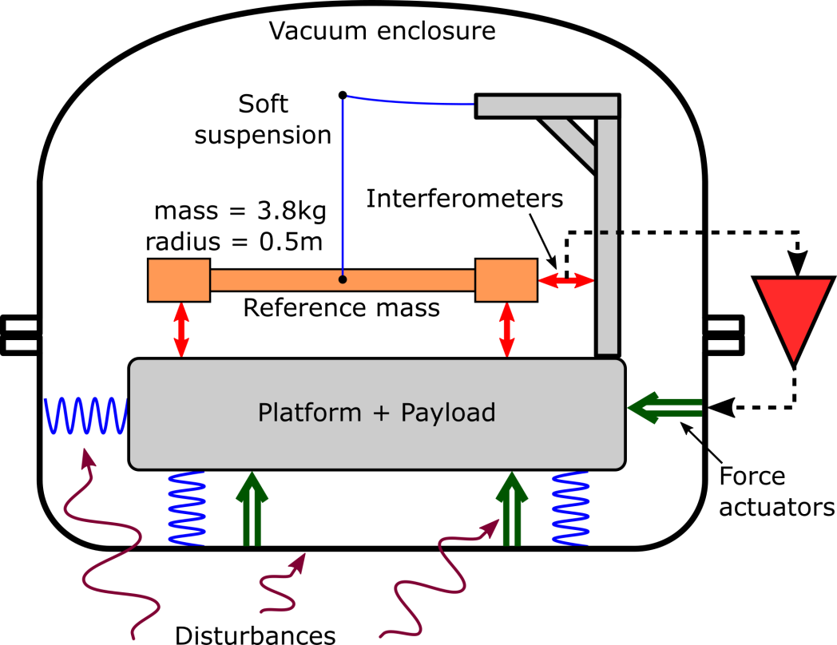
The OmniSens Concept
(or terrestrial drag-free control)
DRS Working Principle – Image: NASA/JPL

Slide 7
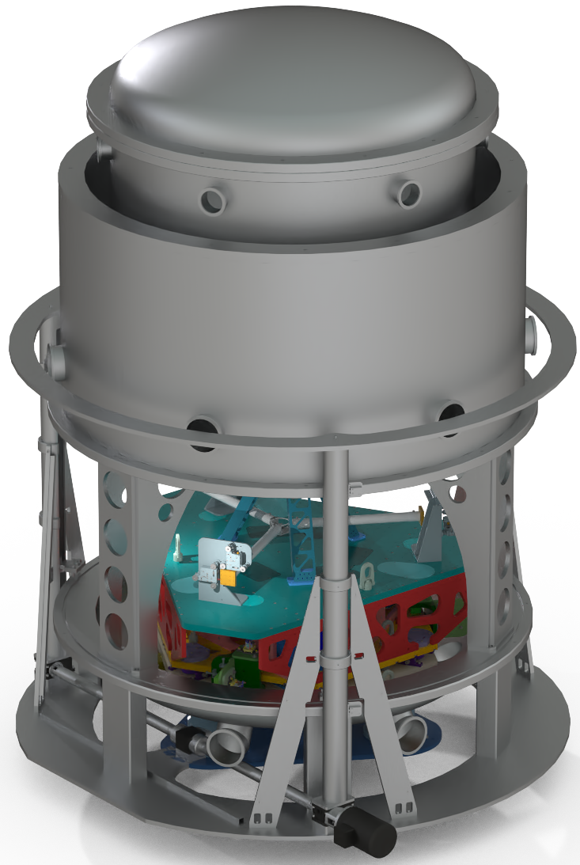
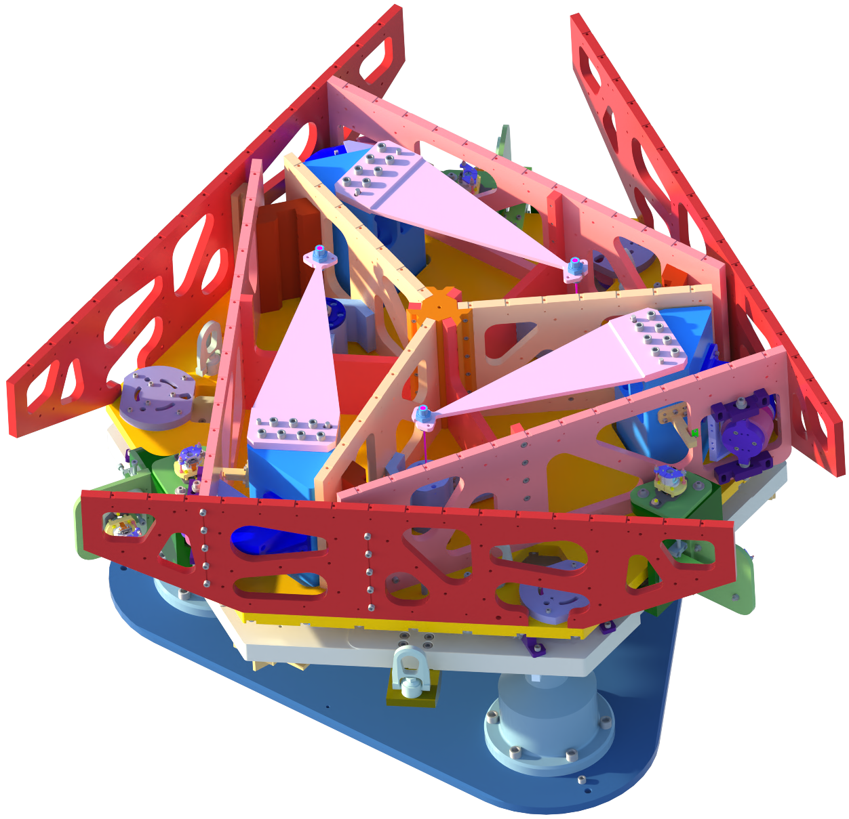
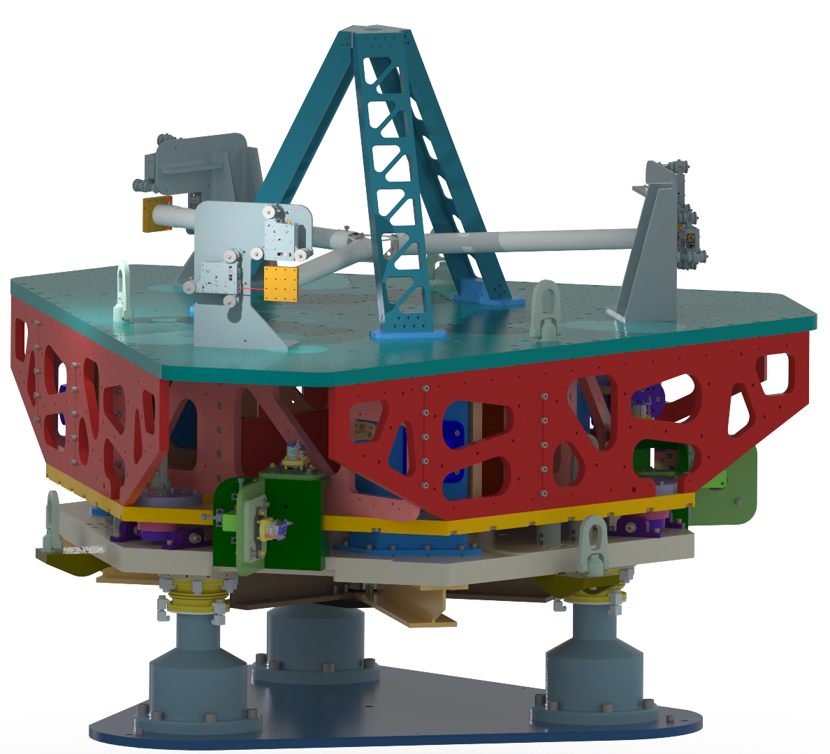

Slide 8
What unlocks the low-frequency sensitivity?
Interferometric sensing (HoQI), compact and proven
Fused-silica suspension, high-stress and low-loss
Closed-loop control, employing a HAM-ISI type platform
Low-frequency expertise, from UW and LISA-Pathfinder labs
Careful shielding for thermal fluctuations, acoustics, and E-M
Mechanical simplicity, no cables or magnets.

Slide 9
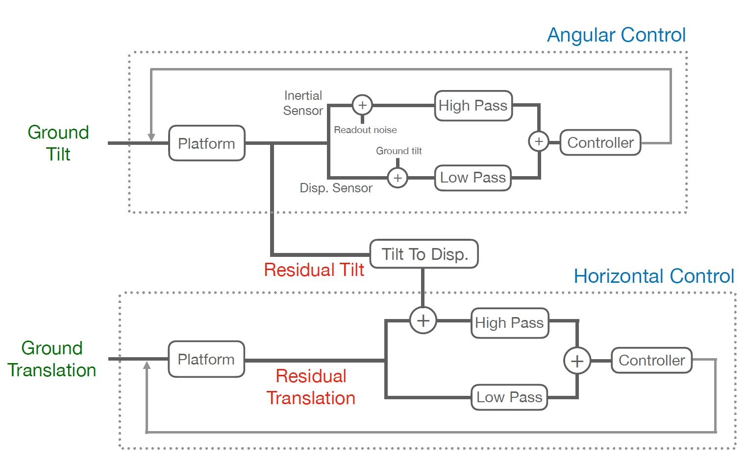
OmniSens control scheme

Slide 10
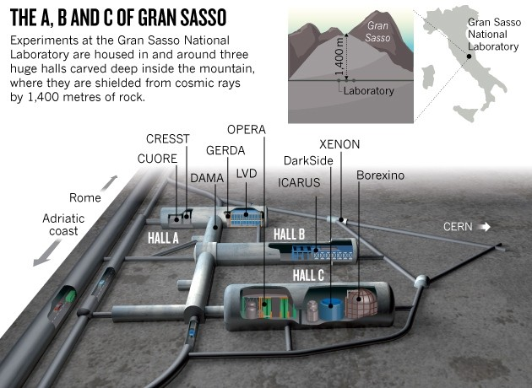
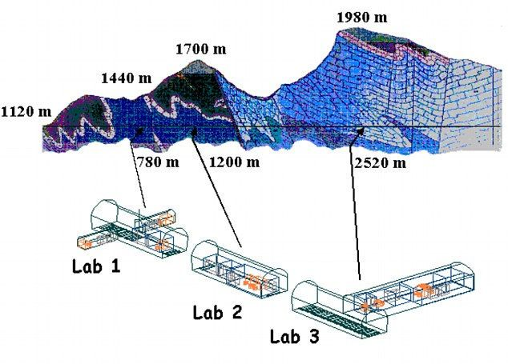
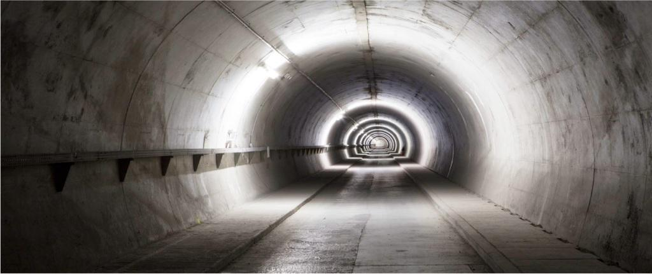
LSC Canfranc (Spain)
The whole lab volume is 10000 m³
Very large experimental halls: 3x36000 m³
L-shaped 3.7Km tunnel, no large experimental halls
Ground input
Deepest seismic vault: 518m depth

Slide 11
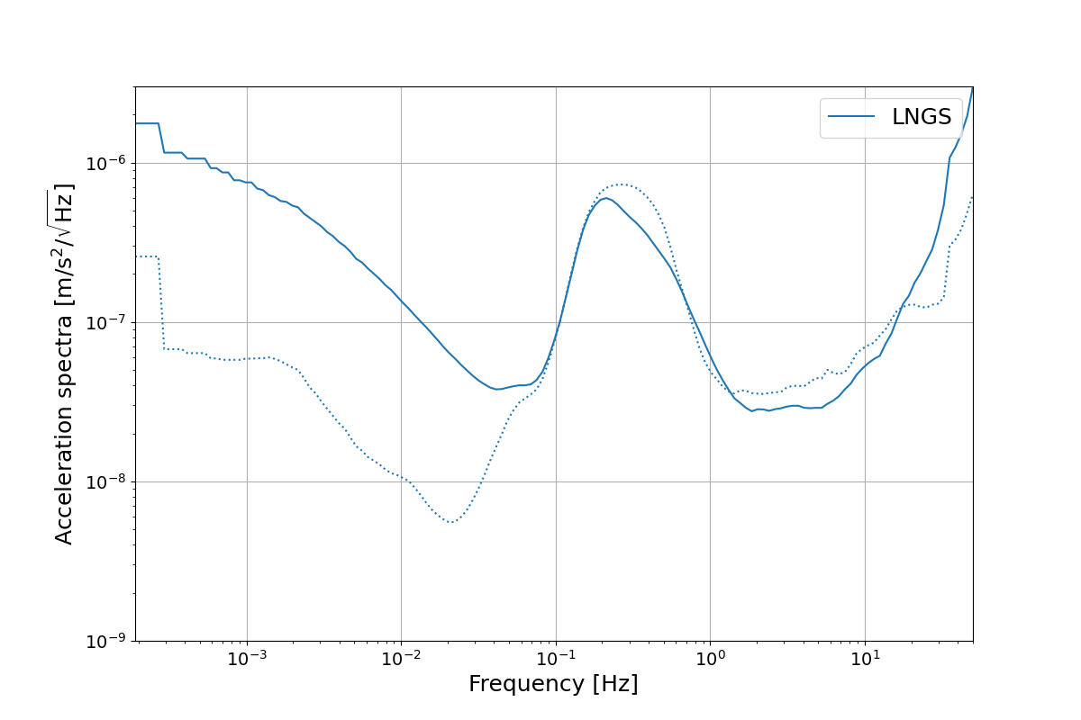
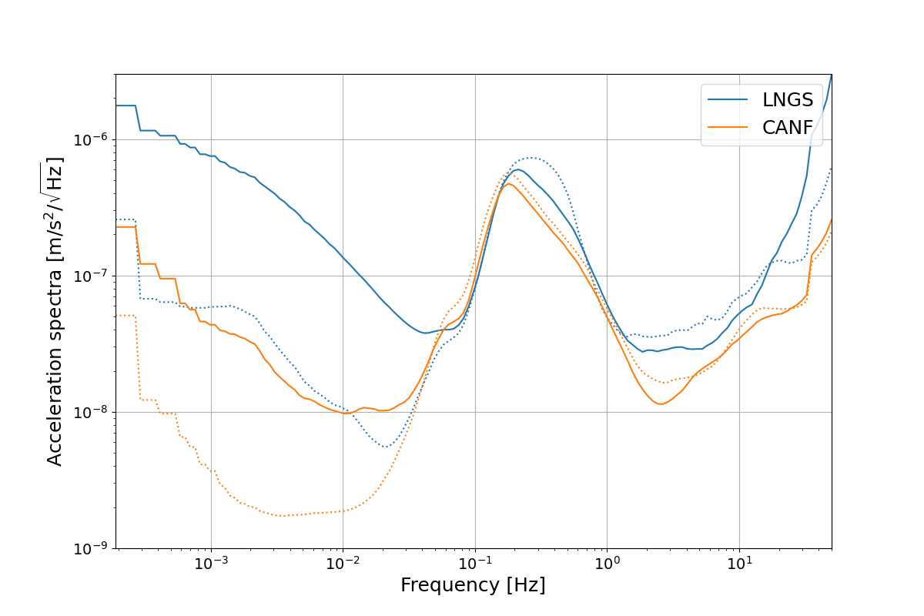
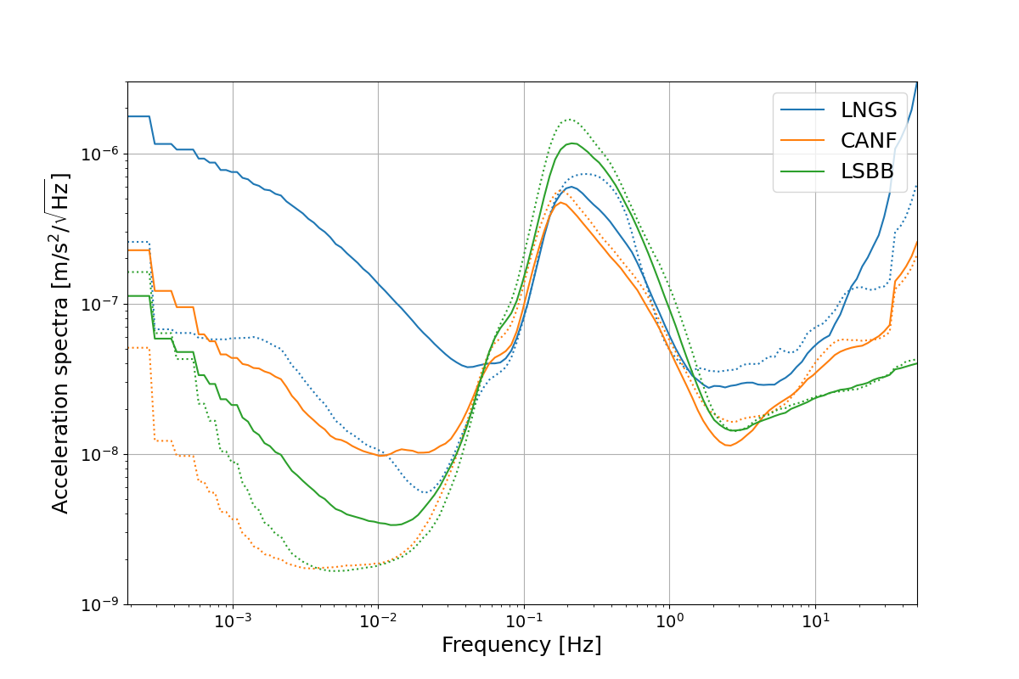
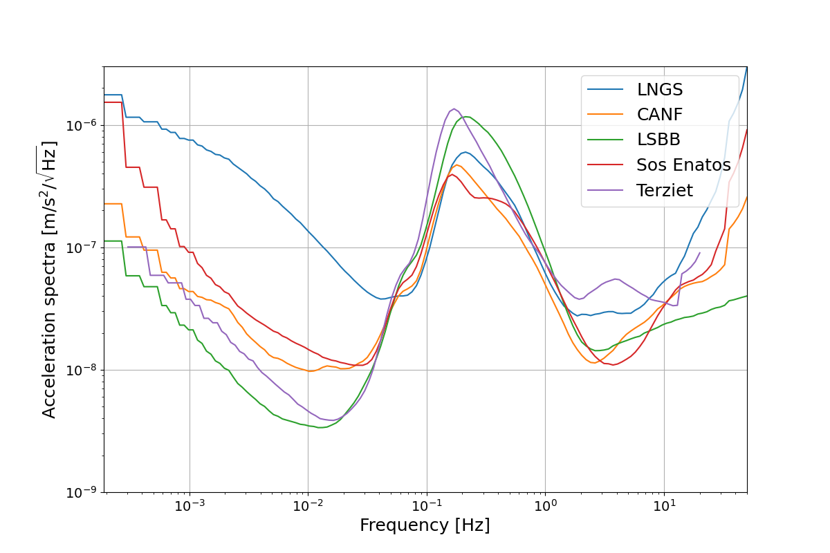
Horizontal acceleration spectra (~2 weeks)
LNGS is 50x noisier than LSBB. We use it as a ‘worst case’ scenario.

Slide 12
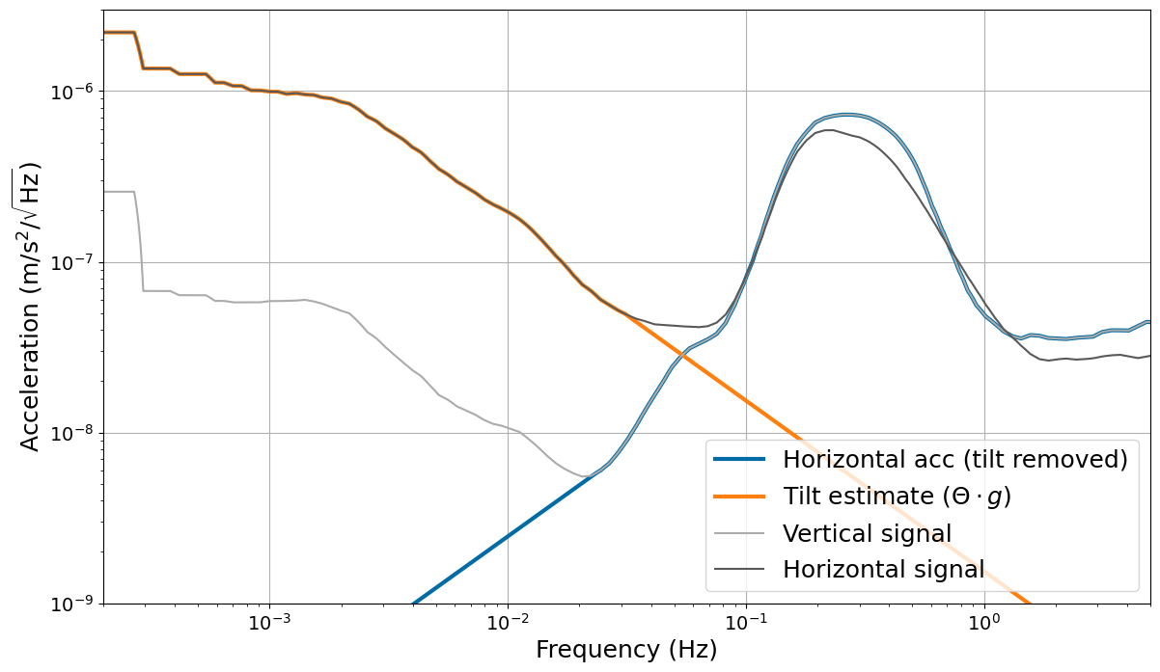
Estimating true tilt and translation (LNGS)
Extrapolating tilt
Estimating translation

Slide 13
Propagating through OmniSens

Slide 14
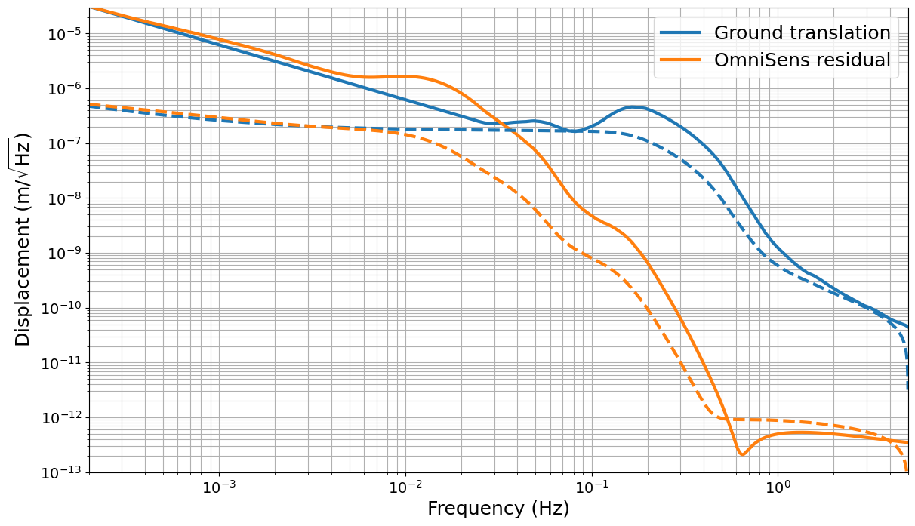
Residual displacement and RMS
OmniSens can potentially reduce RMS at 0.1Hz. Is it enough … ?

Slide 15
Can we meet the DAC noise requirement?
Propagate OmniSens residuals through ET Suspension models (pitch and length)
Construct reasonable payload actuation scheme with offloading to higher stages
Compare sites and situations
See Nathan Holland’s talk
at GWADW in 2 weeks !

Slide 16
Conclusions
Pre-isolation is critical to reduce payload actuation noise that couples directly to DARM.
Borehole and small caverns provide insufficient information for large, ventilated caverns.
Ventilation appears responsible for substantial excess tilt that drives RMS motion both with and without pre-isolation.
Creating a realistic model for actuation noise requires both the final residual motion and a controls model of the payload.

Slide 18
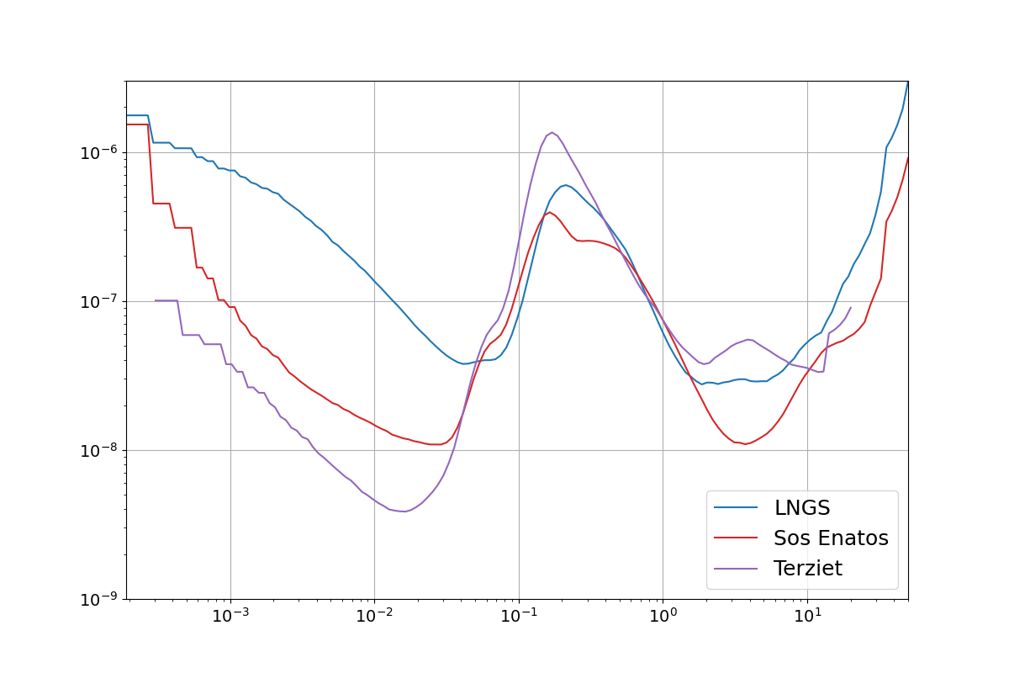
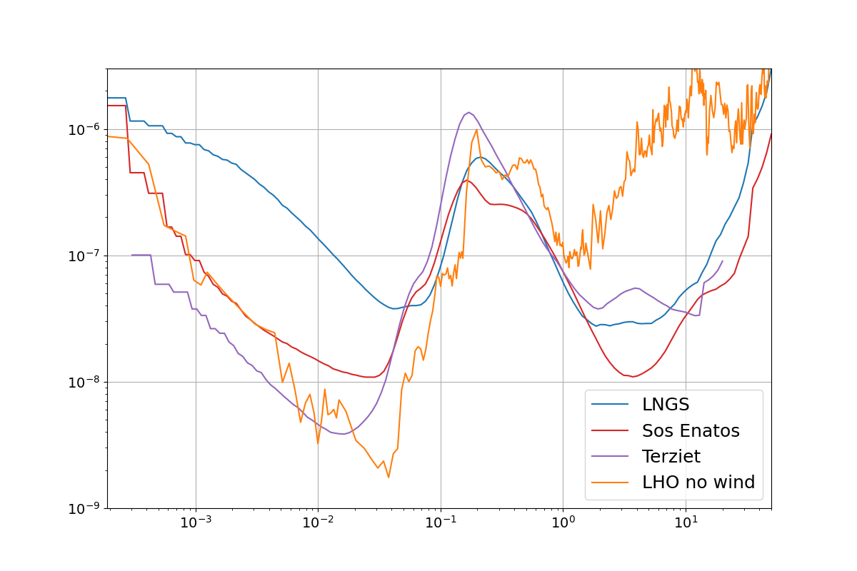
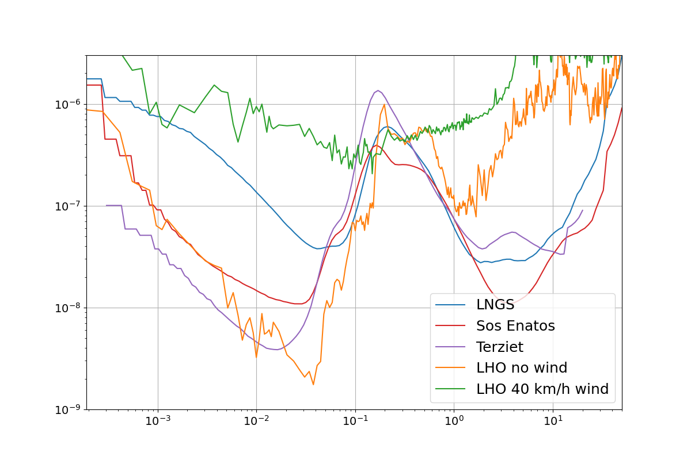
Comparison with LIGO Hanford site

Slide 19
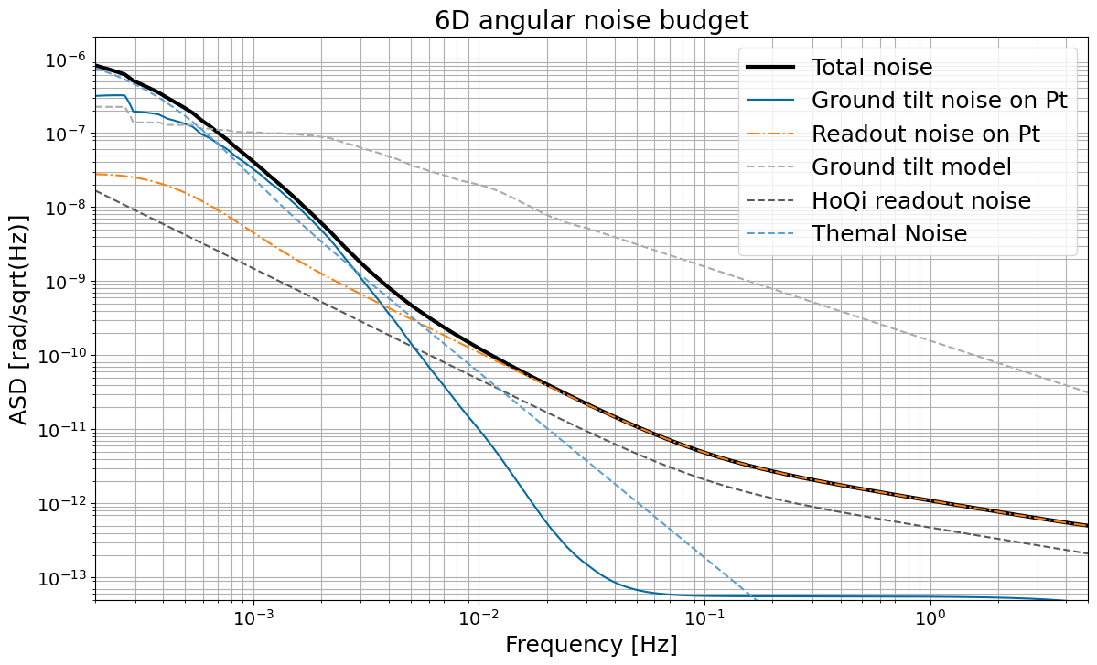

Slide 20
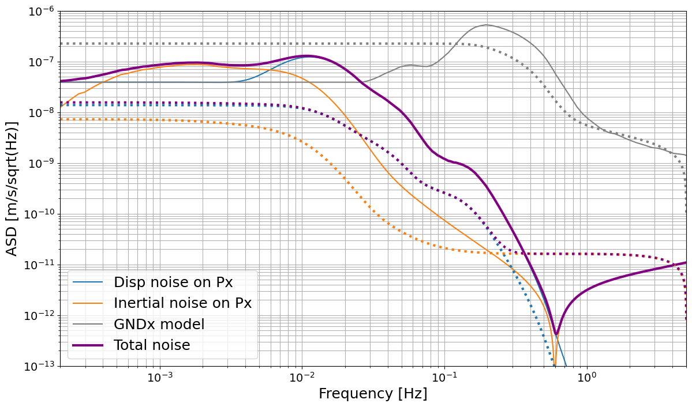

Slide 21
Reducing actuator noise in ET
Mechanical filtering gets harder below 10Hz
DAC and Driver electronics dynamic range gets harder below 10Hz
Underground environment should reduce displacement
This places strict requirements on the performance of the seismic platform and suspension controls.
Ground rotation in ventilated caverns is a major problem See, eg Badaracco GWADW 2022

Slide 22
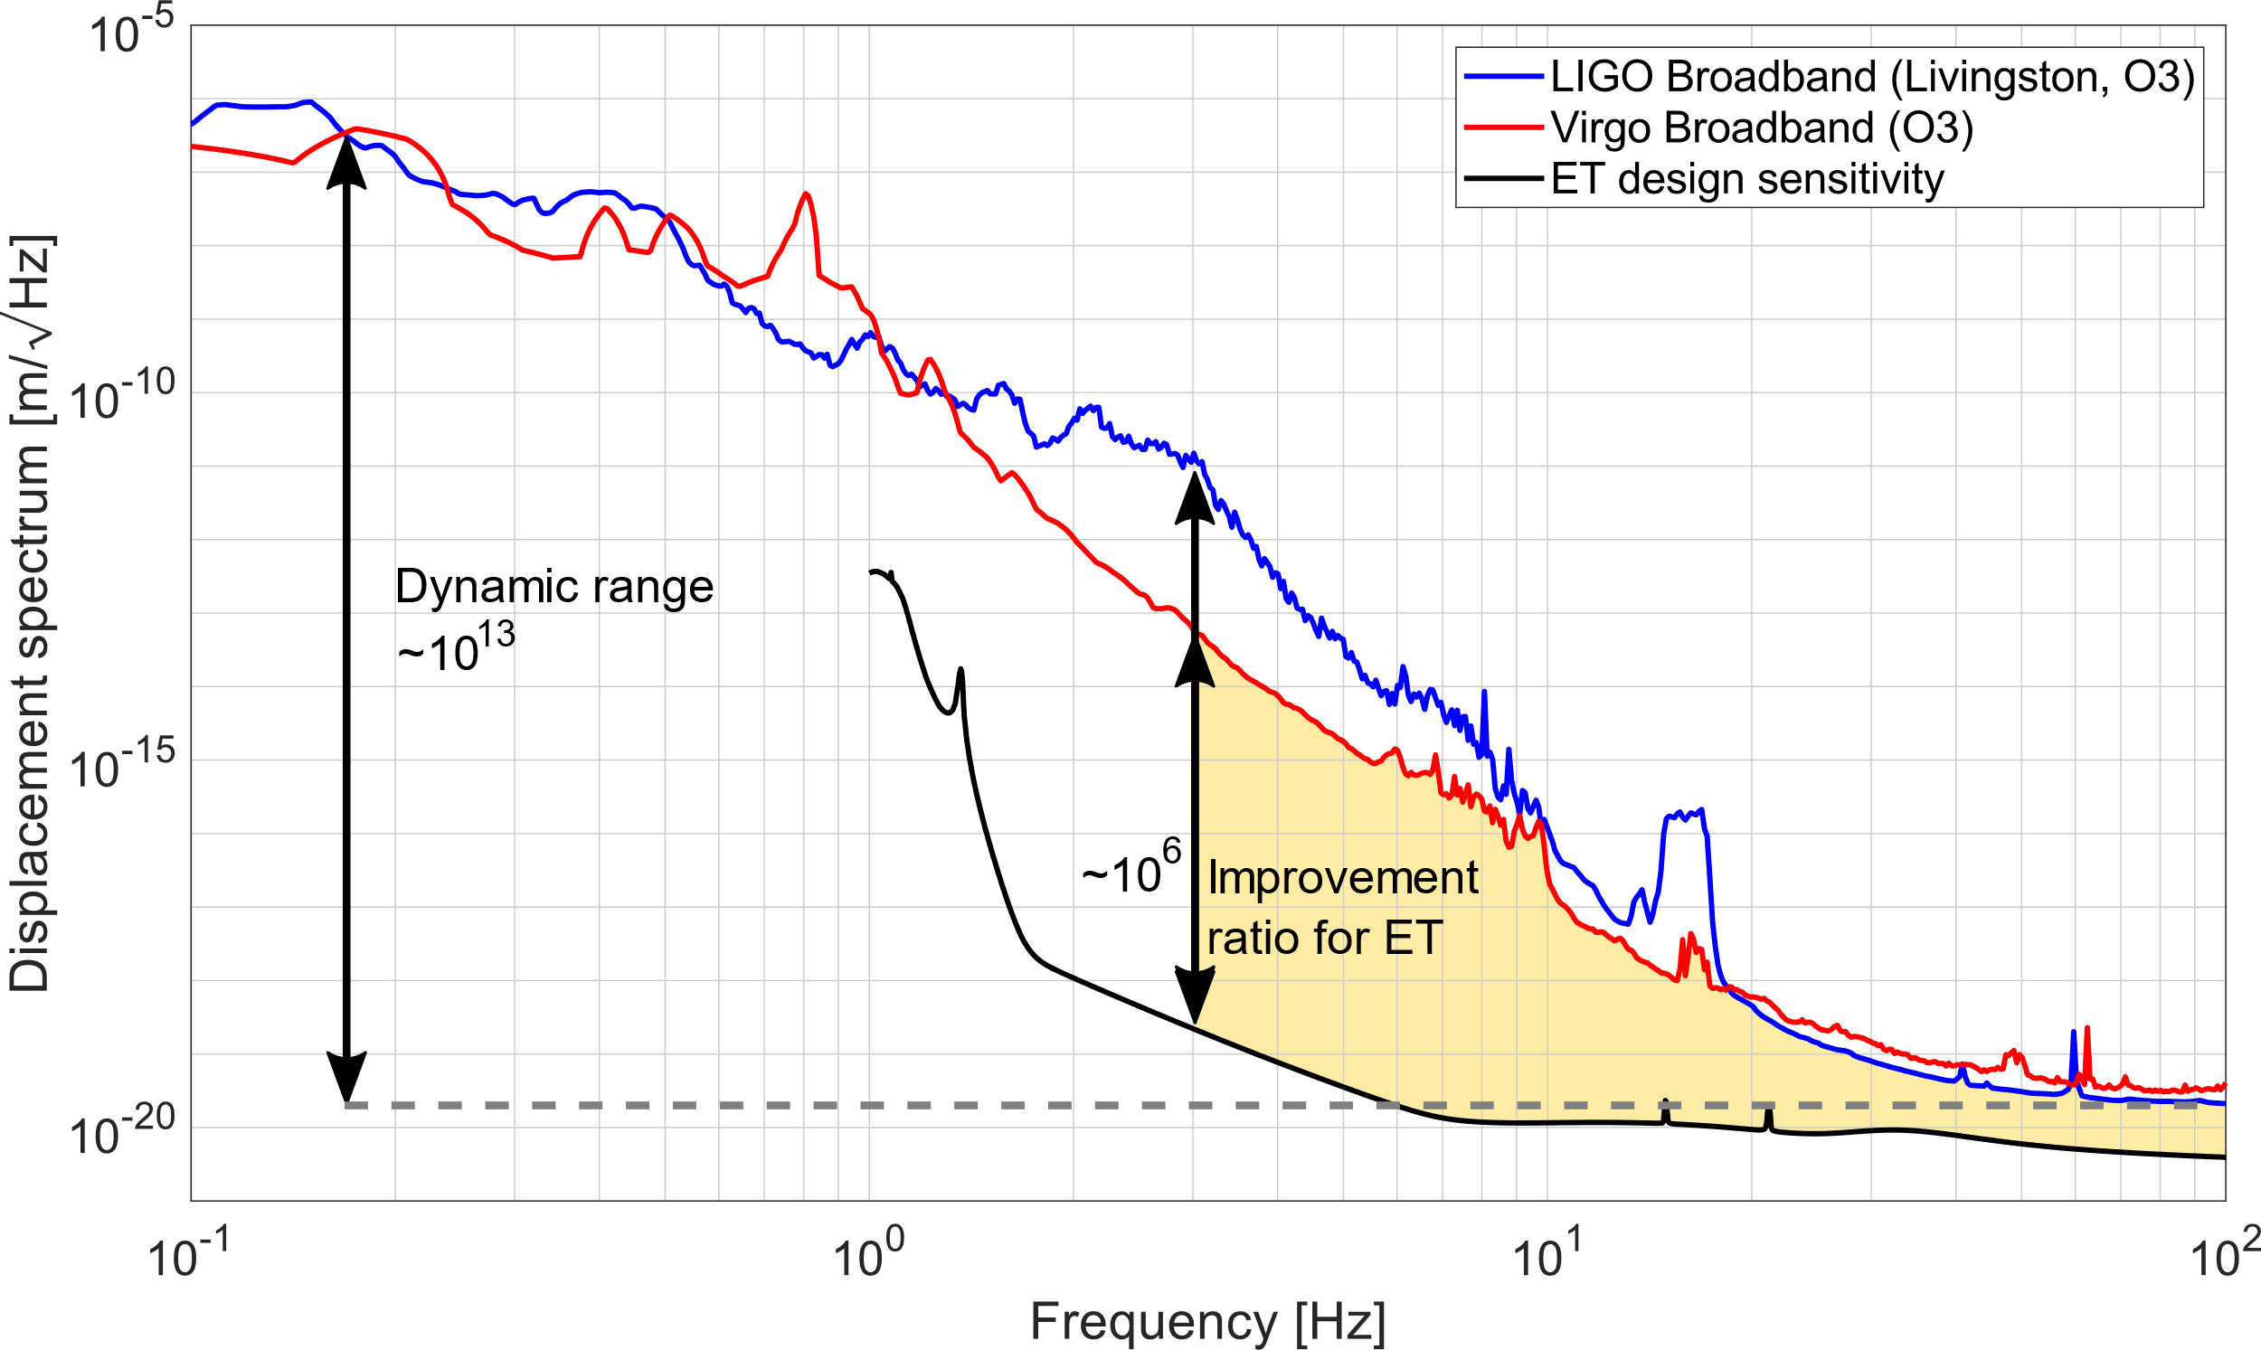
Martynov, Virgo log 37982

