Slide 1
Cryogenic measurements of the loss angle of thin films: a geometric approach
Alex Amato, Gianpietro Cagnoli, Federica Fabrizi, Massimo Granata, Matteo Montani, Lorenzo Mereni, Francesco Piergiovanni, Laura Silenzi, Angela Trapananti, Flavio Travasso

Slide 2
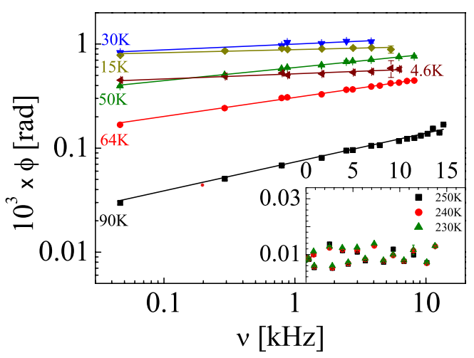
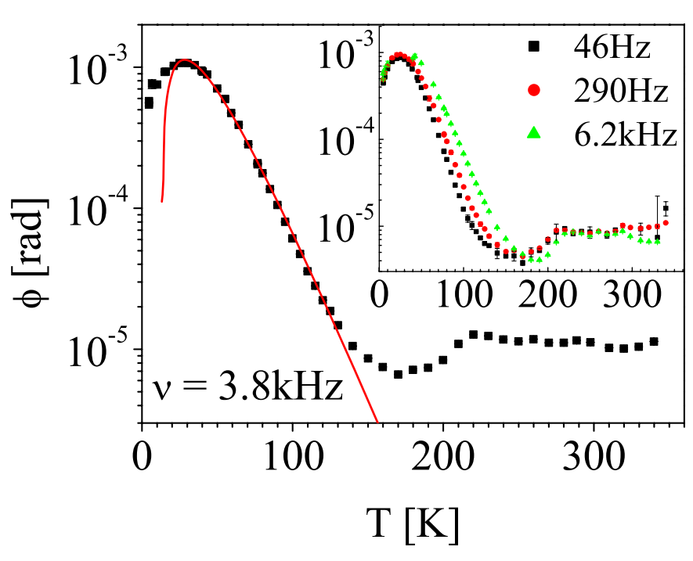
Why cryogenic measurement
To obtain information on the processes that produce the mechanical losses
…e.g., fused silica measurements
Loss angle vs Frequency at different temperature
Loss angle vs Temperature => info on the Asymmetric Double Well Potential (ADWP) that rules this process at low temperature
VIR-1070A-22
EPL, 80 (2007) 50008, doi: 10.1209/0295-5075/80/50008

Slide 3
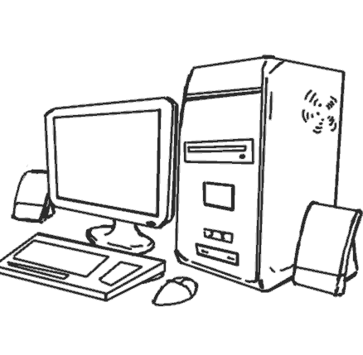
Why silicon and sapphire
Materials that have excellent thermal conduction characteristics and a high-quality factor at low temperatures
A geometry that allows the measurement of many resonance frequencies
Cheap to have a good statistics
The first idea was to use the materials proposed for ET (silicon and sapphire) and to use them for the study of the coatings
$$φ=\frac{1}{πf_{res}τ}$$
Second meas.
First meas.
Extrapolation
HV
$φ_{sub+coat}=φ_{sub}$ + ${ \frac{E_{coat}}{E_{tot}}φ}_{coat}$
$φ_{sub}=φ_{mat}$ + ${ \frac{E_{exp}}{E_{tot}}φ}_{TE} +{ φ}_{extra}$
Cesarini E. & al, Rev. Sci. Instrum. 80 (2009)
M. Granata et al. VIR-0499A-16

Slide 4
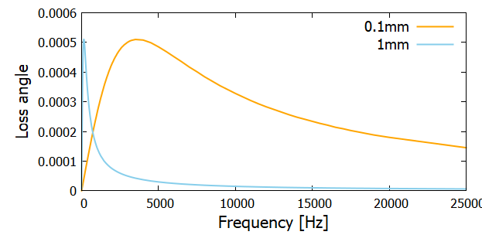
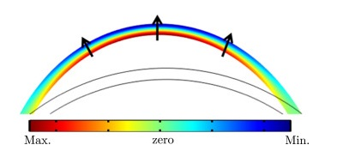
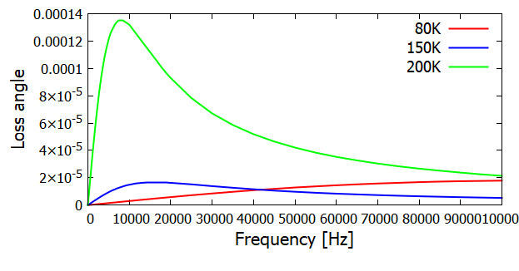
Thermoelastic losses
Thermoelastic peak vs. thickness
Thermoelastic losses happen when a body is bent => one side gets compressed (heated) and the other gets expanded (cooled). Heat flows from a side to the other.
$$φ_{TE} \left(ω\right)=D_{dil}⋅∆\frac{ωτ}{1+{(ωτ)}^{2}}$$
$$D_{dil}=\frac{E_{exp}}{E_{tot}}$$
No bending in pure expansion =>
=> there are no thermoelastic losses
Thermoelastic peak vs. temperature
$$∆=\frac{{(3α)}^{2}BT}{ρc_{v}}$$
Set the amplitude => strong dependency with α => for silicon, α = 0 for 2 temp. (120K, 18K)
$$τ=\frac{1}{π^{2}}\frac{ρc_{v}h^{2}}{k}$$
Time of thermal diffusivity => to compare with period of oscillations => maximum TE when they are equal

Slide 5
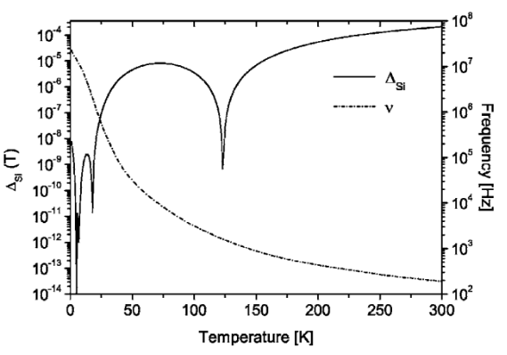
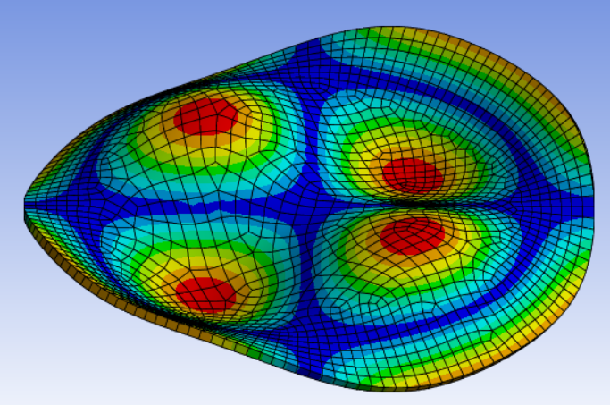
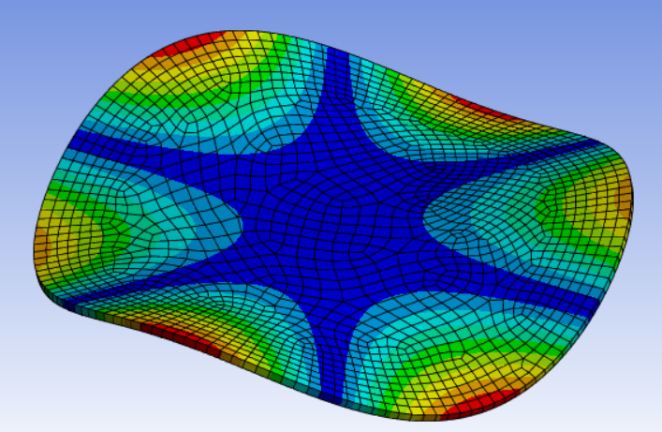
...a geometrical approach
Find a possible "geometric" solution to avoid/reduce the predominance of thermoelastic losses in the frequency region of interest….
...some modes should be not affected by thermoelastic peak, as a function of temperature
RIGHT SIDE OR LEFT SIDE OF TE PEAK??
(see the excel file)
Thermoelastic losses
Resonance frequencies
(modes) of the silicon disk
Thermoelastic losses for a silicon disk 3 inches in diameter and 0.2 mm thick.
Rev. Sci. Instrum. 77, 044502 (2006), doi: 10.1063/1.2194486

Slide 6
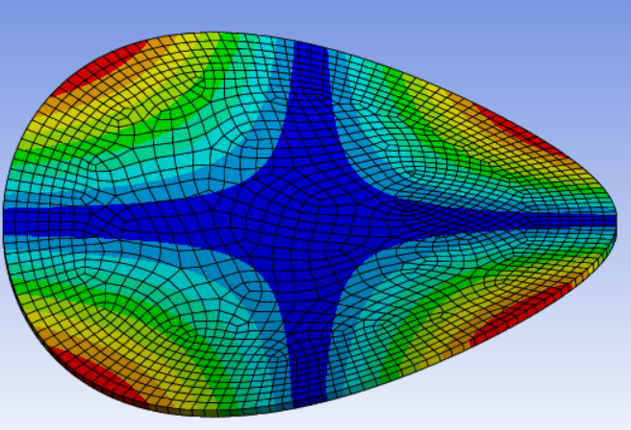
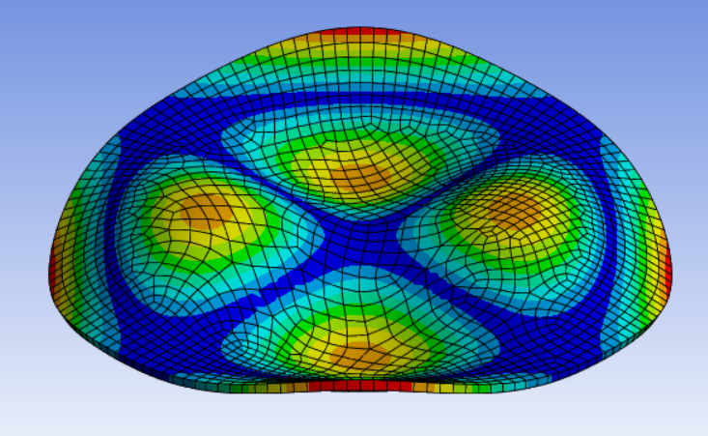
Loss angle (work in progress)
Butterfly modes
Mode (0,2) seems only slightly affected
Mixed modes

Slide 7
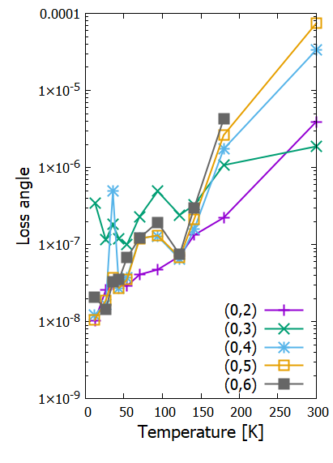
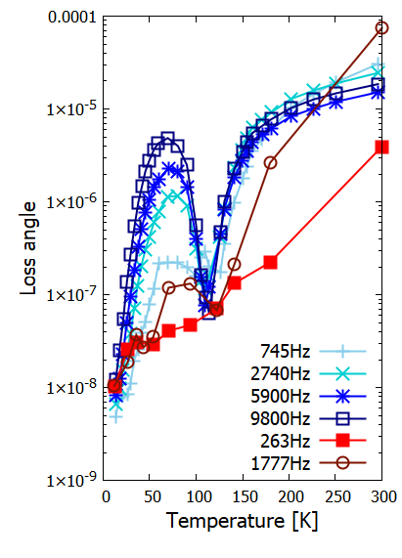
Different substrate thickness
Silicon disk φ=3’’ and th=0.2mm
Silicon disk φ=3’’ and th=0.5mm (blue points) vs.
Silicon disk φ=3’’ and th=0.2mm (blue points)
(0,5)
(0,2)
Granata M. et al, Archives of Metallurgy and
Materials 60, 2015 DOI: 10.1515/amm-2015-0060

Slide 8
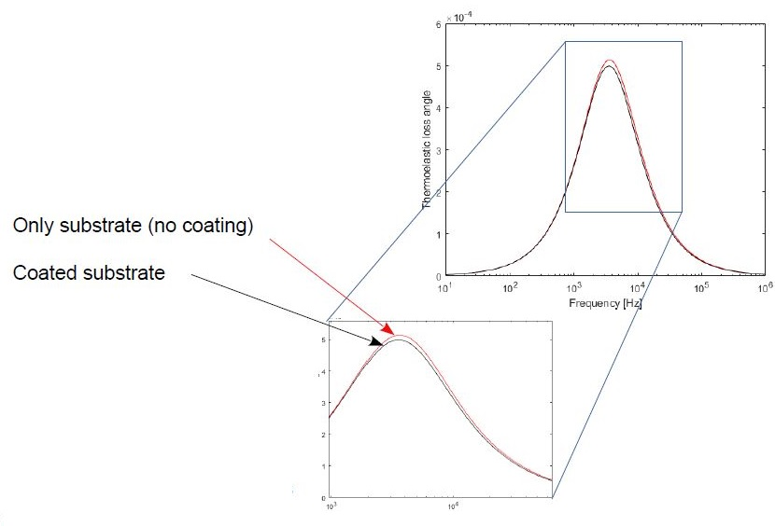
Thermoelastic issue: coating
The coated sample represents a composite system (sub + coat) in which the properties of both parts must be considered: thermo-mechanical properties of the coating are usually unknown at any temperature => the thermoelastic peak is unpredictable
The difference of the two thermoelastic peaks (substrate only vs. sub+coat) seems to decrease/zero to the left of the peak.
F. Fabrizi, VIR-0271A-21
J. E. Bishop and V. K. Kinra, Comp. Mater. Struct. 3 83-95 (1996)
S. Vengallatore et al., Jour. of Micromech. and Microen. (2005)

Slide 9
Next steps and open questions
New geometries are needed for the study of thin films due to bonding (HCB, metal bonding, direct bonding, ….):
asymmetrical approach to avoid bonding in the central part: no energy is stored there => very hard to simulate and to extrapolate the mechanical losses
access to many resonance modes to determine any trends with frequencies
cheap samples (statistics)
easy to handle

Slide 10
Conclusions
The geometrical approach was able to reduce the effect of thermoelastic => silicon disks of 3inchs-0.2mm can be a good candidate for the study of amorphous coating
Geometrical approach can work, but further tests needed (e.g. increasing the statistics and the sampled temperature points)
Tests with amorphous coating deposition should be done
New geometries are needed for the study of thin films due to bonding

