Slide 1
Newtonian Noise of underground water
in Kamioka mine
ET Symposium
May 2023
Tokyo Tech^{A}, RESCEU^{B}, NAOJ^{C}, ICRR^{D}
K.Somiya^{A},A.Nishizawa^{B}, T.Suzuki^{A}, T.Washimi^{C}, T.Yokozawa^{D}
K.Somiya

Slide 2
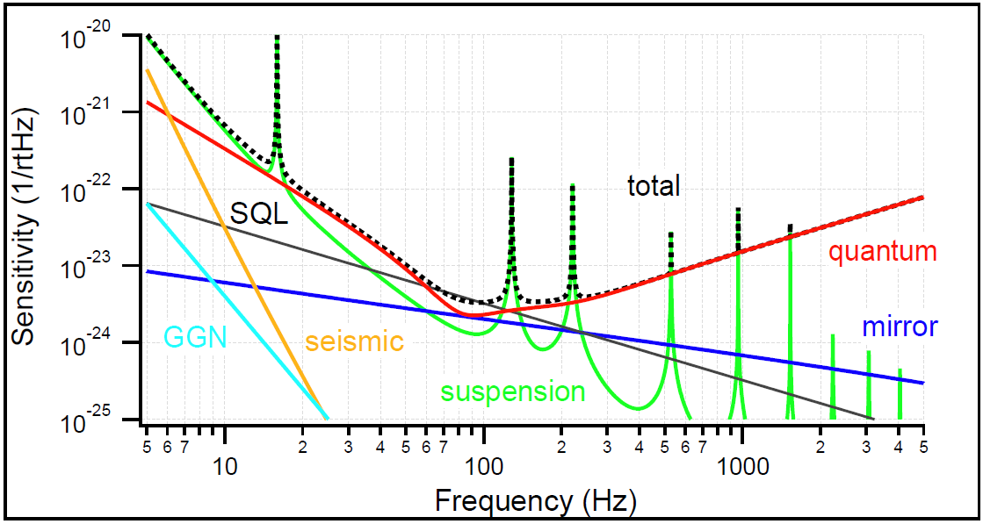
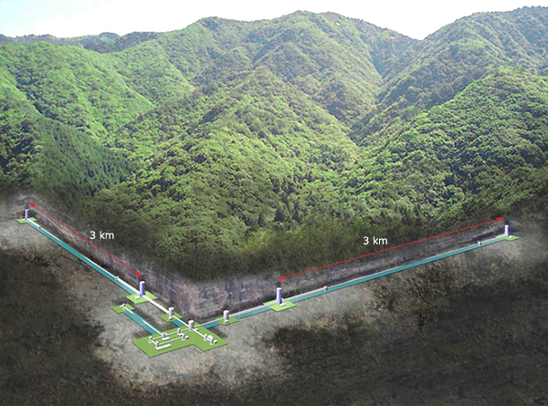
Gravity gradient noise
According to the model, GGN is small in KAGRA for its low seismic motion and its distance from the ground surface
However, there is a lot of water flowing behind the rock, which may or may not cause excess fluctuation of the gravity gradient
Can we estimate GGN from the spring water?

Slide 3
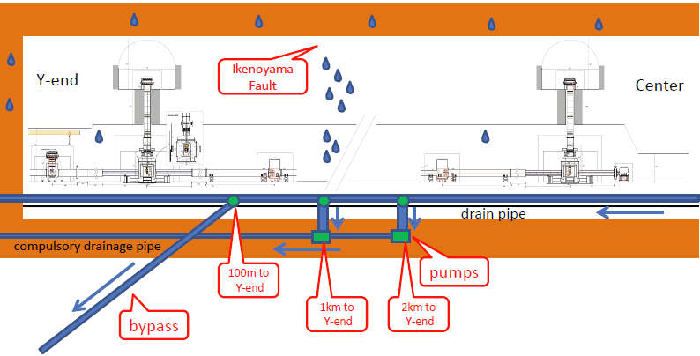
How do we drain spring water in KAGRA?
[Somiya ELiTES 2015]
The Y-end used to flood in the spring for melting snow
Now 400t/h water can be drained via each new pipe and 700t/h
water can go through the main channel (1500t/h in total)

Slide 4
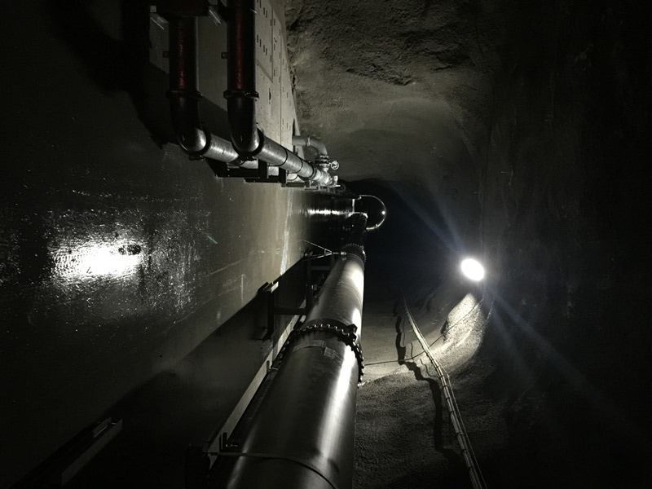
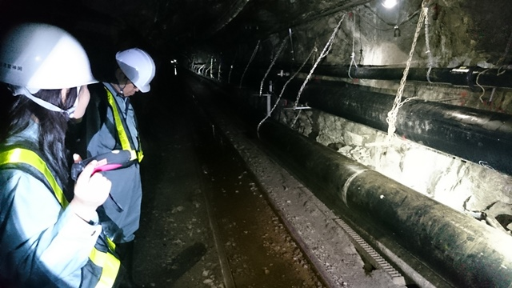
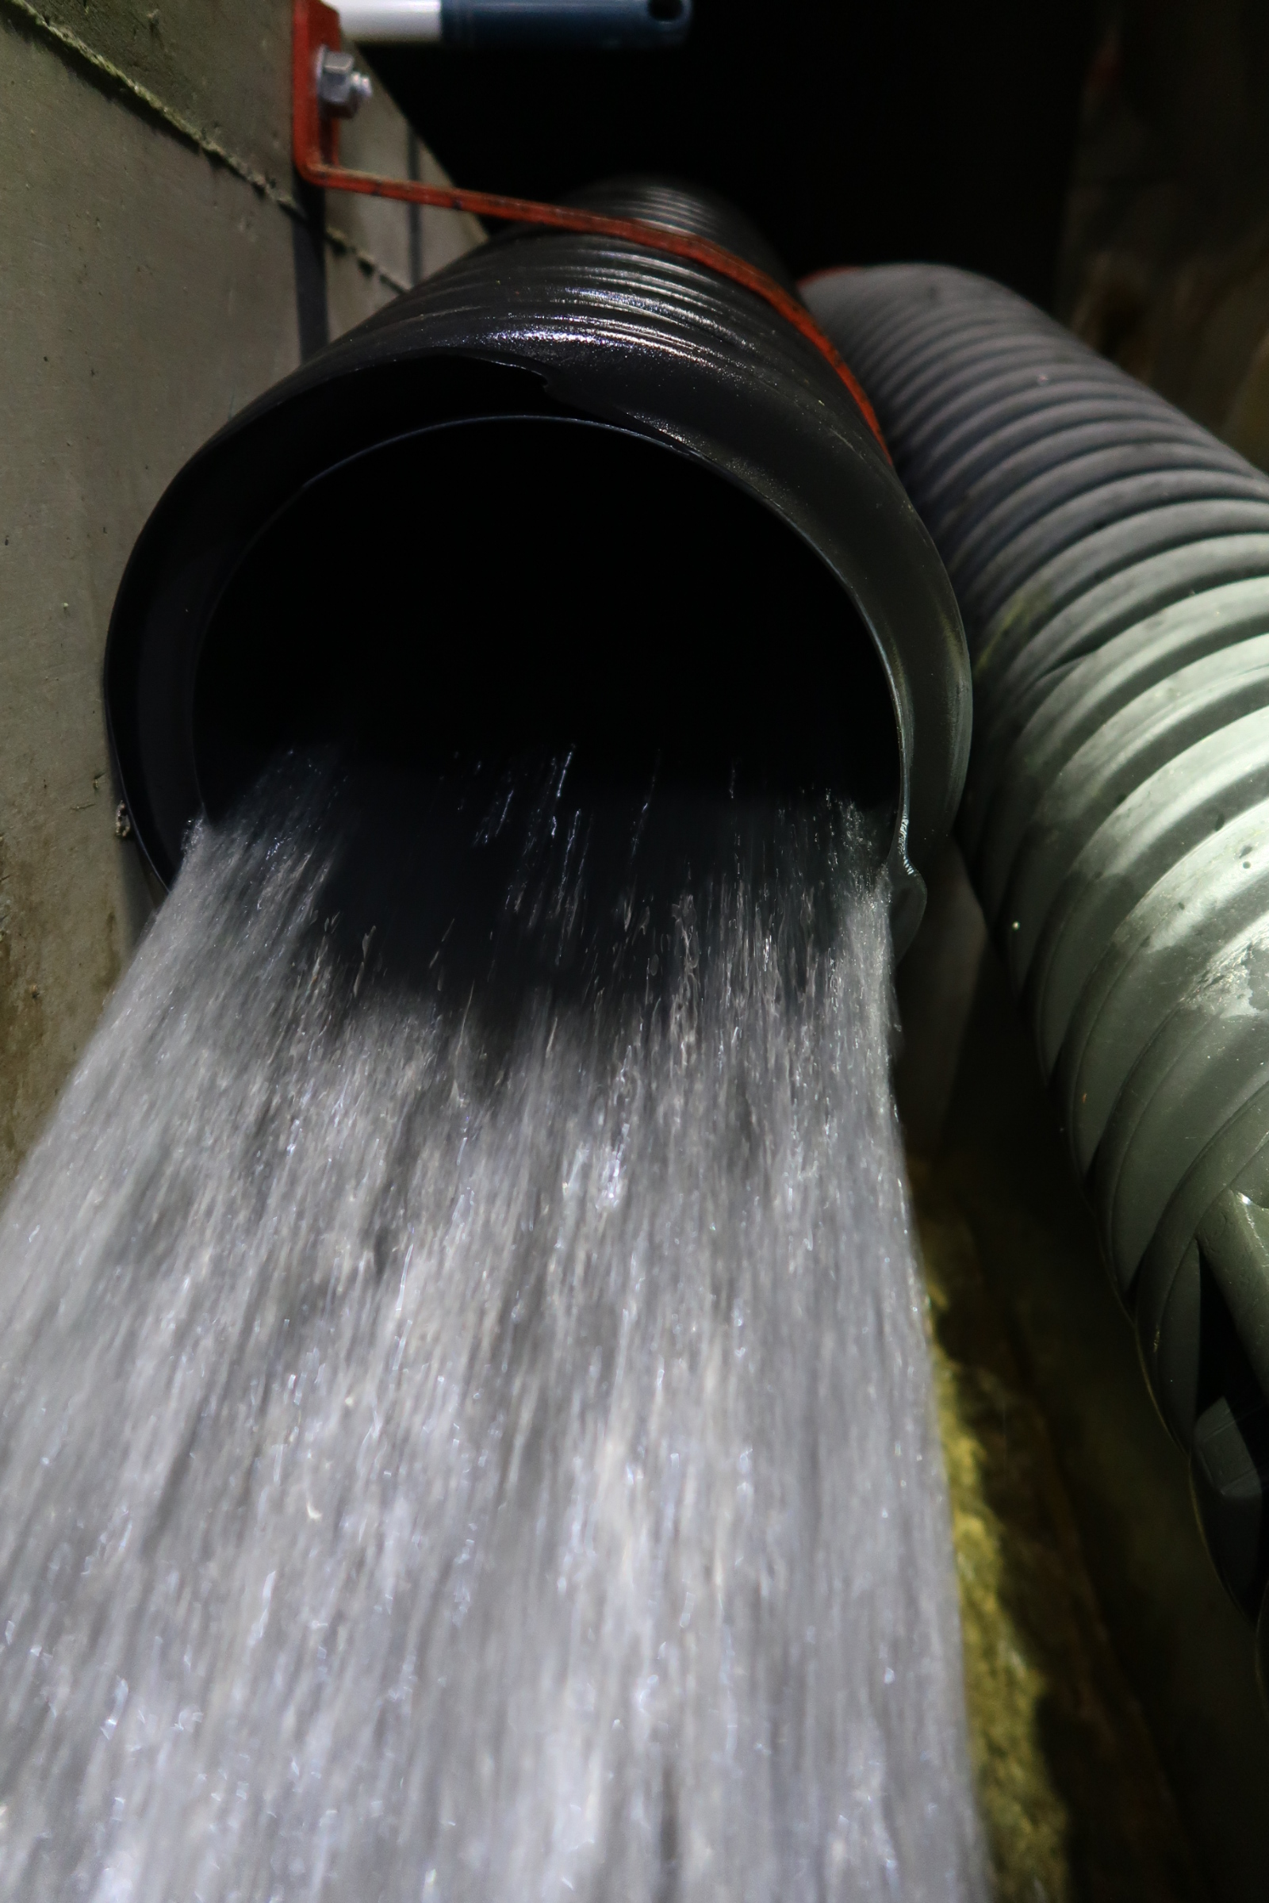
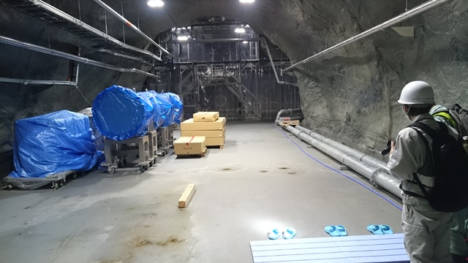
How do we drain spring water in KAGRA?
left: drain system (2km to Y-end)
middle: water pipes after the bypass
right top: water flow
right bottom: Y-end station

Slide 5
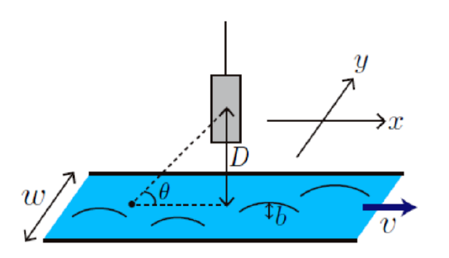
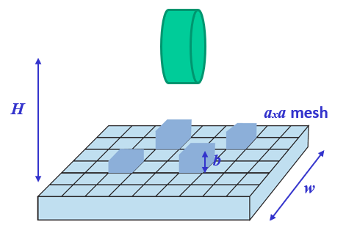
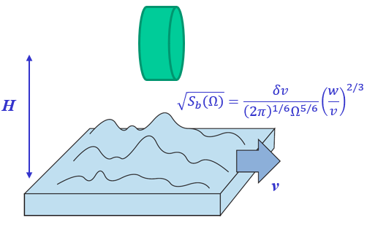
Newtonian noise
[Nishizawa 2017]
[Somiya TAUP 2019]
Gravitational acceleration
to x direction
$$a=\int{\frac{Gρbcosθ}{x^{2}+y^{2}+D^{2}}}dxdy$$
Chen-Nishizawa models
(i) Uncorrelated heigh fluctuation (ii) Static pattern flow

Slide 6
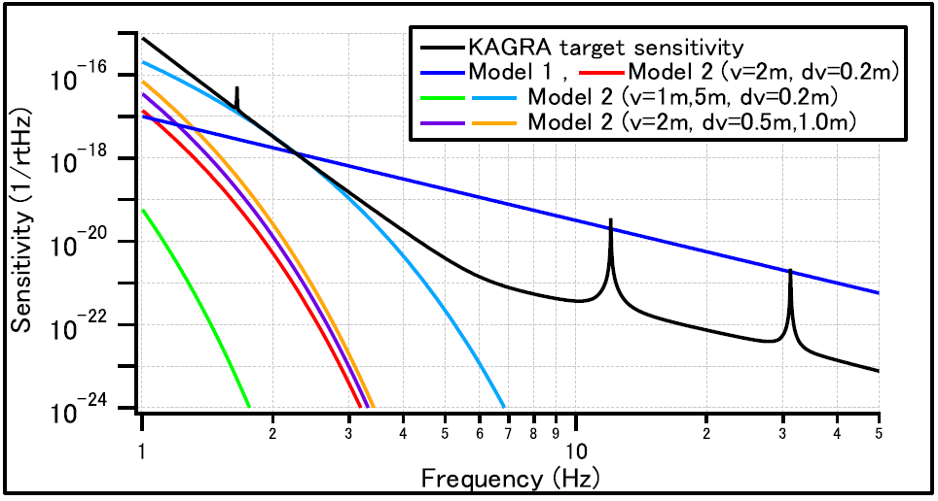
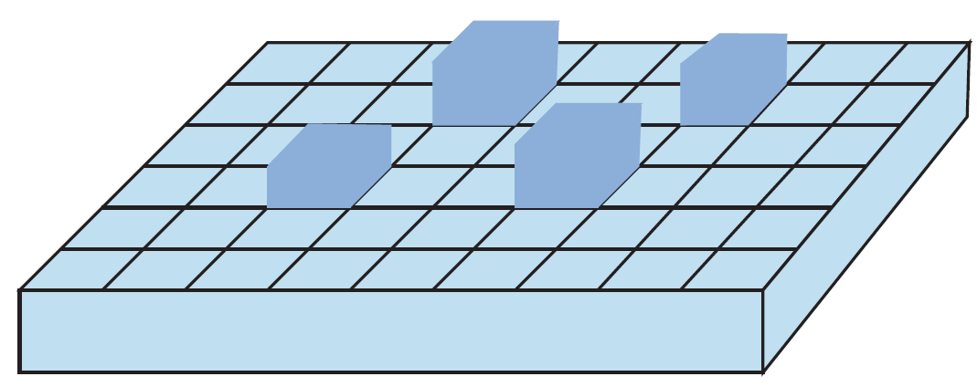
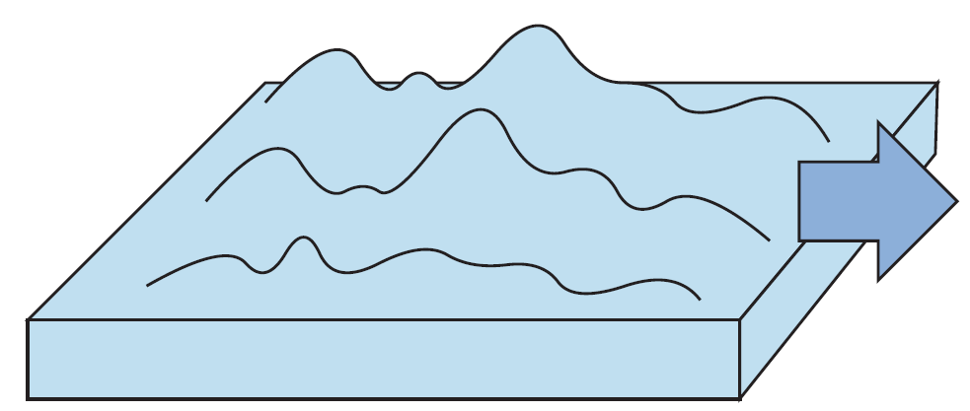
Newtonian noise
[Somiya TAUP 2019]
Model 1
Model 2
(H=2m, a=10cm, b=5mm, w=40cm)
Actual noise level would be somewhere inbetween
We performed fluid dynamics simulation to calculate actual water surface fluctuations

Slide 7
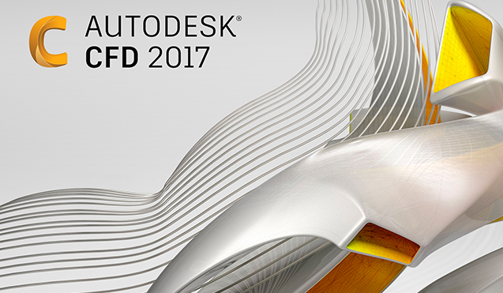
CFD simulations
CFD = Computational
Fluid Dynamics
For this research,
we use Flow-3D.

Slide 8
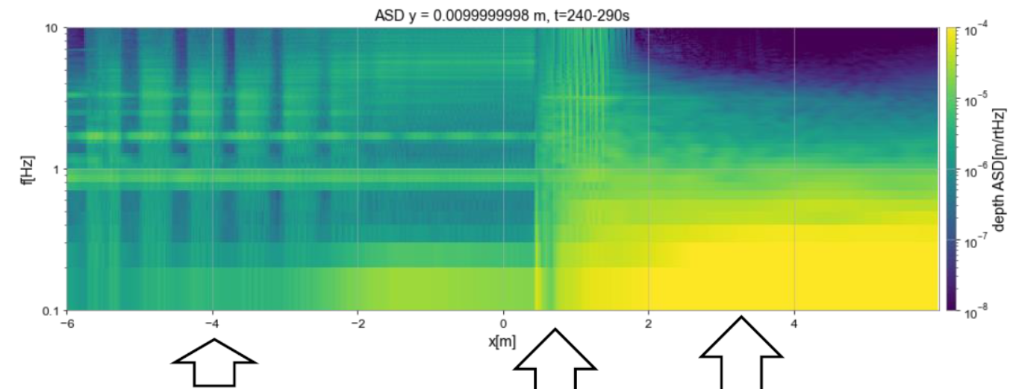
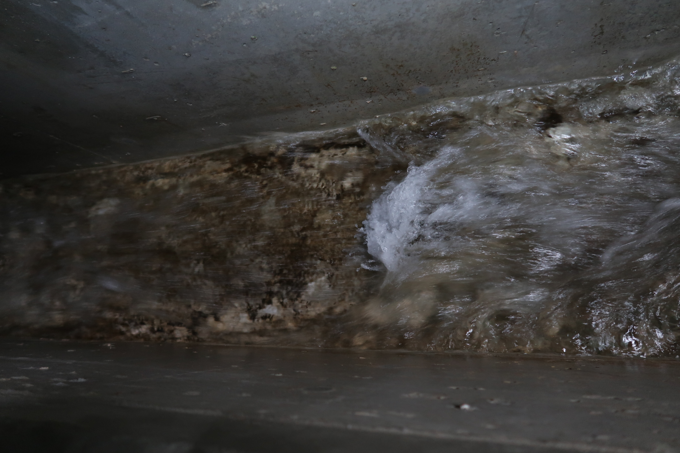
Sim-1 : fundamental test w/straight pipe
wave velocity $v_{w}$
[Suzuki JPS 2022]
It is called
sub-critical flow when $v_{f}<v_{w}$
super-critical flow when $v_{f}>v_{w}$
and hydraulic jump at $v_{f}=v_{w}$.
flow velocity $v_{f}$
hydraulic jump
super-critical
super-critical
hydraulic jump
sub-critical
sub-critical
The simulation was performed with a low damping.
Well-known behavior of a turbulent flow was well realized.
Notes:
In this simulation, Frude number was nearly one at around the hydraulic jump.

Slide 9
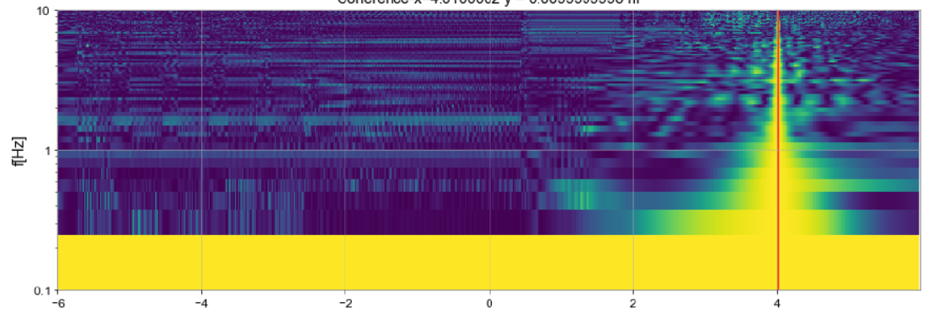
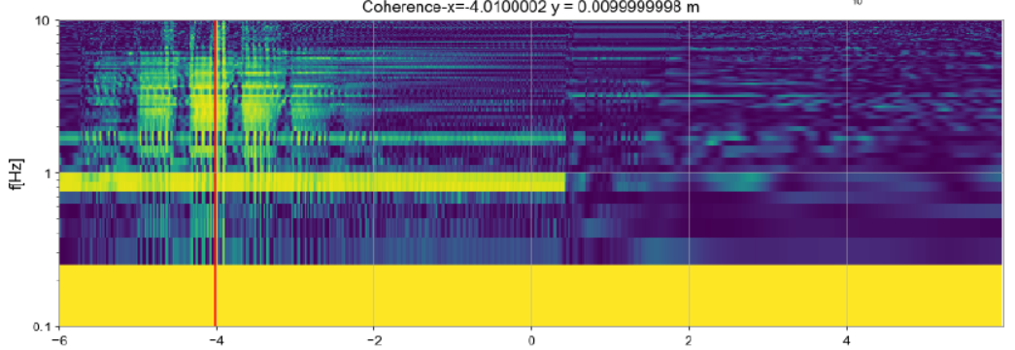
Sim-1 : interpretation of the two models
[Suzuki JPS 2022]
Coherence with x=+4m does not spread over the sub-critical flow area; it is like model 1.
Coherence with x=-4m spreads over the super-critical flow area;
it is like model 2.
We did not succeed in observing the exponential decay suggested in model 2. The NN level is dominated by the distance from the hydraulic jump (high if it is close to TM).

Slide 10
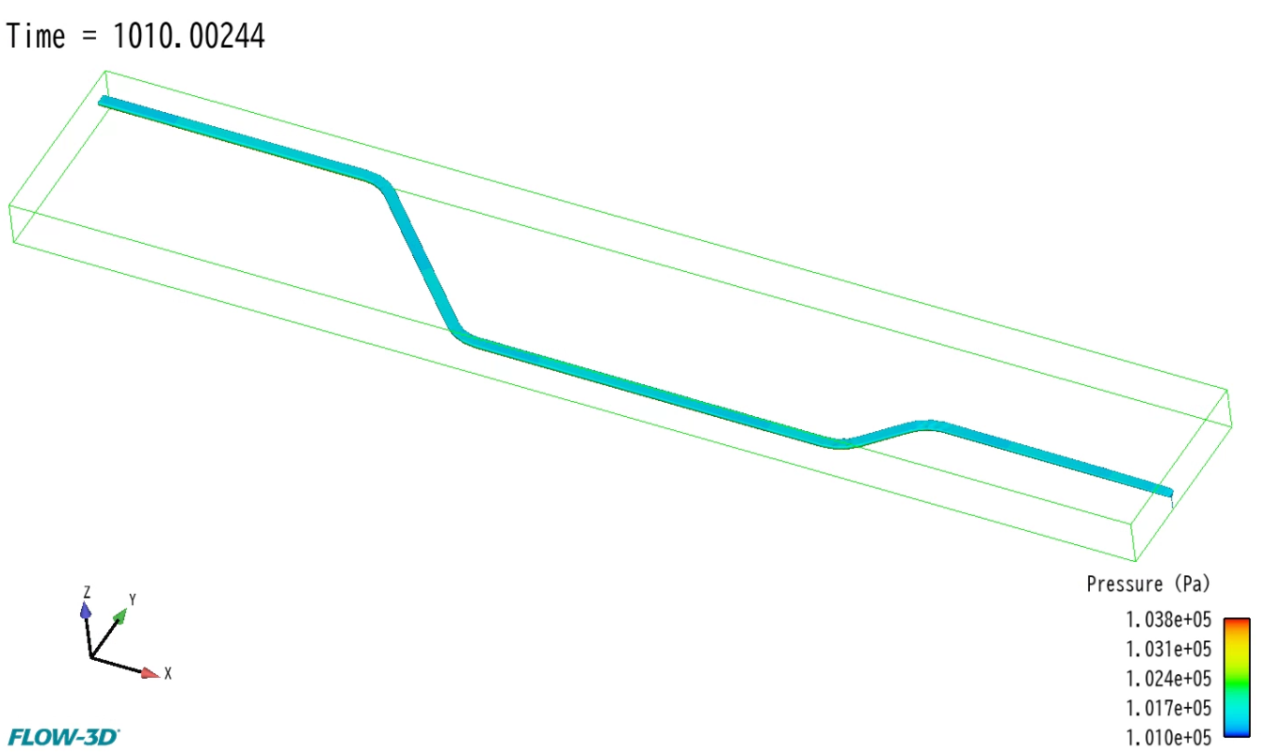
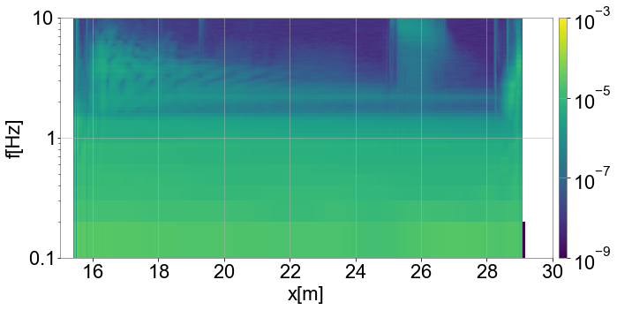
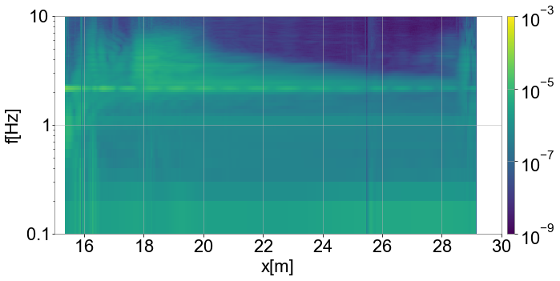
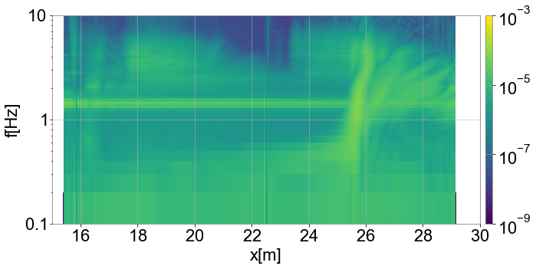
Sim-2 : NN calculation with KAGRA-like pipe
Amplitude Spectrum Density
36.2t/h
109t/h
A bent pipe near the Y-end TM was implemented.
Hydraulic jump could not be clearly indetified.
High ASD at f~2Hz comes from the collision at a corner.
181t/h

Slide 11
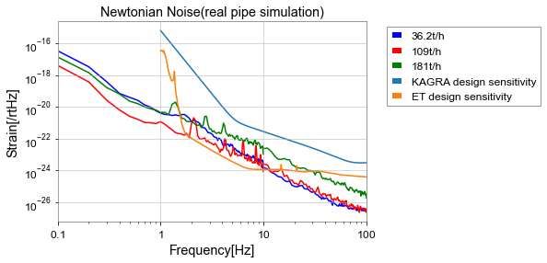
Sim-2 : NN calculation with KAGRA-like pipe
[Suzuki Thesis 2023]
36.2t/h
Pipe length: 40m
Pipe radius: 0.2m
Roughness coeff: 0.016
Equivalent roughness: 3.2mm
Slope: 0.13%
Mesh size: 2.0cm
109t/h
Newtonian Noise level was calculated with three different water amount.
The spectra look a little different with different water amount, but they do not limit the KAGRA sensitivity.

Slide 12
Summary
Underground water flow in KAGRA can be as much as 1200t/h in spring.
We performed CFD simulation to calculate Newtonian Noise from the underground water.
A simple simulation showed a well-known behavior of the turbulent water flow, and the NN level was high at around the hydraulic jump.
With a KAGRA-like bent pipe, the water flow structure was more complicated, but Newtonian Noise does not seem to limit the KAGRA target sensitivity.
The water NN can easily limit the ET sensitivity, so the telescope should be built in a dry mountain.

