Slide 1
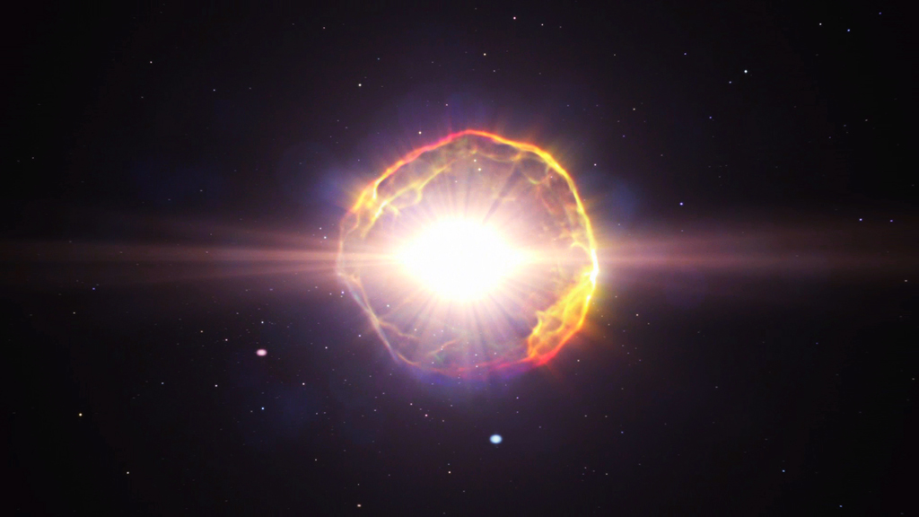
The initial mass – remnant mass relation for core-collapse supernovae
XIII ET Symposium
Cristiano Ugolini - SISSA PhD Student
cugolini@sissa.it
Collaborators: Prof. Marco Limongi, Prof. Mario Spera, Prof. Raffaella Schneider, Prof. Alessandro Chieffi, Prof. Alessandro Bressan
Notes:
Hello Everyone! I’m cristiano ugolini, a SISSA PhD student.
Today I will show you the results we obtained for the initial mass-remnant mass relation for core-collapse supernovae and that we are about to submit for publication.
I have worked under the supervision of mario spera at sissa and marco limongi at rome, and the main collaborators for this works are prof. Raffaella schneider, sandro bressan and alessandro chieffi.
supervision

Slide 2
Before GWs
Stellar BH upper limit $∼25M_{⊙}$
BH detected in X-Ray Binaries
Cristiano Ugolini - SISSA
XIII ET Symposium
Notes:
Let me introduce briefly the motivations of my work with this picture I am sure you are all familiar with.
In the picture we have the masses in the stellar graveyard before the GW discovery, thus detected through eM observations. as you can see the most massive BHs we knew had mass of roughly 20 solar masses, and all the BHs we knew of had masses in the range between 5 to 20 solar masses.

Slide 3
After O3
Discovered a new population of stellar BHs that can form BH-BH binaries
The heaviest BH has mass $86M_{⊙}$
How such massive objects can form?
Cristiano Ugolini - SISSA
XIII ET Symposium
Notes:
Now the picture is completely different, with the GW we discovered a new population of BHs, that can form BH-BH binaries and that are sistematically more massive than those observed through EM. Through GW we have found rather extreme object, with the heaviest BH ever found in a BH binary with mass of 86 solar masses, which is the primary black hole of the binary dectected with the event GW190521.
This leave us with a question: How such massive objects can form?

Slide 4
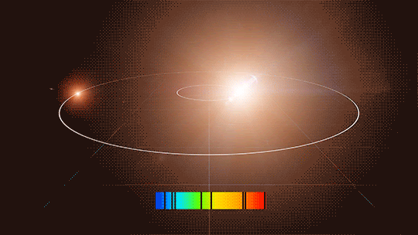
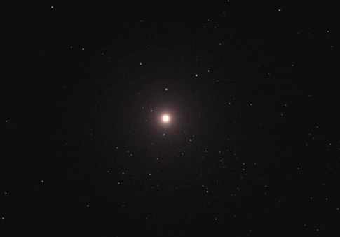
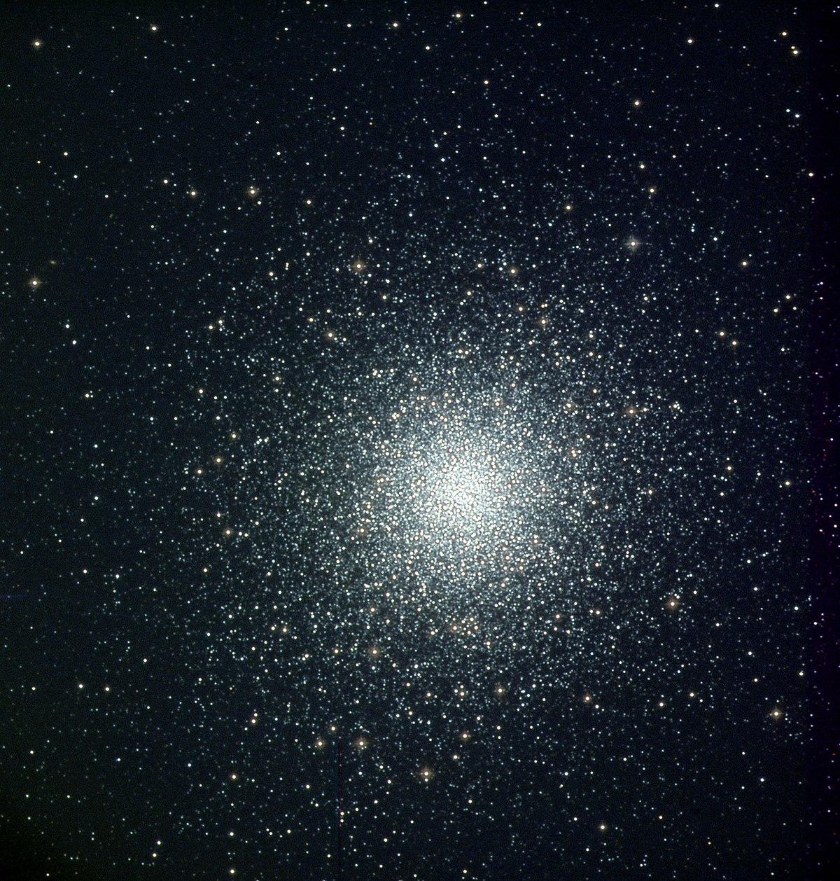
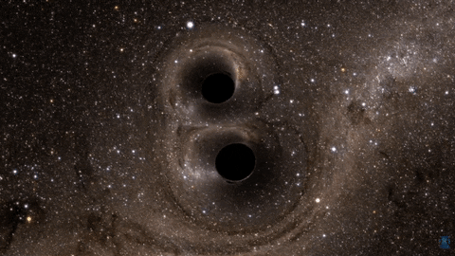
Ingredients for BHB merger
Final Fate of Massive Stars
Dynamical evolution of Stellar System
Evolution of Stellar Binaries
GW merger
Cristiano Ugolini - SISSA
XIII ET Symposium
Notes:
Several ingredients are needed to study the merger of BH binaries, such: dynamical evolution of stellar systems, evolution of stellar binaries anf the final fate of massive stars

Slide 5
Ingredients for BHB merger
My research’s Topic
Final Fate of Massive Stars
Dynamical evolution of Stellar System
Evolution of Stellar Binaries
Our tools:
FRANEC stellar evolution code (Chieffi & Limongi 2013, Limongi & Chieffi 2018)
HYPERION hydrodynamical code (Limongi & Chieffi 2020)
We performed a self-consistent and homogeneous study of stellar progenitors and their supernova explosions
Cristiano Ugolini - SISSA
XIII ET Symposium
Notes:
Specifically, this one is the topic of my research and of today’s talk.
The tool we used in our work are:
The FRANEC stellar evolution code, developed by marco limongi e alessandro chieffi, which we used to create a homogeneous grid of stellar progenitors with various initial masses, metallicities and angular rotations;
The HYPERION hydrodinamical code, which allowed us to simulate the supernova explosion of the progenitors coming from the franec code.
Therefore, in this work we performed a self-consistent and homogeneous study of stellar progenitors and their supernova explosions, which is relevant to the ET science case.

Slide 6
Ingredients for BHB merger
Final Fate of Massive Stars
Dynamical evolution of Stellar System
Evolution of Stellar Binaries
GW merger
Cristiano Ugolini - SISSA
XIII ET Symposium
Notes:
Several ingredients are needed to study the merger of BH binaries, such: dynamical evolution of stellar systems, evolution of stellar binaries anf the final fate of massive stars

Slide 7
Ingredients for BHB merger
My research’s Topic
Final Fate of Massive Stars
Dynamical evolution of Stellar System
Evolution of Stellar Binaries
Our tools:
FRANEC stellar evolution code (Chieffi & Limongi 2013, Limongi & Chieffi 2018)
HYPERION hydrodynamical code (Limongi & Chieffi 2020)
We performed a self-consistent and homogeneous study of stellar progenitors and their supernova explosions
Cristiano Ugolini - SISSA
XIII ET Symposium
Notes:
Specifically, this one is the topic of my research and of today’s talk.
The tool we used in our work are:
The FRANEC stellar evolution code, developed by marco limongi e alessandro chieffi, which we used to create a homogeneous grid of stellar progenitors with various initial masses, metallicities and angular rotations;
The HYPERION hydrodinamical code, which allowed us to simulate the supernova explosion of the progenitors coming from the franec code.
Therefore, in this work we performed a self-consistent and homogeneous study of stellar progenitors and their supernova explosions, which is relevant to the ET science case.

Slide 8
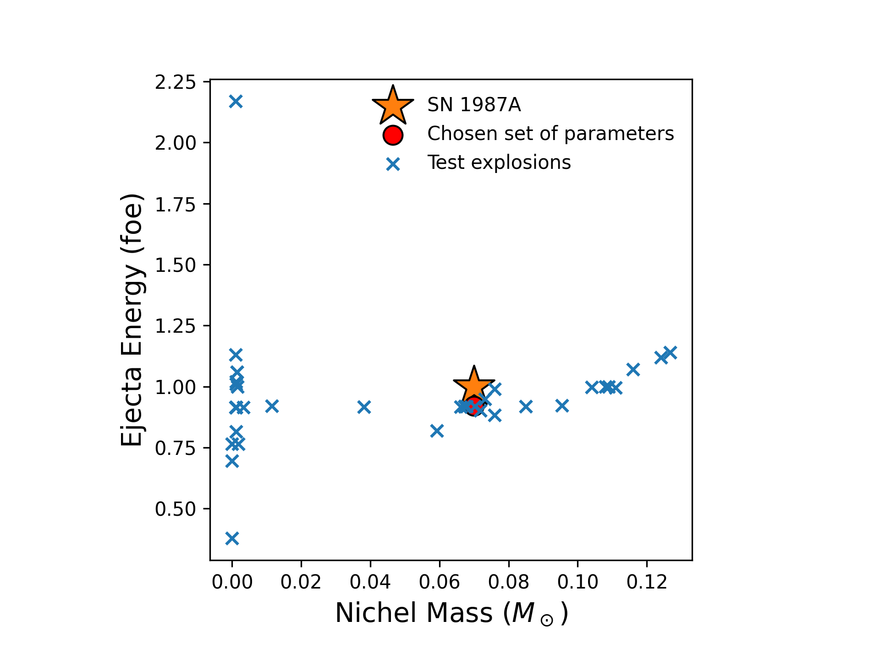
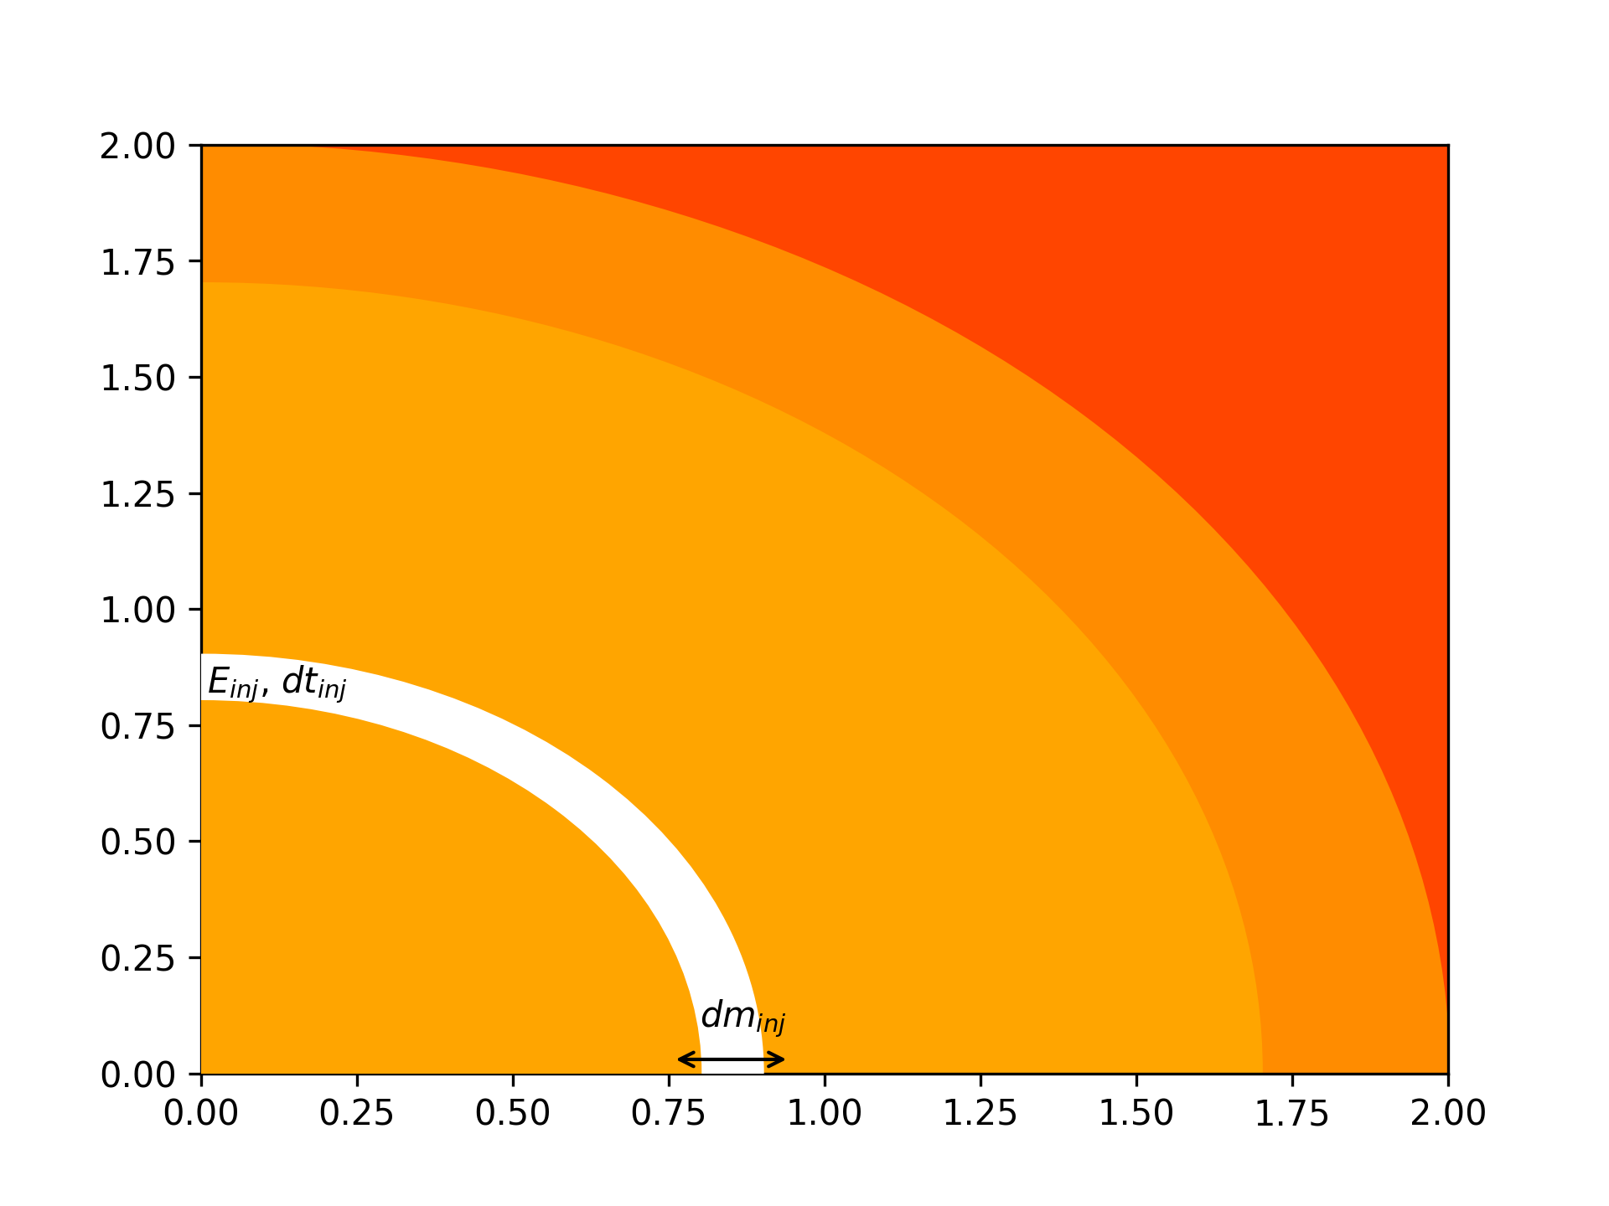
Calibration of supernova explosions
The free parameters of the HYPERION code are:
$E_{inj}$, the injected thermal energy;
$dm_{inj}$, the mass interval where the energy is injected;
$dt_{inj}$, the time needed to inject the energy
One shell
Ugolini et al. in prep
Silicon Shell
Iron elements core
We calibrate the free parameters of HYPERION to match the observed properties of SN1987A
Cristiano Ugolini - SISSA
XIII ET Symposium
Notes:
HYPERION is an hydo-code that work in the framework of a thermal bomb, thus it stimulate the supernova explosion by injecting a given amount of thermal energy in to the iron core. Such injection of energy is described by three free parameters of the code that are:
The termal energy injected, the mass interval where we inject the energy and the time needed to inject the energy, as you can see from this cartoon the injection of energy takes place at a mass coordinate of 0.8 solar masses, so well within the iron core.
We calibrated the free parameters of HYPERION to match the observed properties of SN1987A in terms of kinetic energy of the ejecta and nichel mass injected into the interstellar medium. In the plot you have in blue the test explosions we have performed to tune the parameters, and the red circle is the final set of parameters we have chosen, while the yellow star is -SN1987A.
Then we have used this set of parameters to simulate the explosion of all the models of our grid, working under the hypothesis that the SN mechanism does not depend significantly on the initial mass, initial metallicity or initial rotation of the stellar progenitor.

Slide 9
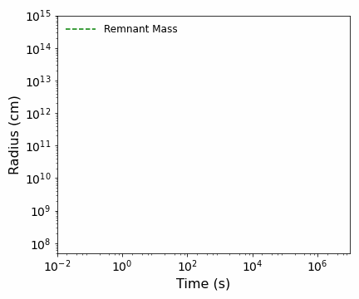
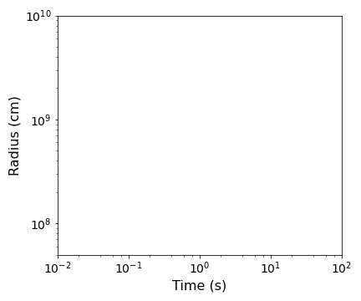
How we determine the remnant mass?
Successful SN explosion:
The most internal region do not reach the escape velocity
Failed SN explosion:
The shock exhausts its energy as it moves through the star
Fallback
Failed-SN
Enclosed Mass = $25M_{⊙}$
[Fe/H]=-2, $M_{ZAMS}=25M_{⊙}$
Enclosed Mass = $20M_{⊙}$
Enclosed Mass = $15M_{⊙}$
Enclosed Mass = 20$M_{⊙}$
Enclosed Mass = 10$M_{⊙}$
Enclosed Mass = $15M_{⊙}$
Enclosed Mass = $5M_{⊙}$
$$M_{rem}=5.8M_{⊙}$$
Enclosed Mass = $10M_{⊙}$
Enclosed Mass = $5M_{⊙}$
Enclosed Mass = $1M_{⊙}$
Enclosed Mass = $1M_{⊙}$
Ugolini et al. in prep
[Fe/H]=-2, $M_{ZAMS}=80M_{⊙}$
Ugolini et al. in prep
Cristiano Ugolini - SISSA
XIII ET Symposium
Notes:
Now the last ingridient we need is the final remnant mass, how we determine it?
Our simulations have only two outputs:
Successful SN explosions, thus the BH is formed through fallback episodes of the layers of the stars that do not reach the escape velocity.
In the Figure we show the evolution of the radius of several mass shells as a function of time of a stellar progenitor with mass at the zero age main sequence of 25 solar masses and metallicity index -2, which means metallicity one hundredth solar. Each gey solid line encloses 1 msun, while the red ones enclose 5 msun. As you can see some layers of the star reach the escape velocity and they escape the star, while the others internal layers at some time after the onset of the explosion stop expanding and they fall back onto the compact remnant and the separation is the remnant itself, that in this case is of 5.8 solar masses and that is represented by the green dashed line.
The other possible output is a failed SN, thus the shock exhausts its energy as it moves through the star. In the figure we show the case of star with mass at the zero age main sequence of 80 solar masses and metallicity index -2. From the figure it is apparent that the layers of the star are accelerated by the shock, exhaust their energy and revert their trajectory falling back onto the compact remnant. As we move outwards in mass we see that the layers are less and less accelerated, up to the region where the shock-wave does not arrive and then the star directlty collapse to a black hole with mass equal to the mass of the star at the presupernova stage
Layers are perturbed but stayes there, it means they do not reache the escape velocity

Slide 10
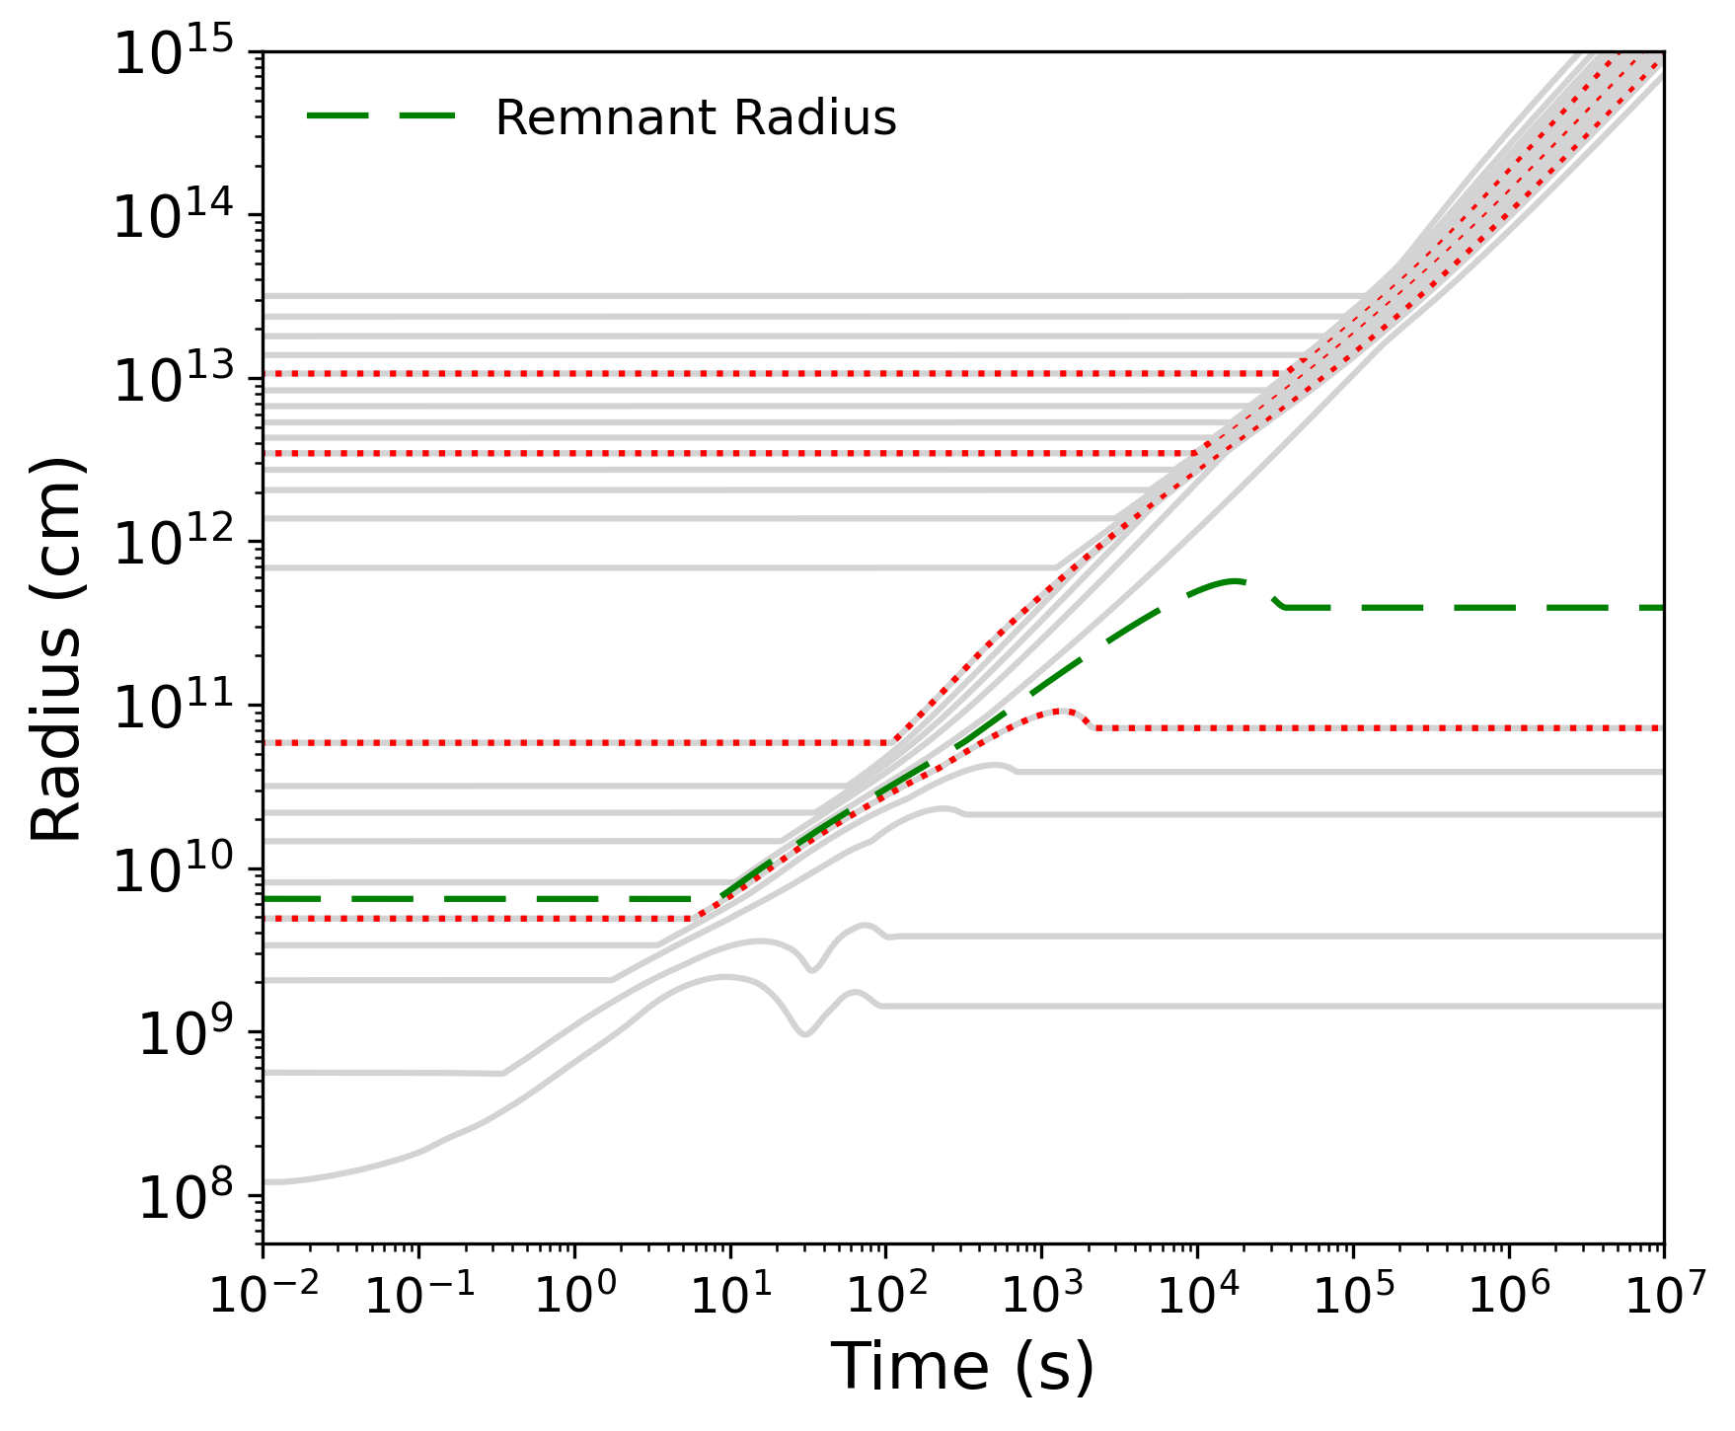
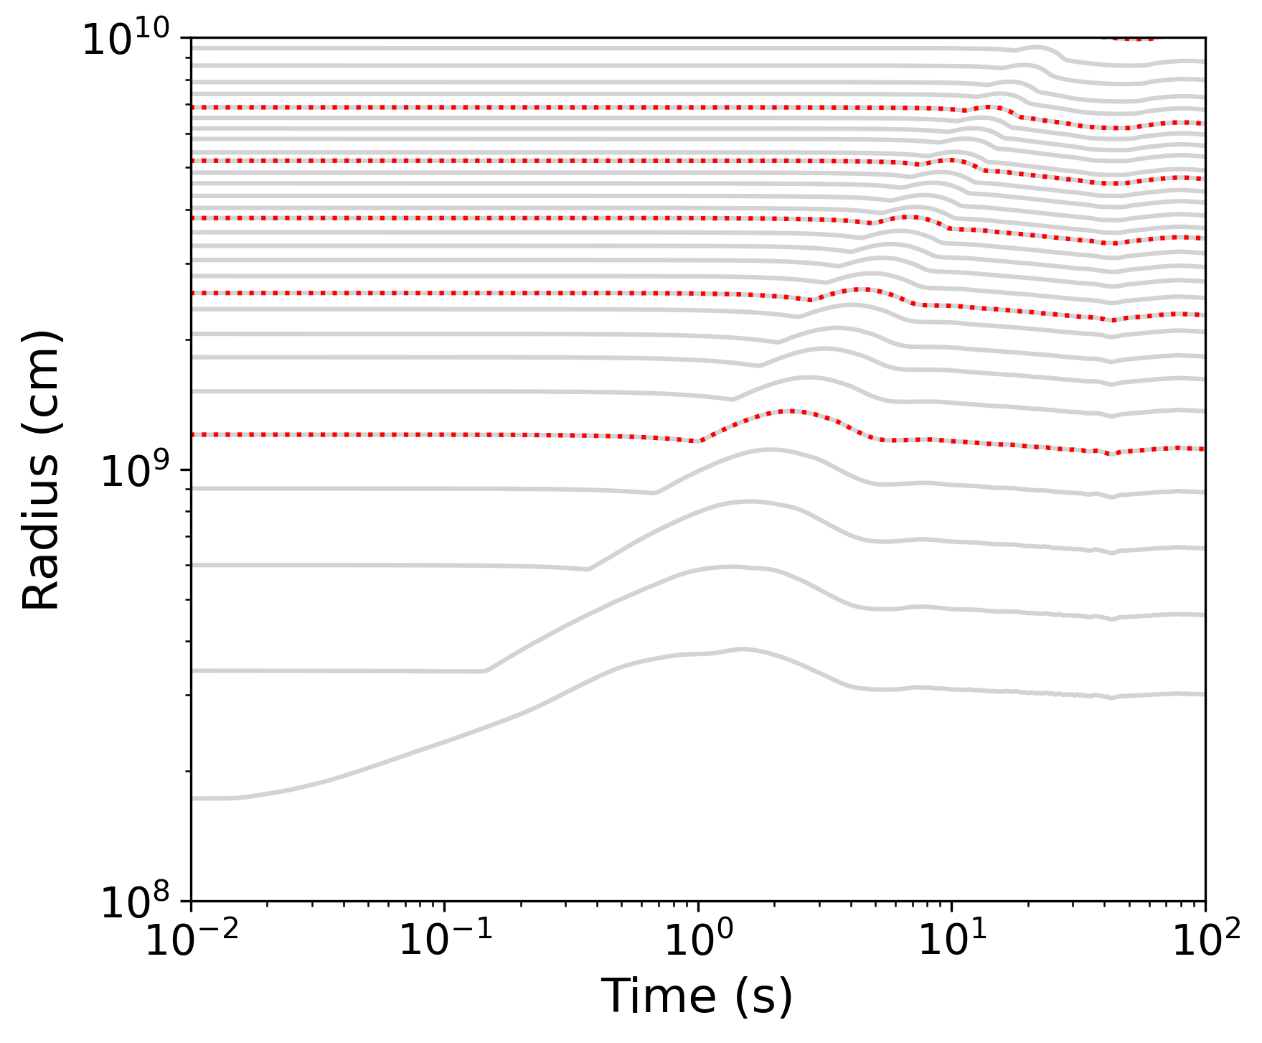
How we determine the remnant mass?
Successful SN explosion:
The most internal region do not reach the escape velocity
Failed SN explosion:
The shock exhausts its energy as it moves through the star
Fallback
Failed-SN
Enclosed Mass = $25M_{⊙}$
[Fe/H]=-2, $M_{ZAMS}=25M_{⊙}$
Enclosed Mass = $20M_{⊙}$
Enclosed Mass = $15M_{⊙}$
Enclosed Mass = 20$M_{⊙}$
Enclosed Mass = 10$M_{⊙}$
Enclosed Mass = $15M_{⊙}$
$$M_{rem}=5.8M_{⊙}$$
Enclosed Mass = $5M_{⊙}$
Enclosed Mass = $10M_{⊙}$
Enclosed Mass = $5M_{⊙}$
Ugolini et al. in prep
[Fe/H]=-2, $M_{ZAMS}=80M_{⊙}$
Ugolini et al. in prep
Cristiano Ugolini - SISSA
XIII ET Symposium
Notes:
Now the last ingridient we need is the final remnant mass, how we determine it?
Our simulations have only two outputs:
Successful SN explosions, thus the BH is formed through fallback episodes of the layers of the stars that do not reach the escape velocity.
In the Figure we show the evolution of the radius of several mass shells as a function of time of a stellar progenitor with mass at the zero age main sequence of 25 solar masses and metallicity index -2, which means metallicity one hundredth solar. Each gey solid line encloses 1 msun, while the red ones enclose 5 msun. As you can see some layers of the star reach the escape velocity and they escape the star, while the others internal layers at some time after the onset of the explosion stop expanding and they fall back onto the compact remnant and the separation is the remnant itself, that in this case is of 5.8 solar masses and that is represented by the green dashed line.
The other possible output is a failed SN, thus the shock exhausts its energy as it moves through the star. In the figure we show the case of star with mass at the zero age main sequence of 80 solar masses and metallicity index -2. From the figure it is apparent that the layers of the star are accelerated by the shock, exhaust their energy and revert their trajectory falling back onto the compact remnant. As we move outwards in mass we see that the layers are less and less accelerated, up to the region where the shock-wave does not arrive and then the star directlty collapse to a black hole with mass equal to the mass of the star at the presupernova stage
Layers are perturbed but stayes there, it means they do not reache the escape velocity

Slide 11
Non-rotating stellar progenitors
Ugolini et al. in prep
Metallicity strongly affects the final BH mass
Our code cannot follow the evolution of stars unstable against pair-production
$M_{CO}=35M_{⊙}$, criterion for the onset of pulsational pair-instability supernovae (Heger et al. 2002)
We use the results of Woosley et al. 2017 for the remnant masses
Cristiano Ugolini - SISSA
XIII ET Symposium
Notes:
We investigated the explosion of both rotating stars and non-rotating stars. These plots show what happens to the mass spectrum of compact object of non-rotating stellar progenitors We confirmed that the BH mass spectrum strongly depends on the metallicity, since at low metallicities the stellar winds are quenched, and therefore we get heaveier BHs at lower metallicities with respect to higher metallicities, where stellar winds are very strond, instead. We also included the effect of PPISNe. We rely on heger 2002 to establish where we have PPISN, and woosley 2017 to calculate the remnant masses, because our stellar evo code cannot follow the evolution of star that at some point become unstable against pair-production. In plots the Gray shaded area are the fainted SN, while the green and yellow shaded area corresponds respectively to PPISNe and PISNe and are determined accordingly to woosley.
It is worth noting that in our simulations, for example at very low metallicity, the progenitor with 80 Msun is stable against pair-production and so we can form very heavy BHs, up to 90 Msun before becoming unstable against pair production (cerchietto sul punto).
Results=resalts

Slide 12
Rotating stellar progenitors
Ugolini et al. in prep
Rotation strongly enhances mass loss and chemical mixing
Pulsational pair-instability supernovae occur for lighter stars with respect to the non-rotating case
Cristiano Ugolini - SISSA
XIII ET Symposium
Notes:
In contrast for rotating progenitors, we show that mass loss in enhanced significantly and the BHs are then smaller.
Furthermore, rotation strongly enhances the chemical mixing, thus pulsational pair instabilities occur for lighter stars with respect to the non-rotating case. As you can see from the picture, at lower metallicities the stars are unstable against pair-production with values of mzams of rougly 70 solar masses

Slide 13
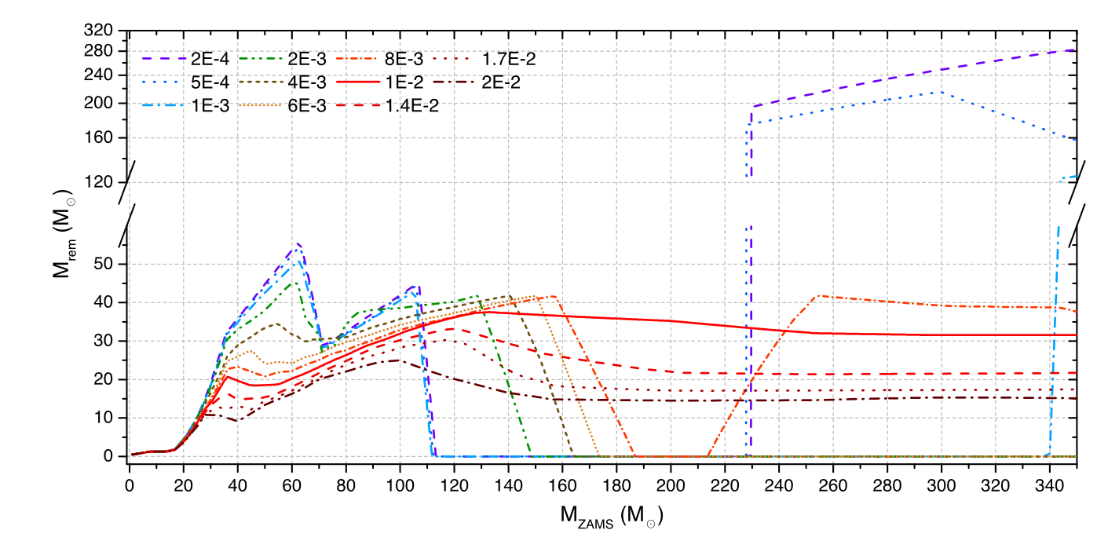
Implications of our results: the upper mass gap
Spera & Mapelli 2017
Ugolini et al. in prep
Ugolini et al. in prep
Cristiano Ugolini - SISSA
XIII ET Symposium
Notes:
One of the first implications of our work is on the pair-instability mass gap, also known as the upper mass gap. This is a plot from Spera and mapelli 2017 that shows an example of the mass gap, which is the dearth of black holes in the interval between 60 solar masses and roughly 120 solar masses, due to the onset fo the PPISNe.

Slide 14
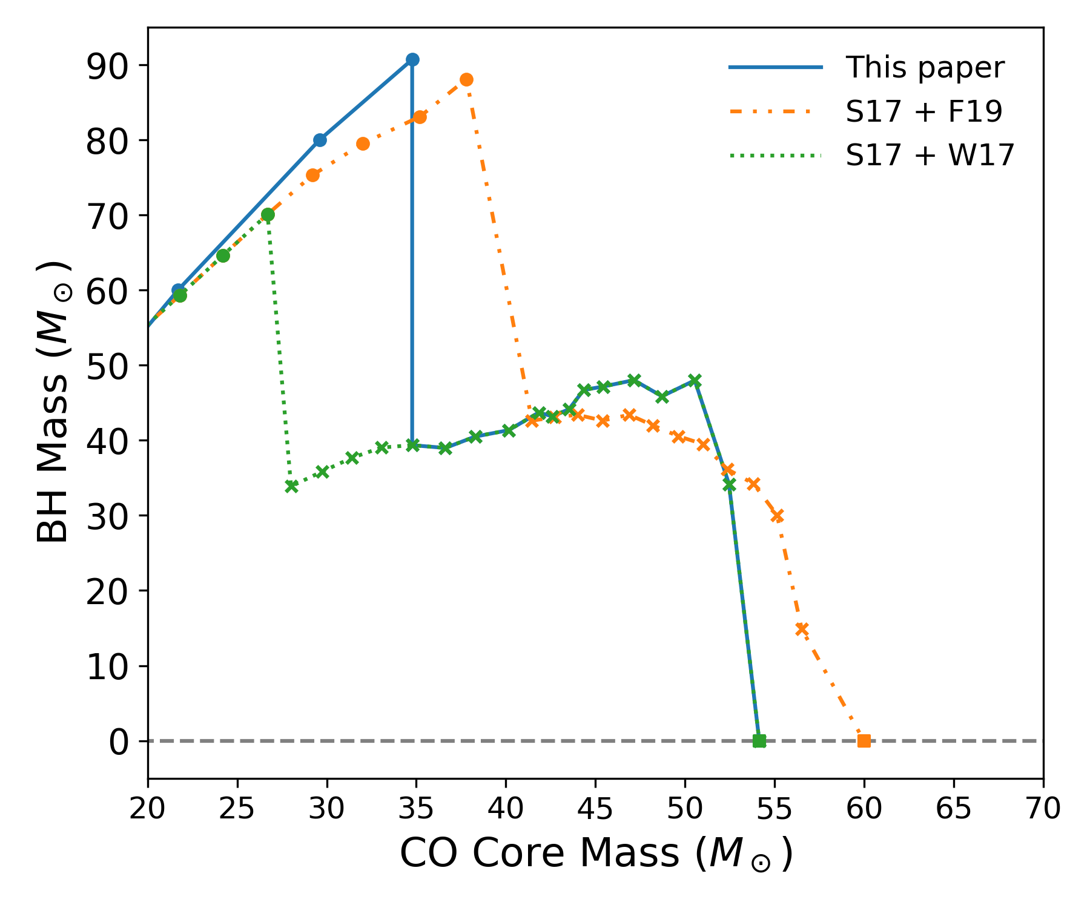
Implications of our results: the upper mass gap
Ugolini et al. in prep
Ugolini et al. in prep
Varying the criterion for the onset of PPISNe has a crucial impact on the heaviest BH that form from the evolution of single stars
Cristiano Ugolini - SISSA
XIII ET Symposium
Notes:
Here it is the same plot but now as a function of the carbon-oxygen core. The pink line in this plot is the curve of spera and mapelli 2017 for metallicity one hunderth solar. In contrast the blue curve is my result. Accordingly to our results the position of the mass gap is not at 60 solar masses but at rougly 90 solar masses instead, which is singificantly more massive than the lower edge of the mass gap of the fiducial model I just showed. In the plot we report also the results of other authors in literature. What is crucial is the criterion for the onset of the PPISNe, in our case we enter in the pulsational pair instability regime later in terms of the co core mass and this allow us to produce more massive BHs.
For example here our results are always the blue curve, while the orange curve and the green curves are always the spera and mapelli 2017 stellar tracks but using different criteria for the onset of PPISNe. And you see that for example the orange curve is quite similar to ours.
Therefore, varying the criterion for the onset of PPISNe has a crucial impact on the heaviest BH that form from the evolution of single stars and so on the upper mass gap

Slide 15
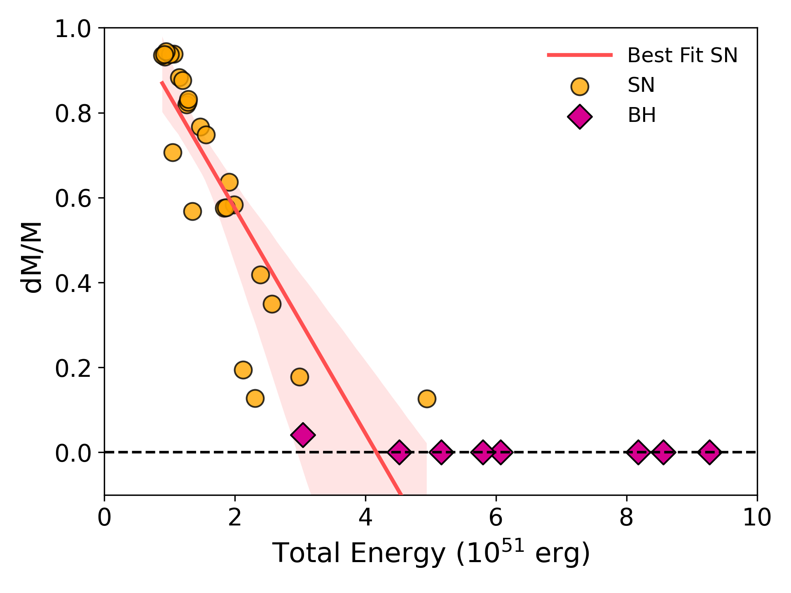
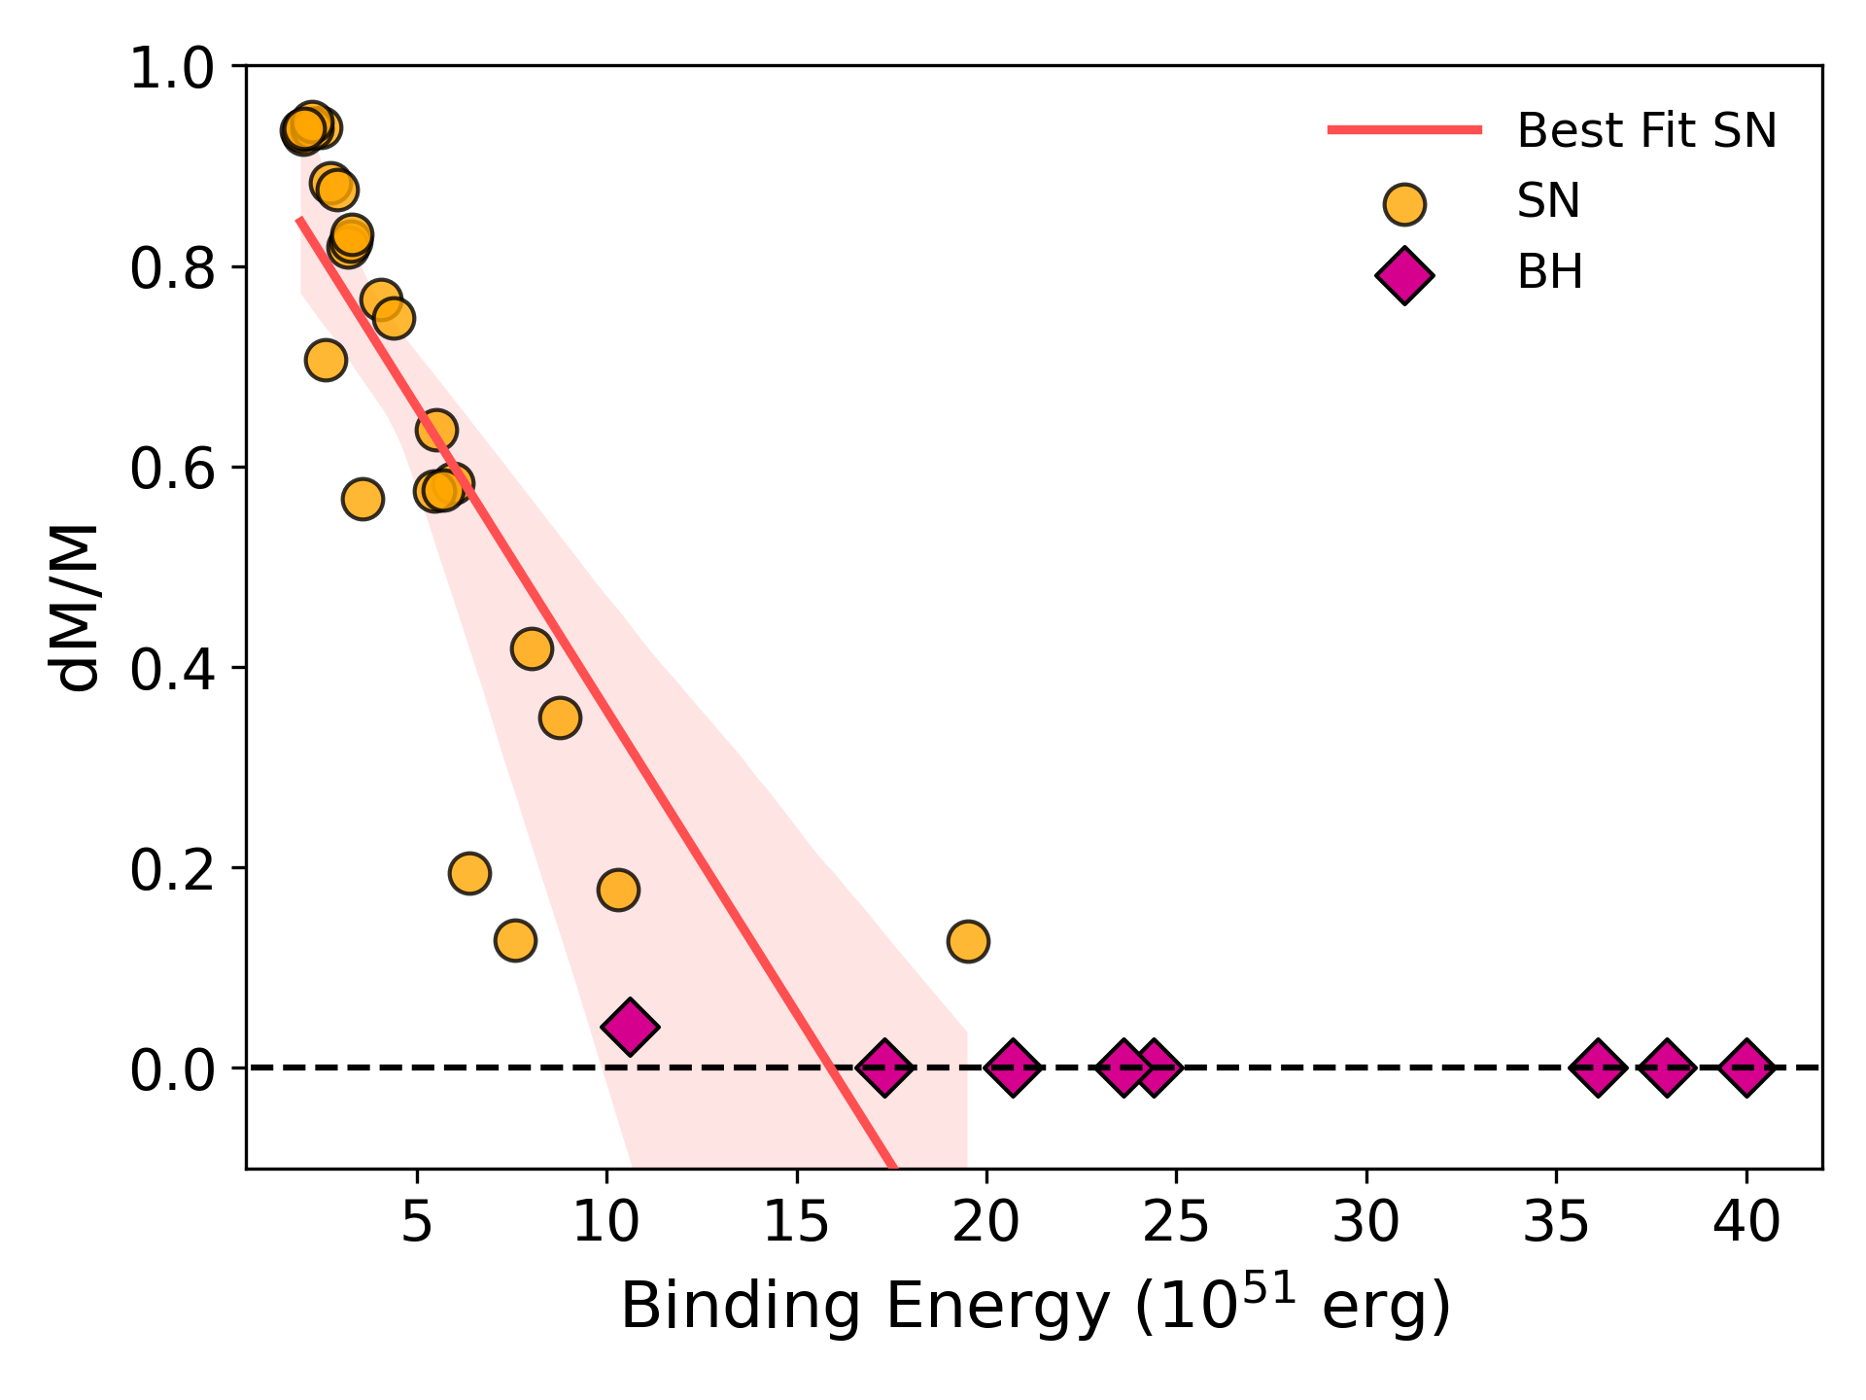
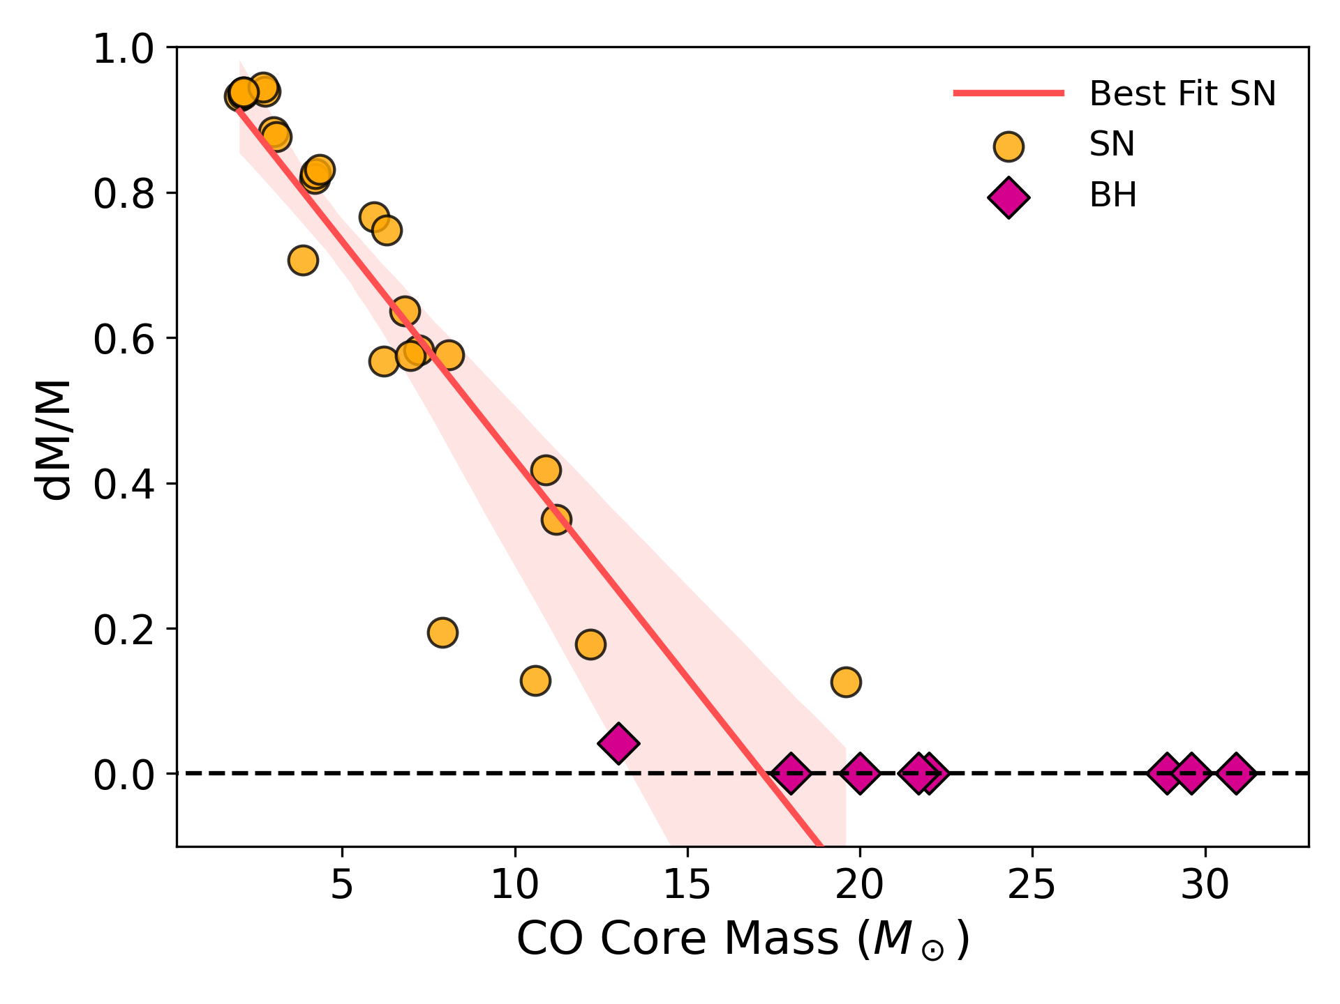
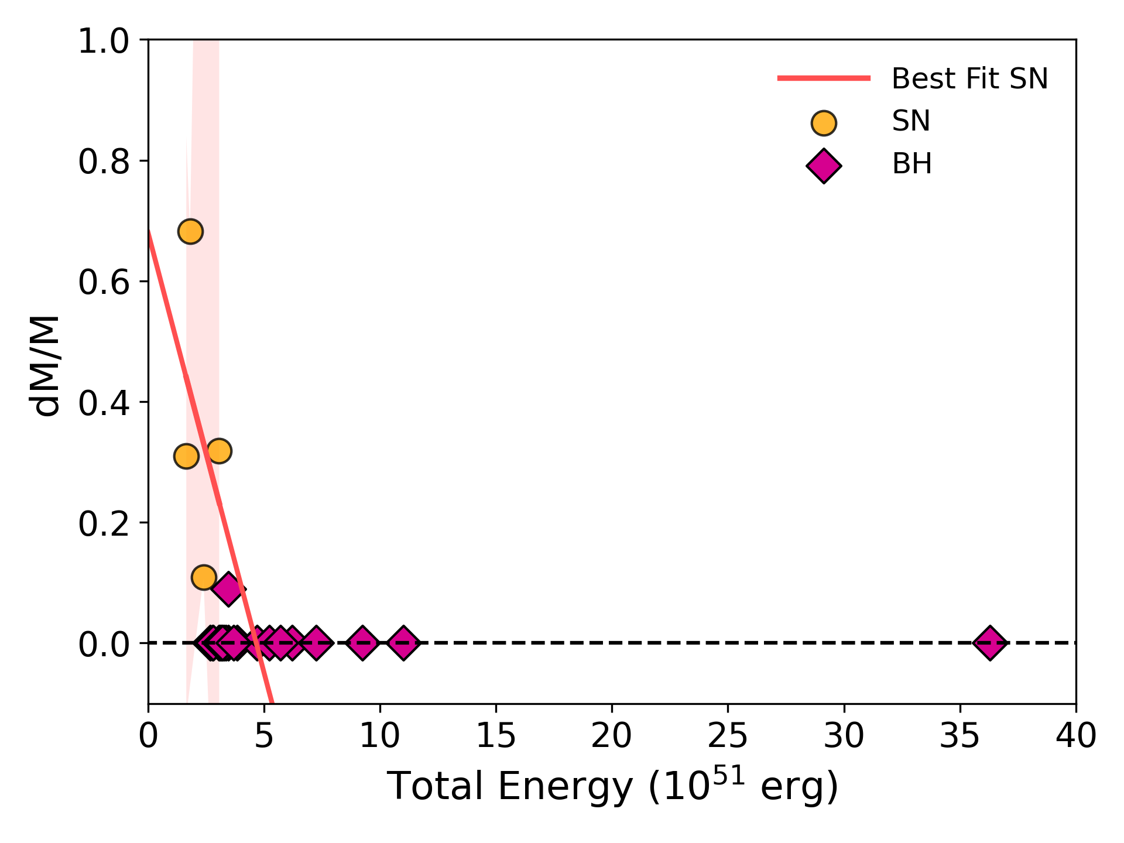
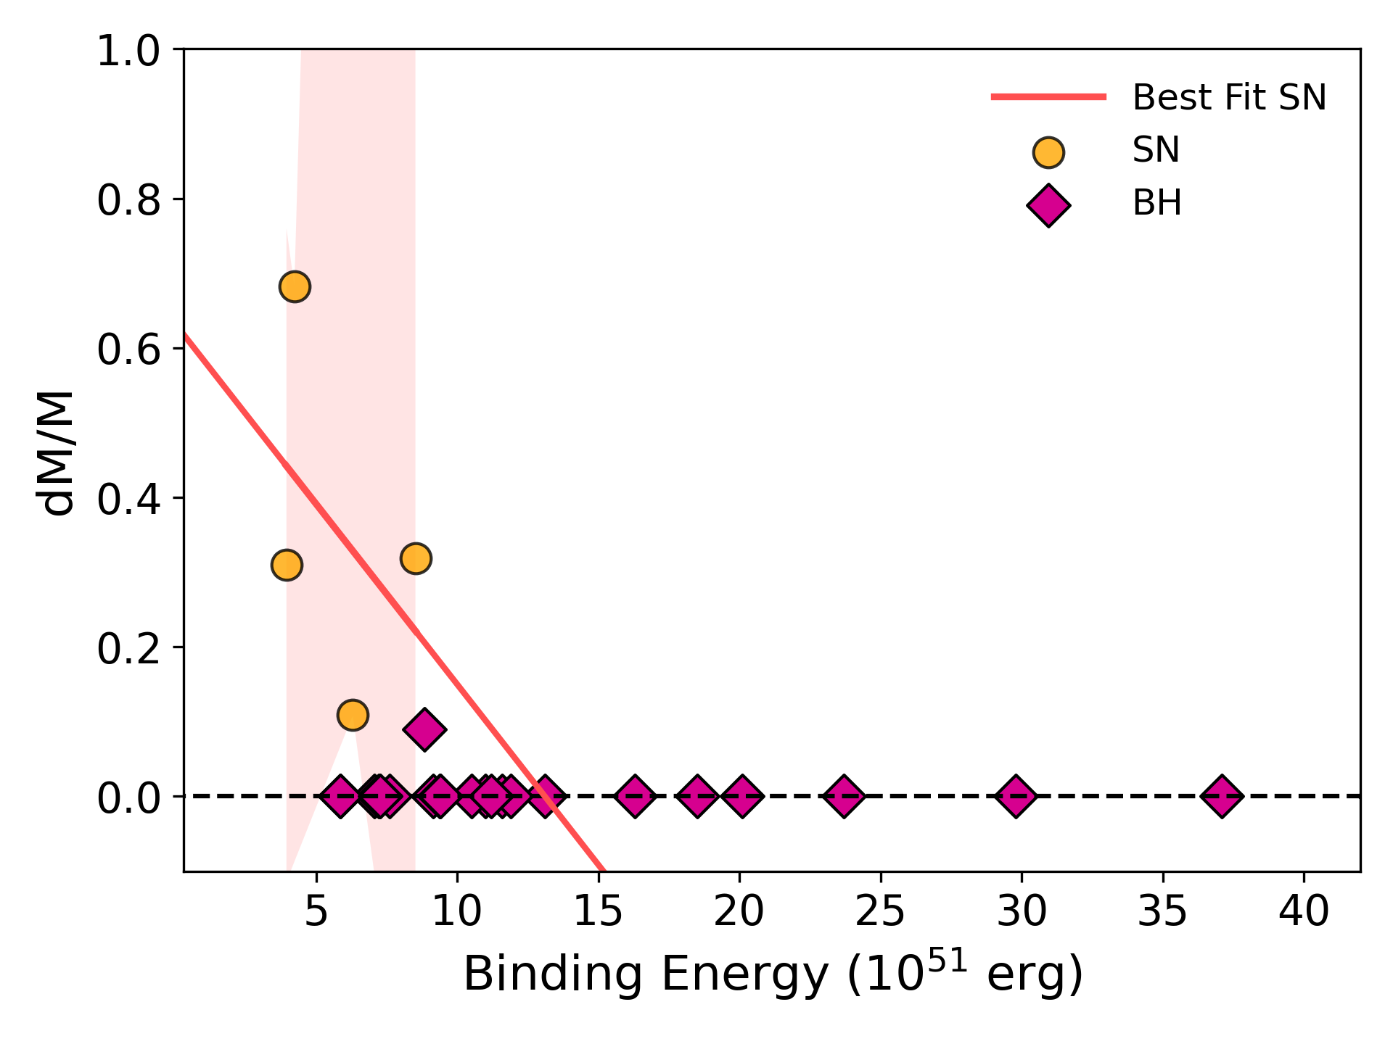
Fitting Formulas
We search for any linear relation between the properties of the star at the pre-SN stage and its remnant mass.
$${dM}/{M=\frac{M_{preSN}−M_{rem}}{M_{preSN}}}$$
For the non-rotating progenitors we find:
Ugolini et al. in prep
$${dM}/{M= \left\{\begin{aligned}mx+b, x≤x_{DC} \\ 0, x>x_{DC}\end{aligned}\right.}$$
For the rotating progenitors, we do not find any linear relation in place
Ugolini et al. in prep
Linear fits cannot capture the complexity of the physics behind the SN explosion mechanism
Cristiano Ugolini - SISSA
XIII ET Symposium
Notes:
We tried to search for for any linear relation between the properties of the star at the pre-SN stage and its remnant mass.
We tried to do that using the mass loss during our simulation of the explosion, so dM/M. As you can see in this plot we find some kind of linear trend as a function of the parameters, total energy, binding and co core mass. Tough you have quite a lot of scattering in the points we obtained from self-consistent simulations and this is significant. Such effect is even more apparent for rotating progenitors.
Therefore we can conclude that linear fits cannot capture the complexity of the physics behind the SN explosion mechanism
So we found that the best ways to procede with is to self-consistently simulate Sne for a given grid of progenitors, without relying on fitting formulas.

Slide 16
Summary and conclusion
Homogeneous study of the evolution and explosion of massive stars
BH mass spectrum and implications on the position of the upper mass gap
Linear fits cannot capture the complexity of the physics behind the SN explosion mechanism
Thank you for your attention
Please feel free to contact me anytime if you have idea on the topic:
cugolini@sissa.it
Cristiano Ugolini - SISSA
XIII ET Symposium
Notes:
Next step: incrementare i punti della griglia delle tracce e calcolare nuove espolioni in modo da identificare bene non solo i black holes ma anche le neutron stars
In this talk i decide to focus only on the BH mass spectrum and on the implications of my results on the position of the upper mass gap
As a future step we plan to significantly increase the number of tracks and so the number of explosions to investigate with details not only BHs but also neutron stars, especially those coming from ecSN and the progenitor mass threshold to start forming BHs
Per il progress report: bump BHs, collaboration con carl rodriguez per la parte dinamica, sto aiutando cecilia con i lambda (cercheremo di fare la stessa cosa con FRANEC er estendere i risultati sui lambda) e francesco con le PISN e che come follow up we will study the transition wd-ns e ns-BH che poi metteremo in sevn, così in sevn togliamo tutte le fitting formulas
Troviamo quelli che dicono che quello è i PPISNE mass bump e la metto tutto in una slide e poi dico: prossimo lavoro dire che questo è non necessariamente corretto

Slide 17
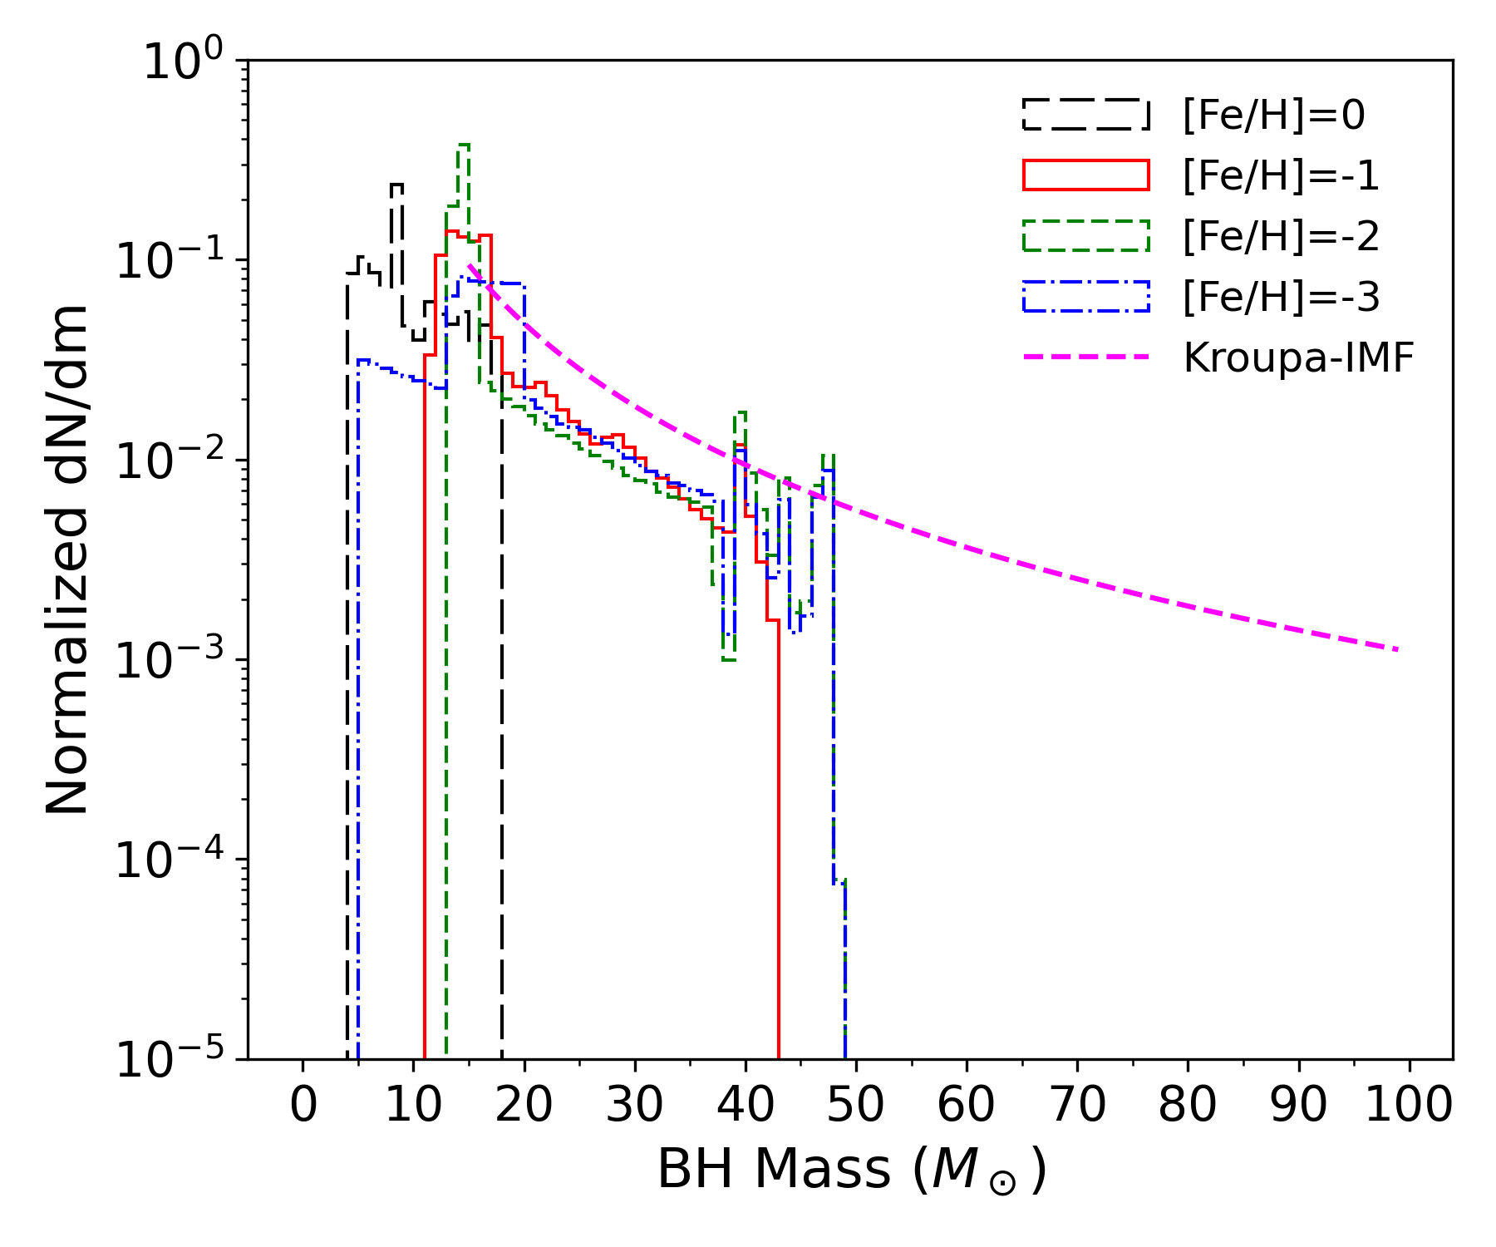
BH Mass Spectrum
We find several peaks in the BH distribution, which are features of the:
IMF
SN details
PPI prescriptions
We apply our results to a populations of ${10}^{6}$ stars, with $M_{ZAMS}∝m^{−2.35}$ (Kroupa IMF)
Ugolini et al. in prep
The feature emerging from the BH mass spectrum are degenerate
Not easy to detach from each other!!!

Slide 18
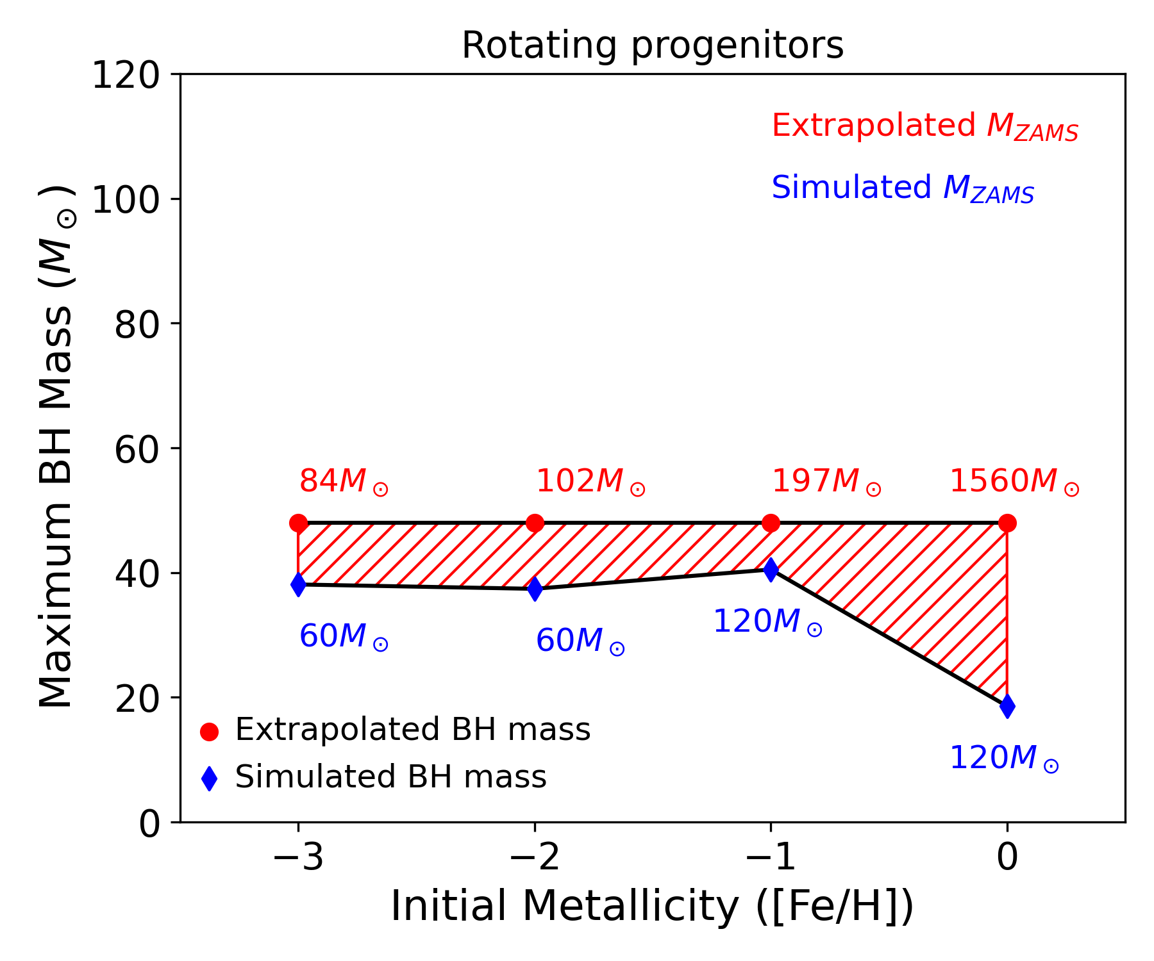
Max BH mass
Ugolini et al. in prep
Ugolini et al. in prep

Slide 19
How we determine the remnant mass?
Successful SN explosion:
The most internal region do not reach the escape velocity
Failed SN explosion:
The shock exhausts its energy as it moves through the star
Fallback
Failed-SN
Enclosed Mass = $25M_{⊙}$
[Fe/H]=-2, $M_{ZAMS}=25M_{⊙}$
Enclosed Mass = $20M_{⊙}$
Enclosed Mass = $15M_{⊙}$
Enclosed Mass = 20$M_{⊙}$
Enclosed Mass = 10$M_{⊙}$
Enclosed Mass = $15M_{⊙}$
Enclosed Mass = $5M_{⊙}$
$$M_{rem}=5.8M_{⊙}$$
Enclosed Mass = $10M_{⊙}$
Enclosed Mass = $5M_{⊙}$
Enclosed Mass = $1M_{⊙}$
Enclosed Mass = $1M_{⊙}$
Ugolini et al. in prep
[Fe/H]=-2, $M_{ZAMS}=80M_{⊙}$
Ugolini et al. in prep
Cristiano Ugolini - SISSA
XIII ET Symposium
Notes:
Now the last ingridient we need is the final remnant mass, how we determine it?
Our simulations have only two outputs:
Successful SN explosions, thus the BH is formed through fallback episodes of the layers of the stars that do not reach the escape velocity.
In the Figure we show the evolution of the radius of several mass shells as a function of time of a stellar progenitor with mass at the zero age main sequence of 25 solar masses and metallicity index -2, which means metallicity one hundredth solar. Each gey solid line encloses 1 msun, while the red ones enclose 5 msun. As you can see some layers of the star reach the escape velocity and they escape the star, while the others internal layers at some time after the onset of the explosion stop expanding and they fall back onto the compact remnant and the separation is the remnant itself, that in this case is of 5.8 solar masses and that is represented by the green dashed line.
The other possible output is a failed SN, thus the shock exhausts its energy as it moves through the star. In the figure we show the case of star with mass at the zero age main sequence of 80 solar masses and metallicity index -2. From the figure it is apparent that the layers of the star are accelerated by the shock, exhaust their energy and revert their trajectory falling back onto the compact remnant. As we move outwards in mass we see that the layers are less and less accelerated, up to the region where the shock-wave does not arrive and then the star directlty collapse to a black hole with mass equal to the mass of the star at the presupernova stage
Layers are perturbed but stayes there, it means they do not reache the escape velocity

