Slide 1
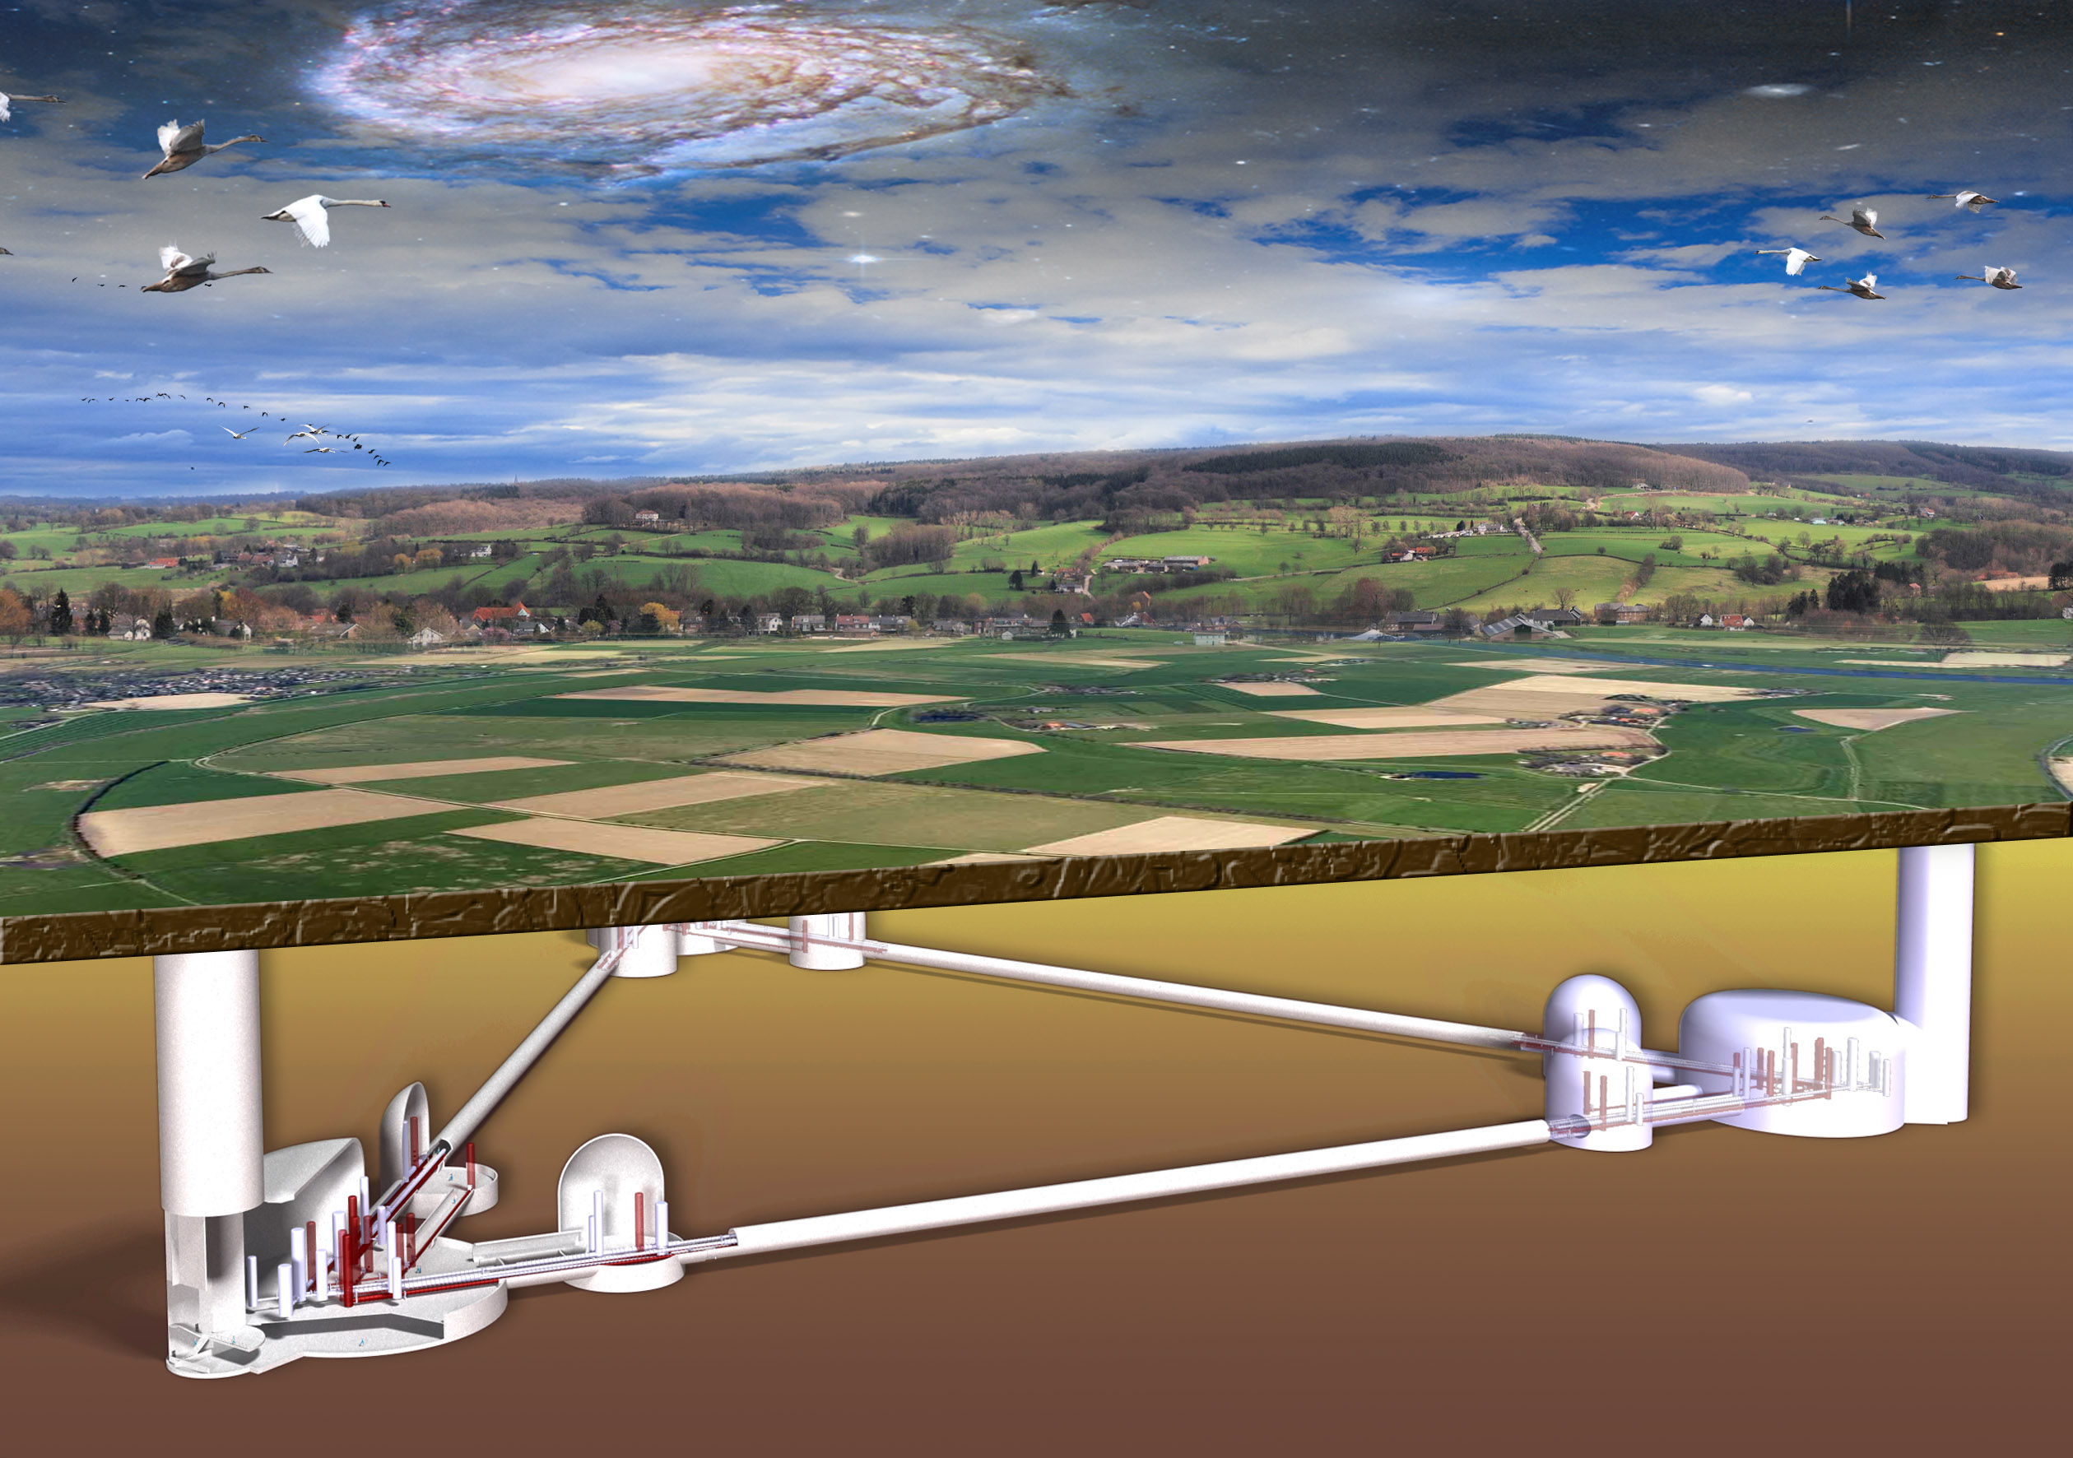
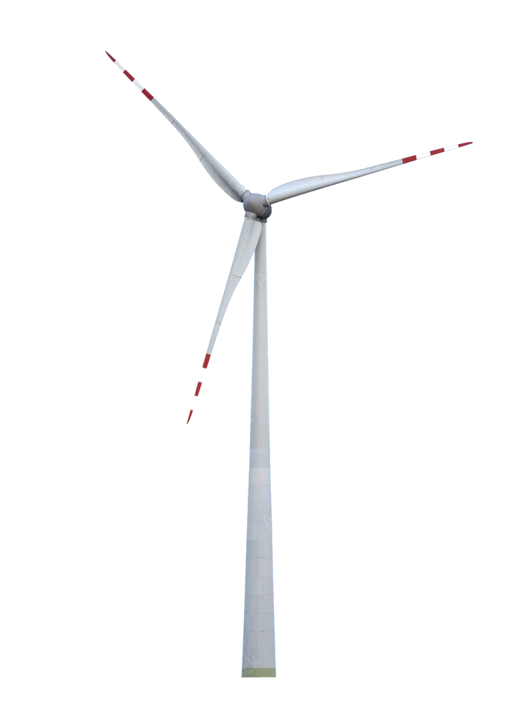
© Marco Kraan
ET & Wind Turbines
Achim Stahl, May 8th, 2023
RWTH Aachen University

Slide 2
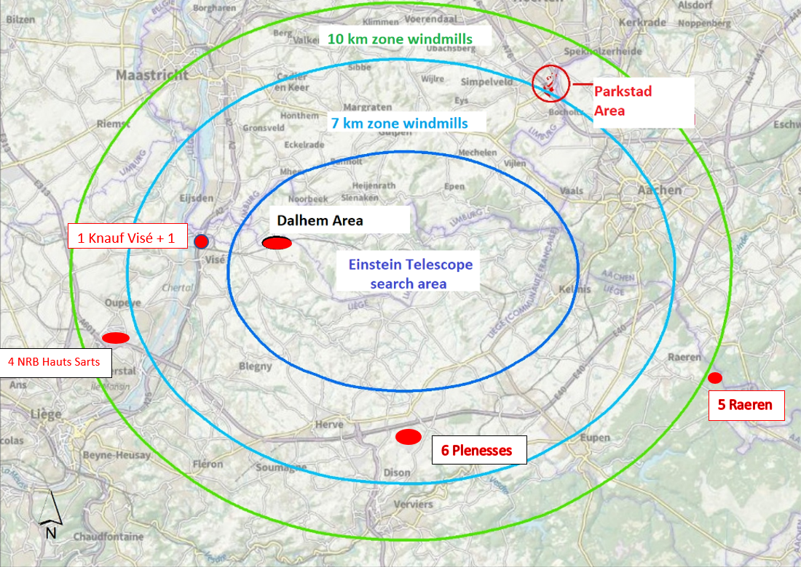

Slide 3
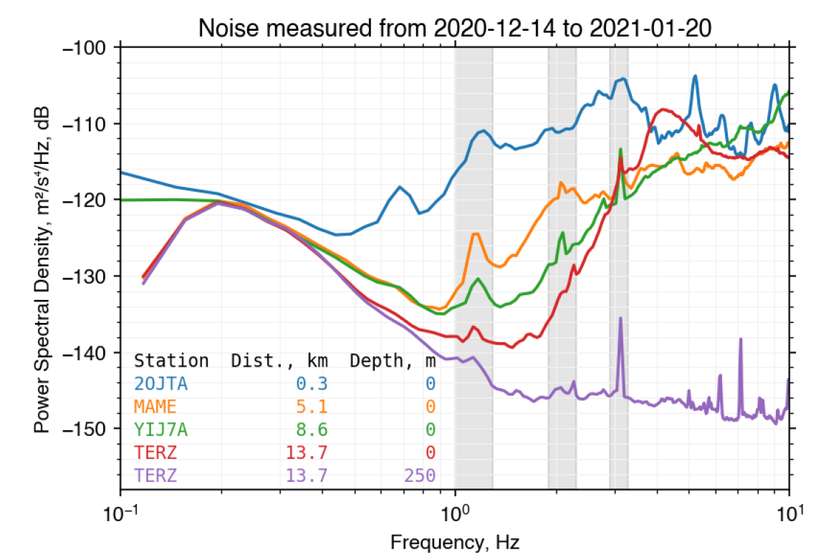

Slide 4
Pitch-Control
status: Idea
effiziency: Unbekannt
cost: none
Rotor passes tower:
Reduced pressure on the tower
Excitation of oscillation
Pitch control:
Increas pressure during passage
→ Reduce excitation.

Slide 5
Lattice Tower
status: Okay
effiziency: high
cost: none
Lattice tower: substantially lower friction to air
Less exciation
Open question:
Lattice towers for large turbines?
Bonus B23/150 Gittermast
150 kW

Slide 6
Dampers in the Tower
status: Idee
effiziency: unknown
cost: < 10 %
Dampers between tower elements:
Absorbs energy in the vibrations
Reduces amplitude

Slide 7
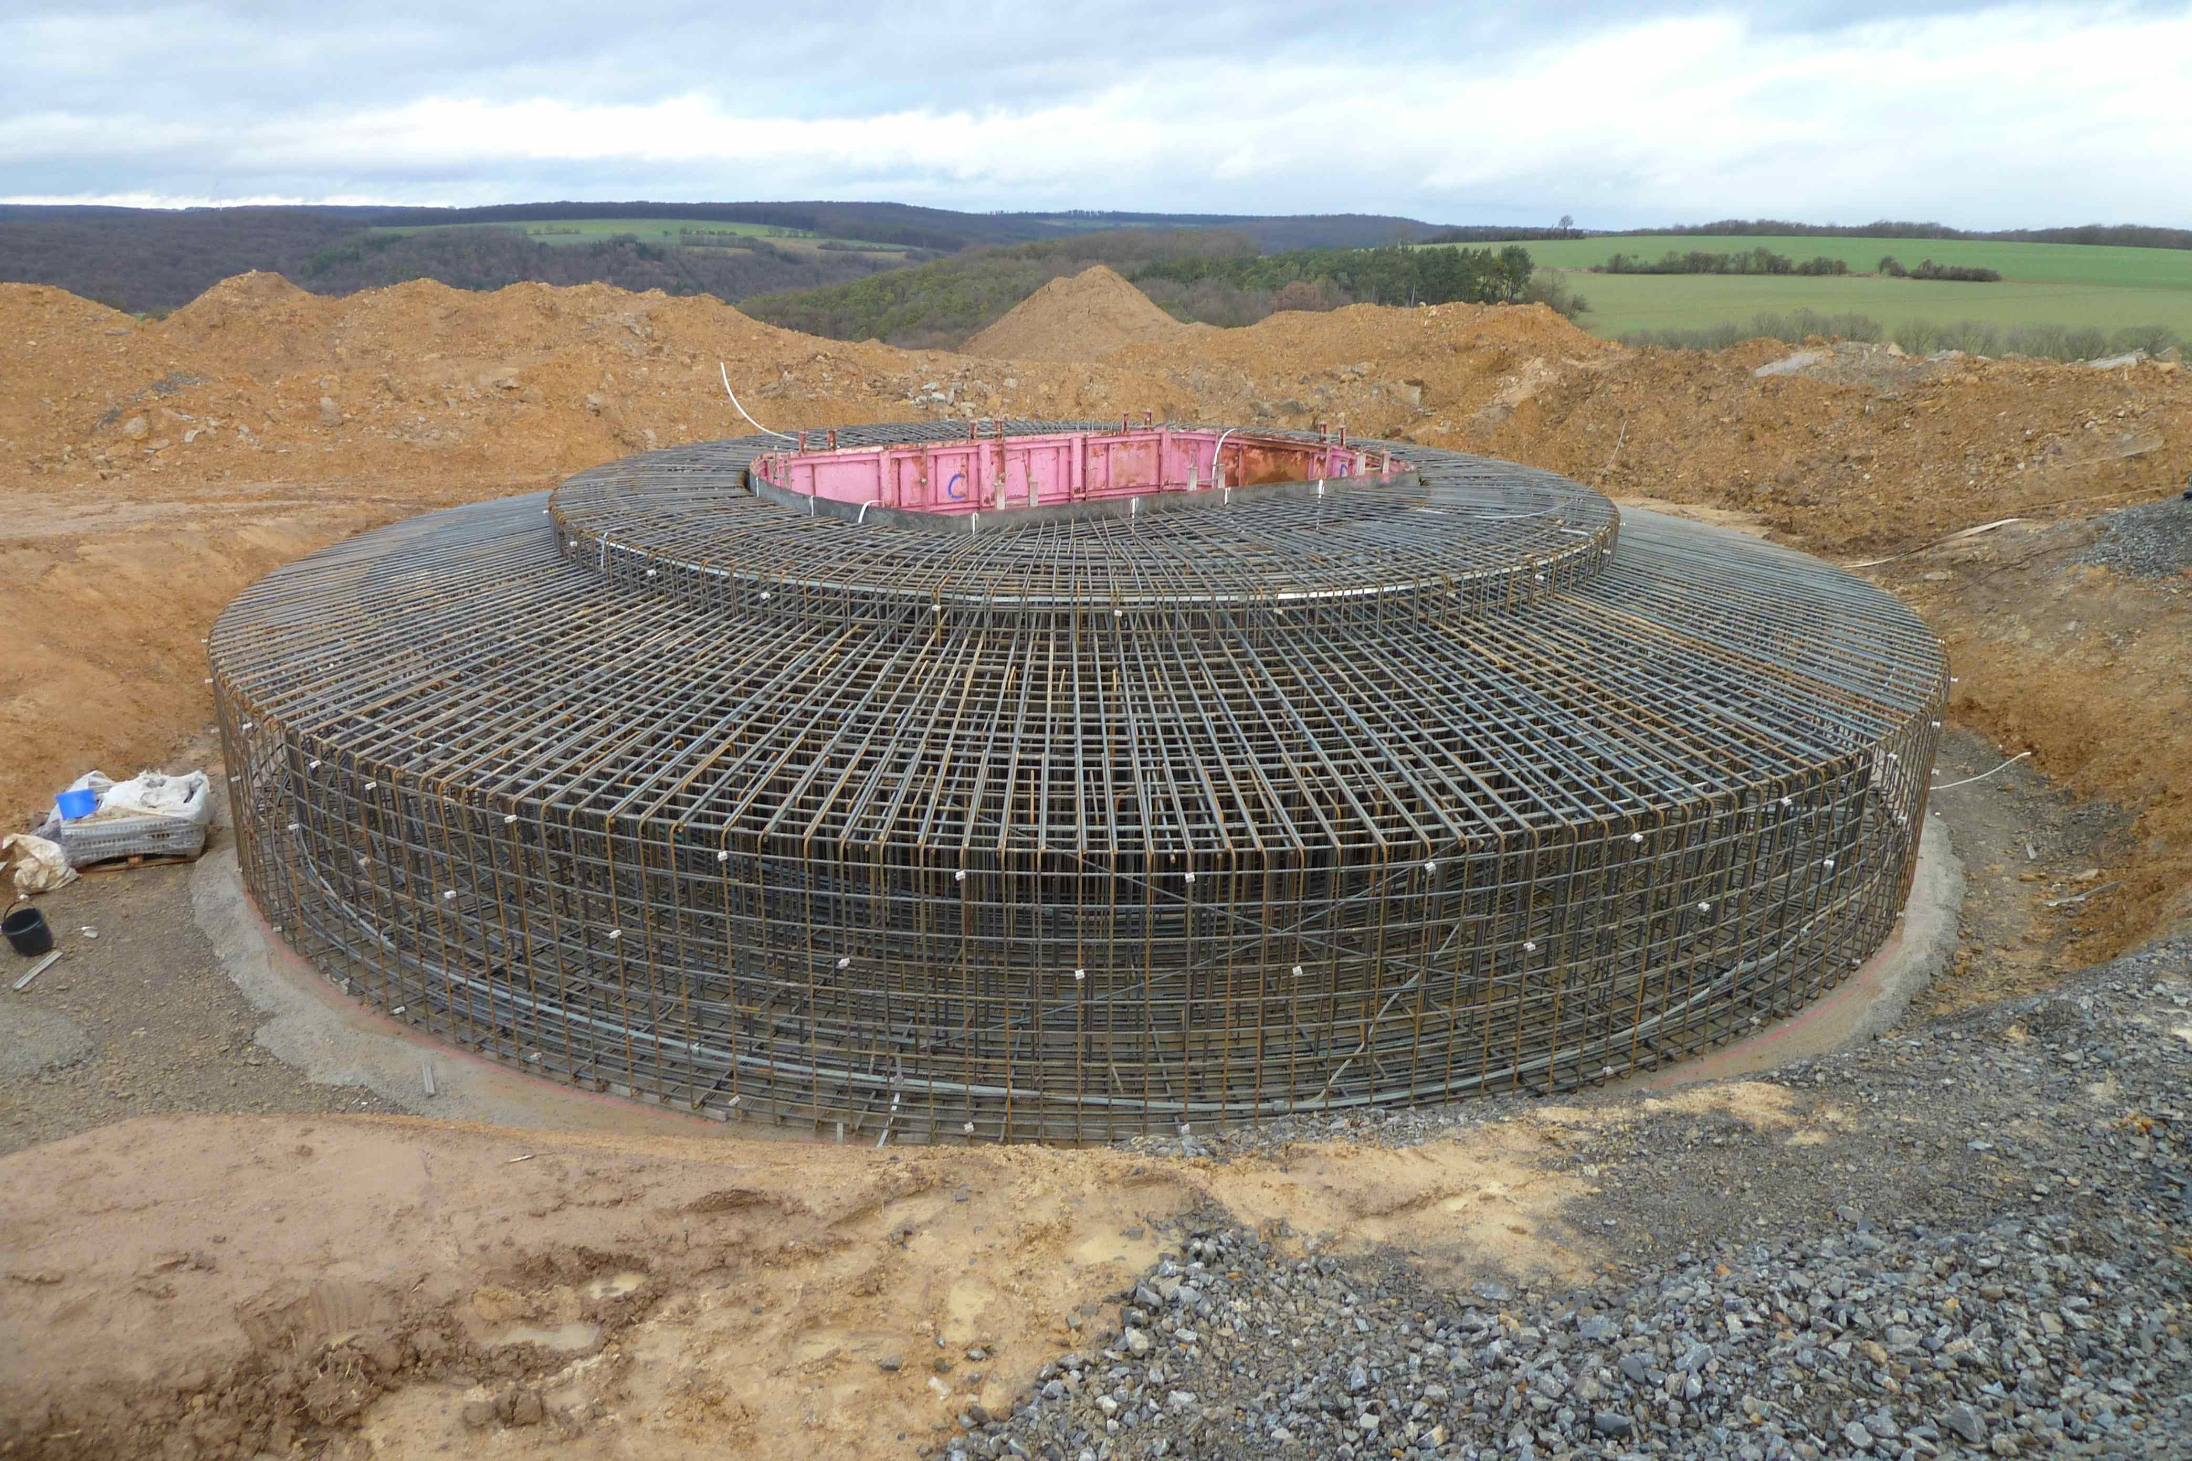
Foundation: Type
status: known
effiziency: high
cost: none
Two type of foundation:
„Flachgründung“ → less impact
„Pfahlgründung“ → higher impact

Slide 8
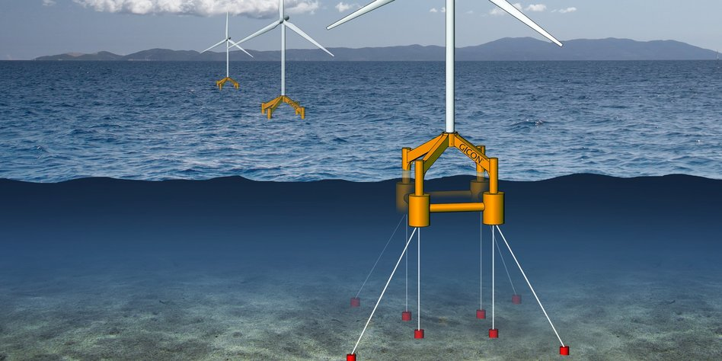
Floating Foundation
status: known
effizienz: (almost) perfect
cost: too expensive
Built water pools; float turbines
Negligible transmission
Problem: too expensive

Slide 9
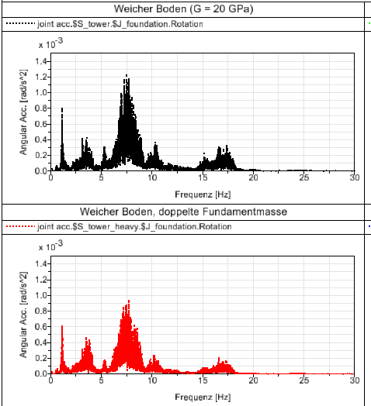
Foundation: Weight
status: first simulations
effiziency: 1,3 to 1,5
Cost: < 10 %
Heavier fundation
(2 x the concrete)
Reduces the vibration of the ground
Can be combined with other measures.
Simulation, Prof. R. Schelenz

Slide 10
Foundation: width
status: Studied in miss
effiziency: ?
cost: < 10 %
Wider foundation shows less vibrations at the same mass
Additional reduction on top of increased mass.

Slide 11
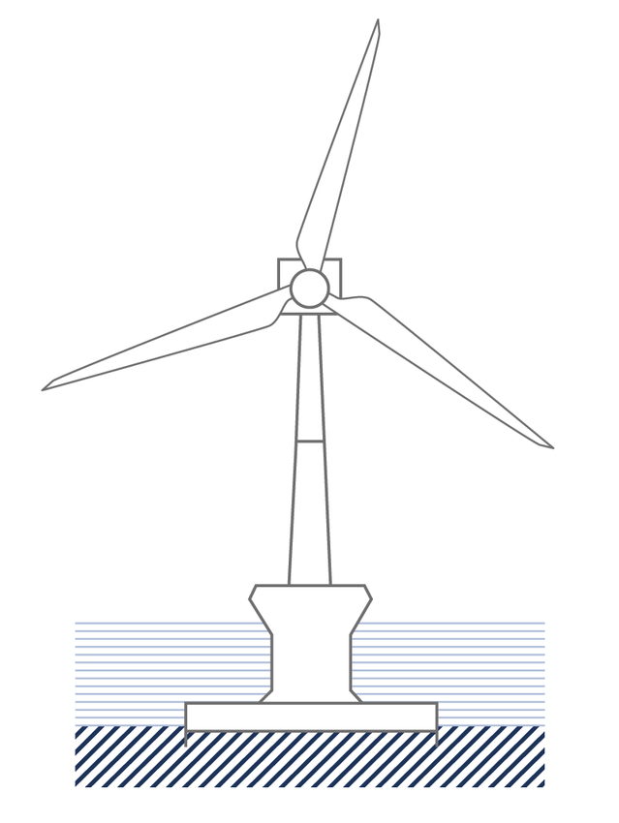
Foundation: Dampers
status: Idea
effiziency: unclear
cost: 10 … 20 %
Dampers between
Fundation and ground

Slide 12
Active damping:
status: Idea
effiziency: probably high
cost: 10 … 20 %
Aktive motion of mass on the base
of the tower
For example pumping of water between tanks
Problem: rather high effort

Slide 13
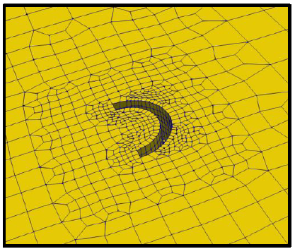
Trenches
status: simulation
effiziency: unclear
cost: < 10 %
Trenches around the base stop the propagation of seismic waves.
Open question: Stops surface waves.
Does it sop bulk waves, too?

Slide 14
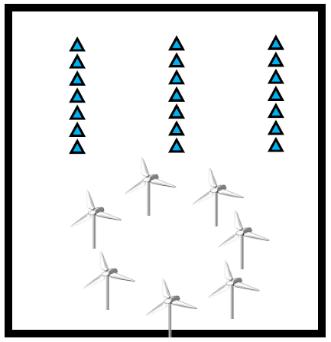
Interference
status: simulation
effiziency: works only in special situations
cost: none
Destructive interference between seismic waves of different turbines.
Problem: Works only for specific wind directions, strengths, ….

Slide 15
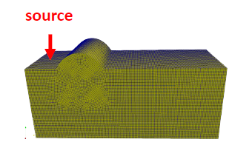
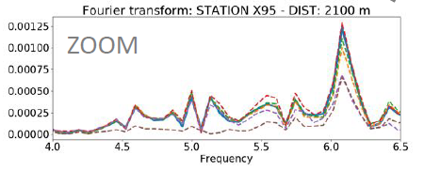
Shielding by local terrain
status: simulation
effiziency: locally varying
cost: none
Local topology / geology impact the proagation of the waves
Built windturbines behind local hills, valeys, etc.
Strongly dependent on local situation

Slide 16
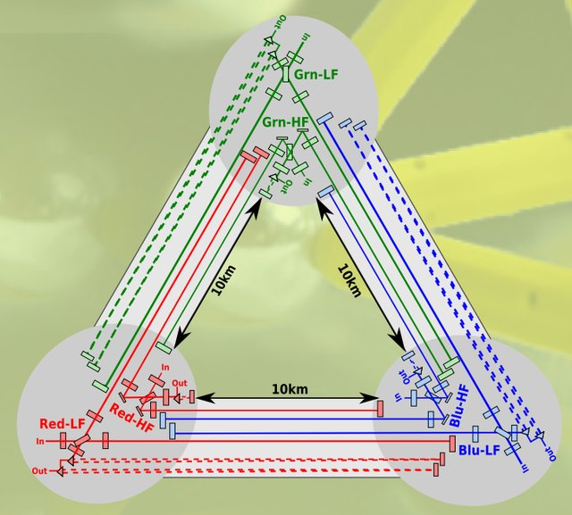
Newtonian noise
Status: Simulation
Effizienz: 2 bis 4
Kosten: im ET Budget
Expertise: Prof. Stahl
Aber: Störungen vermeiden ist besser als korrigieren
Active Noise Mitigation
seismic wave
seismic sensors
wave field reconstruction
active compensation
test at DZA underground lab

Slide 17
© Marco Kraan
ET & Wind Turbines
Thanks
Achim Stahl, March 31st, 2023
RWTH Aachen University

