Slide 1
ET Sustainable Development Strategy Main goals WP9 - INFRADEV
Minimize the global carbon footprint of the Einstein Telescope (ET)
Evaluate landscape, environmental and societal impact and how to implement valorization and mitigation actions
Contribute to sustainable goals (enforce a strong multidisciplinary approach by addressing other science-based targets for natural hazards and climate change mitigation)
Maria Marsella - Sustainable Design WP6-ETIC
09/05/23

Slide 2
ET Sustainable Development Strategy topics
Estimate Carbon Footprint by collecting all available measurements, Virgo, LVK and other Infrastructures and simulation of running and computing needs for ET
Maria Marsella - Sustainable Design WP6-ETIC
09/05/23

Slide 3
ET Sustainable Development Strategy Task 9.1 ET Carbon footprint assessment and mitigation (CNRS, EGO, INFN)
ET carbon budget
evaluation of ET carbon footprint during both its construction and initial operation stages due to power consumptions of instruments, service plants, computing facilities, and transportations (commuting, supplies, travels)
analysis of existing studies GW detectors: LIGO (USA), Virgo at EGO (Italy) and KAGRA (Japan, underground) and simulation of running and computing needs for ET
Analysis of surveys made by CERN and SKA
Energy production and consumption optimization
increasing the efficiency of all devices
Reuse energy as possible (e.g. heat from cooling systems)
the three main elements of the on-site infrastructure – underground constructions, surface buildings and the local computing center
Maria Marsella - Sustainable Design WP6-ETIC
09/05/23

Slide 4
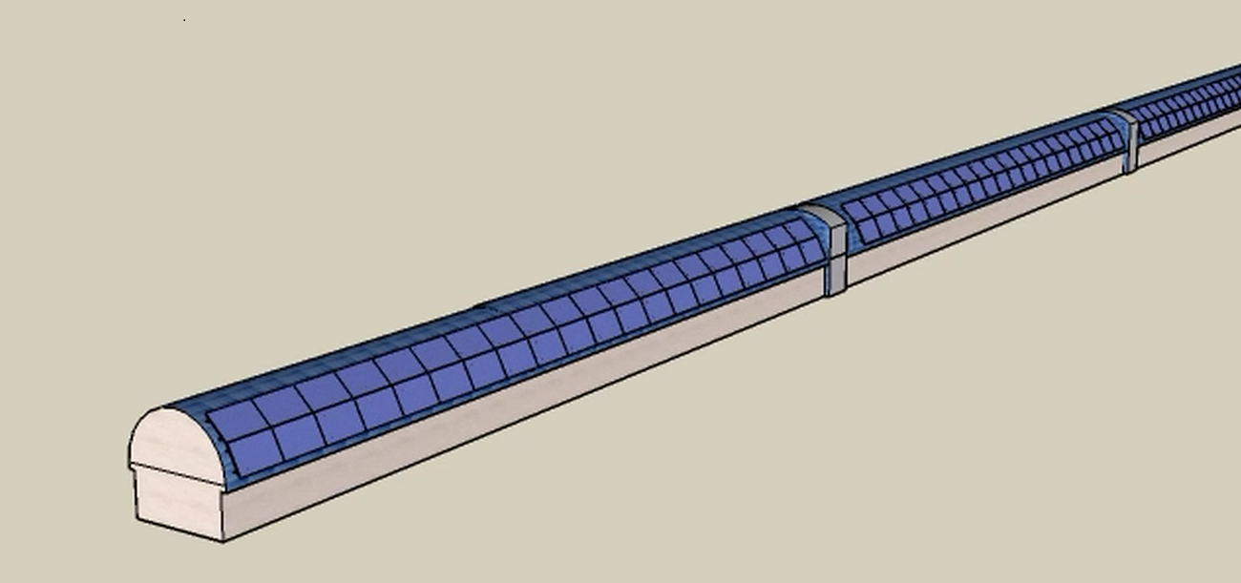
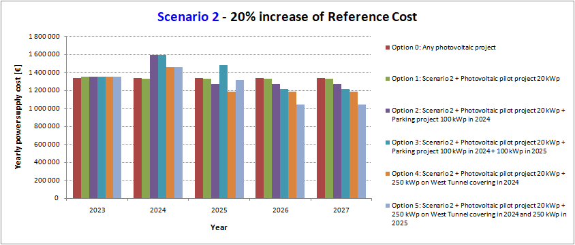
10% of energy in photovoltaics 100 k€/year savings Annual power consumption: 3 GWh Daily average power 350 kW Preliminary estimation from EGO Team in WP9 (2 engineers within INFRADEV)
ET Sustainable Development Strategy
ET carbon budget
evaluation of ET carbon footprint during both its construction and initial operation stages due to power consumptions of instruments, service plants, computing facilities, and transportations (commuting, supplies, travels)
analysis of existing studies GW detectors: LIGO (USA), Virgo at EGO (Italy) and KAGRA (Japan, underground).
Analysis of surveys made by CERN and SKA
Energy production and consumption optimization
increasing the efficiency of all devices
Reuse energy as possible (e.g. heat from cooling systems)
the three main elements of the on-site infrastructure – underground constructions, surface buildings and the local computing center
Maria Marsella - Sustainable Design WP6-ETIC
10/05/23

Slide 5
Landscape, environmental and societal impact Task 9.2 Landscape, environmental and societal impact (INFN, EGO, CNRS, Austria, KIT, ZAB)
optimize the surface transportation network and design an underground transportation system for personnel and materials, by identifying the paths, the types of users, the vehicles needed, and also by considering the highest safety standards
impact of different scenarios for the design of the underground structures (tunnels, shafts and caverns) to minimize interference with external surface infrastructure networks, urban and natural areas; and optimize connection with existing infrastructure and service plants
development of integrated processes for environmental assessment evaluation in agreement with local regulations
study of the impact on biodiversity and on the hydrologic cycle
a global approach for non-hazardous and hazardous waste management and recycling both during the construction and operation phases
Maria Marsella - Sustainable Design WP6-ETIC
10/05/23

Slide 6
Landscape, environmental and societal impact Task 9.2 ET Environmental Protection Strategy
an ET Environmental Protection Steering Board to identify and prioritize environmental areas to be addressed and to propose programs of action, and
an ET Energy Management Panel to monitor the ET energy consumption and identify measures to improve efficiency and promote energy re-use.
actions will be developed in the framework of the environmental protection regulations of the ET hosting and member states.
Maria Marsella - Sustainable Design WP6-ETIC
10/05/23

Slide 7
Contribution to sustainable goals Task 9.3
ET will extend its sensibility down to the Hz range- It will be necessary to deploy surface and underground distributed or mobile monitoring networks to measure
low frequency seismic activity and other vibrations (e.g., sea waves),
electromagnetic noise and atmospheric pressure variations that may have an impact on GW measurements.
Through these monitoring systems developed for the ET noise mitigation strategy other studies in geosciences and atmospheric sciences can be supported also developing specific machine and deep learning techniques for data analysis.
ET can become an interdisciplinary and technological hub open to a variety of collaborations with geoscientists, electromagnetic and data science expert and contribute to the studies on natural hazards and climate changes
Maria Marsella - Sustainable Design WP6-ETIC
10/05/23

Slide 8
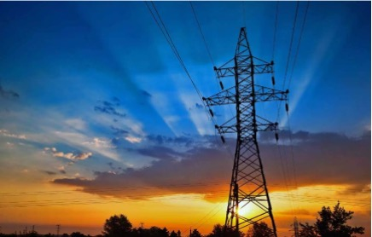
Ancillary works post-construction
Improvement of local roads and connection with the main network through road infrastructure for access to the site Recovery of construction site tracks to increase the paths and constitute a network of cycle paths Development of lighting systems with solar systems Improving digital connection infrastructures

