Slide 1
Configuration
Document ID | ET.IDV.05.00.SMT.00005
Author: Alessandro Variola | Verified: Alessandro Variola | Validated: Alessandro Variola
Document type | ET Symposium Slides
Status | Approved
Alessandro Variola, INFN sezione Roma1
ET XIII Symposium
Cagliari, T Hotel, 10/05/2023
.

Slide 2
Changing….

Slide 3
At present
PBS √
CDR √
We started the process concerning the functional layouts
We have, as priority, to provide the civil infrastructure TDR
In this phase it is crucial that all the stakeholders share a unique coherent scenario, to allow everybody work assuming the same assumptions, constraints, parameters….
This needs a BASELINE configuration

Slide 4
Configuration
In SE the configuration is defined as a snapshot of the project, in ALL its phases. In the preliminary phase it is so important to freeze a baseline ‘as designed’ configuration to have a well-defined reference.
For this reason it is a f(t)!
It is represented by a set of characteristics and functional relationships that DEFINE a final deliverable.
In this framework the configuration assures the ACCURACY and CONSISTENCY of our deliverable knowledge, during the project lifecycle
It is therefore mandatory that the configuration assures that, in the lifecycle, changes are managed by processes that guarantee their individuation, analysis, proposal, approval, integration and record for their traceability as an f(t)

Slide 5
How to build the configuration
The configuration is defined by the CONFIGURATION ITEMS (CI)
These are not pre defined objects or categories but are project-related characteristics (no golden rule to define them!)
Parameters tables, requirements, functional layouts, physical layouts, drawings, specifications….all these provide a description of the project, of its systems or elements.
All of them must be TRACEABLE
Modification has to be managed

Slide 6
CI can be very different! They need only to be well defined
Hardware/Devices
Software/Applications
Communications/Networks
Integration and functional layouts
Databases
Services
Risks
Documentation
People (Staff, vendors, buyers and contractors)
THE QUESTION IS HOW WE WANT TO DEFINE THE CONFIGURATION
(WHAT ARE THE NEEDED CI) TO MANAGE THE PROJECT & THE CONFIGURATION CHANGES

Slide 7
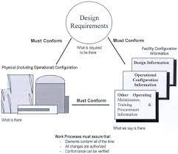
Goal: configuration management triangle
Takes into account the correspondence between what we have in our mind (requirements),
what is illustrated in the documentation (as design, as built) and what exist in the reality.

Slide 8
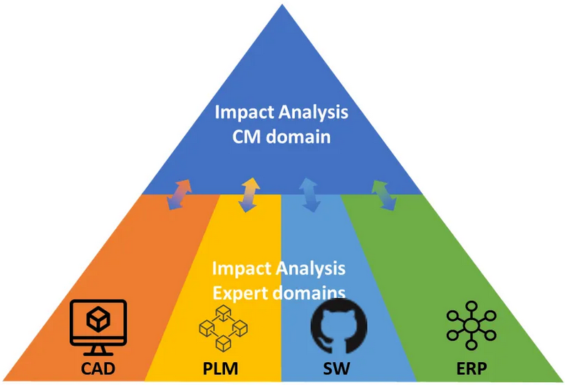
The CM-SW tools domains

Slide 9
What configuration for ET?
To be defined
As far as the PO is concerned, three main actors:
1) Configuration Manager – Christian Olivetto
2) Quality Manager - Luca Latronico
3) Technical Coordinator – Alessio Rocchi

Slide 10
What we can do now?
To define a change process we need to define a baseline
Not ready to specify the full configuration framework
We can start working on the main parameters of the PBS systems and elements (the ones already existing in the CDR has to be identified)
For each PBS unit we can assess a table of parameters – AT LEAST :
- Functional parameter: p.ex -> for a pump is the pumping speed (or other). Not the power supply power…
- Integration parameter: all parameters linked to the integration (beams diameter, FP cavity lengths, needed pressure, ventilation etc etc…). We have this priority.
These can be defined for all the ‘defined’ elements and for the systems-subsystems. Where not existing the element need to be further developed.
At the end we will have a ‘parameter oriented- as designed’ configuration. Associated to the layouts it can be seen as a first (important) step towards the configuration definition
TEMPLATES WILL BE PROVIDED

Slide 11
Processes
- In theory the CDR should represent a perfect basis for the CI definition (a representation of it..)
- Unfortunately there are still some unconsistencies in the parameters and layouts definition. To be clarified towards a baseline
So the reference document for the parameters table has to be the CDR. When conflicts arise the unit responsible shall be responsible of a proposal. He will be responsible also to propose values for parameters that are missing.
A solid approval process flowchart shall be provided, to get the final approved result

Slide 13
Methodology
We worked well with the WG configuration
Starting from the PBS we can defined responsible and PARAMETERS CI
Fill tables (always waiting for databases)
Link layouts (when possible and available)
At the end a parameters based configuration baseline will be available
But this time we need also to define a shared, coherent and solid process for the baseline approval

Slide 14
To be done and discussed
Elements parameters ID
Responsibles
Templates
Tables
PBS links
Parameters verification and approval flow
Baseline approval flow

Slide 15
Simple template can be…(to trigger suggestions)
Where applicable
 | PBS UNIT NAME | PBS ID
 | FUNCTIONAL PARAMETERS
 | Parameter | Value | Units | Description
1
2
3
4
5
6
7
8
9
10
 | INTEGRATION PARAMETER
 | Parameter | Value | Units | Description
1 | Dimensions
2 | Dimensions
3 | Dimensions
4 | Dimensions
5 | Power
6 | Water
7 | Cryo
8 | Gas
9 | …..
10

Slide 16
Discussion

