Slide 1
Bylaws Update Committee
ET Collaboration
Bylaws
May 2022
§
DRAFT
Harald Lück
Michele Maggiore
Viviana Fafone
Patrice Verdier
Samaya Nissanke
TDS Link

Slide 2
Two Tier Bylaws
The Bylaws are divided into two Levels. The Level-1 part provides a stable basis for the underlying organisation of the Collaboration, which should only be changed for very important reasons and with the support of a large majority of the Collaboration members, initiated with a sufficiently high threshold to avoid too frequent changes. The Level-2 part describes the rules of the collaboration at the working level, with a lower threshold to adapt to changing needs without too much bureaucracy. Level 1: describes the foundations of the Collaboration: • Code of Conduct • Collaboration structure • brief descriptions of the specific boards the threshold for changes requires a 15% Collaboration Board majority for a change motion and a 2/3 or even ¾ qualified majority in voting to make the change. Level 2: details on specific boards in separate documents • Mandates • Policies • Procedures lower threshold for changes allows keeping the Bylaws up to date and to respond to changing needs, along the ET lifetime.

Slide 3
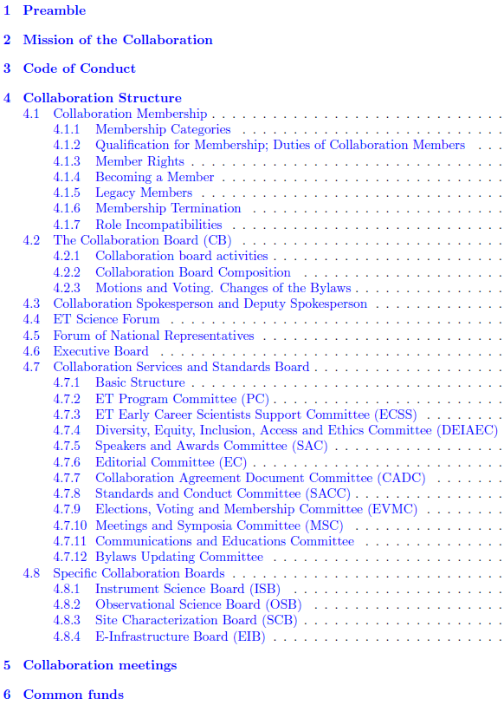
ET Bylaws
Bylaws committee:
Harald Lück
Michele Maggiore
Viviana Fafone
Patrice Verdier
Samaya Nissanke
ET Collaboration
Bylaws
May 2022
§
DRAFT
TDS Link
Notes:
Draft of Bylaws available, defining the rules that govern the Collaboration
Will be completed and elaborated asap.
Bylaws are public, see link in presentation file

Slide 4
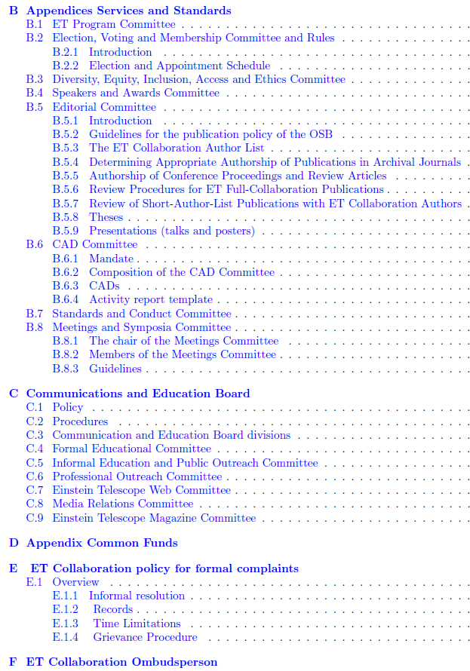
ET Bylaws
Bylaws committee:
Harald Lück
Michele Maggiore
Viviana Fafone
Patrice Verdier
Samaya Nissanke
ET Collaboration
Bylaws
May 2022
§
DRAFT
TDS Link
Notes:
Draft of Bylaws available, defining the rules that govern the Collaboration
Will be completed and elaborated asap.
Bylaws are public, see link in presentation file

Slide 5
Changes / Discussion items
Removed Section on procedures for forming the Collaboration
We state „authorship rights in full collaboration paper“ as a member right, but we do not define when a paper becomes a full-Collaboration paper. Delegate to Editorial Committee?
How long does a person leaving the Collaboration remain in the authorlist?
CB Membership: A question was raised in the Update committee: „… I am not convinced by the possibility of having more than 1 delegate per RU: with 1 member per RU, the CB is already a committee with more than 80 members. Should we consider a weight per RU as a function of FRTE? “
Suggestion to call the Diversity, Equity, Inclusion, Access and Ethics Committee (DEIAEC) IDEA committee and form a separate one for ethical aspects and academic integrity

Slide 6
FRTE vs FTE
FRTE takes better account of personal commitment
FRTE is not verifiable (with reasonable effort)
FTE allows a better estimate of the true workforce

Slide 7
Bylaws Update Committee
Shall the Bylaws Update Committee become a standing committee inside the SSB, regularly checking whether the Bylaws need updating?
In that case we propose for the Bylaws:
Changes of the Level-1 Bylaws can be initiated by
• the ET Collaboration Spokesperson
• the ET Collaboration Board with a motion supported by at least 15% of its total membership
• the Bylaws Updating Committee, which is a committee of the Service and Standards Board
by proposing changes of the Bylaws to the CB. The proposal will be submitted to the CB at least three weeks prior to a CB meeting, where it will be discussed. It may be amended by the proponents following this discussion.
The final version of the proposal is again discussed in a CB meeting and then voted on. Accepting a change of the Bylaws requires a qualified 2/3 majority of votes excluding abstentions, votes not cast and blank votes.
The vote must be done electronically

Slide 8
Communications Board
How to handle the Communications Board in the Bylaws?
Inside SSB? Keep it separate due to its special role? The Communications Board was agreed as an overarching body for both the Collaboration and the Organisation.

