Slide 1
The 13th ET Symposium
May 8th - 12th 2023
INFN Cagliari - UniCA - INFN LNS - UniSS

Slide 2
Local Organizing Committee (LOC)
Prof. Mariano Cadoni (UniCA & INFN CA)
Dr. Alessandro Cardini (INFN CA)
Dr. Andrea Contu (INFN CA)
Prof. Domenico D’Urso (UniSS & INFN-LNS )
Dr. Alberto Masoni (INFN CA)
Dr. Davide Rozza (UniSS & INFN-LNS)
Prof. Gianluca Usai (UniCA & INFN)
…

Slide 3
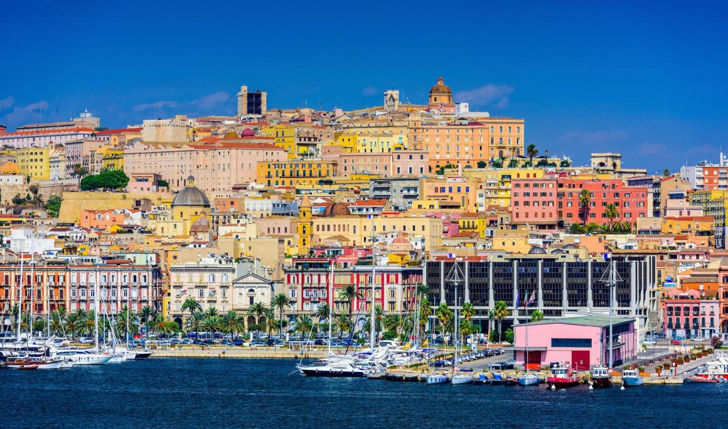
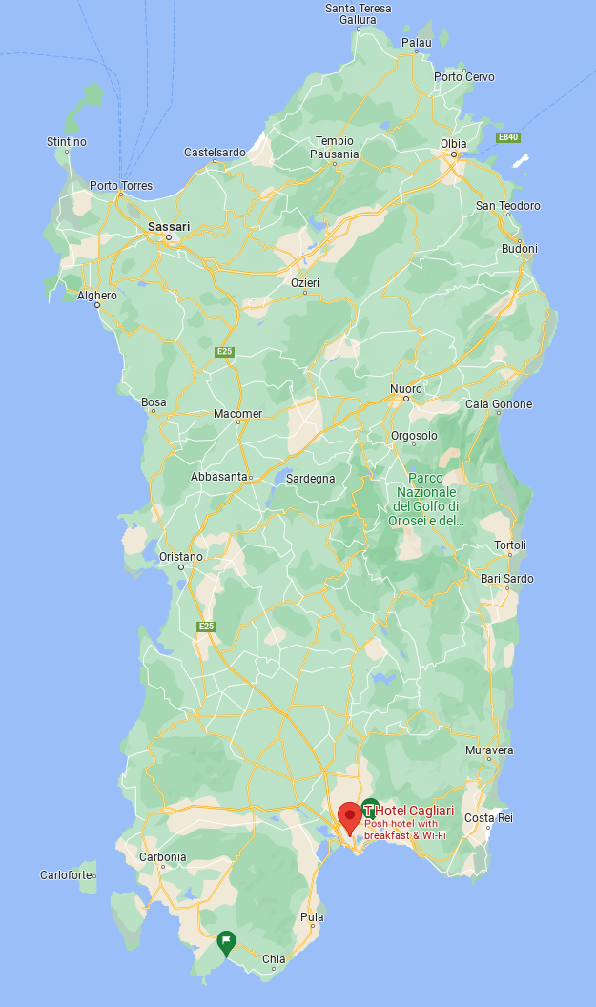
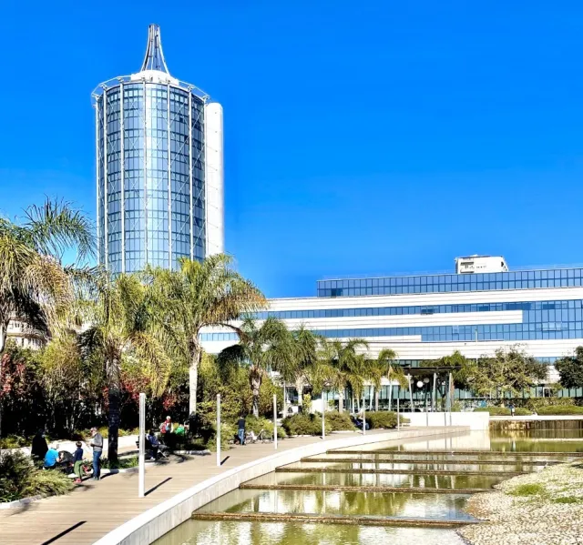
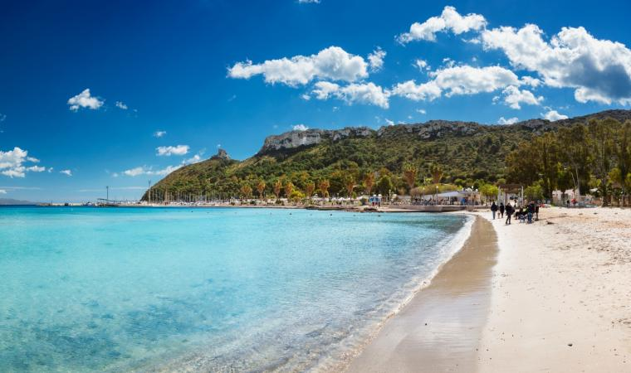
Location: Cagliari, Sardinia (IT)
THotel (Hotel+ Conference center): https://www.thotel.it/en

Slide 4
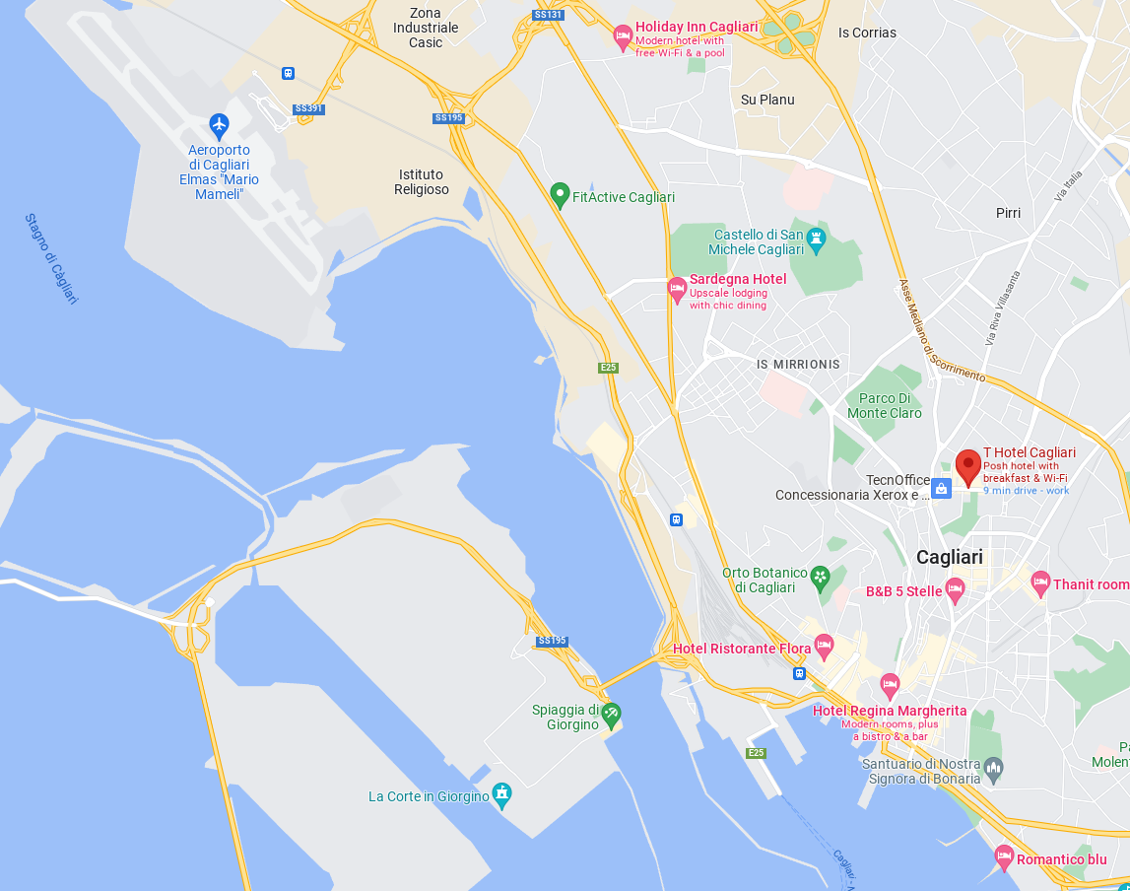
Location: getting there
The airport (CAG) is close to the city center (7km) Frequent flights from Rome and Milan, but you may find direct connections to many airports from the spring
Options to reach THotel:
Cheap and frequent training from Airport to downtown + Local Bus (<5€)
Taxi (~20€)
Dedicated transportation from Airport to Hotel and back can be arranged on first and last day
Airport
Train
THotel
Bus
City Center

Slide 5
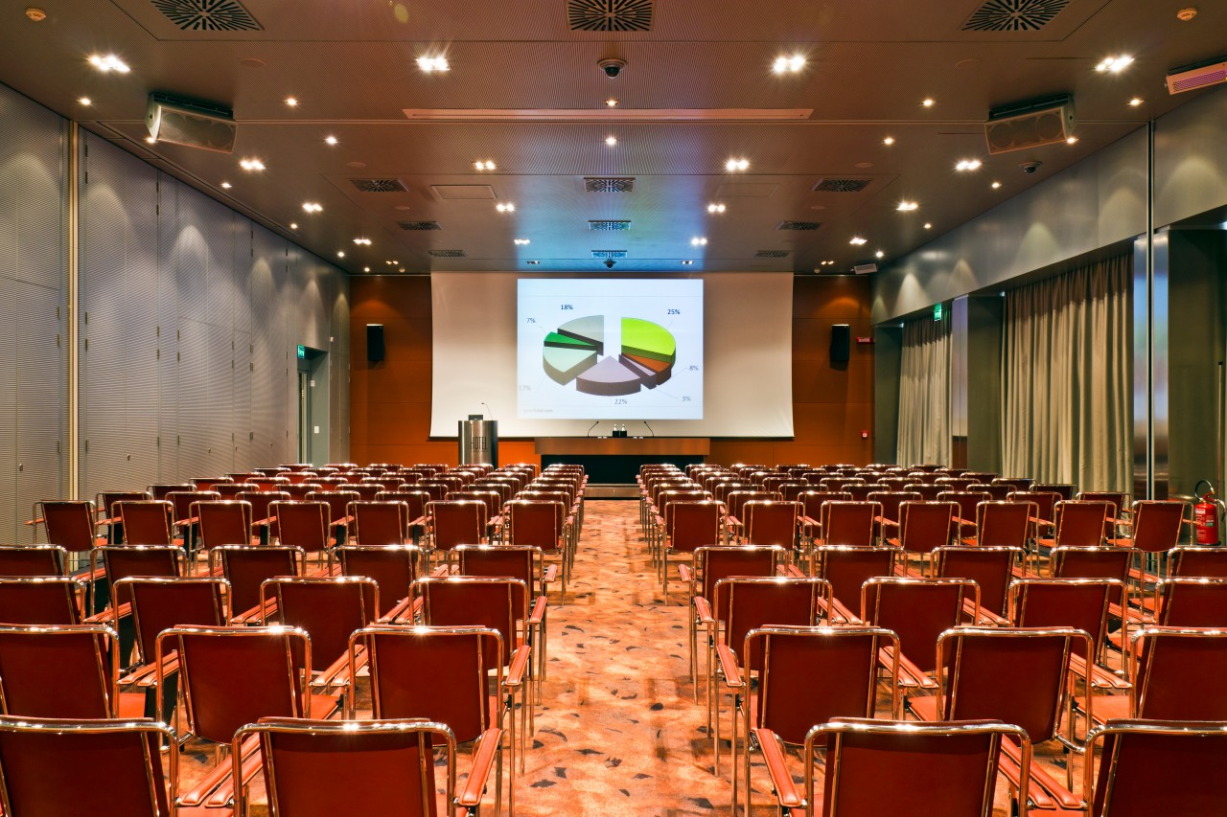
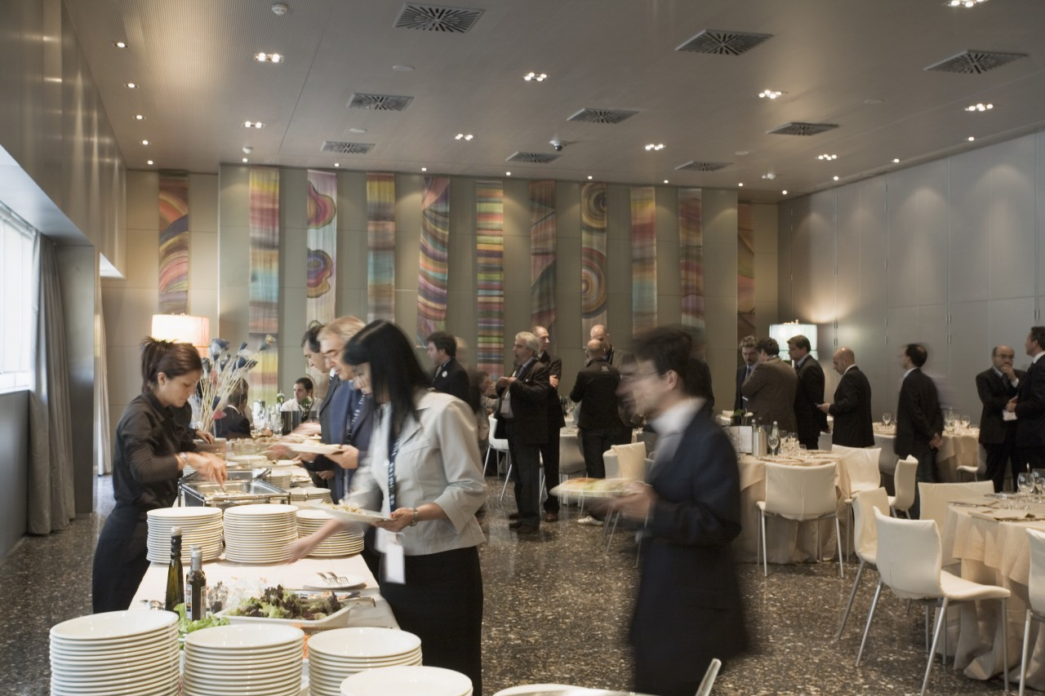
Location: services
Great location for meetings, provides fully equipped conference rooms (+technical support), coffee breaks, lunch
T3 and T4 congress halls for up to 90 people each
Rooms T5, T6 & T7: to accommodate 8, 6 and 12 persons, respectively.
The T2 Banqueting Hall is a remarkably versatile solution: a congress hall to seat up to 300 delegates the hall is ideal for Working Lunches or Gala Dinners (up to 250 guests for a seated meal or 300 for a buffet).
Hall T2 with its linear design and furnishings, can be sectioned by means of a system of soundproofed panels to obtain two separate halls of varying dimensions.
Hall T1 to seat up to 300 delegates. With natural daylight, equipped with a podium, lectern and speaker’s table.
A system of soundproofed panels sections T1 into three separate halls for parallel sessions.

Slide 6
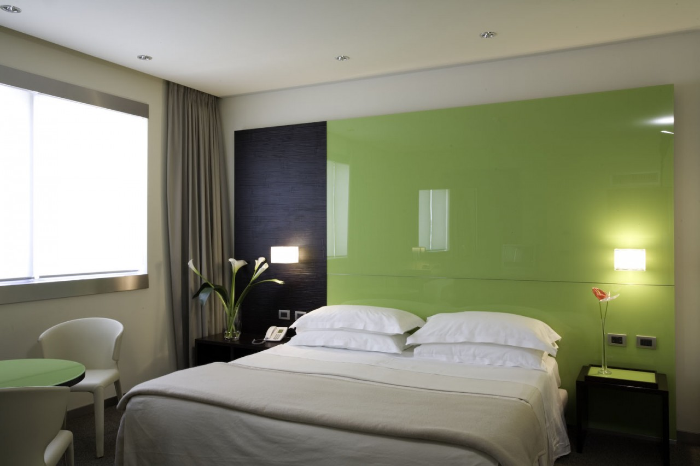
Possible Accommodation
Thotel (limited number of rooms reserved for the
ET Symposium till March 15th):
Double room for 1 person (with breakfast):
Double room for 2 persons (with breakfast):
Alternatives:
Hotel Regina Margherita (4 stars) - 2km from workshop venue
Hotel Ulivi e Palme (3 stars) - 1km from workshop venue
Other cheaper alternatives
B&B Attico Bianco - 200m from workshop venue
B&B Foyer - 350m from workshop venue
B&B Bissenti - 500m from workshop venue
B&B Marysol - 700m from workshop venue
B&B Al Teatro Lirico - 650m from workshop venue

Slide 7
Registration Info
Registration open on Feb 10th
Registration fee (includes coffee breaks and social dinner):
200 euro (till April 25th)
Late registration fee (from April 25th): 250 euro
Max in person participants: 300
Possible Social Activities
Cagliari City tour
Molentargius natural park tour
Visit to Su Nuraghe in Barumini
…

