Slide 1
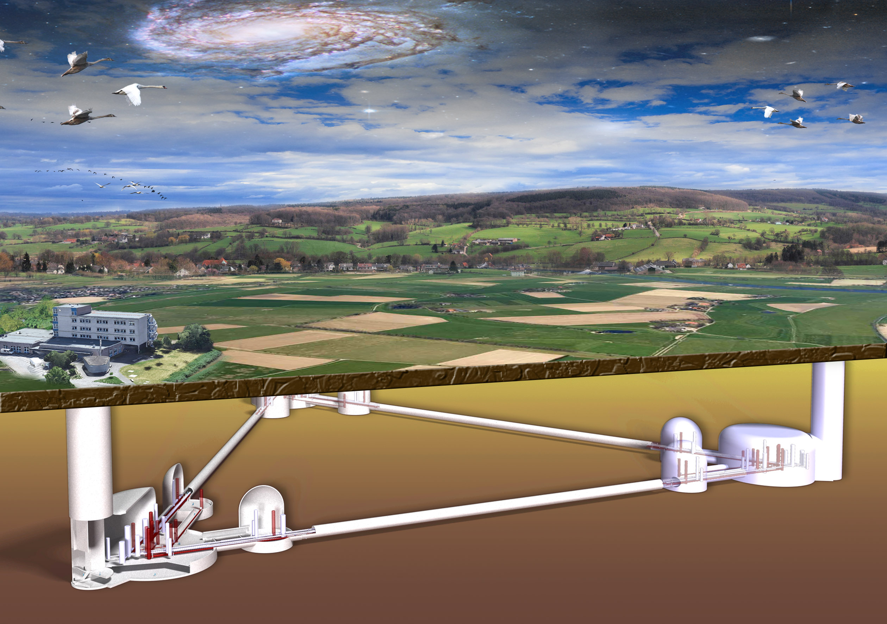
Einstein Telescope
RWTH Aachen University
Achim Stahl, March, 9th 2023

Slide 2
Computing Center
RWTH Aachen University
Achim Stahl, March, 9th 2023

Slide 3
Purpose
distributed computing – opportunistic use of resources
We need more!
operation of the telescope
data acquisition
low-latency alerts ?
data storage
data basis
administrative services
user services (mail, ZOOM, …)
software coordination
management
user support
We need a center!

Slide 4
Purpose
distributed computing – opportunistic use of resources
We need more!
operation of the telescope
data acquisition
low-latency alerts ?
data storage
data basis
administrative services
user services (mail, ZOOM, …)
software coordination
management
user support
We need a center!
Located near the telescope

Slide 5
Funding
ET operational cost: 40 mio. € / year
(shared between host countries and authors)
Includes: computing center 10 mio. € / year
A very, very rough guess
Hardware: 2 mio. € / year
Operation: 2 mio. € / year
Personnel: 4 mio. € / year
Others

Slide 6
Purpose
operation of the telescope
data acquisition
low-latency alerts ?
data storage
data basis
obvious
Offline-Analysis:
We need to supply data & software for remote usage!
Model installation of the complete analysis chain: For others to copy!
Test bed for all ET software.
Training for IT-experts at remote sites.
No user operation. Limited hardware resources (CPU, GPU, etc.)

Slide 7
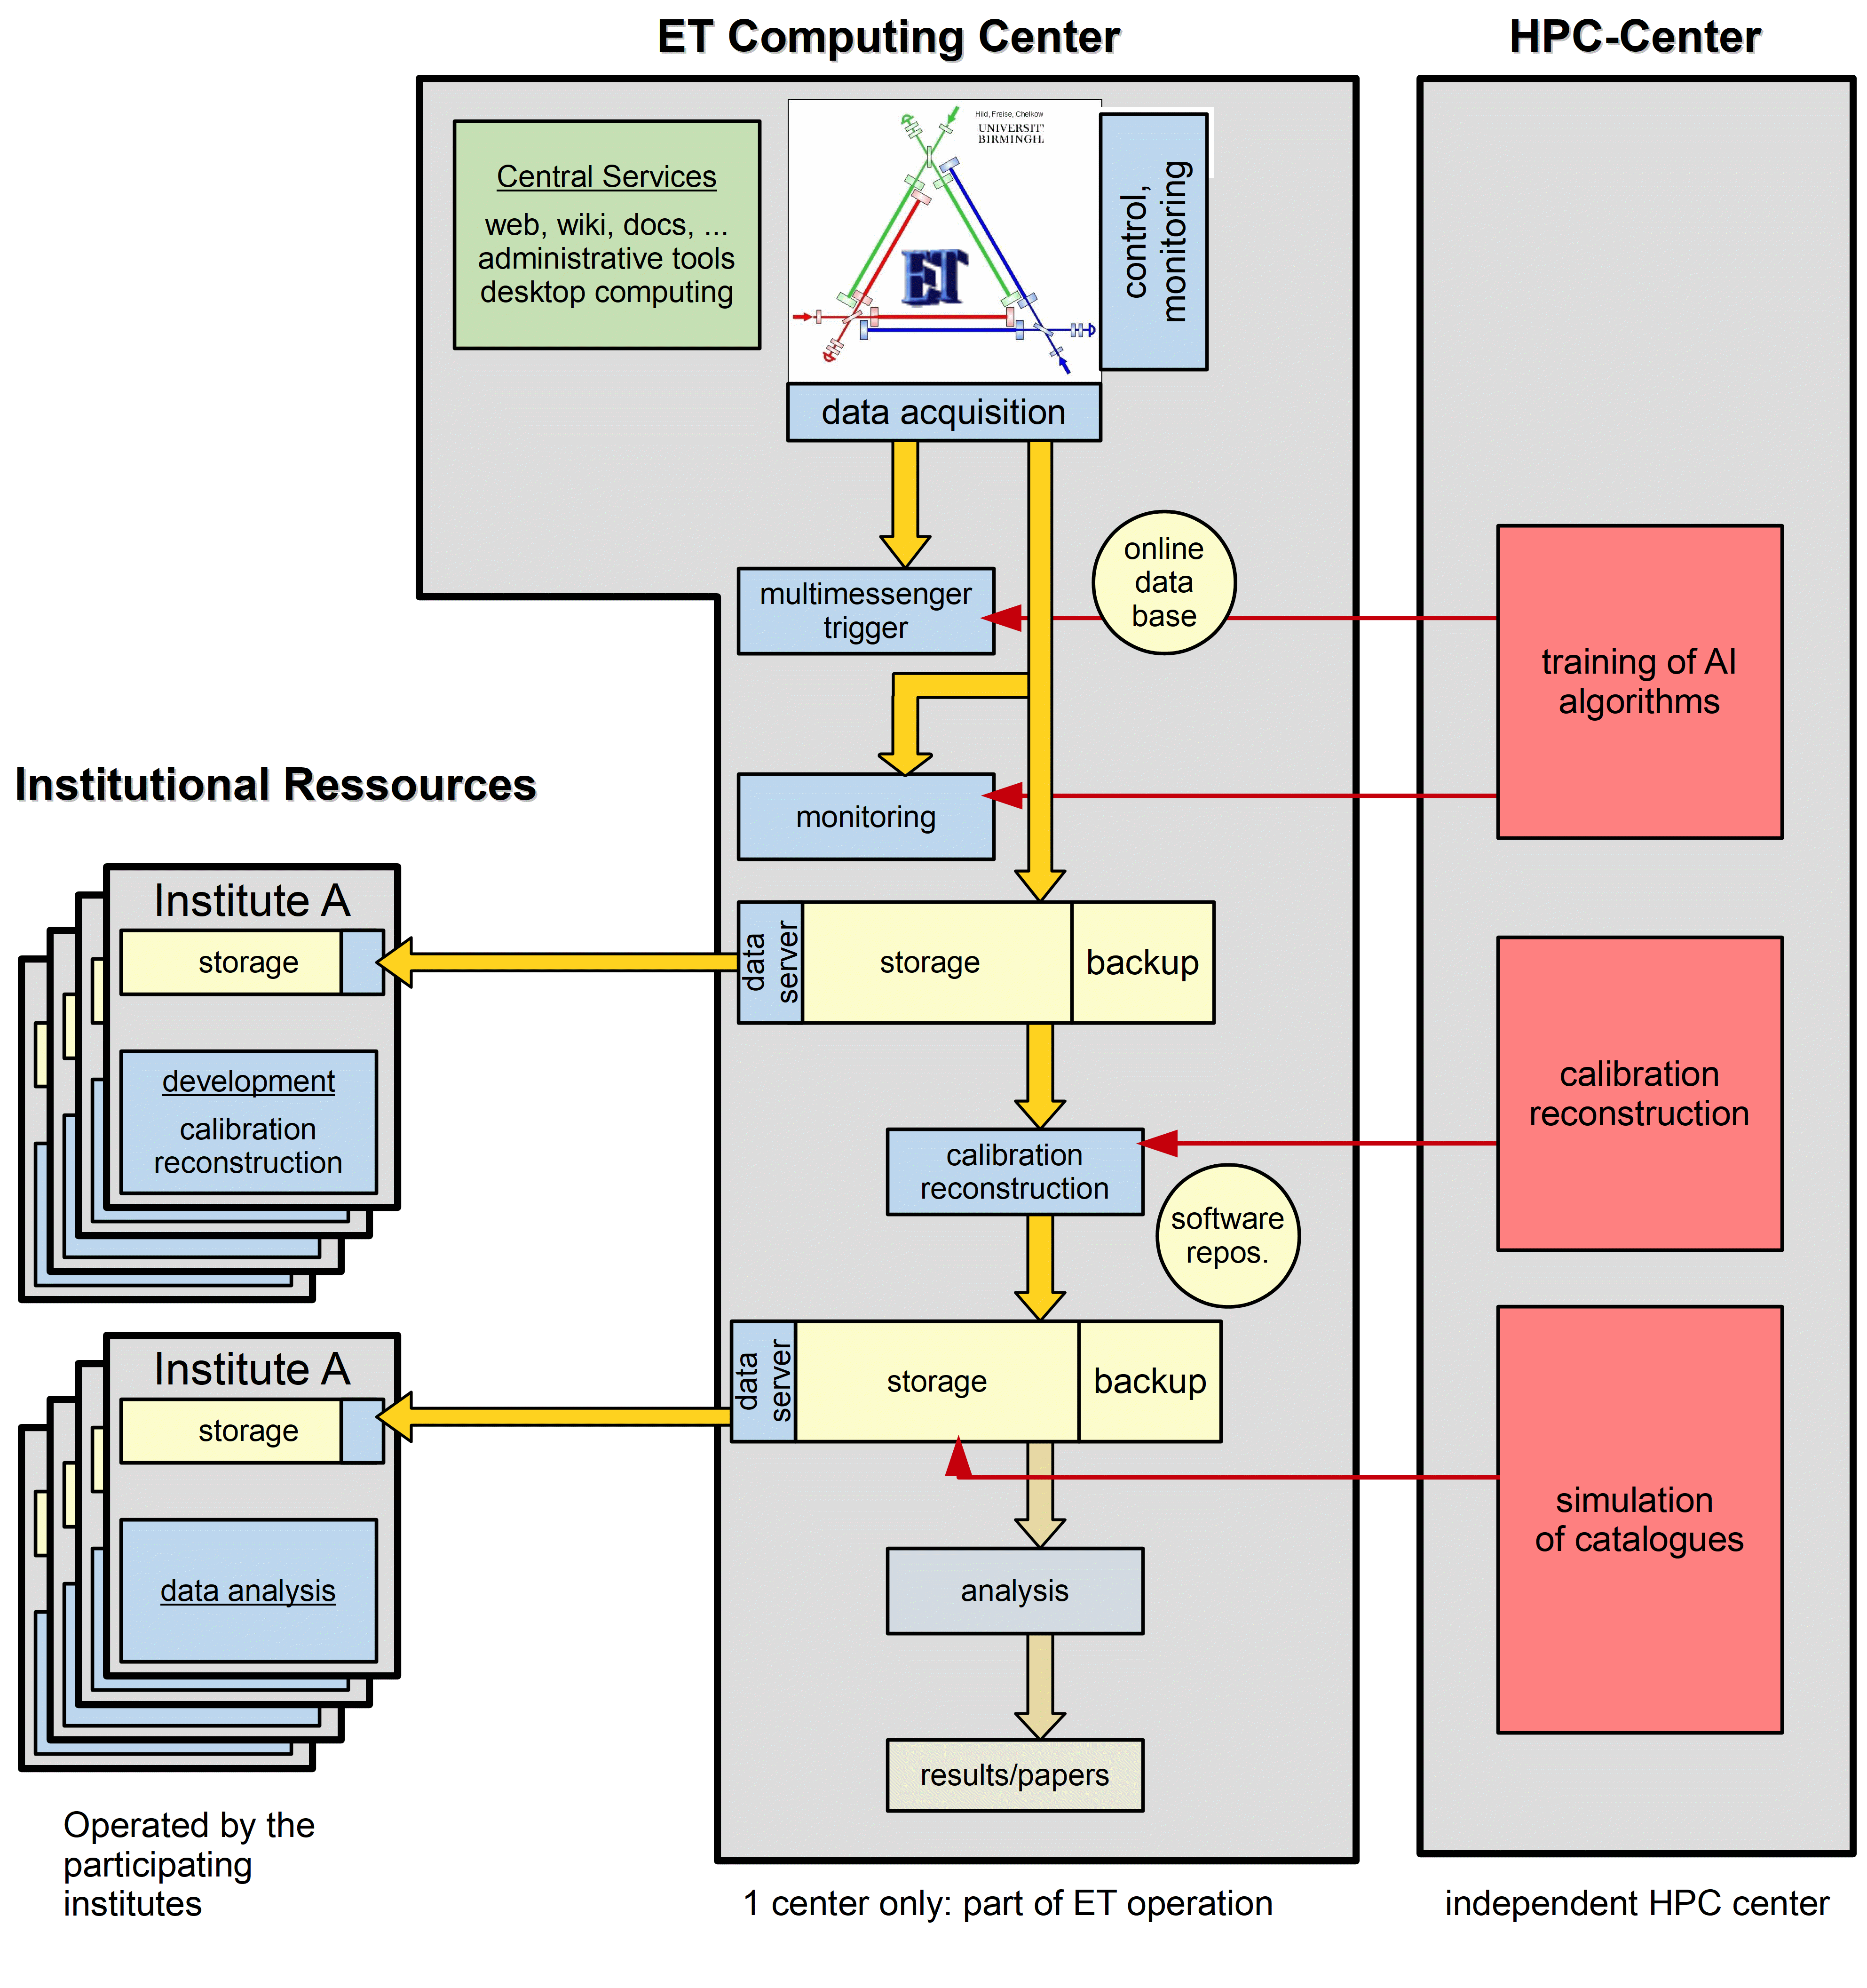
Concept
Just a very first idea!

Slide 8
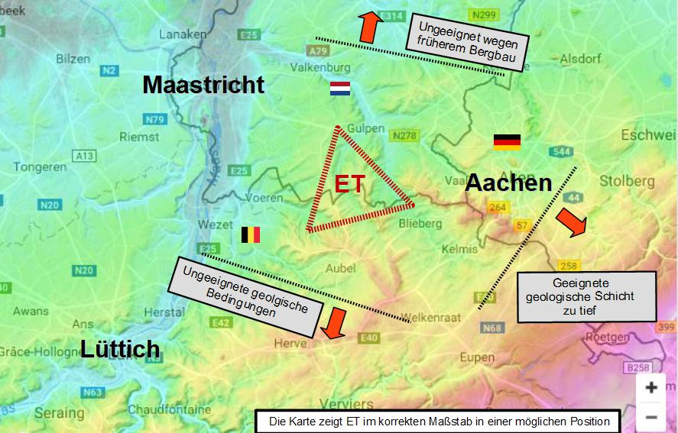
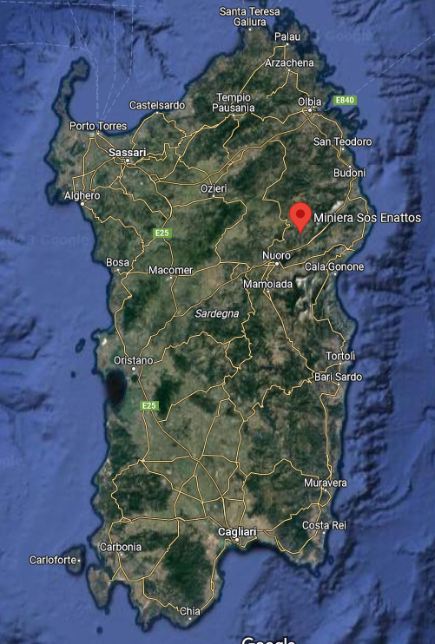
Location
Northern Site
Southern Site
in Cagliari ?
in the mountains ?
on the coast ?
Corner to Aachen: 5 to 10 km

Slide 9
Computing Center
Thanks
RWTH Aachen University
Achim Stahl, March, 9th 2023

