Slide 1
ET-PP
ET Preparatory Phase Project
WP8 chairs and task leaders

Slide 2
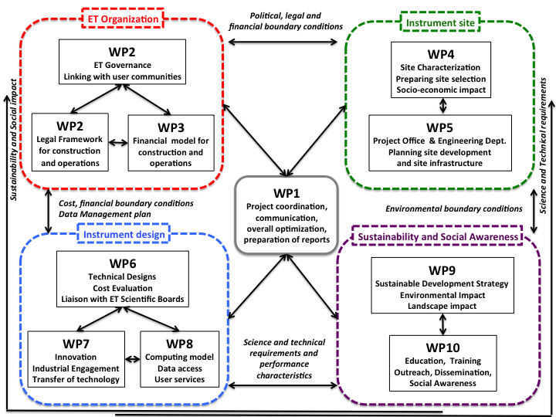
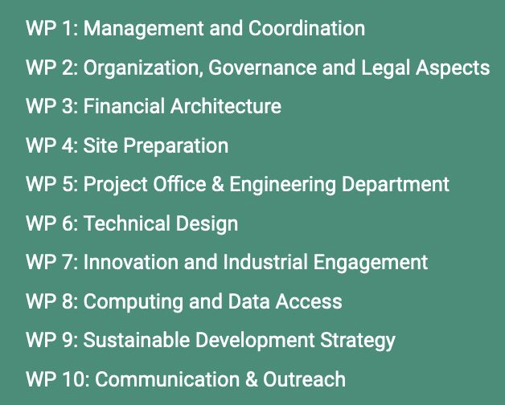
INFRA_DEV Project for ET Preparatory Phase
ET-PP
Address a number of fundamental prerequisites for the approval, construction and operation of ET
Start: September 2022
Duration: 4 years
Coordinator: Mario Martinez -IFAE
Organization: 10 WPs
Notes:
EiB goal is to deliver an efficient computing and software infrastructure for ET users.
The goal for ET-PP WP8 is to deliver the computing and data model, together with EiB and experts.

Slide 3
INFRA_DEV Project for ET Preparatory Phase
ET-PP
WP1: ET-PP management and coordination
ET organization
WP2: Governance and legal aspects
WP3: Financial architecture
WP10: Communication and outreach
WP9: Sustainable devel.
WP4:Site preparation
WP5: Project Office engineering dpt.
WP8: Computing
and
data Access
Sustainability and outreach
ET site
WP7: Innovation and Industry engagement
WP6: Technical design
ET design

Slide 4
ET-PP WP8 Computing and Data models
ET-PP
Definition of the computing and data model of the Einstein Telescope.
Definition of the workflows.
Estimation of the resources.
Data Access – technical guidelines and principles for implementing the data access policies.
WP8 objectives
Task 8.1 | T0 data center | CNRS | Patrice Verdier
Task 8.2 | Computing and Data Model | UniGe | Tassos Fragkos
Task 8.3 | Resources estimation | INFN | Silvio Pardi
Task 8.4 | Data Access Implementation design | BSC | Nadia Tonello
WP8 organization
Co-leads: Achim Stahl, Sergi Girona/Nadia Tonello

Slide 5
ET-PP WP8 Computing and Data models
ET-PP
 | Workshops | WPs | Due date
M8.1 | Workflows Requirements collection and constraints: computing and data |  | Sep 2023
M8.2 | Computing Infrastructures availability for ET workflows, characteristics | WP9 | Sept 2024
M8.3 | On site infrastructure, computing and data model | WP6 | Sept 2025
M8.4 | Low latency and offline workflows and computing model | WP6 | Feb 2026
M8.5 | Data management, access, policy and implementation | WP2, WP6 | July 2026
WP8 milestones
 | Deliverables | Lead | Due date
D8.1 | Workflows Requirements collection and constraints: computing and data | UniGe | Mar 2024
D8.2 | Computing Infrastructures availability for ET workflows, characteristics | UniGe | Apr 2026
D8.3 | On site infrastructure, computing and data model | BSC | Sept 2026
WP8 Documents

Slide 6
ET-PP WP8 Computing and Data models
ET-PP
Lead CNRS, Patrice Verdier
Objective
Design the T0 data center and define the services regarding distributed computing
Activities
Define Tier-0 storage and computing requirements to contribute to D8.1
Collaboration with other ET-PP WPs for workshops and sessions regarding ET
WP2 Governance
WP4 On-site data storage and data access
WP6 Technical design
Close collaboration with ISB (and other Boards) about the conceptual design of the Tier0.
T8.1

Slide 7
ET-PP WP8 Computing and Data models
ET-PP
Lead UniGe, Tassos Fragkos
Objective
Develop the computing and data model of ET
Activities
Define the workflow requirements from instrument to publication to contribute to D8.1
Collaboration with other ET-PP WPs for workshops and sessions regarding ET WP2 Governance
WP6 Technical design, cost evaluation
WP9 Data mid-long term curation and preservation sustainability
WP10 Dissemination, distribution of legacy data
Close collaboration with ISB and OSB (and other Boards) to define data computing model.
Edition of D8.1 & D8.2
T8.2

Slide 8
ET-PP WP8 Computing and Data models
ET-PP
Lead INFN, Silvio Pardi
Objective
Estimation of the computing resources (computing power and data storage)
Activities
Define operational cost requirements and potential mitigation to contribute to D8.1
Collaboration with other ET-PP WPs for workshops and sessions regarding ET WP2 Governance
WP4 On-site data storage and data access
WP9 Data mid-long term curation and preservation sustainability
WP10 Dissemination, distribution of legacy data
Participation of EiB (and other Boards) discusión about computing resources and data needs.
T8.3

Slide 9
ET-PP WP8 Computing and Data models
ET-PP
Lead BSC, Nadia Tonello
Objective
Define the data Access implementation strategy , according to the policy defined in WP2
Activities
Define data model and data access requirements to contribute to D8.1
Collaboration with other ET-PP WPs for workshops and sessions redarding ET data
WP2 Governance
WP4 On-site data storage and data access
WP9 Data mid-long term curation and preservation sustainability
WP10 Dissemination, distribution of legacy data
Participation of EiB (and other Boards) discusión about data availability and access needs.
Edition of D8.3
T8.4

Slide 10
ET-PP WP8 Computing and Data models
ET-PP
WP8 Tasks
 | T8.1 T0 data center | T8.2 Computing and data model | T8.3 Resources | T8.4 Data access implementation
D1 SW frameworks and Data Challenges |  | Computing frameworks domains and data formats | Resources for frameworks execution and data storage availability | Data availability Data releases format
D2 Services and collaboration support |  |  |  | Tools for monitoring, AAI (IAM) data access
D3 Computing and data models, resources estimation | T0 storage and computing resources estimation | Computing model Data model | Resources estimation
D4 Multimessenger alerts infrastructure |  |  |  | Tools for multi-messenger alerts
ET EiB Divisions
Technology tracking working group

Slide 11
ET-PP WP8 Computing and Data models
ET-PP
Web: https://etpp.ifae.es
ET-PP wiki https://wiki.et-gw.eu/INFRA_DEV/WebHome
ET TDS for sharing files withing ET
CERN indico
(Temporary) Google Drive
CERN and EGO collaborative tools
Communication channels
ET-PP DMP contribution (now)
ET symposium (8-12 May)
ET-PP meeting in Barcelona 12-13 June (SAVE THE DATE)
Fall workshop (M8.1)
D8.1 Workflows Requirements collection and constraints: computing and data (Mar’24)
Next events

Slide 12
Thank you! Nadia Tonello nadia.tonello@bsc.es
ET-PP

