Slide 1
IGWN Software
Rhys Poulton – EGO
on behalf of the LIGO, Virgo and KAGRA collaborations
ET-EIB workshop| 09 March 2023

Slide 2
Overview
A Worldwide Network: The International Gravitational Waves observatory Network (IGWN)
Data and data flow schema
The Challenge
The common solutions and the common tools
The IGWN environments: Conda + CVMFS
Development and Operation

Slide 3
What is IGWN
International Gravitational Waves observatory Network (IGWN)
A coordination effort aimed at jointly discussing the computing policy, management, and architecture issues of LIGO, Virgo, and KAGRA.
igwn.org will host common Virgo/LSC services, and KAGRA is joining
Migration planning for common services (GitLab, software tarballs archive, etc.) is unfolding
The effort comprises all computing domains (online, offline, LL), with different levels of engagement.
Plans for migration from custom/legacy tools to common, mainstream tools are being implemented
Data management and transfer (CVMFS/StashCache, Rucio and Kafka)
Software management (GitLab, CMake/Meson, Conda, CVMFS)
The tools (and the general architecture) are chosen to be consistent with many large scale computing projects such as WLCG

Slide 4
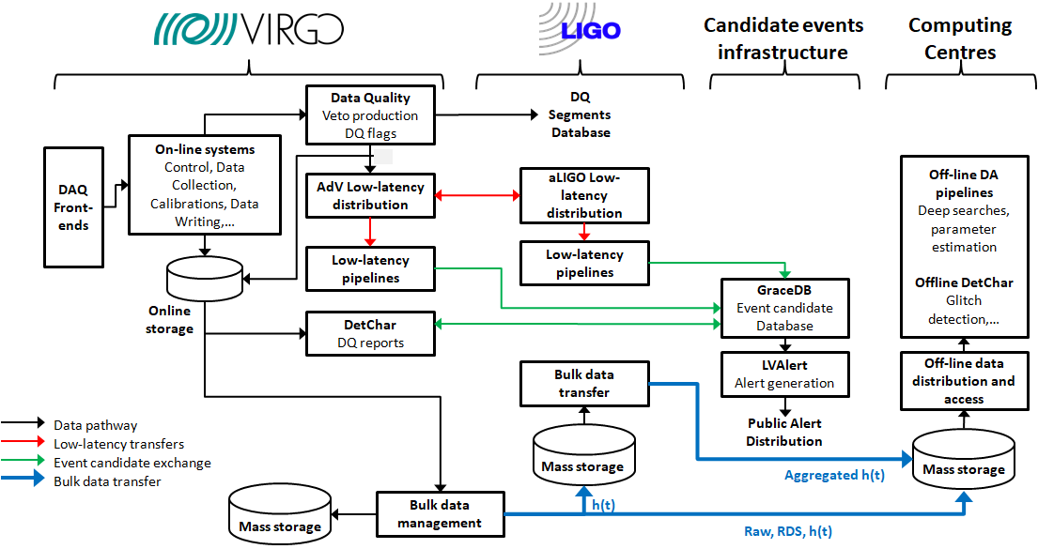
The Data Flow Schema

Slide 5
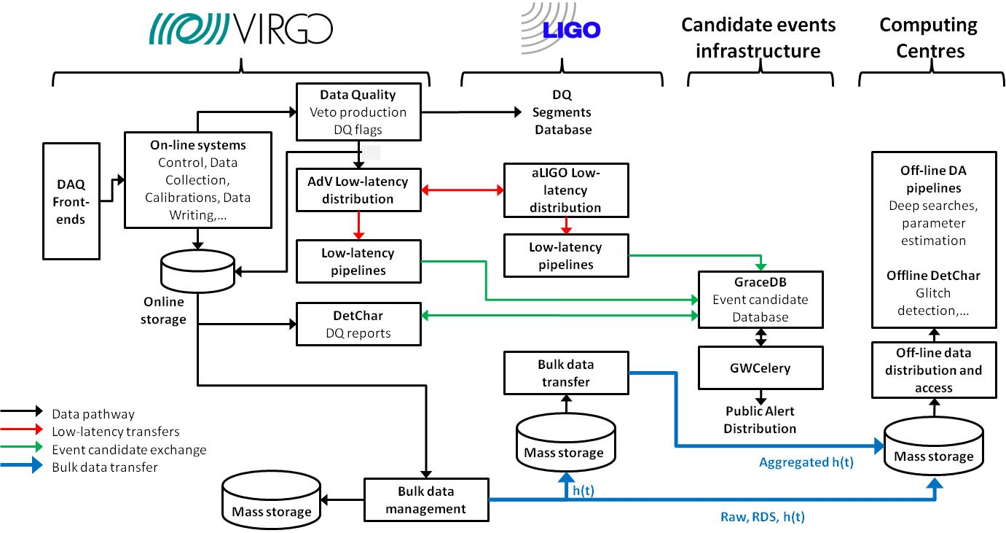
Data Flow: The O3 case
The signal arrives
Data composed into frames
Calibration of the data
Veto, DQ flags production
h(t) transfer
Low-latency matched-filter pipelines
Upload to GraceDB
Data written into on-line storage
Low-latency data quality
Low-latency sky localization
GCN Circular sent out
Data written into Cascina Mass Storage
Data transfer toward CCs

Slide 6
The Challenge
The geographical separation of the detectors and the short timescale involved (e2e latency from signal detection to alerts generation in the order of 30 sec) imply the creation of a common distributed cyber infrastructure which must guarantee:
Adequate storage and computing resources for detector characterization, low-latency searches and alerts generation
Low-latency data distribution among the different observatories and computing clusters for low-latency searches
An ubiquitous and uniform running environment on dedicated resources and heterogeneous infrastructures
Reliable bulk data transfer to custodial storage in CCs
An homogeneous model for offline data distribution and access
A robust support for development and operation

Slide 7
The Common Solutions
Storage and computing resources
Present: dedicated or highly-prioritised resources provided by observatory computing centers
Future: High Availability (HA) deployment on top of Kubernetes
Low-latency data distribution
Kafka
Running environment
IGWN environments: Conda + CVMFS
Bulk data transfer
Rucio
Offline data distribution and access
StashCache + CVMFS
A robust support for development and operation
GitLab

Slide 8
IGWN software distribution and management
In GW science a lot of custom software is produced to control detectors, handle data, detect signals, and interpret astrophysical results.
For an effective collaboration we need a sustainable means of software development and distribution and that maximises the person power available
This requires that:
Effective software distribution:
scalable
reliable
low maintenance
Effective software management:
OS independent
Ensuring of software compatibility
Management of third party dependences

Slide 9
Effective software distribution
We would like to have IGWN software readily available everywhere software is to be run:
Computing centres
Observatories
Personal workstations
This is what CernVM-File System (CVMFS) was created to do for the High Energy Physics collaborations
Optimized for software distribution
Already available at most computing centers
Installable client on most Linux and macOS machines
Proven to be scalable, reliable and low maintenance
Notes:
So CVMFS is well suited to software distribution and is currently being used by IGWN to enable high availability of software., but what about software management?

Slide 10
Effective software management
Software is Operating System (OS) agnostic
Different OS between workstations and Computing Centers (CC)
The various OS often use different software libraries
Packages can drop support for old software
Example: astropy only develop new features for python 3.7
Ensure compatibility for older packages
Control over package dependencies
Different pace when software adopts new changes
Testing ensure software compatibility
Access to third-party libraries not installed at CC
Understandable reluctance to install at system level at CC
Same versions of third-party software to ensure reproducibility
Notes:
There are a few issues that software management needs to take charge of:
The first one is: How to ensure that software is agnostic of the underlying operating systems? This is particularly the case between people's workstations where data is typically analysed and the computing centers where the data is typically processed. The various operating systems often use different software libraries, which at worst could lead to different outcomes.
The second one is: the fact that packages can drop support for old software. An example of this is the python package used by collaboration that currently only develops new features for python 3.7, so need a easy means to build these new software environments. But it is also important to maintain compatibly for software that depend on older versions.
The third one is: control over package dependencies. Software packages within the collaboration often adopts new changes at a different pace, so there is a need for dependency control and testing to ensure compatibility
And finally: access to third party libraries typically not installed at computing centers. There is a understandable reluctance to install these libraries at system level at computing centers so it make sense to have these in software environments that are used by the collaboration to so everyone can use the same versions ensuring reproducibility,

Slide 11
Effective software management
Software is Operating System (OS) agnostic
Different OS between workstations and Computing Centers (CC)
Difference in libraries
Packages can drop support for old software
Example: astropy only develop new features for python 3.7
Ensure compatibility for older packages
Control over package dependencies
Different pace when software adopts new changes
Testing ensure software compatibility
Access to third-party libraries not installed at CC
Understandable reluctance to install at system level at CC
Same versions of third-party software to ensure reproducibility
Conda
Notes:
All these are resolved by Conda a open source package management system

Slide 12
Effective software management
Software is Operating System (OS) agnostic
Different OS between workstations and Computing Centers (CC)
Difference in libraries
Packages can drop support for old software
Example: astropy only develop new features for python 3.7
Ensure compatibility for older packages
Control over package dependencies
Different pace when software adopts new changes
Testing ensure software compatibility
Access to third-party libraries not installed at CC
Understandable reluctance to install at system level at CC
Same versions of third-party software to ensure reproducibility
Conda supports Linux, macOS and Windows and creates its own environment with minimal reliance on the underlying OS
Notes:
To ensure software is OS agnostic, Conda natively supports Linux, macOS and windows and creates its own environment that has minimal reliance on the underlying operating system

Slide 13
Effective software management
Software is Operating System (OS) agnostic
Different OS between workstations and Computing Centers (CC)
Difference in libraries
Packages can drop support for old software
Example: astropy only develop new features for python 3.7
Ensure compatibility for older packages
Control over package dependencies
Different pace when software adopts new changes
Testing ensure software compatibility
Access to third-party libraries not installed at CC
Understandable reluctance to install at system level at CC
Same versions of third-party software to ensure reproducibility
Conda supports Linux, macOs and Windows and is in its own environment with minimal reliance on operating system
Conda allows us to have multiple software environments that can support a particular release of python
Notes:
To ensure the continued support for old software while getting new features Conda allows for multiple software environments that will support particular releases of python

Slide 14
Effective software management
Software is Operating System (OS) agnostic
Different OS between workstations and Computing Centers (CC)
Difference in libraries
Packages can drop support for old software
Example: astropy only develop new features for python 3.7
Ensure compatibility for older packages
Control over package dependencies
Different pace when software adopts new changes
Testing ensure software compatibility
Access to third-party libraries not installed at CC
Understandable reluctance to install at system level at CC
Same versions of third-party software to ensure reproducibility
Conda supports Linux, macOs and Windows and is in its own environment with minimal reliance on operating system
Conda allows us to have multiple software environments that can support a particular release of python
Conda enables version pinning of packages and tests are run to ensure compatibility along with testing and proposed environments
Notes:
To have control over package dependencies and their compatibility Conda enables version pinning of packages and tests are run to ensure compatibility along with testing and proposed environments

Slide 15
Effective software management
Software is Operating System (OS) agnostic
Different OS between workstations and Computing Centers (CC)
Difference in libraries
Packages can drop support for old software
Example: astropy only develop new features for python 3.7
Ensure compatibility for older packages
Control over package dependencies
Different pace when software adopts new changes
Testing ensure software compatibility
Access to third-party libraries not installed at CC
Understandable reluctance to install at system level at CC
Same versions of third-party software to ensure reproducibility
Conda supports Linux, macOs and Windows and is in its own environment with minimal reliance on operating system
Conda allows us to have multiple software environments that can support a particular release of python
Conda enables version pinning of packages and tests are run to ensure compatibility along with testing and proposed environments
Third party software can be added to Conda environment and version controlled
Notes:
And finally to have easy access to third party libraries it is easy to have them add to the Conda environment and have them version controlled

Slide 16
IGWN software distribution
Sustainable software development and distribution
=
CVMFS
+
Conda
Conda environments hosted
in CVMFS file system available at most CC
The effort to manage and distribute IGWN software and environments is called the IGWN Conda Distribution
Notes:
So, to have a sustainable software development and distribution for IGWN will be to have Conda environments hosted in CVMFS file system available at most Computing centers.
But how does Virgo software fit into all this?

Slide 17
What is IGWN Conda Distribution
What are the benefits of the IGWN Conda Distribution
Readily available at most Computing Centers, Observatories and anywhere that mounts CVMFS
Can also install locally using the provided environment files
No need to define, maintain and document for your own custom build
Gives access to LVK software
Anyone can put their software into the IGWN Conda Distribution
Particularly beneficial if:
Multiple users use the software
Is required by other LVK software
To be used at multiple Computing Centers

Slide 18
How to put software into IGWN Conda Distribution
3 stages to upload packages to the IGWN Conda Distribution
Preparing the package recipe
Recipe is a collection of files that defines:
Package name and version
Dependencies
How to build the software
Packaging with Conda-forge
First, the conda-forge/staged-recipes repository needs to be forked on github
You add your own recipe
Commit this new recipe to a branch of your fork, and propose a Pull Request
Fix issues with the support of the conda-forge community and “IGWN Conda –forge support team”
Submit a ticket to the Software Change Control Board (SCCB)
Need to add an issue template in the SCCB github

Slide 19
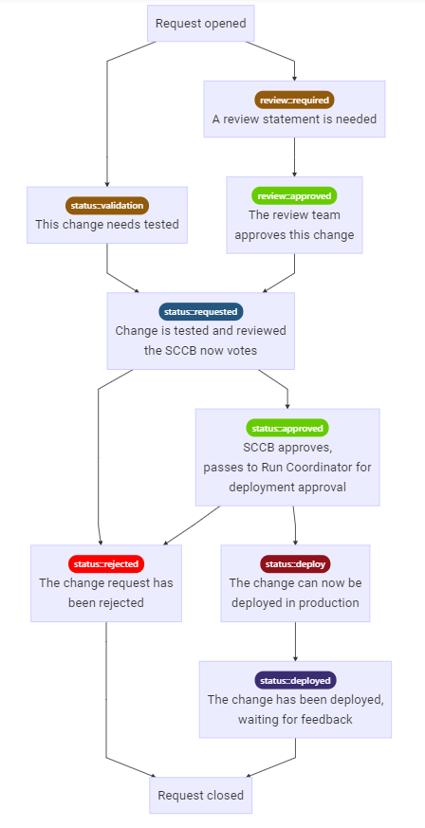
What is the SCCB
The SCCB is charged by the joint IGWN Computing & Software Committee with assessing the impact of proposed changes to specifications and software used for scientific analyses and deciding to adopt, revise or reject these changes
In charge of deployments to other software environments (e.g. RPMs) not just the IGWN Conda Distribution
The SCCB follow the procedure on the right the deployment in these software environments

Slide 20
How to put software into IGWN Conda Distribution
Includes:
Packaging
Testing
Scientific review (with the package developer)
This stage is done by a
Run coordinator

Slide 21
VIRGO Software in IGWN Conda
pyserver
IGWN env
PythonVirgoTools
Conda-forge
PyFd
Not uploaded
Fd
dataDisplay
Needs to be ported to ROOT6
PyCm
Cfg
Frv
Cm
Frv
Xforms

Slide 22
Example of VIRGO Software: FdIOServer
FdIOServer
Software designed for the transport of frames
Can transport file via files/ shared memory or network (Cm)
Can also manipulate frames like:
Channel selection
Frame resizing
Frame merging
Trend frame generation
Automatically updates via a Cm server (if available)
FdIOServer to replay data from disk
FdIOServer to replay a particular data channel from disk
FdIOServer to merge the data from the above processes and send the data out to computing centers via Kafka

Slide 23
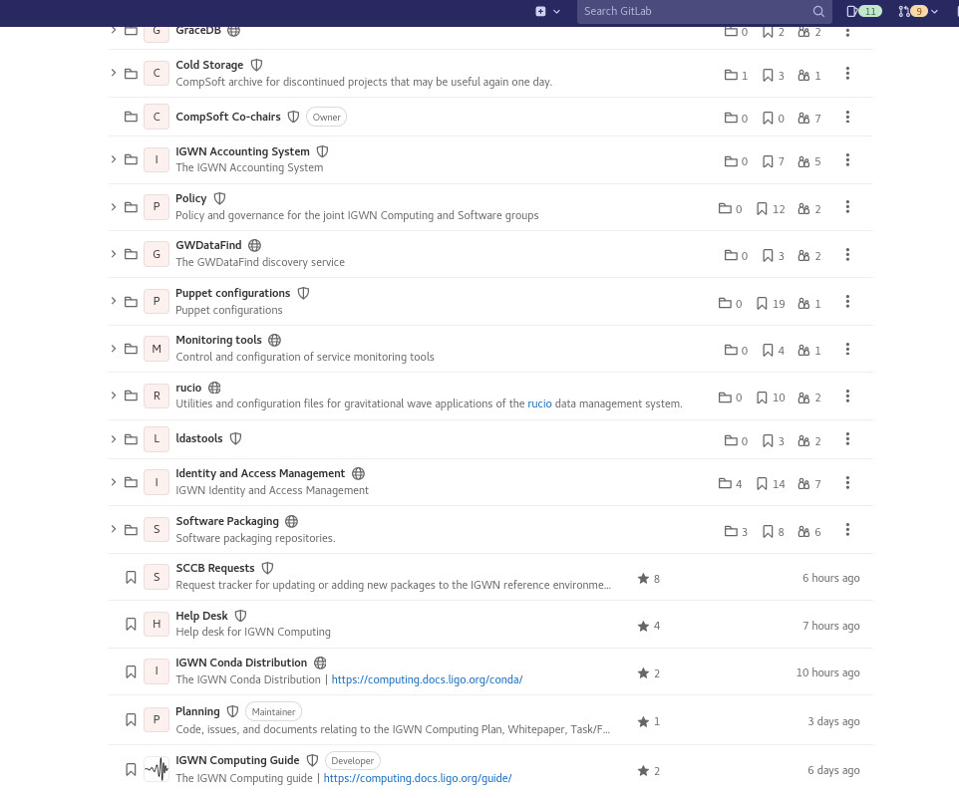
Development and Operation
LIGO, Virgo and KAGRA Computing & Software teams increasingly working together using GitLab centered DevOps practices. IGWN Gitlab provides/supports:
Code repository for IGWN Detectors Control, Data Analysis and Low-latency software
Enables easy collaboration on software
Continuous integration (CI) capabilities to enable the automation of building, testing and deployment of code.
Software Configuration Control Board (SCCB) activities
IGWN Computing HelpDesk (via tickets)

Slide 24
Development and Operation
Conda software distribution management
Online IGWN Computing Guide (via GitLab Pages)
IGWN Computing Planning (via the growing GitLab support for projects management)
Issues
Epics

