Slide 1
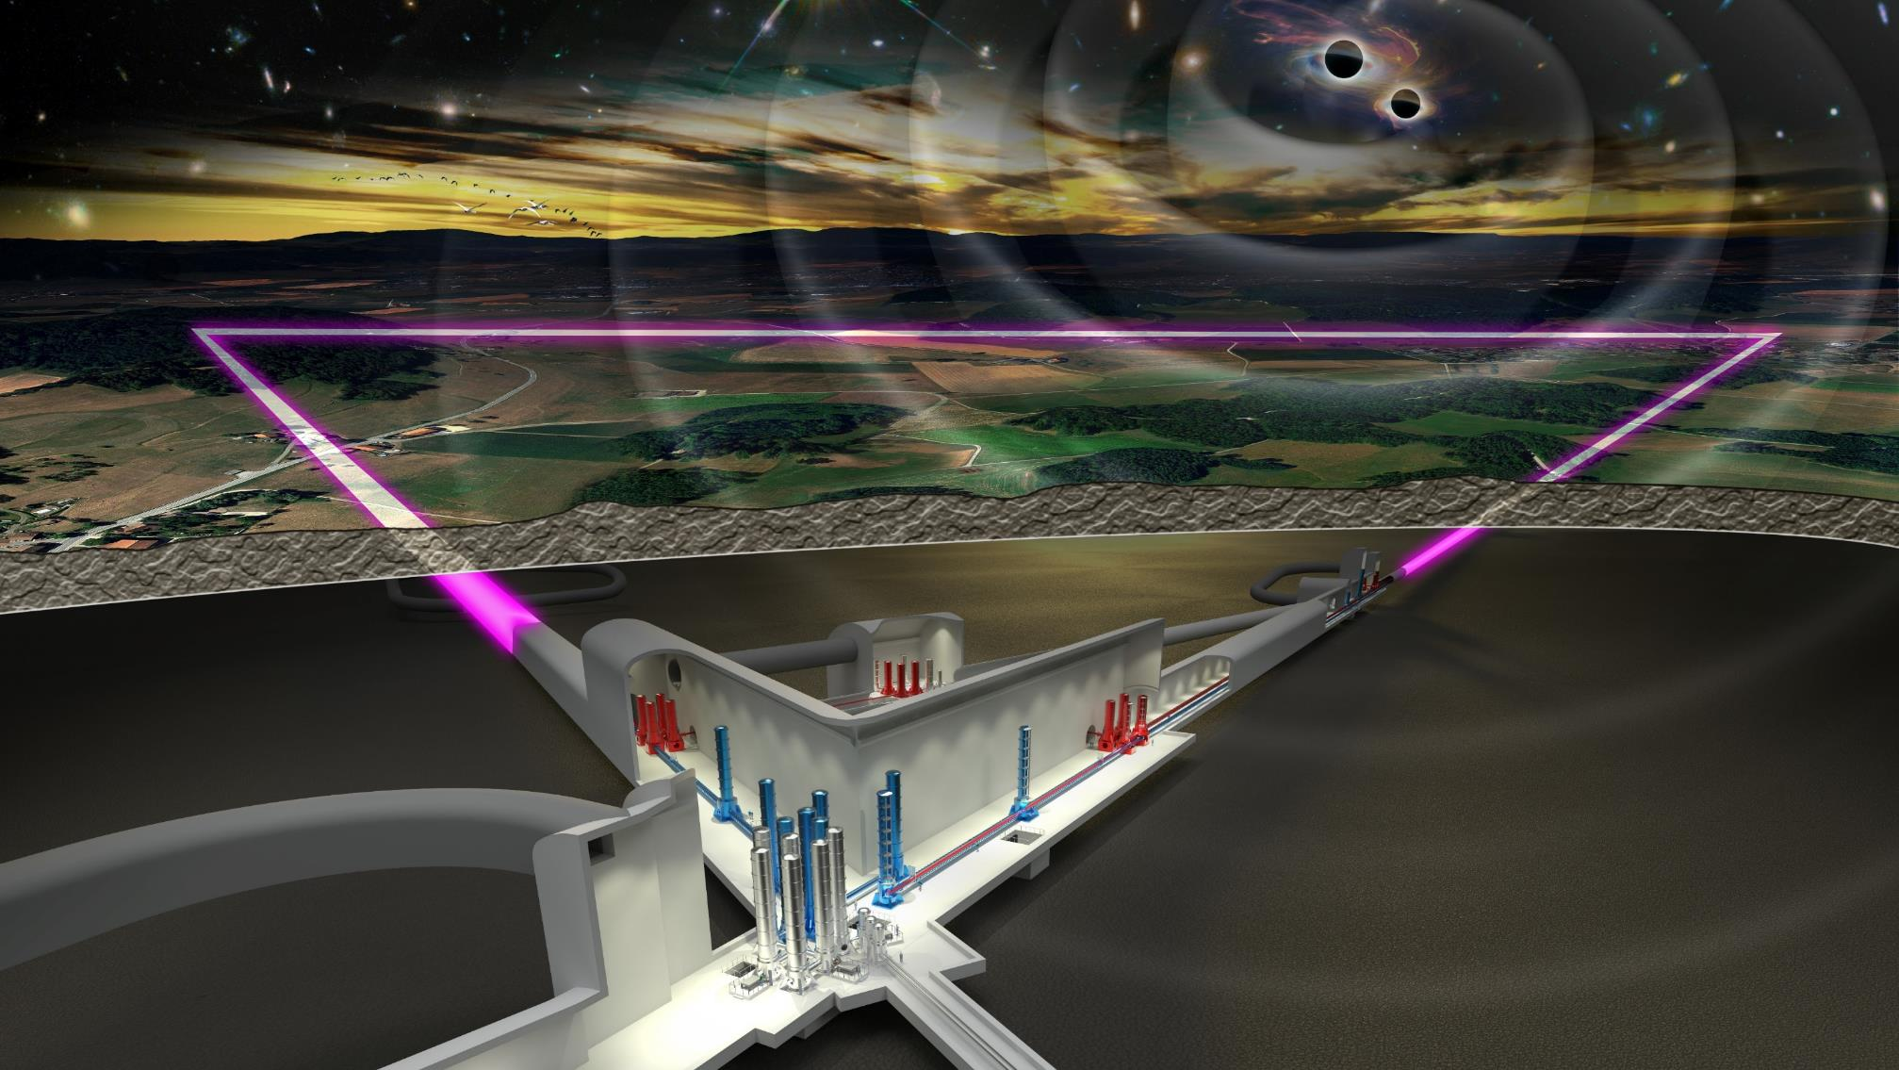
ET Monthly Meeting
05-09-2023

Slide 2
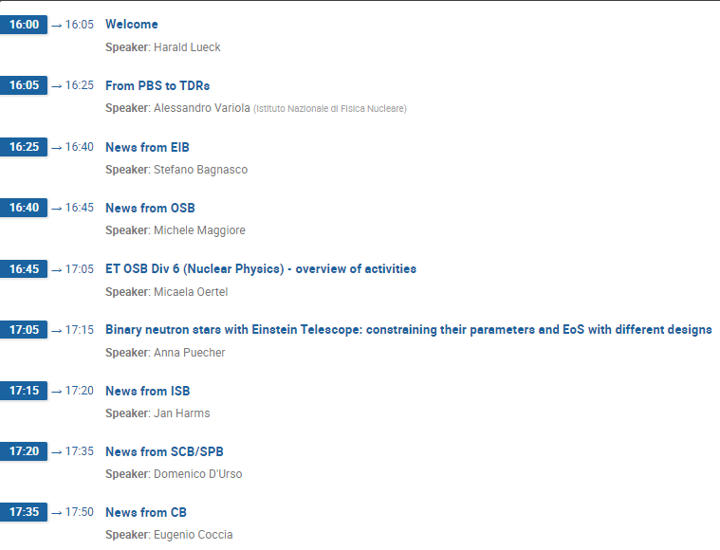
Agenda today

Slide 3
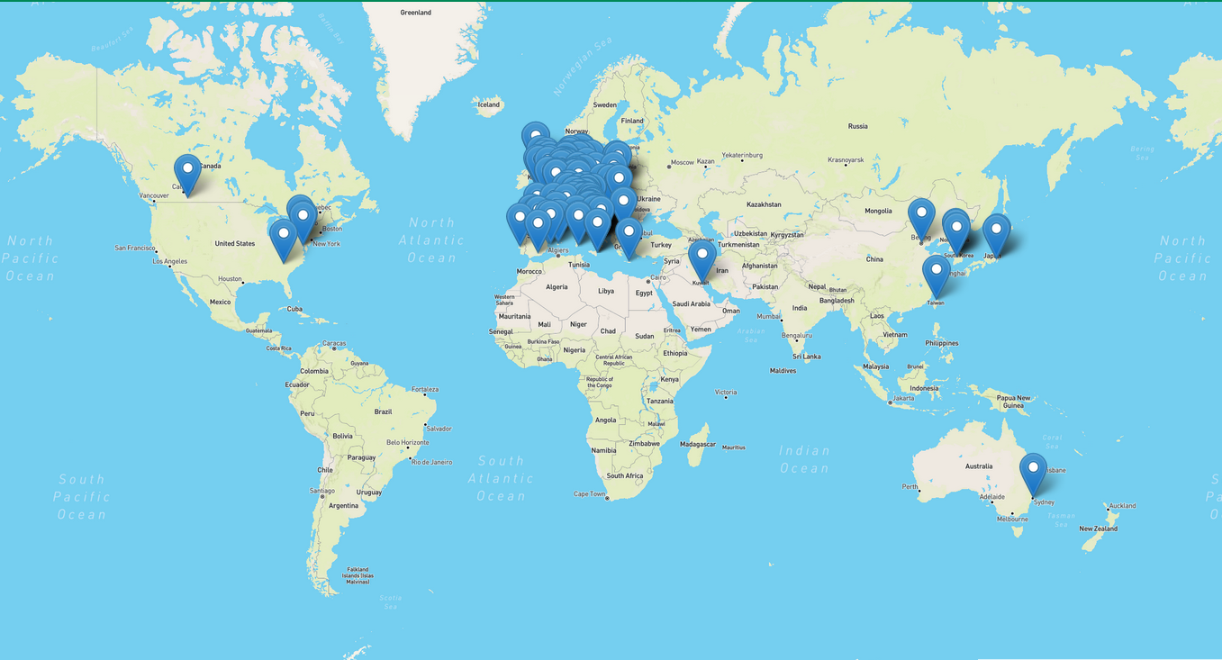
The Einstein Telescope Collaboration
ET Member‘s affiliation map
ET member database (https://apps.et-gw.eu/etmd/)
1494 members (4.9.2023)
82 Research Units (+2 requests pending)
Total: 213 Institutions
in 23 Countries
Notes:
Collaboration consists of 79 research Units with about 1300 members;
Concentrated in Europe

Slide 4
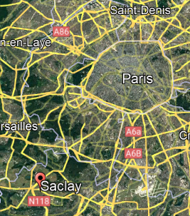
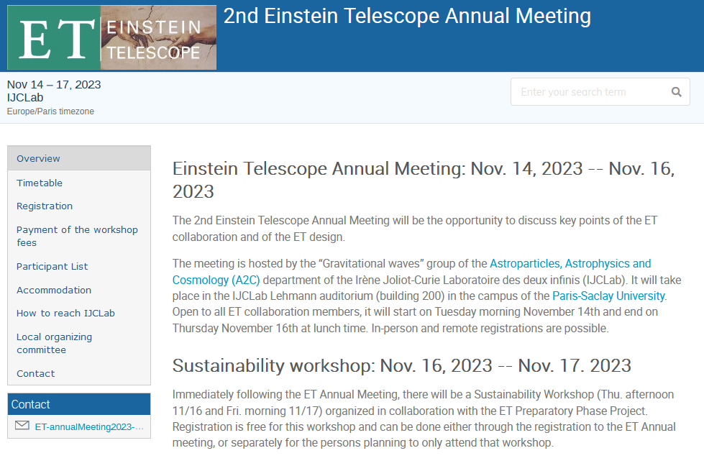
ET Annual Meeting
https://indico.ijclab.in2p3.fr/event/9686/
Paris

Slide 5
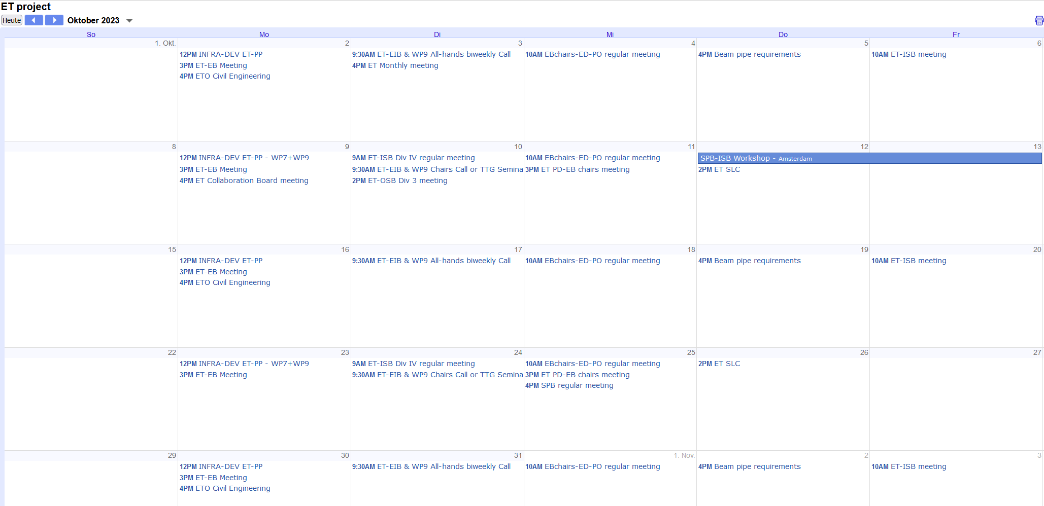
Next ET Monthly meeting
https://indico.ego-gw.it/category/32/
3.10.2023 16:00 CEST
Indico page :https://indico.ego-gw.it/event/644/

Slide 6
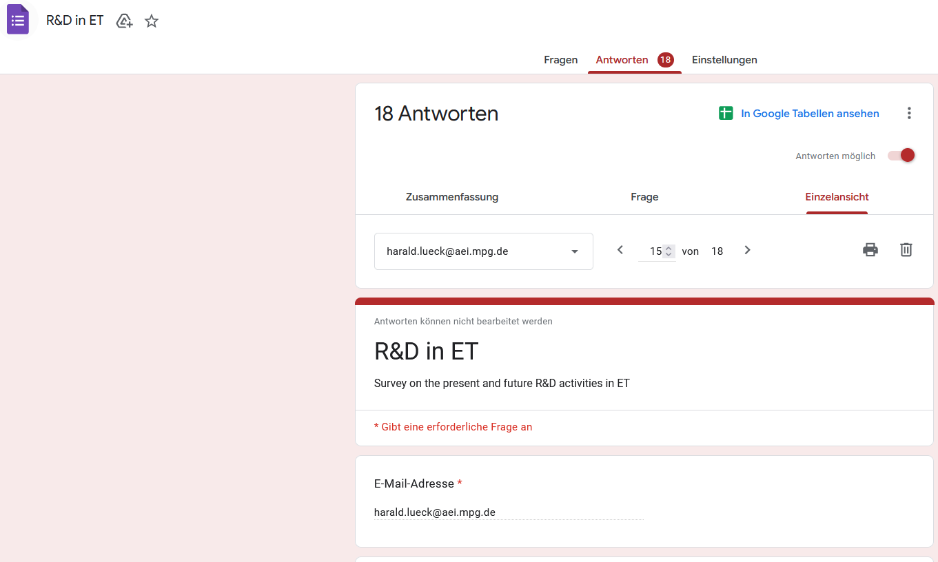
R&D survey
Only 18 answers from 82 RUs! Some replied per institution → even less RUs replied.

Slide 7
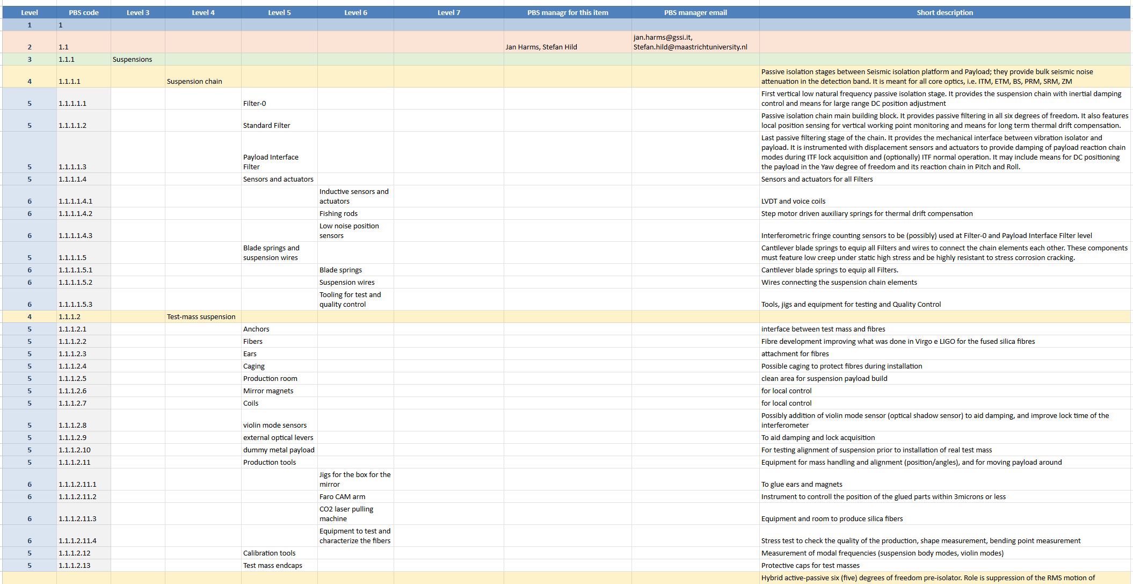
Towards TDR: Product Breakdown Structure
https://wiki.et-gw.eu/Main/PBSWorkingGroup/WebHome
ISB PBS = 1896 lines of Excel sheet
All parameters for each element will be defined
The report from the PBS group on parameters and layout
has been already submitted to EDS, ET-0278A-23.
Here you will find many indications, also on verification.
Will be transformed into a relational database
(initially MS Access)

Slide 8
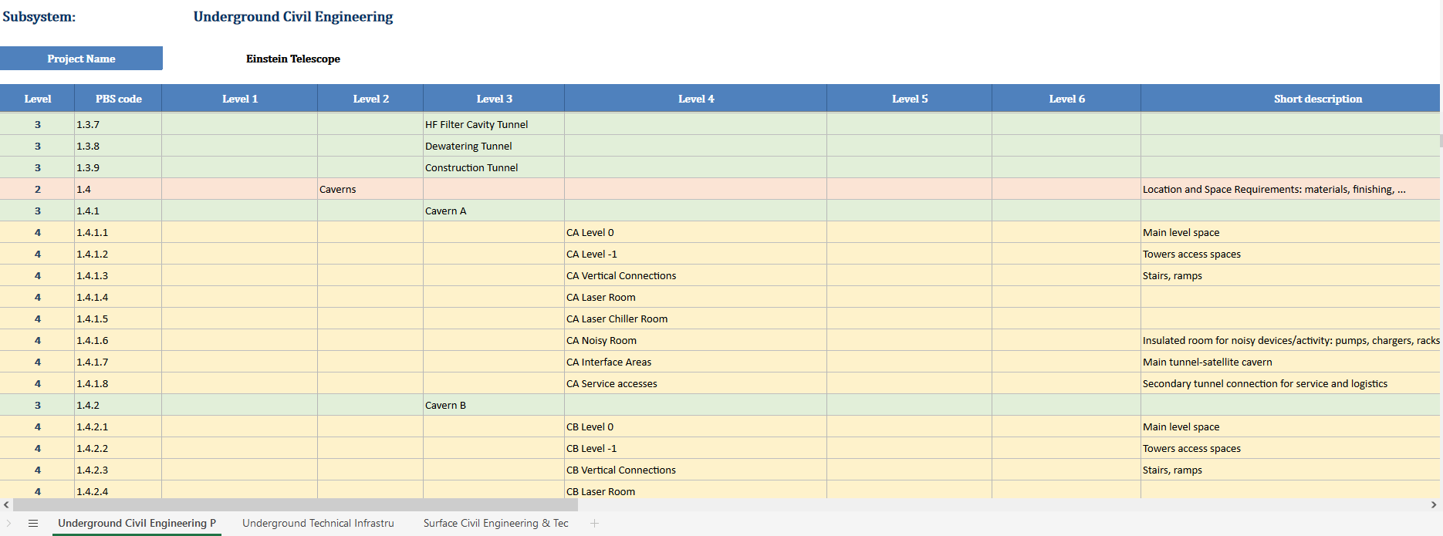
Infrastructure PBS
613 lines Excel Sheet

Slide 9
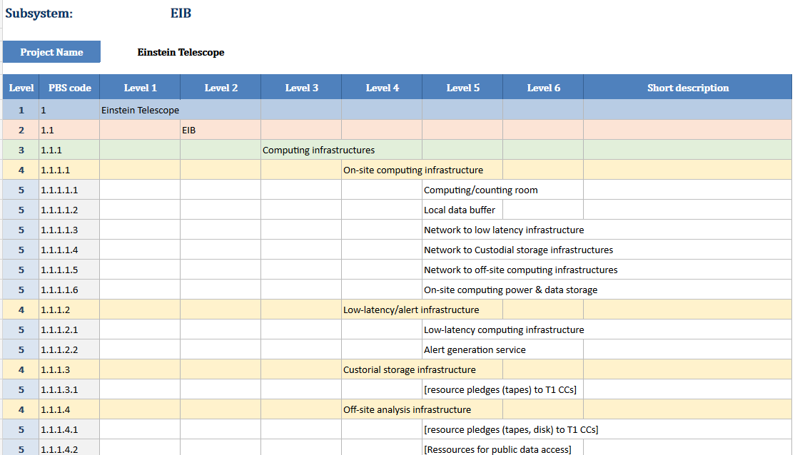
EIB PBS
71 Lines, Excel Sheet

Slide 10
From PBS to TDR
This is the starting point for the realization of the TDRs of the ET observatory, objective that it is the first target of the ISB mandate (ET-0085A-20, https://apps.et-gw.eu/tds/ql/?c=15719) and of the EIB mandate (ET-0323A-21, https://apps.et-gw.eu/tds/ql/?c=16044).
The ET EB and PO defined the following procedure:
Appointment of the PBS item reference persons (PBS-IRP):
Each item in the PBS database (examples can be found in the Instrument PBS) will be associated with the name of a reference person. Considering that the PBS has been built by mapping it on the structure of the ISB, the natural choice would be to associate the PBS items with the name of a division or WP chair. …
Duties of the PBS-IRP:
In this initial phase, the duties of the PBS-IRP are:
Look in the updated CDR (or elsewhere in the available documentation, if the PBS item has not been covered by the CDR) and identify functional and integration parameters relative to PBS items. The PBS working group will provide instructions and tutorials on the definition of functional and integration parameters used.
Attach to each PBS item a standard table describing these parameters. The standard table template will be provided by the PBS working group after some iteration with the ISB members.
Each parameter table will have a verification step, to ensure compliance with the (current) ET design. The verification chain still has to be defined.
The time frame for this operation will be on the order of a few months, considering that in 2024 we need to deliver an initial TDR documentation.

