Slide 1
Stable recycling cavities for AdV+ and status of AdV+ Phase II
Viviana Fafone, Raffaele Flaminio
for the Virgo Collaboration

Slide 2
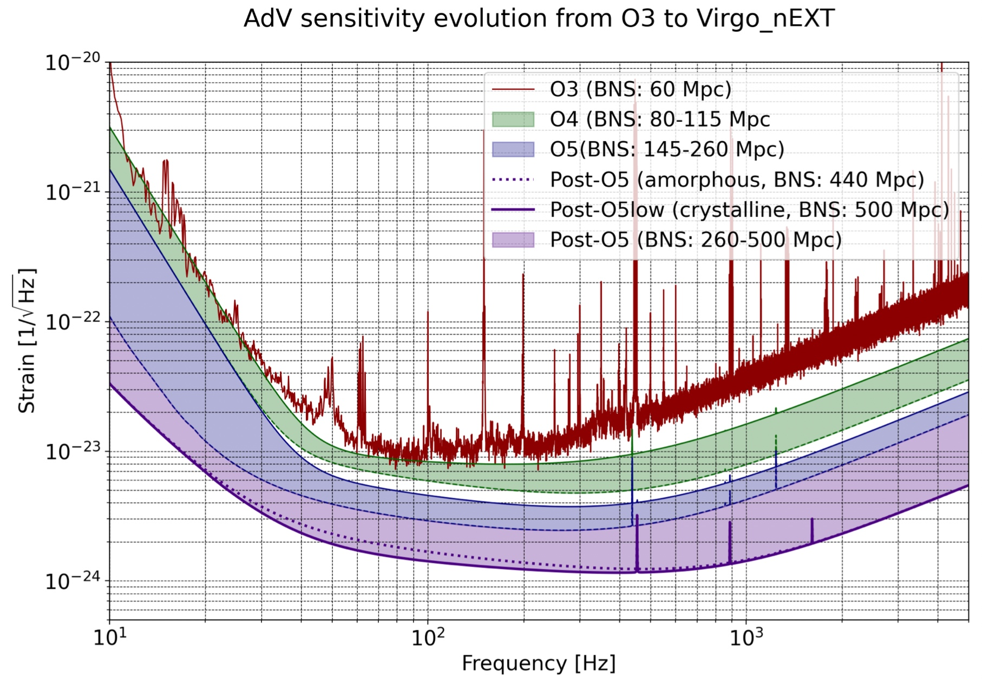
Sensitivity goals
Short term
  AdV+ Phase II sensitivity
Long term:
  Virgo-nEXT sensitivity
  Infrastructure, vacuum systems and seismic isolation should be compatible with Virgo-nEXT

Slide 3
Reminder
Stable recycling cavities have been studied deeply in the context of the Advanced Virgo design in 2009-2011
Since then LIGO and KAGRA have designed and operated stable recycling cavities
Bottom line
  We did not start from scratch

Slide 4
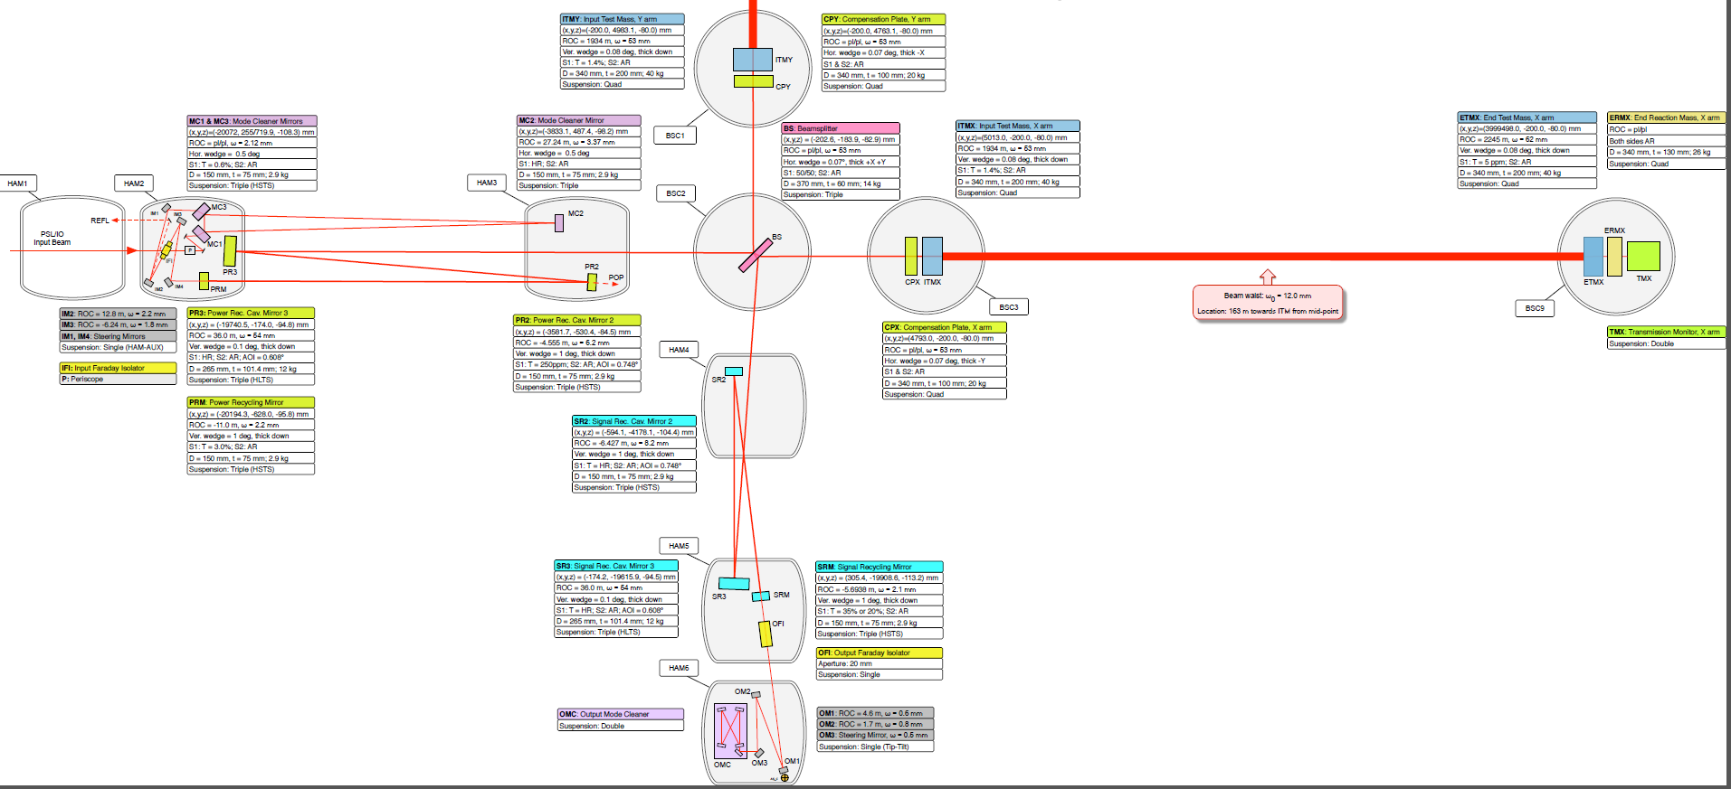
Stable recycling cavities
The LIGO scheme (also adopted by KAGRA): folded cavity with three curved mirrors
~15 m (11 m in KAGRA)

Slide 5
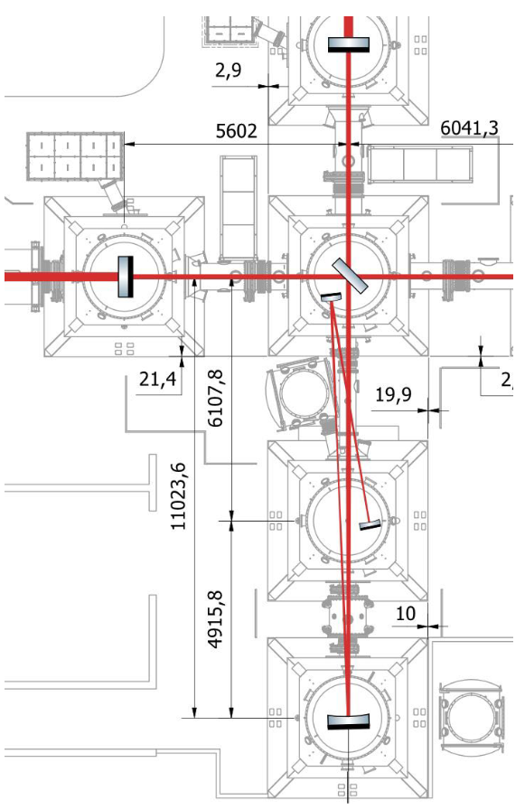
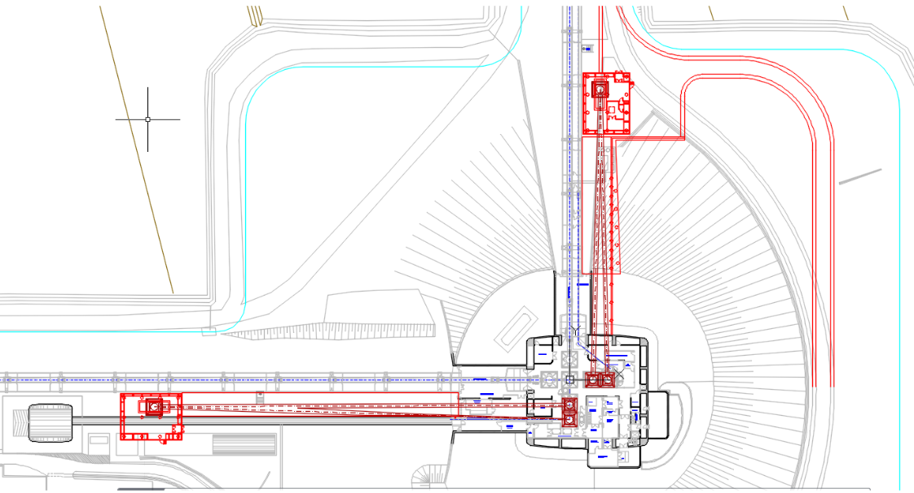
The two options
Long solution (~80 m)
  Requires additional buildings and vacuum systems
Short solution (~10 m)
  Within the present infrastructure; requires modifications to the vacuum system
“Short”
LIGO-like
3 curved mirrors
“Long”
1 flat mirror &
2 curved mirrors

Slide 6
Optics: requirements
Stable cavities
  Break the cavity degeneracy by reducing the beam size within the recycling cavities
    Gouy phase >> 0
  Other important items to be considered that we have been looking into:
    The effect of astigmatism
    The feasibility of the required mirrors radius of curvature
    The needed remote control over the mirrors radius of curvature
    The losses in the signal recycling cavity
    The ability to safely extract the auxiliary beams avoiding scattered light effects
    The sensitivity to thermal lenses in the input mirrors
    The beam intensity on the mirrors
    The effect of radiation pressure on the alignment control
    The modulation frequencies needed for the interferometer sensing and control
    The interferometer length and alignment sensing and control scheme
Many discussions and exchange
of information with LIGO members

Slide 7
Suspensions: requirements
Displacement noise requirements
  Requirements for Signal Recycling Cavity mirrors:
    10⁻¹⁷ m/√Hz @ 10 Hz (and 3 10⁻¹⁷ m/√Hz @ 100 Hz)
      Same requirement as for AdL and A+
    Requirements for Virgo-nEXT relaxed by the use of balanced homodyne
  Requirements for Power Recycling Cavity mirrors less stringent because of smaller coupling to h(t)
  These requirements are orders of magnitude less stringent than the requirements for the main test masses
Three vertical stages of seismic attenuation are sufficient
  They provide some additional margin
  See V. Boschi et al. VIR-0661A-23 and H.J. Bulten et al. VIR-0622A-23

Slide 8
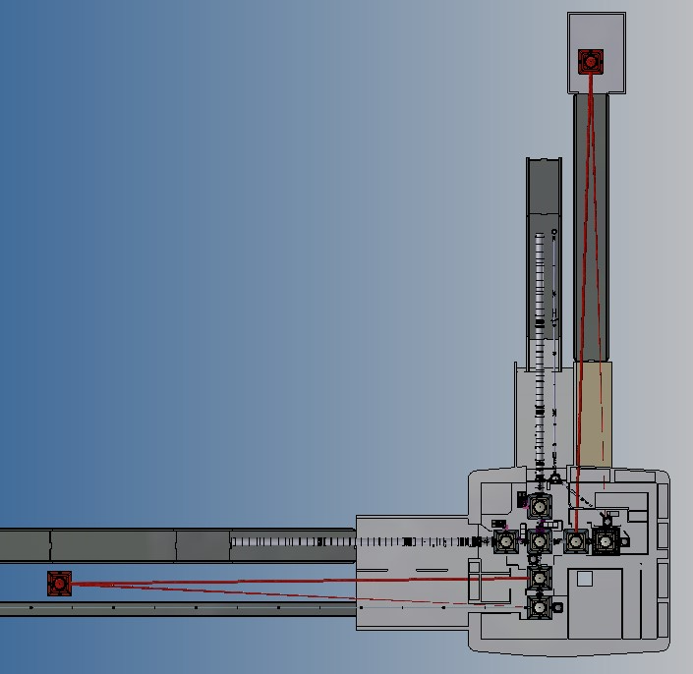
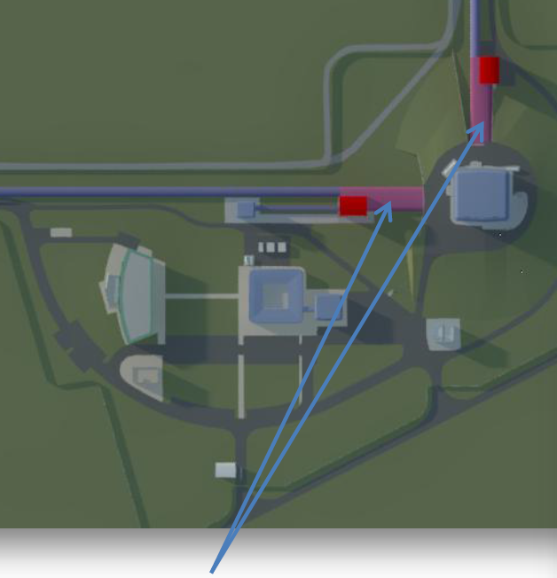
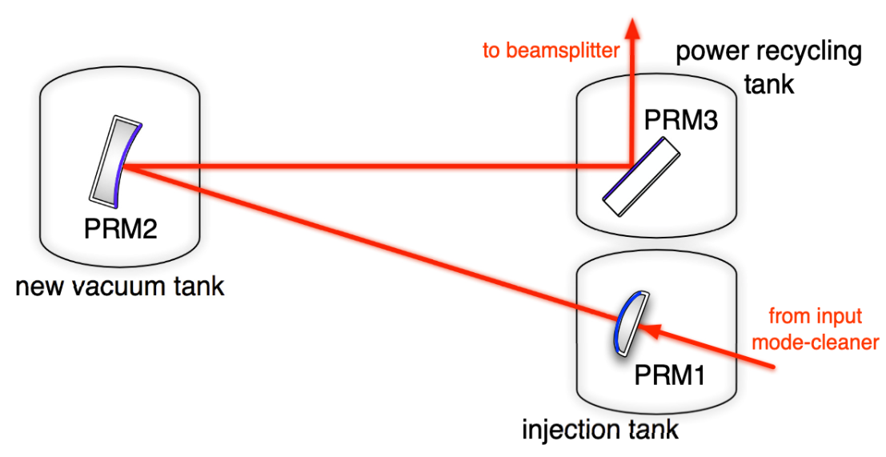
Layout: long cavities
160 m long V-shaped recycling cavities: two curved mirror and one flat folding mirror
Two buildings at 80 m from the central building, two tunnels and 320 m vacuum tubes
North
~ 80 m
Additional buildings to host PR2/SR2
and tunnels with tubes to bring the light there

Slide 9
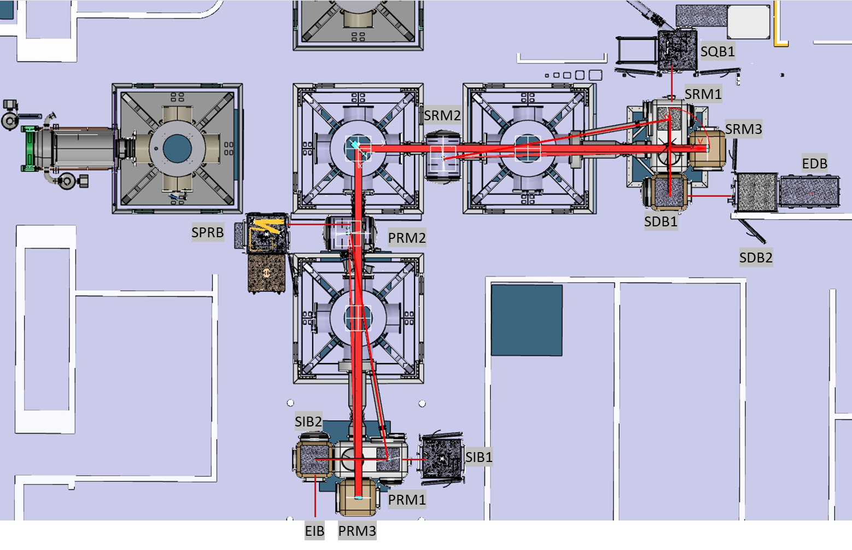
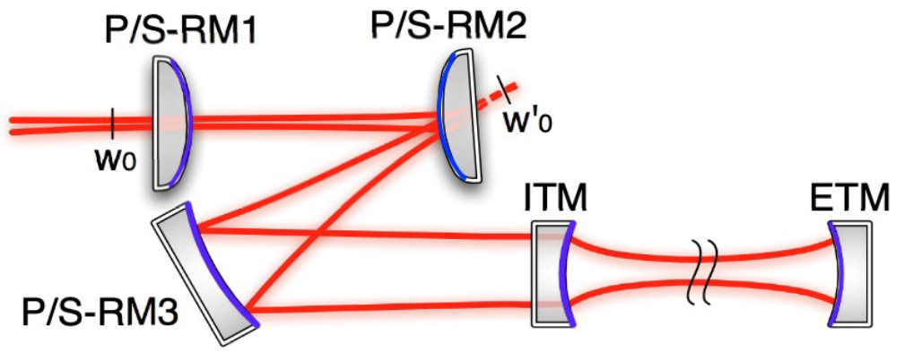
Layout: short cavities
Removal of 2 large vacuum chambers; addition of 8 smaller vacuum chambers
Three curved mirrors suspended at the input port (and three at the output port)
Two benches instead of one at the input port (and two at the output port)

Slide 10
Mirrors: long cavities
Four large mirrors needed
Two mirrors can be small
 | Diameter | Thickness | Mass | RoC | Remarks
PR1/SR1 | 100 mm | 75 mm | 1.3 kg | -2.8 m | Easier suspension on bench
PR2/SR2 | 350 mm | 100 mm | 21 kg | 163 m | Avoid B5 clipping
PR3/SR3 | 550 mm | 65 mm | 34 kg | Flat | Works at 45 degrees
Mirrors to be changed
when arm cavity mirrors
will be changed

Slide 11
Mirrors: short cavities
Two large mirrors needed
Four mirrors can be small
 | Diameter | Thickness | Mass | RoC | Remarks
PR1/SR1 | 100 mm | 75 mm | 1.3 kg | -7.8 m | Easier suspension on bench
PR2/SR2 | 150 mm | 75 mm | 2.9 kg | -1.9 m | Same size as LIGO
PR3/SR3 | 265 mm | 100 mm | 12 kg | 20.2 m | Same size as LIGO
Mirrors to be changed
when arm cavity mirrors
will be changed

Slide 12
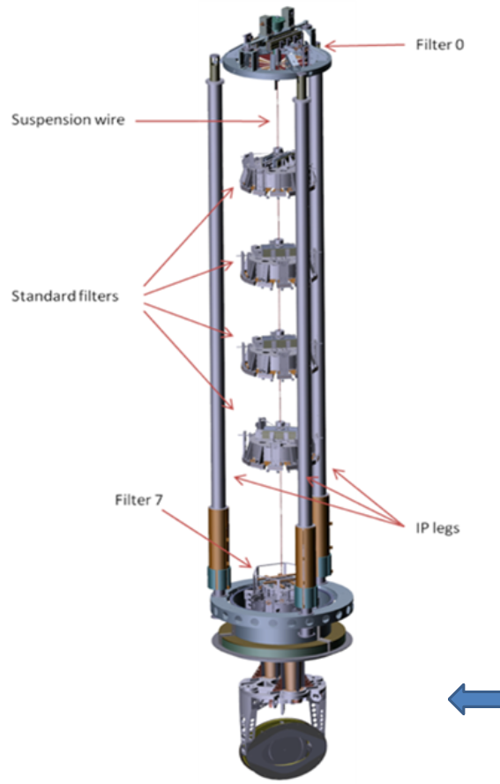
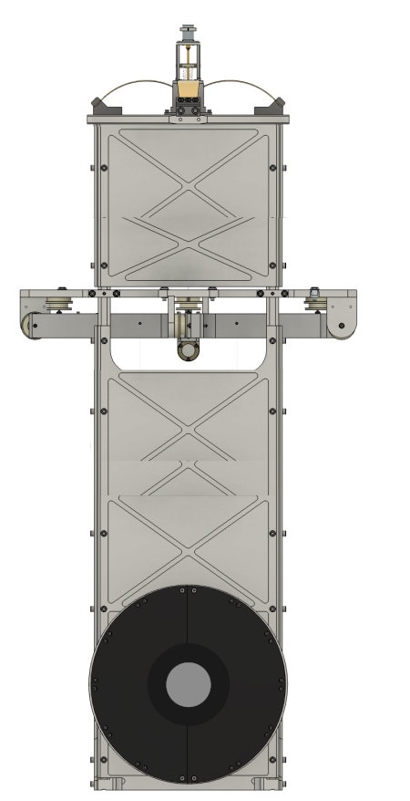
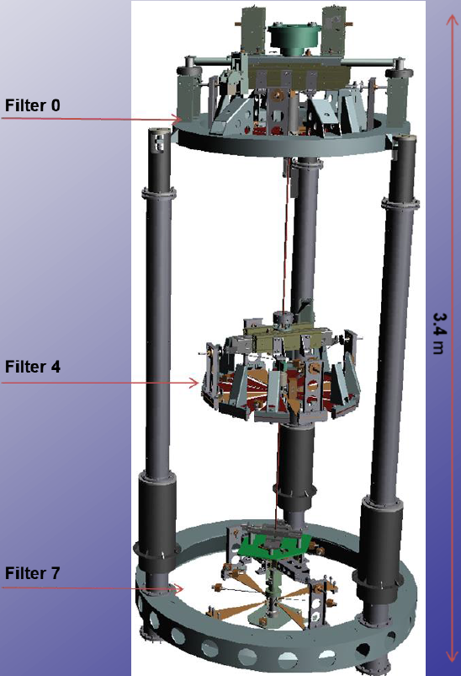
Suspension and payloads: long cavities
Needed suspensions
  PR3/SR3 (34 kg)
    Reuse of PR/SR Super-Attenuators
    New payload (Beam splitter type)
  PR2/SR2 (21 kg)
    New short seismic isolators
    MC-like SAT (or MSAS)
    Virgo-like payload
  PR1/SR1 (1.3 kg)
    Double pendulums on top of present SDB1/SIB1 benches
    Modification of SDB1/SIB1 suspensions required
    Prototype needed
  Suspension needed for the balanced homodyne bench for Virgo-nEXT
    Similar to SDB2
350
500

Slide 13
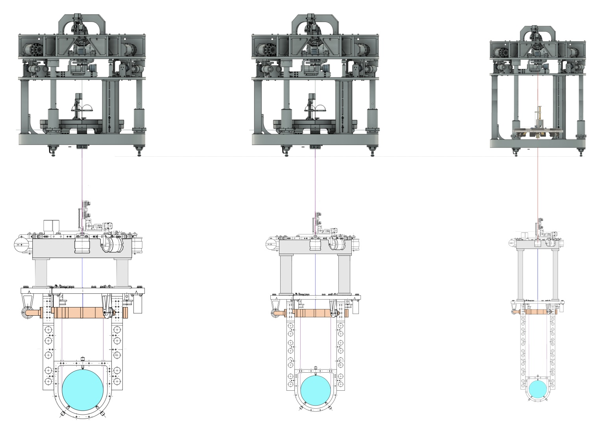
Suspension and payloads: short cavities
Needed suspensions
  PR3/SR3 (12 kg)
    MultiSAS + Virgo-like payload
  PR2/SR2 (3 kg)
    MultiSAS + Virgo-like payload
  PR1/SR1 (1.3 kg)
    MultiSAS
    Double pendulum on top of PR1/SR1 benches hosting
    Prototype needed
  Two seismic isolators for SDB1/SIB1
    MSAS + Virgo-like bench payload
1100
800
350
3170
3060
500
12kg,∅26-cm
3kg,∅15-cm

Slide 14
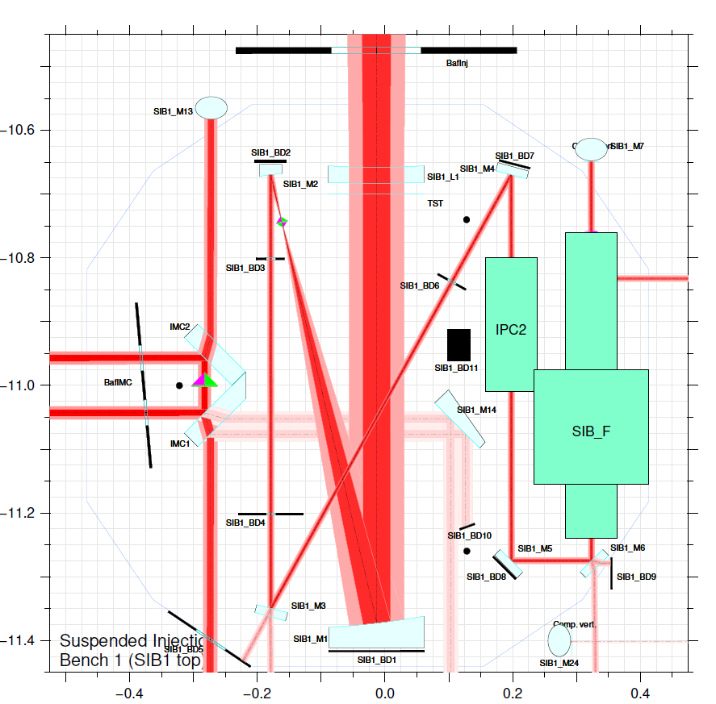
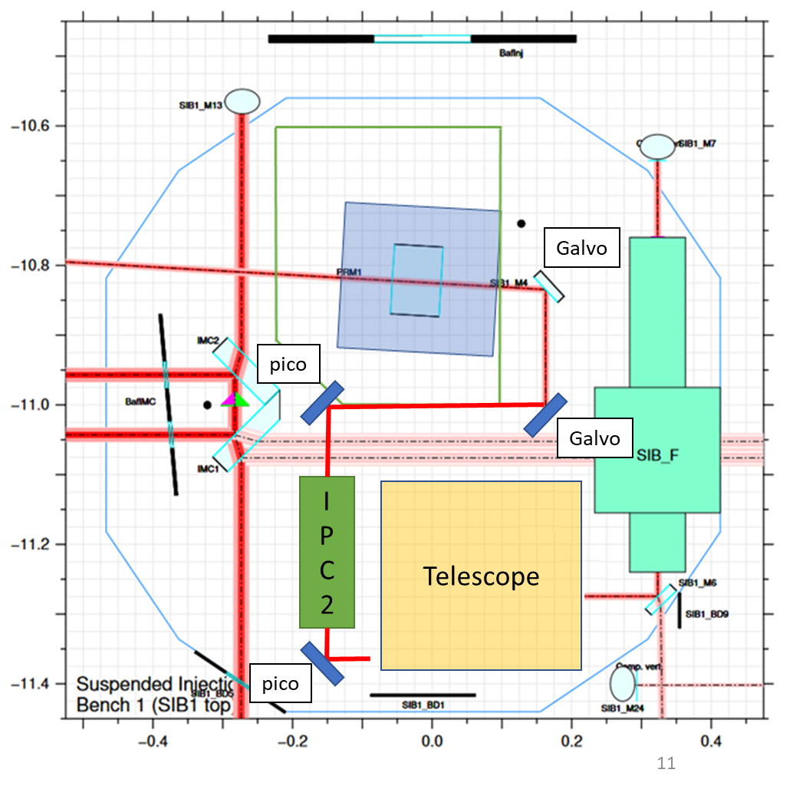
Injection: long cavities
Requirements
  Need to host PR1 double pendulum on the injection bench
  No large telescope anymore but space remains limited
    What about if dihedron needs to be suspended as well?
Suspension
footprint

Slide 15
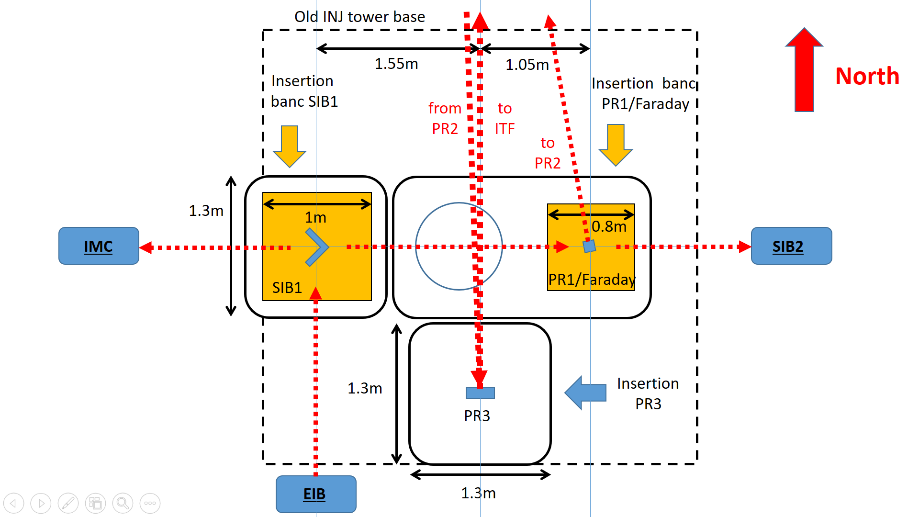
Injection: short cavities
Requirement
  Need to place PR3, PR1, Input Faraday and Dihedron in the Injection area
Two benches instead of one
  More space available
  Compatible with IMC dihedron suspension, if needed

Slide 16
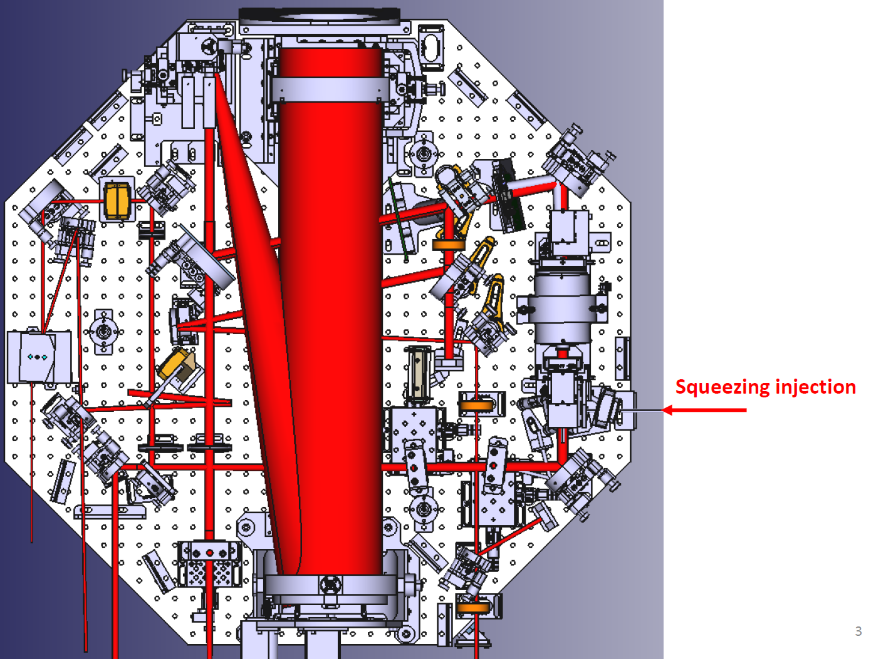
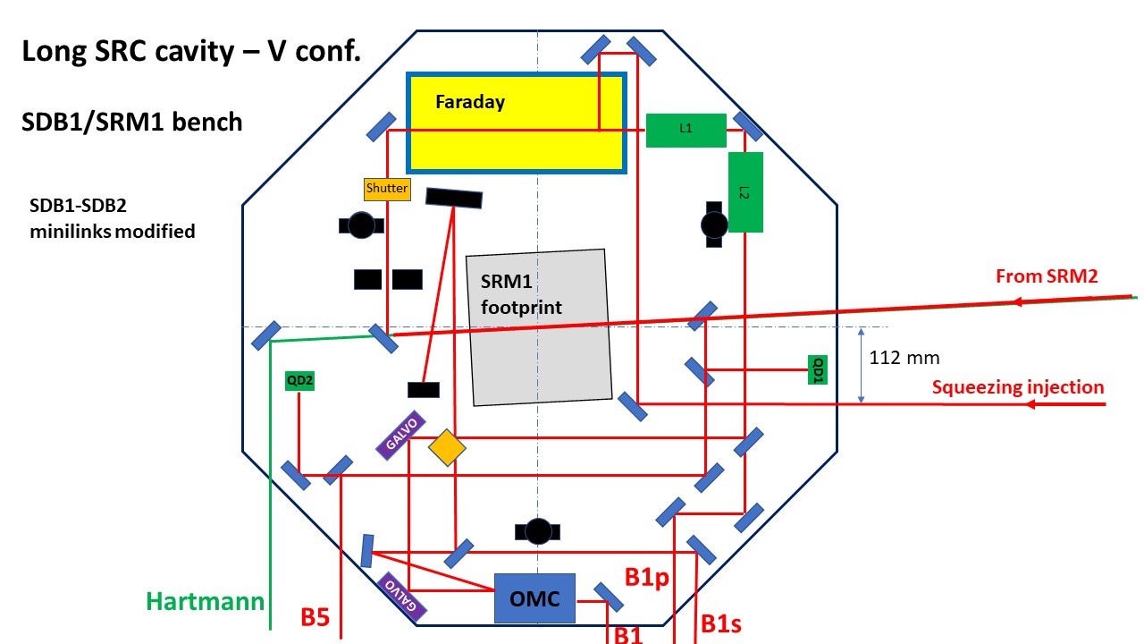
Detection: long cavities
Requirements
  Need to host SR1 double pendulum on the detection bench
  No large telescope anymore but space remains limited
    N.B. Will need an additional minitower/suspension to install balanced homodyne for Virgo-nEXT

Slide 17
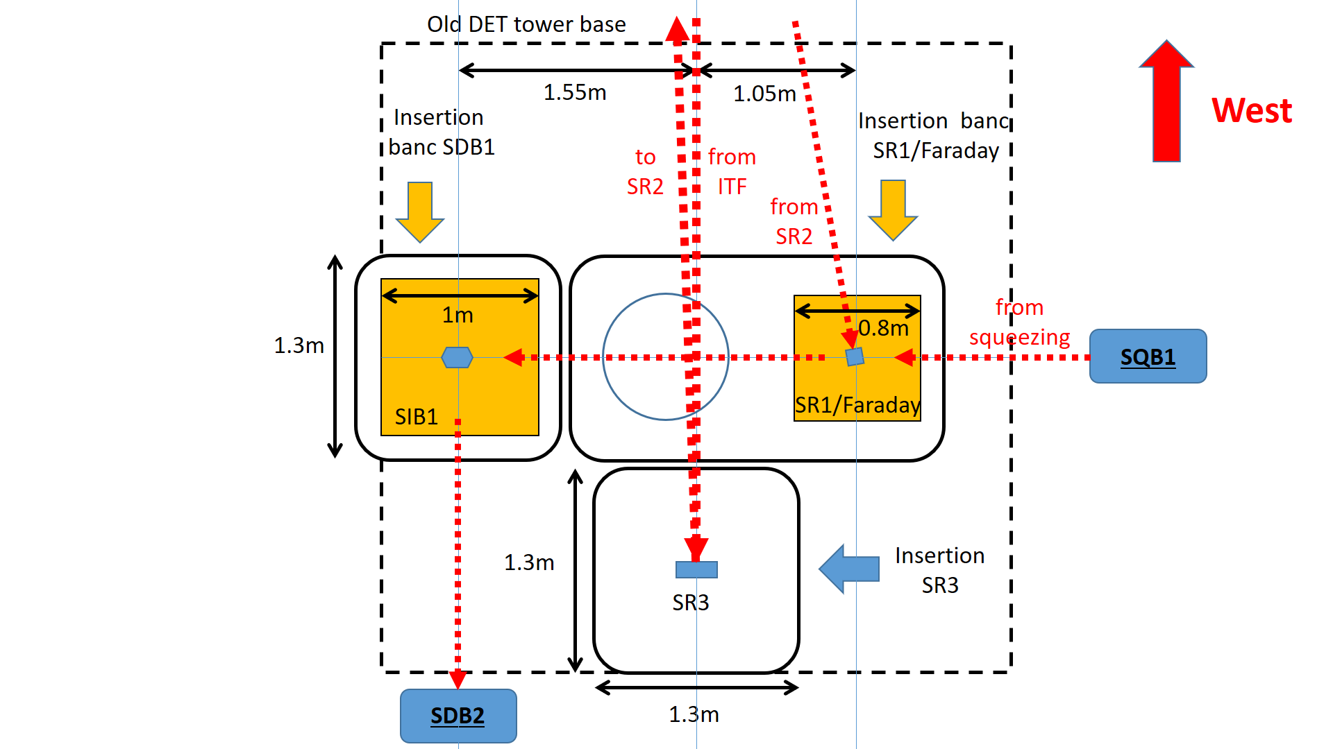
Detection: short cavities
Requirement
  Need to place SR3, SR1, Output Faraday and Output mode-cleaner in the detection area
Two benches instead of one
  More space available
  Already compatible with homodyne detector for Virgo-nEXT

Slide 18
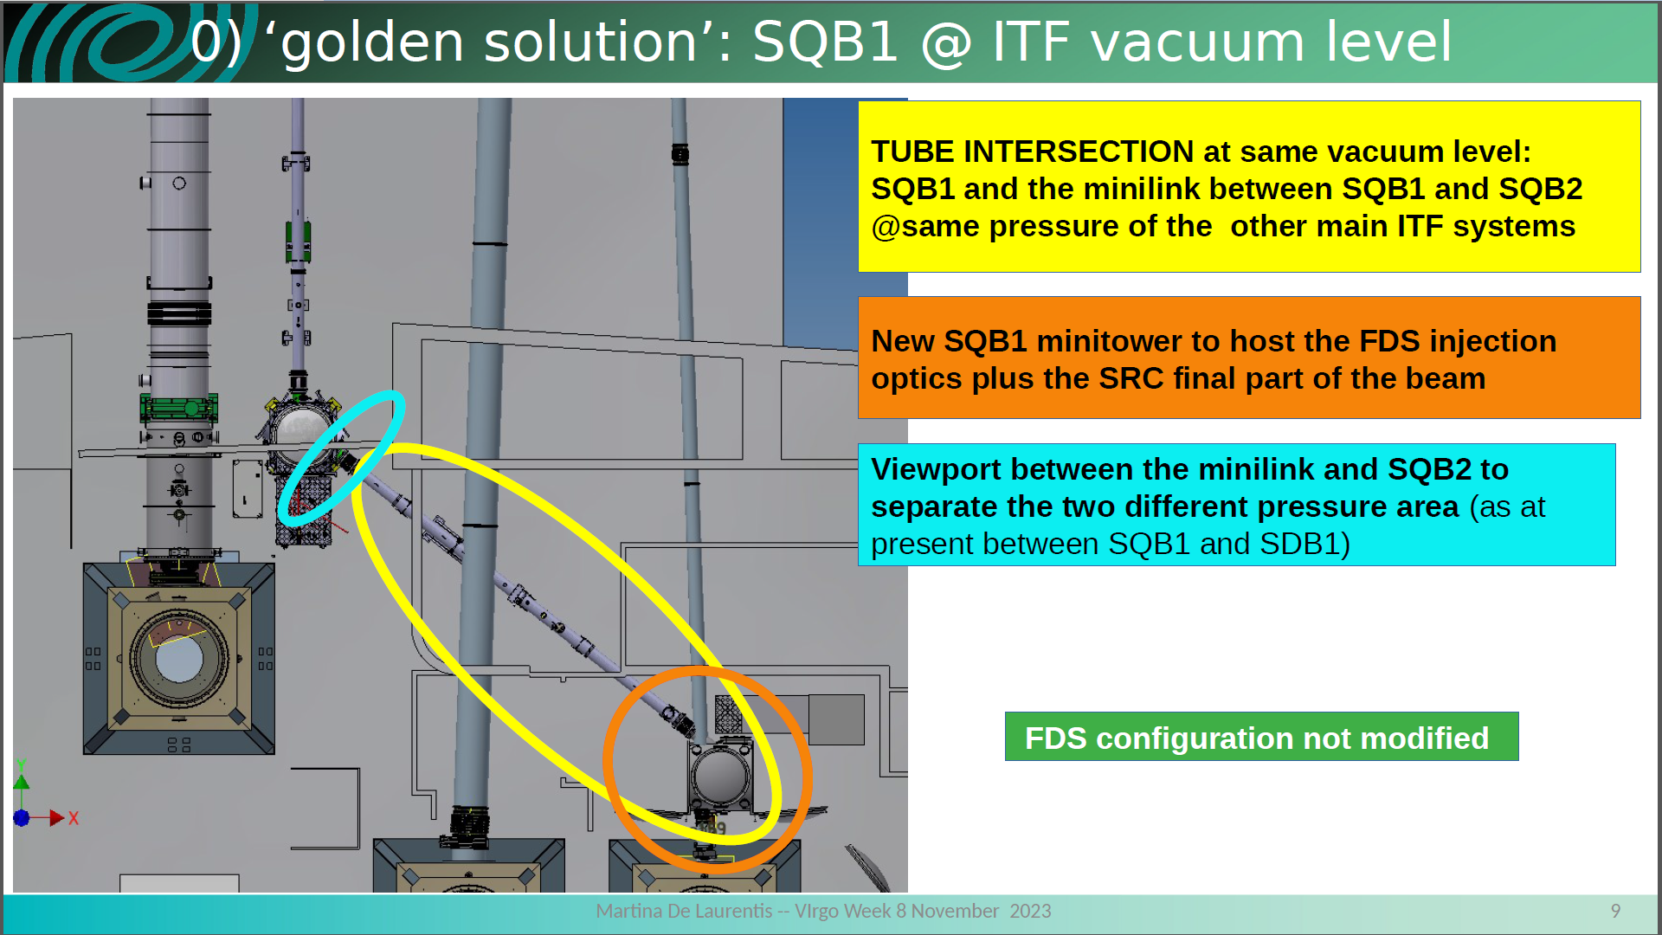
Long cavity solution: impact on QNR
Intersection between vacuum squeezed system and signal recycling cavity
  Need to change the SQB1 minitower and bench

Slide 19
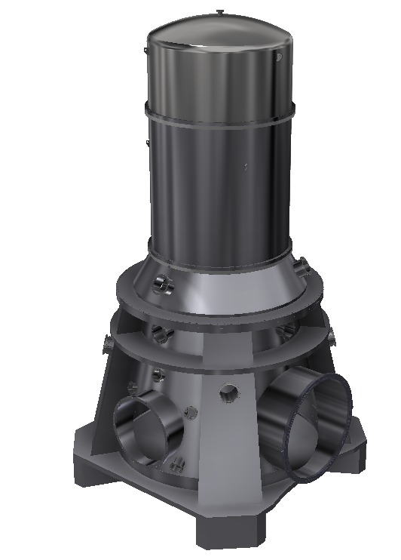
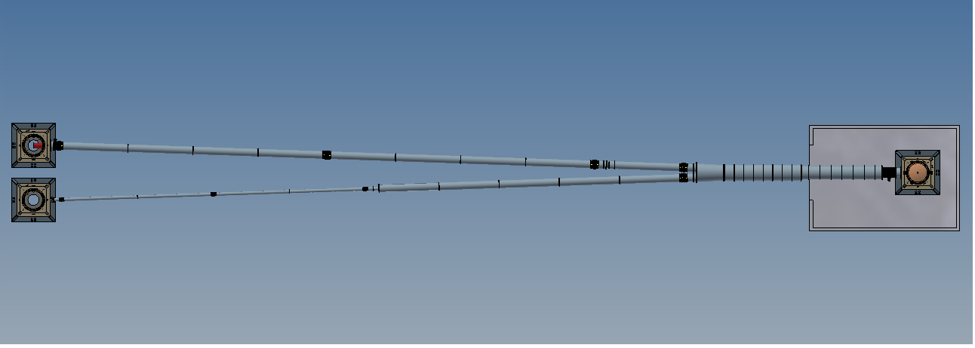
Vacuum: long cavities
Vacuum for long cavities
  Two new towers for the PR2/SR2 mirrors
  80m x 4 long tubes to bring the light from central building to PR2/SR2 and then back to the central building
  Two V shaped large modules
  Four large gate valves

Slide 20
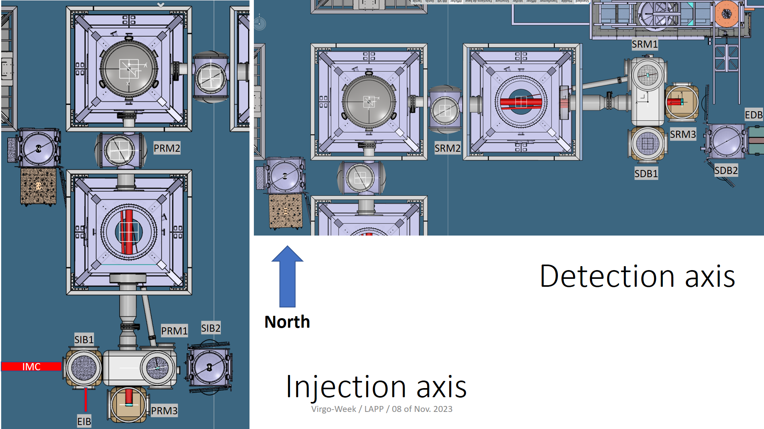
Vacuum: short cavities
Short solution
  Remove INJ&DET towers
    Large footprint
    Not adapted to stable cavities
  Four vacuum chambers (PR1/PR2/PR3/SIB1) + tube connections and gate valves for Injection area
  Four vacuum chambers (SR1/SR2/SR3/SDB1) + tube connections and gate valves for Detection area

Slide 21
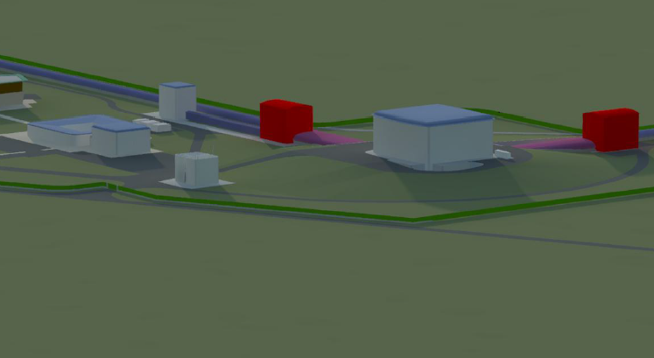
Infrastructure: long cavities
Requirements for long solution
  Two buildings at 80 m from the central building in the north and west directions to host the PR2/SR2 payloads
  Crane at 6 m to install the suspension
  Clean area on the side of the PR2/SR2 towers to install the payload
  Two 80m long tunnels along the arm tunnels to host the vacuum tube

Slide 22
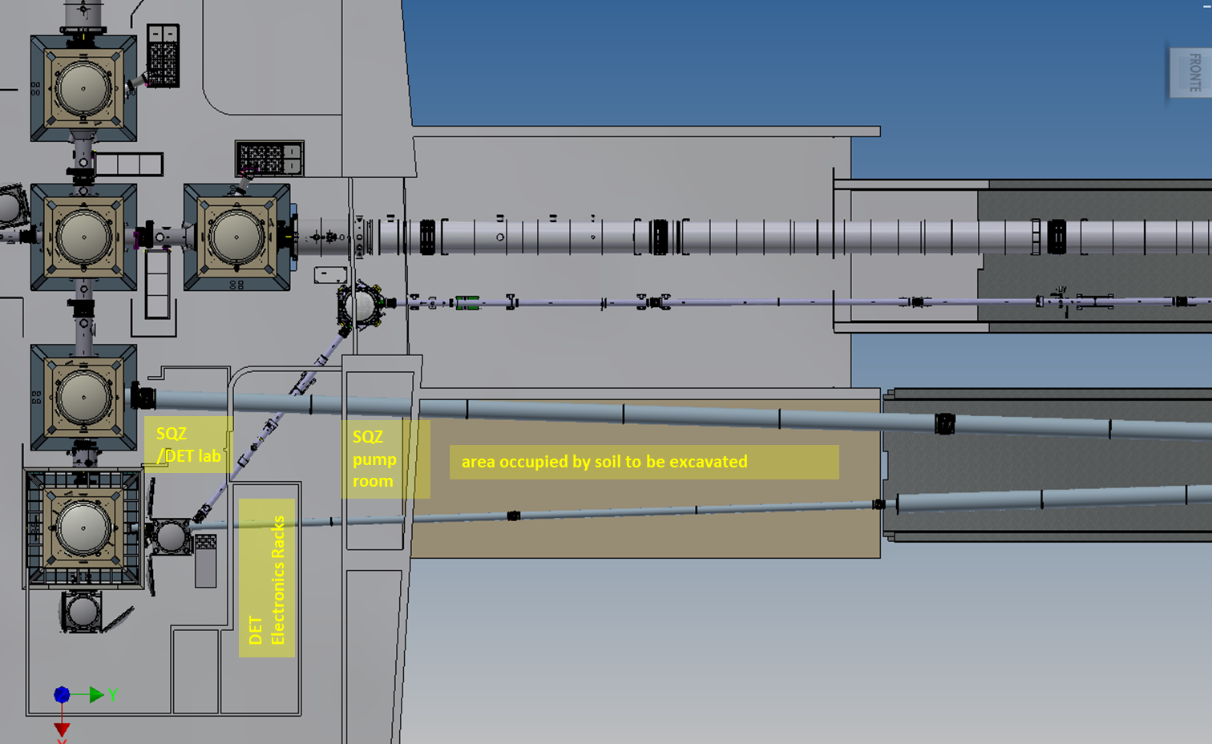
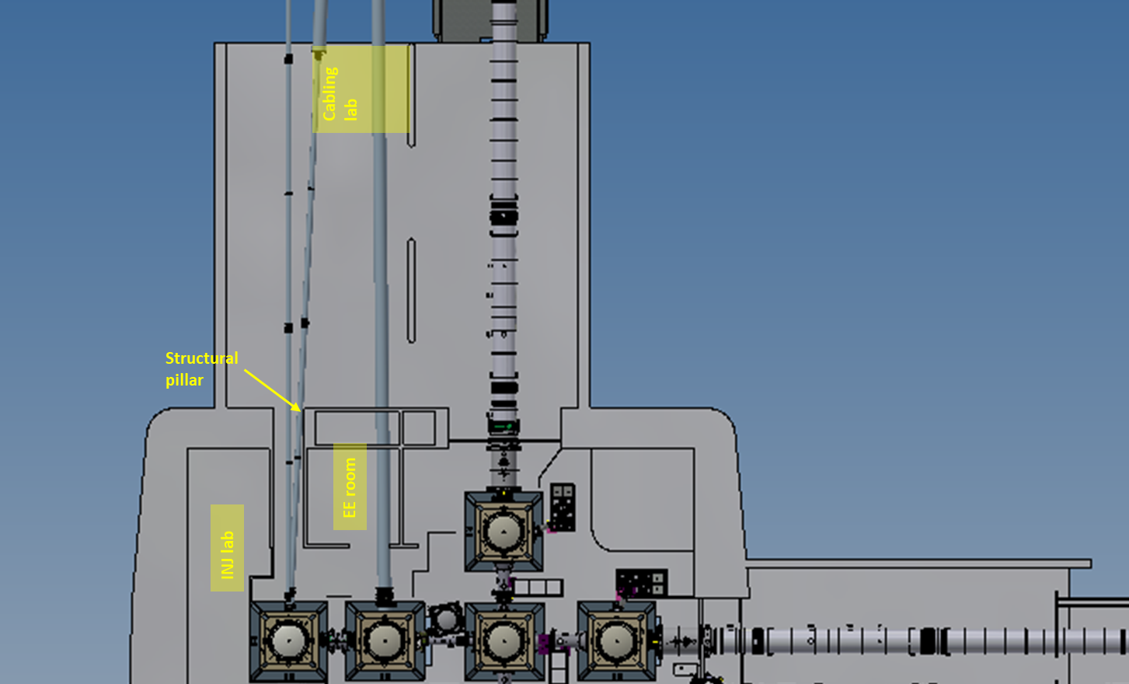
Building modifications for long cavities
Some works to be done in the CEB and around it to pass the tubes
  Walls to be traversed and laboratories to be re-arranged (see pictures below)
  Soil to be excavated along the north arm

Slide 23
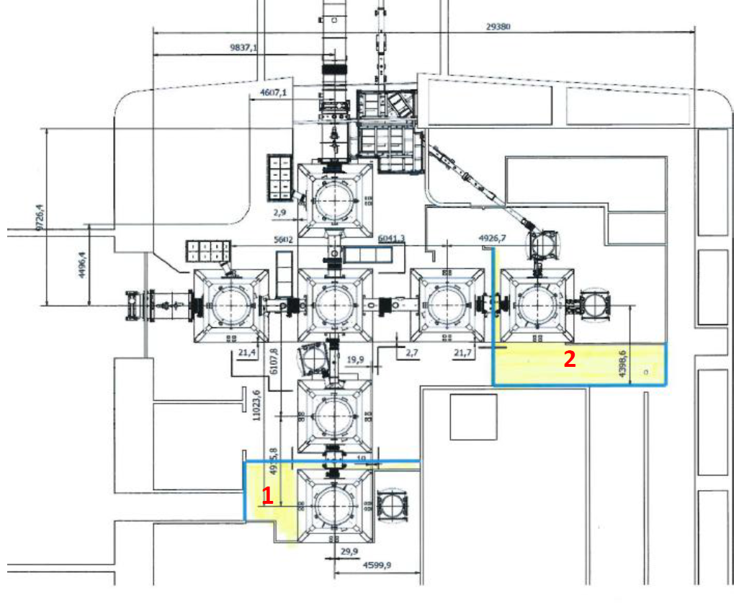
Infrastructure: short cavities
Requirements for short solution
  Install clean areas in the INJ/DET areas to allow the payloads installation in clean conditions
  Reshape the holes in the concrete slab in the INJ and DET areas to allow the installation of the new chambers

Slide 24
Budget: long cavities
First estimate
N.B. VAT included; Additional suspension control, DAQ and EMS not included; Contingency 20%

Slide 25
Budget: short cavities
First estimate
N.B. VAT included; Additional suspension control, DAQ and EMS not included; Contingency 20%

Slide 26
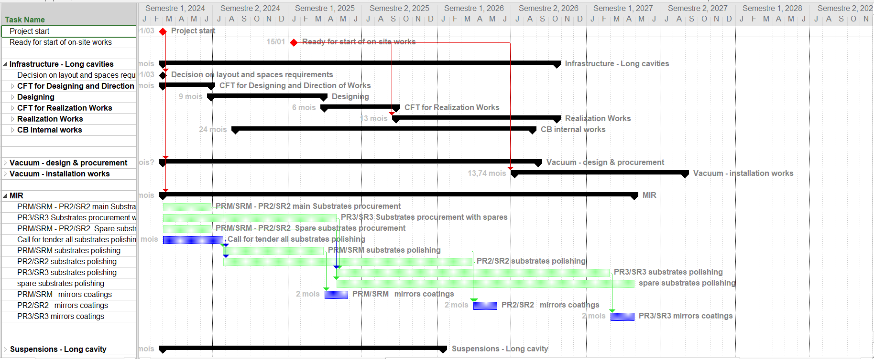
Schedule: long cavities
Need to add suspension installation and commissioning

Slide 27
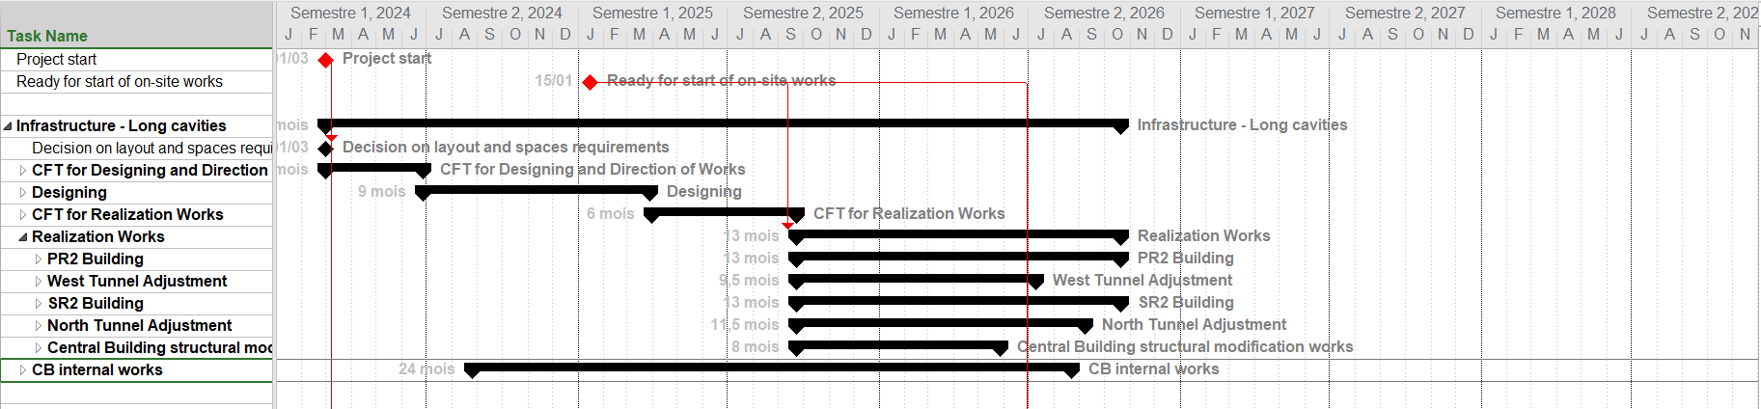
Schedule: long cavities
Critical path is going to be infrastructure construction
  13 months for works realization
  Five works sites in parallel
    PR2 building
    SR2 building
    North tunnel
    West tunnel
    Central building modifications

Slide 28
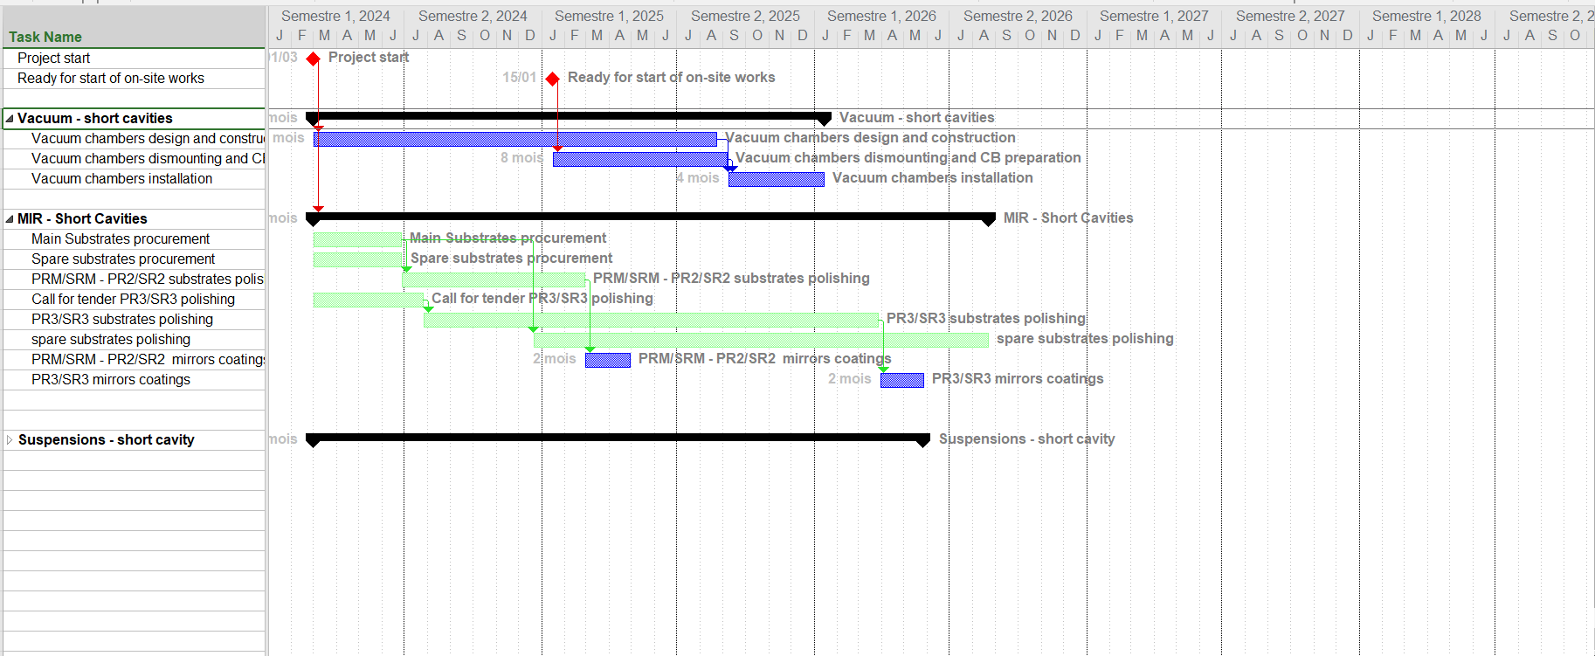
Schedule: short cavities
Need to add suspension installation and commissioning

Slide 29
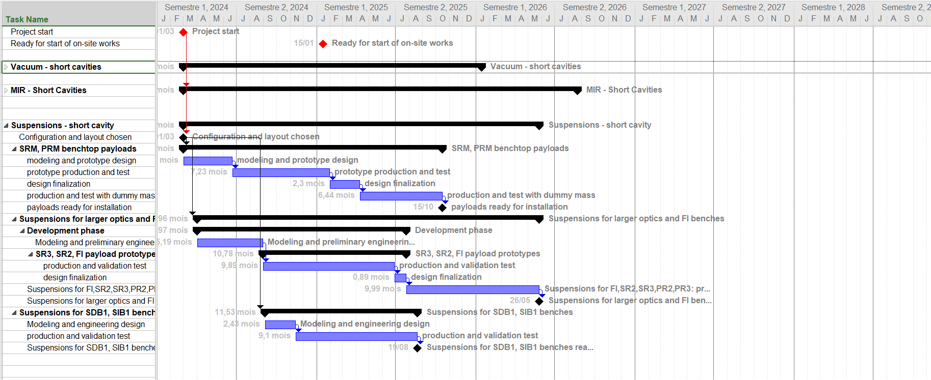
Schedule: short cavities
Critical path is going to be suspensions construction and installation

Slide 30
Short summary on stable cavities
Possible to install stable recycling cavities in Virgo, also in the present infrastructure
Schedule and cost
  The short cavity solution allows completing its installation in a shorter time and at a reduced cost
  The schedule of the long cavity solution is dictated by the time necessary to build the new infrastructure, install the additional vacuum systems and realize more large mirrors. These are also the main ingredients of its cost.
  The schedule of the short cavity solution is dictated by the time necessary to realize the required new suspensions.
Technical risks and flexibility
  Both solution requires to suspend the signal recycling and power recycling mirror on the top of suspended benches. This part will require the development of a prototype.
  The other suspensions needed for the short solution require to combine MSAS and Virgo-like payloads
  In terms of flexibility the short solution provide more space for optical benches at the injection and detection ports thus letting more options open for the future
  The long solution requires modifying QNR, the short doesn’t

Slide 31
In the meantime …

Slide 32
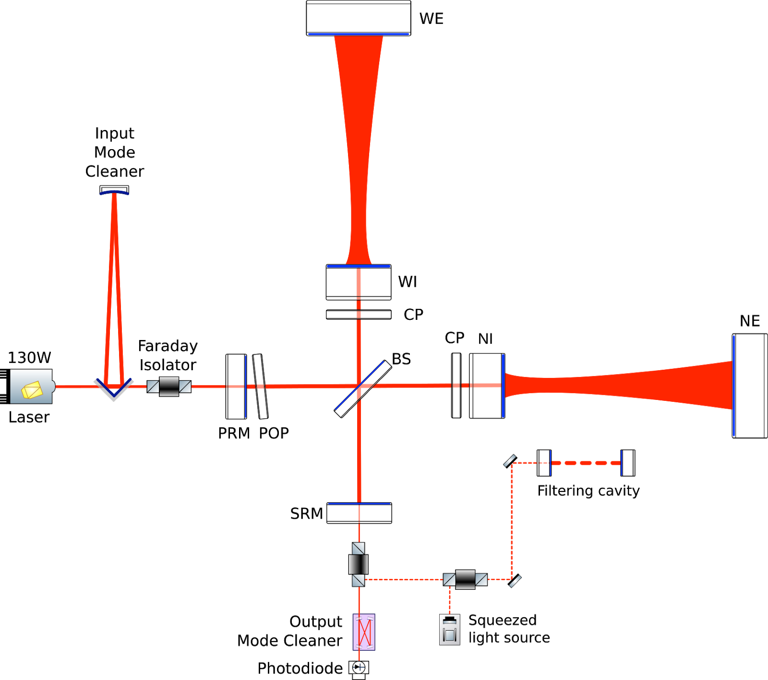
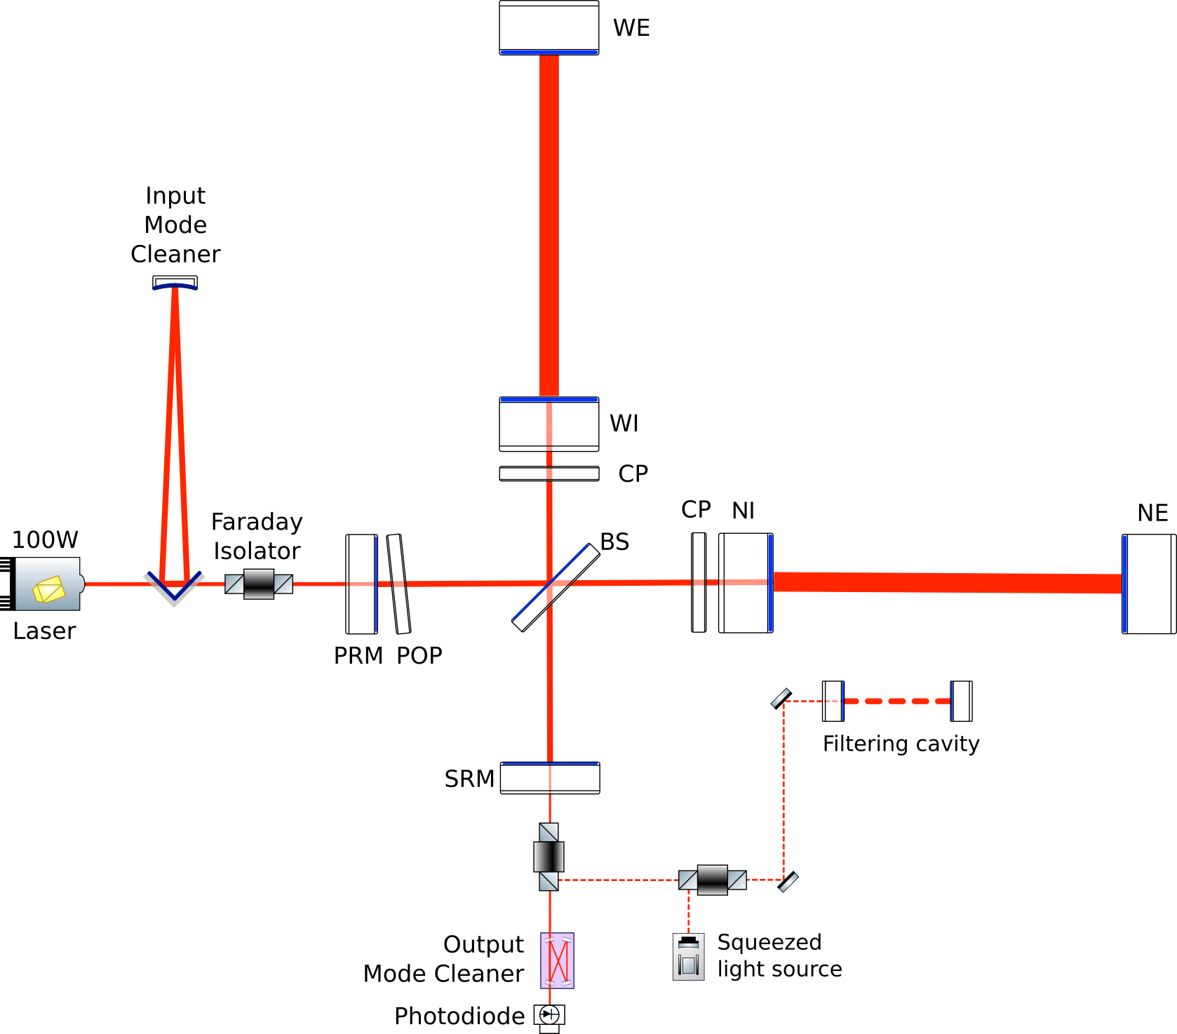
Advanced Virgo+ Phase II
Main changes
  Larger beams on end test masses
    6 cm radius ⇒ 10 cm radius
  Larger end mirrors
    35 cm diameter ⇒ 55 cm diameter
    40 kg ⇒ 100 kg
  Better mirror coatings
    Lower mechanical losses, less point defects,
    better uniformity
  New suspensions/seismic isolators for large mirrors
  Further increase of laser power
    40W ⇒ 60W ⇒ 80 W

Slide 33
AdV+ Phase II progress
MIR: Mirror polishing progressing at the companies
PAY: Large payloads construction progressing at the site
SAT: Preparation of super-attenuators upgrades continue at INFN Pisa
DET: Design of end telescopes completed. Ready for production readiness review
TCS: Development of thermal compensation upgrades progressing at Roma TV
VAC: Production readiness review held for “Additional pumping stations for 3km tubes” and “Ion pumps for four most critical towers”
PSL: Pre-stabilized laser strategy to be redefined. Waiting for inputs from Nice
SLC: Development of large instrumented baffle progressed at IFAE

Slide 34
Coating research continuing at LMA
Two materials being tested at LMA within a joint LIGO-Virgo working group
  TiSiO2 coatings:
    Low optical losses : A=0.7 ppm; S<10 ppm
    Coating Thermal Noise = 71% of AdV coatings
    But cracks after annealing (850°C for 100h)
  TiGeO2 coatings:
    New recipe tested in November: 2 tests
    No bubbles after annealing (just a few small bubbles close to the edge)
    Optical losses after annealing (600°C):
      Absorption = 1 ppm
      Scattering =10 ppm
    Coating Thermal Noise measured at 80% on « old recipe », not yet measured on new recipe
      N.B. « Quaterwaves » design, not optimized
    Large silica substrate (Ø 140m, t=45 mm) coated with new recipe:
      Scattering =14 ppm, no bubbles after annealing at 600h for 10 h. Long annealing in progress
Bottom line: there are interesting progresses
  N.B. This can affect also the LIGO schedule

Slide 35
Status of budget
About 57% of the budget committed
Possibility to start some preliminary investment for stable cavities as soon as we have a solid plan
  How much could be available in 2024?
  Hypothesis
    Use the entire project contingency
    Rely on already declared in-kind
    Delay large mirrors
  About 3ME available in 2024

Slide 36
Conclusions about AdV+ Phase II
Preparation for large beams/end mirrors is progressing
Coatings are improving at LMA
  Better coatings not available yet but larger mirrors will be available
Need to redefine the plan for Phase II once the plan for stable cavities will be available

Slide 37
Spare slides

Slide 38
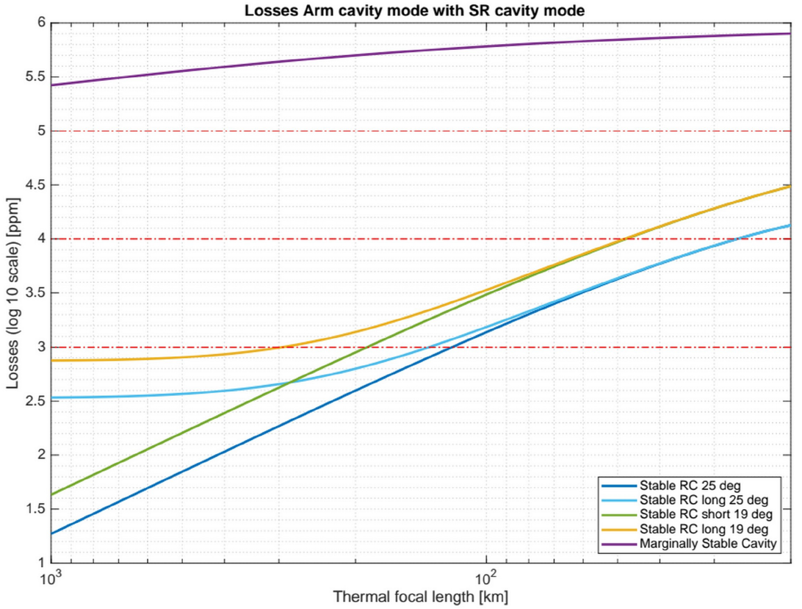
One interesting plot
Effect of thermal lens in the input mirrors
  Losses vs thermal lens for different Gouy phases
    0 degrees i.e. marginally stable
    19 degrees (long or short)
    25 degrees (long or short)
Bottom lines
  Stable cavities orders of magnitude better than marginally stables
  Only Gouy phase matters
    No difference between short and long with stronger lenses
    Short better with weak lenses
      Due to less astigmatism
100%
10%
1%
0.1%
1000 km 100 km 20 km

Slide 39
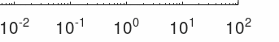
Gouy phase / stability
Both short and long cavities can have enough Gouy phase (~20 degrees)
  Short can more easily have even larger values
Initial
Virgo
LIGO
KAGRA
AdV
Gouy phase (degrees)

