Slide 1
ISB Status
Jan Harms, Stefan Hild for the ISB
https://wiki.et-gw.eu/ISB/WebHome

Slide 2
ISB Summary of ET Symposium
60 ISB abstracts were submitted
16 accepted for contributed presentations mostly on ongoing design studies and hardware development
“Hot-topic sessions”:
Optical / detector layout (A Green, J Degallaix)
ET-HF suspension requirements (S Hild)
ISB <> Infrastructure interfaces (J Harms)
ET-LF Tower Integration Concept (S Grohmann)
Electronics standards (B Swinkels)

Slide 3
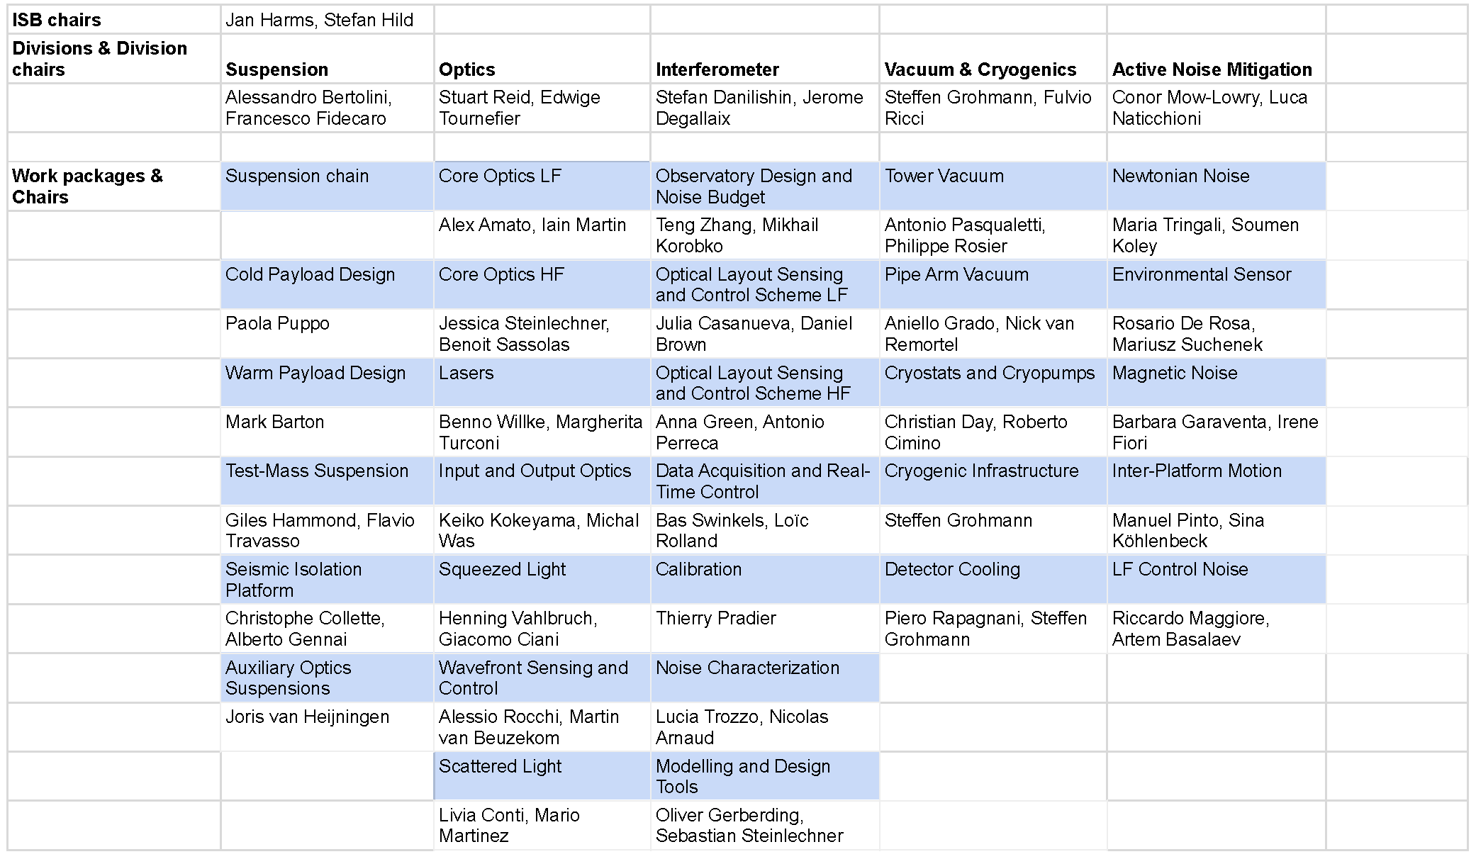
Current ISB Chairs

Slide 4
May 9, 2024:
454 subscribers to et-isb-all mailing list
328 members of the ISB on ETMD
Out of the 328 ISB members (117 FRTE), 145 (45 FRTE) have declared activities under specific divisions and work packages

Slide 5
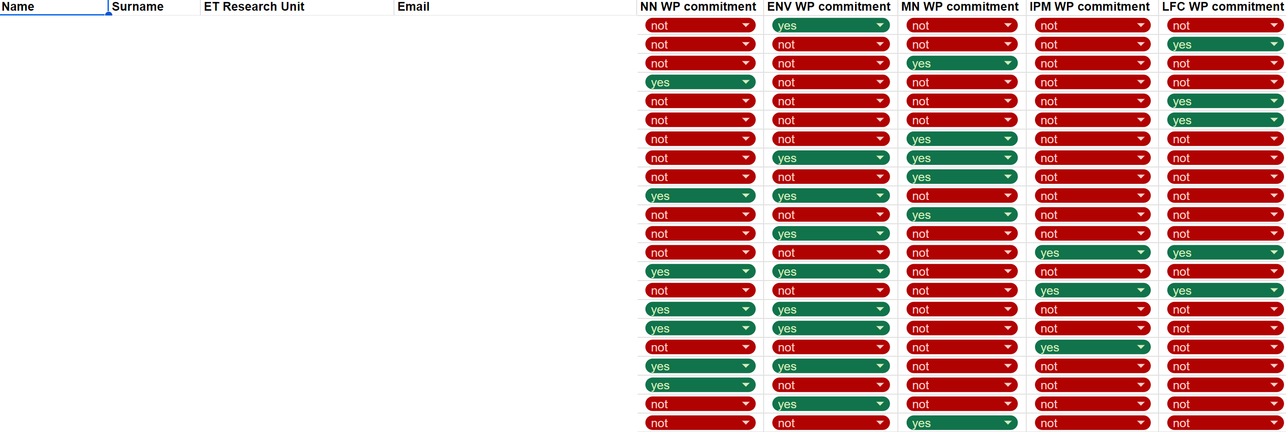
An ISB activities census was carried out to obtain more reliable information about the commitments of people to the ISB

Slide 6
Main Recent/Ongoing ISB Activities
Product Breakdown Structure: Parameterization
Optical layout / detector layout
Beam-pipe requirements
And always in parallel: Design studies and hardware developments

Slide 7
Instrument PBS and its Parameterization
The ET-LF/HF PBS currently contains 1824 items.
A complete PBS parameterization will be a major milestone of the collaboration towards the ET Technical Design.
638 parameter files were submitted, but we don’t have a detailed analysis yet of what parts of the PBS are covered. There are known “problem zones” of the PBS, which we must deal with urgently in the coming weeks-months.
Completed PBS review meetings :
April 11, 12: Active Noise Mitigation
April 29, 30: Interferometer (Part 1)

Slide 8
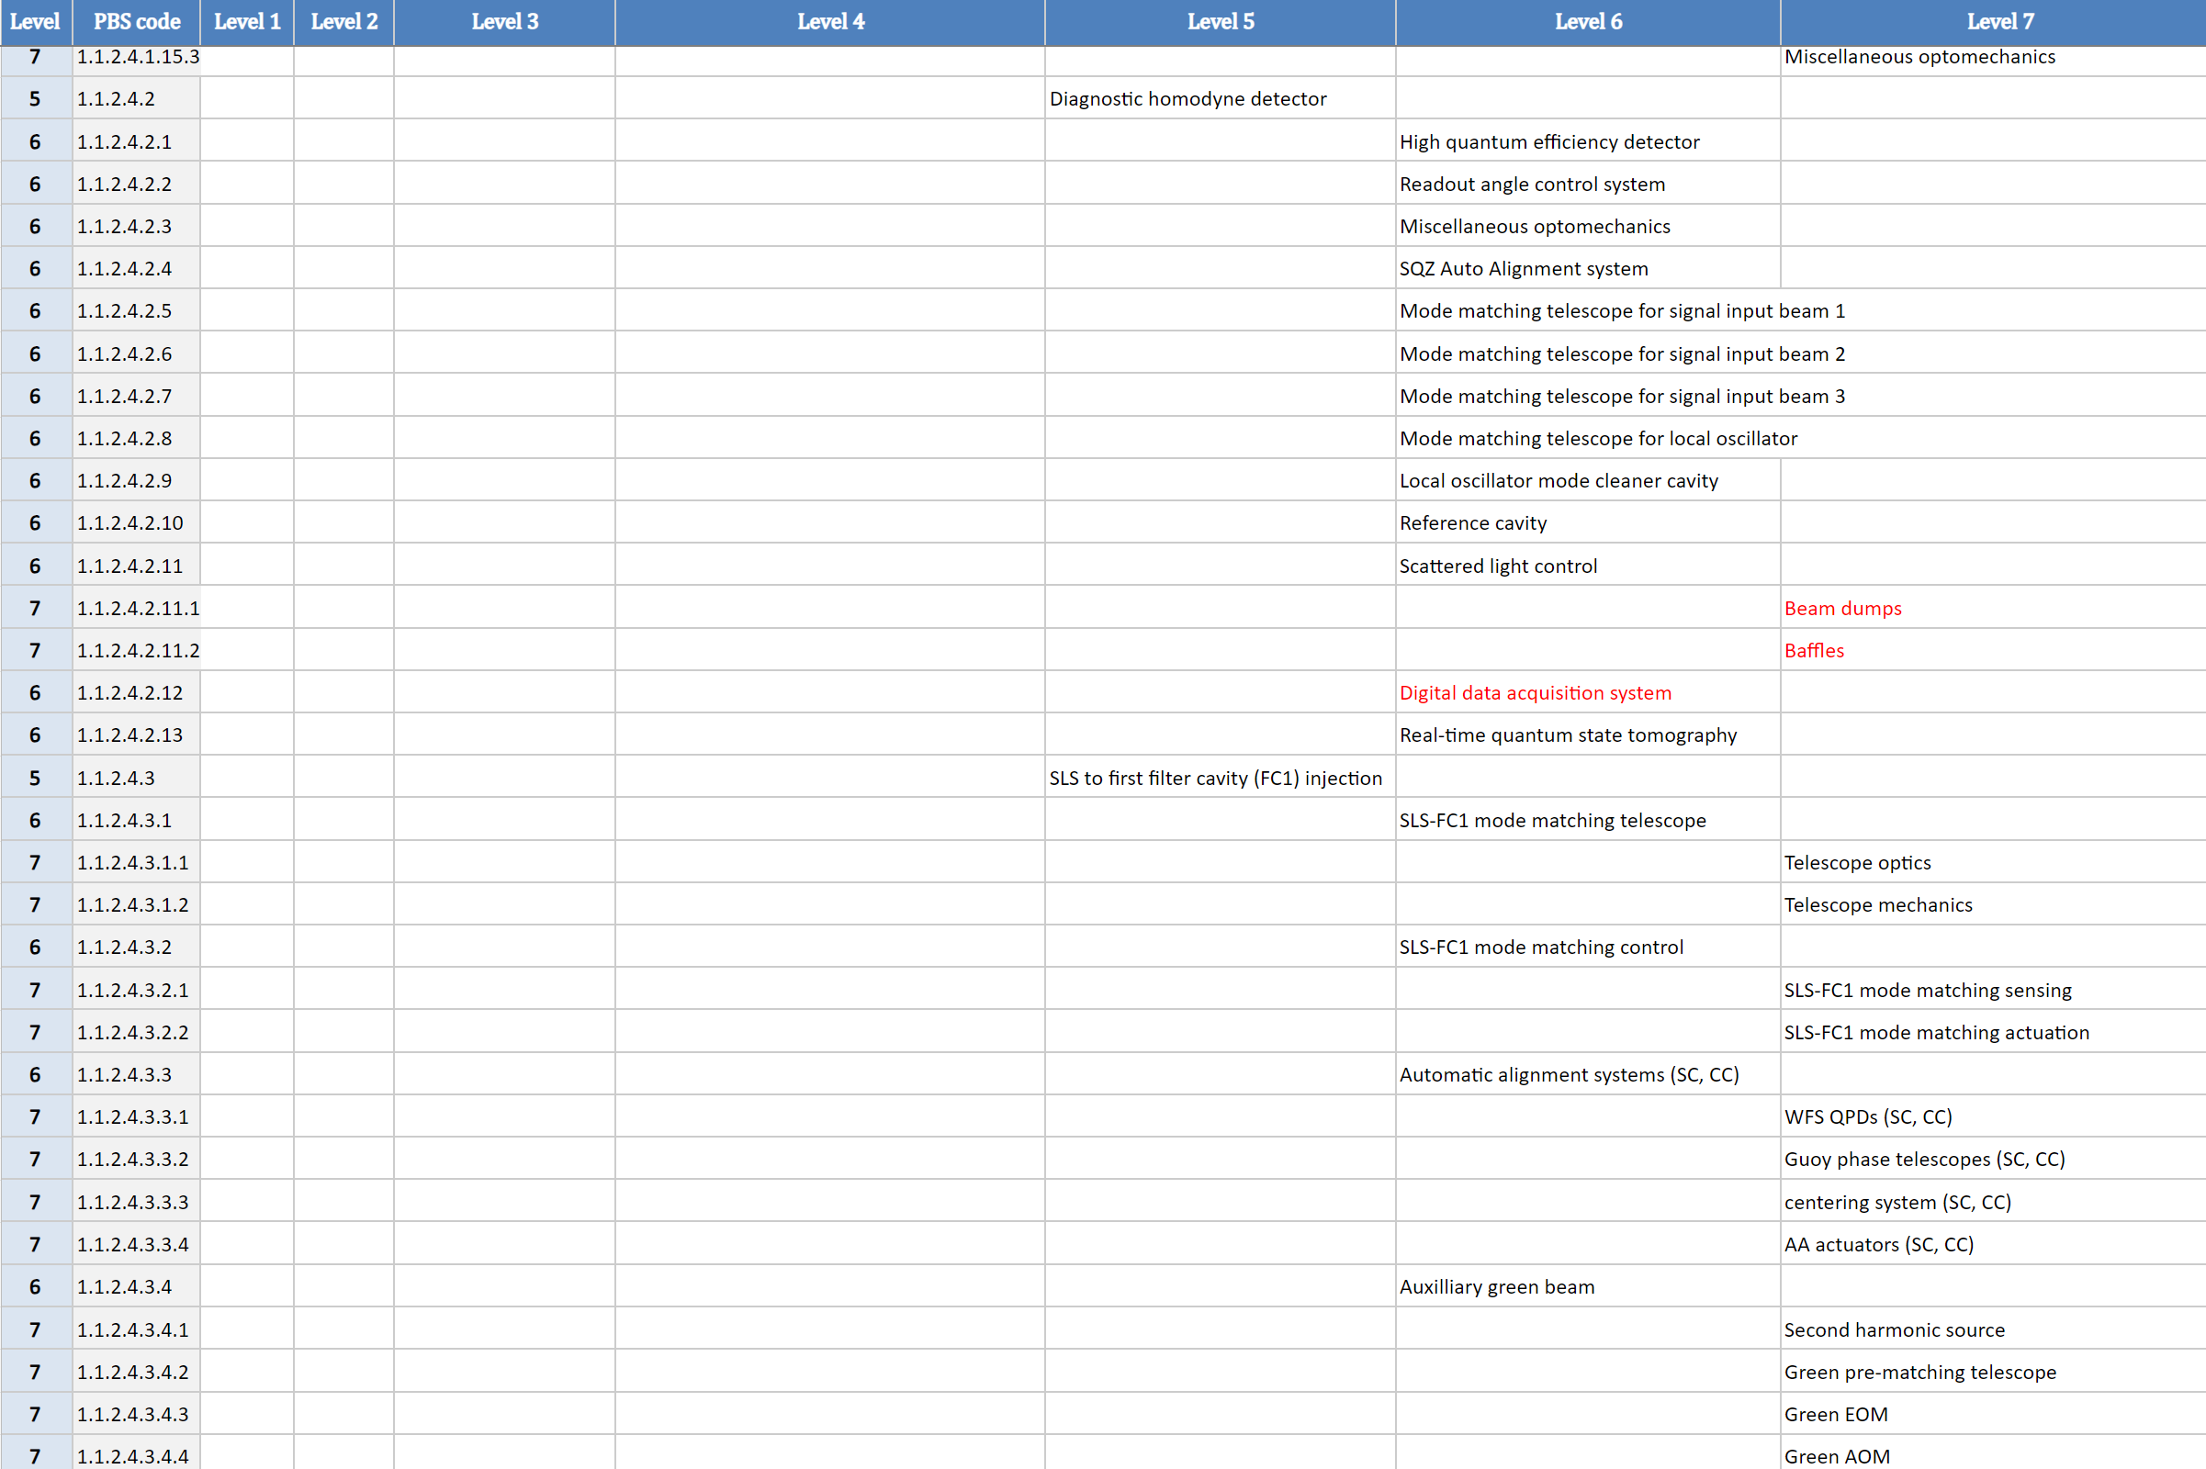
Instrument PBS

Slide 9
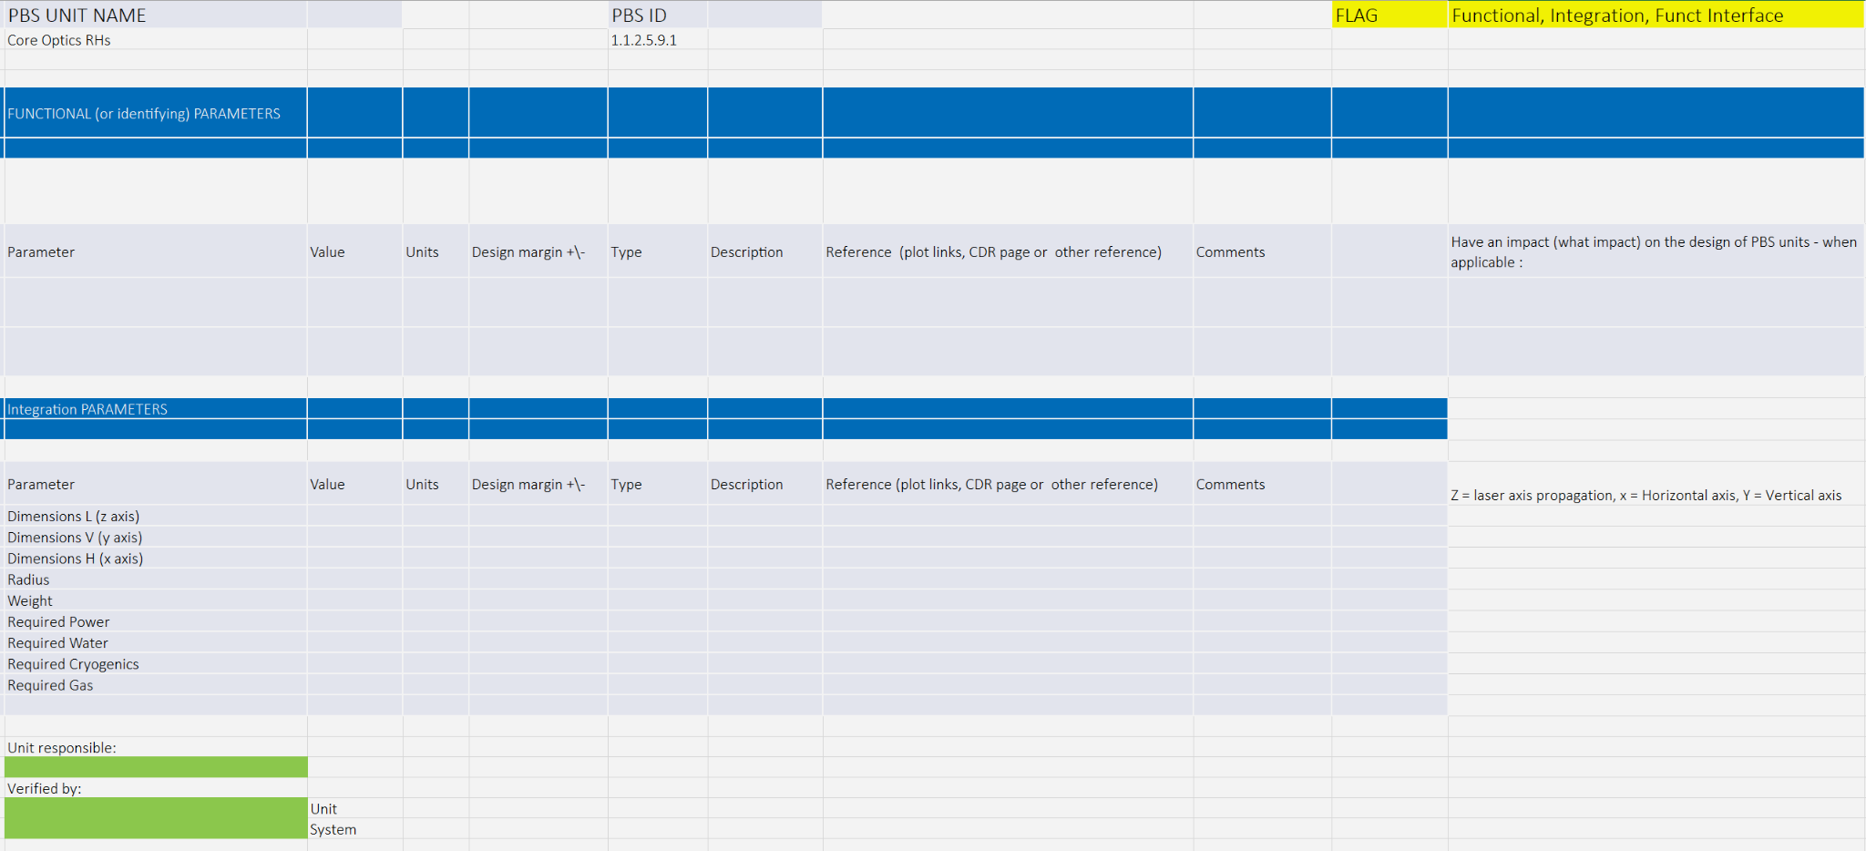
PBS Parameterization

Slide 10
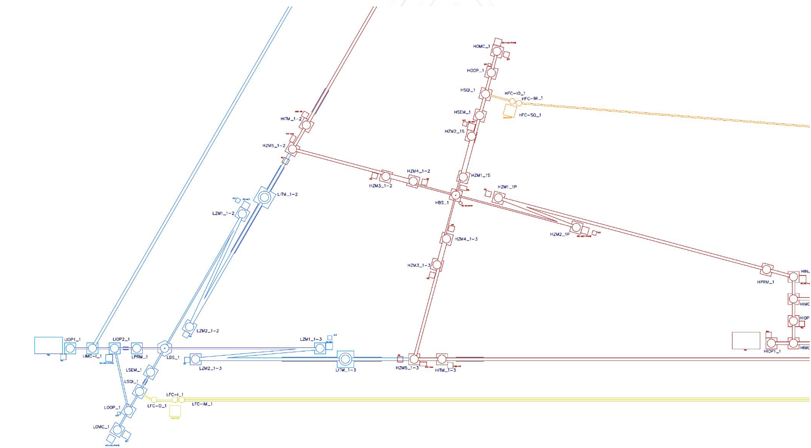
Optical Layout
Two workshops were organized to develop an updated optical layout (https://indico.ego-gw.it/event/711/, https://indico.ego-gw.it/event/714/).
Layout document will be submitted by May 31 and be reviewed.

Slide 11
Slide: A Green / J Degallaix

Slide 12
Example of an open issue:
Slide: A Green / J Degallaix

Slide 13
Slide: A Green / J Degallaix
https://gitlab.et-gw.eu/et/isb/interferometer/et-optical-layout-10km-triangle/

Slide 14
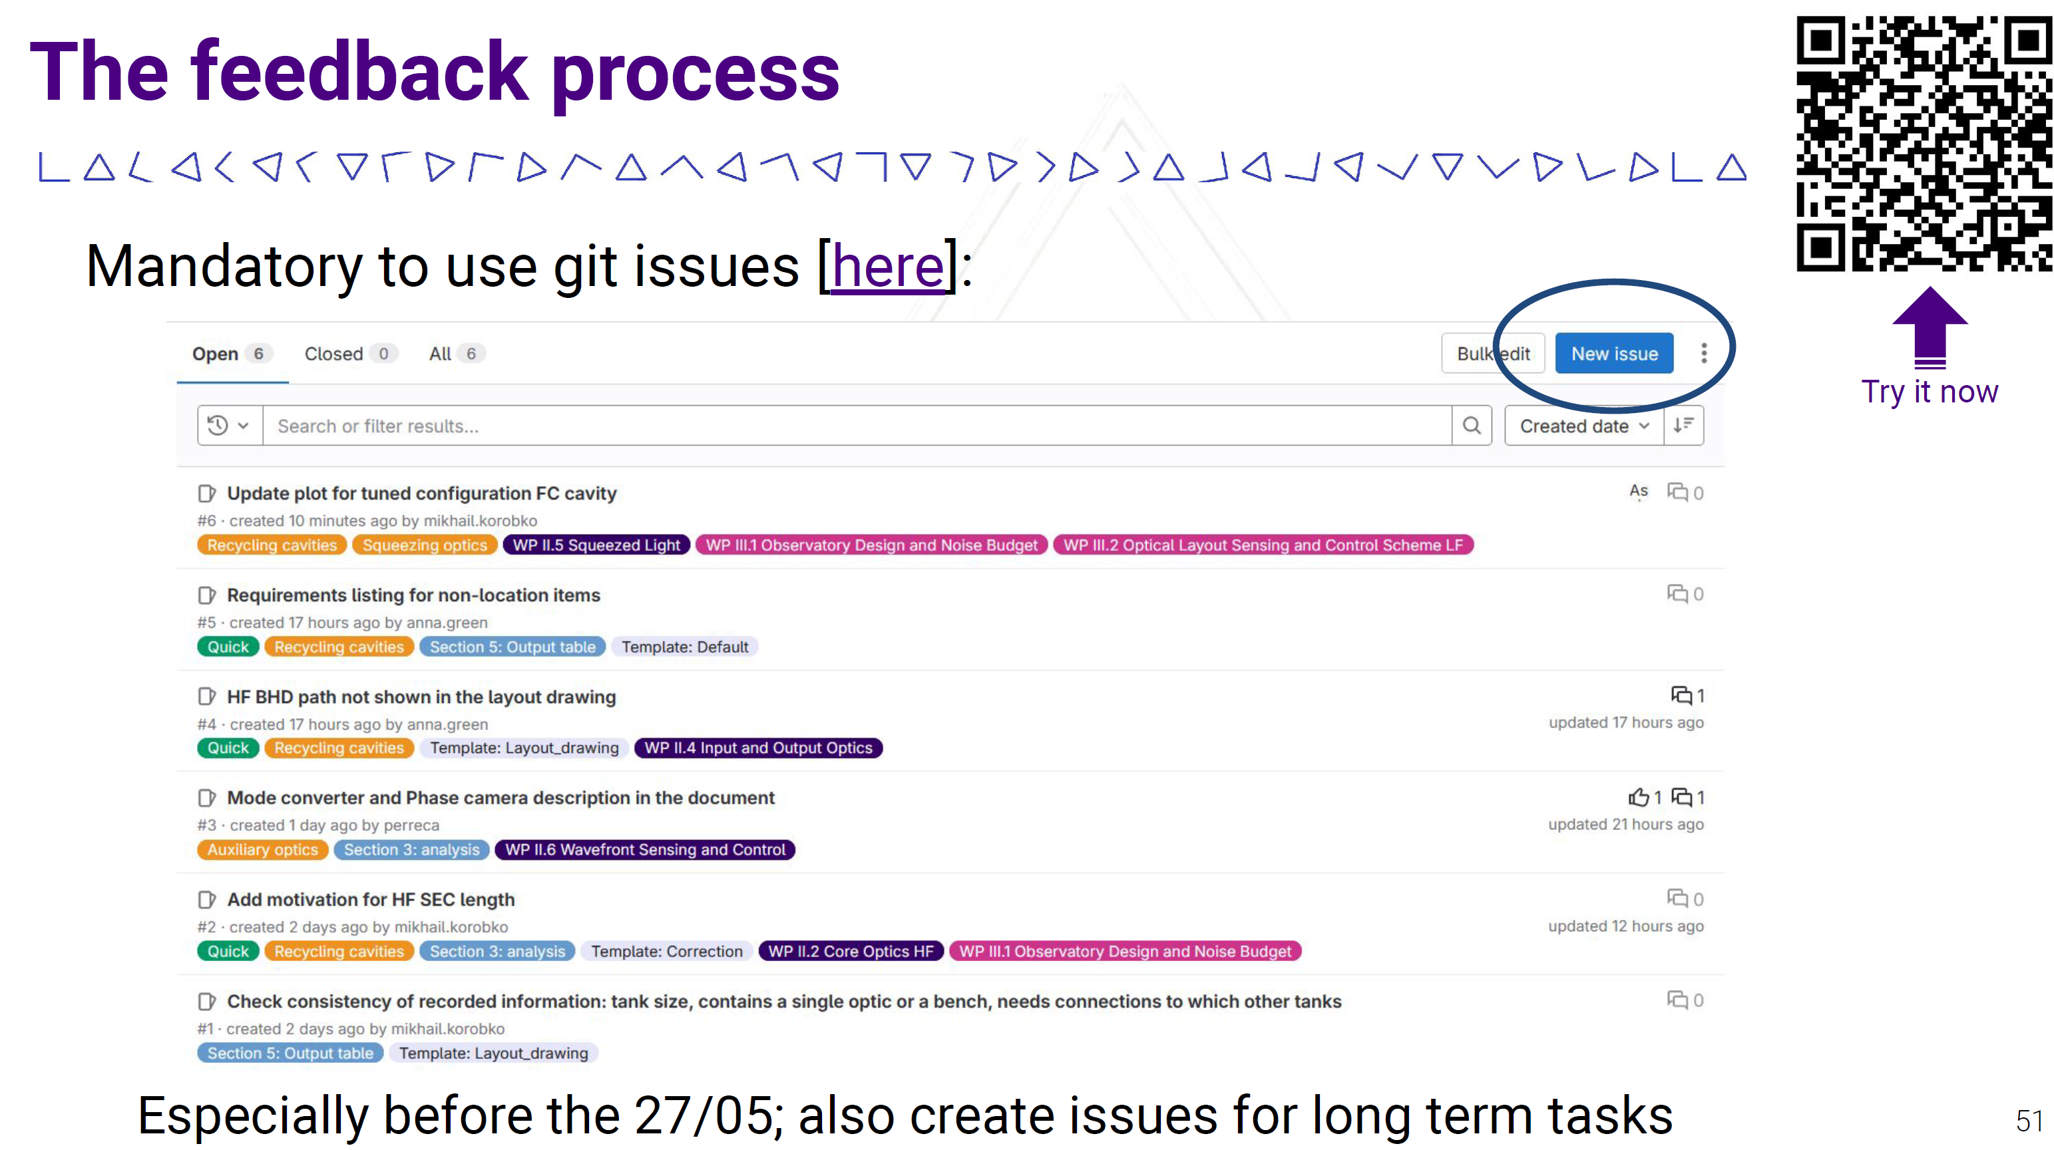
Slide: A Green / J Degallaix

Slide 15
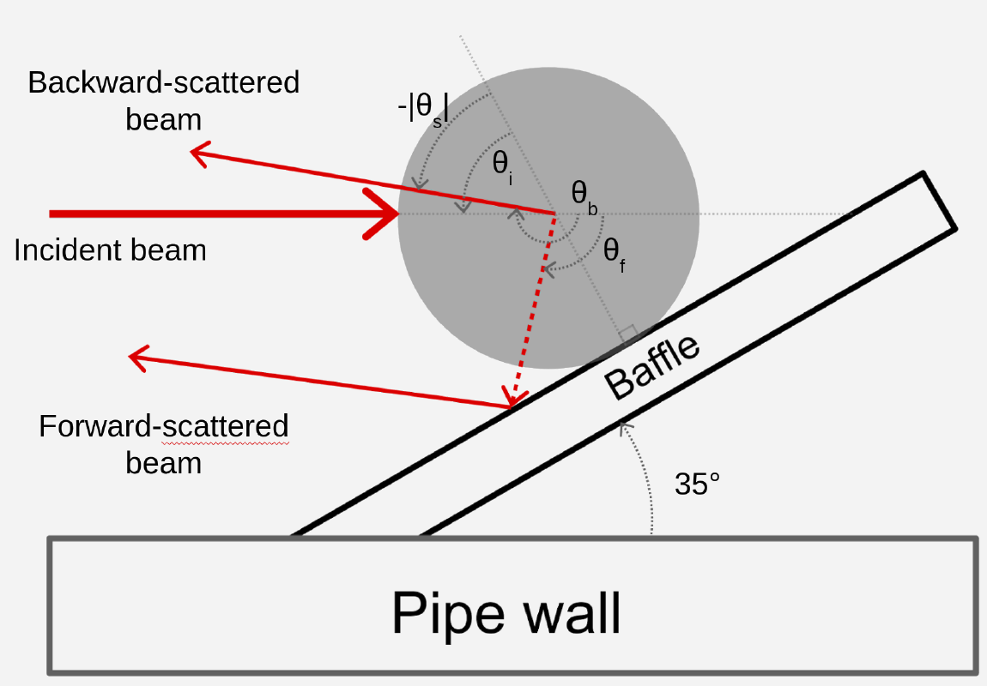
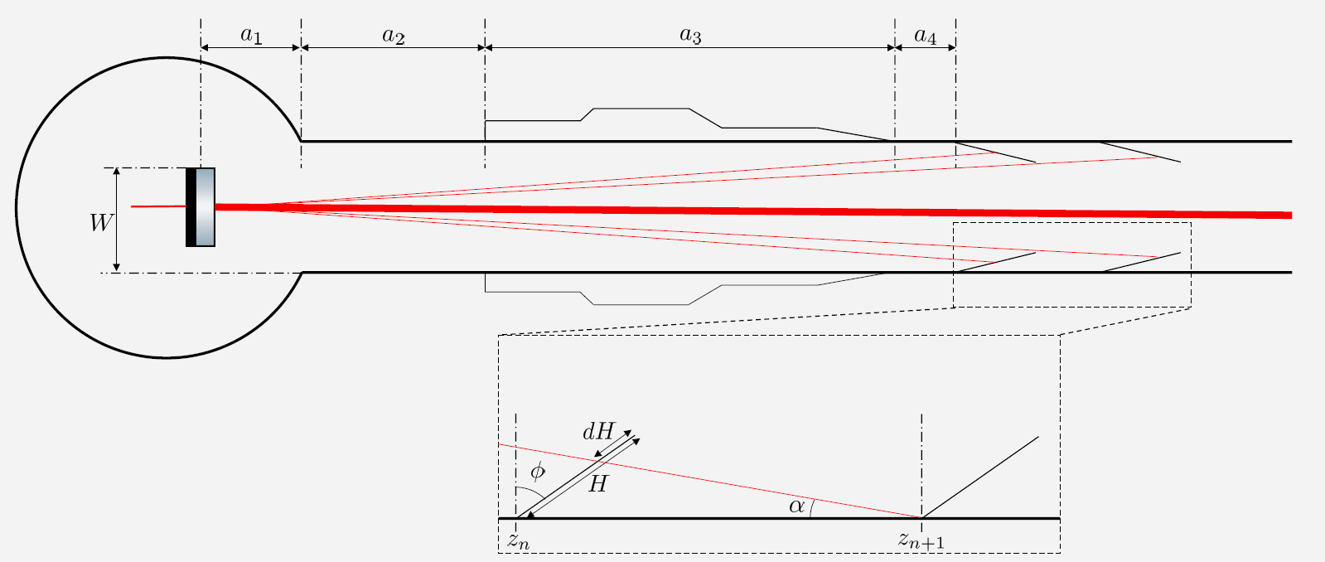
Beam-pipe Requirements
Complex system to analyze. A few ISB aspects:
Baffles (placement, material, vibrations, …)
Dust (how clean do we need to keep the beam pipes?)
Residual-gas pressure
An initial requirements document was reviewed in March, and an updated version addressing the comments from reviewers was produced in April.
Modeling scattering from dust
Beam pipes close to test masses

Slide 16
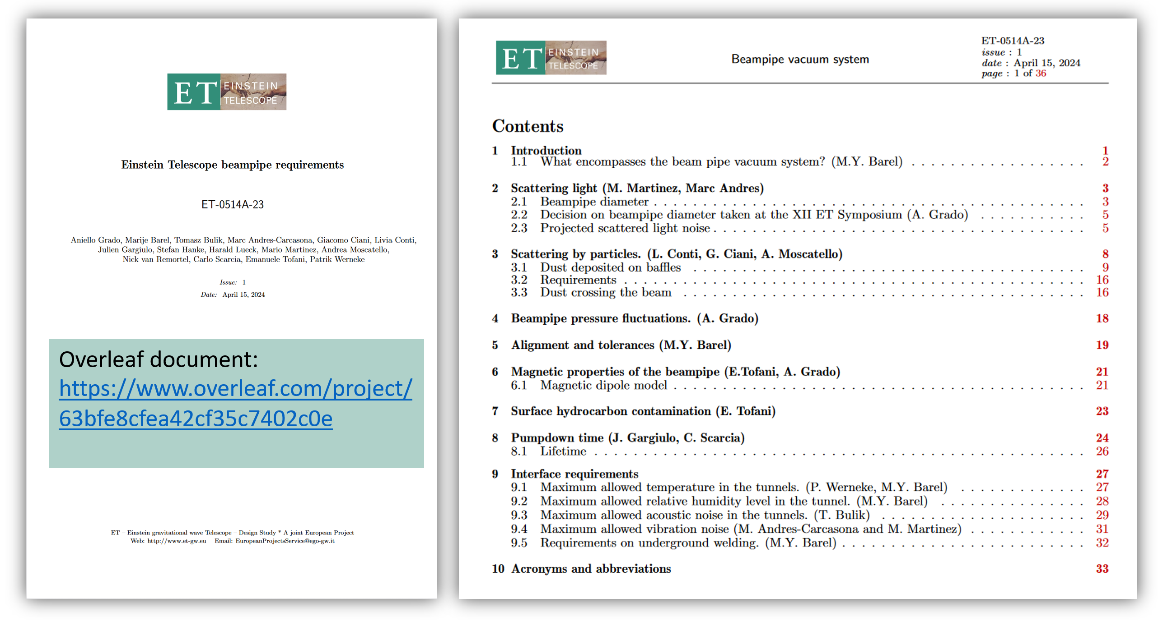
Slide: M Barel

Slide 17
Slide: M Barel

Slide 18
Slide: M Barel

Slide 19
NeXt Generation Collaborative Design (XGCD)
(https://indico.gssi.it/e/xgcd)
The goal of this series of online meetings is to provide a forum for regular discussions between the teams that work on common design aspects of next-generation gravitational-wave detectors Einstein Telescope and Cosmic Explorer.
The plan is to have a meeting each 2-3 months and start with topics that are more urgent, i.e., that have a strong impact on the detector infrastructure including optical layout, stray-light noise, Newtonian noise, ...
January 22, 2024, Optical Design
March 25, 2024, Stray-light control (Part 1)
April 22, 2024, Stray-light control (Part 2)

Slide 20
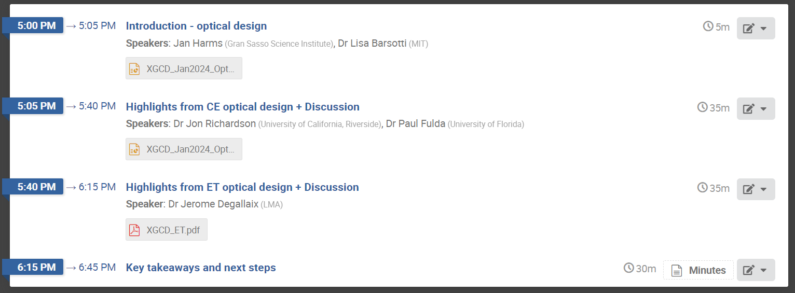
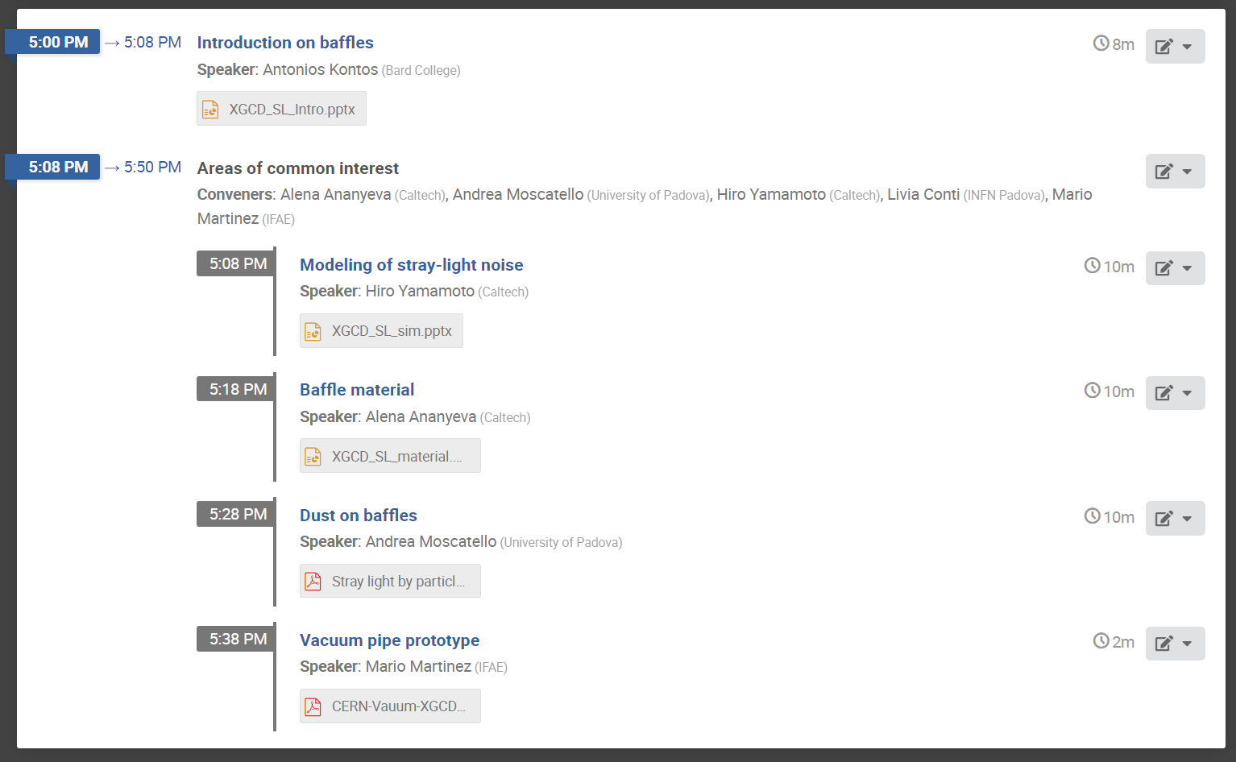
Slides and written meeting notes are available publicly on the indico page.
Meeting recordings available only to ET/CE collaboration members through separate web sites.

Slide 21
A few large and high-priority tasks were given to the ISB in the past year
Communication and organization mechanisms were put under stress
People including early-career scientists were asked to step up and take responsibilities
This process is immensely important for the ISB to develop and learn
Everyone has done their work excellently
Suspension division: Weekly meetings on Fridays, 14:30.

