Slide 1
Sardinia – Updates from TETI (Team for Einstein Telescope in Italy)
May 10, 2024
http://www.einstein-telescope.it

Slide 2
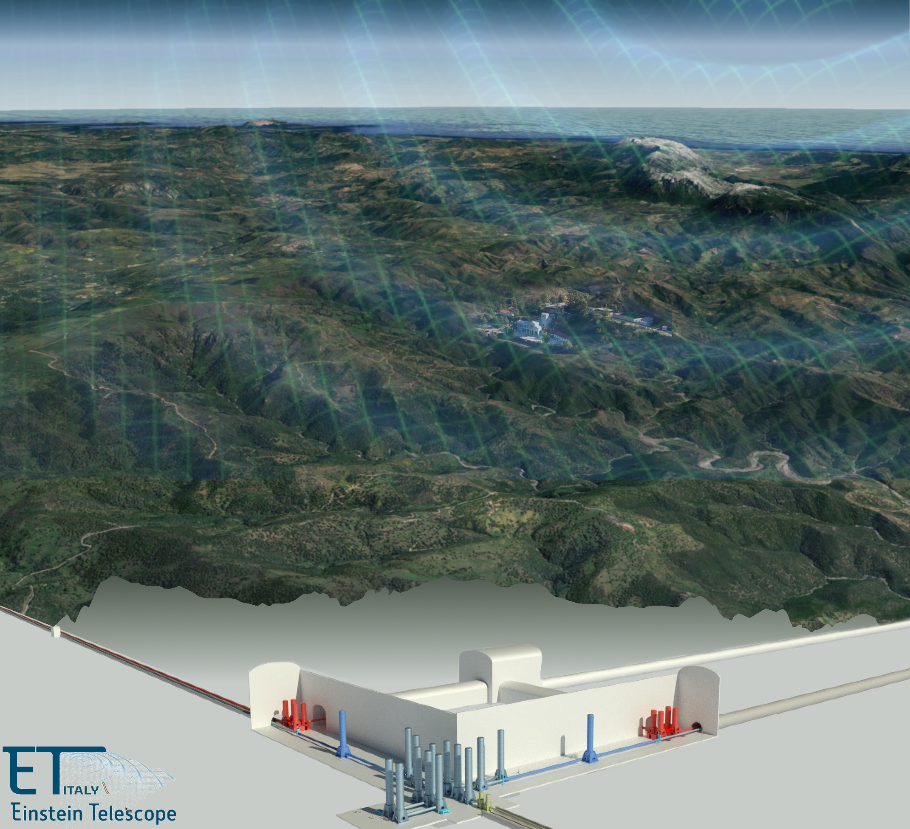
TETI mandate and structure
WP2,3 – Preliminary engineering design
Time schedule
TETI and ETO

Slide 3
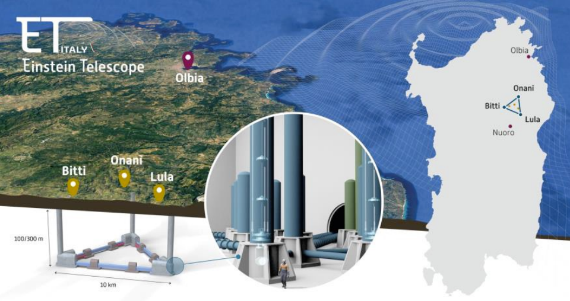
Low seismic noise
Limited presence of groundwater
Rock masses that are ideal for safely building the underground spaces for the ET laboratory
Large rural areas (very low population density and, limited anthropogenic and industrial activity)
All this makes the area around Sos Enattos, between the municipalities of Bitti, Lula and Onanì, the ‘silent’ environment that the ET needs to operate

Slide 4
Management
Executive
Knowledge base

Slide 5
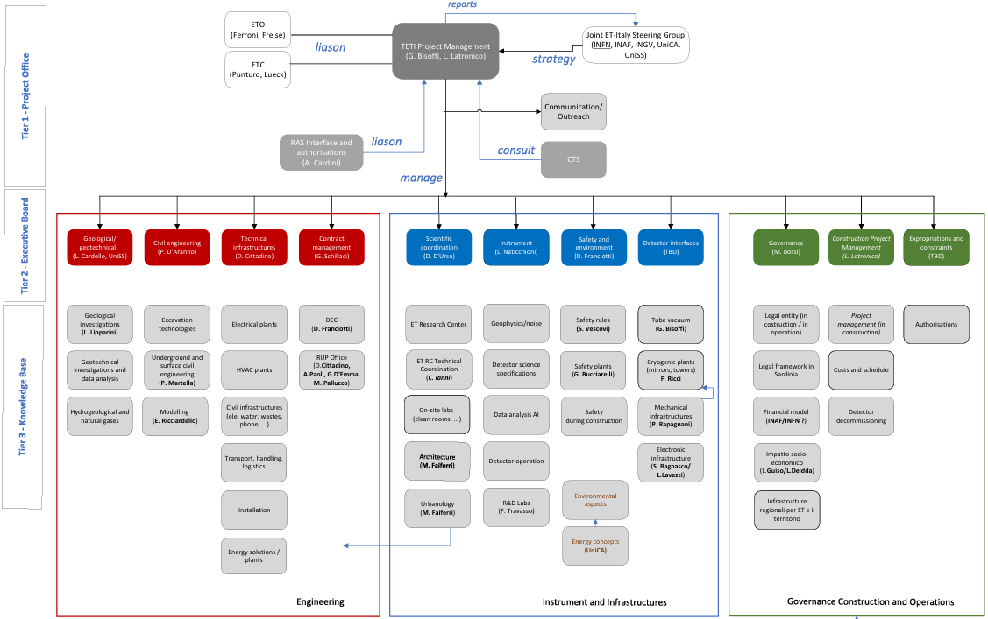

Slide 6
TETI Mandate (Team per ET in Italia; Team for ET in Italy)
Operational structure with the scope of supporting Italy's candidacy to host the Einstein Telescope detector in Sardinia
Ensuring the success of all the activities necessary to support the Italian application, including the one provided for in the contract stipulated by the INFN with private entrepreneurs, giving a technical, managerial and financial reference to the project
TETI reports to a supervisory structure the Institutes and Universities involved in ET-Italia (provisionally represented by INFN)
TETI will maintain close and fruitful contact with the coordinators of ETO (Einstein Telescope Organization) and ETC (Einstein Telescope Collaboration).

Slide 7
PMP
List of acronyms 2
1 Introduction 3
2 Purpose 4
3 Scope 4
4 Mandate 4
5 Stakeholders analysis 5
6 Organization Breakdown 5
6.1 Tier 1 - Project Management (PM) 5
6.2 Tier 2 – Executive board (EB) 6
6.3 Tier 3 – Knowledge Base (KB) 7
7 Work Breakdown 7
7.1 Work Package Description 7
8 TETI tools 8
8.1 Meetings 8
8.1.1 Weekly technical meetings 8
8.1.2 Weekly RUP meetings 9
8.1.3 Weekly TETI executive meetings 9
8.1.4 Technical meetings 9
8.1.5 Bi-weekly meetings with the ETO 9
8.1.6 Meetings with the stakeholders 9
9 Communications and reports 10
10 Conclusions 10
Annex A – Stakeholders table 10
Annex B – Organizational Breakdown 12
Annex C – Work Breakdown Structure 13
Annex D – Critical RACI Matrices 15
Annex E – Work Package and Task Table description 15

Slide 8
The activity is structured in work-packages
Work Package | Description
WP1 - TETI Management | Plan, organize and manage TETI activities. Manage stakeholders’ requirements.
WP2 - Contract management | Manage INFN contract with RTI-RS for the feasibility studies in Sardinia
WP3 - Contract follow up | Review technical choices proposed by RTI-RS Validate contract deliverables.
WP4 - SUNLab | Plan and build the Sos Enattos UNderground Laboratory, for INFN, INGV, INAF, UniCa, UniSS
WP5 - DNSH & Sustainability | Ensure environmental sustainability and apply the DNSH principle throughout the project activities
WP6 - Sardinia Infrastructures | Local area infrastructures adequate to host ET during construction and exploitation phases
WP7 - Bid Book | Compile the candidature proposal (Bid Book)
Notes:
Remove last 2 columns

Slide 9
Contract execution and follow-up
Contract execution (WP2)
Technical aspects (WP3)

Slide 10
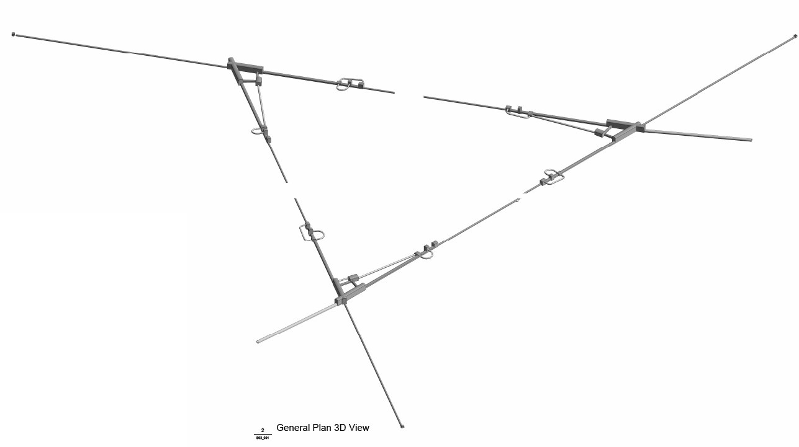
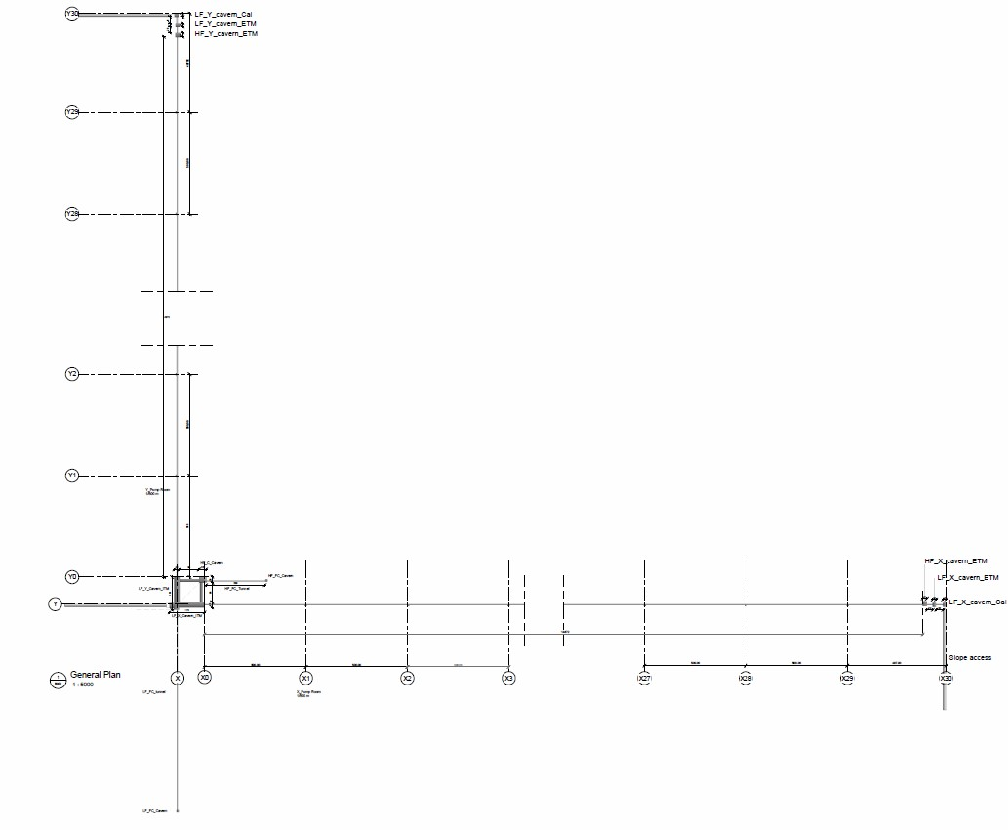
The preliminary design
TAKING INTO ACCOUNT:
Respect of the territory, environment, DNSH principle
Safety of workers, during construction and operation
Scientific lab efficiency
50 years lifecycle
Minimum noise in caverns
STUDYING:
Underground siting of infrastructures, underground survey
Underground infrastructures
Surface infrastructures
Goal of the contract: technical/economic feasibility study of each of the two configurations T10km and L15km, at a minimum 120 m depth.
For each configuration:
final report describing main design and engineering solutions, costs, environmental impact.

Slide 11
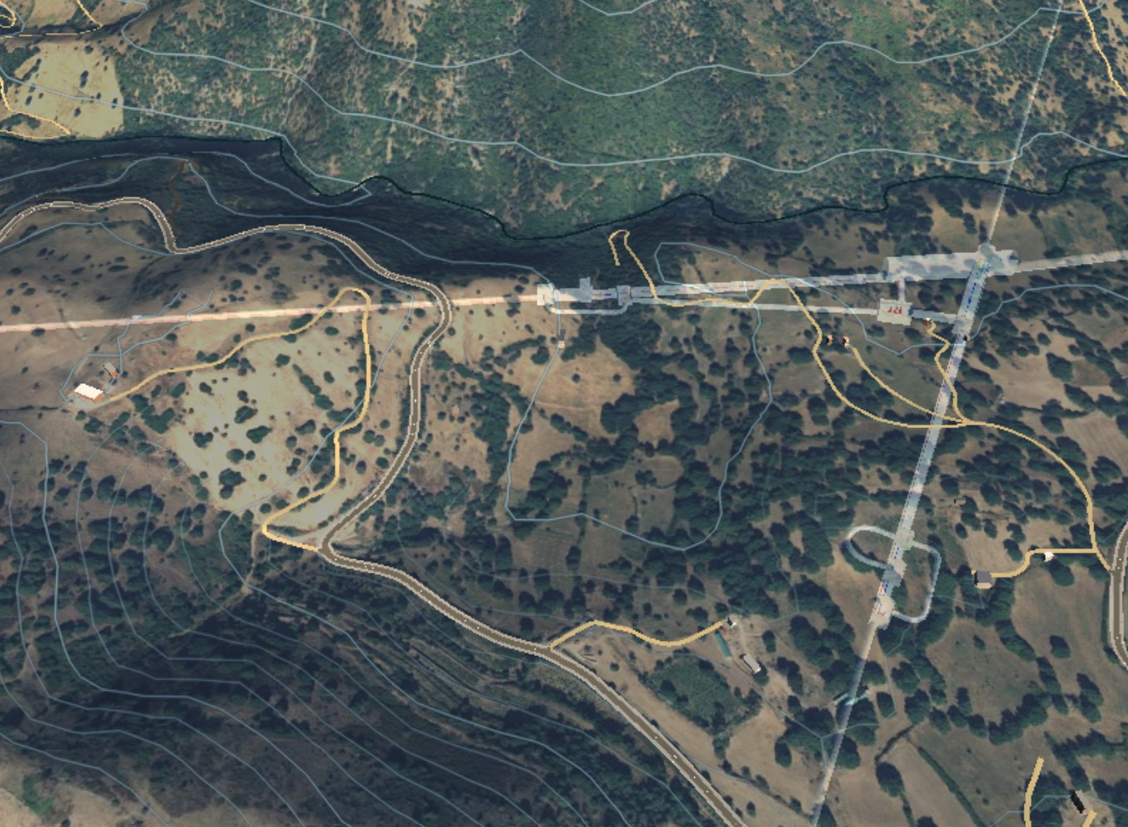
Temporary Association of Companies – led by Rocksoil SpA
Rocksoil S.p.A. main contractor- Milano [geotechnical, hydrological];
Leonardo Consorzio Europeo per l’ingegneria e l’architettura - Cagliari [safety, external building architecture]
Ferro Ingegneria S.r.l. - Torino [technical plants];
Criteria S.r.l. - Cagliari [environment];
INAR S.r.l. - Milano [civil];
GDP-Geomin S.r.l. - Torino [geological];
Geotec S.p.A. - Campobasso [geotechnical and surveys]
Contract awarded on Dec 18, 2023
Start of activities: Feb 19, 2024
Conclusion within: June 30, 2025 (strictly limited by the European rules of the Recovery and Resilience Funds - RRF)
Sustainable design - Contract

Slide 12
Time schedule
Start: February 19, 2024
End: June 30, 2025
(constrained by the European rules of the Recovery and Resilience Funds - RRF)

Slide 13
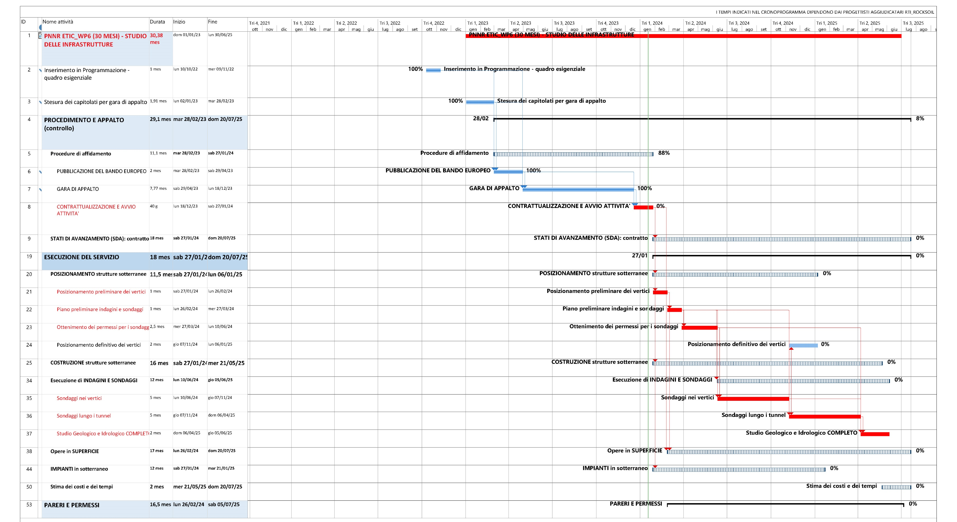
Time schedule: critical path
Start date: Feb 19, 2024
Today
End date: June 30, 2025
Preliminary positioning of the vertexes, survey
plan, their license
Design of the underground infrastructures
Civil infrastructures at the surface
Execution of the surveys
Underground technical plants

Slide 14
First round of questions submitted by TETI to ETO-ED (on April 24)
Sharing of questions/answers among TETI, EMR and ETO is needed
These points impact on the design of undeground infrastructures and technical plants
Consistent input ffrom ETO-ED to the 2 teams is mandatory (boundary conditions)
- - - - - - - - - - - - - - - - - - - - - - - - - - - - - - - - - - - -
Possible answers are proposed (to ease ETO, ETC, … analysis process)
References for answers: added
Answers needed asap (a couple of weeks, as for possible further question bunches)
In absence of prompt answer: TETI will have to proceed according to the proposed answers
Tunnel diameter (fixed)
Tunnel dewatering
Positioning of the L-shaped detector configuration (assumptions)
Available transverse space in the tunnel (from vacuum pipe infrastructure)
Materials, located underground
Electrical power table
Location of cryogenic refrigerator compressors
Notes:
Gabarit: cutout, contour, cross section

Slide 15
TETI internal process in the technical exchange with RTI-Rocksoil
Normal process: 10 working days
Technical questions requiring external input: a similar process was presented by ETO-ED
A similar time schedule is required (around + 10 days)

Slide 16
Layout: present and future
New optical layout for the triangle, 1st agreed-upon version planned to be released by May 31. A global layout will follow…
- from what we have seen, tunnel overall length: +21 km (=+70%) ?
On the Italian front, based on the present layout, the geological investigation plan will be confirmed in June and investigations will then immediately start
If new «global» layouts for triangle and L will be released, we may consider whether we can take them into account (money/time/rules/company…)

Slide 17
Turbulent or laminar?
We are in full swing with the preliminary design of the Italian site for triangle and L.
We (and our Dutch colleagues) are an opportunity to streamline the ET turbulent flow
The opportunity is time-constrained: pick it up!

Slide 18
Spare slides

Slide 19
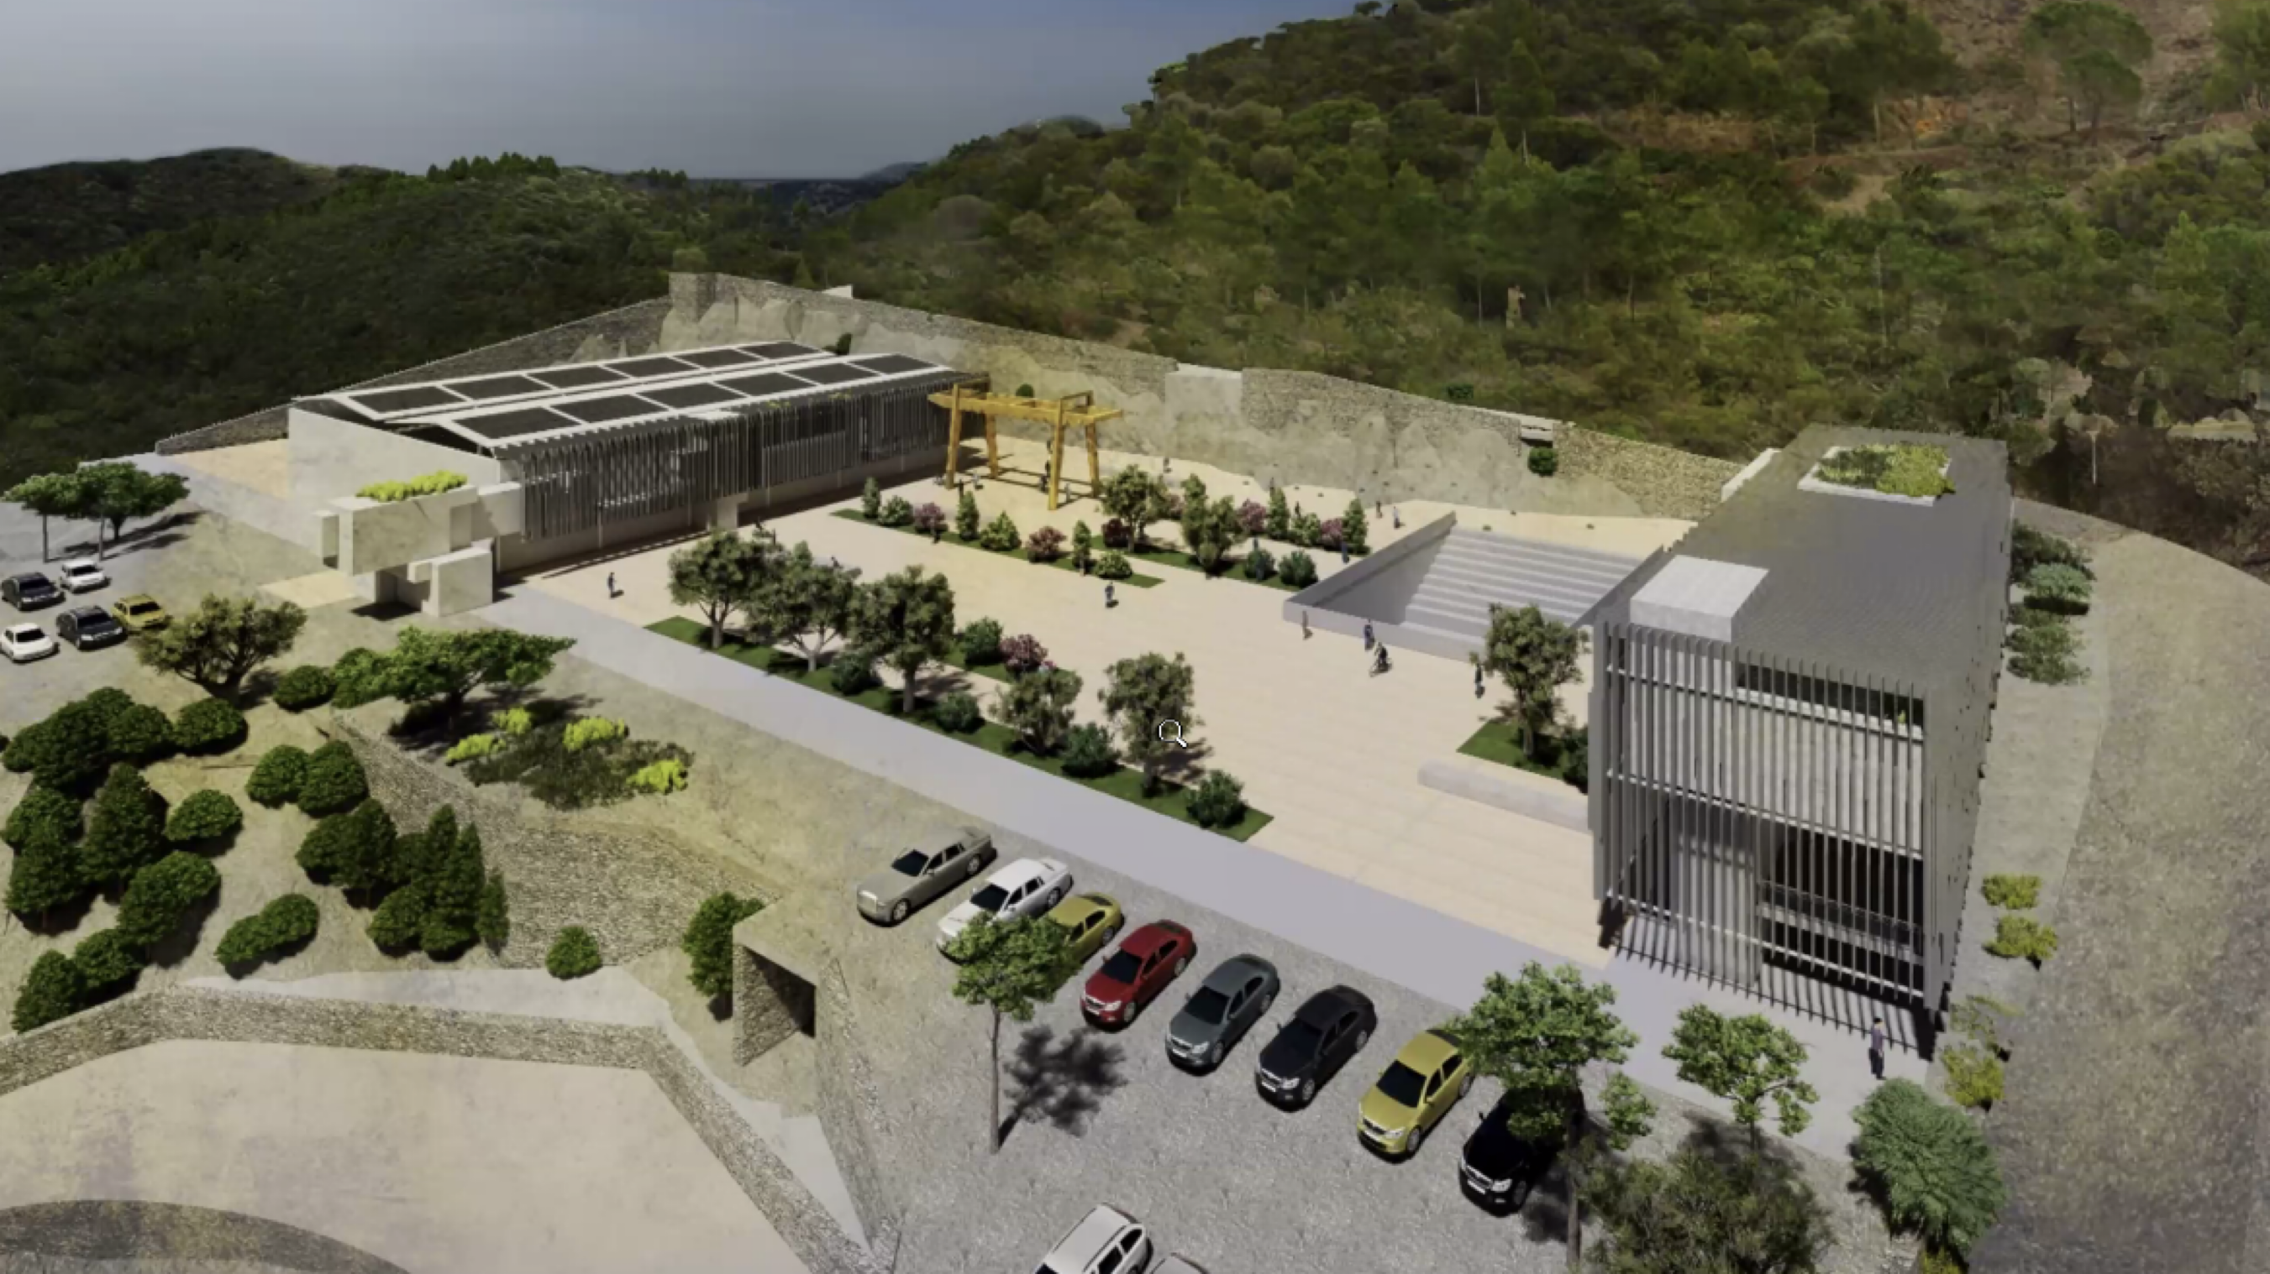
WP4: SUNLab
Funds: 20 M€ (10M€ RAS, 10M€ scientific institutions)
Involved institutions: INFN, INGV, INAF, UniSS, UniCA, RAS.
GOAL: Realization of the Sos Enattos UNderground Laboratory (upgrade of the SarGrav Lab) to host low seismic noise experiments, low frequency sensor development, test of ET low frequency technology solutions, low noise Earth Observatory
Funds: 20 M€ (10M€-Sardinia Region (RAS), 10M€-scientific institutions)
Involved institutions: INFN, INGV, INAF, UniSS, UniCA, RAS.

Slide 20
The socioeconomic study within WP6
Mandate
Provide a full study on the socio-economic impact of ET including: employment, technological spillover, map of the concerned market sectors, and economic impact both during the construction and operation phases.
The study aims at identifiying all impacts at large: e.g. scientific publications.
Committed by the Italian government under INFN supervision
Timeschedule
Consolidated draft: May 2024
Final report: October 2024
Experts
Luigi Guiso, Household Finance, Einaudi Institute for Economics and Finance (EIEF)
Luca Deidda, Macroeconomics: Finance and Growth (Uni. of Sassari)
Giovanni Carosio, Environmental Sociology (Uni. Of Trieste)
Francesco de Carolis, micro economics (Uni. L. Bocconi)
Alessandra Fagian, Applied Economics (GSSI)

