Slide 1

Einstein Telescope
Hydrogeology: planning and progress from EMR regional model to local measurements
SPB Meeting – Maastricht 06/05/2024
Orban Philippe, Guillemoto Quentin, Dassargues Alain, Nguyen Frédéric

Slide 2
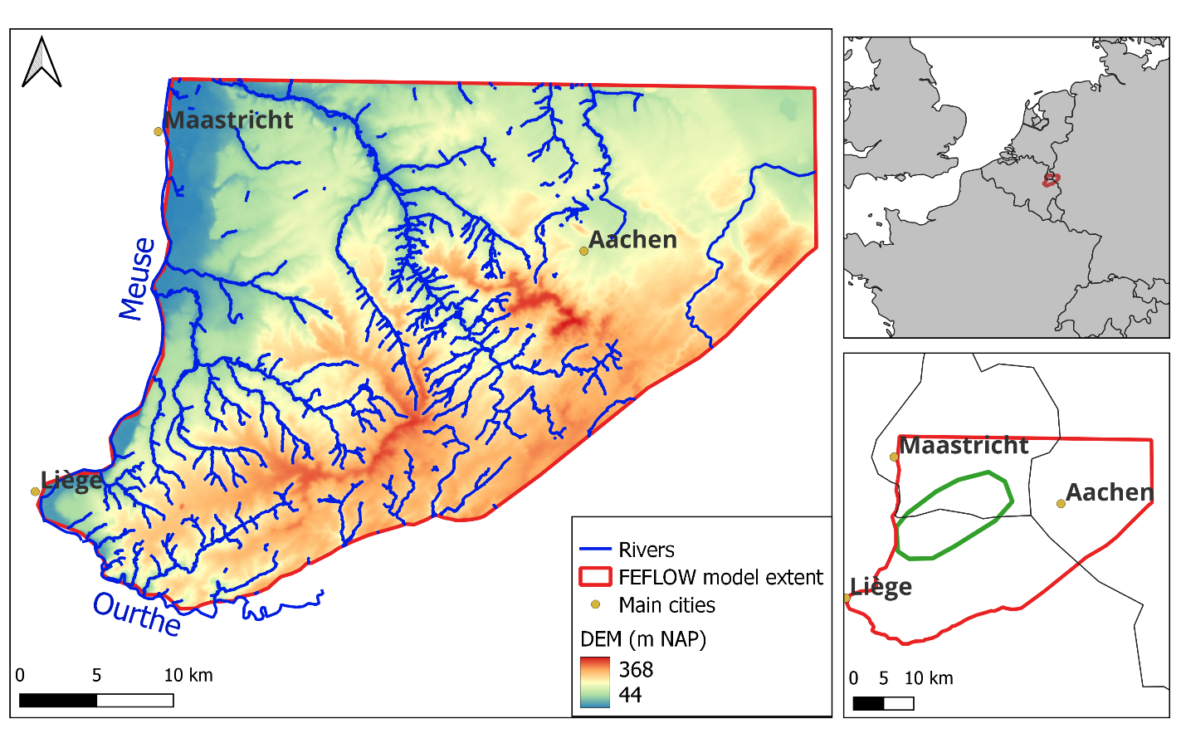


First hydrogeological approach for ET in the EMR
… reminder
Exact location of the ET remains unknown => development of a regional approach based on :
an inventory of existing data
the development of a 3D numerical groundwater flow model
Notes:
Summary of what we have… Mainly done in E-TEST

Slide 3
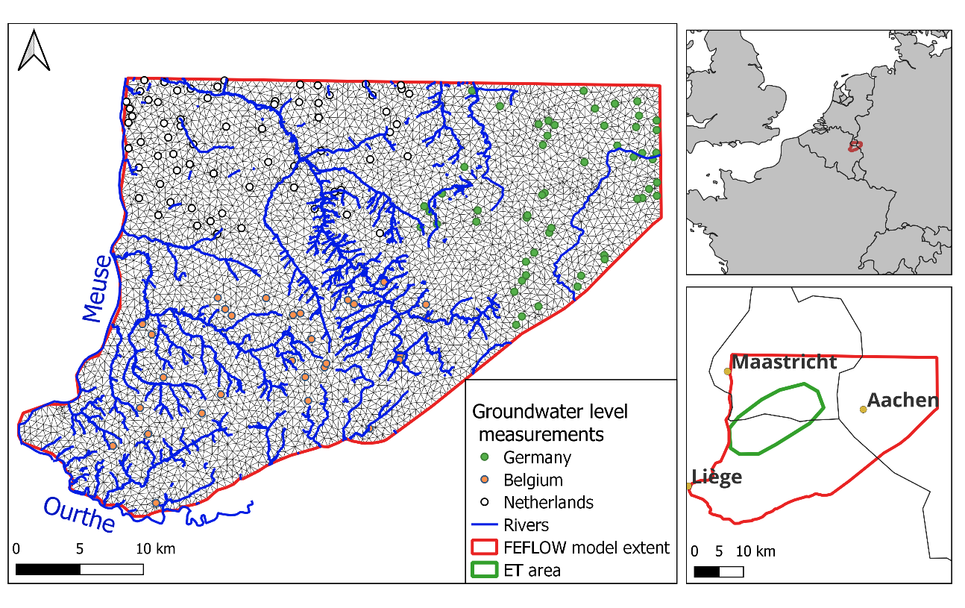
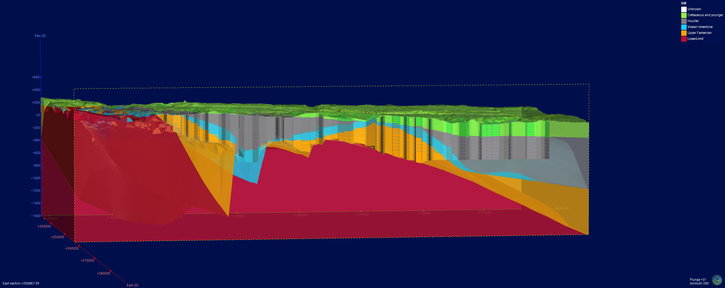
First hydrogeological approach for ET in the EMR
… reminder
River network, groundwater level measurements and mesh of the finite elements model
Feflow® hydrogeological flow model construction:
  finite element mesh
  steady flow model
  based on 2018 data
Regional database used in the model:
  groundwater water level observations, groundwater abstractions (Wallonia, Germany, The Netherlands)
  hydraulic conductivities
  topography
  geology
Element sizes about 500 meters length
Hydrogeological model according to regional geological model
Notes:
Summary of what we have… Mainly done in E-TEST

Slide 4
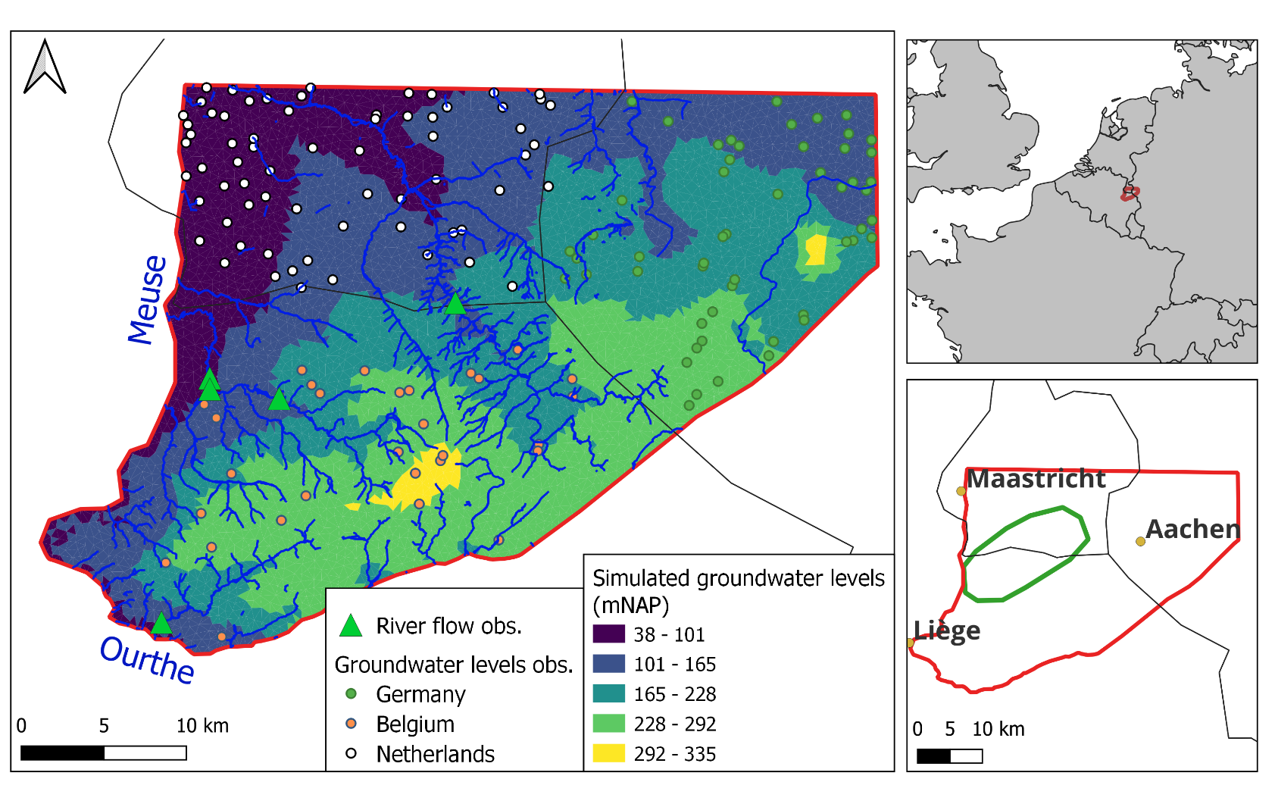
First hydrogeological approach for ET in the EMR
… reminder
Calibrated in steady state based on groundwater levels and base flow in rivers
First simulations of the impact of ET infrastructures on the groundwater
First estimations of groundwater inflows in tunnels
Notes:
Summary of what we have… Mainly done in E-TEST

Slide 5
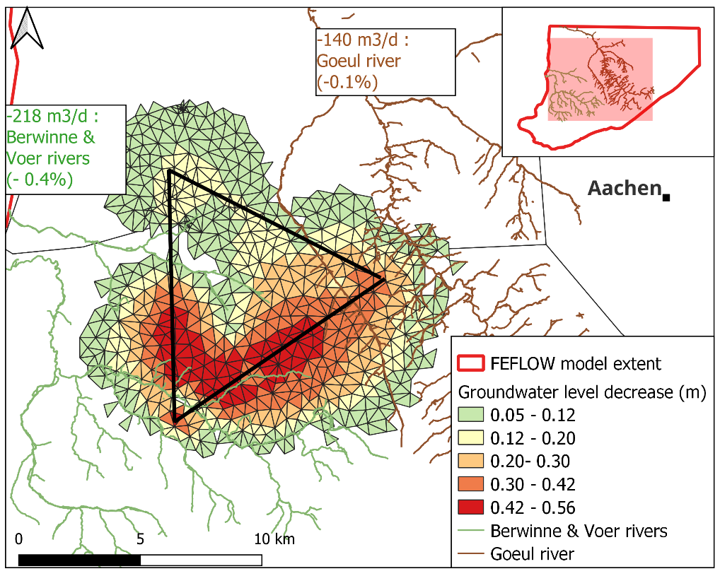
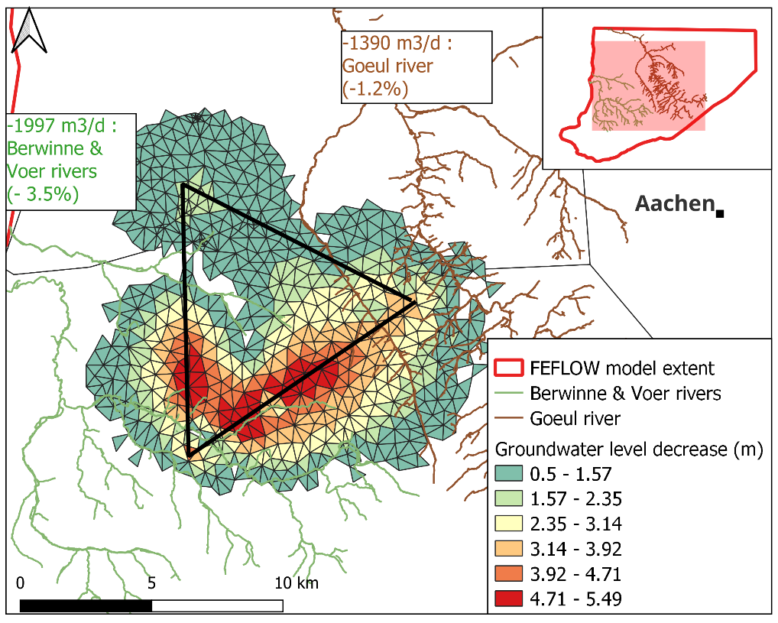
First hydrogeological approach for ET in the EMR
… reminder
In the case of K_{aq}=10⁻⁸ m/s conductivity, calculations with analytical solution: 380 m³/d -> 4850 m³/d (depending on H)
for a 380 m³/d tunnel water inflow
for a 4850 m³/d tunnel water inflow
Notes:
Summary of what we have… Mainly done in E-TEST

Slide 6
First hydrogeological approach for ET in the EMR
… reminder
Regional numerical model adapted to predict regional impacts of ET infrastructures on regional groundwater resource
Hydraulic conductivities are key parameters and have to be determined locally near the future ET infrastructures
Notes:
Summary of what we have… Mainly done in E-TEST

Slide 7
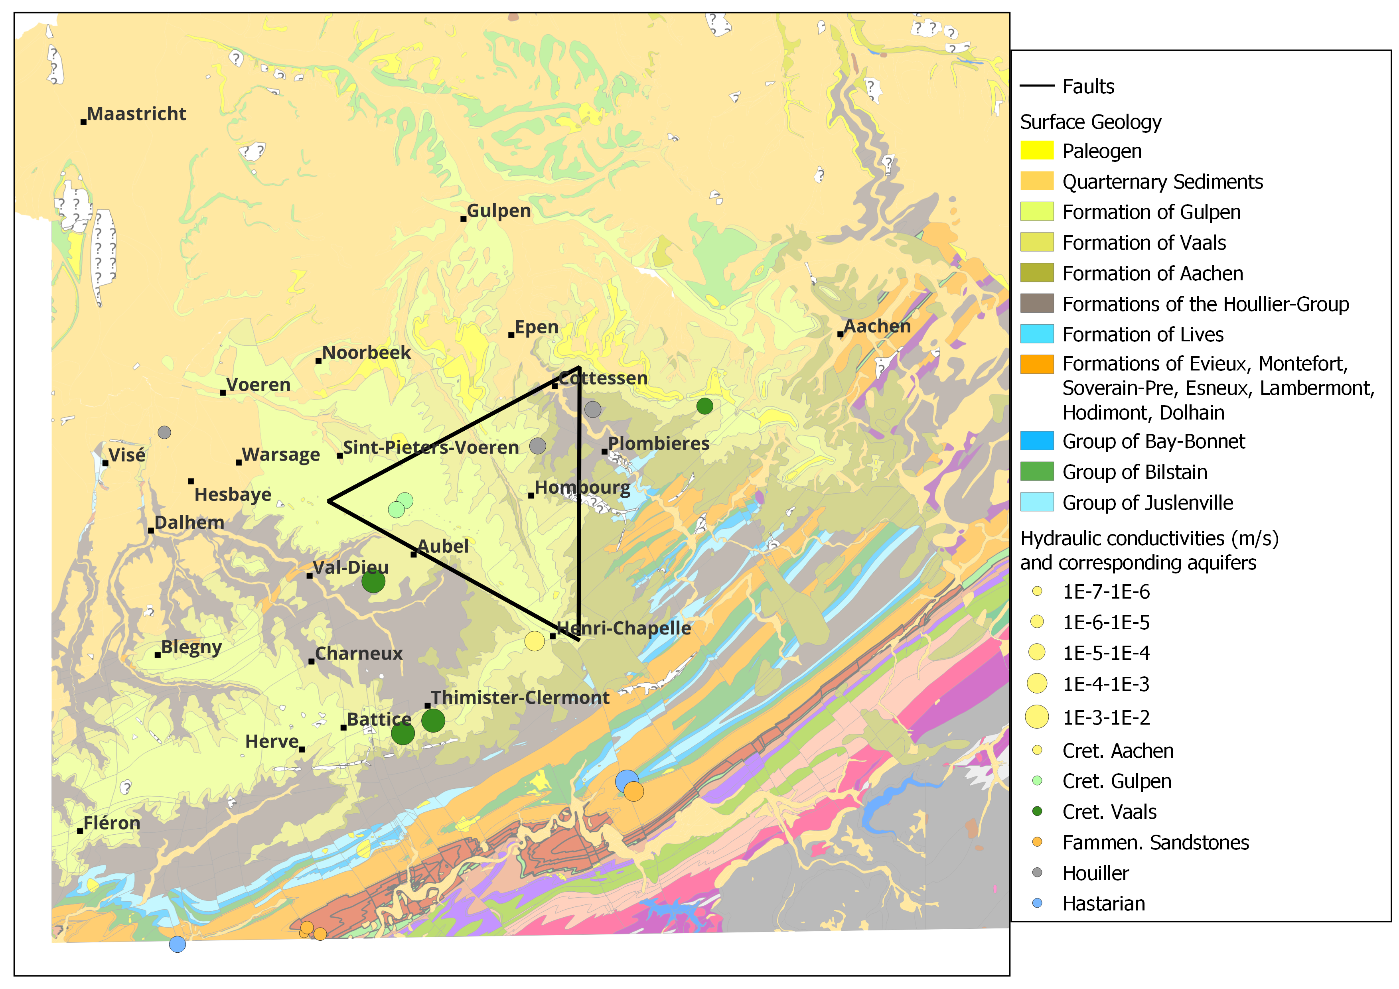
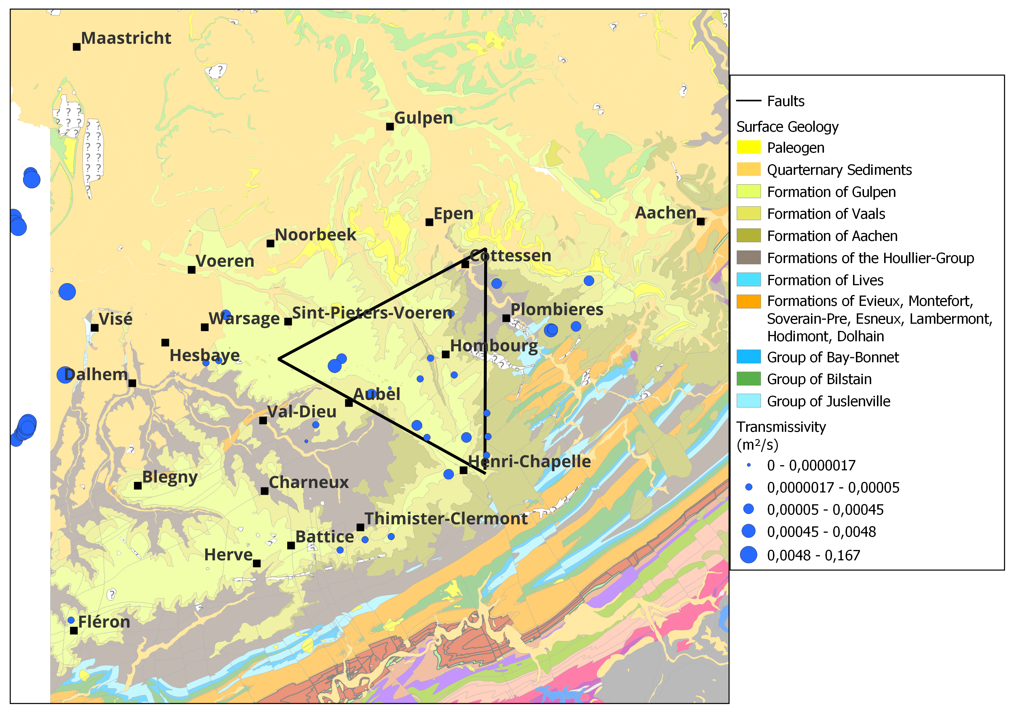
Acquisition of hydraulic conductivity values
  Inventories of existing data
Notes:
PAGE DE CONTENU 1 / Possibilité d'insérer du texte, des images, de la vidéo, des graphiques …

Slide 8
Acquisition of hydraulic conductivity values
  Hydraulic packer tests
Carried out along the new boreholes
Testing of different parts of the borehole (faulted zones, fractured zones, intact zones, …)
Local estimations of the hydraulic conductivity values
Example: Aubel K : [1×10⁻⁵ – 1 × 10⁻⁸] m/s
Notes:
PAGE DE CONTENU 1 / Possibilité d'insérer du texte, des images, de la vidéo, des graphiques …

Slide 9
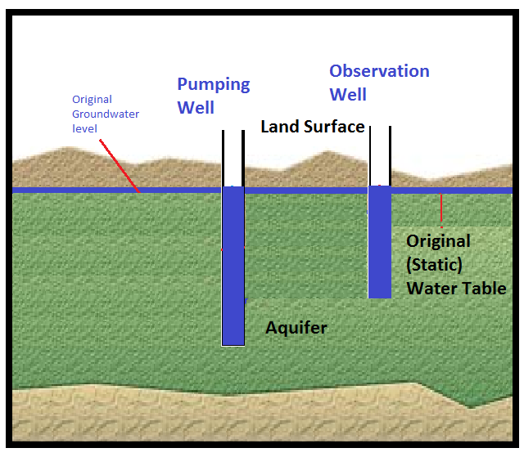
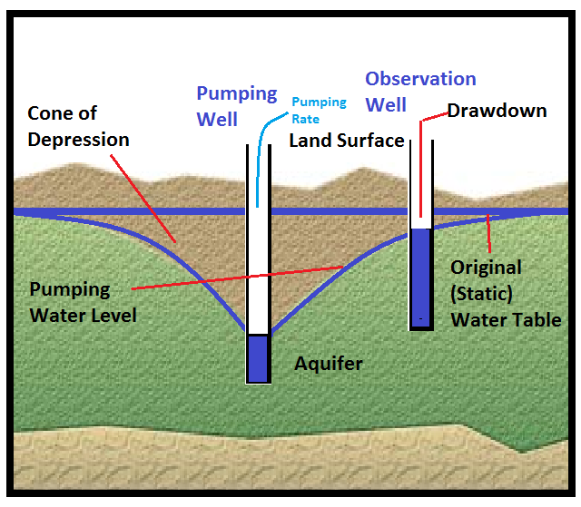
Acquisition of hydraulic conductivity values
  Pumping tests
  Allow the investigation of larger volume of underground (by comparison with packer tests)
  Allow to characterize interactions between aquifers…
  Interpretations give values of K, Storage coefficients
Allwell Drilling
Notes:
PAGE DE CONTENU 1 / Possibilité d'insérer du texte, des images, de la vidéo, des graphiques …

Slide 10
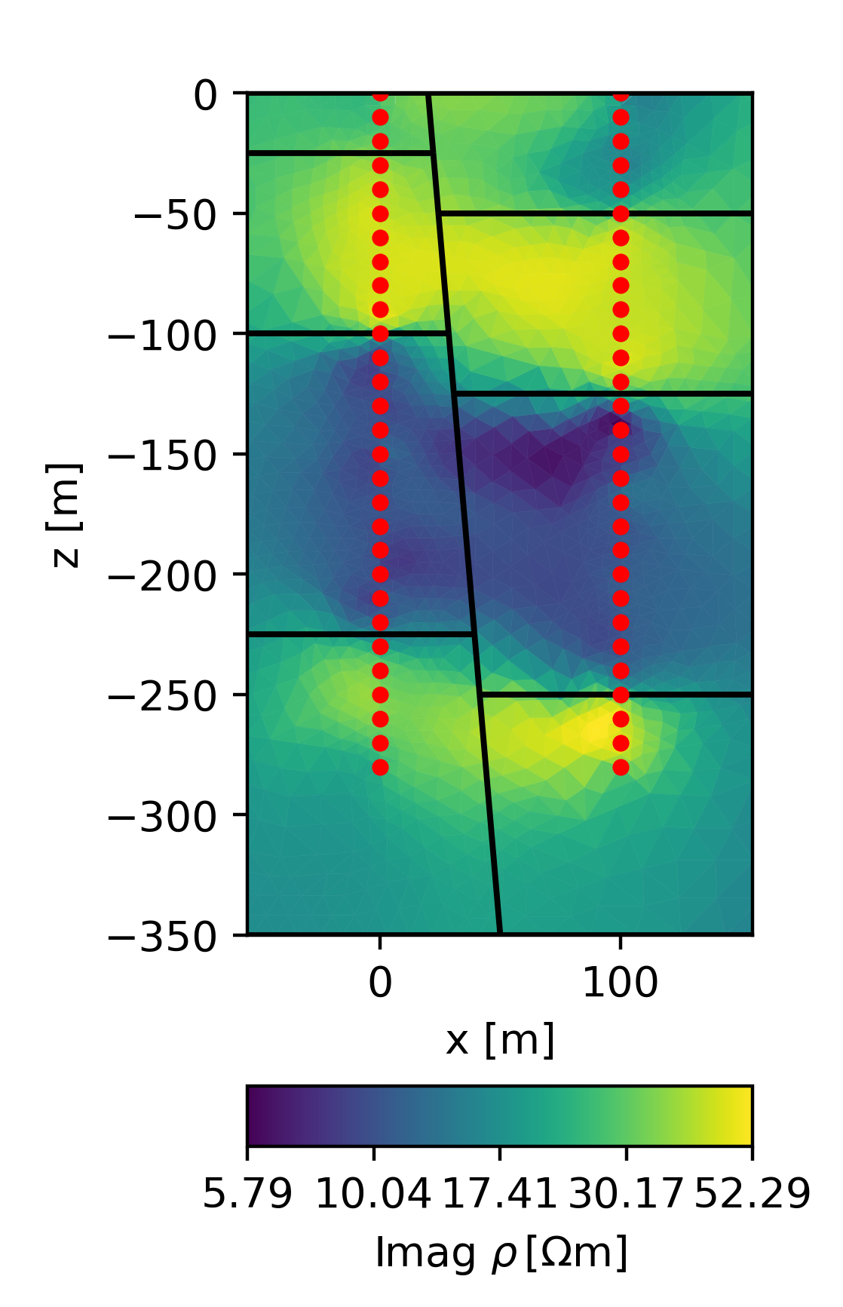
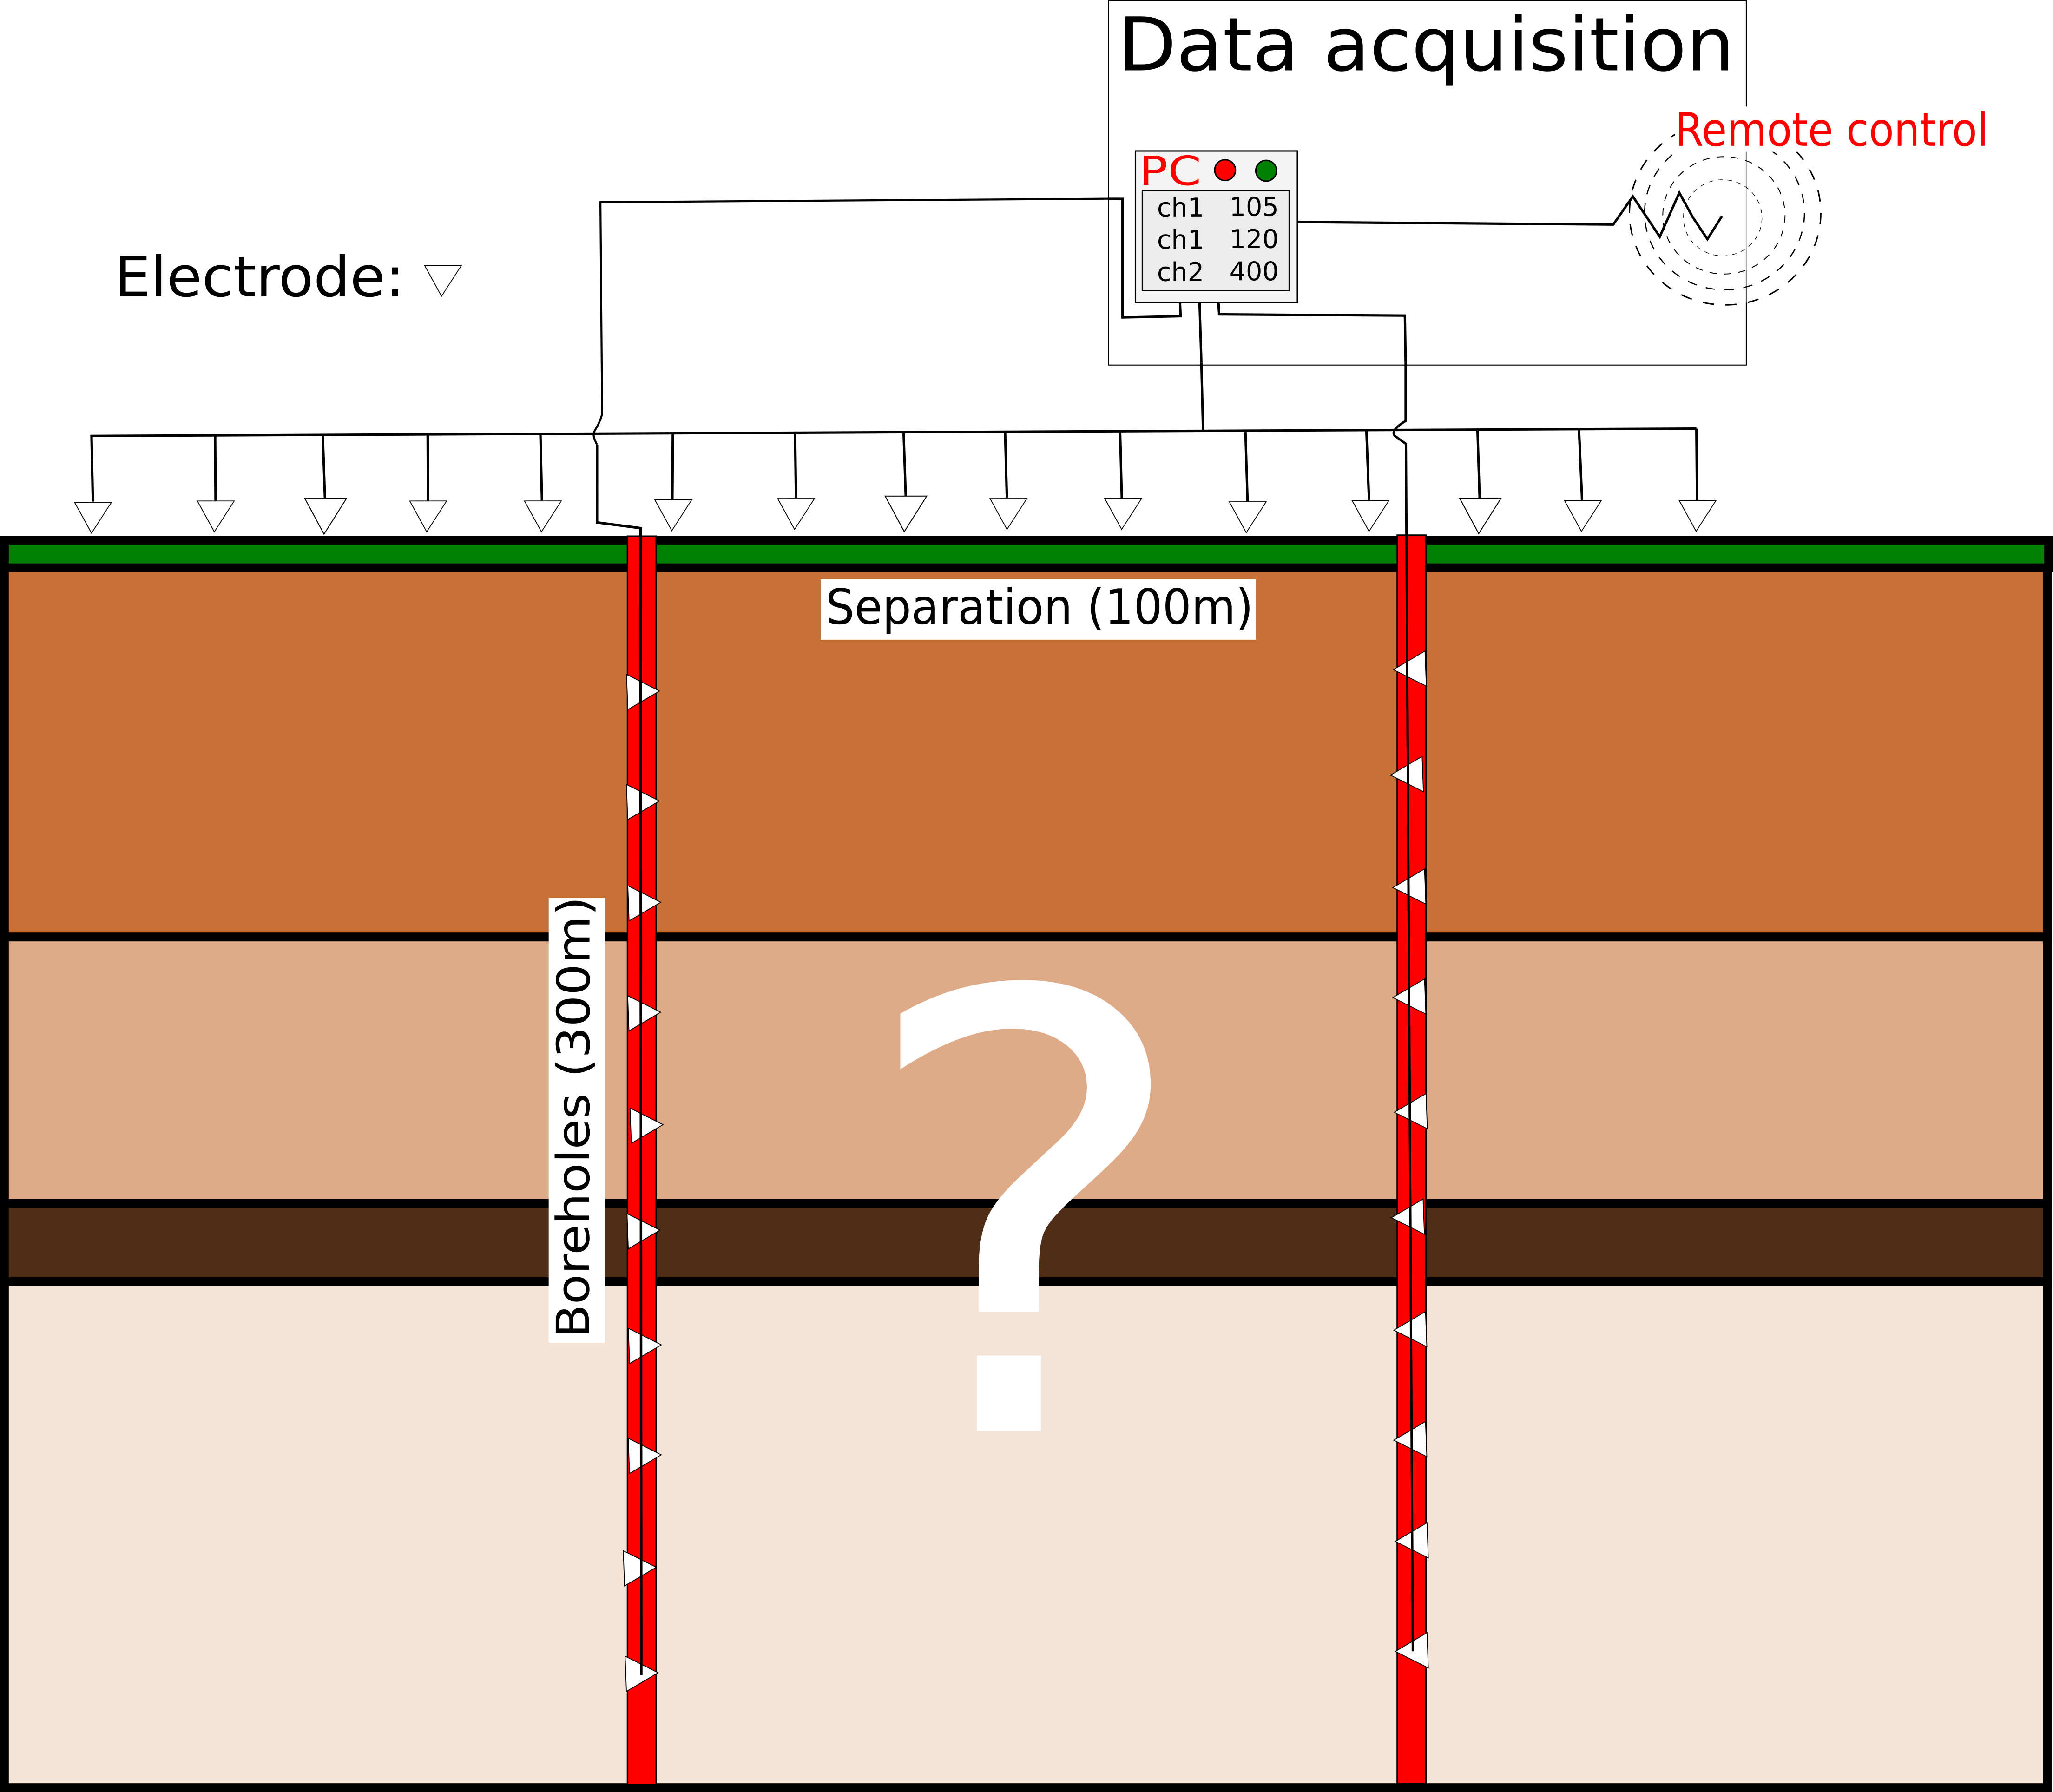
Acquisition of hydraulic conductivity values
  Testing of the hydraulic behaviour of faults
  Detection of faults
  Drilling of boreholes on each side of the fault
  Characterization of the faults using pumping tests, tracer tests, geophysics…
Notes:
PAGE DE CONTENU 1 / Possibilité d'insérer du texte, des images, de la vidéo, des graphiques …

Slide 11
Improvement of the regional model
Use of this new data to improve the regional model
sensitivity of model results to hydraulic conductivity values (inflows, regional impacts)
Notes:
Summary of what we have… Mainly done in E-TEST

Slide 12
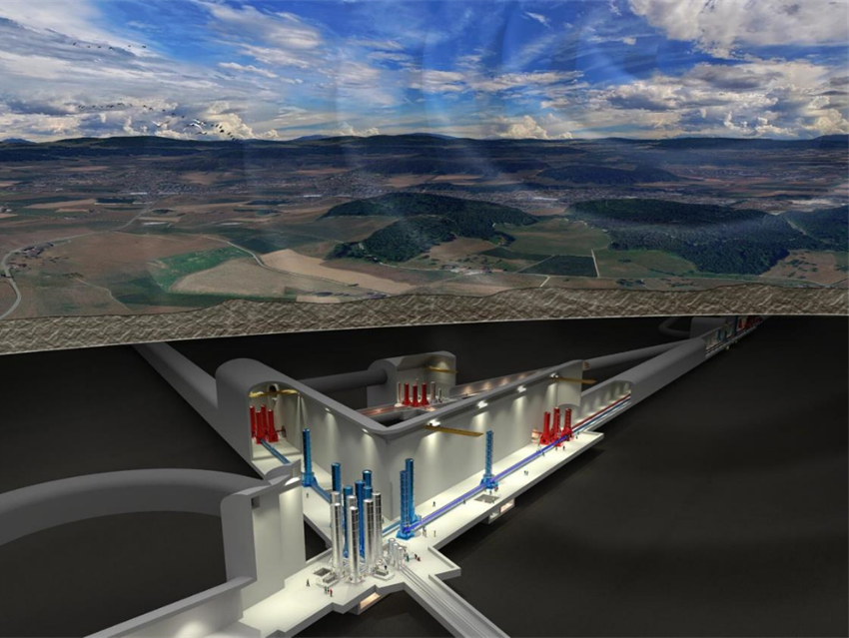
Development of local models
  Taking into account :
  local geological features
  local values of hydraulic properties
  the detailed design of the infrastructures
  ….
  and results of the regional model, for example, for prescribing the boundary conditions and values
Notes:
PAGE DE CONTENU 1 / Possibilité d'insérer du texte, des images, de la vidéo, des graphiques …

