Slide 1
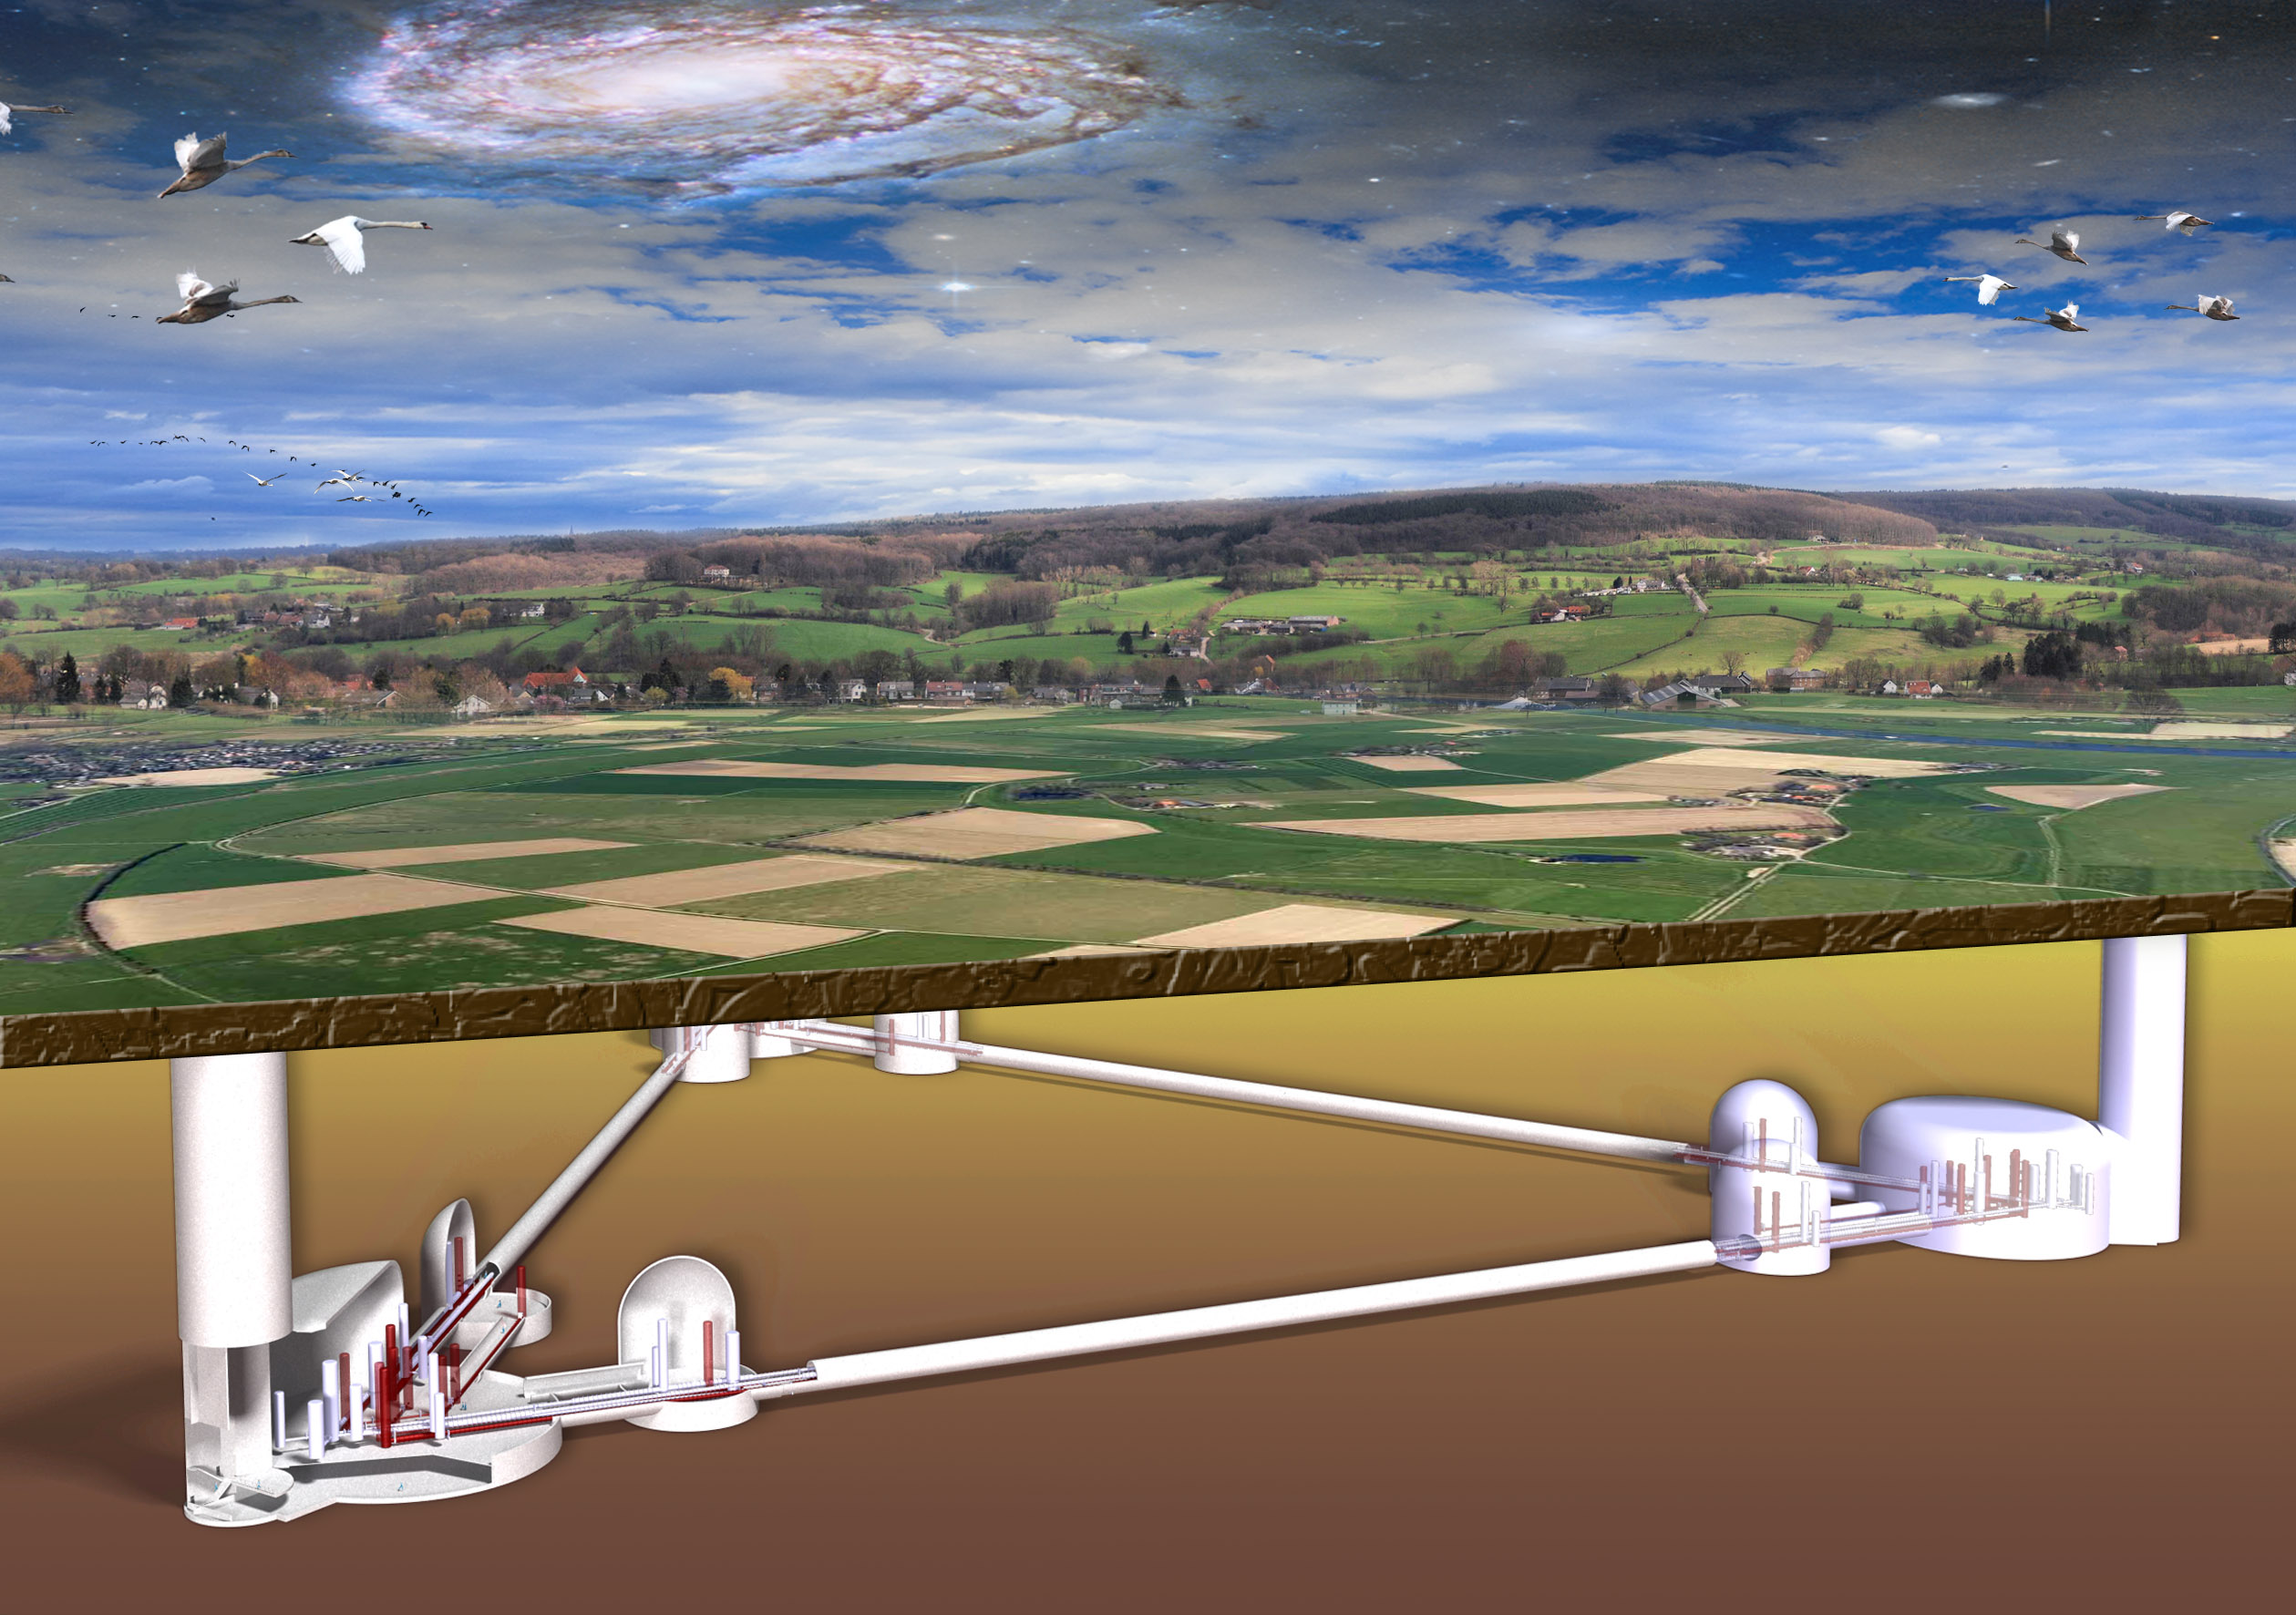
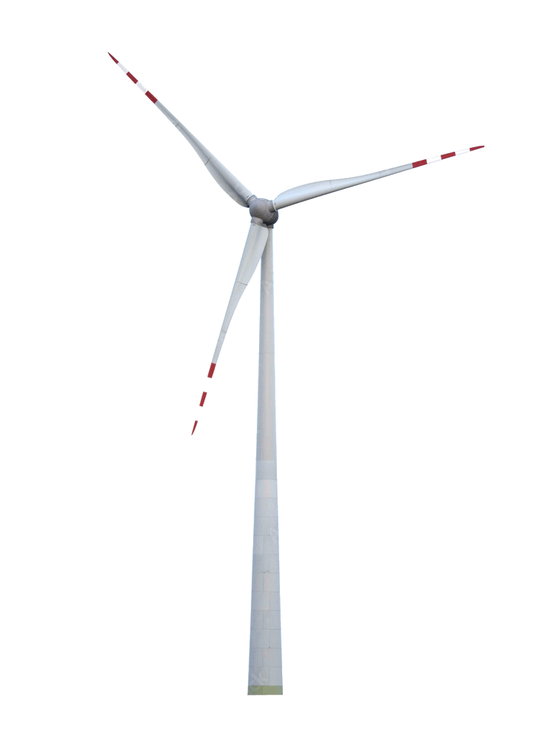
© Marco Kraan
Wind Turbines
Achim Stahl, May, 8th, 2024
RWTH Aachen University

Slide 2

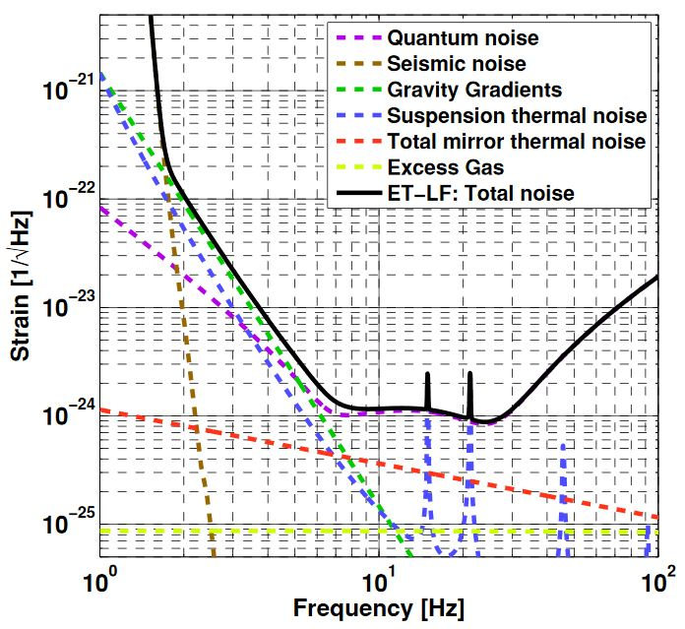
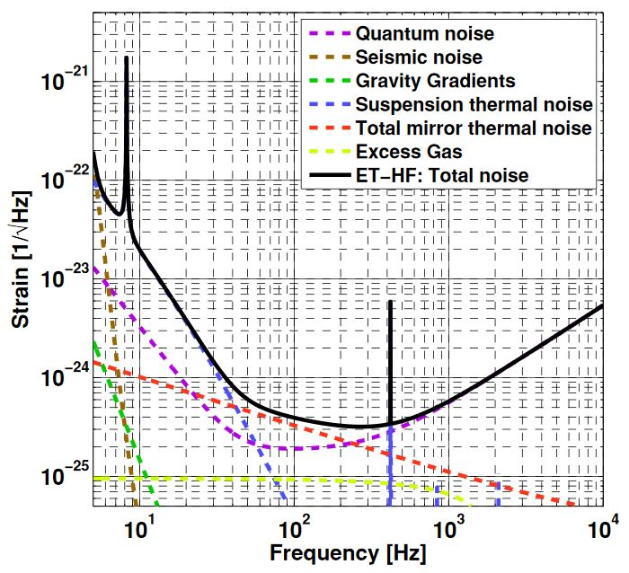
The noise
Low-frequency (cryogenic)
High-frequency (conventional)

Slide 3
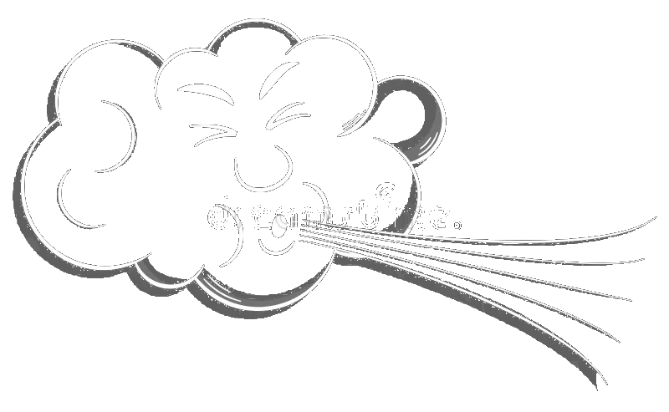
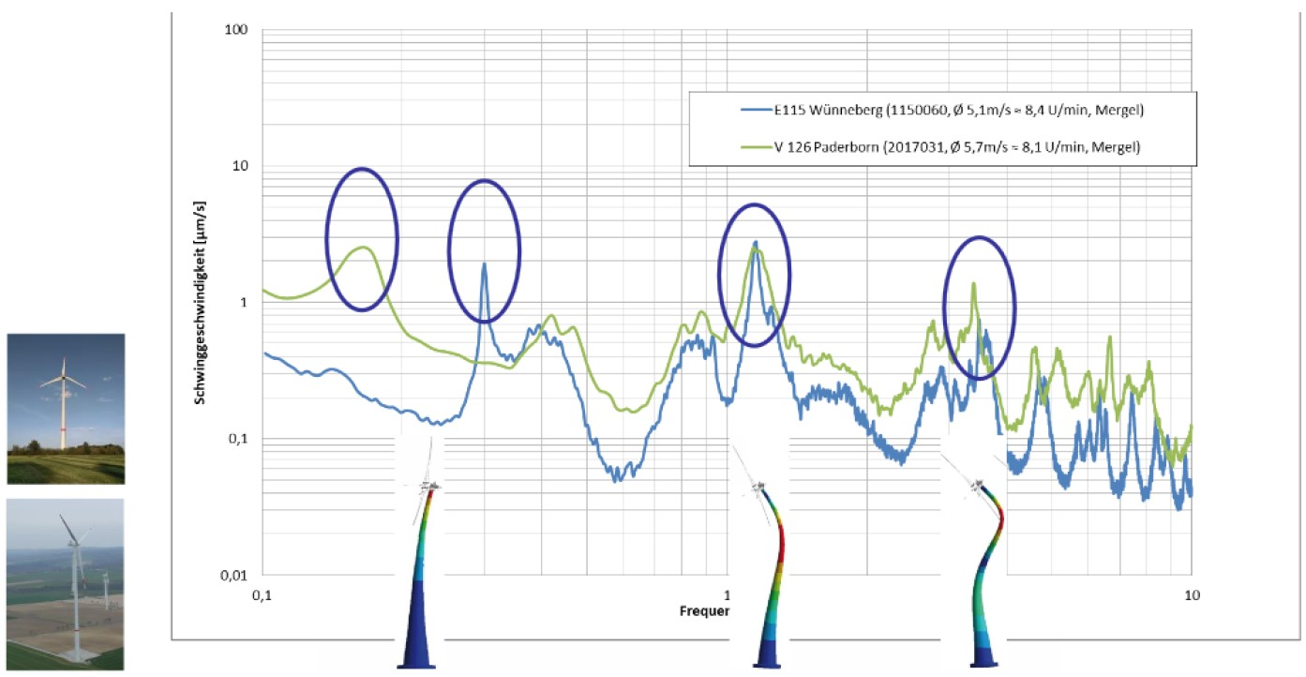
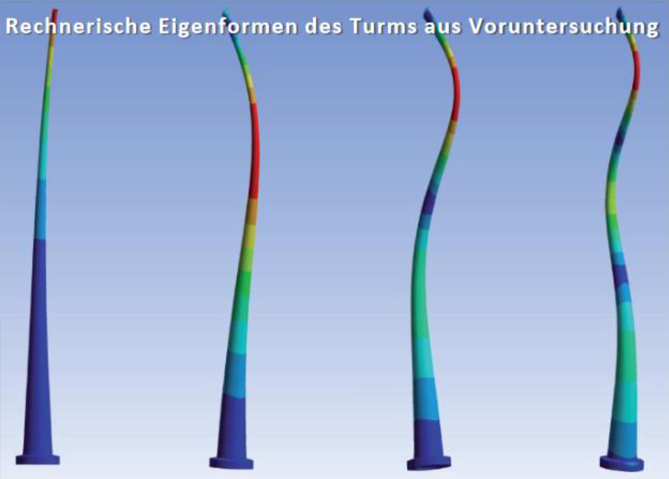
Excitation of vibrations
Rotor passes tower:
Reduced pressure on the tower
Excitation of oscillation
Frequency of rotor:
5 … 16.5 turns per min.
(0.08 … 0.28 Hz)

Slide 4
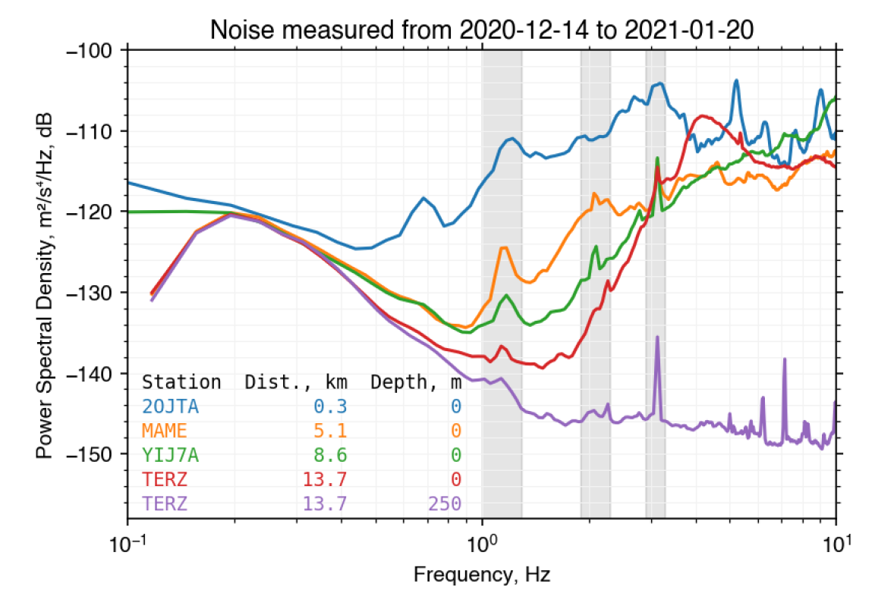
noise from Aachen windpark; measurement by Sahar Shani-Kadmiel

Slide 5
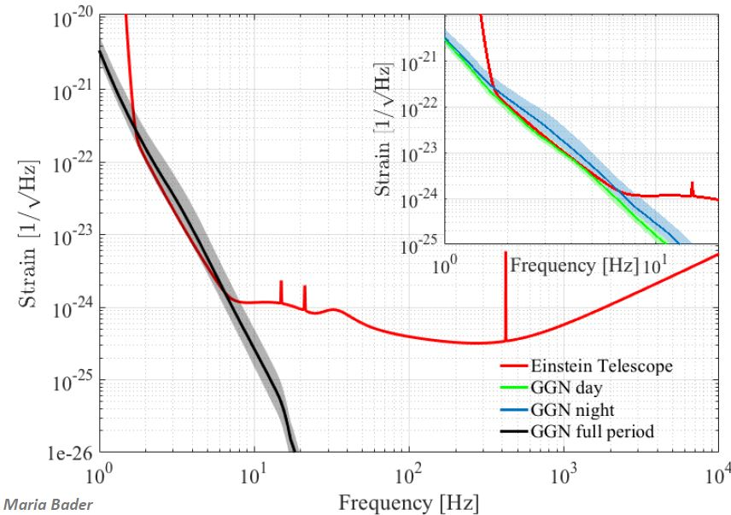
The noise

Slide 6
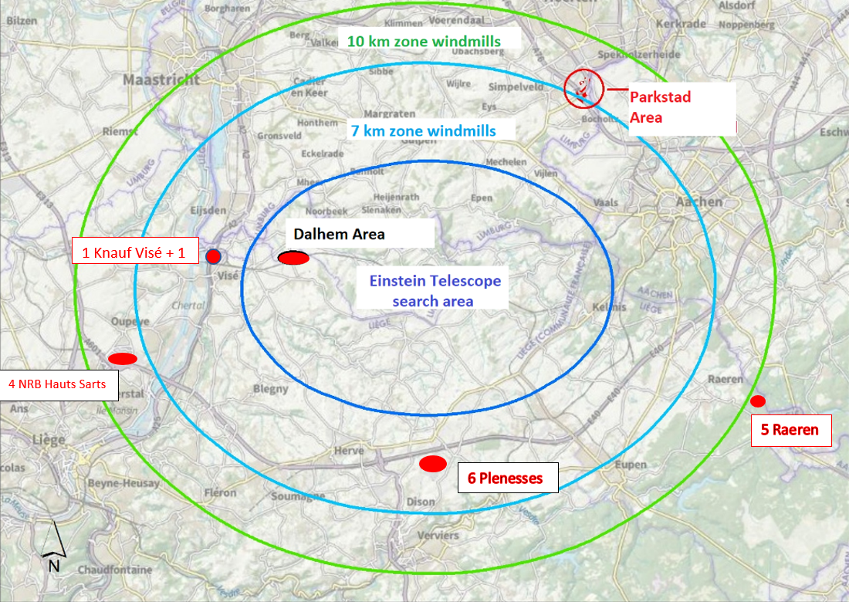
Exclusion Regions

Slide 7
Compatibility ?
temporal compatibility
spacial compatibility
technical compatibility

Slide 8
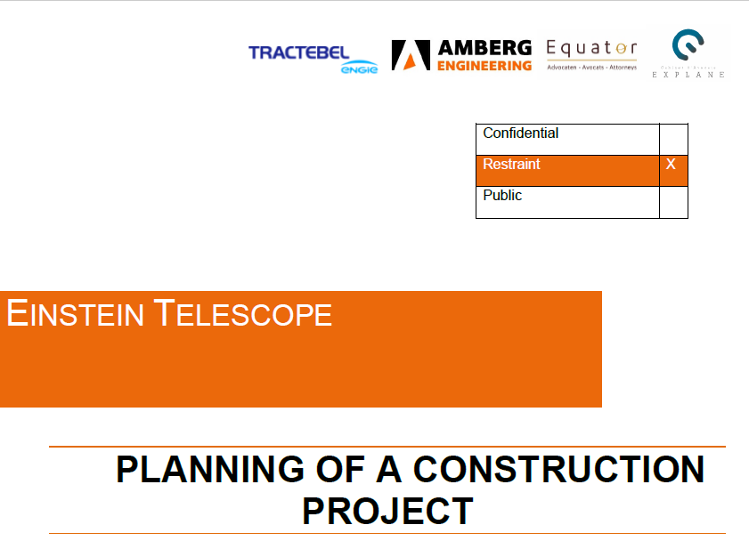
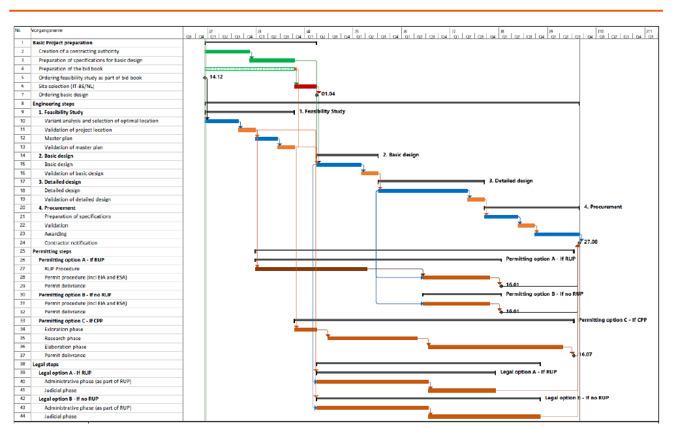
Legal Study
T₀
+ 1,75 Jahre
Genehmigung
+ 7,5 Jahre
Baubeginn
2023
2025
2030
+ 5,5 years of tunneling
+ 2 years installation of first interferometers
+ a few years of commisioning
→ until 2040 wind turbines will not interfer
In our opinion, it is imperative to create an organisation around the project very fast, further proceed with the investigations on all legal and permitting aspects and start the feasibility study/master plan before to submit the bid books to have a mature project.
Figure 3: Realistic Timeline

Slide 9
Compatibility ?
temporal compatibility
spacial compatibility
technical compatibility

Slide 10
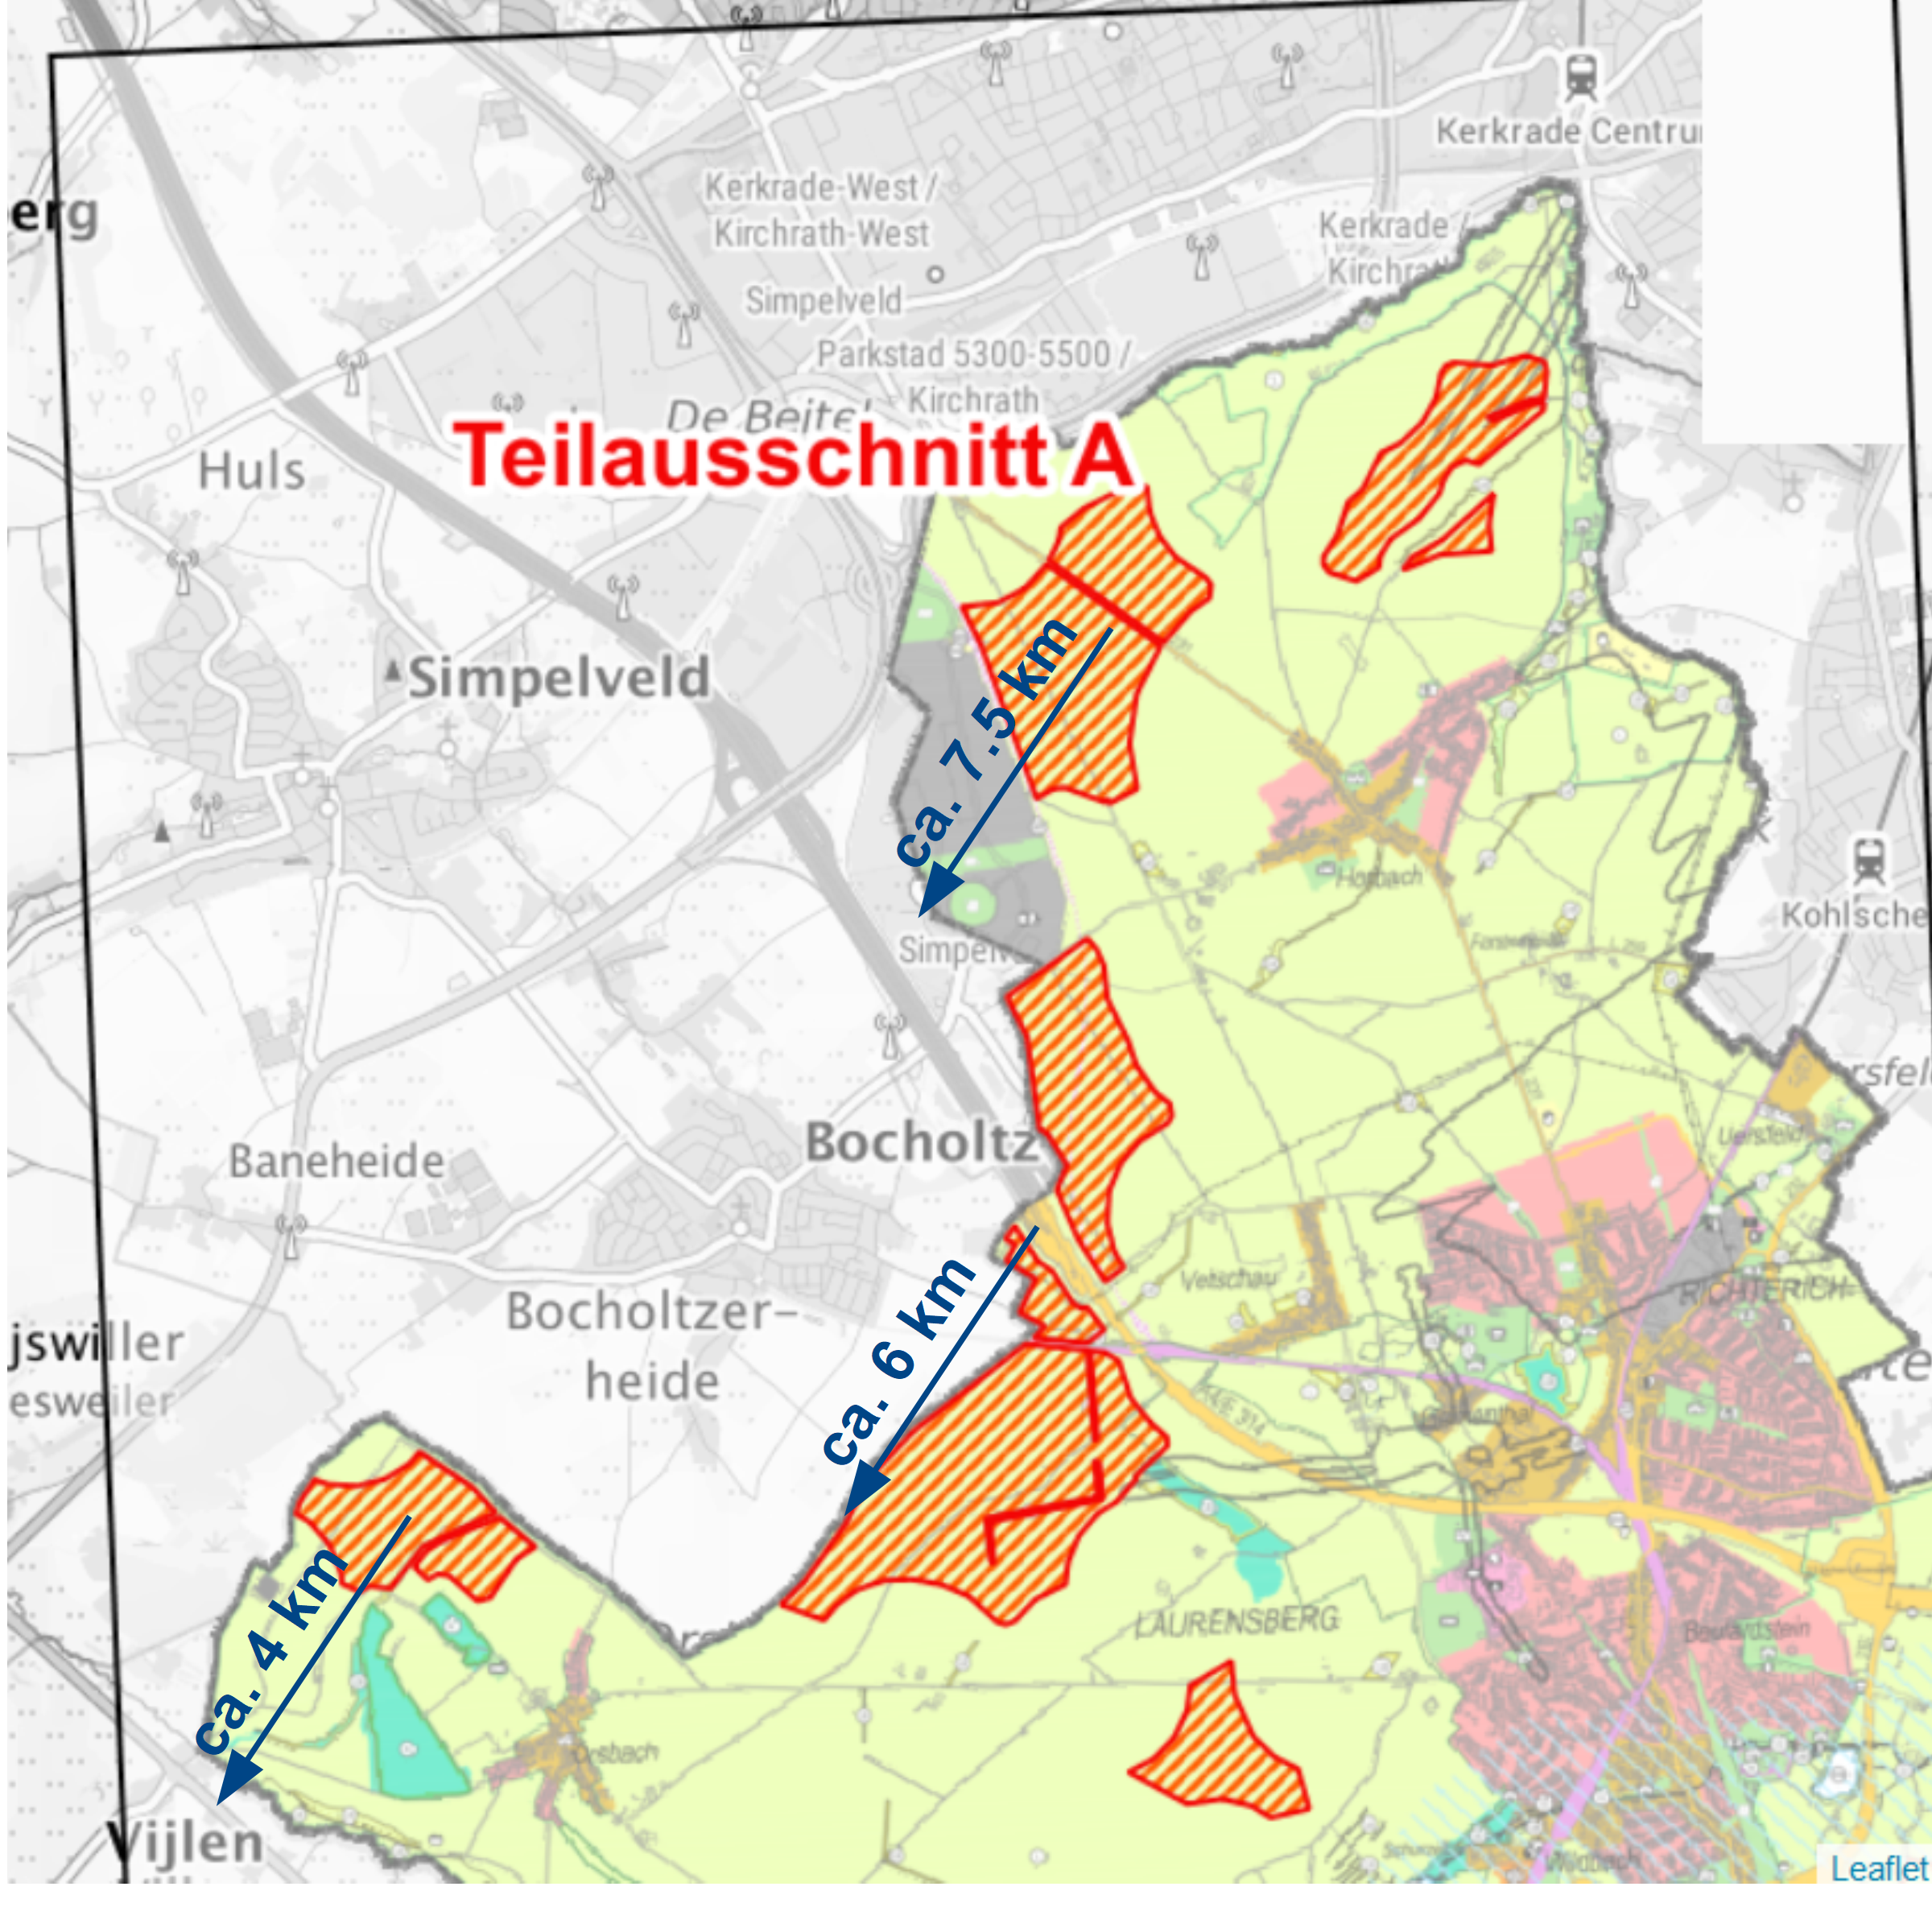
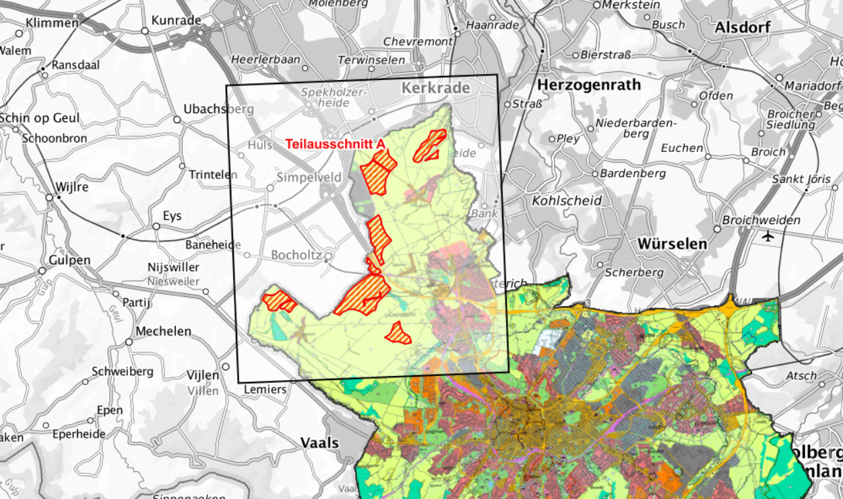
Aachen Windparks

Slide 11
Technical Compatibility ?
reduce excitation
dampen oscillation
decrease coupling to underground

Slide 12
Technical Compatibility
Workshop: Feb. 15th, Aachen: Identified 5 promising approaches
Larger / more massive foundation
Tuned mass dampers (pendulum)
Pitch control
Girder masts
Active damping

Slide 13
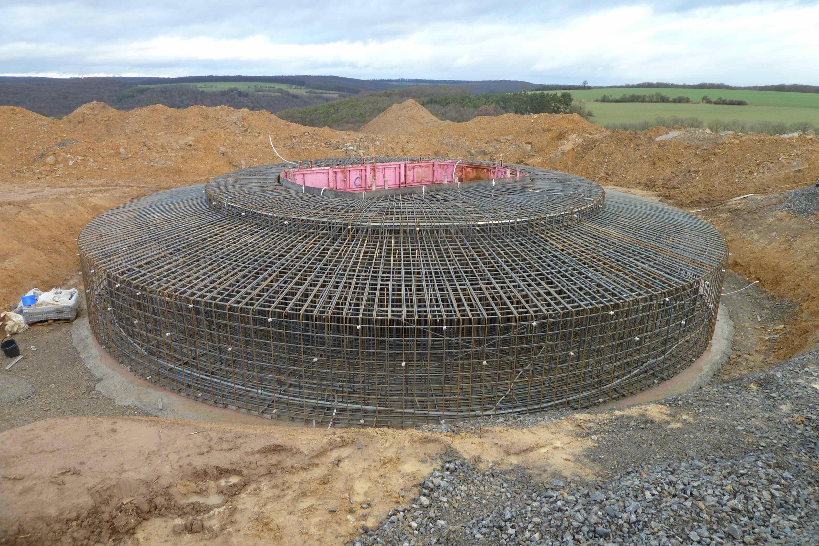
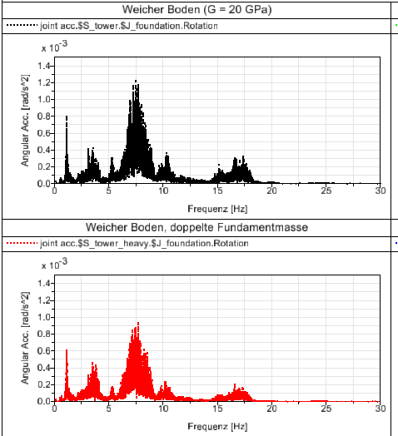
Foundation
Shallow foundations preferred over deep foundations:
Aachen ✔
Double the mass:
30 – 50% Reduction; cost < 10%
Wider Fundations:
Reduction ?; no cost
Initial investigation by Prof. Ralf Schelenz (RWTH)
Center for Wind Power Drives
Waiting for approval of funds for a more detailed study.

Slide 14
Tuned Mass Dampers
Very efficient
better than x 1/10
single frequency only
Cost:
design ~ 50 k€
hardware + installation
~ 20 k€
Waiting for approval of funds for
the design of one damper.

Slide 15
Pitch Control
Increase pressure on the rotor upon passage in front of the tower
But:
Different impact point of force
Pitch control is used for other purposes
(optimization of efficiency)
Reduction ?
Air pressure on the tower
Rotor blades shield the tower:
Reduced air pressure
Excitation of tower modes

Slide 16
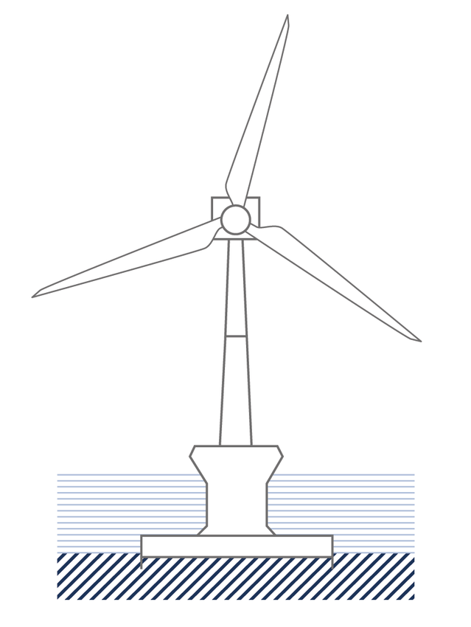
Active Damping
Active counter motion of masses
i.e. pumping water between tanks
Optimal location: gondola, but space?
Alternatively on the foundation
Probably a good measure; but substantial effort.
Submitted a proposal for the design of such a system (RWTH internal competition)
Partner: Prof. Heike Vallery
Chair of of Automatic Control

Slide 17
Girder Masts
Largely permeable to wind
Less excistation
Maximale height?
ArcelorMittal offers towers up to 180 m:
Cheaper
Lighter
Optically transparent
Less foundation (by 60%)
Easy to transport and erect
(from their own advertisement)
© ArcelorMittal
Laasow, Brandenburg
180 m Nabenhöhe

Slide 18
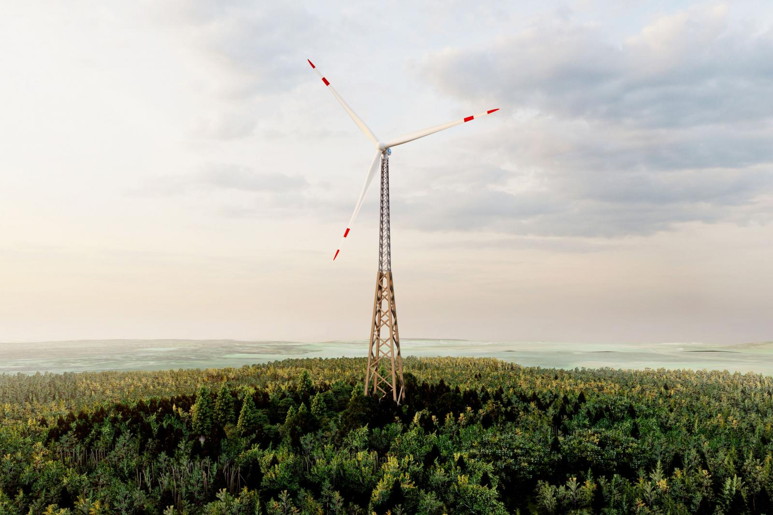
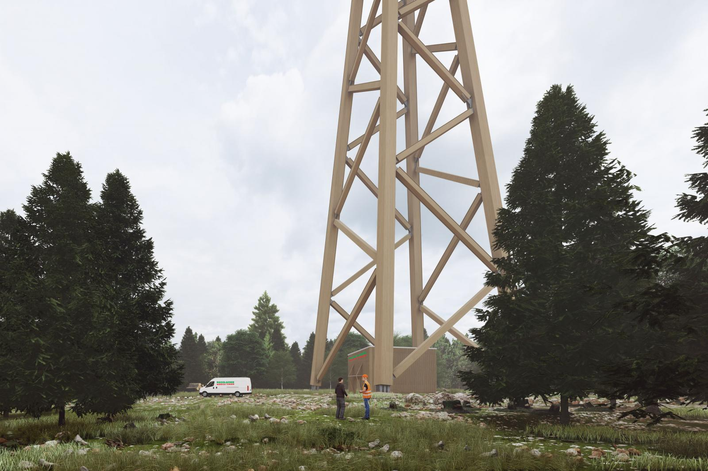
Wooden towers
Girder mast
transparent to wind
→ low excitation
Wooden structurs
high damping
→ low amplitudes
low elasticity
→ low frequencies
Large base,
point foundations
→ high coupling
to underground?
© Hasslacher Green Tower

Slide 19
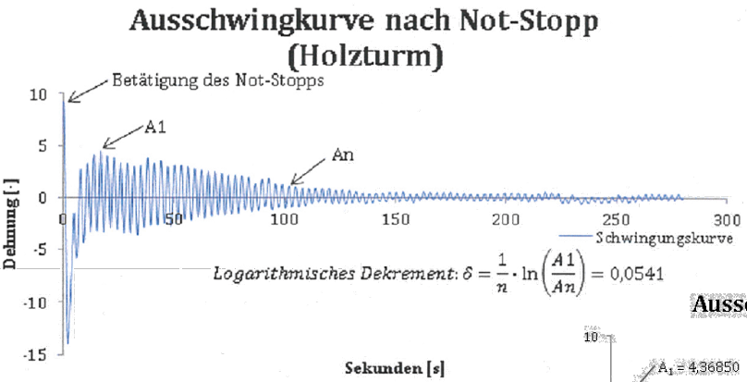
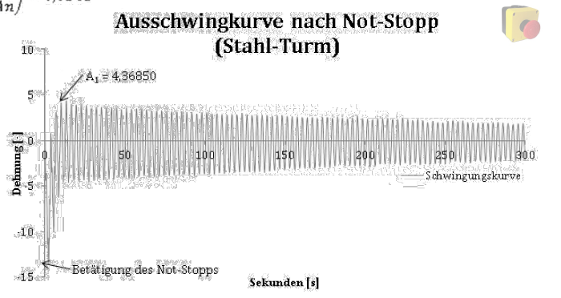
Wooden towers
Vibrations and damping
Hasslacher is working on it
Measurements planned in Hannover
Foundation
prestudy (being awarded)
full study awaiting approval of funds.
Prototype:
Discussions with the city of Aachen.
Measurement by Hasslacher Green Tower

Slide 20
© Marco Kraan
ET & wind turbines
Achim Stahl, May 8th, 2024
RWTH Aachen University

